Slide 1
A data statistics service for data publication and usage metrics in the climate domain
Alessandra Nuzzo
EGI Conference
Lecce, October 1, 2024

Slide 2
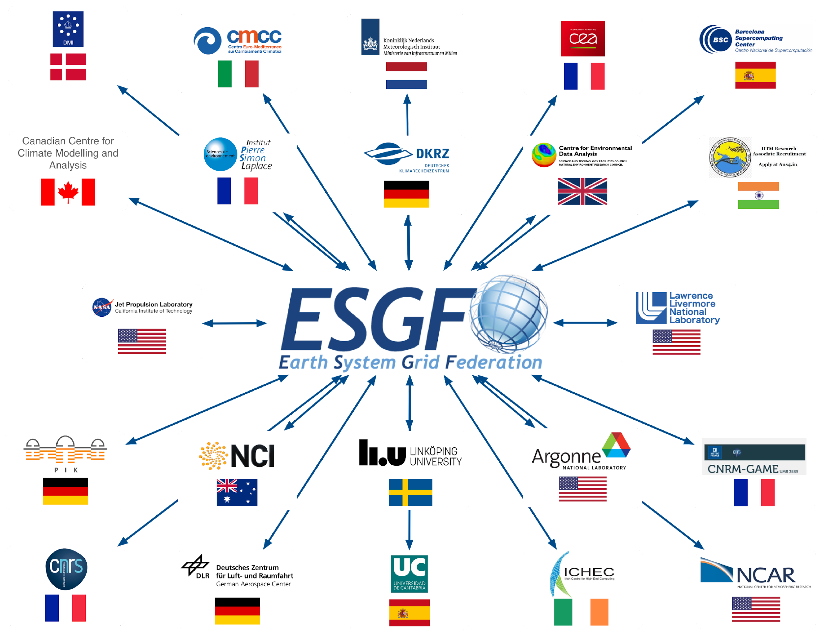
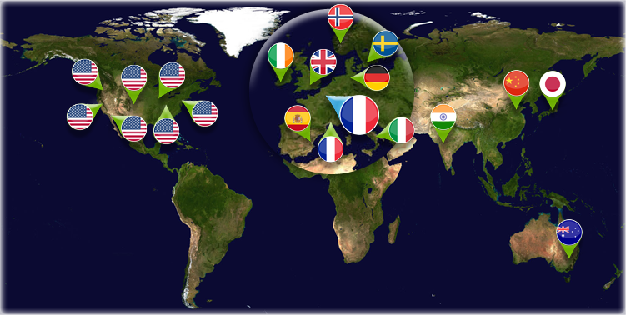
Earth System Grid Federation (ESGF)
The Earth System Grid Federation (ESGF) is a globally distributed peer-to-peer network of data servers using a common set of protocols and interfaces to archive and distribute Earth system models output.

Slide 3
CMCC involvement in ESGF
Design, development, bug fixing and maintenance of a software module for data usage statistics
Leadership of the ESGF Data Statistics Working Group (https://esgf.llnl.gov/working-groups.html) since 2016
Membership of the CMIP Data Node Operation Team (CDNOT)* since 2017
Hosting and maintenance of two ESGF data nodes for publishing datasets (SCC staff)
Main contributors:
Alessandra Nuzzo
Sandro Fiore
Fabrizio Antonio
Paola Nassisi
Maria Mirto
Giovanni Aloisio
*Coordinating an operational data distribution network for CMIP6 data, Petrie R., Denvil S., Ames S., Levavasseur G., Fiore S., Allen C., Antonio F., Berger K., Bretonnière P.-A., Cinquini L., Dart E., Dwarakanath P., Druken K., Evans B., Franchistéguy L., Gardoll S., Gerbier E., Greenslade M., Hassell D., Iwi A., Juckes M., Kindermann S., Lacinski L., Mirto M., Nasser A. B., Nassisi P., Nienhouse E., Nikonov S., Nuzzo A., Richards C., Ridzwan S., Rixen M., Serradell K., Snow K., Stephens A., Stockhause M., Vahlenkamp H., Wagner R. 2021, Geoscientific Model Development, Volume 14, Issue 1, pp. 629–644, DOI: https://doi.org/10.5194/gmd-14-629-2021, 2021

Slide 4
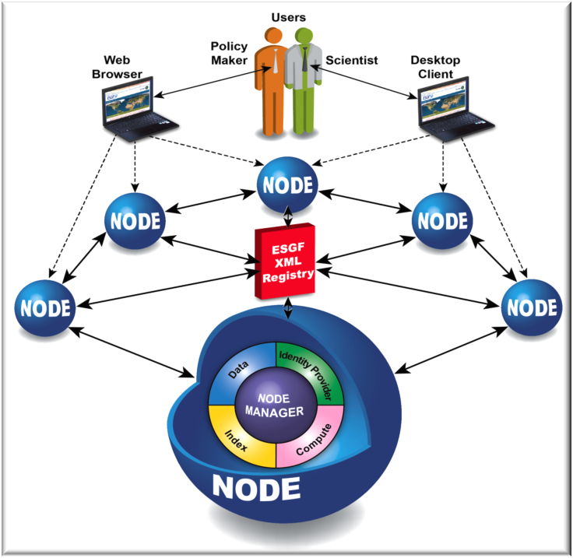
Earth System Grid Federation architecture
ESGF consists of a global system of distributed nodes, interoperating each other according to a peer-to-peer paradigm.
Data node: access to data
Index node: indexing & searching
Identity Provider node: federated user authentication
Compute node: data analysis capabilities

Slide 5
The ESGF Data Statistics service context
Distributed and decentralized database
tens of federated sites
more than 37 Petabytes
about 30 projects
almost 16,000,000 datasets
How to get statistics from the sites?

Slide 6
The ESGF Data Statistics service
Collects and stores a high volume of heterogeneous metrics, covering data download statistics as well as the status of the federated archive in terms of published datasets, models and istitutes. etc.
How much, how frequently and how intensively the federation is being exploited by the end-users
The amount of downloaded data
The data available through the federation
The most
downloaded data
The less
accessed data
Useful insights on the long tail of research

Slide 7
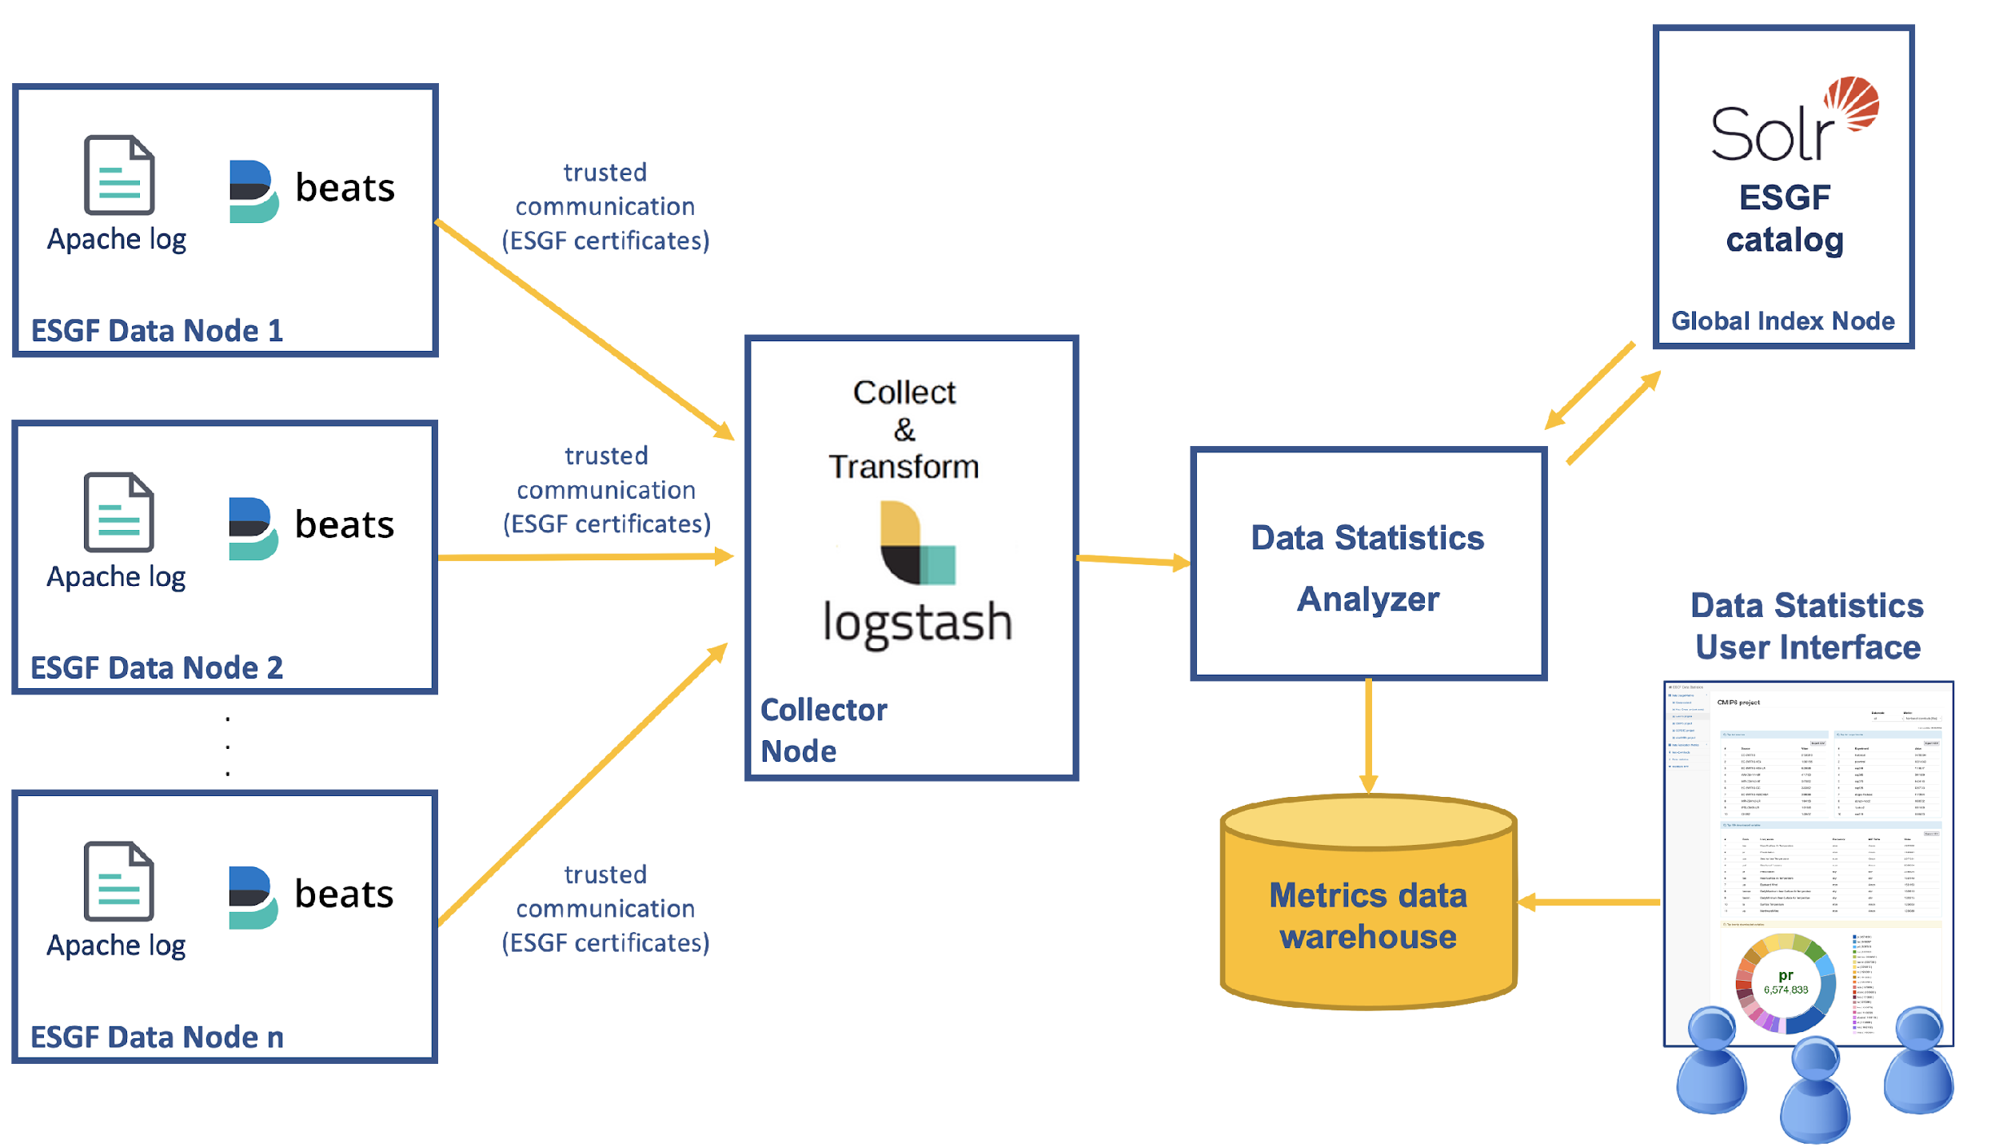
The ESGF Data Statistics service

Slide 8
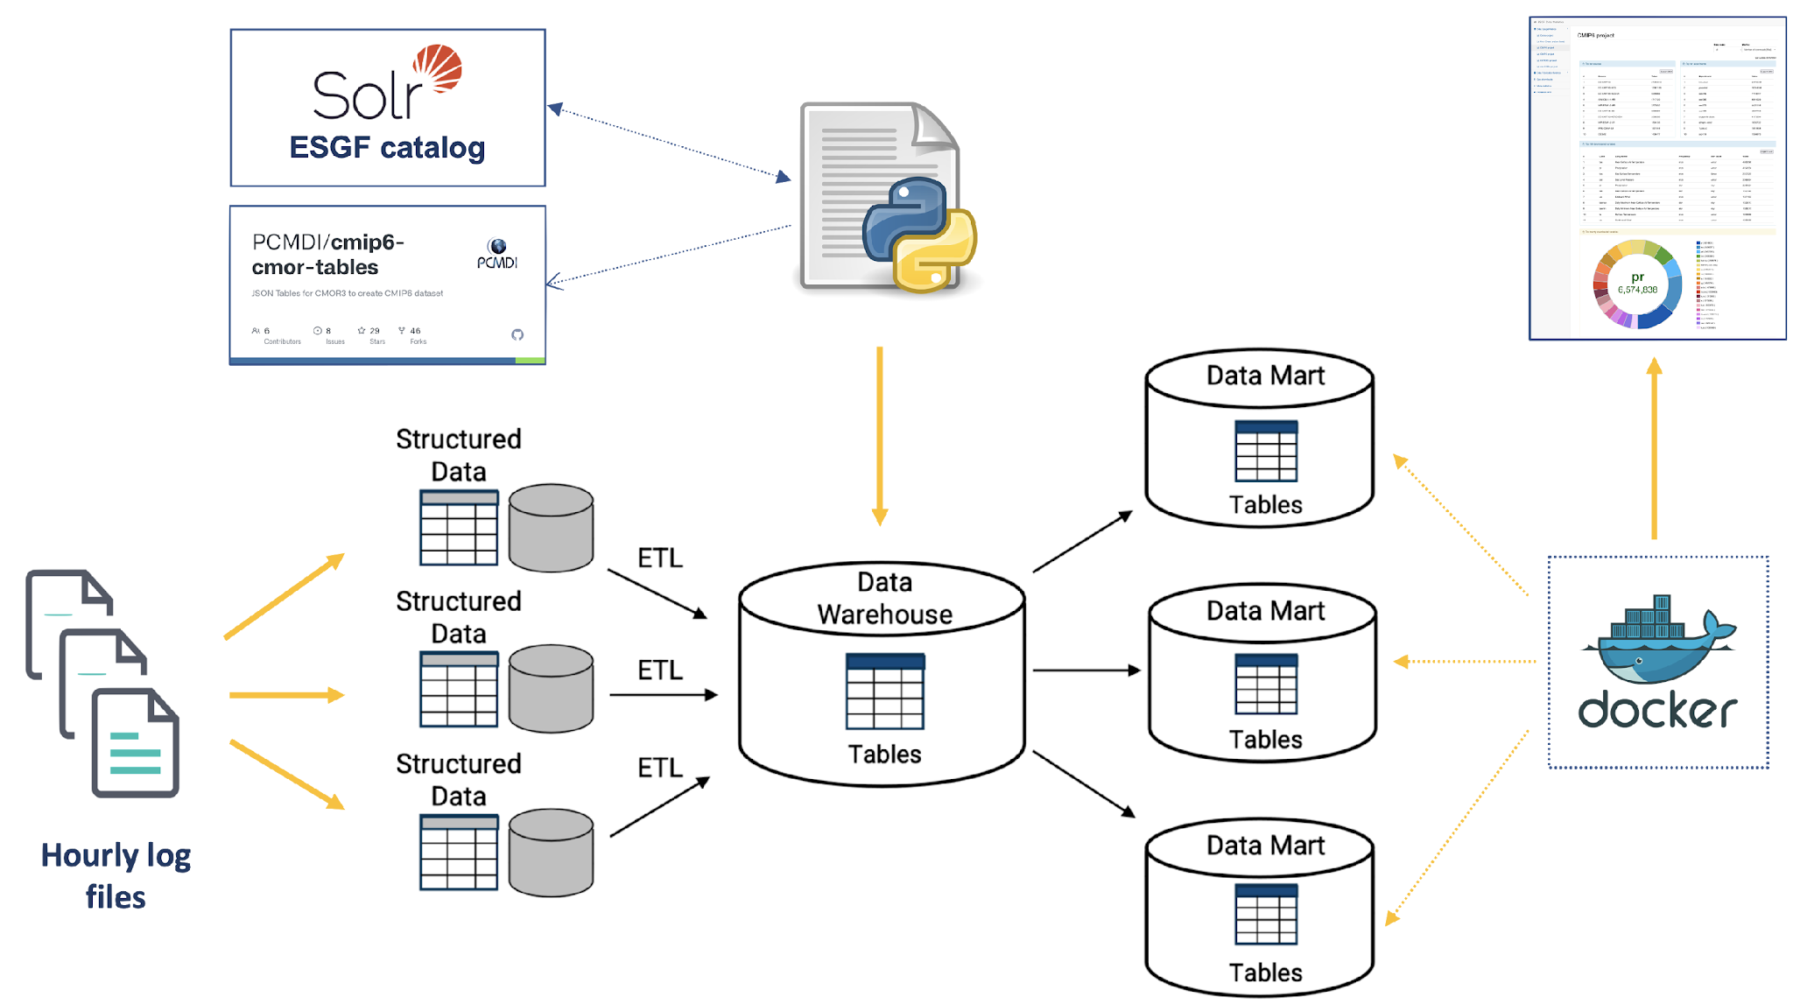
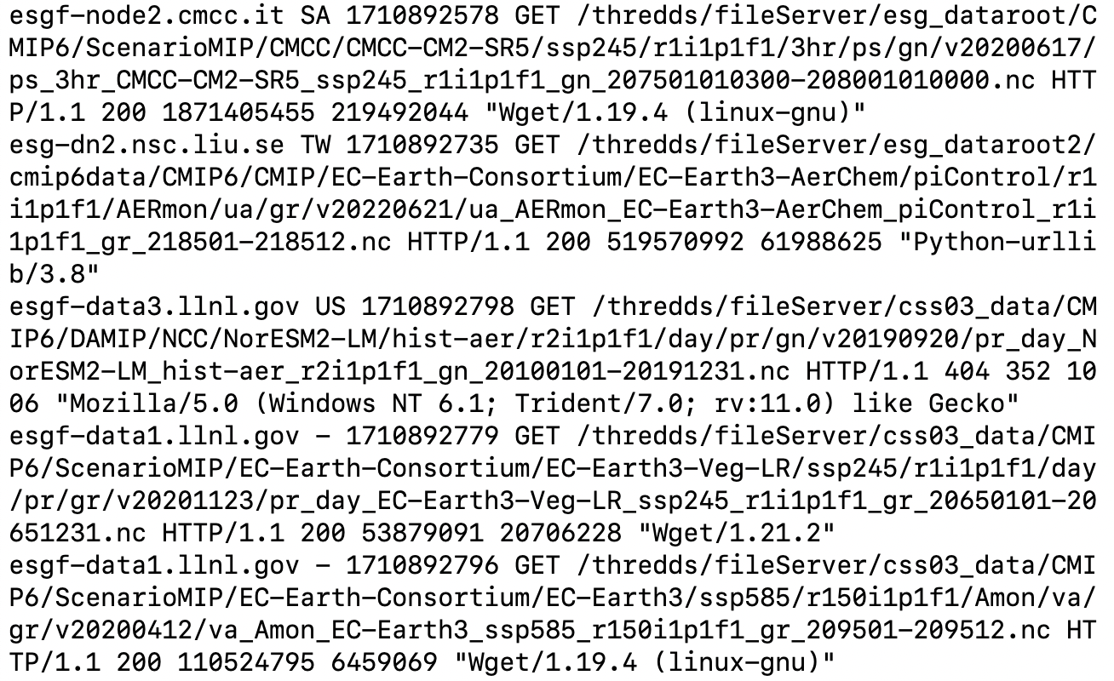
The Data Statistics analyzer

Slide 9
The Data Statistics User Interface
http://esgf-ui.cmcc.it
ESGF Data Statistics User Interface provides user-friendly access to a comprehensive set of data usage and data archive metrics across the whole ESGF.
A Climate Change Community Gateway for Data Usage & Data Archive Metrics across the Earth System Grid Federation, Fiore S., Nassisi P., Nuzzo A., Mirto M., Cinquini L., Williams D., Aloisio G. 2021, Proceedings of IWSG 2019 (11th International Workshop on Science Gateways), 12-14 June 2019, Ljubljana, Slovenia

Slide 10
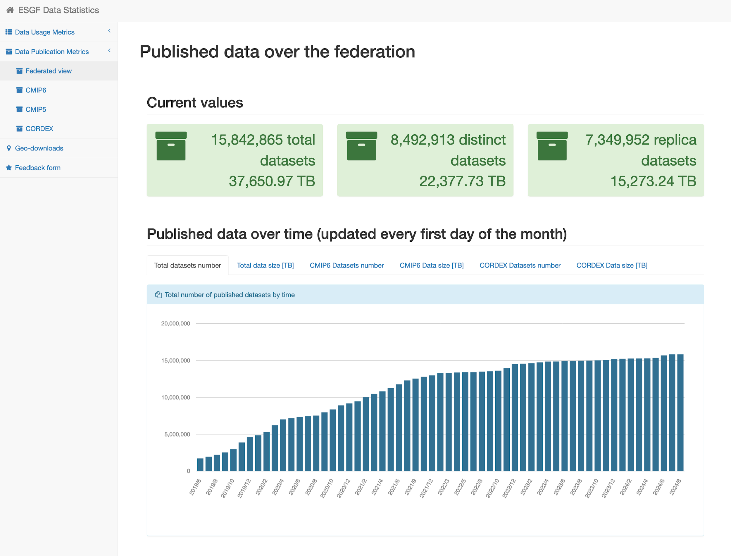
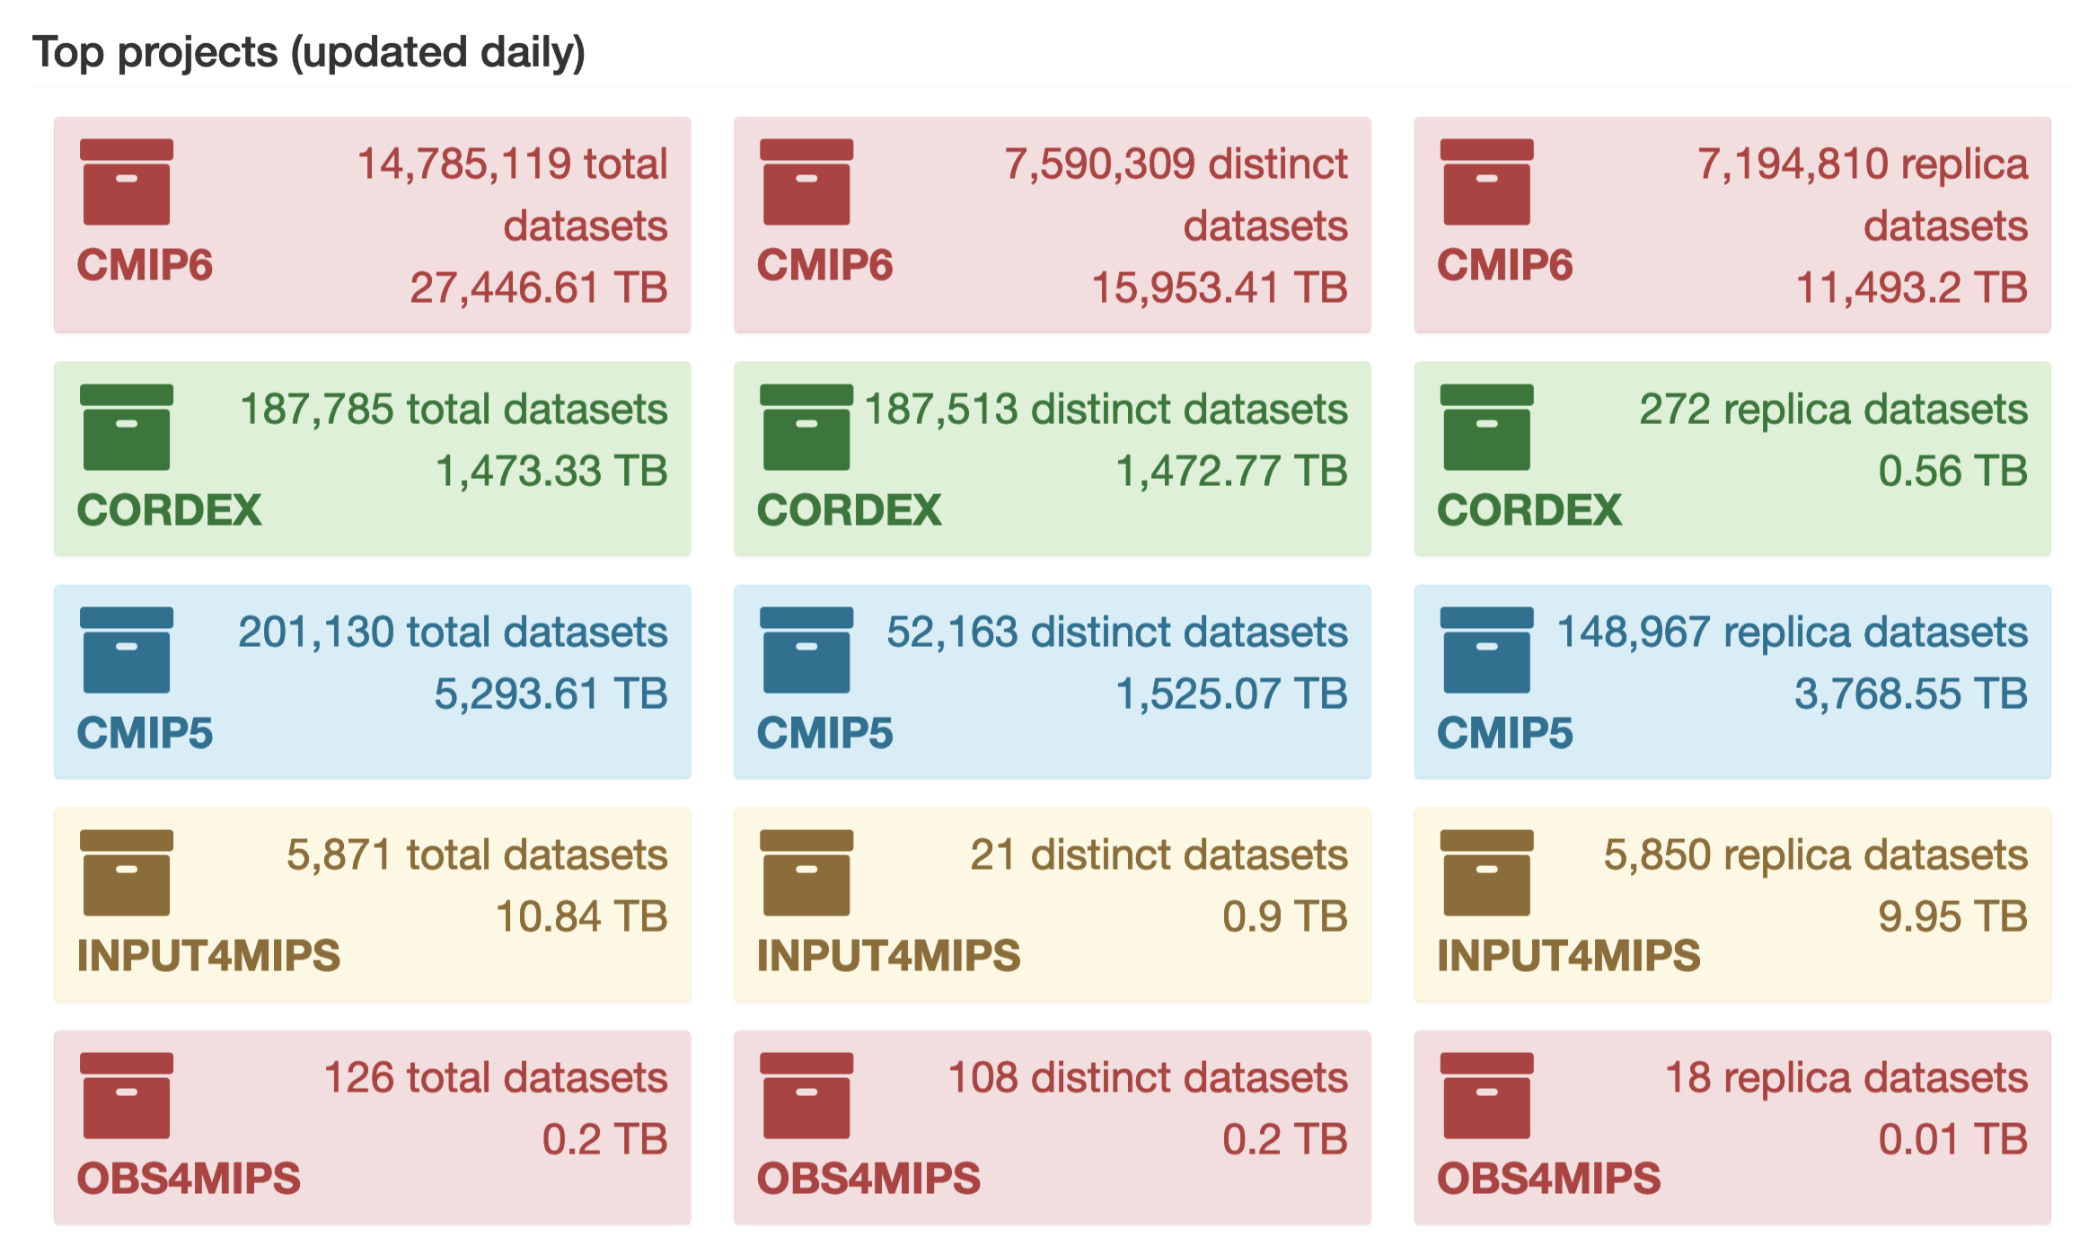
Data Publication metrics
Published data over the federation:
Total number of datasets and data volume (in TB)
Total number of distinct datasets and data volume (in TB)
Total number of replica datasets and data volume (in TB)
Projects: CMIP6, CMIP5, INPUT4MIPS, OBS4MIPS, CORDEX
Based on the community’s requests
Published data per model and institute
Other projects can be easily added

Slide 11
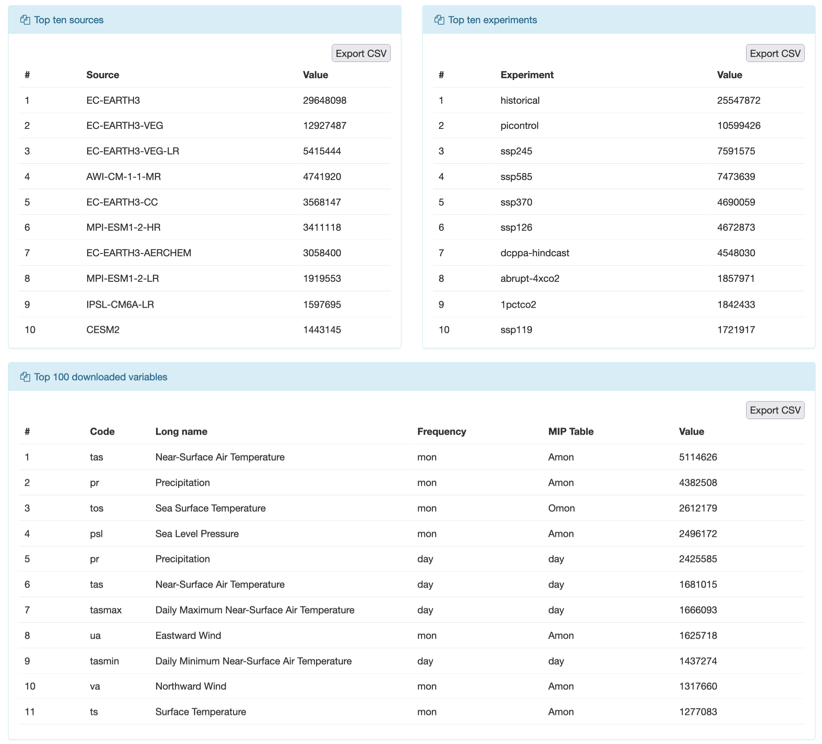
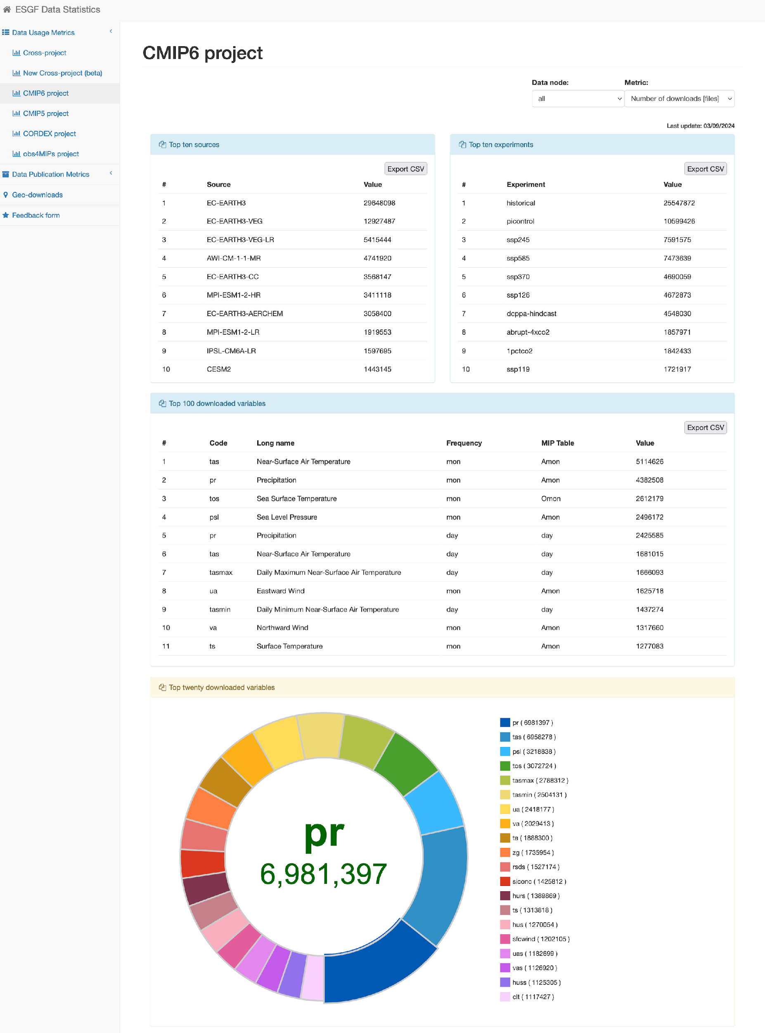
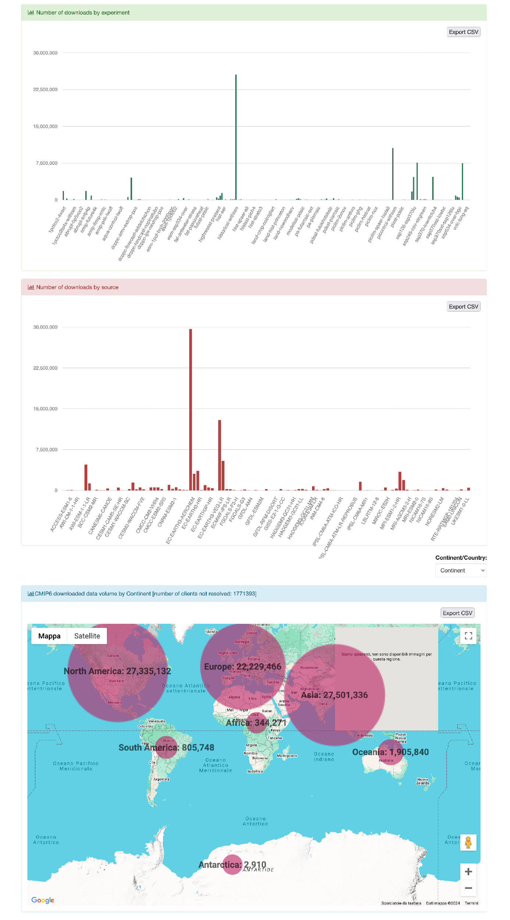
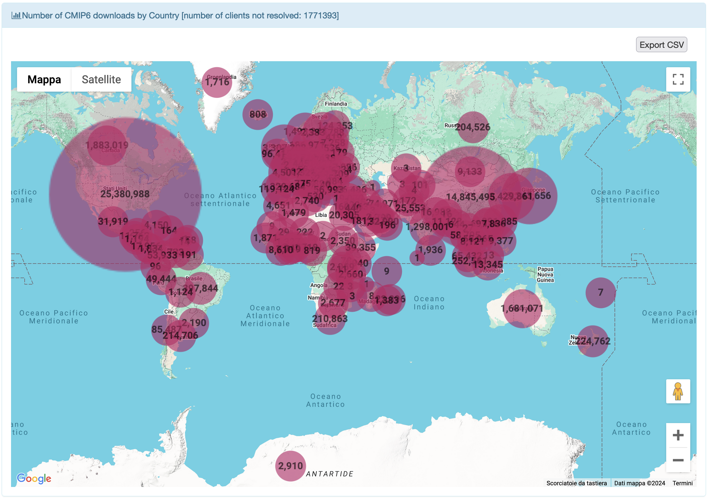
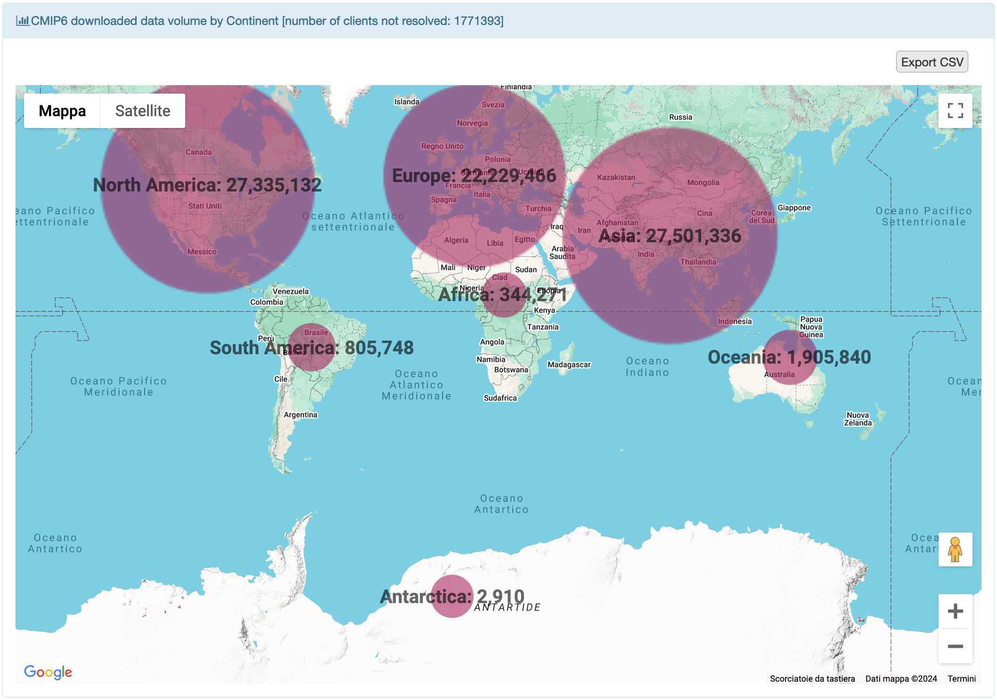
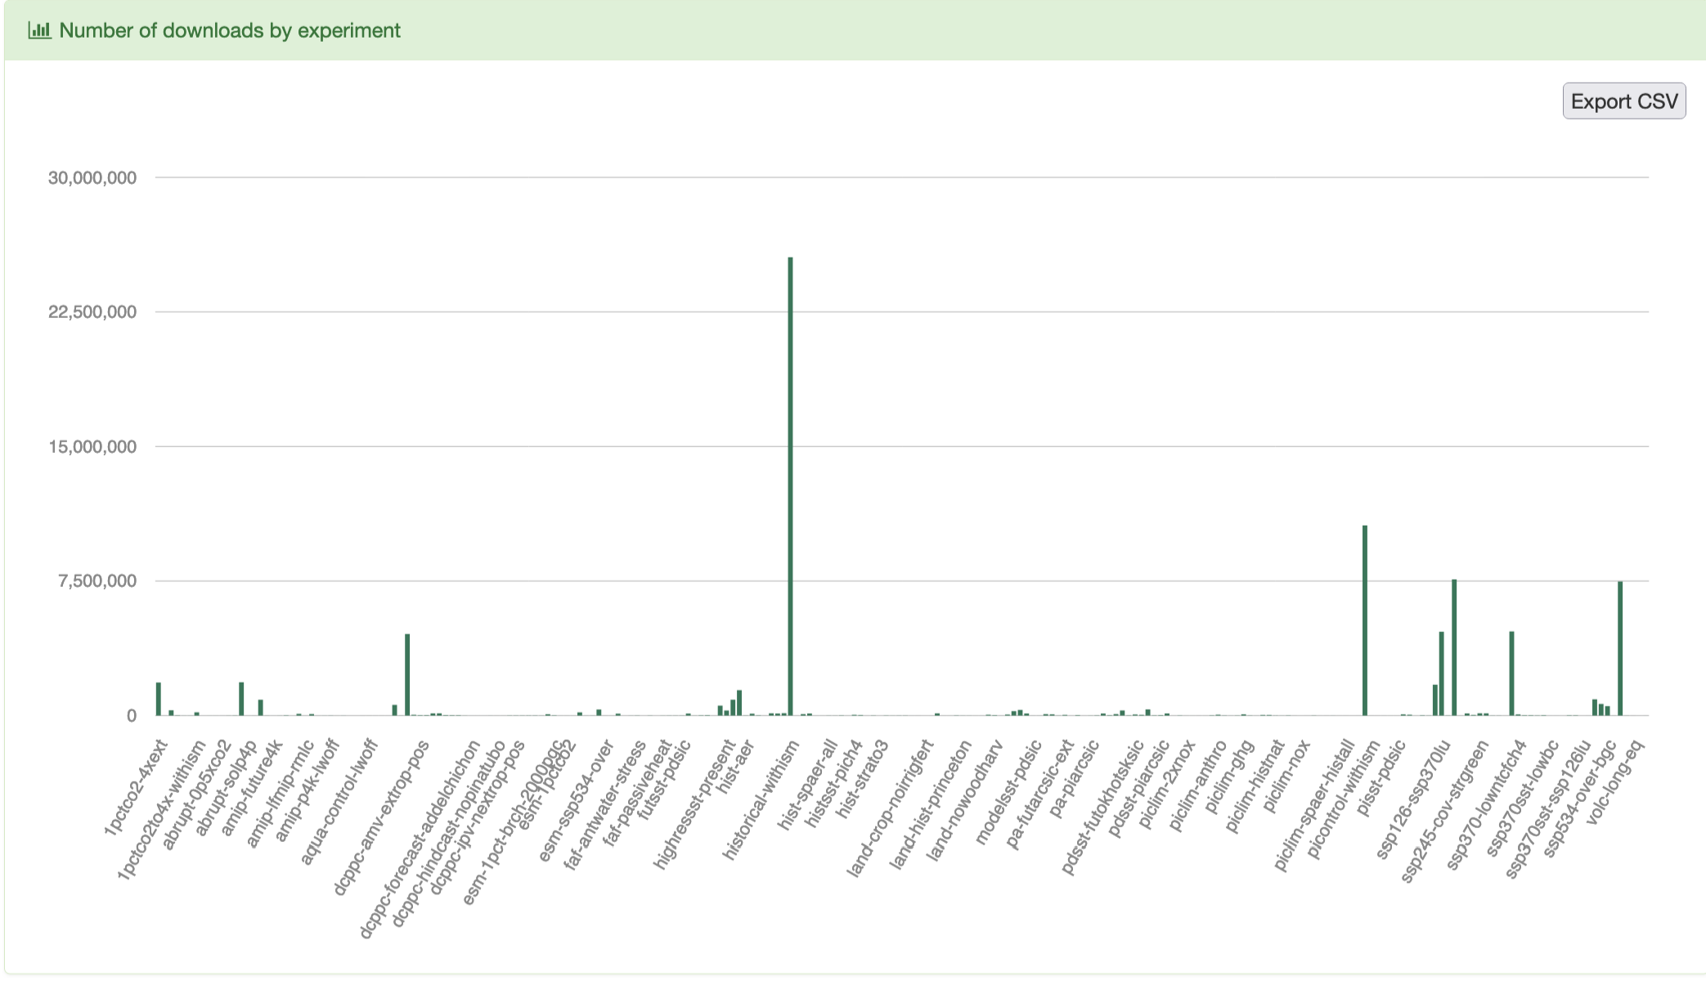
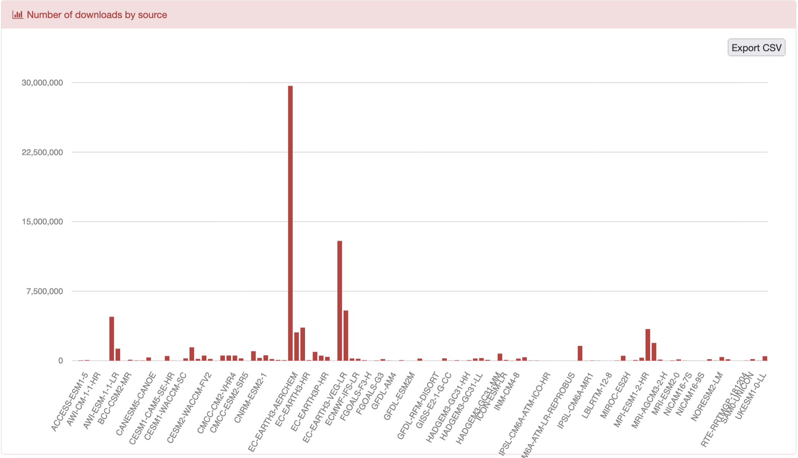
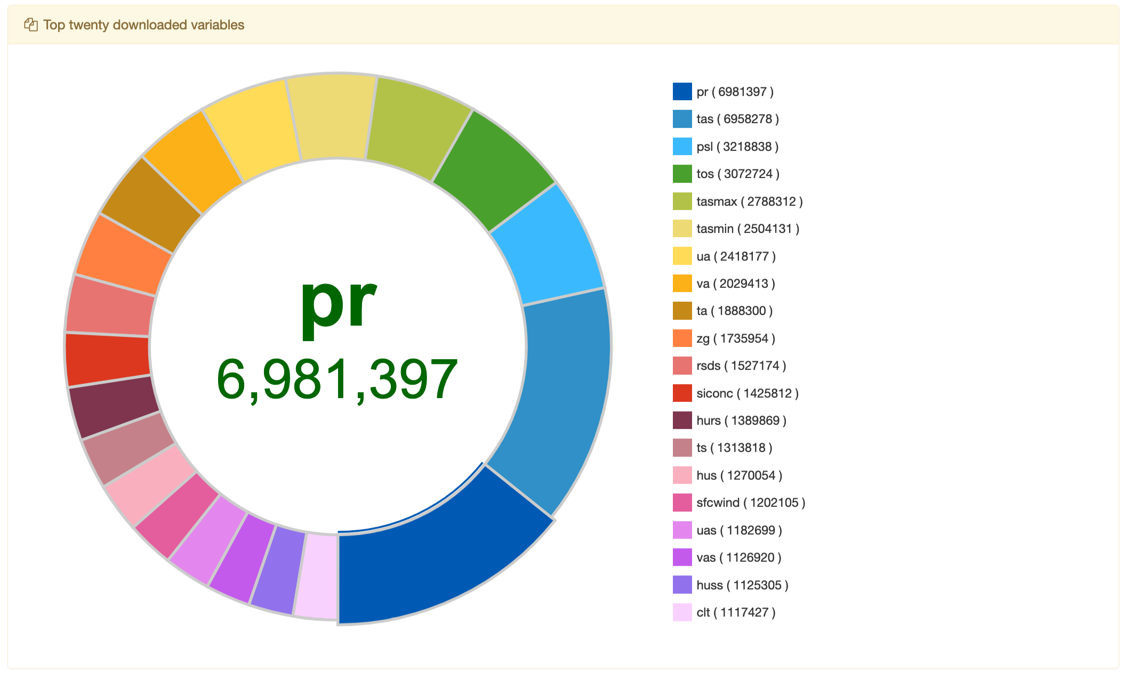
Data Publication metrics

Slide 12
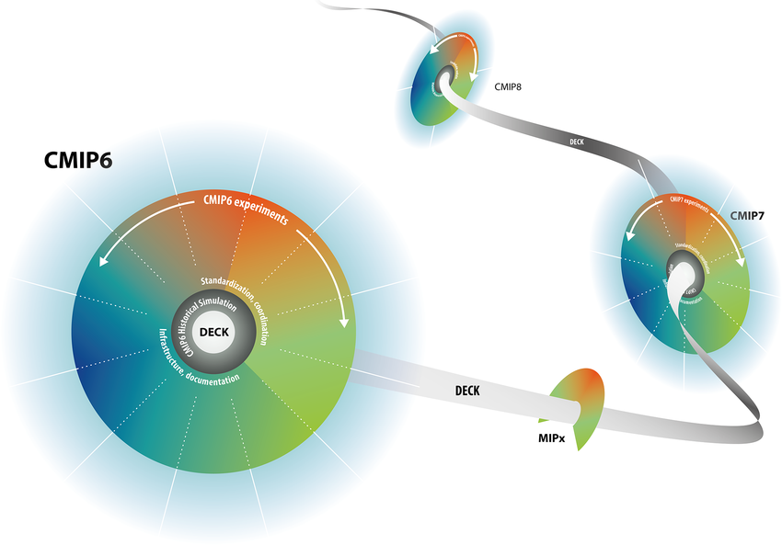
To conclude/Looking forward to CMIP7
The ESGF Data Statistics service provides a distributed and scalable software infrastructure responsible for capturing a set of data usage and data archive metrics both at the single site and federation level.
The work highlights the relevance of the data usage metrics, the complexity of gathering them across the whole ESGF federation from a distributed system as well as the quantitative and visualization aspects related to them.
Looking forward to CMIP7:
Extension of the metrics’ environment to manage CMIP7 data
New services to track (e.g. Globus)
Adaptation of the service looking forward to STAC interoperability
Inclusion and tracking of new data nodes

Slide 13
Other activities in the future roadmap
Cloud-based release to address stronger availability/reliability
EOSC ecosystem and link with EGI
Opportunity to deploy a backup instance on EGI providers, in EOSC
API to expose statistics for wider exploitation
Other activities within a new proposal (HORIZON-INFRA-2024-TECH-01-01), led by EGI and named RI-SCALE, e.g.:
smart caching of the Data Exploitation Platform (DEP)
AI-based real-time anomaly detection and system health alerting and monitoring

Slide 14
Thank you for your attention

Slide 15
ESGF main challenges
Some of the challenges that ESGF is committed to addressing include:
the enormous scale of the data holdings, moving from Peta-bytes to Exa-bytes
support for both model output and a wide variety of observational data
the distributed nature of the data archives, which are geographically distributed and autonomously operated
the need to enable users to access and analyse data with a wide variety of client tools
the need to harmonize and federate multiple local access policies

Slide 16
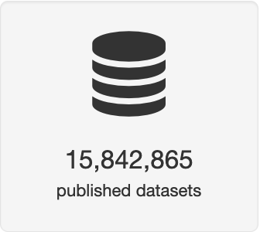
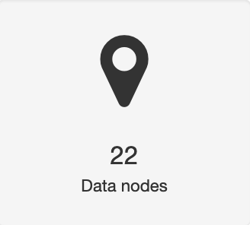
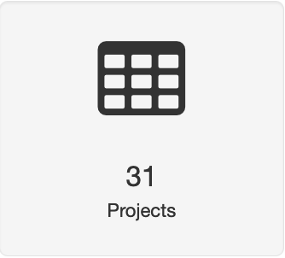
ESGF by the numbers
Data archive information
37 PetaBytes
from
over
around 7 millions
datasets are replicas
As expected, CMIP6 reached 20 PB in June 2021, with about 10 millions and 700 hundred datasets.

Slide 17
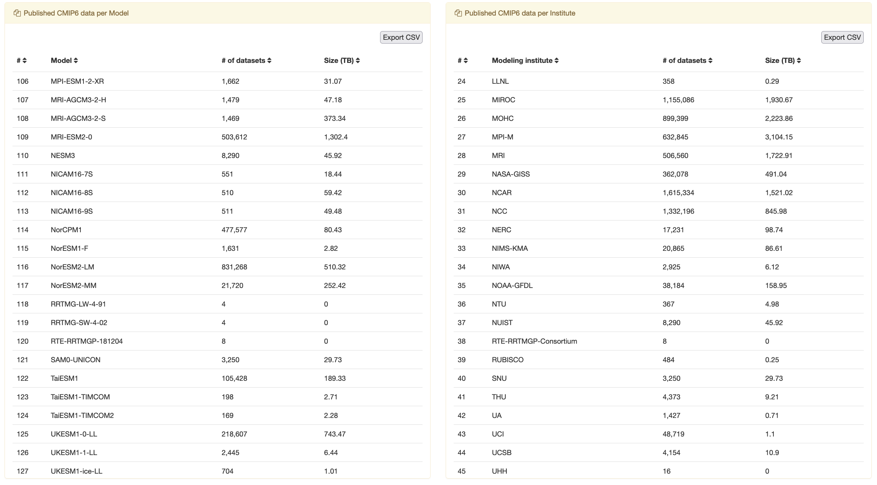
ESGF by the numbers
Data archive information
Currently, CMIP6 counts more than 27 PB and almost 15 millions datasets.
Datasets from about
130 models and
45 different institutions have been published for CMIP6.

Slide 18
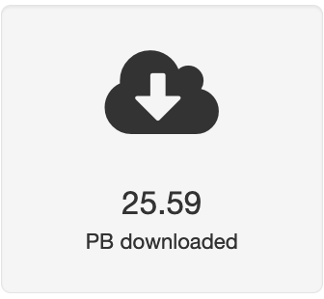
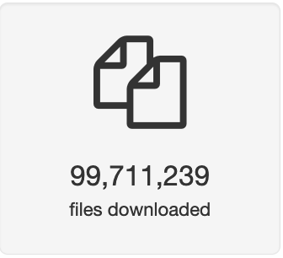
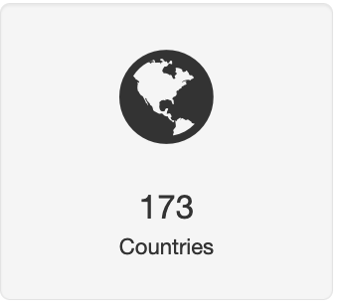
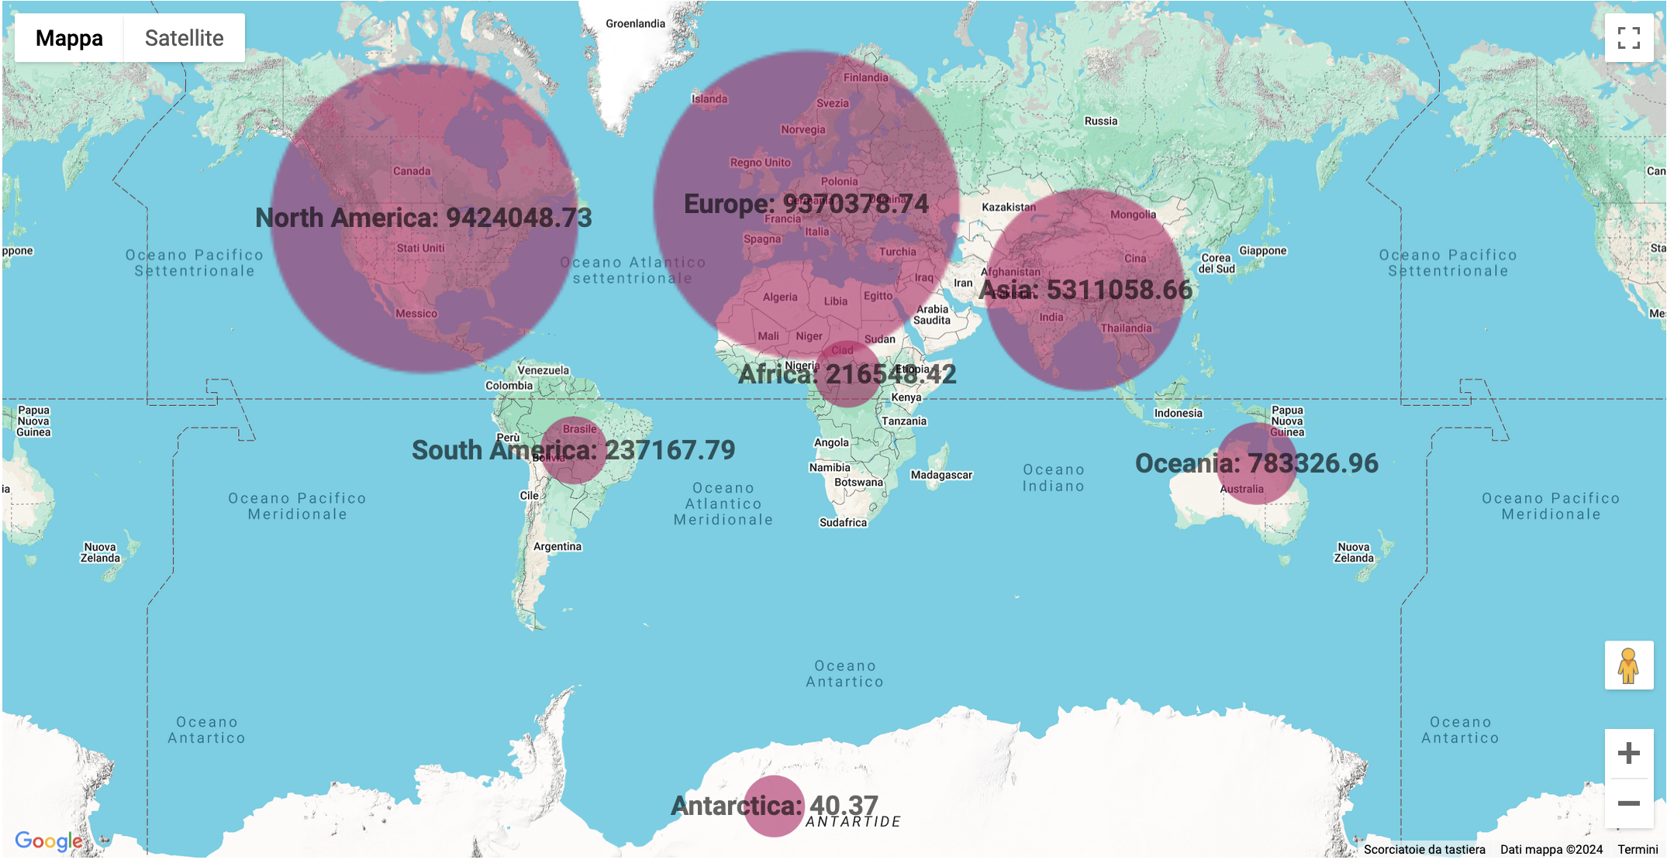
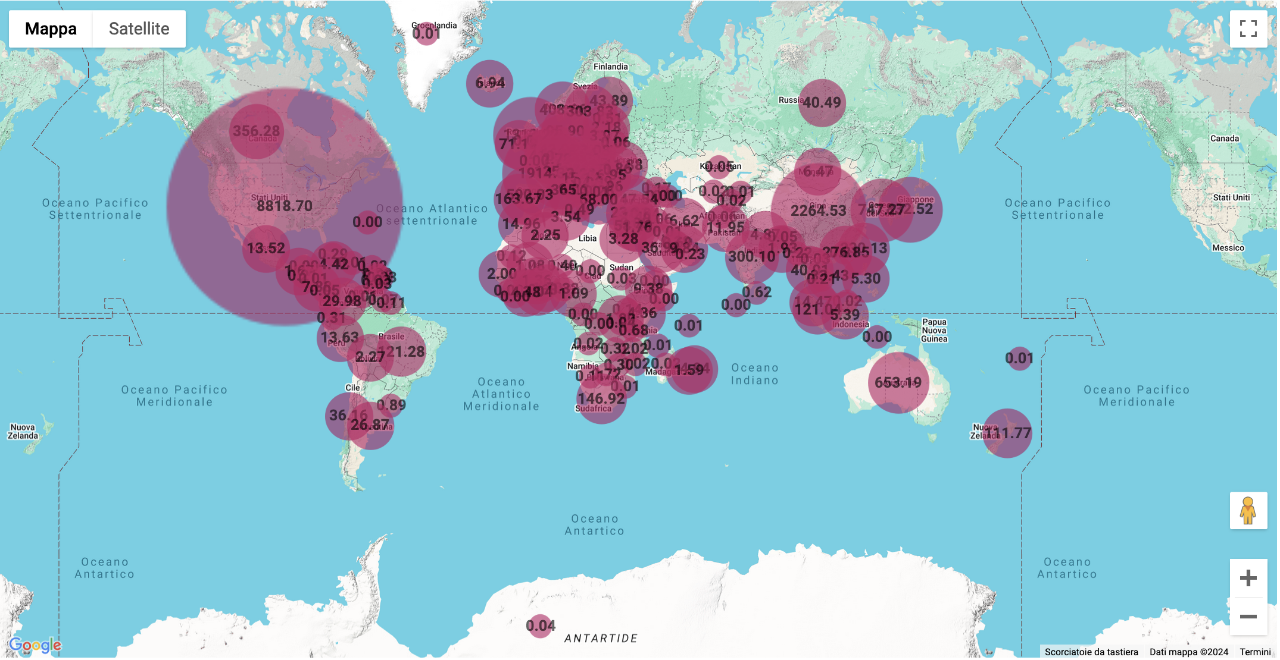
ESGF by the numbers
Data usage information
and
from

Slide 19
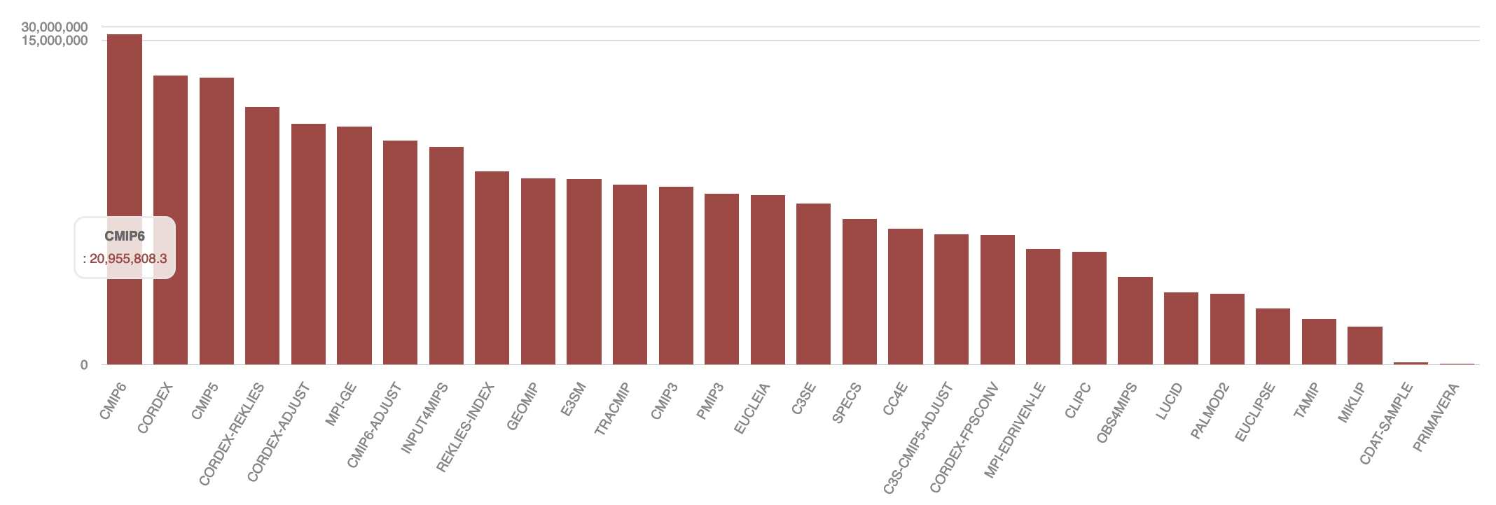
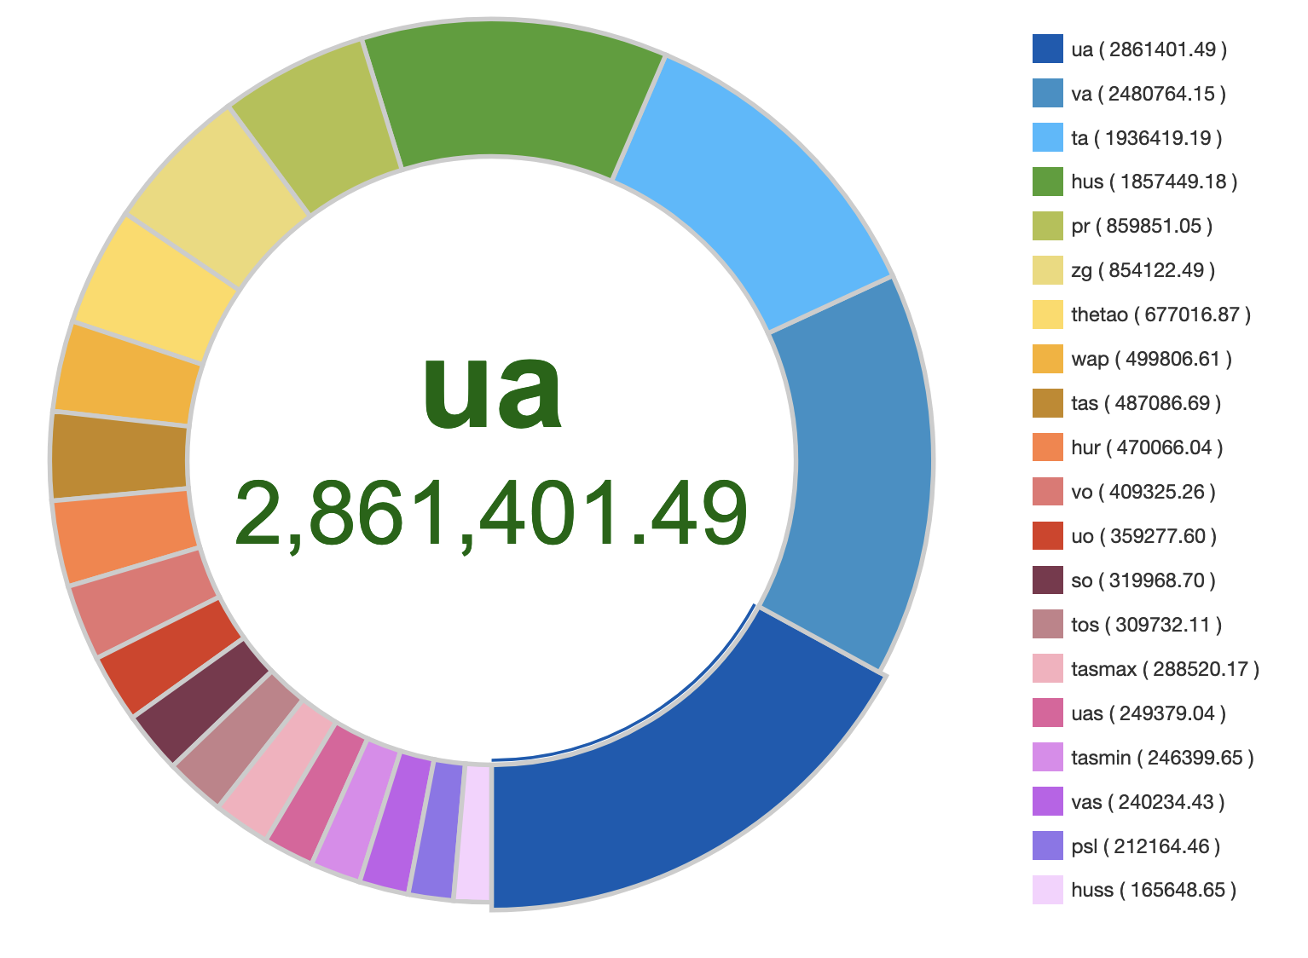
ESGF by the numbers
Data usage information
CMIP6 is the most downloaded project with about 21 PB and 85 million files.
The CMIP6 most downloaded variable is the Eastward Wind (ua) (about 3 PB), followed by
Northward Wind (va) and Air Temperature (ta)

