Slide 1
Towards an EOSC compliant research data repository in Hungary with ARP
Balázs E. Pataki SZTAKI – DSD
pataki@sztaki.hu

Slide 2
About us
Balázs Pataki, senior software architect
Research Institute for Computer Science and Control in Hungary, Budapest
Department of Distributed Systems, 30 years expertise in collaborative systems, digital libraries and repository systems

Slide 3
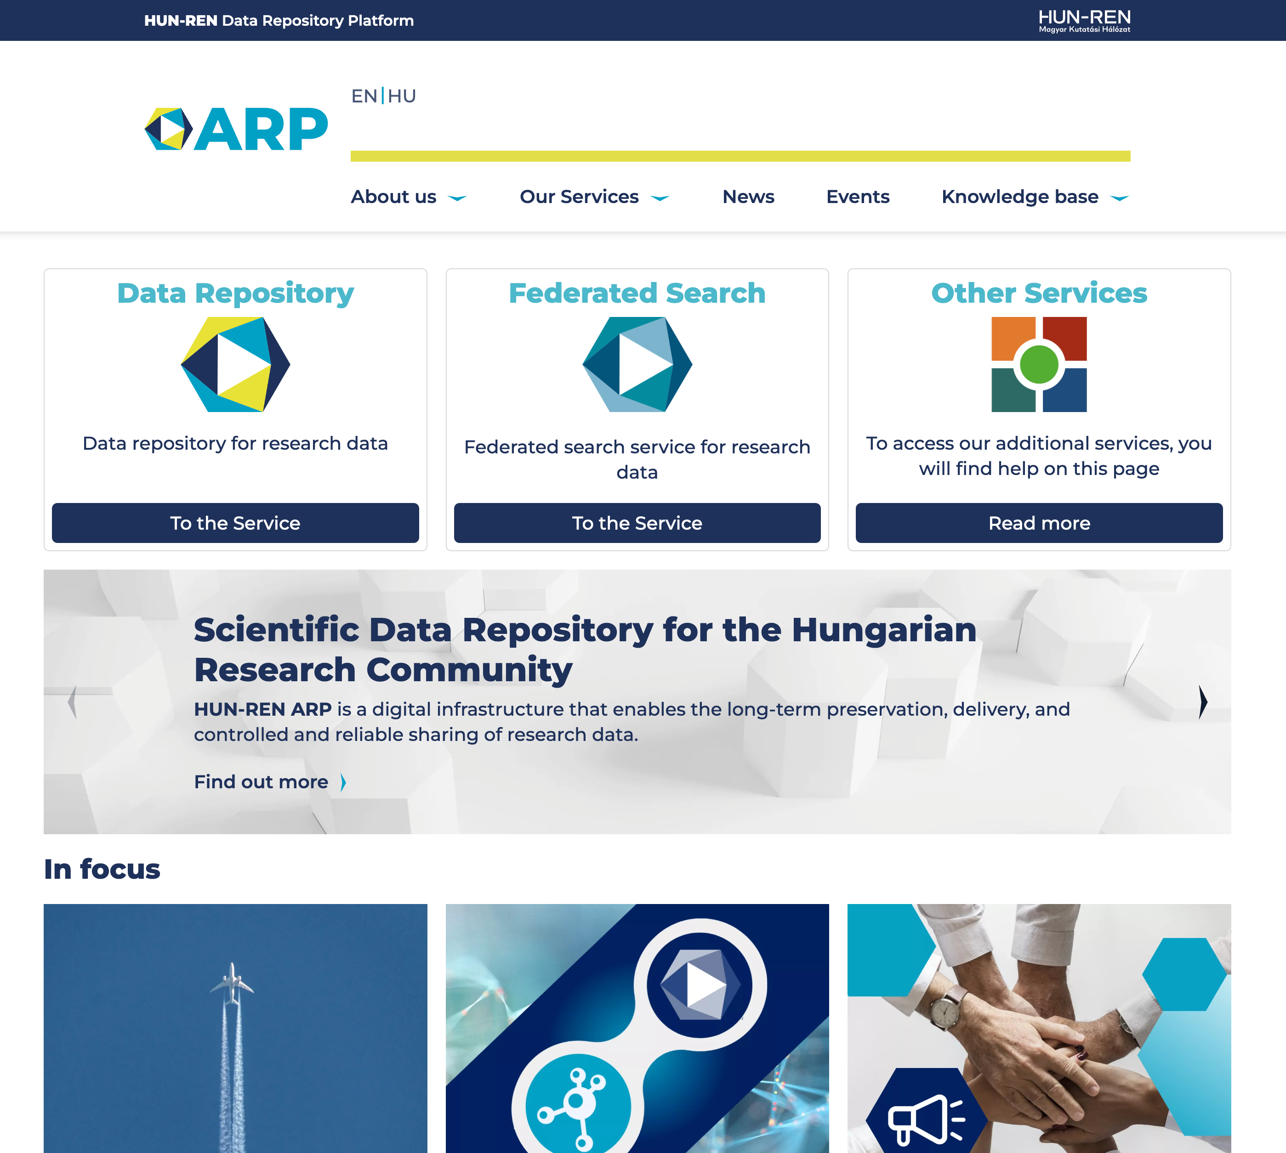
What is ARP?
ARP (AdatRepozitórium Platform, researchdata.hu) is a Hungarian national research data repository platform built by SZTAKI in partnership with the Center for Social Sciences (TK) and the Wigner Research Centre for Physics (Wigner FK)
ARP has been created to provide comprehensive and adaptable data repository service, capable of accommodating all research disciplines practiced in Hungary.
Make it possible to publish any kind of research data with associated metadata.

Slide 4
Hungarian Research Infrastructure

Slide 5
The Hungarian Research Network – HUN-REN

Slide 6
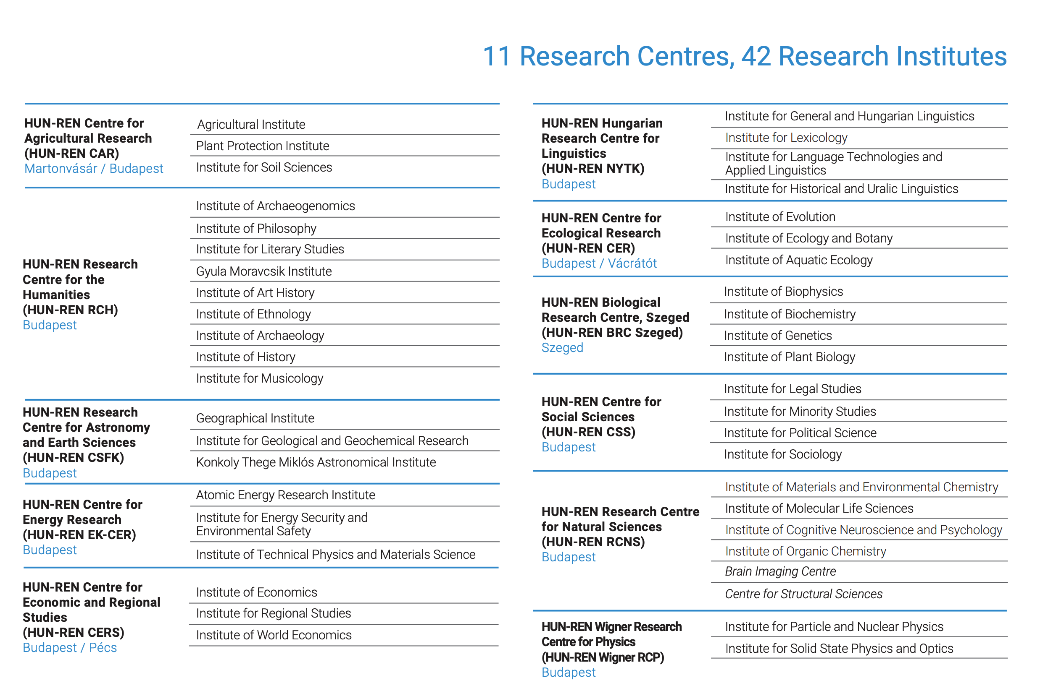
The Hungarian Research Network – HUN-REN

Slide 7
ARP Goals
A central repository platform capable of serving all research institutes with diverse data and metadata needs
A federation of existing data repositories
Long-term preservation of research data
Adherence to the Open Science and FAIR principles
Development of services to ensure EOSC compatibility
Integration and extension of existing tools

Slide 8
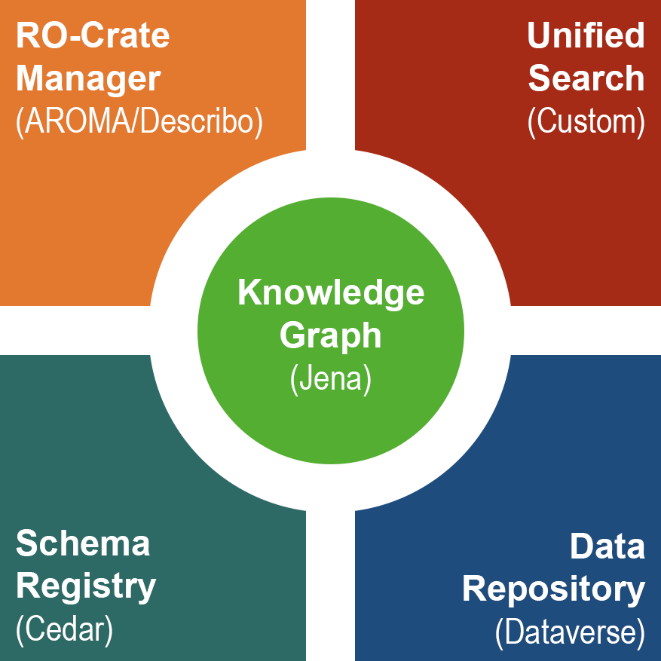
ARP CORE Components

Slide 9
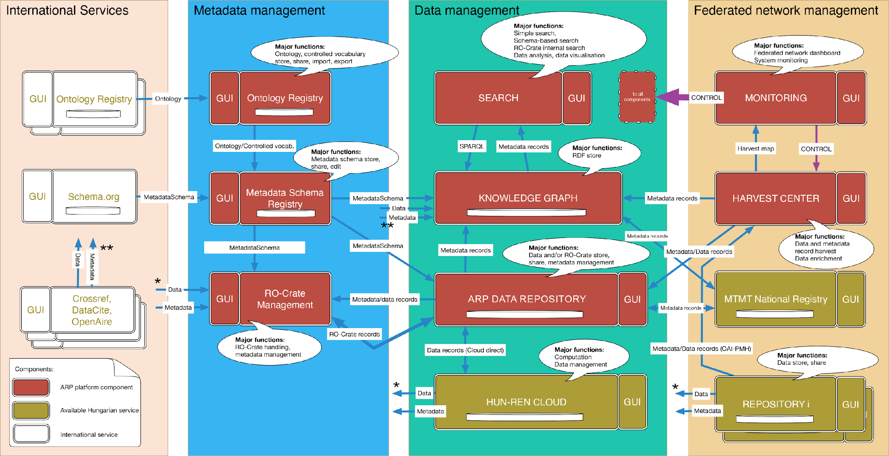
ARP CORE Architecture

Slide 10
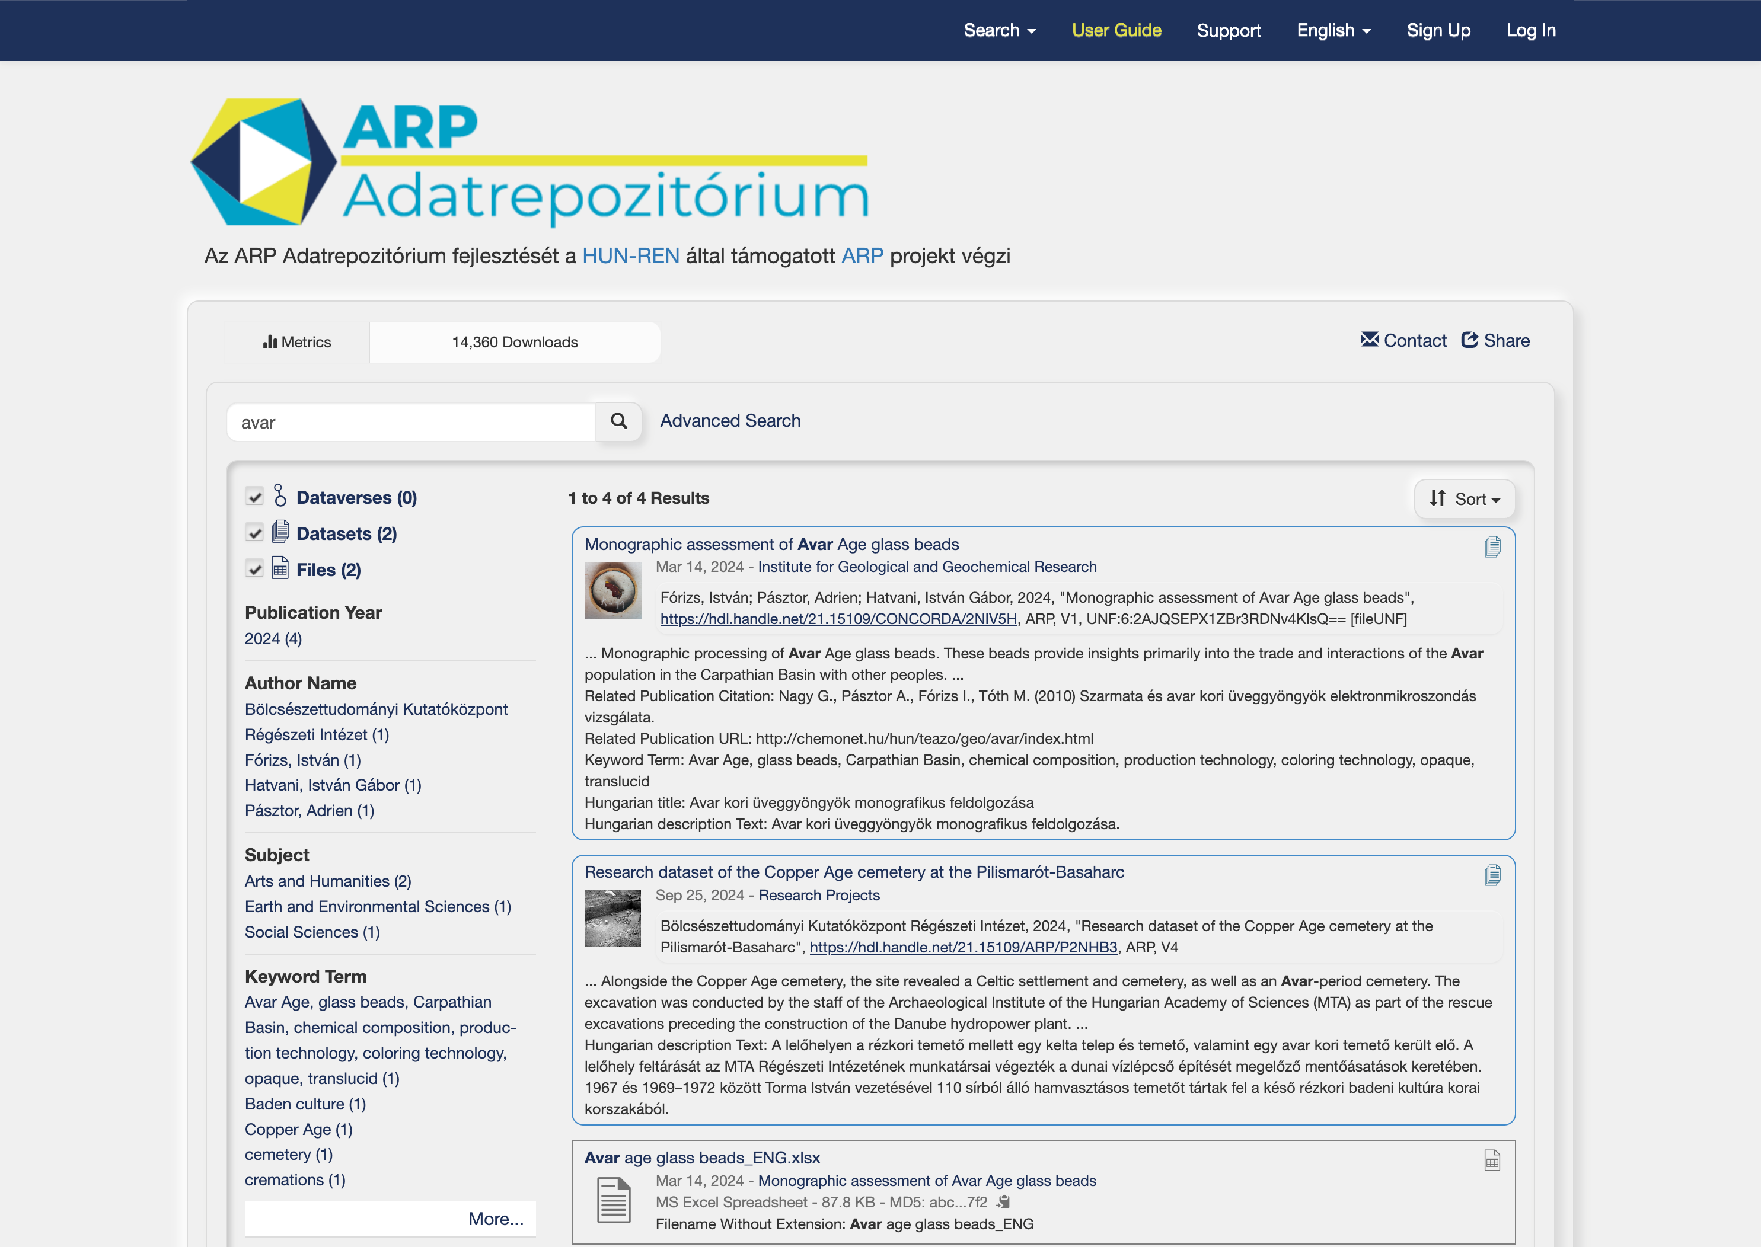
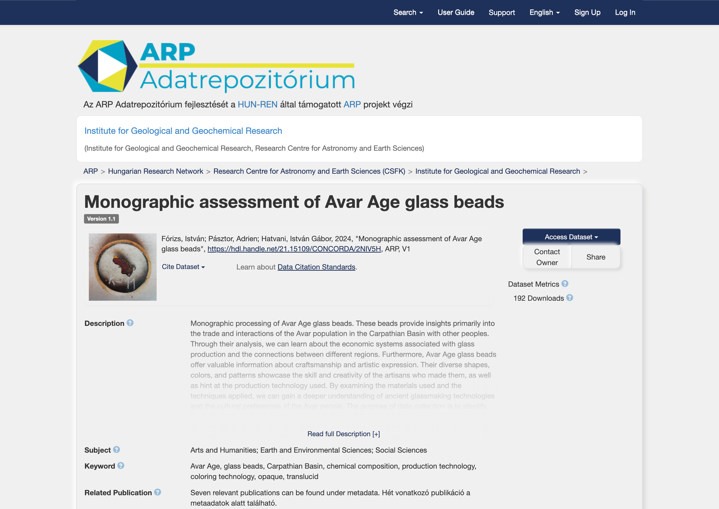
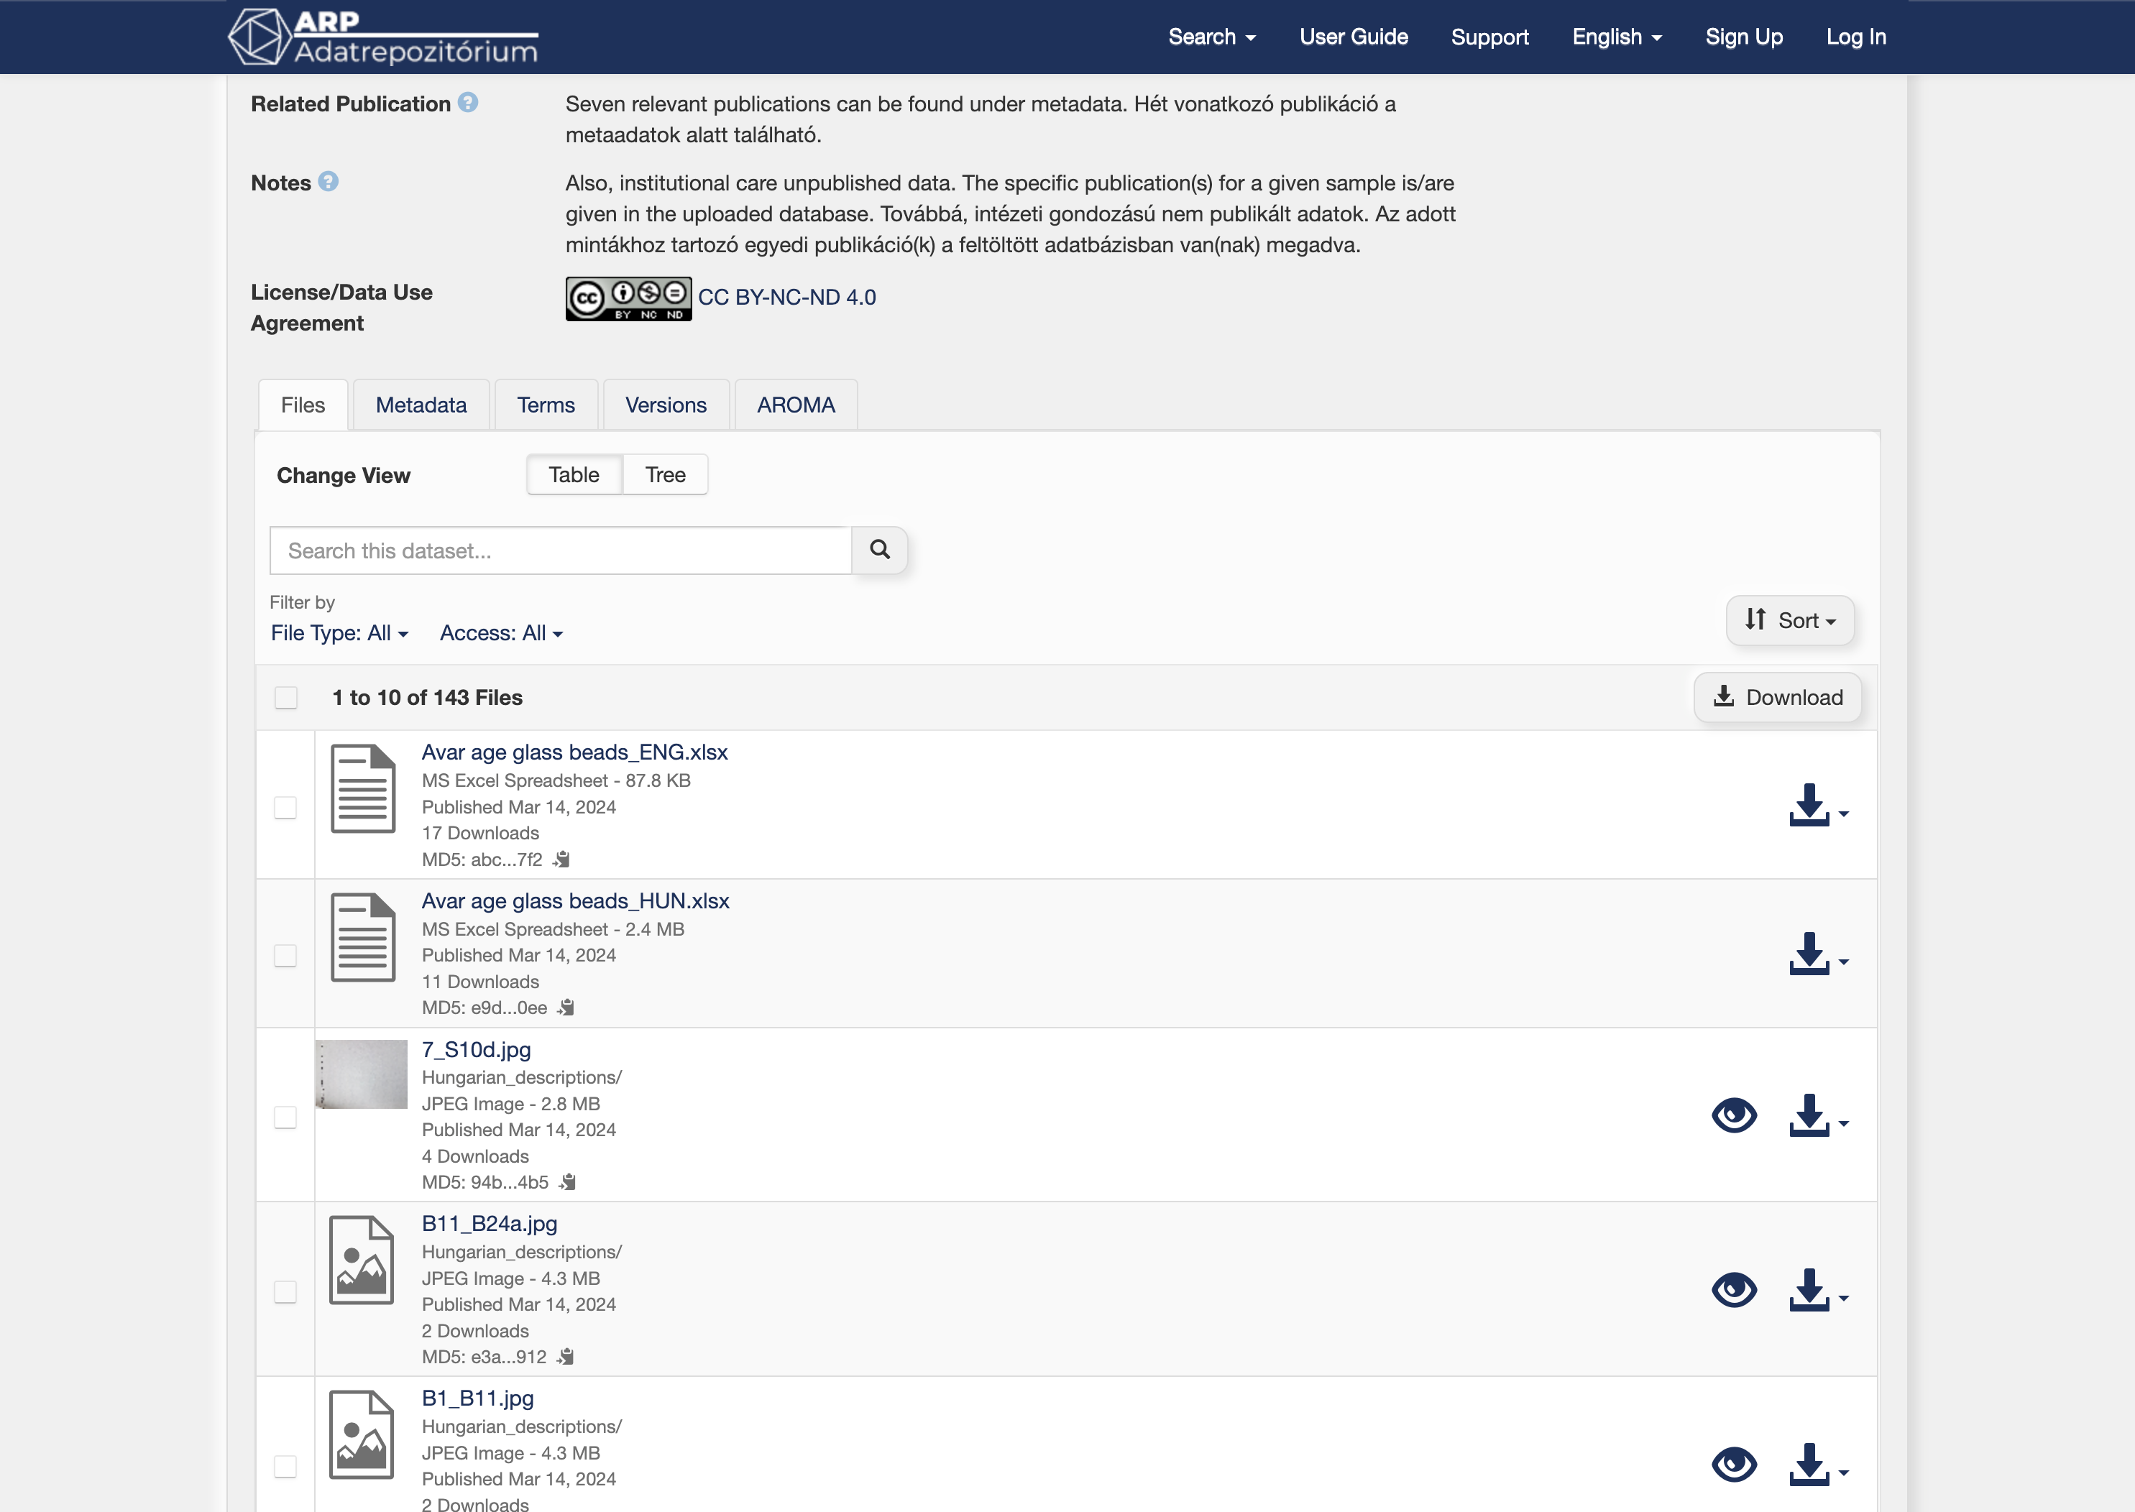
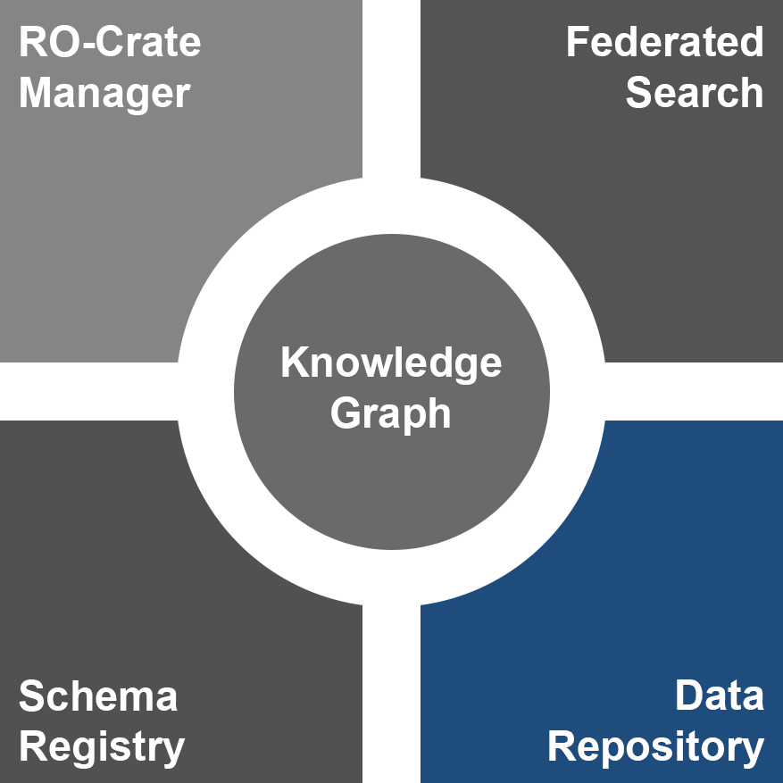
ARP CORE – Data Repository

Slide 11
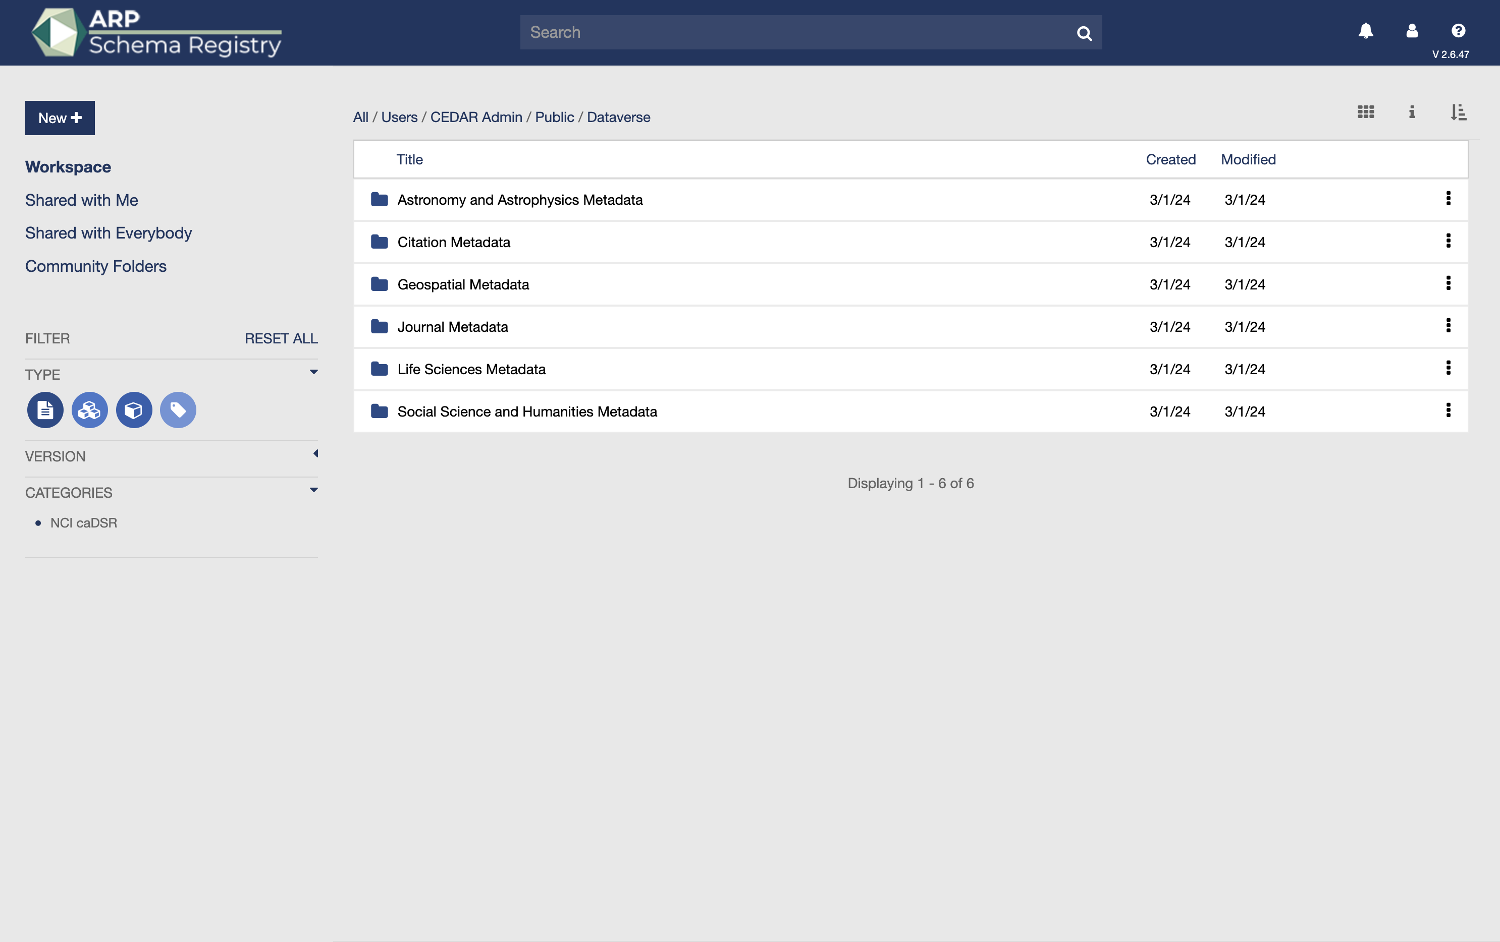
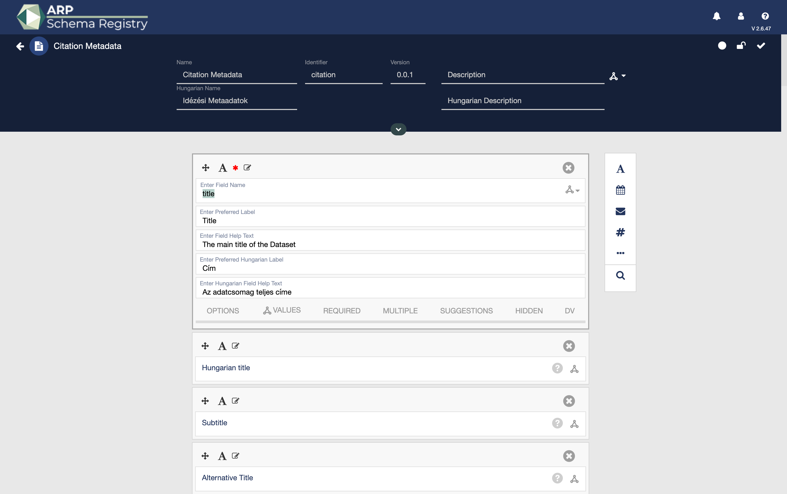
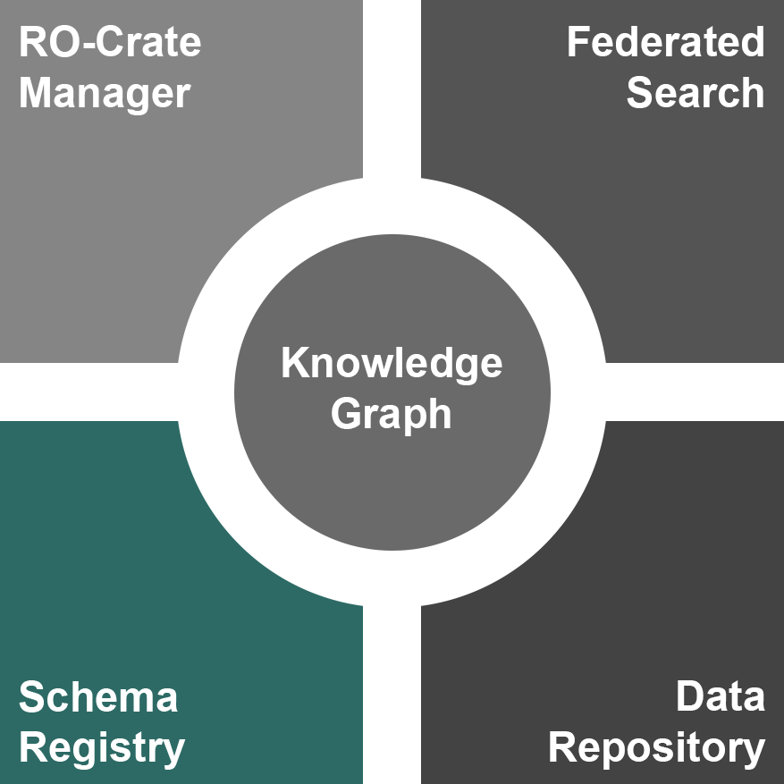
ARP CORE – Metadata Schema Registry

Slide 12
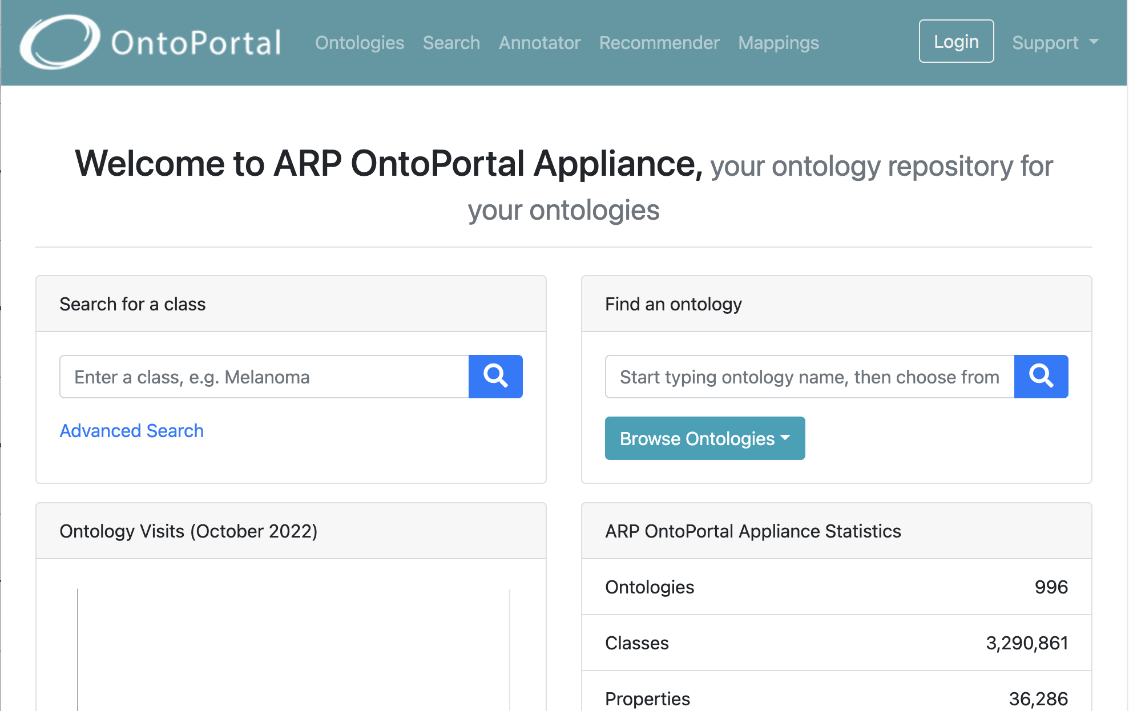
ARP CORE – Ontologies

Slide 13
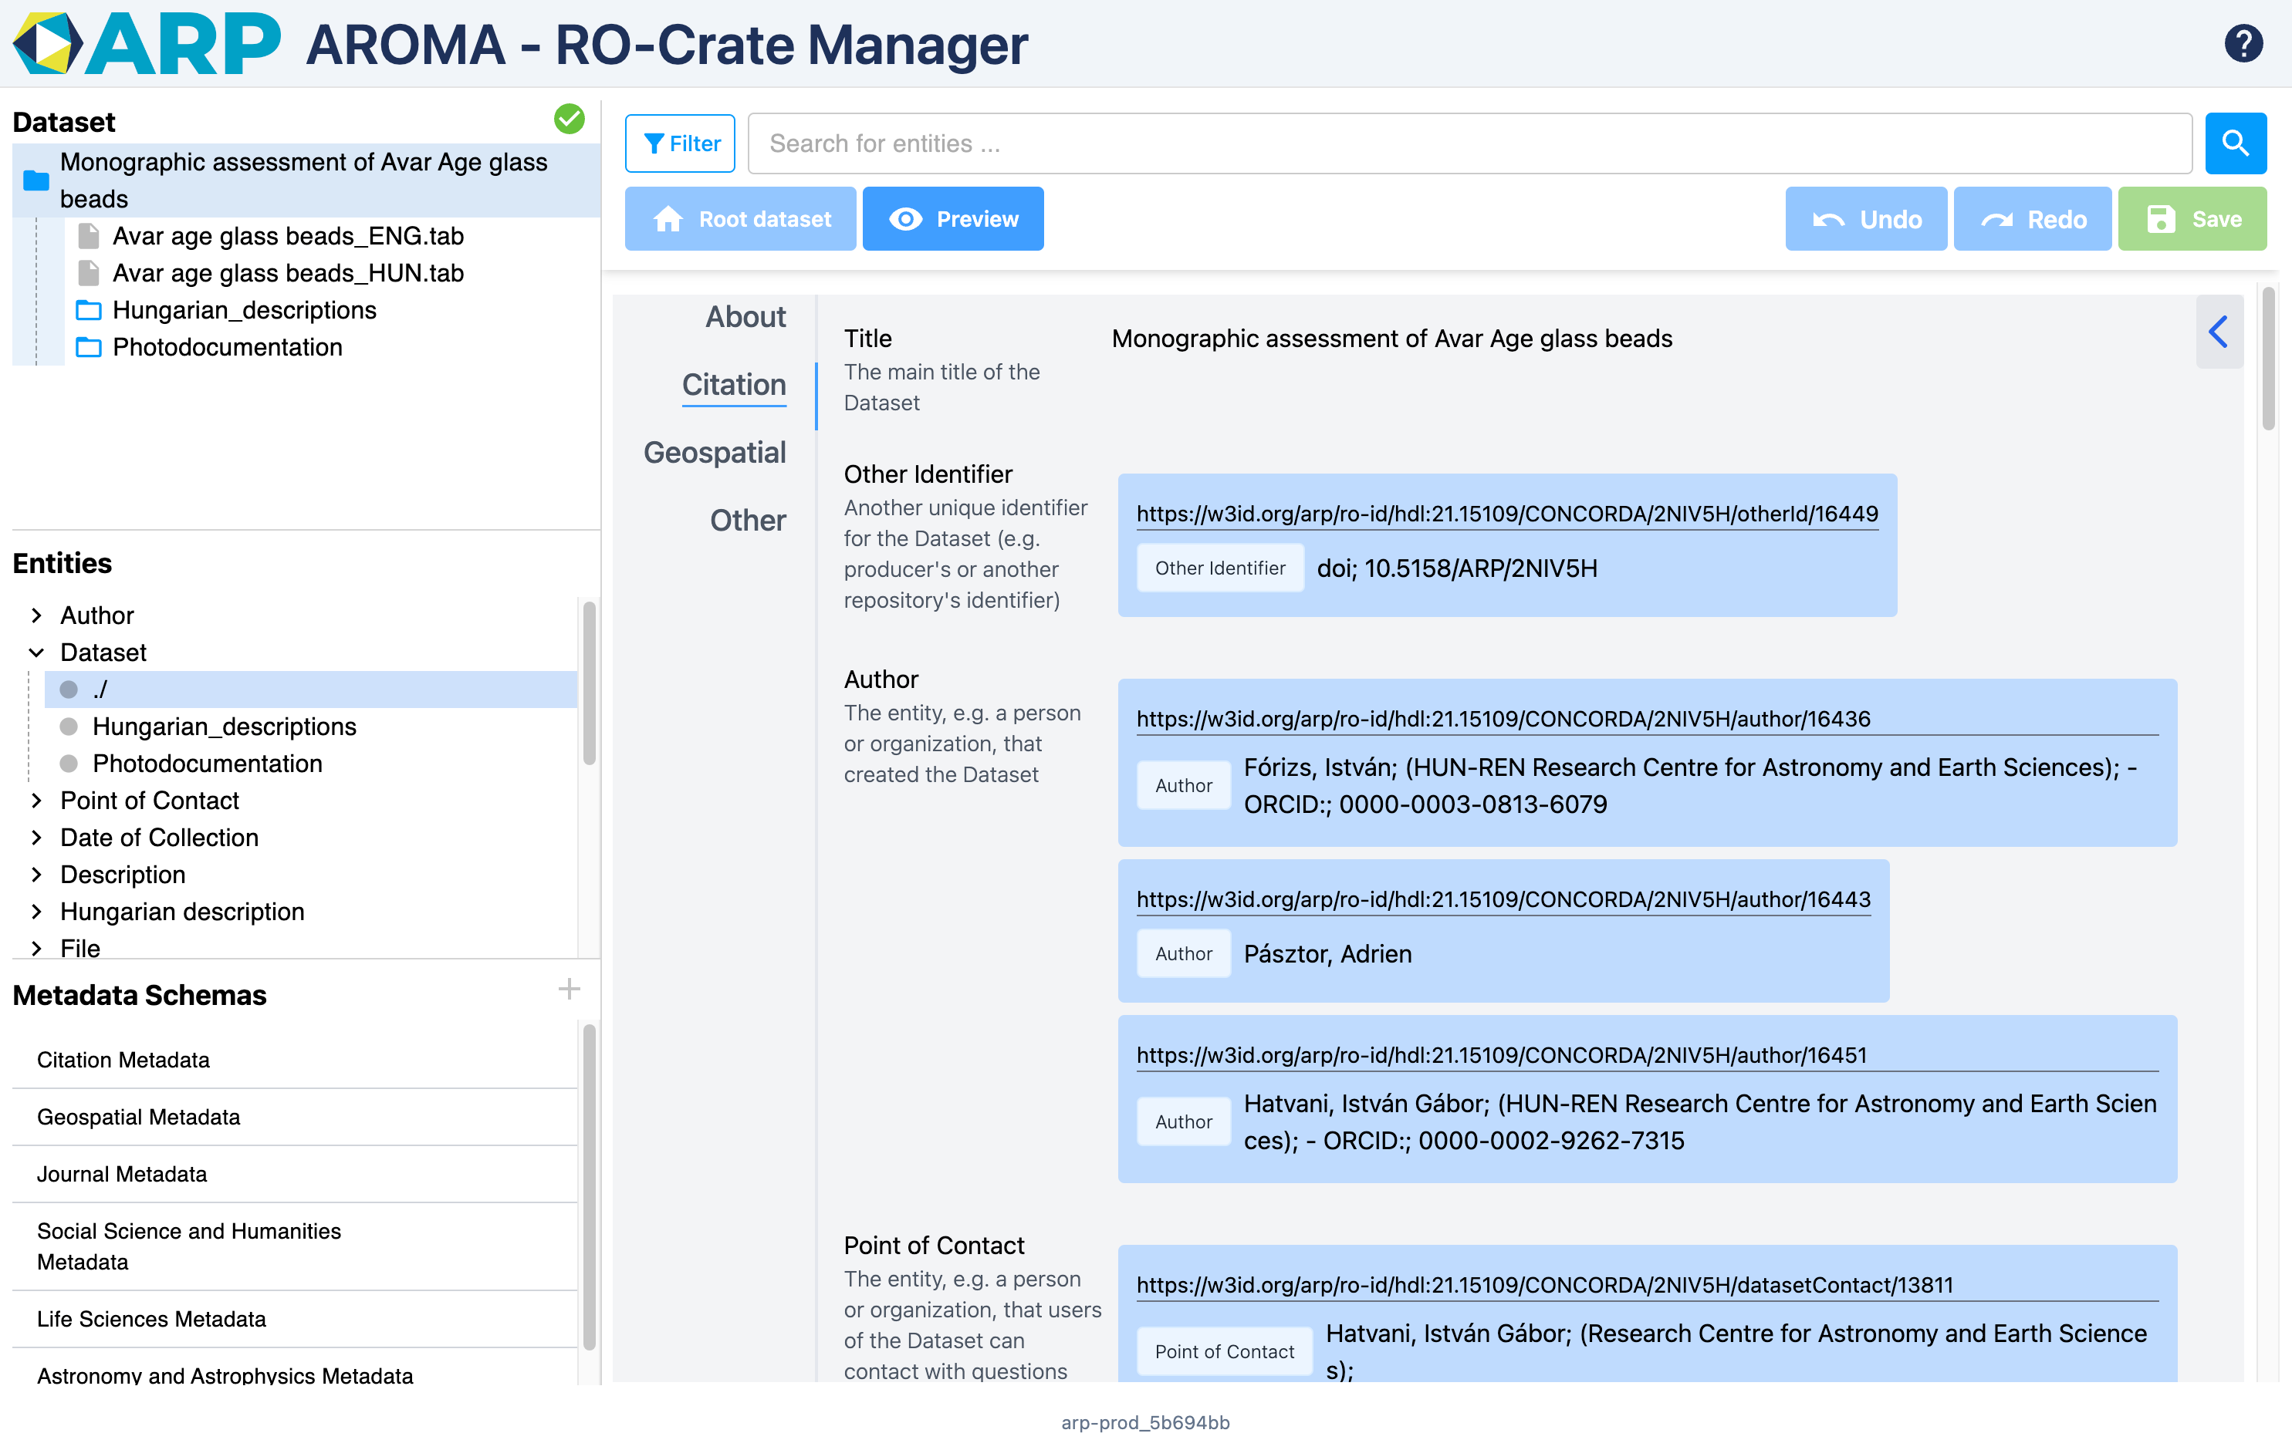
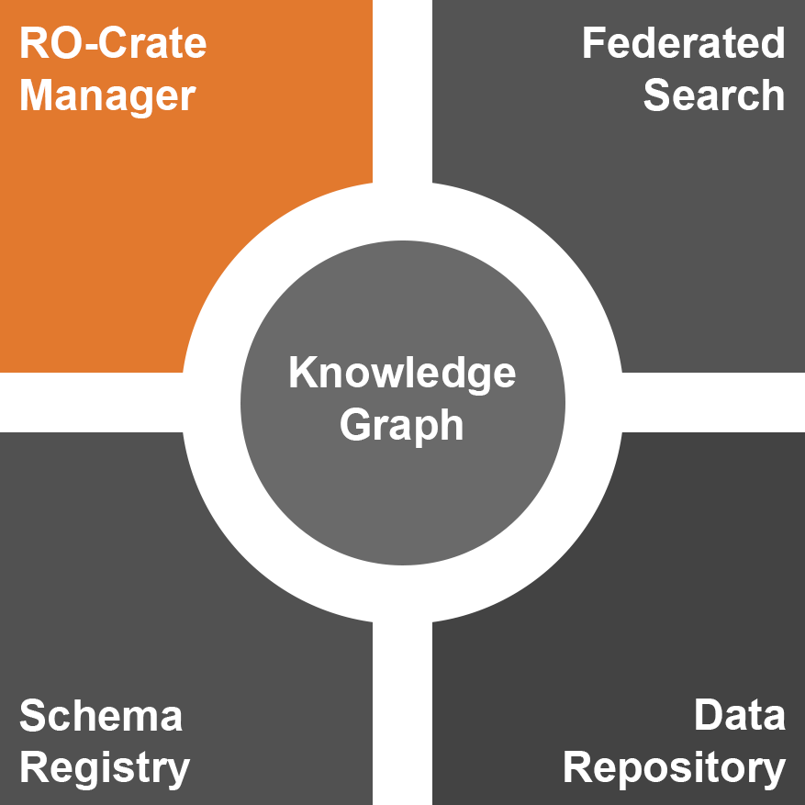
ARP CORE – RO-Crate Manager

Slide 14
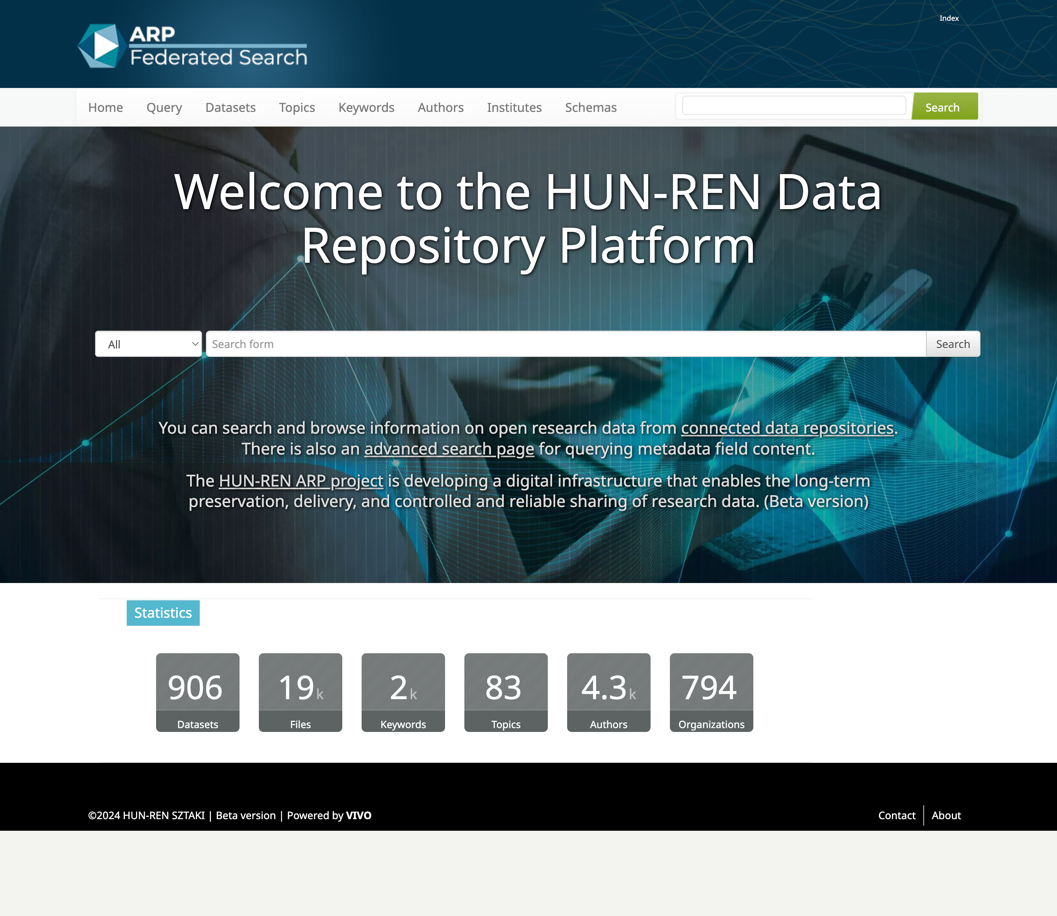
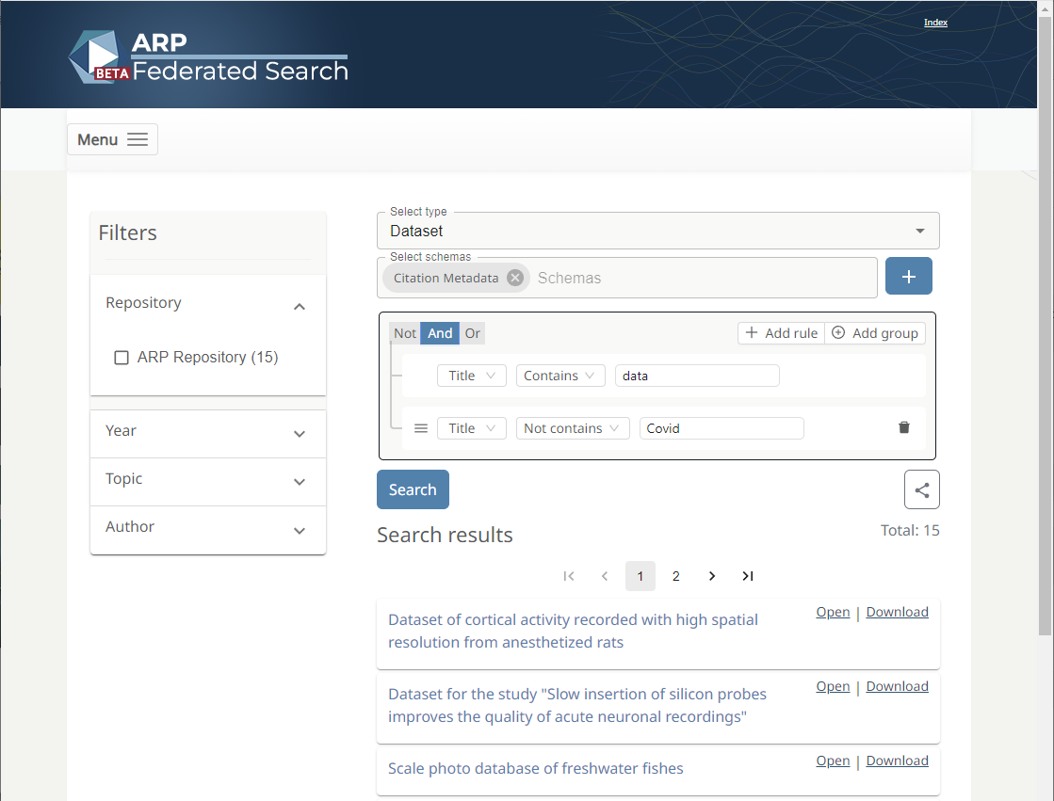
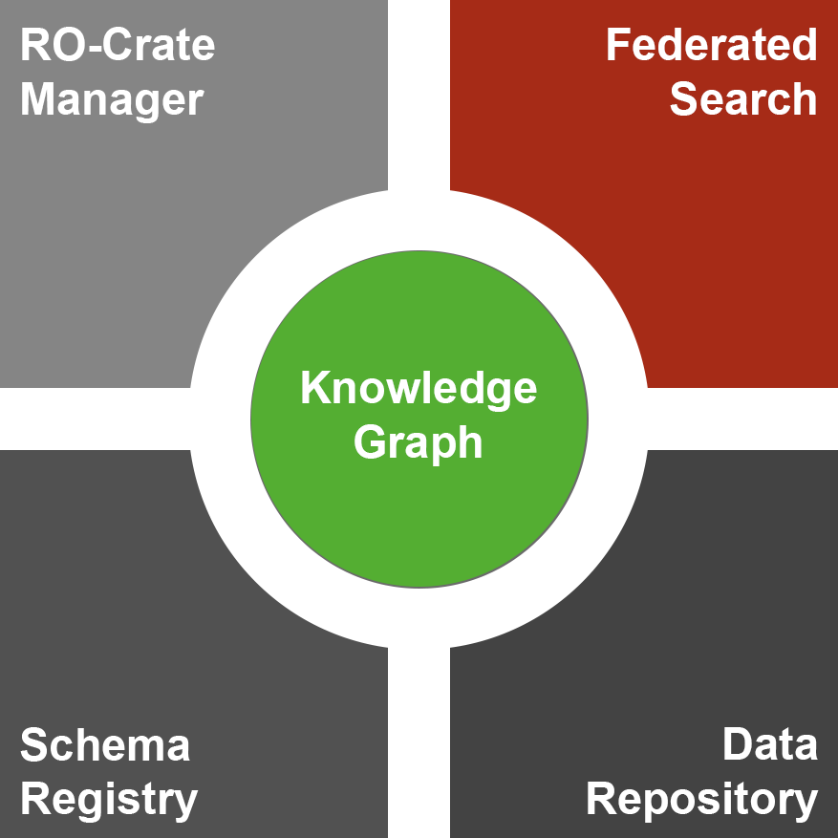
ARP CORE – Unified Search, Knowledge Graph

Slide 15
ARP and EOSC
 | EOSC-CORE services | ARP-CORE services
PID handling | PID Graph PID Meta Resolver (PIDMR) | DOI, ARK, Handle, W3ID
Metadata registry | Metadata Schema and Crosswalk Registry (MSCR) | CEDAR schema registry
Metadata element handling | EOSC Data Type Registry (DTR) | OntoPortal
Authentication | Authentication and authorisation infranfrastructure (AAI) | EDUID

Slide 16
Balázs Pataki SZTAKI – DSD
pataki@sztaki.hu
ARP - https://researchdata.hu/en
SZTAKI - https://www.sztaki.hu/en

