Slide 1
EGI2024: Processing Research Data with Artificial Intelligence and Machine Learning
Exploring the Potential of Graph Neural Networks to Predict the State of Seagrasses Ecosystem in Italian Seas
Angelica Bianconi, Sebastiano Vascon, Elisa Furlan and Andrea Critto
This project has received funding from the European Union’s Horizon 2020 research and innovation programme under grant agreement No 869710

Slide 2
Motivation & Objective
Explore the application of GNNs to assess the impact of anthropogenic and climate change-derived pressures on Seagrass ecosystem in Italian seas
Compare GNNs with commonly used models in this context (i.e., Random Forest, Support Vector Machine, Multi-Layer Perceptron)
Marine and Coastal Ecosystems (MCEs) and their ability to flow ecosystem services are threatened by the complex interplay between human-made and climate change-related pressures
Although existing Machine Learning (ML) methods can simplify the impact evaluation of multiple environmental stressors on MCEs, they do not consider the potential spatial dependence of the effect of pressures
Recent advancements in Graph Neural Networks (GNNs) offer potential solutions and are gaining popularity in environmental sciences
Massive thanks to the Food and Agriculture Organization of the United Nations (FAO)’s The Youth Guide to the Ocean 1st Edition for the resources provided.
Notes:
Traditional ML models such as SVML, RF, MLP can simplify the impact evaluation of the stressors, but they do not consider the spatial dependences of the data. For this reason we decided to investigate the suitability of modern graph neural networks models in the context of stressors evaluation. GNNs explicitly model the relationships between data points, hence offer potential solutions to the issue of neglecting spatial dependencies in the prediction
The main aims of this work are explore the application of GNN based models to evaluate the impact od pressures on Seagrasses ecosystem and compare these methods with the models that usually are employed in this field.

Slide 3
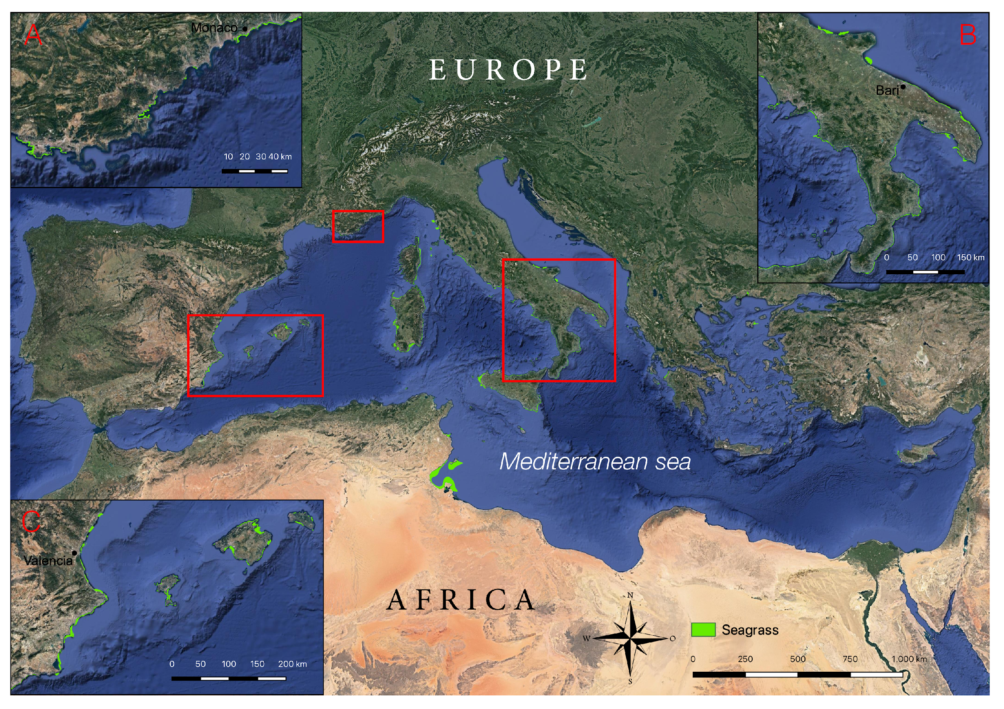
Case study & dataset
Key pressures:​
Endogenic
(nutrient load, shipping traffic, coastal development, …)​
Exogenic
(changes in sea surface temperature, sea level rise, …)
MCE state:
Seagrasses meadows
State (spatial distribution identified as Presence or Absence)
Notes:
The output is the spatial distribution of seagrasses identified as Presence or Absence pixel paired with the stressors

Slide 4
Case study & dataset
Italy - Bathymetry layer up to 50 meters
The dataset was compiled involving domain experts
Spatial resolution: 4km
Temporal resolution: annual (2017)
Notes:
The case study is identified by the Italian Seas with a bathymetry layer up to 50 meters. Stressors data were downloaded from several open-source platforms with a spatial resolution of 4km. For each indicator annual metrics were computed, so the temporal resolution is annual, and the reference year is the 2017 because the most representative dataset of the spatial distribution of Seagrasses refers to that year.

Slide 5
Graph construction scheme
Method
Each pixel from the dataset, identified by latitude and longitude coordinates, was mapped to a node in the graph
Layers containing metrics related to selected input variables were vectorized into feature vectors associated with each node
The edges of the graph were determined based on the distance between nodes, particularly each node was connected to its four or eight nearest neighbouring nodes (pixels)
Notes:
The study includes the comparison between RF, MLP and SVM with the GNN-based models GAT and GCN.
GNNs require a graph as input, hence we need to convert the seagrass map into a graph. To construct the graph, each pixel of the case study, identified by latitude and longitude, is a node into the graph. The input variables represent the feature vectors associated with each node. Each node is connected with the 4 and also the 8 nearest pixels.

Slide 6
Experimental settings
A mask was applied to each node of the graph specifying whether the node is a training (80%), validation (20%) or test (10%) node.
For models that are not applied directly on the graph structure, the observations corresponding to the training nodes were used to construct the training set, applying the same procedure to the validation and test data.
Training:
1. On the entire graph
2. On subgraphs obtained through a weighted random sampling based on class distribution.
Notes:
The dataset was divided in training validation and test. The training was performed considering two strategies, on the entire graph and on subgraphs obtained by weighted random sampling based on class distribution.

Slide 7
Experimental settings
Architectures were tested with different layer configurations, including a single convolutional layer (or attention layer) followed by a linear layer and three convolutional layers (or attention layers) followed by a linear layer
Architecture configurations were explored on graphs with both 4-node and 8-node connectivity
Models applied to 8-node connected graphs perform better and are used for comparison
All compared models were optimized by hyperparameter tuning
Notes:
Several architectures were tested with different layer configurations, including a single convolutional layer and attention layer and three convolutional layers and attention layers and these latter perform better. Architectures were also explored on graphs with both 4-and 8-node connectivity and models applied to 8- node connected graphs perform better and are used for comparison. All compared models were optimized by hyperparameter tuning with cross-validation.

Slide 8
Results
Error maps show that the RF model incorrectly predicted seagrass absence among connected presence pixels (Focus A and B), demonstrating the limitation of treating pixels in isolation for accurate predictions
Notes:
Results show that all models perform well in terms of accuracy. GNNs show the highest F1-score in presence class detection.
Error maps show qualitative results. On the left side there is the prediction map of RF on the test set. On the right side there is the prediction of the GCN on the test set. White pixel are absence pixels and dark green are presence pixels. The light blues are right prediction and for example here in the focus A the red pixel is predicted as absence pixel, but it is a presence pixel, and it is in the middle of a meadows, so closed to presence pixels. The same can be observed in the focus B. Here, this yellow pixel is predicted as Presence, but all the nearest pixels are absence. These errors could be related to the fact thar RF model consider each pixel in isolation. On the contrary, these kinds of errors are not observed in the GCN errors map, where the wrong prediction are mostly related to the border of the meadows.

Slide 9
Sensitivity analysis
Morris Method
Purpose: Identify key variables affecting model predictions by measuring their influence and interactions.
Approach:
Global SA technique using a One-at-a-Time (OAT) approach.
Variables perturbed from multiple randomized starting points.
Key Metrics:
Mean (𝜇): Measures overall influence of a variable.
Standard Deviation (σ): Captures non-linear effects and interactions.
Absolute Mean (μ*): Prevents cancellation of positive/negative effects.
Result: Identifies significant variables and their interaction effects on the model’s output.

Slide 10
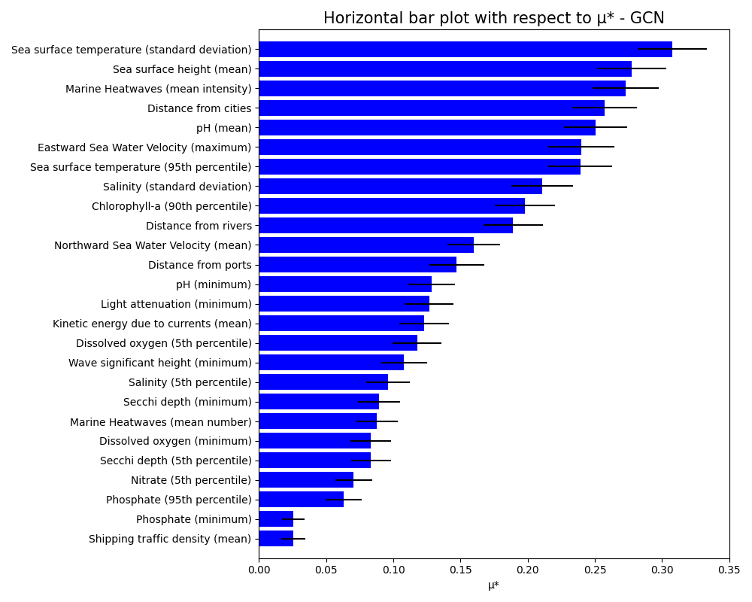
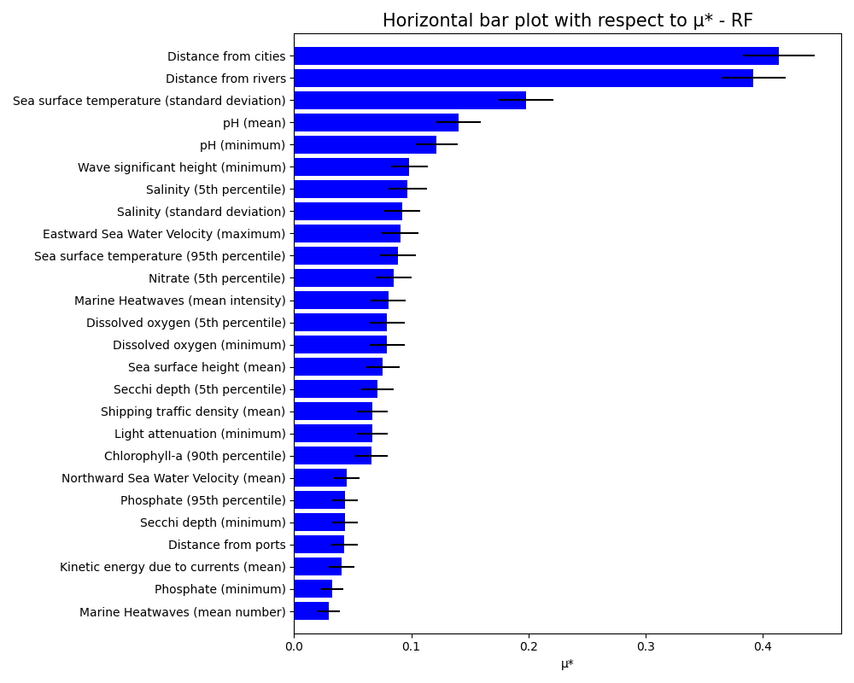
Sensitivity analysis
GCN
RF
.
Primary Drivers: Sea surface temperature, sea level rise, ocean acidification, distance from cities
Impact: Climate factors affect seagrass state and distribution
Primary Drivers: Proximity to urban centers, river mouths and sea surface temperature
Impact: Anthropogenic pressures significantly affect seagrass distribution

Slide 11
Unveiling Spatial Dynamics:
GNN-based models demonstrated superior predictive accuracy over traditional models, particularly in identifying seagrass presence, by incorporating spatial dynamics.
This result emphasizes the importance of spatial context in improving the predictive accuracy of models.
Impact on environmental applications:
The graph structure allows for the integration of spatial and temporal component of the data and the domain-specific knowledge, making predictions more interpretable and accurate
GNNs have proven successful in environmental contexts where processes are interconnected (e.g. urban pollution and climate forecasting) suggesting their potential for wide application in complex environmental systems.
Conclusions
Future Directions:
Future improvements in graph construction focus on integrating higher spatial and temporal resolution data and incorporating variables like currents and waves for a more dynamic and comprehensive understanding of environmental processes.
Aligns with the Physics-Informed Neural Networks (PINNs) framework, combining data-driven models with the physics of environmental systems.
These advancements will lead to more sophisticated digital tools for ecosystem protection and restoration.
Notes:
In conclusion, the spatial context helps us in prediction, but we have limitation in high resolution data. In the future, moving to a local scale, we aim to collect more high-resolution data to construct the graph not considering only the spatial component of the data, but also map into the graph the time domain and physical laws and processes (like currents) regulating ecosystems dynamics.

Slide 12
EGI2024: Processing Research Data with Artificial Intelligence and Machine Learning
Exploring the Potential of Graph Neural Networks to Predict the State of Seagrasses Ecosystem in Italian Seas
Angelica
Bianconi
Sebastiano
Vascon
Elisa
Furlan
Andrea
Critto
angelica.bianconi@cmcc.it
This project has received funding from the European Union’s Horizon 2020 research and innovation programme under grant agreement No 869710

