Slide 1
Distributed computing platform on
EGI Federated Cloud
EGI Conference 2024
Martin Šeleng, Viet Tran, Álvaro López, Saúl Fernández, Ignacio Heredia, Ondrej Habala, Alessandro Costantini, Francesco Sinisi, Luca Giommi, Giacinto Donvito, Miguel Caballer
IFCA-CSIC, IISAS, INFN, UPV

Slide 2
Workload Management System
Platform that helps managing and distributing computing workloads across a cluster or infrastructure
Kubernetes
Complex management and ecosystem
Originally it was designed for a single cluster
Focused on managing complex microservices architectures
Consul + Nomad
Simplicity
Native support for multi-datacenter deployments
Task-based approach
Consul: Networking and service registry
Consul mesh: Additional functionality
Nomad: Orchestrator

Slide 3
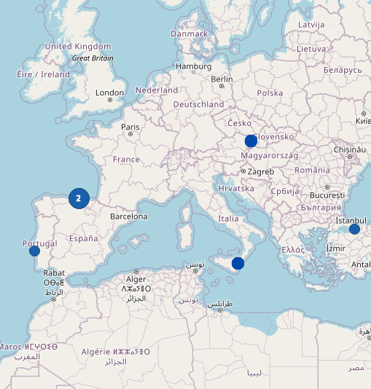
Cluster architecture
Federated cluster:
1 primary datacenter is deployed in first place.
5 secondary datacenters (in total).
Traefik is used as a proxy and load balancer.
4 Nomad namespaces to organize workloads
2 Openstack VOs for accounting
Minimum requirements for the cluster:
At least 2 nodes with public IPs.
1 Consul server (service registry and networking with other sites)
1 Traefik node (proxy, makes services accessible from outside)
Compute nodes (cpu or gpu): At least one node.
iMagine + AI4EOSC datacenters

Slide 4
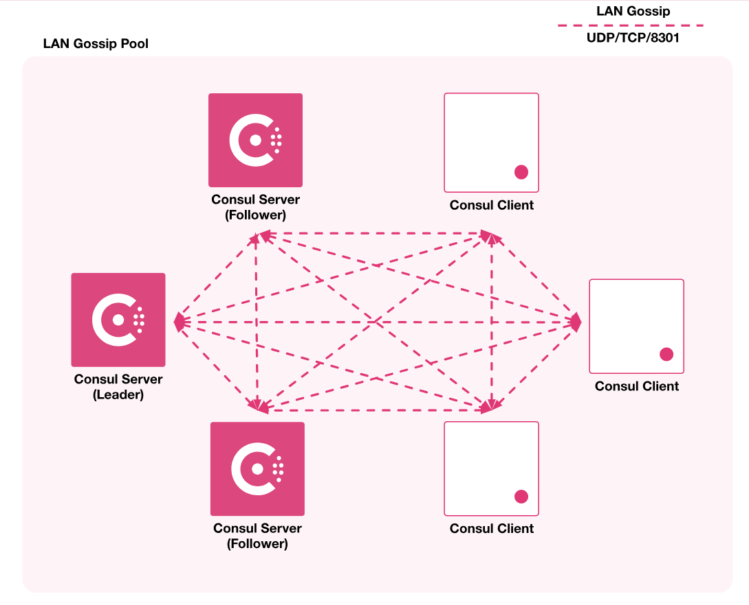
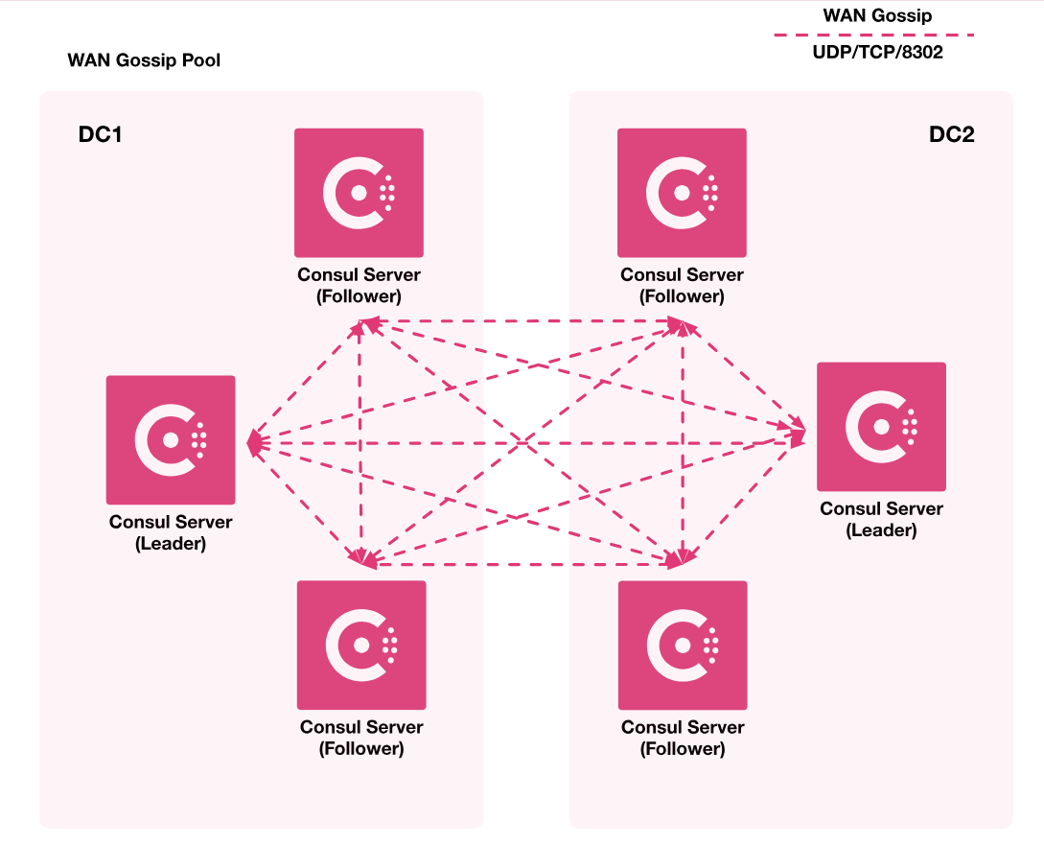
Cluster architecture
LAN Federation (on each site)
WAN Federation (across sites)

Slide 5
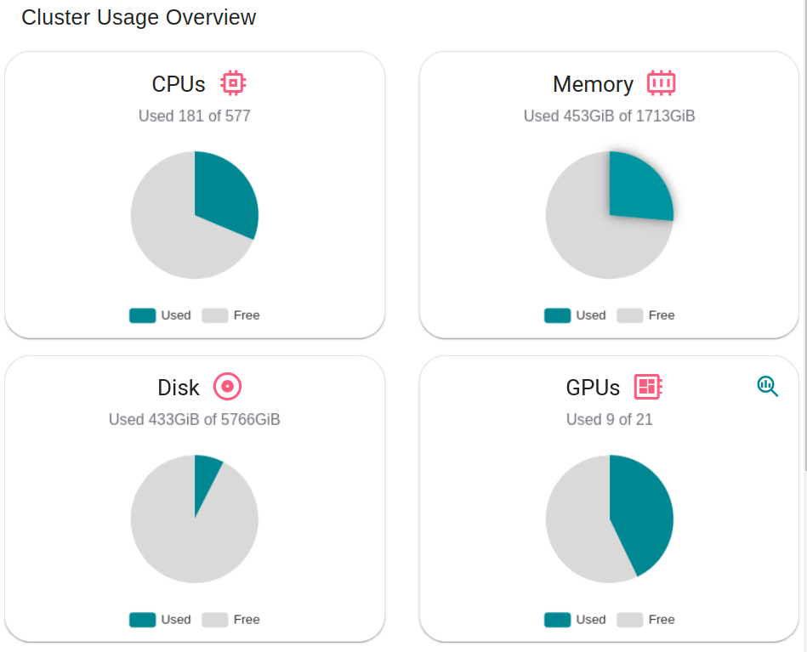
Cluster resources
7 server nodes
27 client nodes
1759 CPUs
70 GPUs (NVIDIA V100, NVIDIA T4, NVIDIA A100)
16.7 TB disc
5.1 TB memory

Slide 6
How we deploy it?
Ansible roles
Available on this repository.
Must create the node instances manually (OpenStack).
Operations defined:
Create new cluster from scratch (primary cluster).
Add new cluster to an existing one (federate secondary cluster).
Generate certificates for a new cluster (secondary cluster).
Tosca templates
Node instances are created automatically.
Operations defined (based on previous Ansible roles):
Create new cluster from scratch (primary cluster).
Add a new cluster to an existing one (federate secondary cluster).

Slide 7
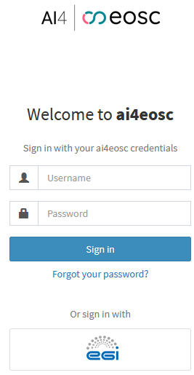
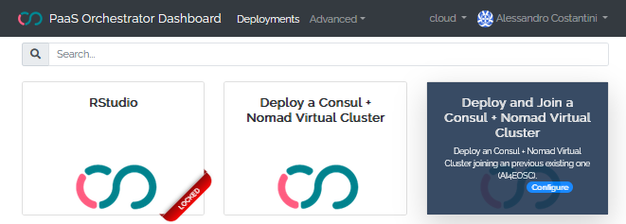
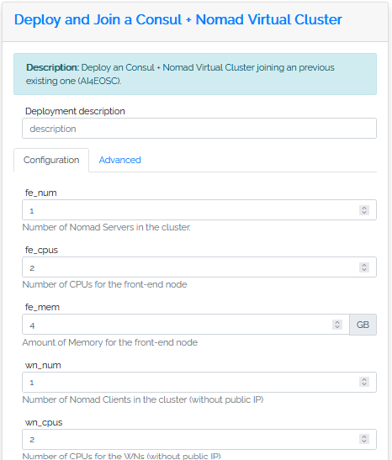
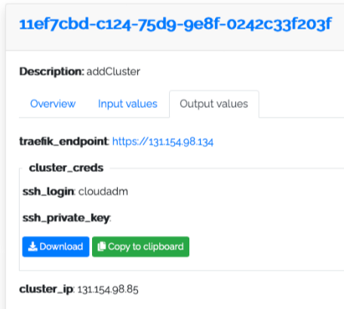
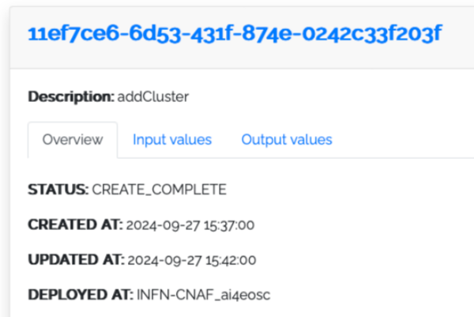
PaaS Deployment workflow
1
2
6
5
3
4

Slide 8
AI4EOSC Customizations
Improved Docker image management
Default: Nomad deletes the image after the job that requested it finishes. Next job that request that image would have to download it again (increases response time).
Ours: Configure nomad to not delete Docker images. To avoid uncontrolled disk usage we use Docuum:
Threshold size: 50GB
Replacement policy: Last Recent Used (LRU).

Slide 9
AI4EOSC Customizations
Try-me nodes.
Reserved nodes that continuously pulls all module images (latest). Allows users to test a specific module with low response time.
Consul internal status (raft) is saved periodically.
The failure of some servers can lead on a irrecoverable inconsistency state.
Snapshots are taken both periodically and before each run of the Ansible roles.
Nomad job node migration (in progress).
Development of a system that allows to save a docker container state and resume it on another node.

Slide 10
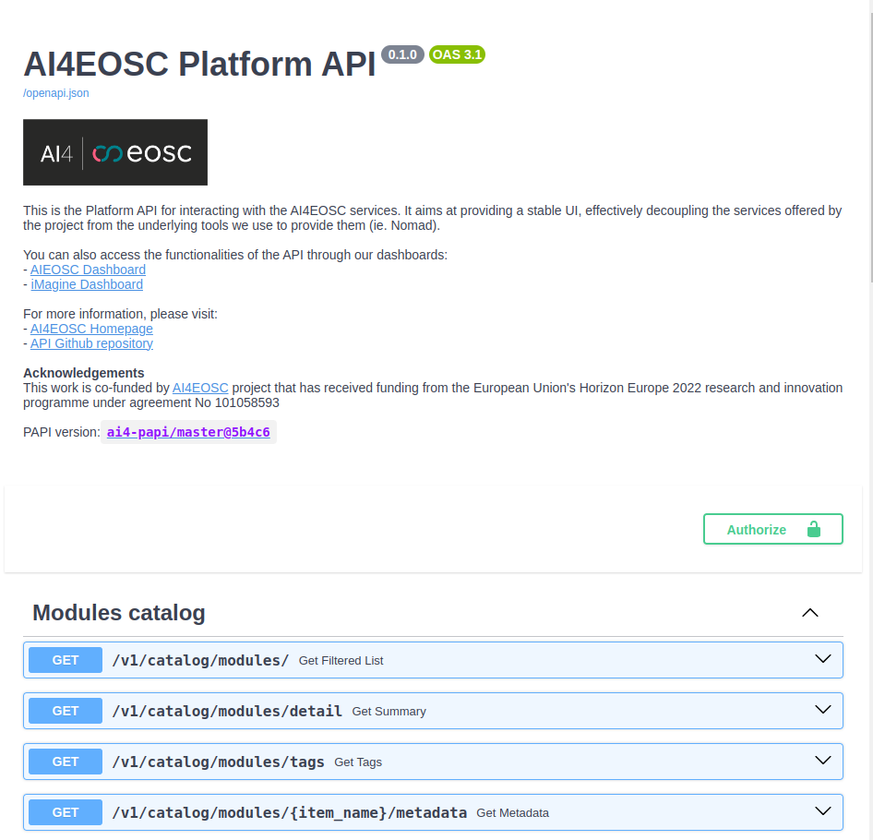
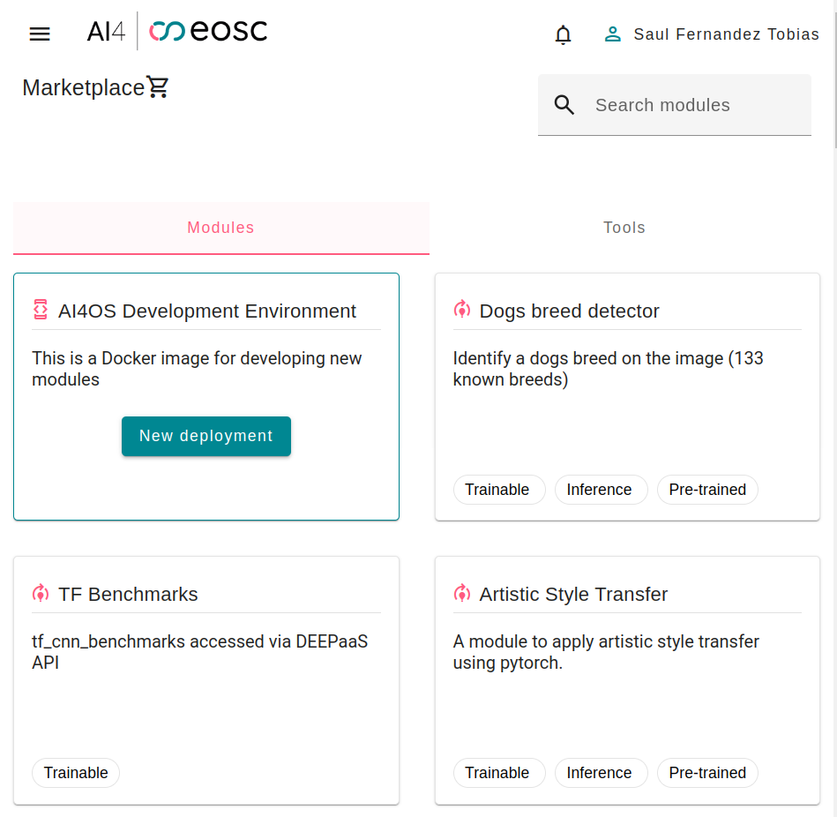
API + Dashboard
Development of an API for deployment management: https://api.cloud.ai4eosc.eu
Development of a Dashboard based on the API: https://dashboard.cloud.ai4eosc.eu

Slide 11
Conclusions
Using Nomad for easily deploying a federated cluster,
Automated deployment with TOSCA+Ansible,
Platform specific customizations for better usability,
Production cluster with:
5 datacenters across 4 countries,
+50 scientific users from 8 different countries,
High computational power (70 GPUs),
Future work: Consul mesh, Infiniband testing, deployment migration, use Vault to distribute certs, …

Slide 12
Thank you for your attention
EGI Conference 2024
sftobias@ifca.unican.es
martin.seleng@savba.sk

Slide 13
Problems solved
Running jobs loses access to GPU.
“Bug” with the nvidia and Docker runtimes (GitHub issue).
Triggered when some Linux daemons reloads, related with Linux cgroups.
Current workaround: Disabling systemd cgroup management in Docker.
Some nomad jobs get stuck on a “Pending” state.
When trying to delete a Nomad Job it could end stuck on a “Pending” state.
The second time the request is made it now sends a “purge” request (via API).

Slide 14
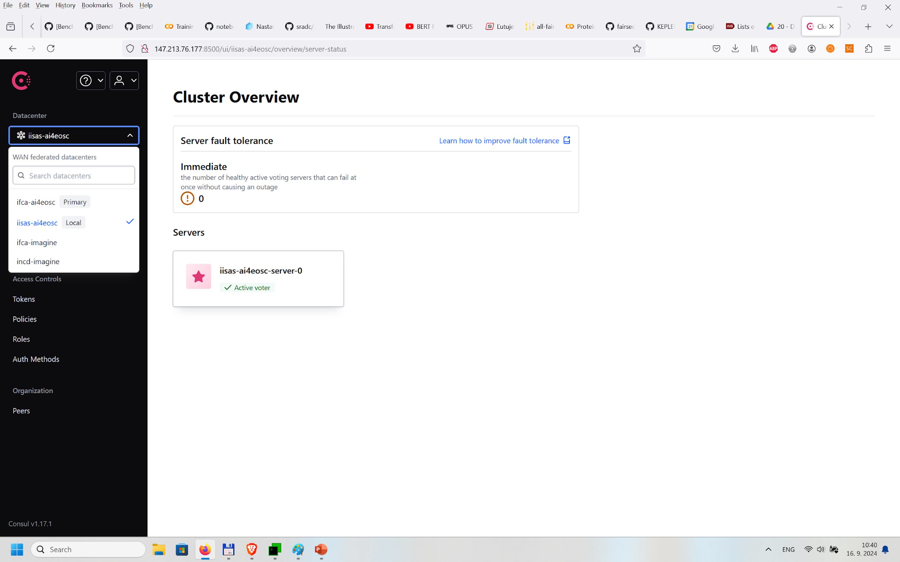
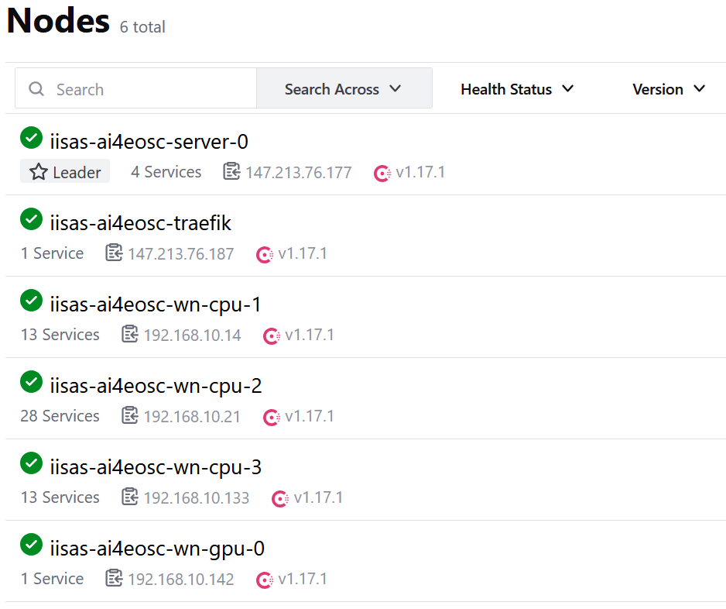
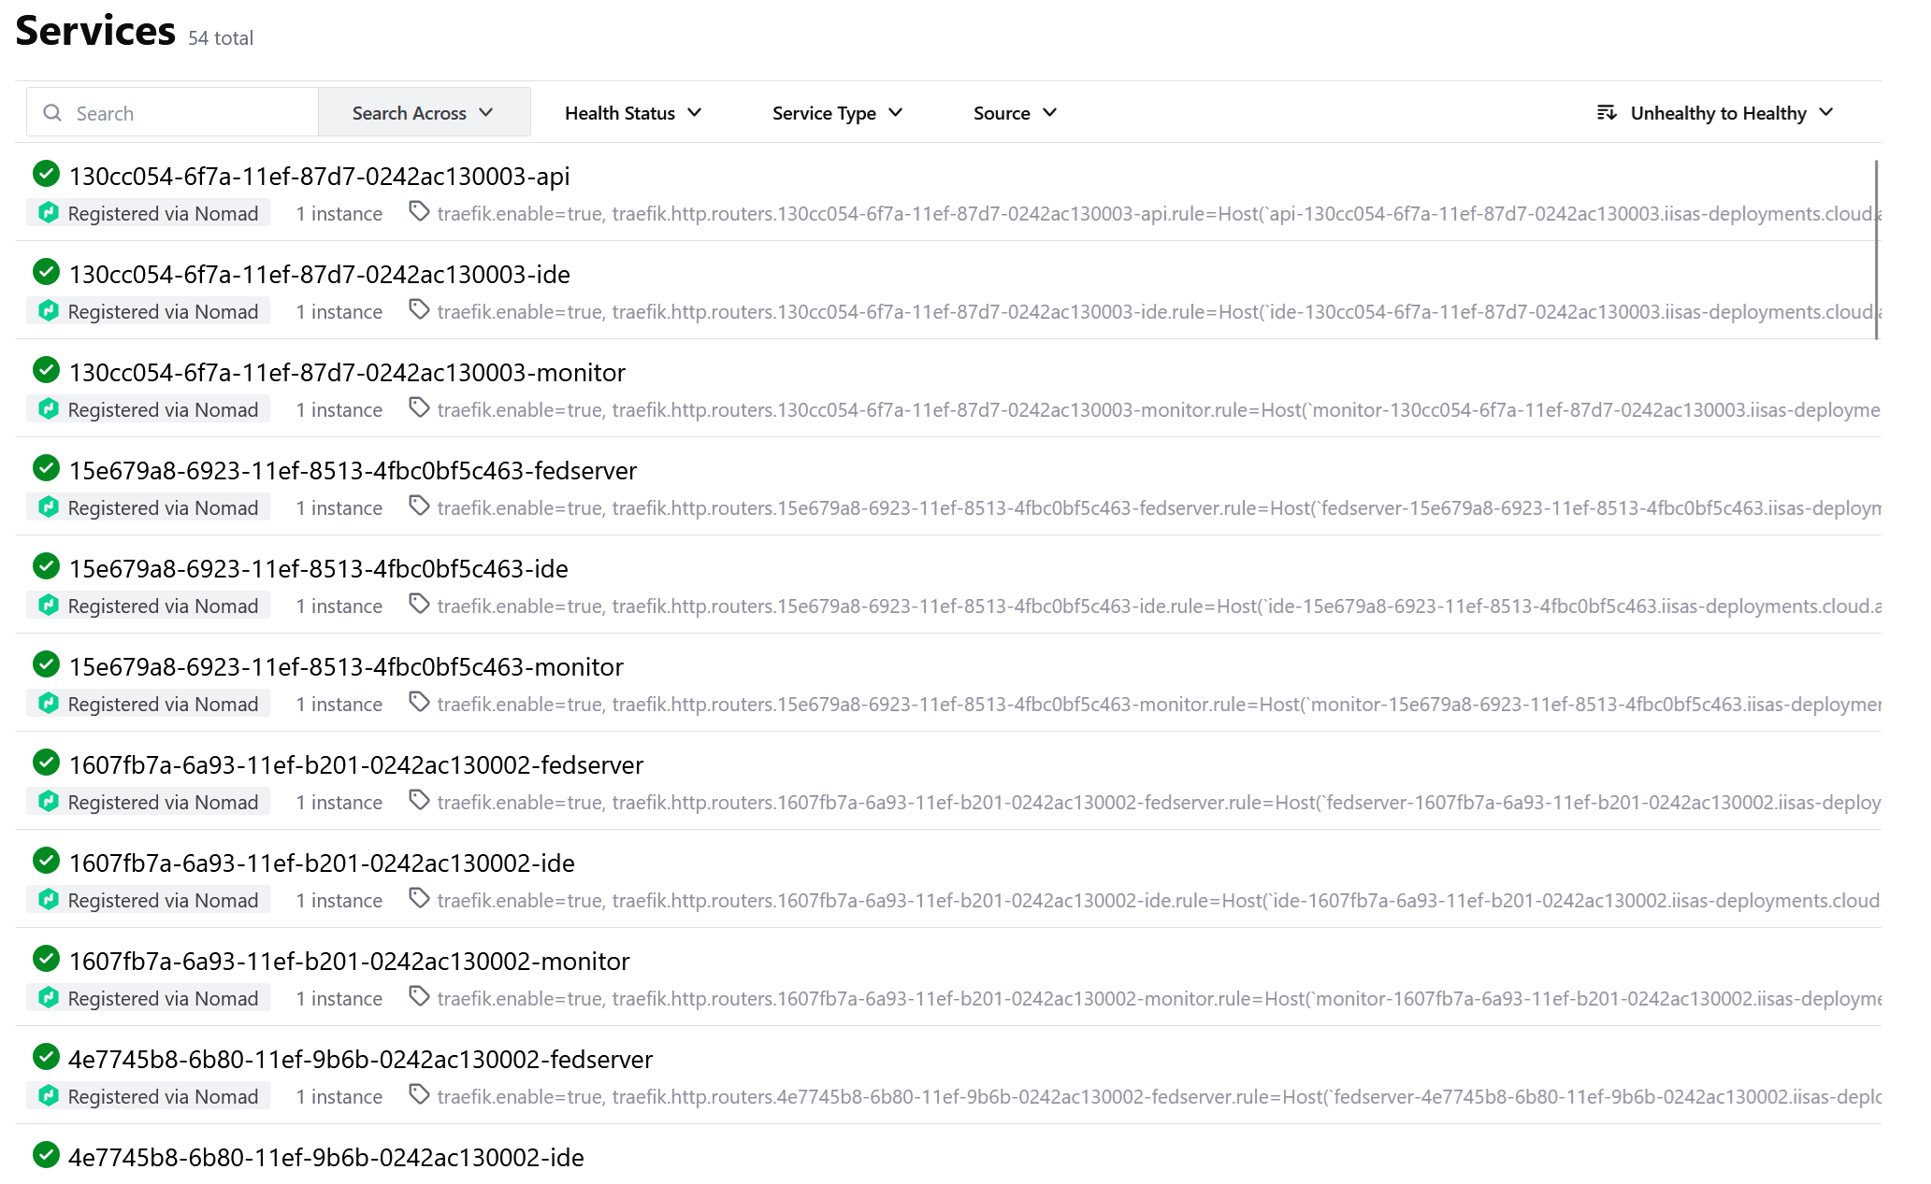

Slide 15
AI4EOSC
IMAGINE

Slide 16
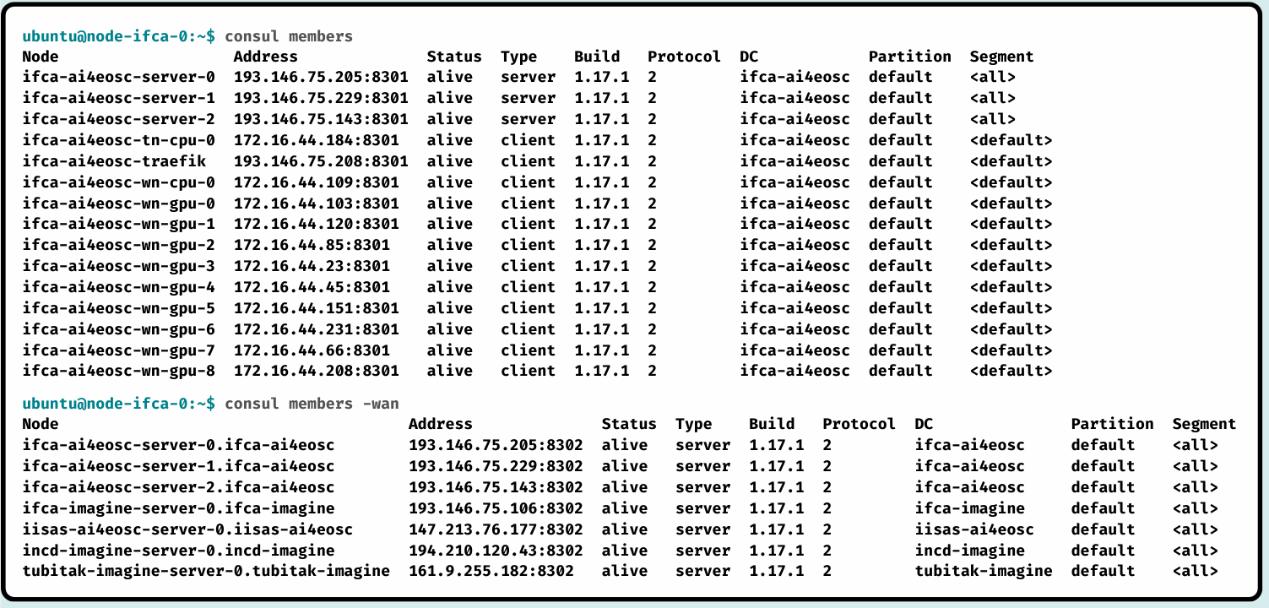
Cluster architecture

Slide 17
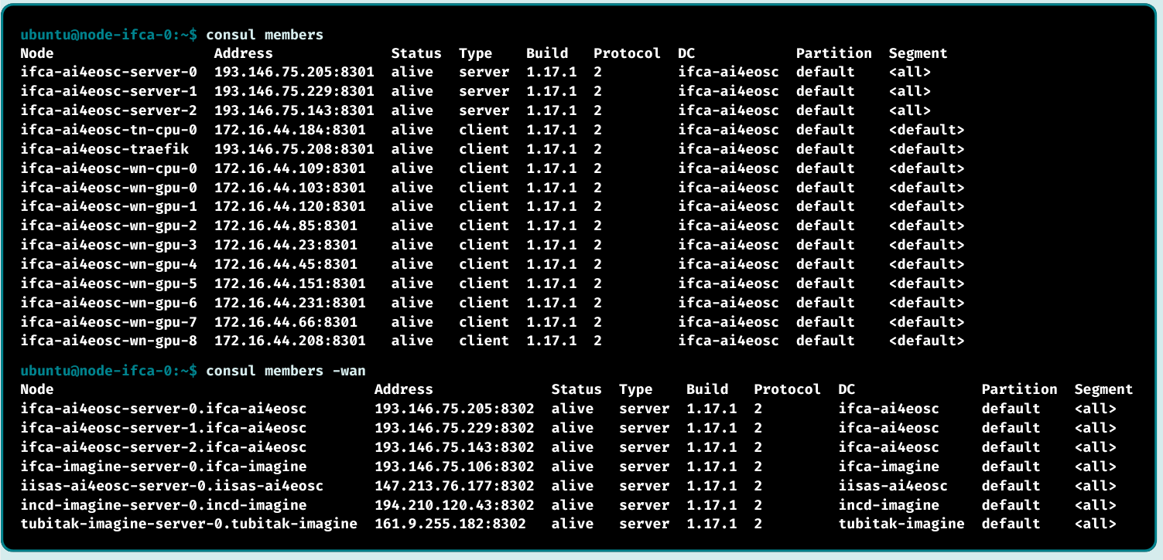
Cluster architecture

Slide 18
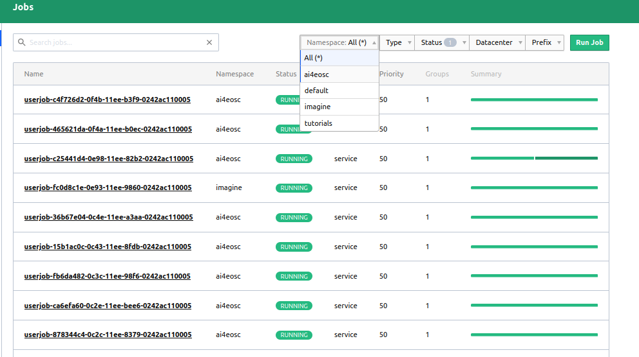
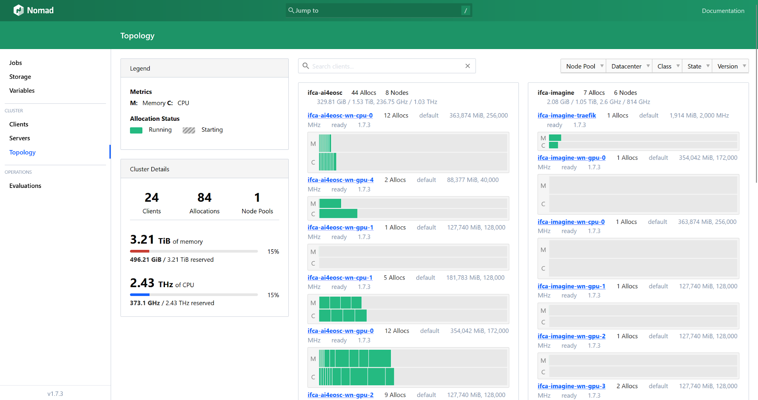

Slide 19
Distributed computing platform on
EGI Federated Cloud
EGI Conference 2024
Martin Šeleng, Viet Tran, Álvaro López, Saúl Fernández, Ignacio Heredia, Ondrej Habala
IFCA-CSIC, IISAS

Slide 20
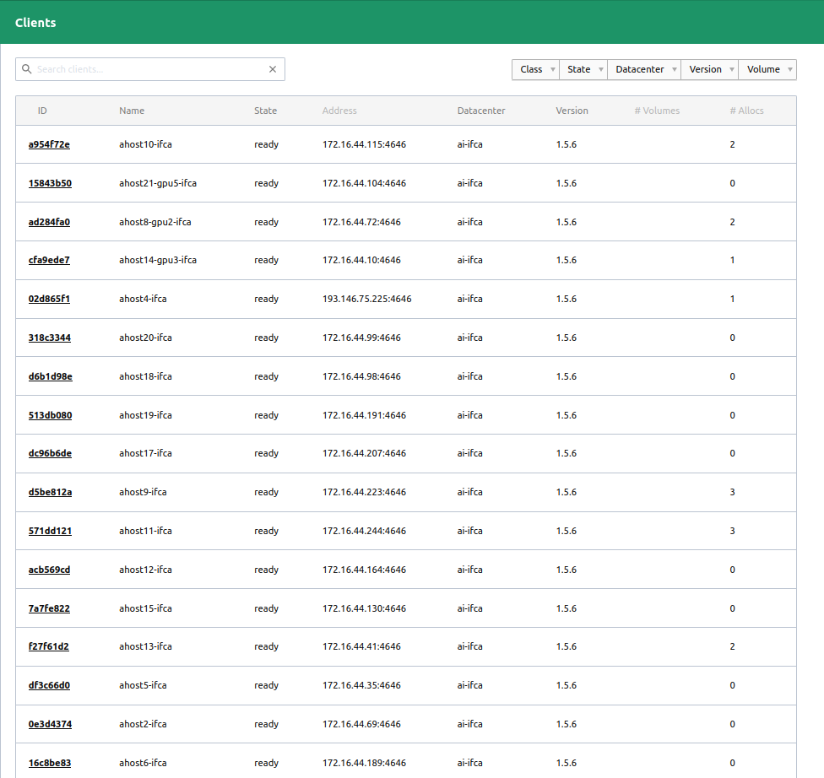
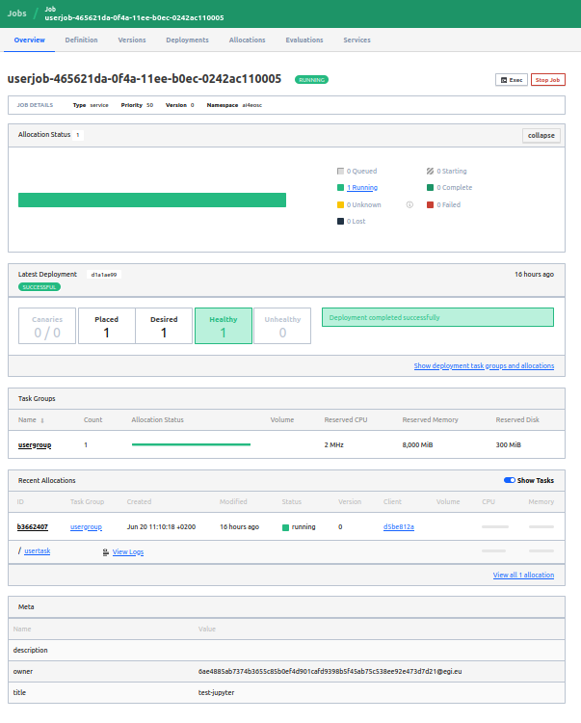
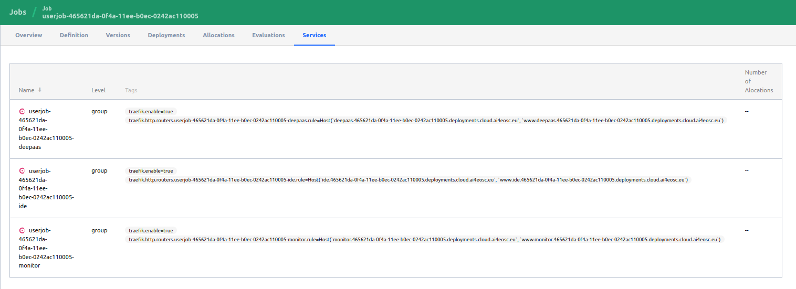

Slide 21
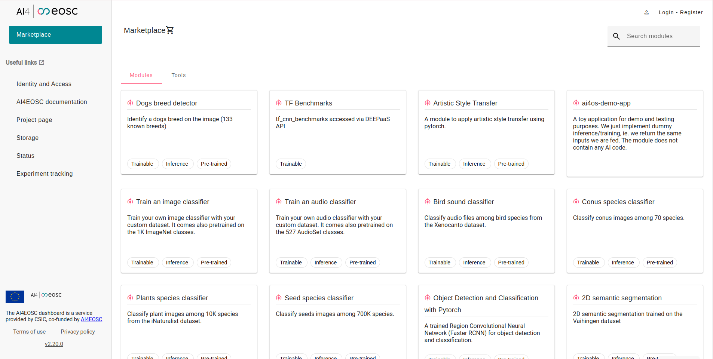

Slide 22
Current cluster state
Production Cluster (federated)
machines splitted in 2 Openstack EGI VOs (vo.ai4eosc.eu and vo.imagine-ai.eu).
7 server nodes, 27 client nodes, 1759 cpus, 62 gpus.
4 namespaces (ai4eosc, imagine, tutorials, ai4life).
Development Cluster

