Slide 1
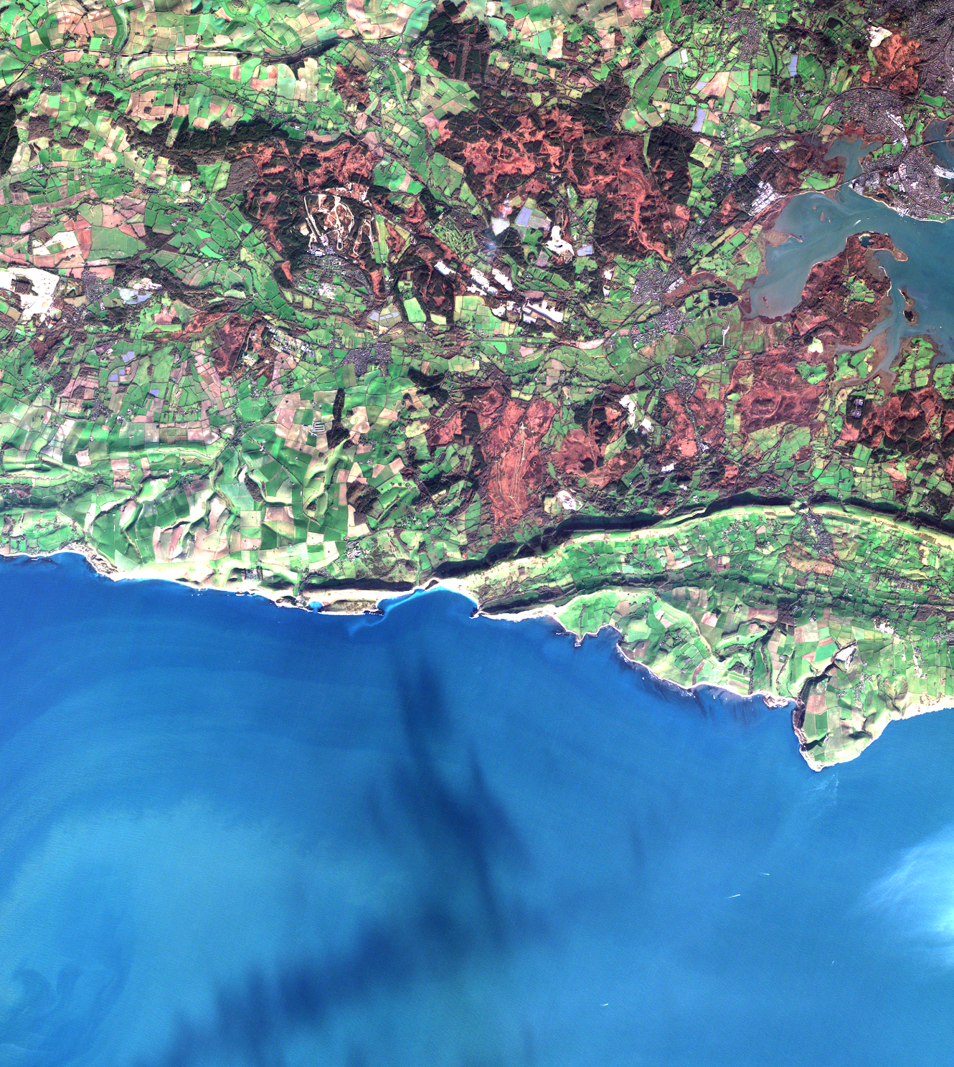
STAC @ CEDA
EGI Conference
2nd October 2024
Rhys Evans
(and CEDA/JASMIN Teams)

Slide 2
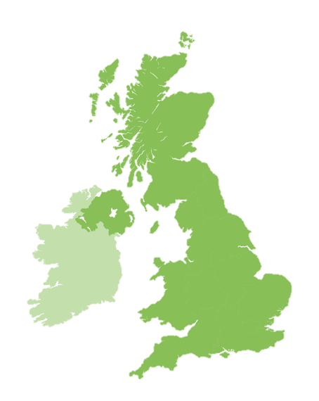
Who are CEDA
Mission: To provide data and information services for
environmental science
Centre for Environmental Data Analysis https://ceda.ac.uk
People: ~40 staff
Data scientists
Software engineers
Community outreach/training
Project management
User support/helpdesk
Range from 20+ years to early careers!
Rutherford Appleton Laboratory (RAL)
– Oxfordshire
Notes:
The Centre for Environmental Data Analysis in the UK
Our role is providing services, training and infrastructure to the research community

Slide 3
Our Services
Collaborative Projects
JASMIN
CEDA Archive
jasmin.ac.uk
archive.ceda.ac.uk
Data intensive supercomputer
Over 44 Petabytes storage
Jointly managed with STFC Scientific Computing Department
Long-term data archive
Over 22 Petabytes of atmospheric and earth observation data
Working on numerous projects at a time
Split between multiple organisations
Notes:
Two of the main services being JASMIN and our Archive
JASMIN a supercomputer used for Environmental data analysis and to host our other services
The archive is a long term data store for a range of EO and atmospheric data
We collect this data from a range of sources and over many year
So it highly heterogeneous being stored in lots of different ways and formats
We also work with other organisations on a range of projects and services

Slide 4
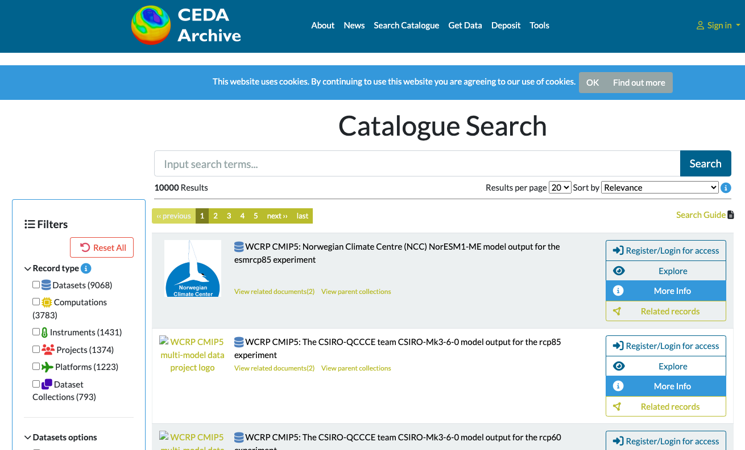
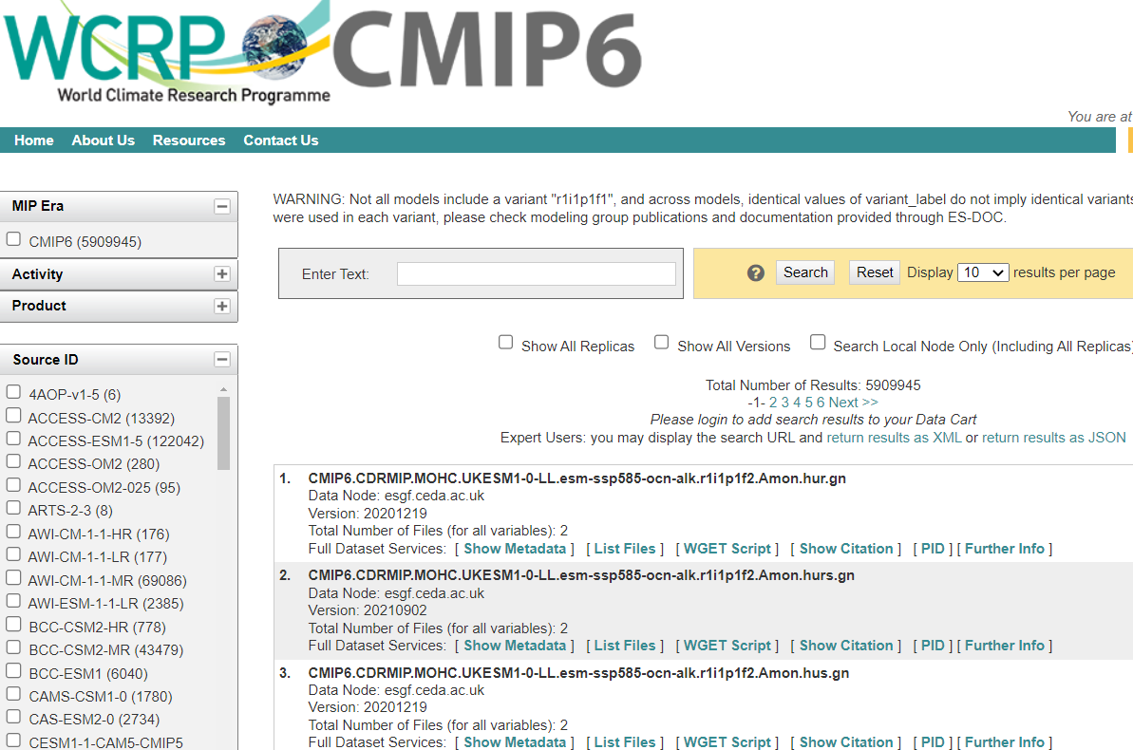
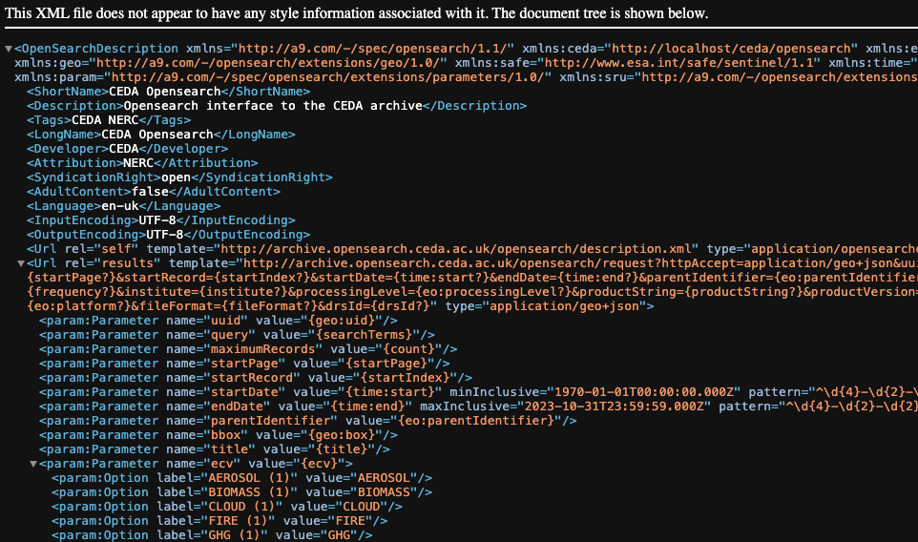
Searching at CEDA
CATALOG
ESGF
CCI
catalog.ceda.ac.uk
esgf.ceda.ac.uk/esg-search
archive.opensearch.ceda.ac.uk
CEDA bespoke
Whole archive
Elasticsearch
ESG Search
CMIP, CORDEX, obs4MIPs, SPECS, EUCLIA, CLIPC
SOLR
Opensearch
CCI products
Elasticsearch
Notes:
All of that data needs to be discoverable
We have the Catalog that use a bespoke format
Some of our projects have specific search requirements
often with the same data across the indexes
Have to juggle to keep everything in sync

Slide 5
One standard to rule them all…
Notes:
Could we find a standard that was flexible enough to handle the different data
Scaleable
Faceted and free text search

Slide 6
STAC
Simple, Flexible, Extensible
“a common language to describe geospatial information.”
3 schema specifications
Item - Data links + metadata
Catalog - Structure
Collection - Catalog + metadata
1 API specifications
Notes:
Built by the EO community
On top of OGC’s features
4 specifications
3 JSON schemas
Item groupings of data references with a shared set of metadata
Catalog groupings of items giving some structure
Collections like catalogs but with some extra metadata about it and it’s items
1 API specification
Restful endpoints that allow you to navigate the catalog and search items
The required information in the schemas and functionality in the specification is minimal
And then they can be extended in a defined way

Slide 7
Success with STAC
Notes:
We’ve been playing with STAC for a while now

Slide 8
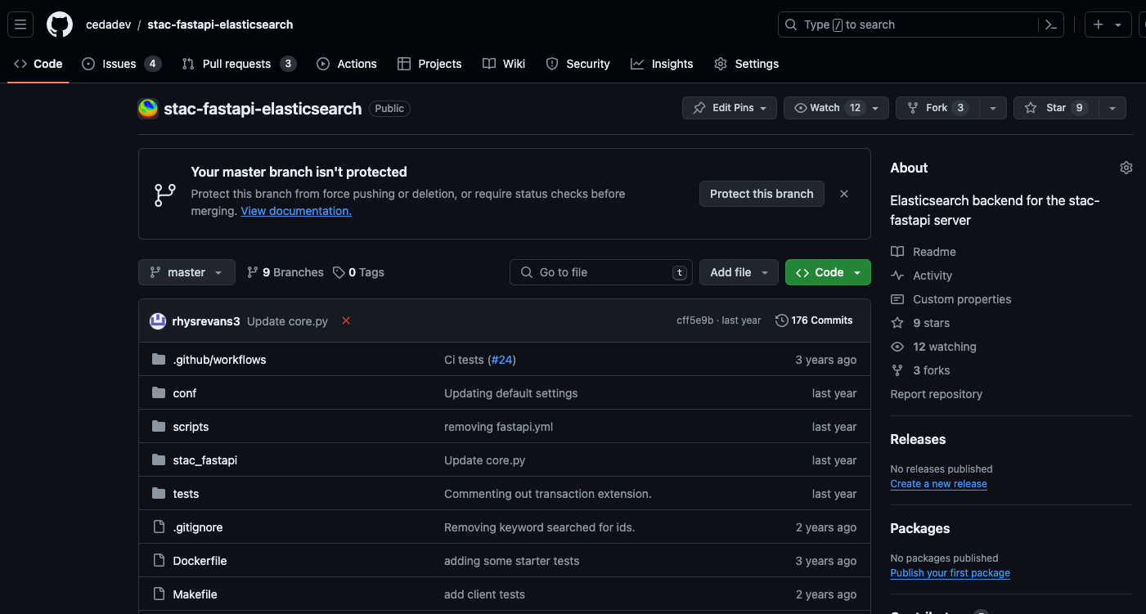
Elasticsearch backend
Notes:
When we first started with STAC the FastAPI was only backed by Postgres
As we were already using Elasticsearch we chose to create a ES backed version of the API
This was then forked by STAC and formed the base of their ES API

Slide 9
Extensions
API
Free-text search https://github.com/stac-api-extensions/freetext-search
context-collection https://github.com/cedadev/stac-context-collections
Asset search (deprecated) https://github.com/cedadev/stac-asset-search
Schema
CMIP6 https://github.com/stac-extensions/cmip6
Notes:
Varying degrees of success with extensions
Free text is being moved to the core extensions
There’s still some questions on how it should look that’s holding this up
Asset search I’ll talk about later
We’ve just started our first extension to the core spec with CMIP6

Slide 10
The STAC Generator
# The paths that the recipe will be run on
paths:
- https://cmip6-zarr-o.s3-ext.jc.rl.ac.uk/CMIP6.CMIP.MOHC.UKESM1-0-LL
- https://cmip6-zarr-o.s3-ext.jc.rl.ac.uk/CMIP6.C4MIP.MOHC.UKESM1-0-LL
# The type of STAC record that will be generated
type: item
# These extraction methods will be run after `extraction_methods` and generate the record id
id:
- method: default
inputs:
defaults:
item_id: $instance_id
# The extaction methods are run in series the output dictionary is passed from one to the next
# extaction methods add, update or remove the data from the output dictionary
extraction_methods:
- method: regex
inputs:
regex: '\/(?P<mip_era>\w*)\.(?P<activity_id>\w*)\.(?P<institution_id>[\w-]*)'
- method: string_template
inputs:
template: '{mip_era}.{activity_id}.{institution_id}.{source_id}.{table_id}.{var_id}.{version}'
output_key: instance_id
# Some methods generate assets these can also include extraction methods to be run on the assets
- method: intake_assets
inputs:
uri: https://raw.github.com/cedadev/cmip6-object-store/catalogs/ceda-zarr-cmip6.json
object_path_attr: zarr_path
search_kwargs:
mip_era: $mip_era
activity_id: $activity_id
institution_id: $institution_id
source_id: $source_id
table_id: $table_id
variable_id: $var_id
version: $version
extraction_methods:
- method: default
inputs:
defaults:
roles: ["data"]
- method: lambda
inputs:
function: 'lambda assets: assets[key] for en, key in enumerate(sorted(assets))}'
input_args:
- $assets
output_key: assets
- method: remove
inputs:
keys:
- uri
# member of defines the other recipes that define a parent of this record
member_of:
- recipes/collection/CMIP6.CMIP.MOHC.UKESM1-0-LL.yaml
STAC Generator
Recipes
{
generator: ...
inputs: [...]
outputs: [...]
}
BADC
{
paths: [...]
id: {...}
ex_ms: {...}
}
FAAM
CMIP6
Inputs
Generators
Outputs
File System
Item
Rabbit MQ
Object Store
Asset
Collection
JSON
Intake ESM
CSV
text file
Extraction Methods
Intake ESM
Rabbit MQ
regex
Posix stats
JSON file
Standard out
Elasticsearch
Elasticsearch
Object store stats
Elasticsearch
header
xml
default
github.com/cedadev/stac-generator
Notes:
Another area we’ve been working on with some success
is generating STAC records
As I mentioned we have very heterogeneous data
We need this to work across the different areas of the archive
We found packages that would create records for specific projects
But we need a general one
So we built the stac generator which can be configured using these recipes
That define how to extract the necessary metadata for an area of the archive

Slide 11
EO DataHub
Notes:
EO Datahub is a new UK project
Aims to provide a middle layer between data providers and application developers
One part of that is data discovery
STAC the common search interface
Data providers will make a stac catalog of their data available
The hub can harvest from these catalogs to create its own

Slide 12
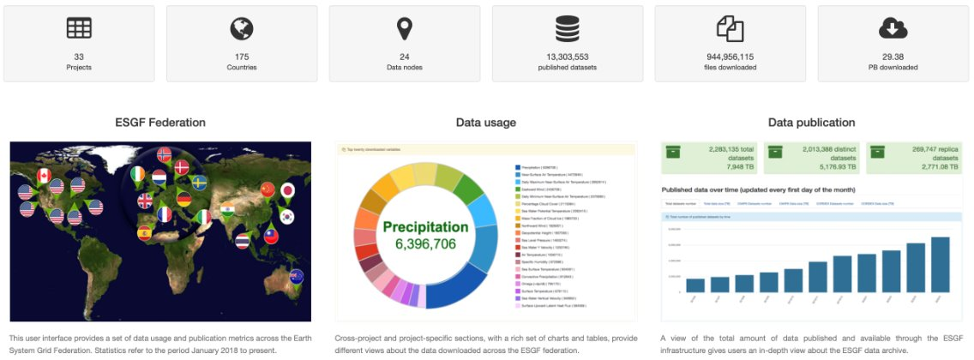
Earth System Grid Federation: a globally distributed data archive for climate data​
Notes:
CMIP7 coming up
Review of the architecture
We’re looking at moving away from our bespoke system to instead use stac as the metadata store
During a face to face I was able to set multiple people up with a STAC catalog
STAC was chosen as the new default search interface

Slide 13
Earth System Grid Federation: a globally distributed data archive for climate data​
Consumer
CEDA
Publisher
Event store
Consumer
USA
Notes:
Raises question on replication
Previously this was done at the database level using SOLR shards
Distributed STAC where the records are replicated onto the notes
Eventually consistent

Slide 14
Learning opportunities with STAC

Slide 15
Elasticsearch backend
Notes:
Stuck with our own implementation after it was forked
Diverged and now we’re trying to re-add our work back to the fork

Slide 16
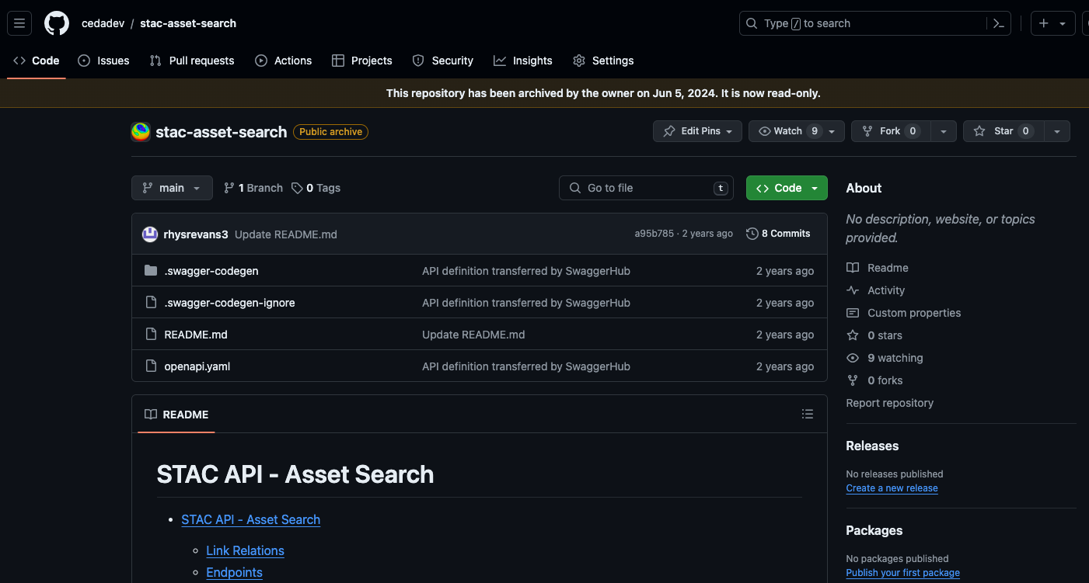
Asset Search
Notes:
ESGF required file and dataset search
Because of how we had defined our items we needed asset level search
The community disagreed
Couldn’t use community software like pystac out the box

Slide 17
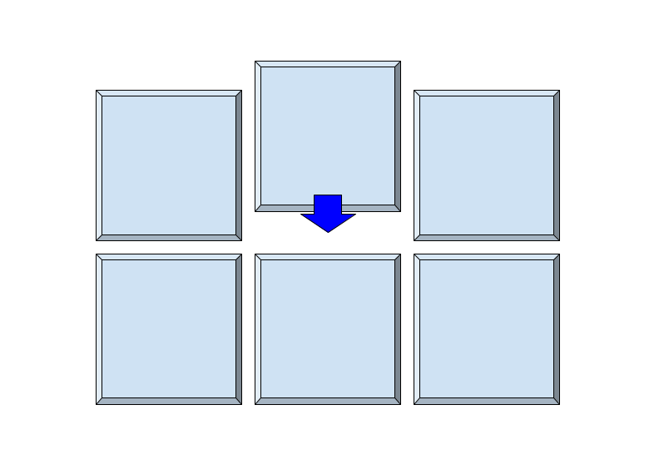
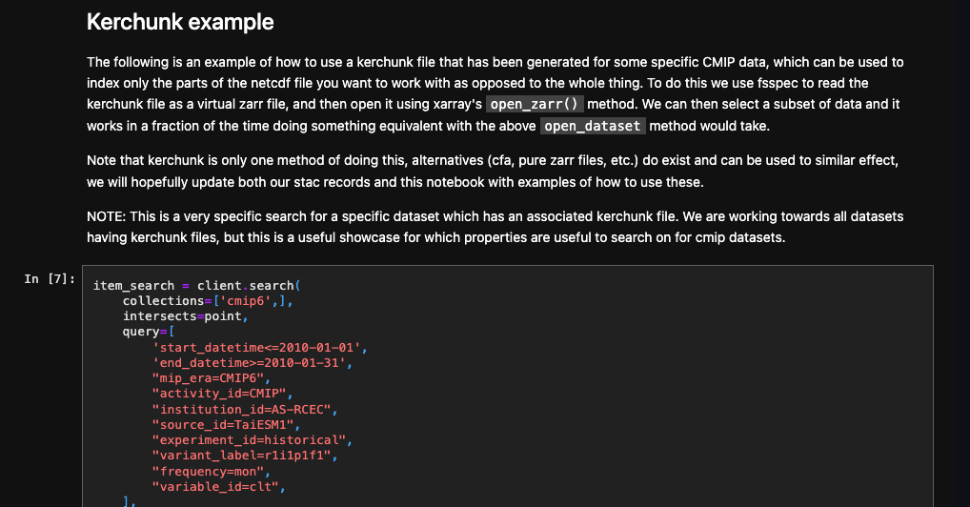
Kerchunk
github.com/cedadev/stac-notebooks
Notes:
We’ve gone back to vanilla STAC
To give us the asset level filtering we’re now looking into kerchunk
A virtual zarr format
Zarr like interface without duplicating the data into zarr files
Instead you created a relatively lightweight reference file
Which users can load in xarray as if it were zarr
And perform further filtering
We’ve got a notebook demonstrating that workflow

Slide 18
Lessons Learnt

Slide 19
STAC Spec & API Spec & STAC FastAPI
are different
Notes:
When introducing people to STAC there has sometime bee confusion on how these different components interact
Not always understood where an extension falls
Typically:
STAC extension are JSON schema extensions most like controlled vocabularies (what properties to expect)
API extensions are more typical software extensions adding functionality to the API
You can use API specification you can follow without using the FastAPI

Slide 20
With great flexibility comes great responsibility
Notes:
It’s easy to add extensions to STAC
But you can go to far and lose access to the set of existing community software
At that point you might as well have used a bespoke specification

Slide 21
Stick with the heard
Notes:
The strength of a community standard is the community
Get involved with the community
Share any extensions you’re working on

Slide 22
Questions we have
Can we use STAC to store non-spatial data?
How would non-spatial data effect discovery?
Can STAC be used to search across catalogues?
Can STAC be integrated with non-STAC catalogues?
Do we need some kind of Asset filtering?
Can we use STAC extensions for specific parts of our archive?
Notes:
How STAC interacts with no spatial or temporal data
Can we store that in STAC
Can we integrate with non STAC catalogs
Is some asset filtering needed
Finally, can we use different extensions within one catalog

Slide 23
Thank you!
JASMIN: support@jasmin.ac.uk
CEDA: support@ceda.ac.uk
Twitter - @cedanews
Website - www.ceda.ac.uk

