Slide 1
Collaborative research in the cloud with Notebook-as-a-VRE
G. Pelouze, S. Koulouzis, Z. Zhao
{g.pelouze, s.koulouzis, z.zhao}@uva.nl
LifeWatch ERIC, Virtual Lab & Innovation Center (VLIC), Amsterdam, The Netherlands
Multiscale Networked Systems, University of Amsterdam, Amsterdam, The Netherlands
EGI 2024 – 2 Oct. 2024 – Lecce, Italy

Slide 2
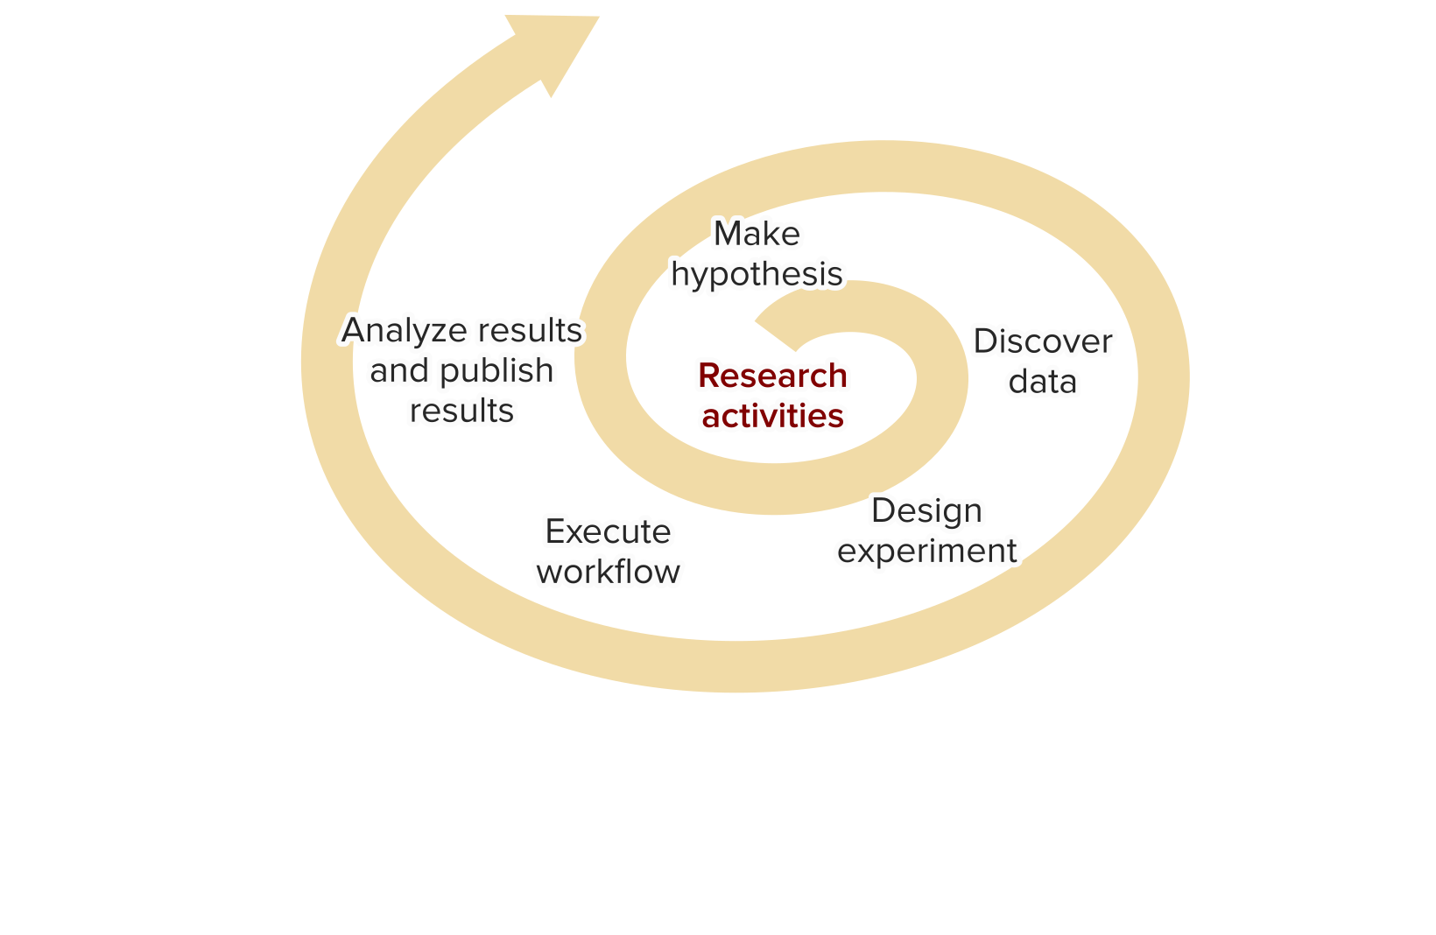
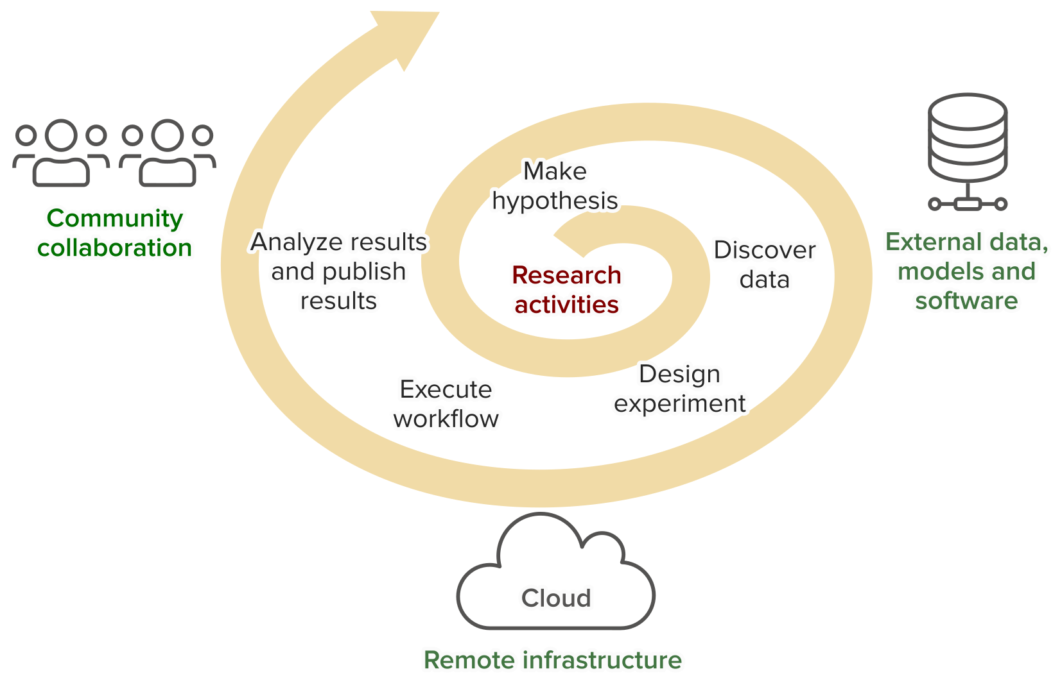
Data-centric research lifecycle
“Virtual Research Environments (VREs) provide user-centric support for discovering and selecting data and software services from different sources and composing and executing application workflows, …” (Jeffery et al., 2020)

Slide 3
How to support data-centric experiments
Computational notebooks
Widely used by researchers
Documentation and visualization alongside code
Interactive code execution
→ developing and tweaking models
Virtual research environment
Collaboration
FAIR data, models and services
Remote infrastructure
Scaling up models (e.g. porting prototype to large-scale cloud environment)
→ sharing mature models & more
Combined, they are NaaVRE

Slide 4
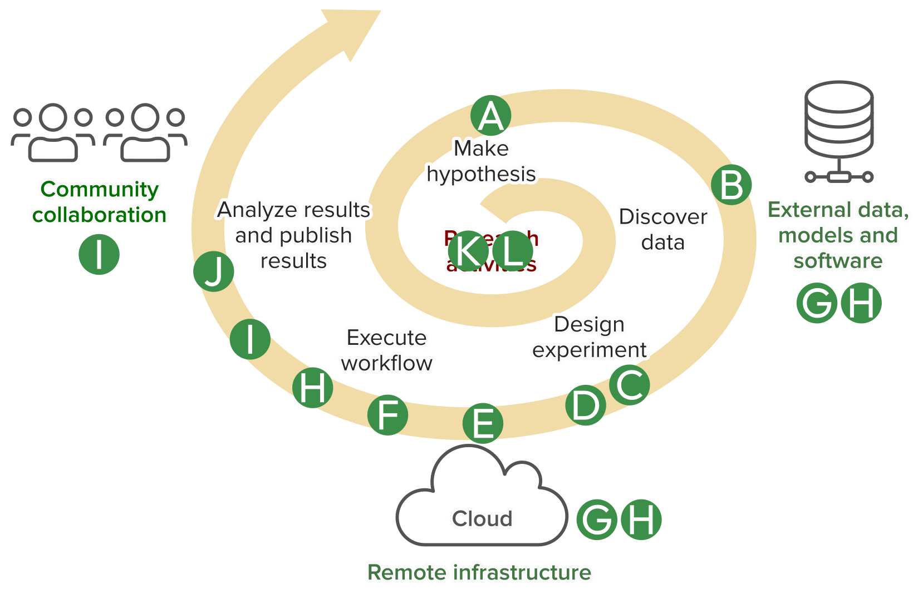
Research activities and Jupyter extensions
Zhao, Z., Koulouzis, S., Bianchi, R., Farshidi, S., Shi, Z., Xin, R., Wang, Y., Li, N., Shi, Y., Timmermans, J., Kissling, W.D.: Notebook-as-a-VRE (NaaVRE): From private notebooks to a collaborative cloud virtual research environment. Softw Pract Exp. spe.3098 (2022). https://doi.org/10.1002/spe.3098.

Slide 5
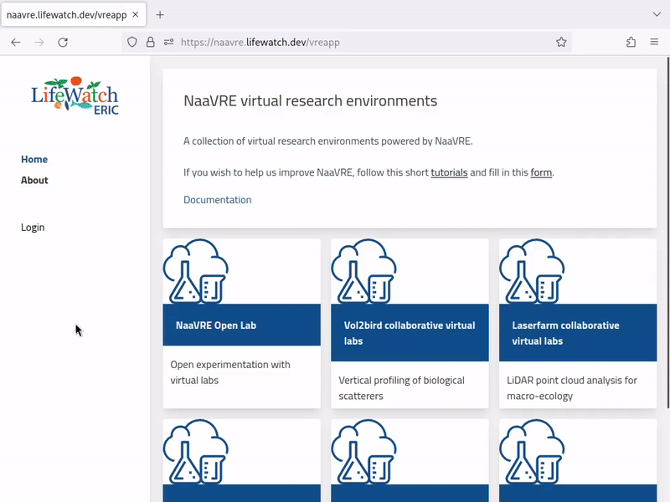
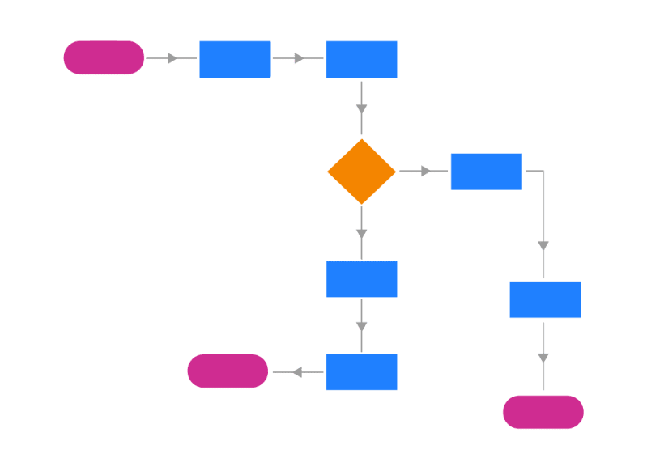
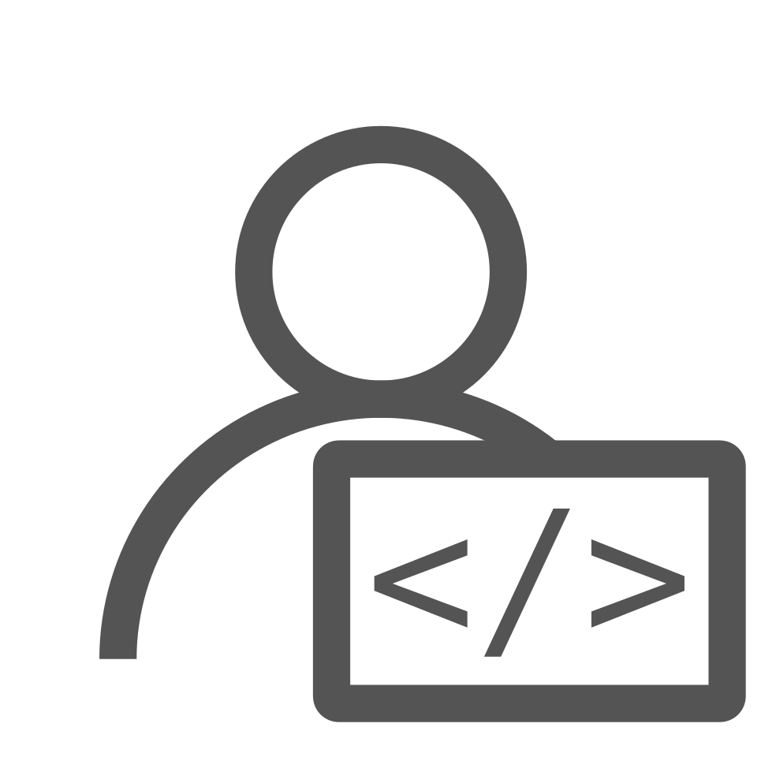
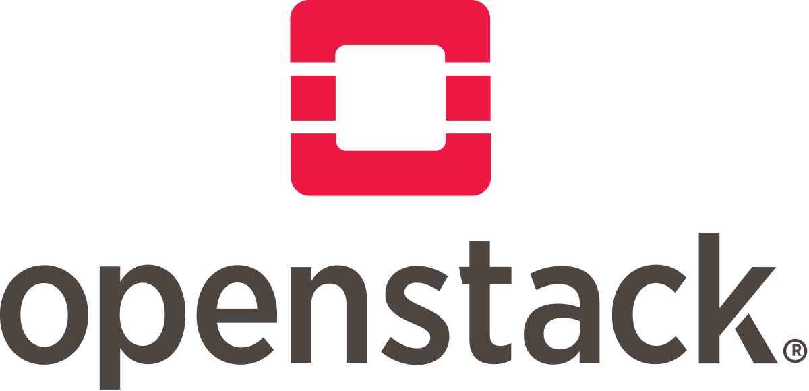
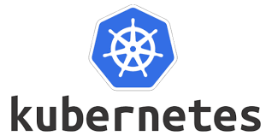
Notebook-as-a-VRE and Virtual Labs
VL user
Virtual Lab
Virtual Lab
Virtual Lab
Virtual Lab
VL developer
NaaVRE PaaS
NaaVRE operator

Slide 6
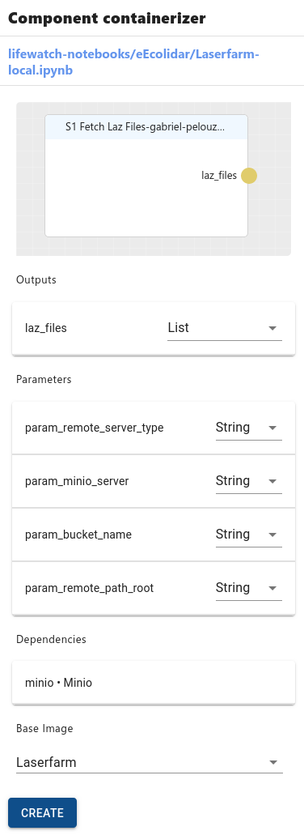
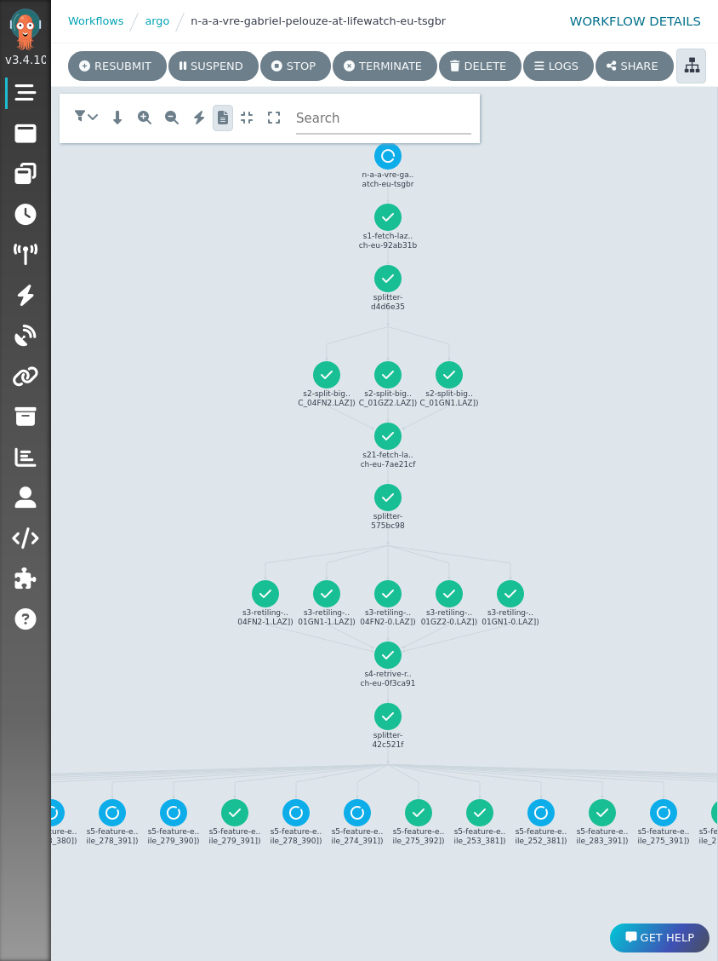
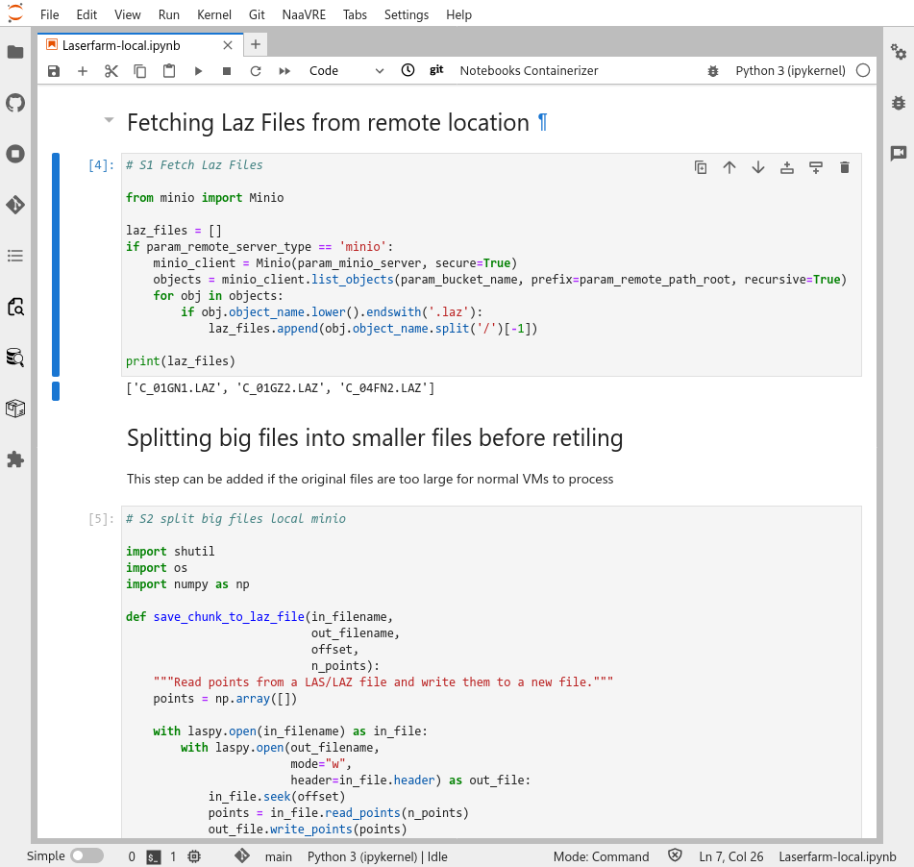
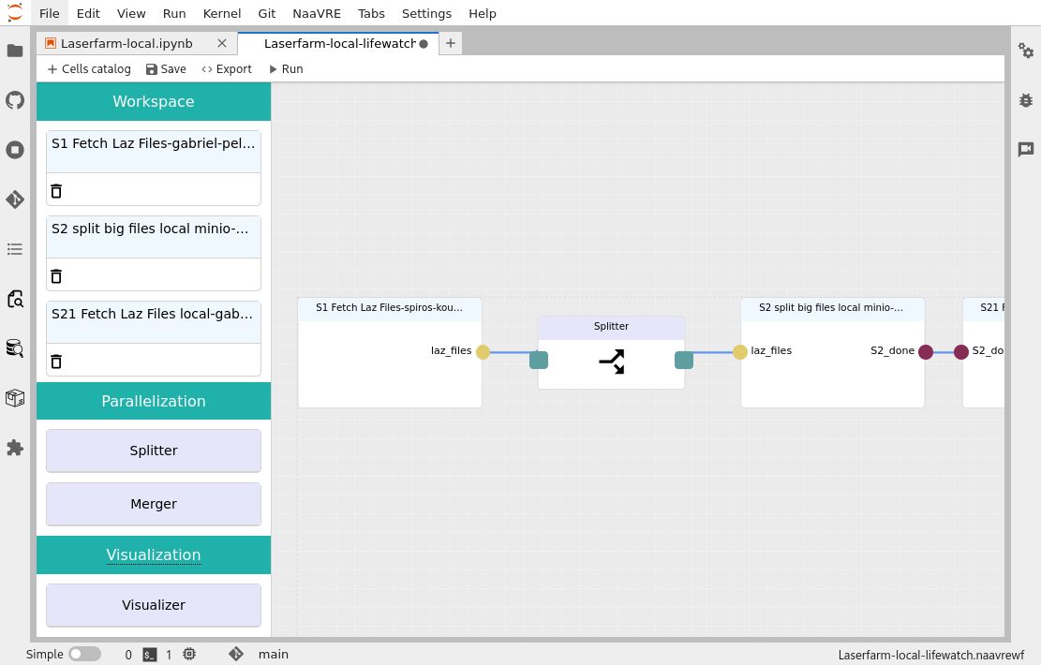
From notebooks to cloud workflows
1. PROTOTYPE MODEL IN NOTEBOOK
2. CONTAINERIZE CELLS
3. COMPOSE A WORKFLOW
4. RUN IT IN THE CLOUD
Catalogue
Container
registry

Slide 7
From notebooks to cloud workflows
1. PROTOTYPE MODEL IN NOTEBOOK
2. CONTAINERIZE CELLS
Catalogue
Container
registry

Slide 8
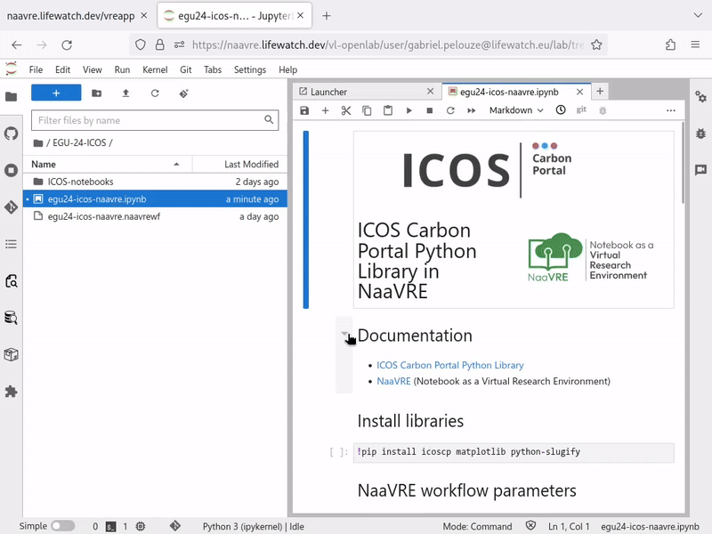
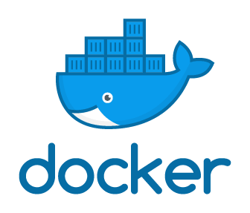
From notebooks to cloud workflows
2. CONTAINERIZE CELLS
Encapsulate user-selected cells as standardized services and containerize them as reusable components.
Code cell

Slide 9
From notebooks to cloud workflows
3. COMPOSE A WORKFLOW
4. RUN IT IN THE CLOUD

Slide 10
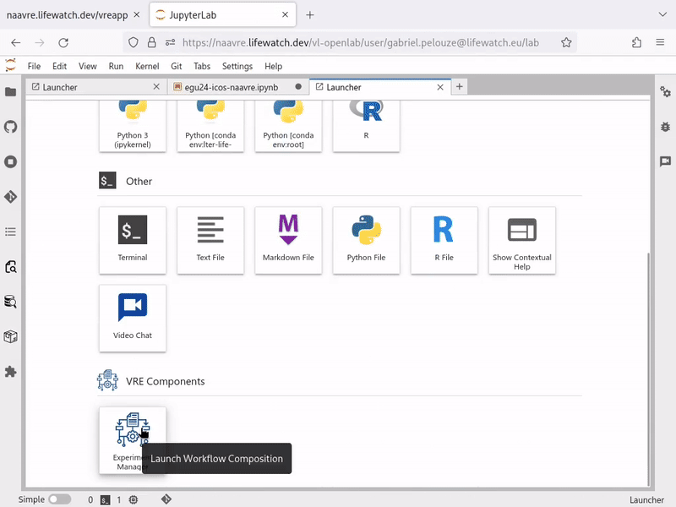
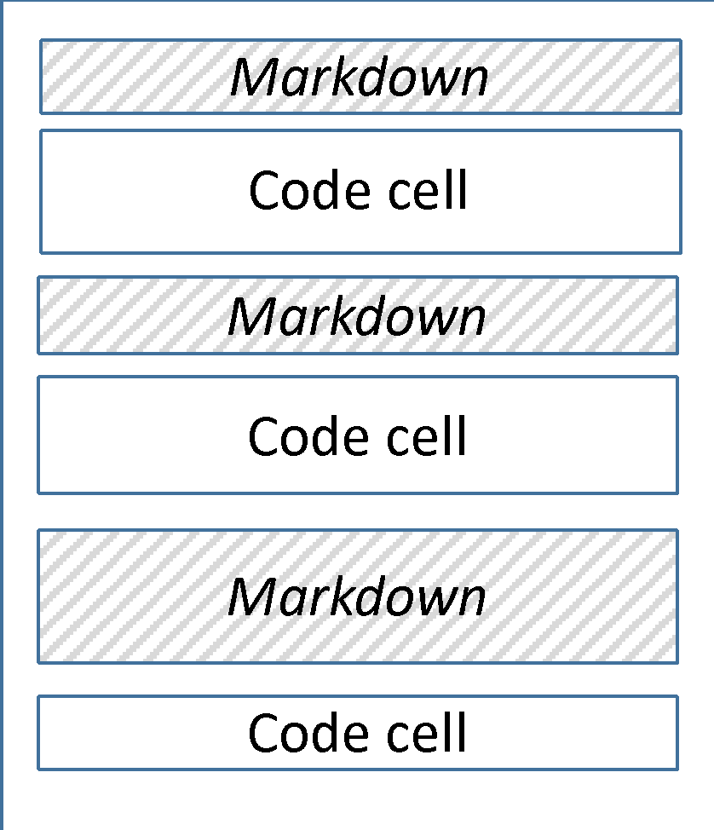
From notebooks to cloud workflows
3. COMPOSE A WORKFLOW: Customize data flow and input
An experiment is a workflow of services, with customized input data and infrastructure
1
2
3
1
2
3
1
S
2
M
3

Slide 11
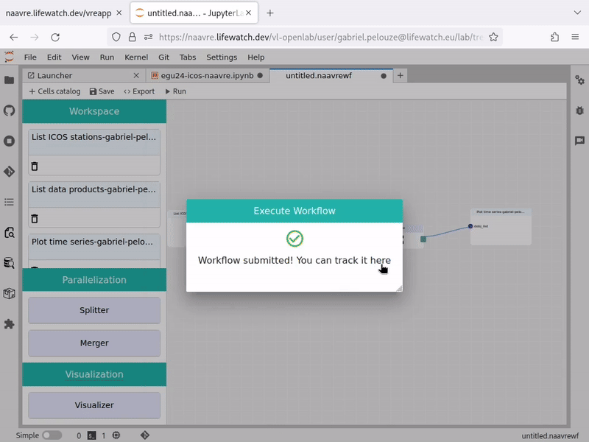
From notebooks to cloud workflows
4. RUN THE WORKFLOW: Automate the workflow components deployment and execution
1
S
2
M
3
2
1
2
3
2
Zhou, H., Hu, Y., Ouyang, X., Su, J., Koulouzis, S., Laat, C., Zhao, Z.: CloudsStorm: A framework for seamlessly programming and controlling virtual infrastructure functions during the DevOps lifecycle of cloud applications. Softw: Pract Exper. 49, 1421–1447 (2019). https://doi.org/10.1002/spe.2741

Slide 12
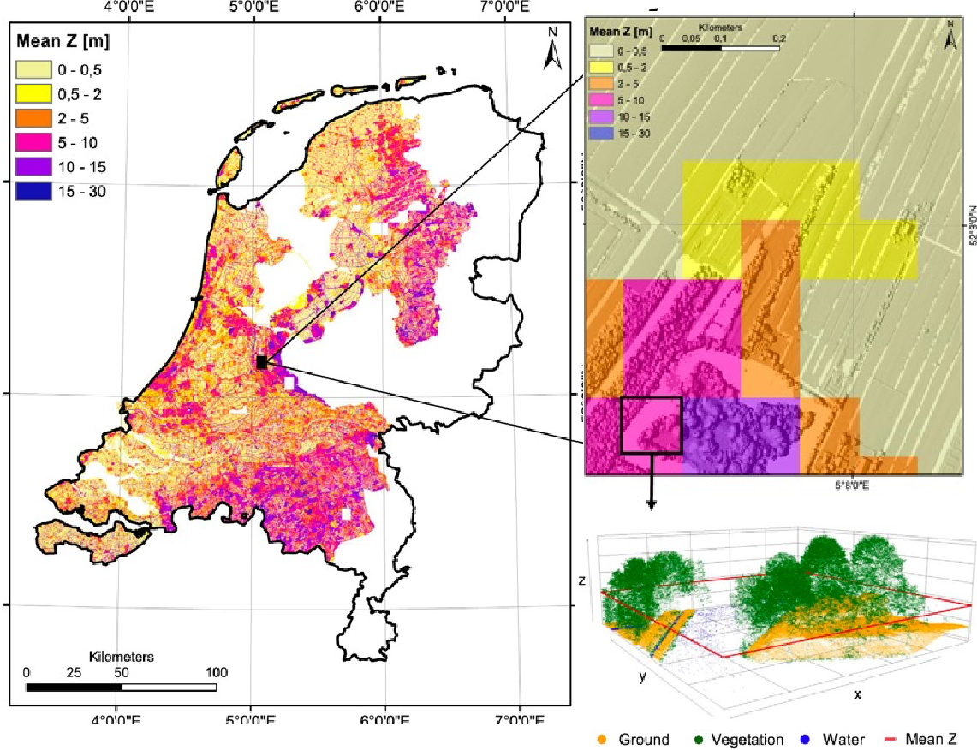
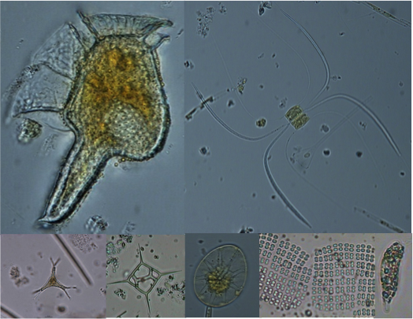
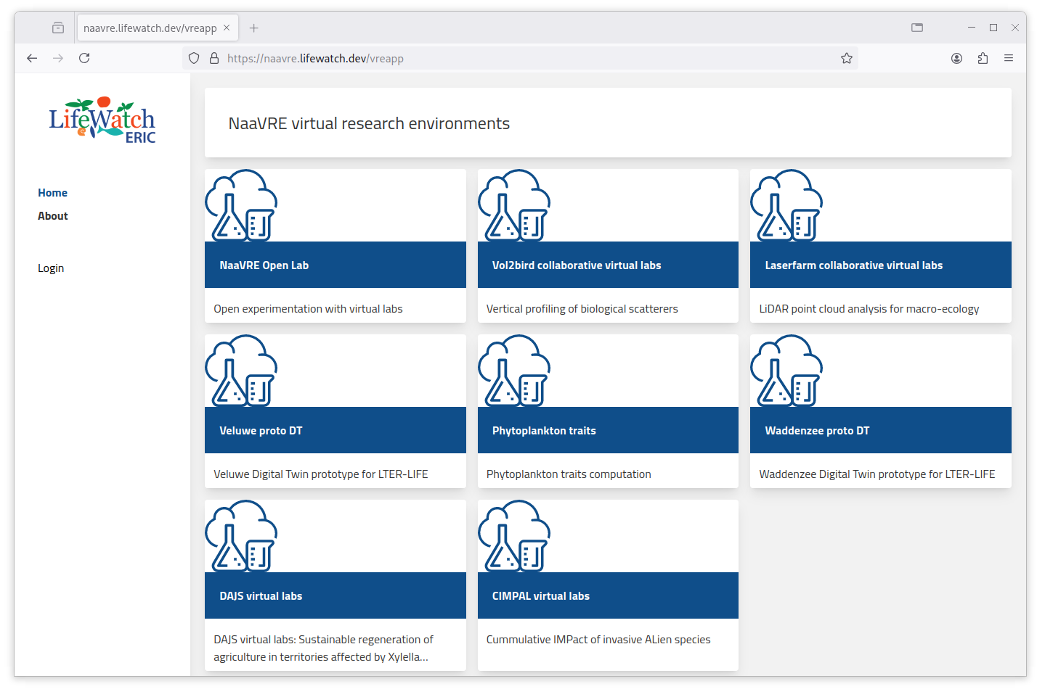
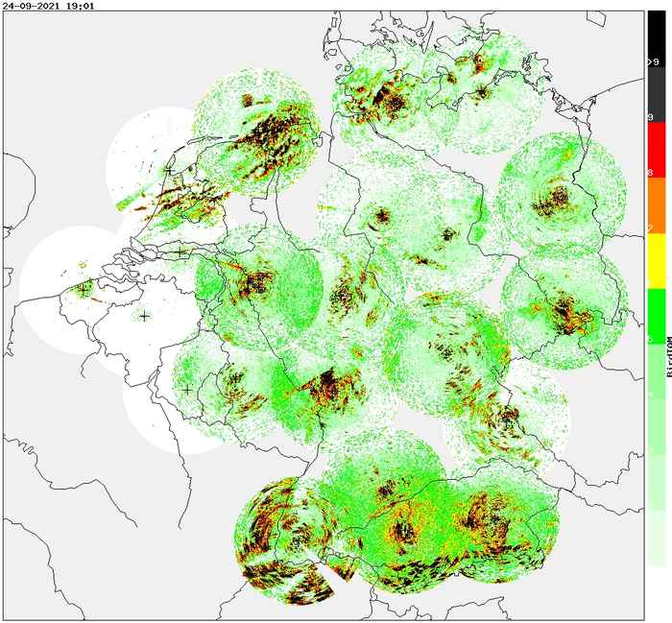
Virtual lab examples
Open Lab: NaaVRE demonstrator
Laserfarm: Lidar analysis for macro-ecology (LifeWatch VLIC / BIOMAC)
Vol2bird: Study bird migration using radar data (LifeWatch VLIC / BIOMAC)
Phytoplankton traits computation (LifeWatch Italy)
Veluwe proto digital twins (NWO LTER-LIFE / NIOO-KNAW)
Waddenzee proto digital twin (NWO LTER-LIFE / NIOZ)
CIMPAL invasive species (LifeWatch / ULouvain)

Slide 13
A project under development
Current development efforts
R code containerization
R Studio support
Visualization in NaaVRE workflows
Shared assets plateforme
FDO support with RO-crate
Digital Twin support

Slide 14
Try it yourself!
https://qcdis.github.io/NaaVRE-website
Tutorials & documentation
https://naavre.lifewatch.dev
Try NaaVRE

