Slide 1
SRCE ecosystem for Croatian science community
Emir Imamagić, Draženko Celjak, Petra Udovičić
www.srce.unizg.hr
EGI2024

Slide 2
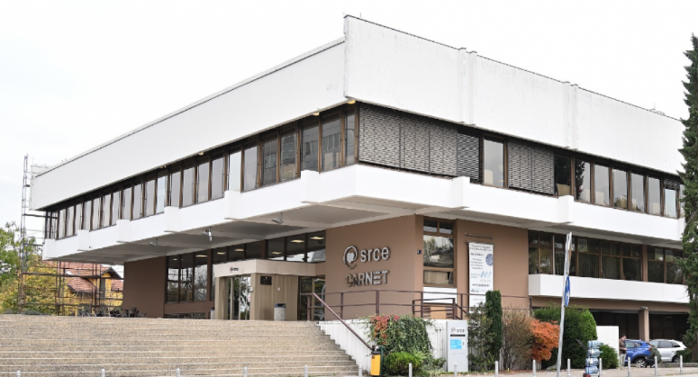
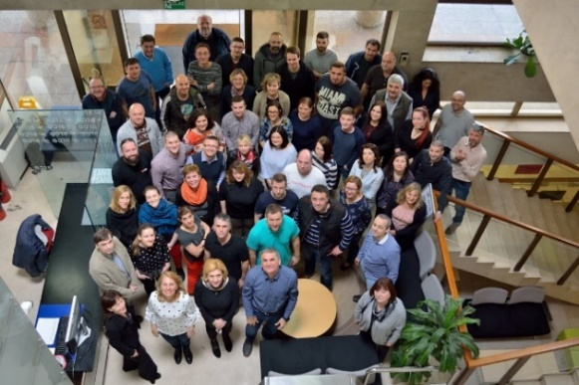
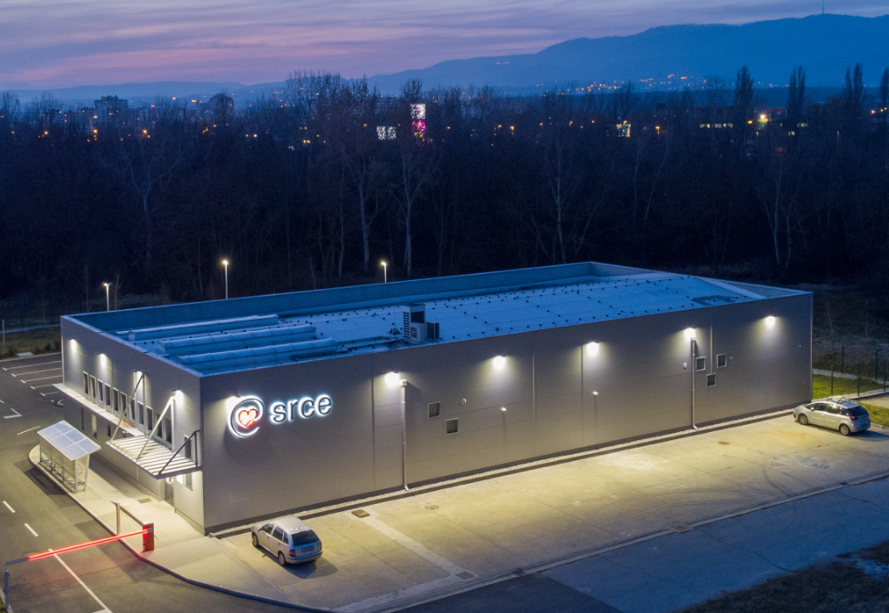
University computing centre - SRCE
Organisation
~ 180 employees
11 organizational units
3 locations
supporting digital transformation of education, research and business in the academic and science.
promoting Open Science and Open Education.
that builds and operate national e-infrastructure and digital services
30 public services for the needs of the academic and scientific community in Croatia

Slide 3
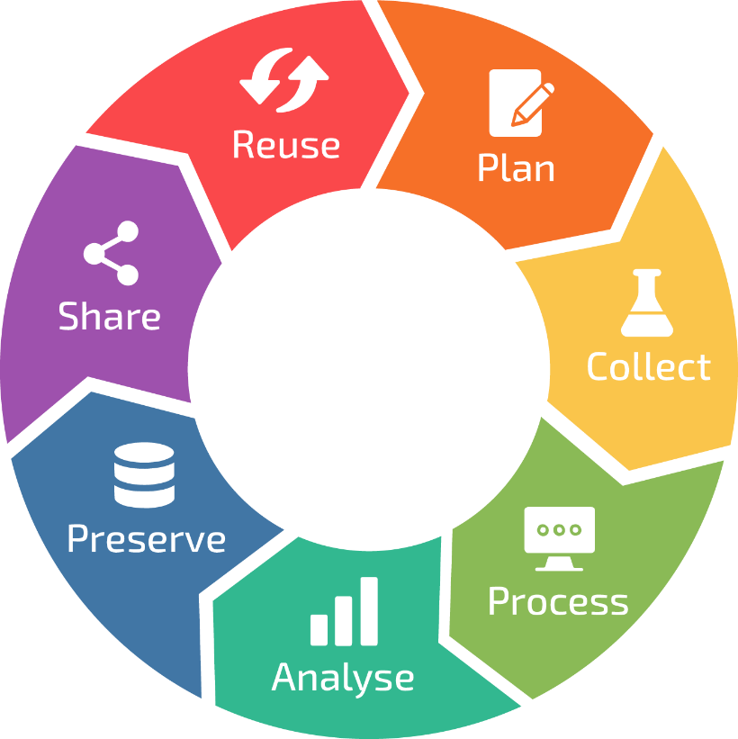
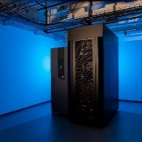
Support for Open Science
INFORMATION SUPPORT
Croatian Research
Information System
Data Science Lifecycle
DATA, REPOSITORY AND OPEN SCIENCE
Dabar I Hrčak I Puh
Support to Open Science
Supek
Vrančić
ADVACED COMPUTING
Supercomputer Supek I resource Vrančić
ACQUIRING HPC COMPETENCE AND CONSULTING Croatian Competence Center for HPC
Education and provision of specialized support in the use of digital resources and services

Slide 4
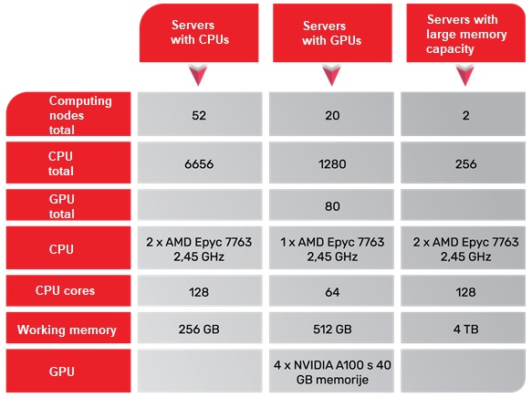
Advanced Computing with „Supek”
The service is established on a High-performance computing resource (HPC) and it is intended for the execution of user applications with very high performance requirements
Advanced computing environment with a power of 1.25 PFLOPS with a total of:
8384 processor cores
80 graphic processors
32 TB of working memory
250+ projects and 500+ users
Ivan Supek

Slide 5
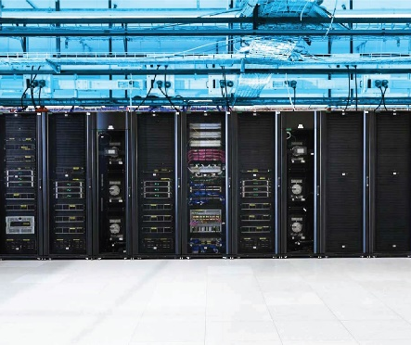
Advanced Cloud Computing with „Vrančić”
The service is established on a resource for High-throughput computing (HTC), intended for a wider set of user applications and systems that require a specific programming environment and significant processing and memory resources
Adaptable, elastic and versatile computing environment
OpenStack & Ceph
Ivan Supek

Slide 6
Croatian Competence Centre for HPC (HR HPC CC)
ONE-STOP-SHOP FOR HPC
The Croatian Competence Centre for HPC is a place where users from the academic and scientific community, industry, and public administration get support in the application of the national and European infrastructure of High Performance Computing (HPC) in their work.
Services to and Interaction with Academia and Public Administration
Collaboration
Education and skills development in HPC/HPDA/AI
Services to and Interaction with Industry
Service Portfolio and Competence Management
HR HPC CC established within the project EuroCC as part of a network of national competence centres for HPC. Project EuroCC 2 is currently underway and will further improve the centre's services and competencies.
https://www.hpc-cc.hr/

Slide 7
Data Infrastructure & Services
CROATIAN OA JOURNALS
Since February 2006
536 scientific & professional journals (406 active)
285.000 + OA articles
65.000+ visits daily
PRESERVATION & DISEMINATION
Digital archives and repositories
16 types of digital objects
179 digital repositories of research & HE institutions
266.000 digital objects
(TEMPORARY)
STORAGE & SHARING SERVICE
640+ researchers and lecturers
200 GB (default)
~353 TB od data
PLAN
REUSE
COLLECT
SHARE
PROCESS
PRESERVE
ANALYZE

Slide 8
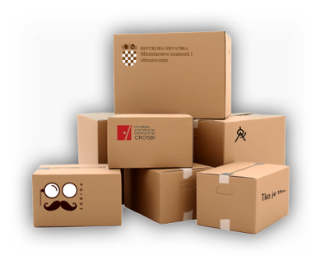
Croatian Research Information System (CroRIS)
Developed within project Scientific and Technological Foresight (2017-2023)
Co-funded by European Union from European Regional Development Fund.
CERIF based
Promote open science,
Provide information reliability,
Ensures openness and interoperability,
Support decision making.
www.croris.hr
Information and processes about institutions, researches, projects, publications, equipment, patents, services, events and much more,
Integration with many national systems and international platforms, such as ORCID, OpenAire, WoS, Scopus.
Ensuring data accuracy and quality,
Data verification,
Designated authorities and various user’s roles with responsibilities.

Slide 9
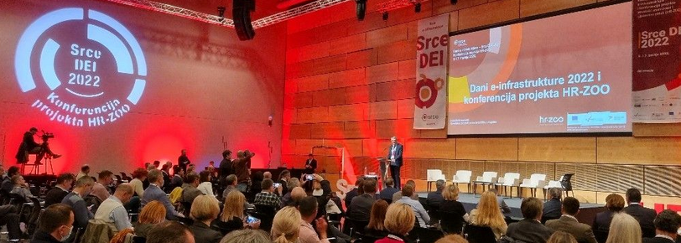
CroRIS – as Catalogue of HR-OOZ services and resources
RBI “POIROT”
Projects
Journals
MSE Register
Funding
Researchers
Publications
MSE Register
Scientific institutions
RBI “CROSBI”
RBI “Šestar”
Equipment and services
HE Institutions
Citations
Scientific disciplines
Events
Patents and products

Slide 10
Thank you for your attention!
Questions?

