Slide 1
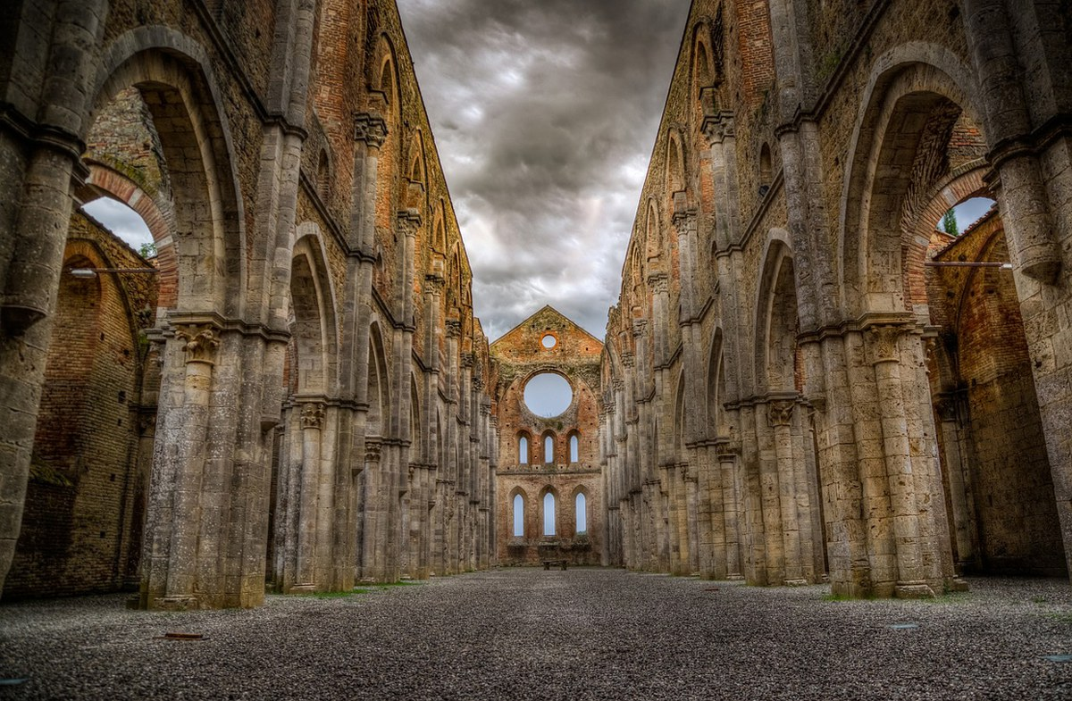

4CH
The EU Competence Centre for the Conservation of Cultural Heritage
A new DDRI in the EU landscape
Luca Pezzati, CNR INO
EGI 2024
Lecce – October 2nd, 2024

Slide 2
4CH
DT-TRANSFORMATION-20-2020 called for a Competence Centre for the Conservation of CH
4CH (www.4ch-project.eu - 2021 Jan. to 2023 Dec.) designed the CC as a Digital Distributed Infrastructure, now in its implementation phase (4CH AISBL)
4CH mission: to map, aggregate, organise, preserve, analyse and advance competences for the preservation of cultural heritage, making them available to anyone engaged in CH preservation (in ready-to-use formats)
4CH typical outputs: recommendations, guidelines, survival kits, success stories, exemplary case studies, preservation projects

Slide 3
4CH as a Digital Distributed Research Infrastructure
4CH mission requires a distributed digital infrastructure
4CH will use CH data and the competences of a world-wide network of CH experts
The key to 4CH success will be combining advanced digital techniques with expert skills and guidance
The activities to be developed by 4CH clearly define 4CH as a research infrastructure
By engaging in CH preservation problems, the 4CH DDRI will support use-inspired research

Slide 4
RIs in the heritage domain
RIs for cultural heritage (or CH-related) are all DDRI, apart from E-RIHS
RIs partner of the European Collaborative Cloud for Cultural Heritage:
  ARIADNE AISBL
  CLARIN ERIC
  DARIAH ERIC
  E-RIHS
  Europeana (Cultural Infrastructure)
ECCCH aims at developing cloud-based vertical services for the different heritage communities, based on digital twins (results expected by 2029)

Slide 5
Major data providers of 4CH
ARIADNE AISBL (archaeological documents and datasets)
DARIAH ERIC (documents and datasets)
E-RIHS (DIGILAB yet under construction)
  ADS (UK) https://archaeologydataservice.ac.uk (HSDS project starting)
  BALaT (BE) https://balat.kikirpa.be
The ECCCH platform (2029)
Europeana (datasets)

Slide 6
4CH core technologies
In line with the ECCCH, digital twins will be used by 4CH
Other core technologies:
  Advanced machine learning (AI)
  3D-based technologies (Virtual Reality/Mixed Reality)
  Collaborative Virtual Research Environments
4CH services will be cloud-based
4CH will use the Heritage Digital Twins developed by its preparatory project

Slide 7
The ARTEMIS project
Reactive Heritage Digital Twins will be a strategic addition to 4CH core digital tools
RHDT will be developed by 4CH, together with DARIAH and ARIADNE in the new project ARTEMIS Applying Reactive Twins to Enhance Monument Information Systems
HORIZON-INFRA-2024-TECH-01-04: AR/VR-empowered digital twins for modelling complex phenomena in new RI application areas
Collaborative VREs for CH will also be developed by ARTEMIS
RHDT and CVREs will be deployed by the end of 2027

Slide 8
luca.pezzati@cnr.it
ARTEMIS Coordinator
www.artemis-project.eu (launch in Jan. 2025)

Slide 9
Clouds, competence centres and research infrastructures in the cultural heritage domain
The proliferation of terms used to characterize digital infrastructures providing services for cultural heritage reflects different perspectives on their role but may be confusing for their potential users. Deciding what is a research infrastructure (RI) and what is not may affect stakeholders’ understanding of them and the related use, and impact on their funding, where support to their creation and management depends on the legal definition of what is eligible and what is not. Adding the qualification of “research” to such infrastructures further complicates the situation, as it also involves the understanding of what research-oriented means. Cultural heritage is a domain in which the term “research” has a broad connotation, including activities performed according to the methodology of social sciences and humanities and to the scientific method (within the so-called heritage and archaeological sciences) and requires a tailored approach to digitization. Important research results can be achieved either by professionals and by researchers, thus also the target user communities can have fuzzy delimitations.
Attempts to identify different approaches to research date back to the well-known study by Stokes, which distinguished among fundamental research, use-inspired research and solution-oriented applied research, with most of the research activities in cultural heritage belonging to the second and the third categories. This distinction was considered in a study carried out in 2018 by the RI-PATHS EU project, which included competence centres in the third grouping but also considered the case of multi-purpose RIs. Digital infrastructures are not considered separately in this RI-PATHS taxonomy, or just mentioned as data and service providers. This requires an update, since research activities now increasingly consist or rely on digital services. Notable examples of digital research infrastructures on cultural heritage are national initiatives such as DIGILAB.be, a Belgian data infrastructure for conservation, and HSDS, a similar one in the UK. Similarly, the ARIADNE RI provides a catalogue of 4,000,000 archaeological research datasets with services to process the data they contain. A European initiative is 4CH, implementing a European competence centre for heritage conservation relying on a knowledge base of heritage information. Thus the question moves to the digital backbones of the above and how they could be further developed to reap the benefits of an advanced digital transformation. The just started ECCCH project aims at developing cloud-based vertical services for the different heritage communities, and will deploy its results by 2029.
So the main question seems to be not just which services are required, but in which cloud environment they should be implemented. If answering to the question “is a cloud the place to develop a digital research infrastructure for cultural heritage” has an obvious positive answer, the features of such cloud still need clarification and further investigation. The present contribution will discuss this question, with a focus on the digital services to be provided by 4CH in its development as an international digital research infrastructure and competence centre.

