Slide 1
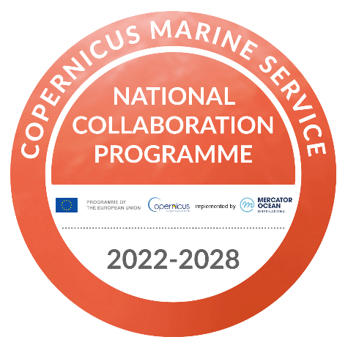
CONNECT: Tagus river-to-ocean collaboratory for thematic digital twins and collaborative management Marta Rodrigues, Anabela Oliveira, Gonçalo de Jesus, André Fortunato, Ricardo Martins, Zahra Mardani, Elsa Alves
EGI 2024, September 30, 2024 to October 4, 2024, Lecce, Italy
CONNECT - local COastal moNitoriNg sErviCe for PorTugal
Copernicus Marine – User – EU Coastal Monitoring Pilot Demonstrations (22050-COP-INNO USER)

Slide 2
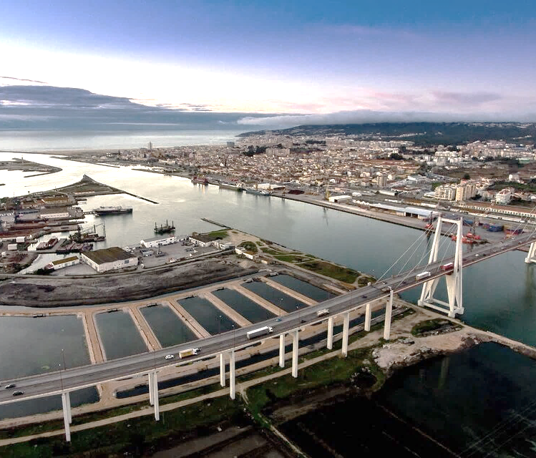
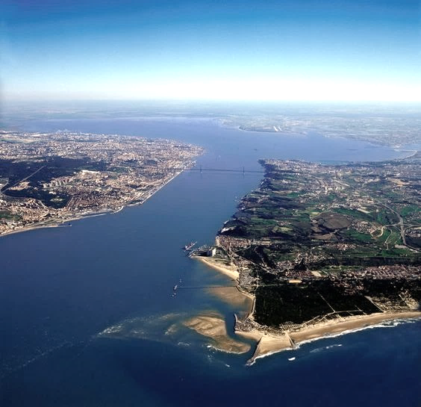
Goals CONNECT
Develop Digital Twins to:
Support the evaluation of the ecological status of estuaries (WFD)
Quantify land inputs to the adjacent coastal waters (MSFD)
Anticipate inundation events (Floods Directive)
Build tailor-made products and facilitate access to them

Slide 3
CONNECT in a nut shell: Seamless Coastal Marine Service
CONNECT delivers a local, high-resolution, coastal service that seamlessly integrates model-based forecasts and observations to provide blue (physical) and green (biogeochemical) data on Portuguese estuaries to CMEMS

Slide 4
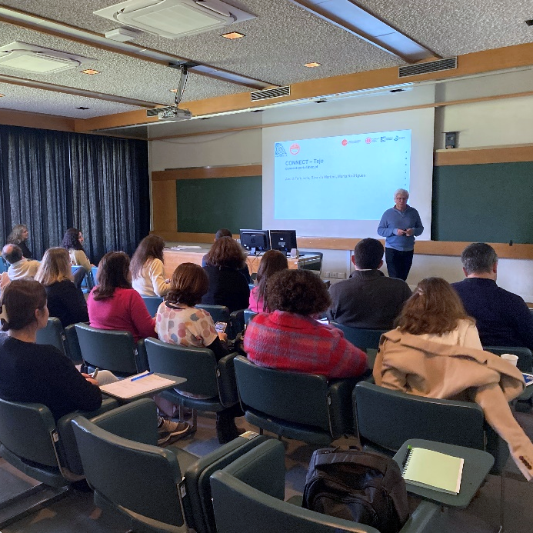
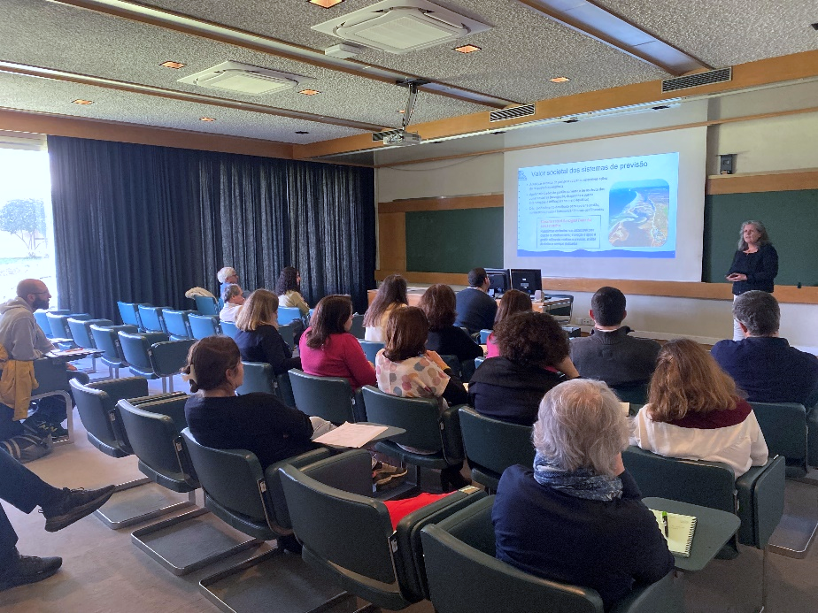
DT Co-design with users
Address user’s requirements and feedback on the coastal service through inquiries and interviews
Dedicated actions with users for DT dissemination with detail improvement and future actions goals

Slide 5
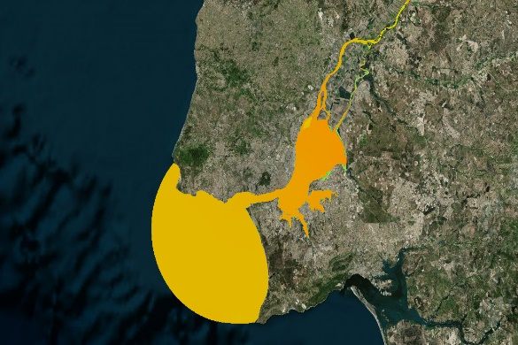
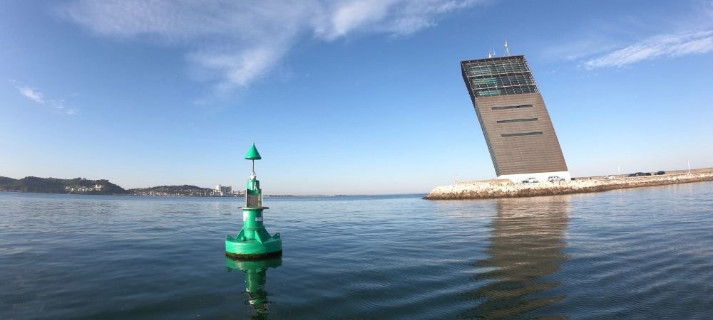
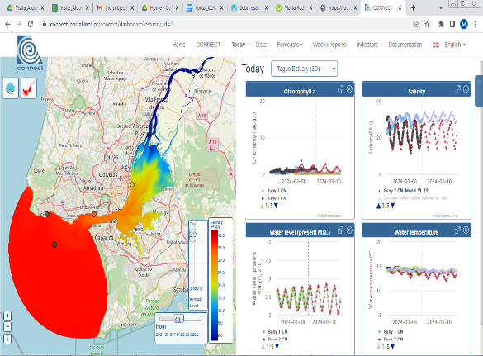
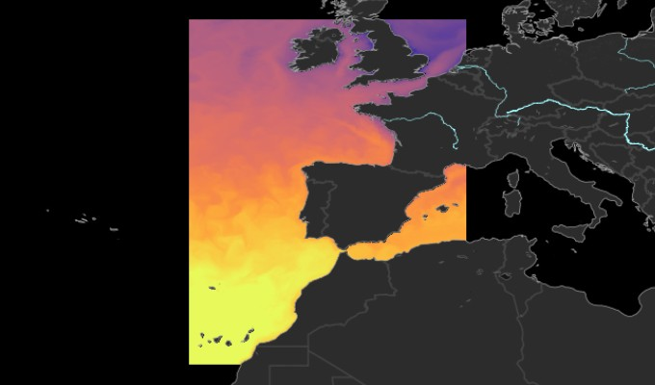
CONNECT DT building blocks
High-resolution operational modelling of estuarine - coastal circulation and water quality, forced by CMEMS regional models
Built using OPENCoastS
Near-real time in-situ data acquisition and Earth-observation data
From CoastNet
WebGIS portal to access physical and biogeochemical 2-day forecasts and observations
Using Collaboratory infrastruture for societal uptake
Seamless integration and provisioning of products to CMEMS

Slide 6
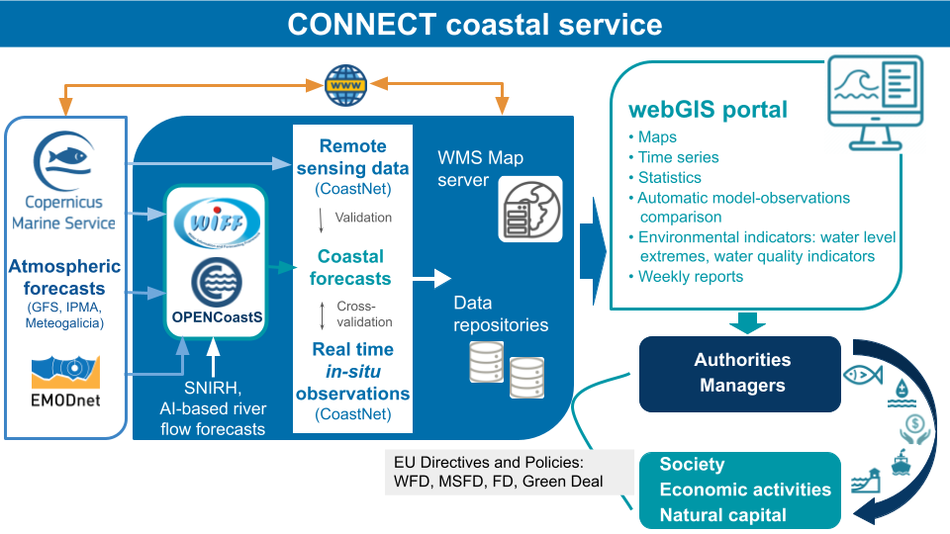
CONNECT Digital Twin architecture

Slide 7
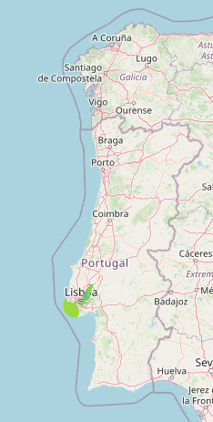
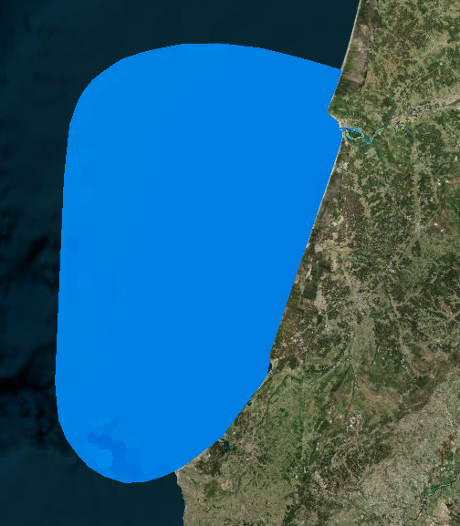
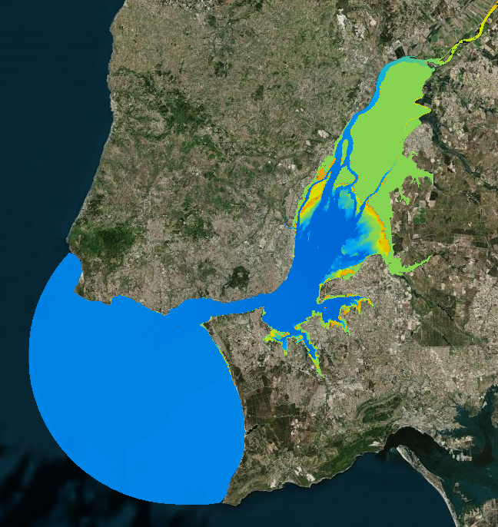
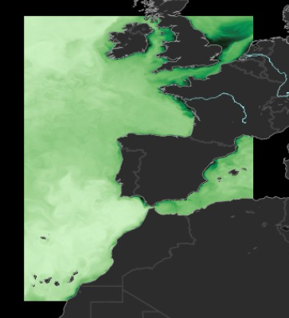
Building the model cascade in the DT
Mondego estuary
Horizontal resolution: 5-5000m
Vertical grid: 25 SZ levels
Downscalling
IBI Physics
IBI Biogeochemistry
Horizontal resolution: 1/36º
Vertical grid: 50 levels
Tagus estuary
Horizontal resolution: 3/5-1600m
Vertical levels: 39 SZ levels

Slide 8
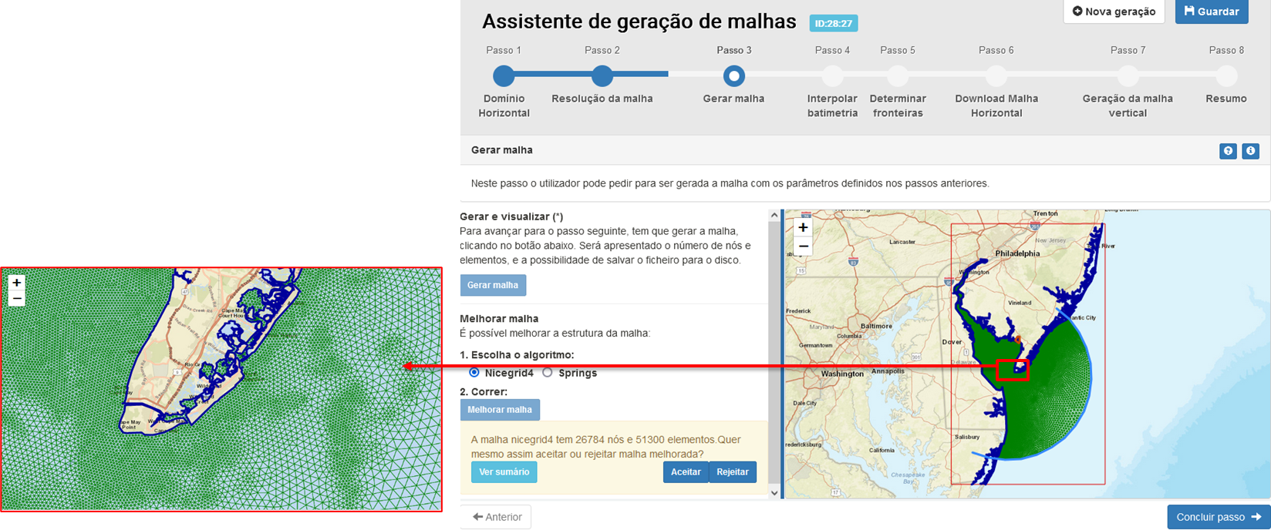
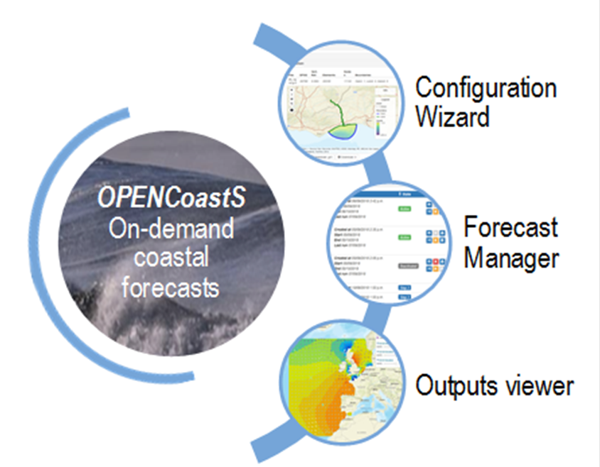
OPENCoastS: build the operational deployments
Create and maintain an operational forecast for the user selected coastal area
Interaction with a simple Web interface
Allow choice of model, forcings, parameters and data sources
Integrate with external forecasts (AI model for the Tagus river)
Easy replication of deployments for fast calibration
Whole forecast cycle: create grid, configure, manage,
outputs viewer
Grid generation

Slide 9
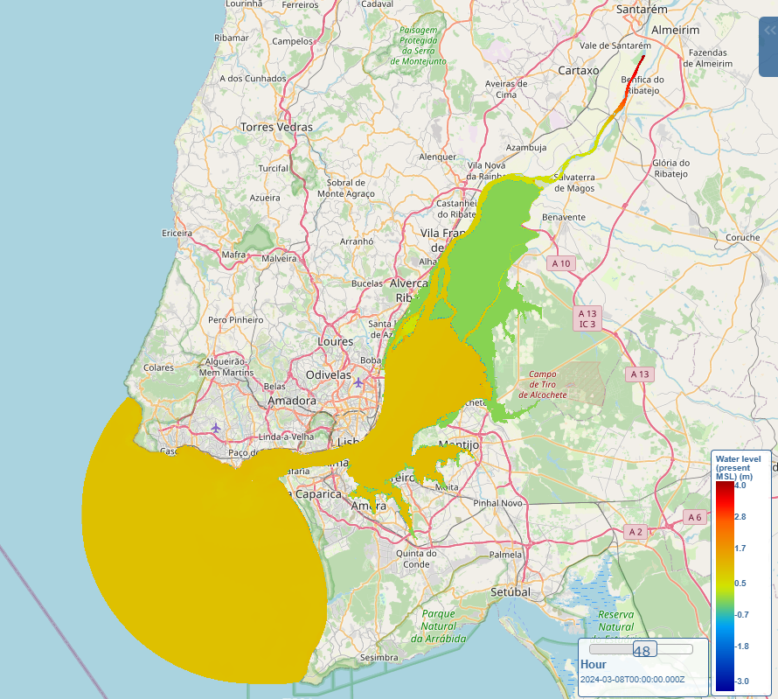
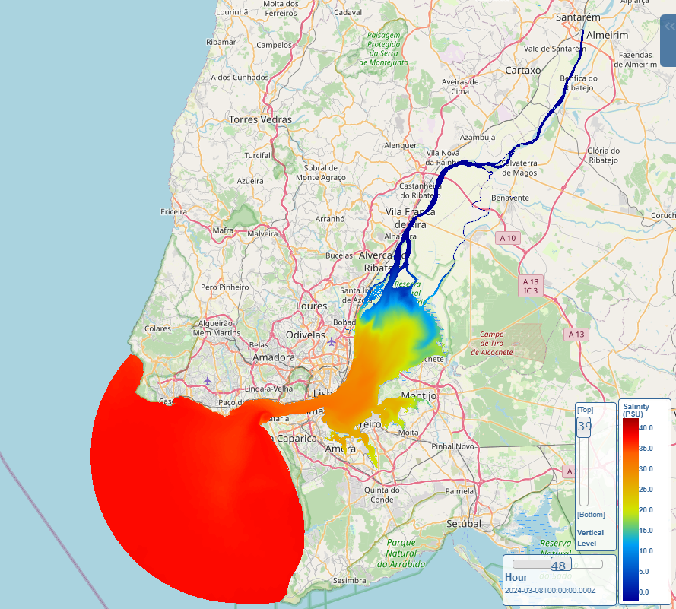
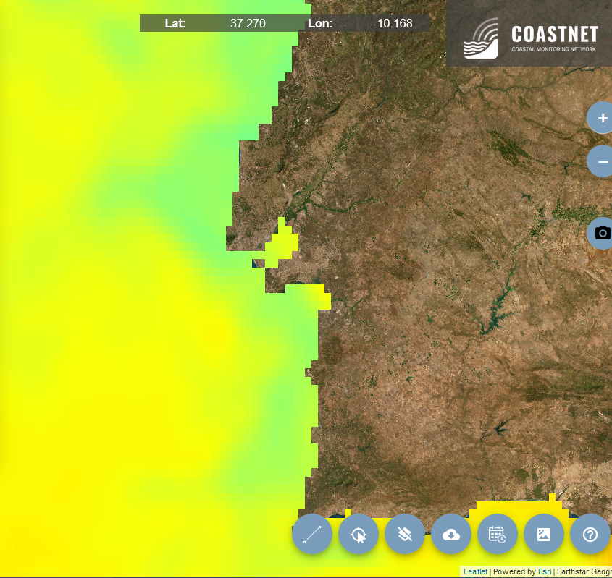
CONNECT DT Products designed for specific themes
Tagus estuary: 2D barotropic model, waves-currents interaction - inundation
Tagus estuary: 3D baroclinic model, coupled circulation-biogeochemistry – water quality
Remote sensing: Copernicus Marine Service
NRT in-situ monitoring network
Water levels, Velocity, Waves (Significant wave height, Mean period, Direction)
Water levels, Velocity, Salinity, Temperature, Ammonium, Nitrate, Phosphate, Silicate, Dissolved oxygen, Chlorophyll-a
Water temperature, Chlorophyll-a
Salinity, Temperature, pH, Dissolved oxygen, Chlorophyll-a, Turbidity

Slide 10
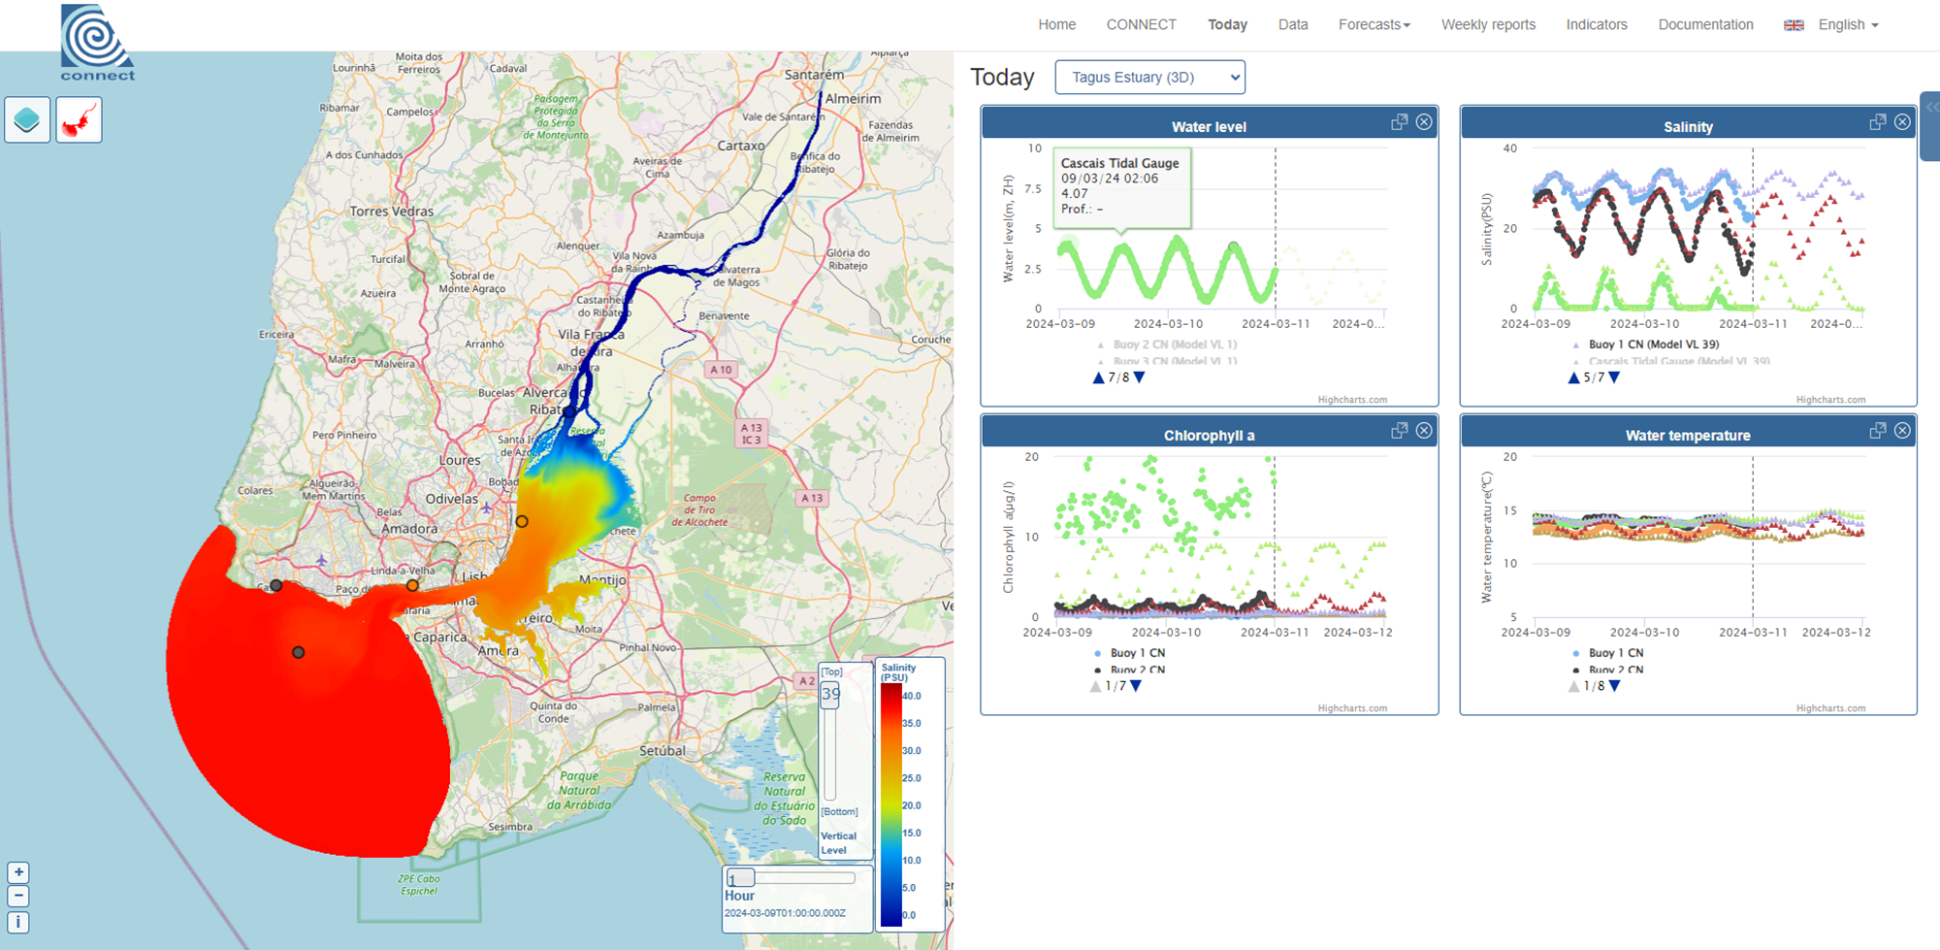
CONNECT DT WebGIS portal: Application of the Collaboratory infrastructure
Collaboratory building
Operational dashboard with a snapshot of the current state of the coastal system, built for the end-user requirements compliance
Information quality: data/model comparison
https://connect-portal.lnec.pt/

Slide 11
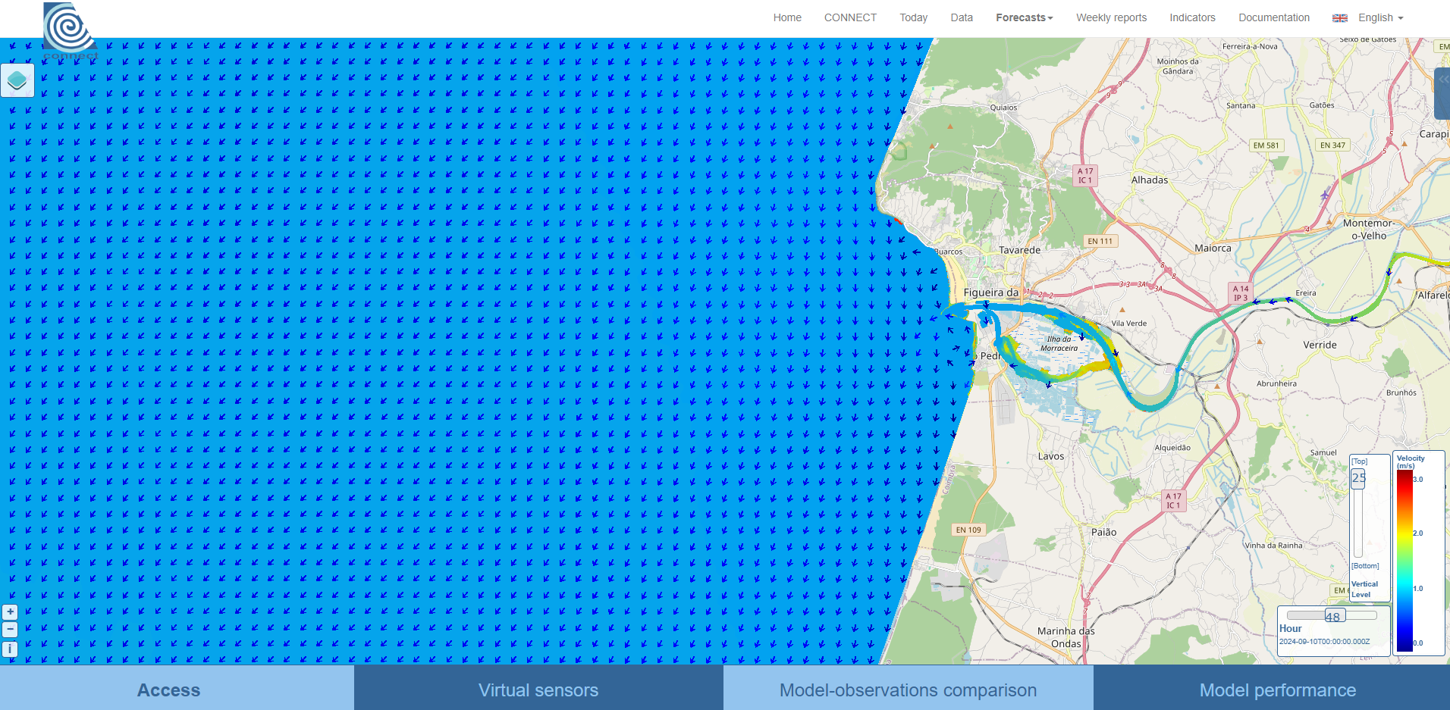
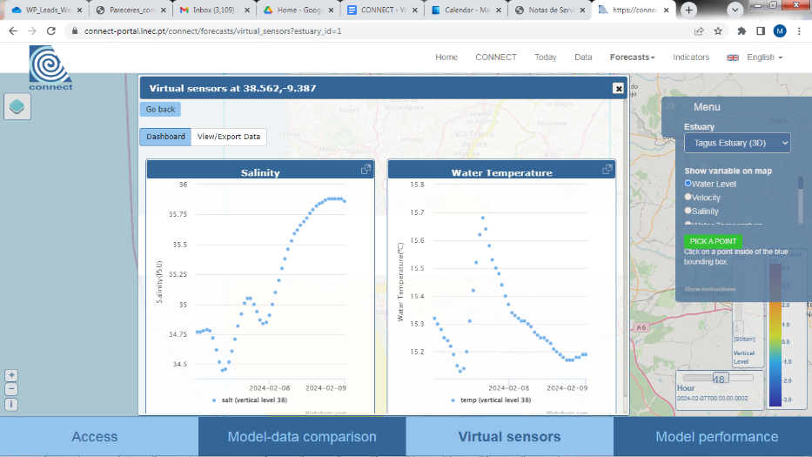
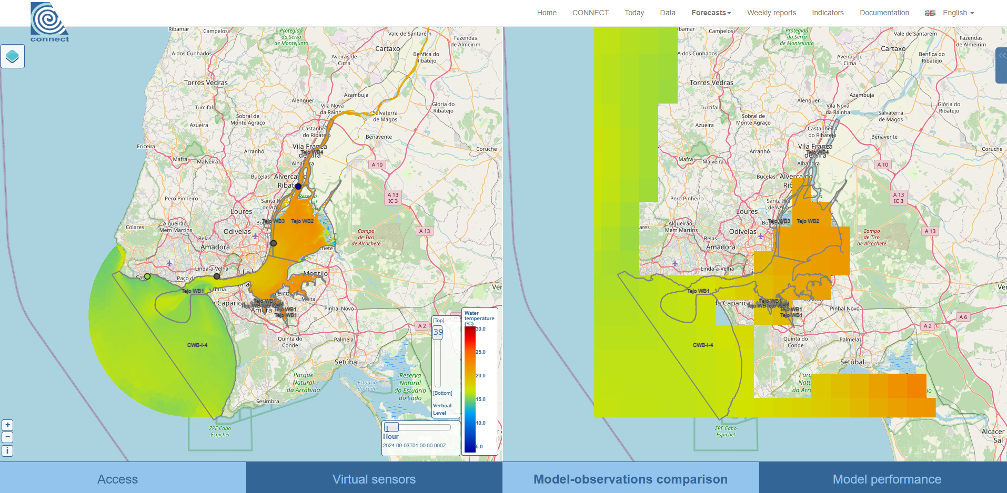
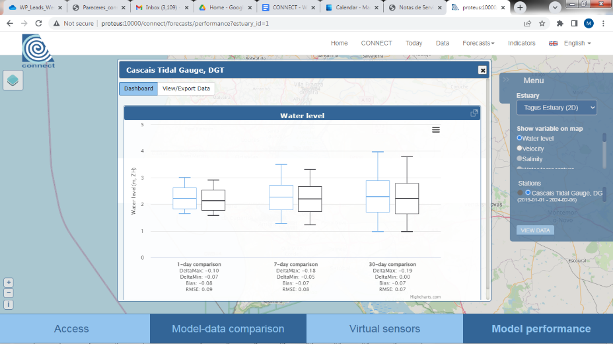
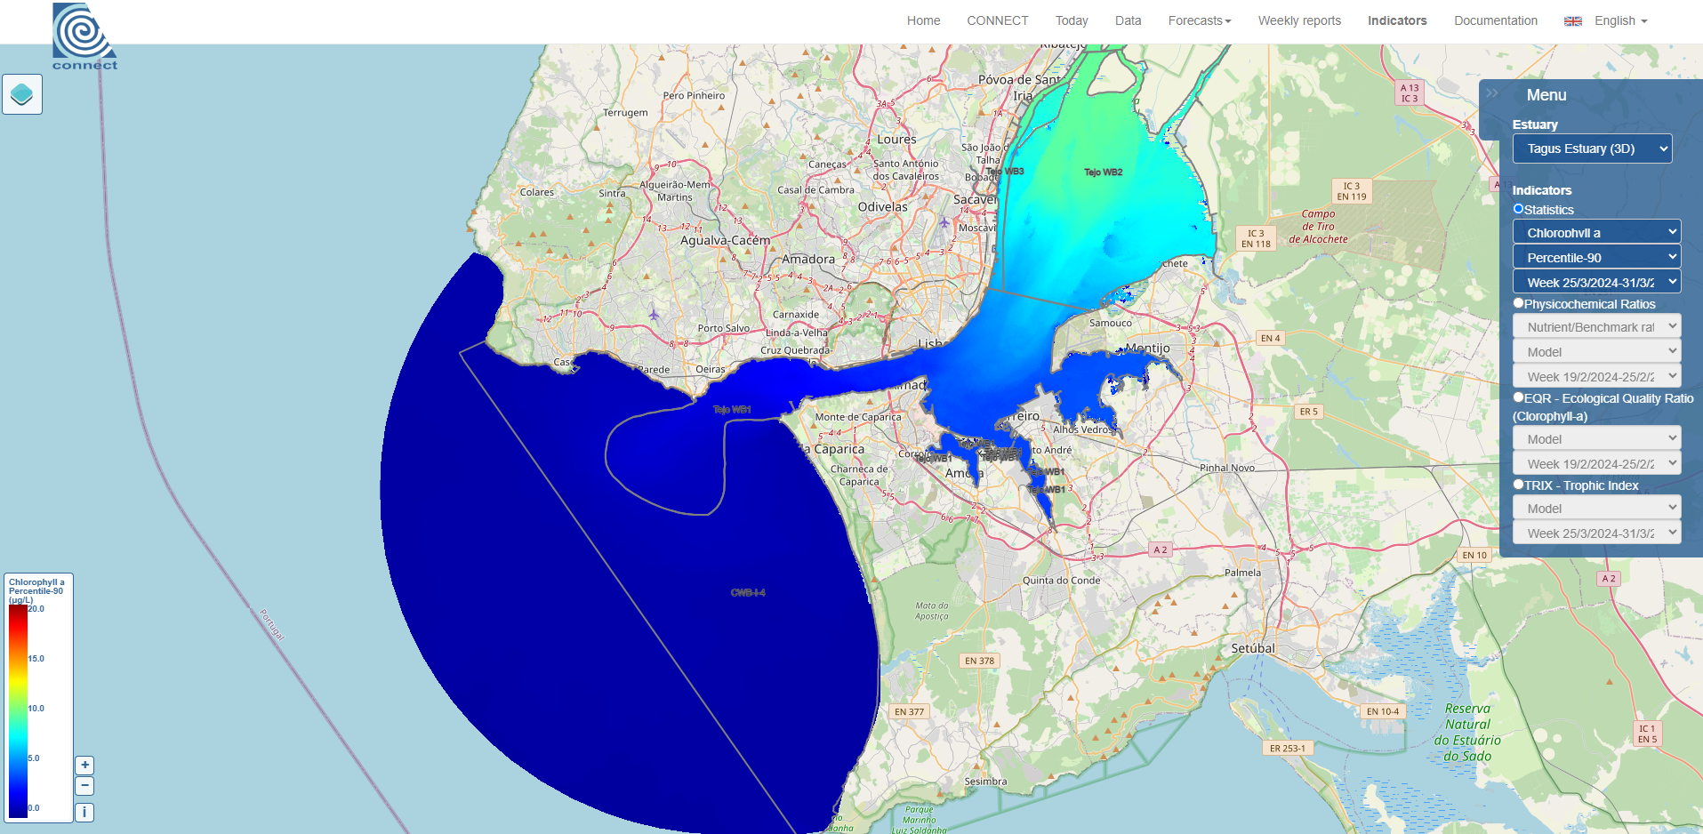
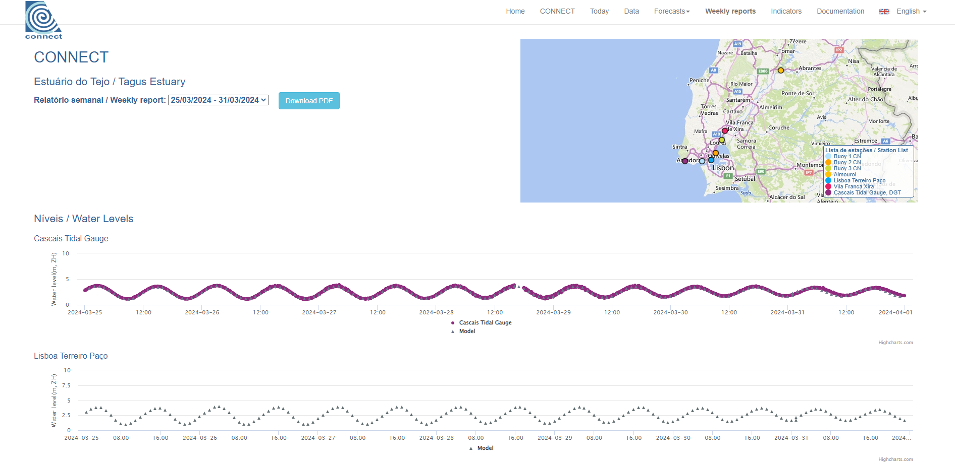
CONNECT webGIS portal: user-tailored services
Circulation and water quality forecasts, next 48 hours
Virtual sensors
In-situ and satellite observations-model comparison
Model performance
Indicators
Automatic weekly reports

Slide 12
CONNECT webGIS collaboratory: behind the scenes
Forecast engine: software stack
web portal: Django, a Python web framework for full-stack web development
Frontend: provides the HTML pages for the user interactions
Backend (with PostgreSQL Database): processes the user requests
Collaboratory architecture

Slide 13
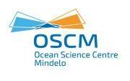
Future developments in DT
Integrate “what-if” scenarios using the collaboratory infrastruture
Climate change
User-defined interventions
Enhance user interaction to build products and create sharable outputs
Capacity to interact with data
Capacity to build (simple) tools
Build consensus tools to support conflicting uses decisions
Implement the DT Collaboratory for distinct user requirements challenges:
WOLLF - Pilot Digital Twins for Water Pollution in Africa - UN Decade project
Duration: 2023-2026 (36 months)

Slide 14
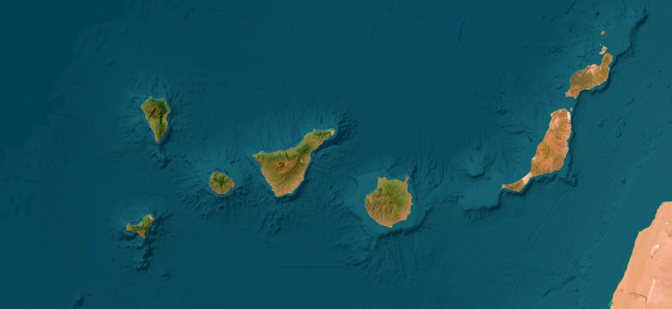
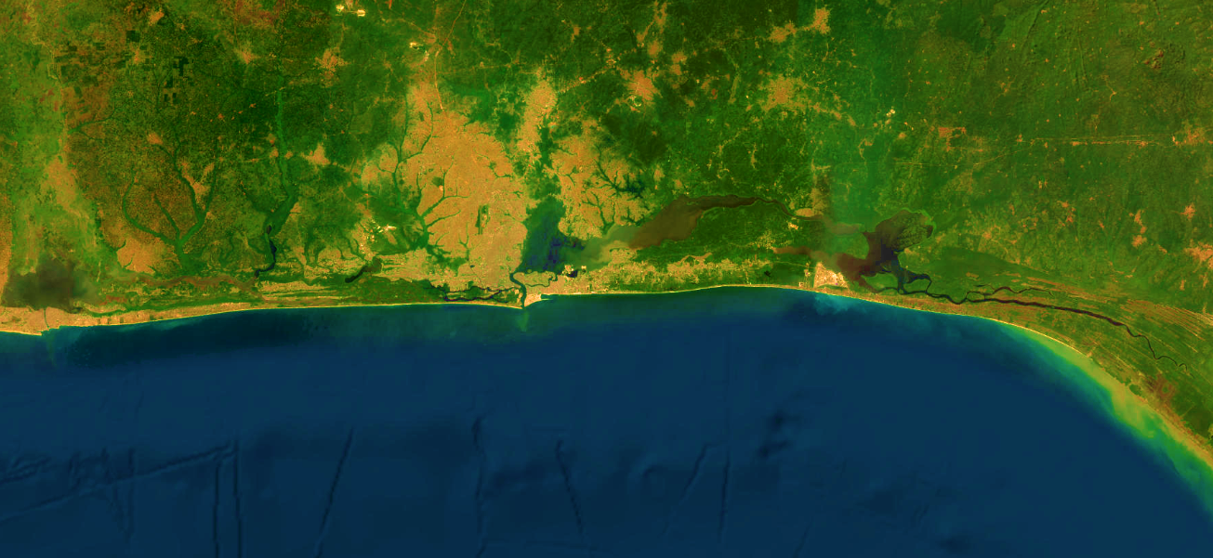
WOLLF – Key expected outcomes
The first Digital Twin for Africa focused on pollution and related areas, built through co-design
The demonstration of this tool in two coastal regions of Africa (Nigeria and Cape Verde)
An open source, relocatable tool that can be applied anywhere and be adapted to other challenges in the future
An open platform for local communities’ engagement through sharing knowledge and experience
Training and learning materials regarding coastal dynamics, forecast systems and Digital Twins
Notes:
Objective: This course aims to provide an overview of circulation and water quality forecasts in coastal regions and covers all the relevant topics to support the implementation of coastal forecasts using the OPENCoastS on-demand forecast service.

Slide 15
Acknowledgements
Copernicus Marine Service National Collaboration Programme 2022-2028
More info here:
connect.lnec.pt
Thank you for your attention!
mfrodrigues@lnec.pt
aoliveira@lnec.pt

