Slide 1
Project Presentation
Antonio Filograna
Engineering Ingegneria Informatica
EGI 2024 – 2nd October 2024, Lecce

Slide 2
Snapshot
BeOpen Framework will enable the development of new digital and AI services by facilitating access to and use of EU Public Sector High Value Datasets (HVDs).
8 pilots will address mobility, urban security, environment, and natural disasters challenges in several EU regions.
The project is now at Month 18 and Pilots are starting to use the Framework to improve their data.
Duration: 30 Months
Jan 2023 – Jun 2025
Budget: 7.447.000 €
Funding 50%
Digital Europe Programme
DIGITAL-2022-CLOUD-AI-02
Consortium: 17 Partners
+1 Associated Partner
Notes:
what is BeOpen?
it is a research project receiving funding from the Digital Europe Programme.
Started in 2023, will end in 2025, so we're now in the middle of the project, in the crucial part of development.
The aim of BeOpen is to support public administrations in increasing the availability and usability of public sector information.
BeOpen means opening up data, making it public and understandable, usable by municipalities.
A central framework to develop
And 8 pilot applications that address several domains that exploit these HVD produced.

Slide 3
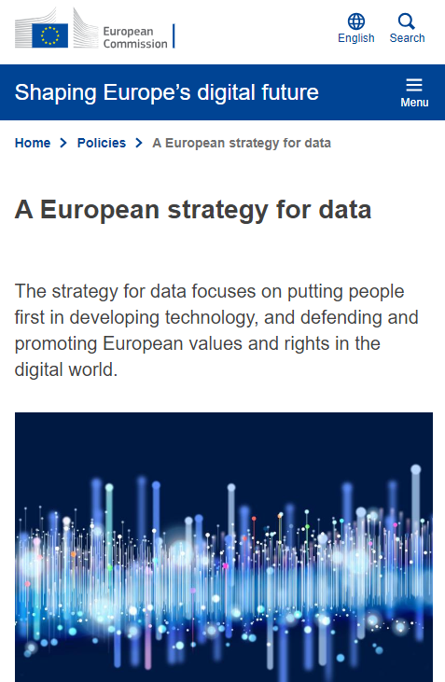
Context overview
The concept of High Value Datasets (HVDs) is central to the EU's strategy for leveraging data as a key asset in the digital economy.
Certain datasets (such as geospatial, environmental, statistical, and other crucial domain) hold significant potential for creating economic value, driving innovation, and improving public services.
The need for HVDs arises from the increasing demand for data-driven decision-making across various sectors.
Ensuring that these datasets are open, standardized, and interoperable across member states can enhance their usability, promote cross-border applications, and ultimately support the EU's broader goals of digital transformation and sustainable growth.
Notes:
What are these High Value Datasets (HVDs) and why are they so important for the European Commission?
They are special datasets‘ because they offer benefits when made easily accessible.
Not all data is useful, some is good to have, other is life saving, important for society
You can understand that guarantee that these datasets are … can enhance their usability and thus provide

Slide 4
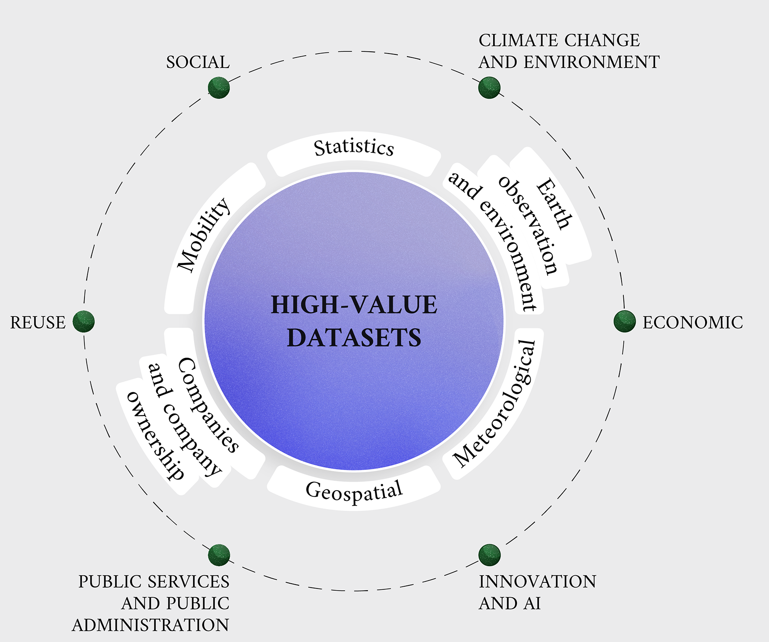
HVDs overview
HVD thematic categories
HVD macro characteristics
Source: https://data.europa.eu/en/publications/datastories/high-value-datasets-overview-through-visualisation
Notes:
the European Commission has recently adopted an implementing act focused on these high-value datasets
They grouped them in a list of 6 HVD thematic categories
And they found several macro characteristics that give them potential value
To be reusable
To have an impact on society
To be used by public services ..
To have economic benefits

Slide 5
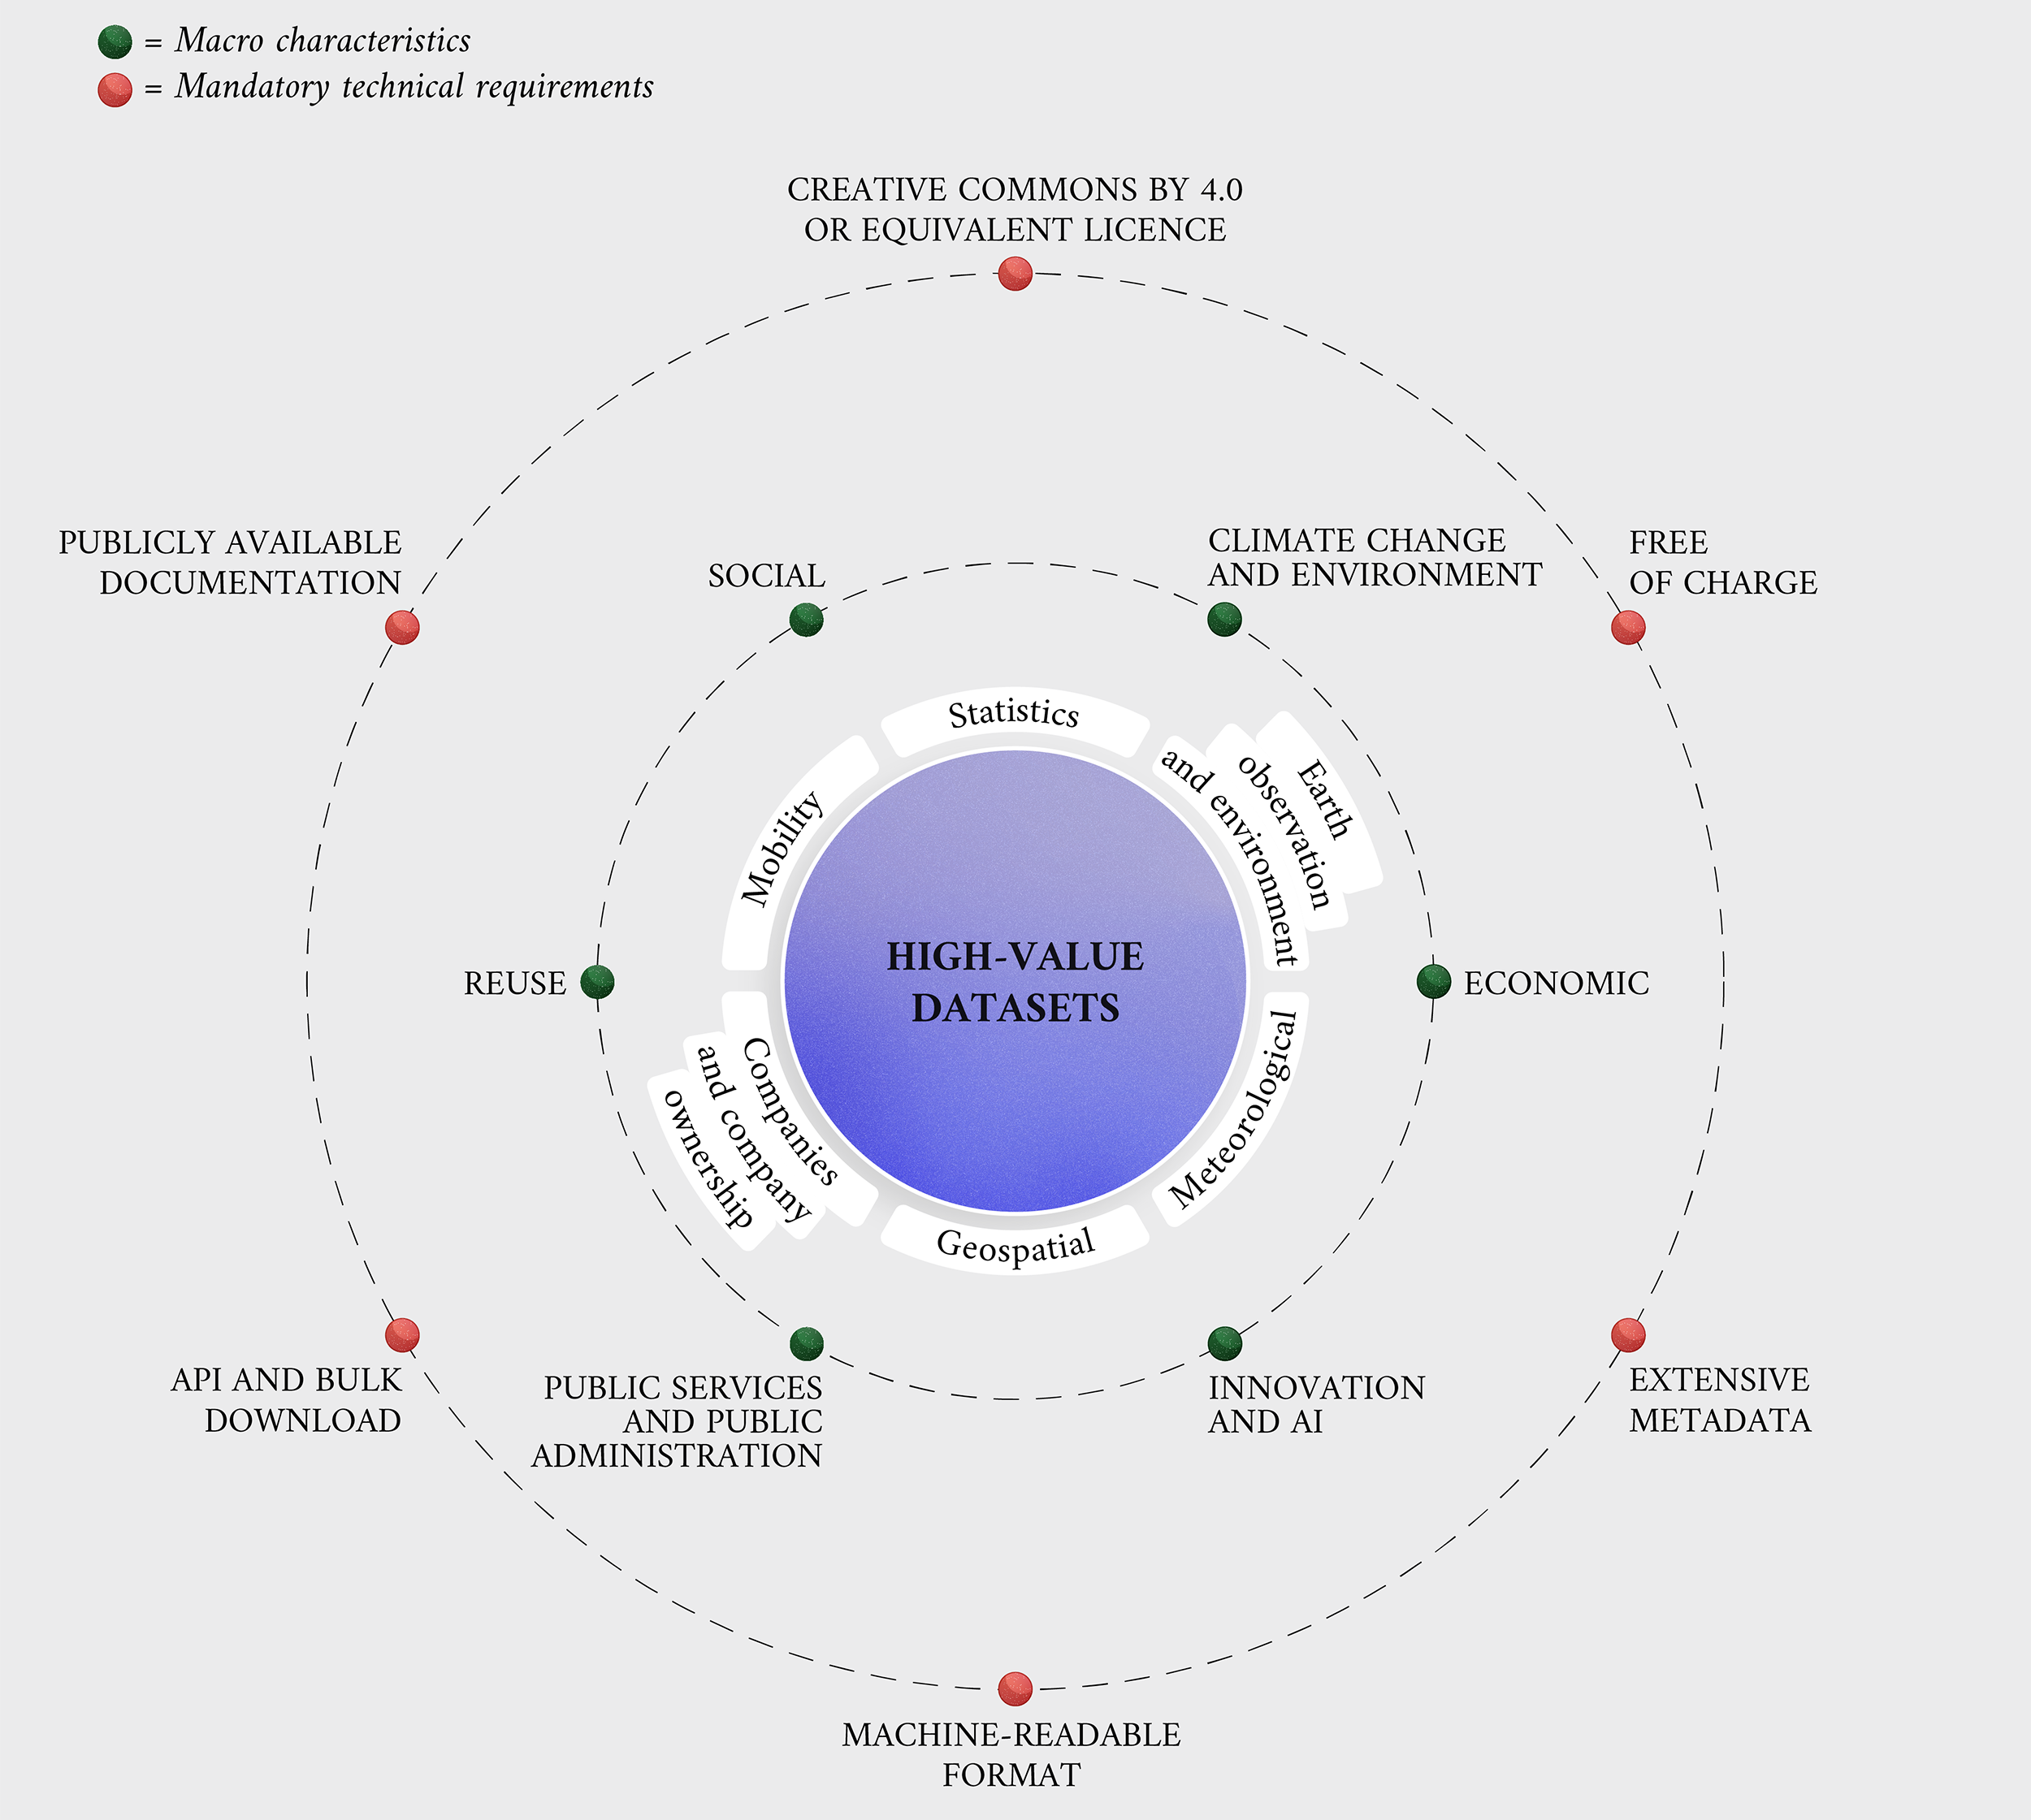
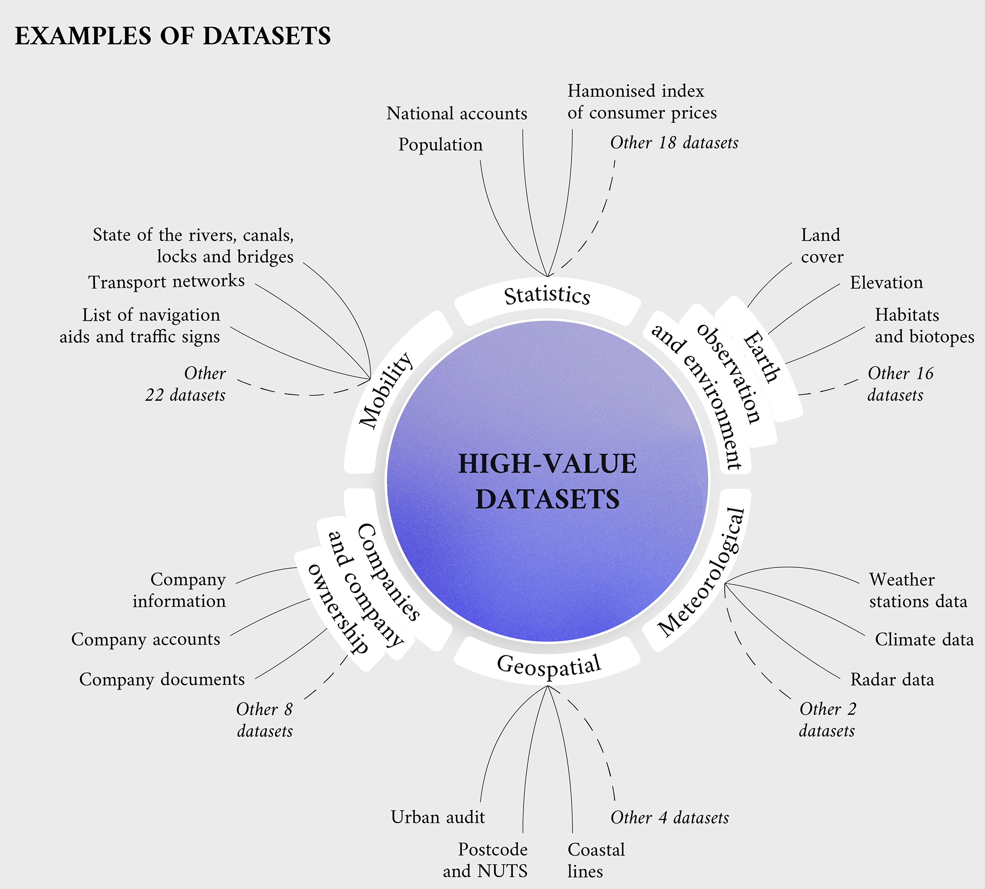
HVDs overview
HVD features
Examples of dataset
Notes:
In addition to them they also found several features that all the HVDs have in common and that they should provide
…
The implementing act also lists a set of examples of datasets, to better understand them at a practical level.

Slide 6
Challenges
The current challenges in the Public Sector are opportunities for BeOpen to
Become the catalyst of Open Data existing in public administrations.
Improve data sharing, interoperability, availability & usability of data sets in different sectors.
Engage a community of stakeholders thanks to sister EU Projects and partners’ networks.
Build on expertise from previous projects, FIWARE open-source components and SMEs / start-ups leaders in data exploitation.
Notes:
Starting from many challenges we have in Public administrations, BeOpen wants to catch them so that they can be opportunities to
provide open-source IT components and use outcomes from previous projects.
Also wants to help public administration data to be improved so that datasets can be shared thought many municipalities without any difficoulties
How can we help public administration so that they can really use the data they capture and the content they produce
How can we improve the sharing and reuse across Europe and several domains
How can we take advantage of already existing technology and tools and make sure we connect with all initiatives going on in Europe, like those presented today.

Slide 7
BeOpen solutions to overcome challenges
Privacy & Trust
Technical framework for data interoperability covering the complete pipeline from data collection, quality improvement, semantic enrichment, to data provisioning and publication.
Catalogue of High Value Datasets (HVD), public Open Data available and accessible for the creation of new services and AI applications.
Guidelines and recommendations - Legal interoperability of data.
Openness
Standard
AI Innovation
Cross Border
Inter-operability
Quality
Notes:
What are in practical the outputs provided by BeOpen?
A tech framework, a web environment, to increase data quality and interoperability
A set of HVDs that are public and accessibile by everyone
Also guidelines, best practices, recommendations extrapolated from the Implementing act

Slide 8
BeOpen Methodology
Needs and Challenges in the Pilots
Identification of the possible HVDs
Develop of a Framework to support the improvements of HVDs
Improve the HVDs
feedback
Evaluation of the Impact in the usage of new services
Development of Digital Services in each Pilot
Definition of Digital Services to exploit the improved HVDs

Slide 9
Testing the results in 8 Use Cases in 6 different EU regions
Napoli (IT)
Attica (GR)
Herne (DE)
Integrating Mobility Data and Urban Environment Information for Decision Making
Creating a “shield" from natural disasters for the region’s citizens and environment
Improving AI-tools for street management and crowd safety at major events
Urban security in historical cities with key critical infrastructure
Molina de Segura (SP)
Climate change mitigation actions: Urban Heat Islands & Heatwaves
Sustainable introduction of LED lighting and its impact on health
Porto (PT)
Vilnius (LT)
Assessing the impact of incidents with urban mobility data
Invading species detection and projected expansion
Cartagena & Torre Pacheco (SP)
Meetings with cities, selection of KPIs, data collection (stakeholder survey, interviews, focus group, data analytics, opinion mining)
Notes:
The HVDs produced are then tested by these 8 use cases, 8 pilot services, that focus on several domains in 6 different European regions
In particular are on

Slide 10
How the HVDs can support the data sharing in cities?
Valuable data
Standardized data
Interoperable data
Easily accessed by different stakeholders
Notes:
By collecting Valuable data, in a standardize and interoperable way, the result is that data is easily to access by several types of stakeholders

Slide 11
How the HVDs can support data sharing in urban environments?
Facilitating Informed Decision-Making
Enhancing Public Services
Supporting Cross-Sector Collaboration
Improving Transparency and Citizen Engagement
Ensuring Data Interoperability and Standardization
Boosting Economic Development
Notes:
We can say that in urban environment these datasets can support data sharing by…

Slide 12
BeOpen will deliver
Technical Framework
Catalogue of High Value Datasets
Community of Stakeholders
Smart Solutions for cities and communities
Set of tools for data improvement and sharing along the public Open Data management pipeline
Public Datasets available in machine readable format discoverable by the EU and national Open Data Portals
Expanded ecosystem of providers of High Value Datasets and developers of Smart Solutions and AI Applications
Replicable services developed using the BeOpen framework and the HVDs made available by the Public Administrations

Slide 13
BeOpen - Benefits
Increased availability, quality, usability of HVDs
Easy development of new services & AI applications
HVD catalogue, guidelines & recommendation for sharing data
Cross-border interoperability, less market fragmentation for digital services
Standard & trusted technologies, leveraging EU* projects results
*Connecting Europe Facility

Slide 15
Built on the blueprint for a common European data space for smart cities and communities

Slide 16
See you soon!
Visit our website for updated information
and follow our social media channels!

