Slide 1
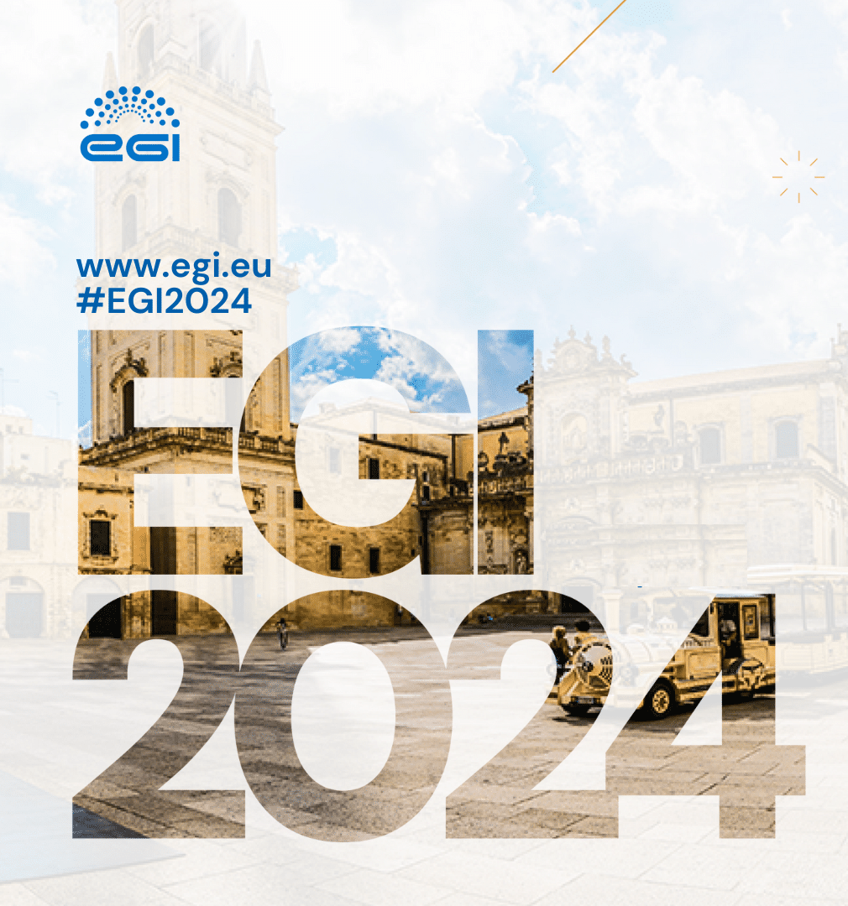
Center for Climate Change and Transformation
climdex-kit
an open-source tool for processing and visualizing climate indices in support to climate change studies and communication
Piero Campalani / Alice Crespi
03.10.2024

Slide 2
Who
PIERO CAMPALANI Software Engineer
ALICE CRESPI Senior Researcher
0000-0002-1032-9825
0000-0003-4186-8474

Slide 3
A bit of background

Slide 4
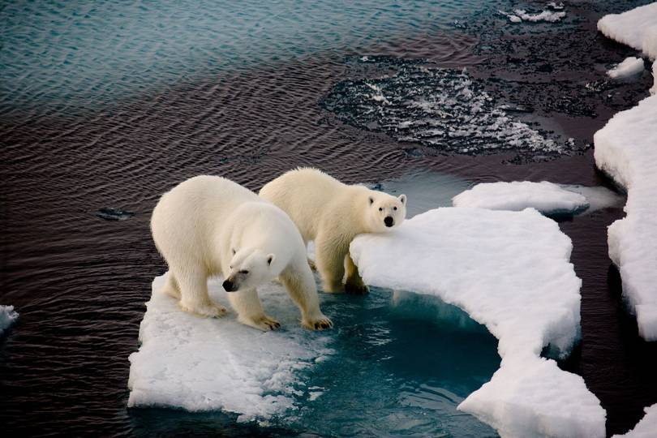
climate change we all know already
credits: human kind

Slide 5
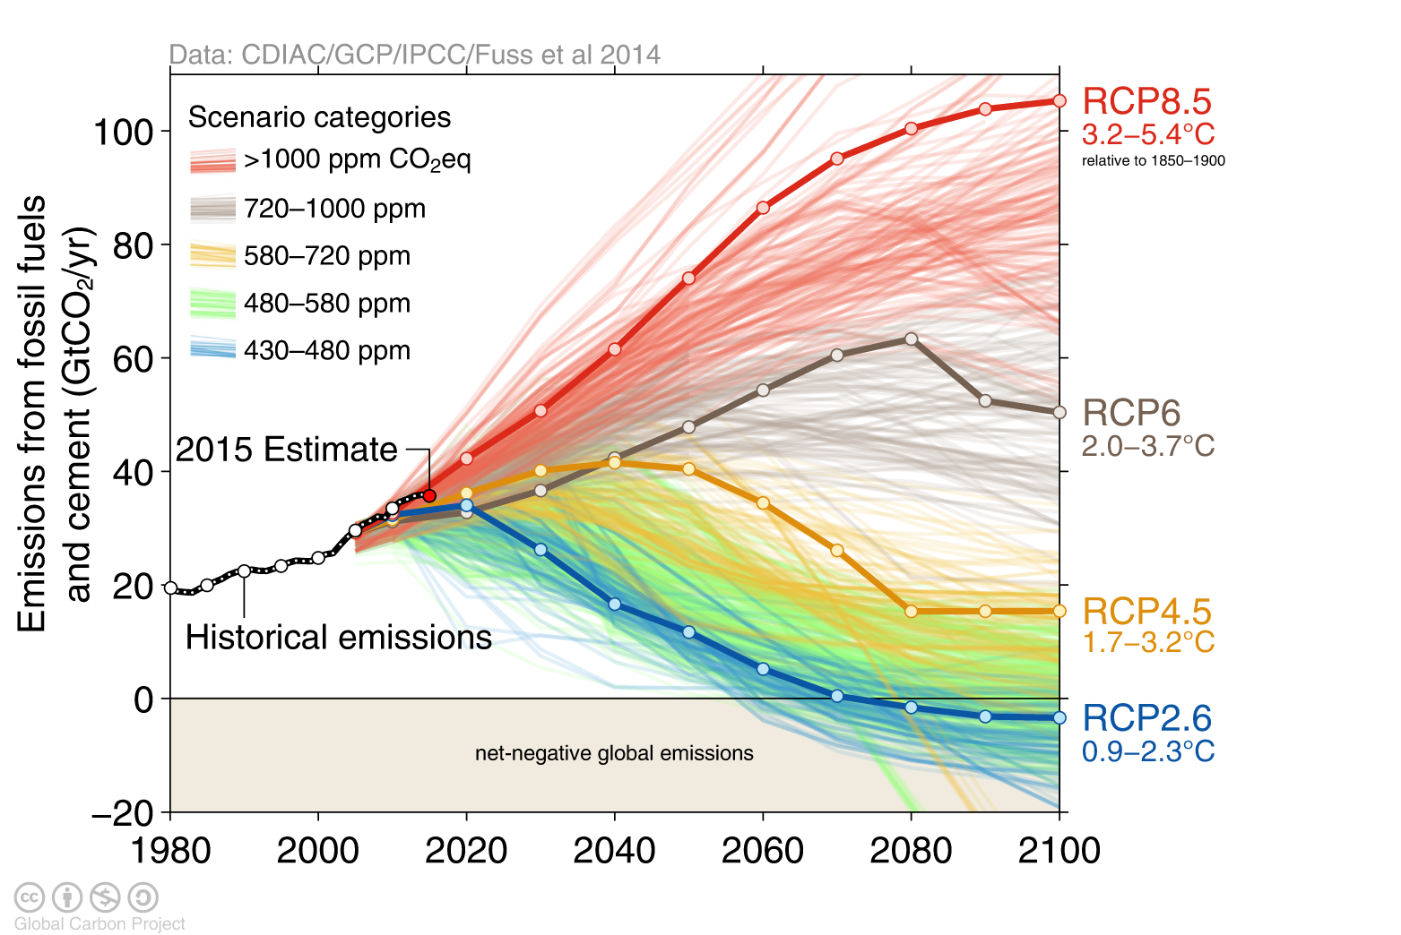
future climate projections
R epresentative
C oncentration
P athways
EMISSION SCENARIOS (greenhouse gases, GhG)
Up to year 2100
Notes:
The future is uncertain, and we don’t know exactly what it will look like. The main causes are: not knowing how greenhouse gas emissions may evolve in the future, how models simulate natural climate variability (known as internal variability) and inter-model differences.
Emissions scenarios allow us to view different ‘what if?’ questions to help us plan for the future.
greenhouse gas emission scenarios used in climate modelling community for future climate experiments up to 2100

Slide 6
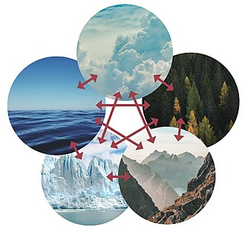
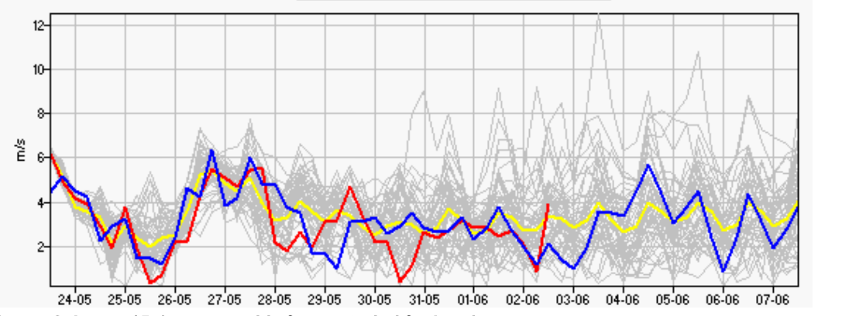
climate ensembles sets of models
A climate ensemble is the group of different climate models used to simulate the future climate based on the same emission scenario.
The aggregated ensemble simulations are expected to be more robust than individual model runs.
credits: Femkemilene + Visme / CC BY-SA 4.0
credits: mailasail
The climate system
Notes:
Earth's climate system is a complex system having five interacting components: the atmosphere (air), the hydrosphere (water), the cryosphere (ice and permafrost), the lithosphere (earth's upper rocky layer) and the biosphere (living things).

Slide 7
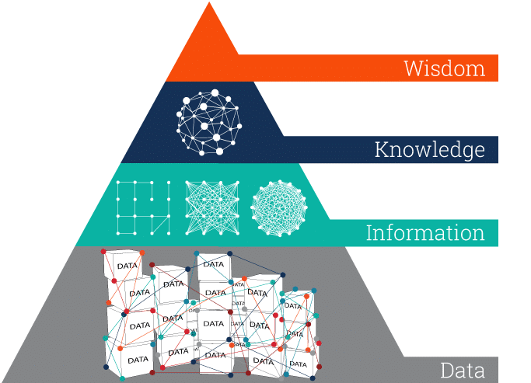
climate indices level up in the information pyramid
A climate index is a diagnostic quantity that is used to characterize and quantify an aspect of a geophysical system.
For instance:
How many tropical nights will we have per year?
How will the frequency of dry spells per year evolve from now?
How intense will the annual maximum 1-day precipitation be by 2050?
climate indices
climate projections
credits: ontotext

Slide 8
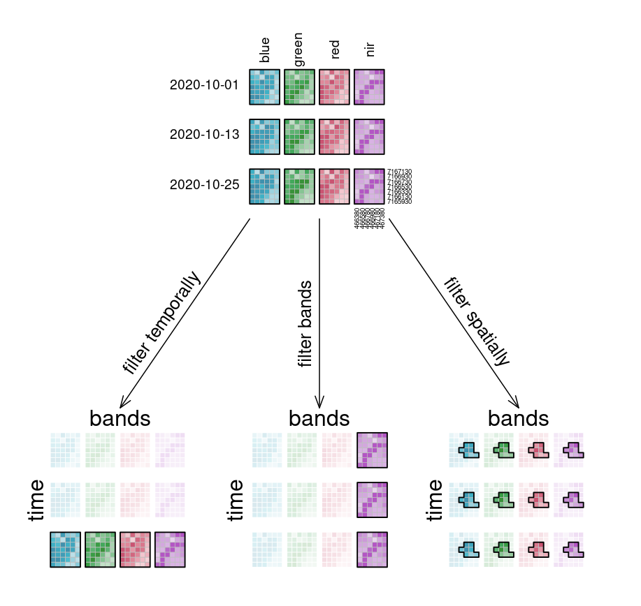
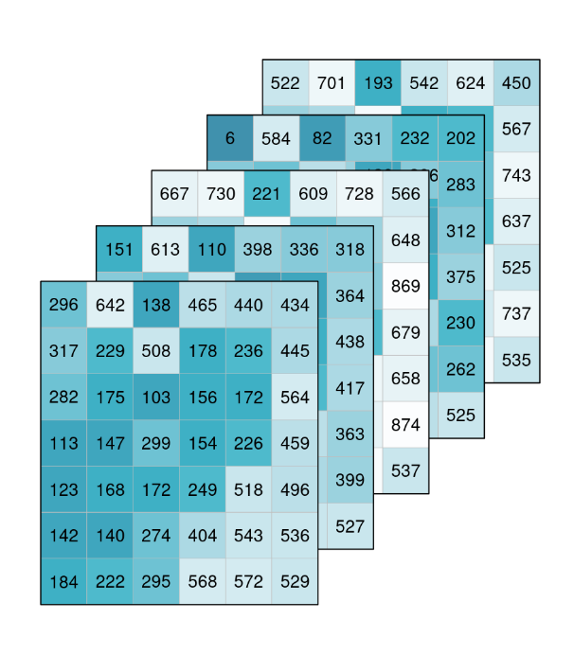
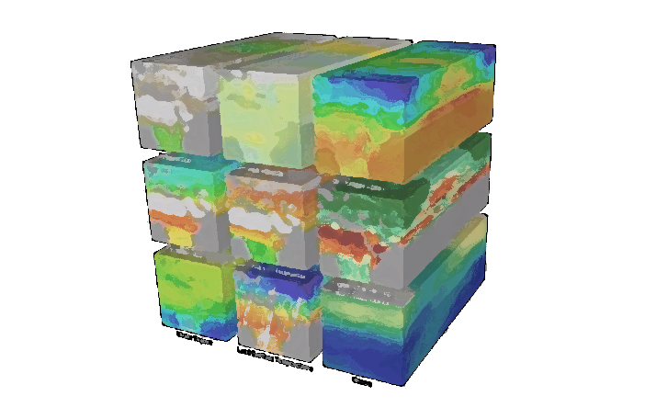
datacubes analysis-ready earth observation
Datacubes are multidimensional arrays (MDAs) with one or more spatial, temporal, or arbitrary dimensions.
credits: openEO
Notes:
Sempre più important I dati climaticii per agevolazione analisi dati

Slide 9
The climdex-kit project

Slide 10
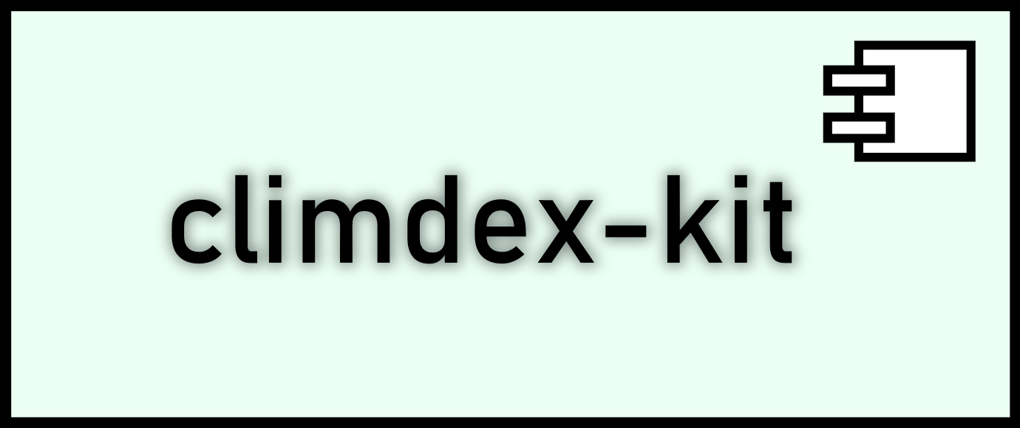
climdex-kit >>> compute > publish > analyse
compute
publish
analyse

Slide 11
climdex-kit >>> compute > publish > analyse
❶
compute
publish
analyse

Slide 12
highly parallelized
customisable
conf. A
conf. B
compute
hides complexity
extendible
CDO
climate data operators
climate-indices
climate index algorithms

Slide 13
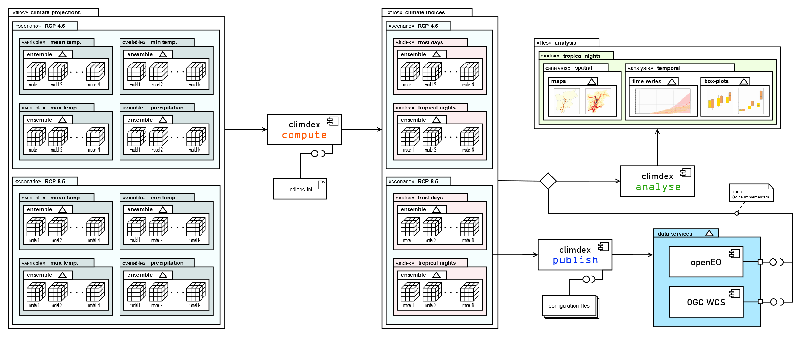
NetCDFs (CF)
compute
> cdo expr,"pr=(( pr > 1 )) ? pr : missval(pr)" [ -selyear,1981/2010 $pr ] $tmp1
> cdo timpctl,99 $tmp1 -timmin $tmp1 -timmax base.nc $tmp2
> cdo yearsum -gt [ $pr $tmp2 ] $ofile

Slide 14
climdex-kit >>> compute > publish > analyse
compute
❷
publish
analyse

Slide 15
F.A.I.R.
open standards
datacubes
clients
publish
API

Slide 16
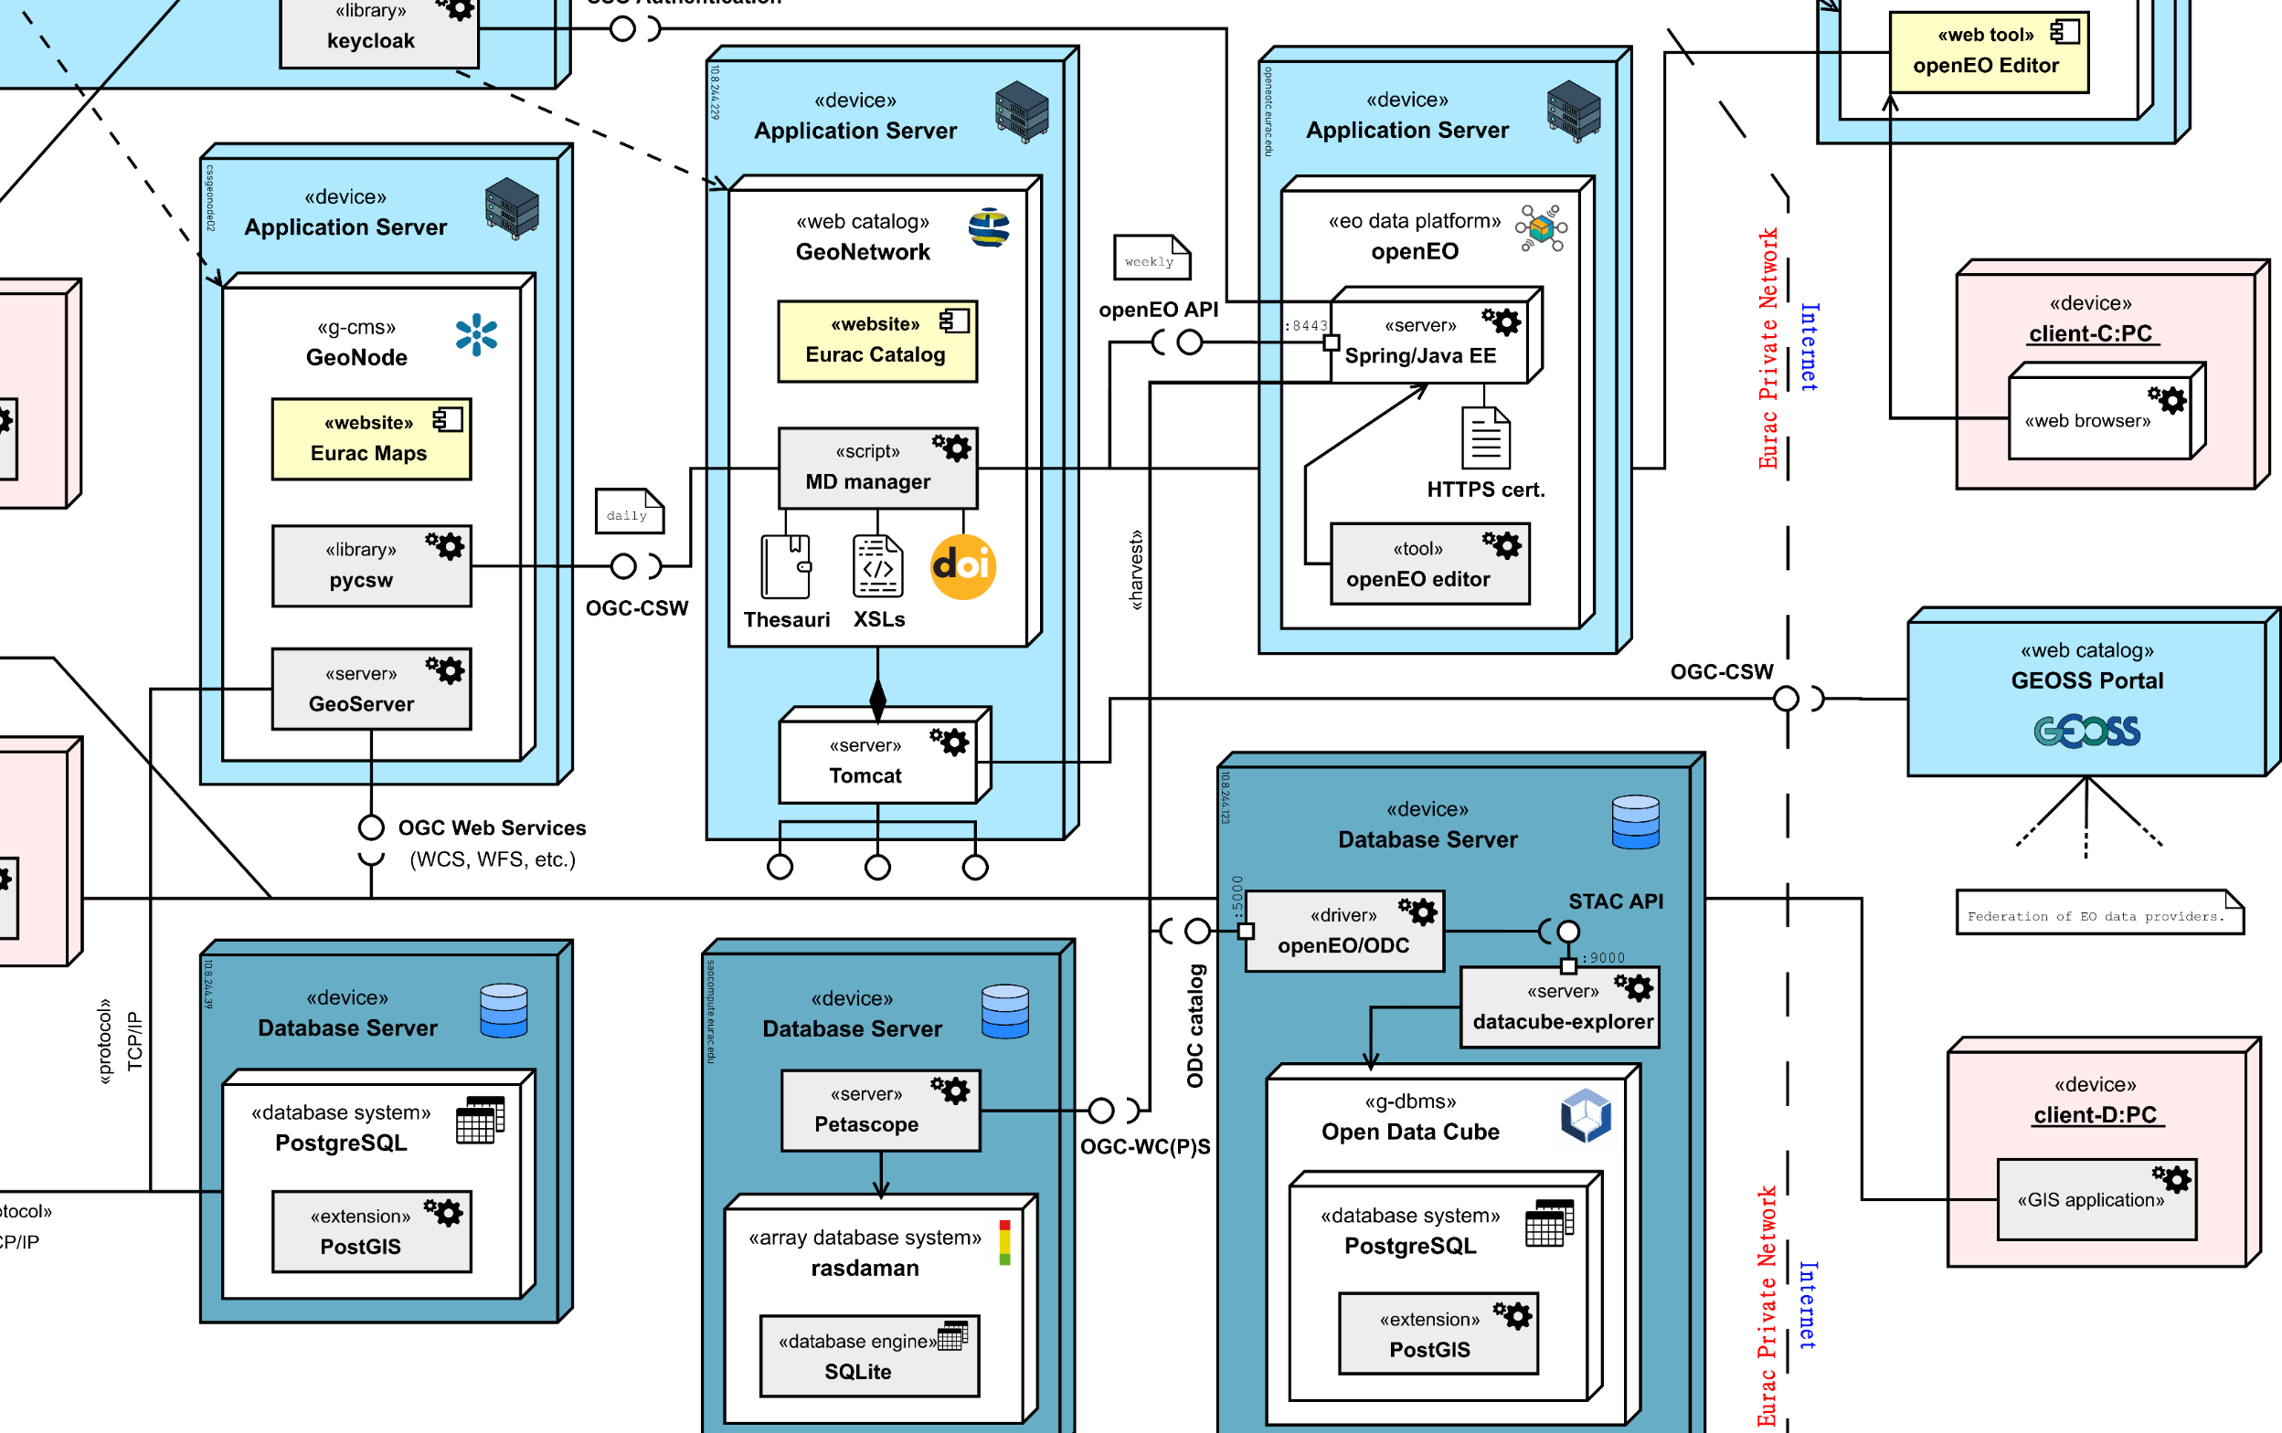
publish

Slide 17
climdex-kit >>> compute > publish > analyse
compute
❸
publish
analyse

Slide 18
analyse

Slide 19
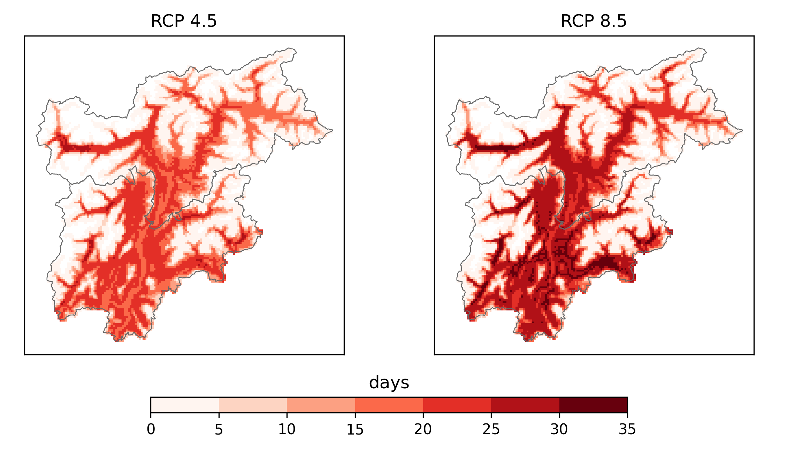
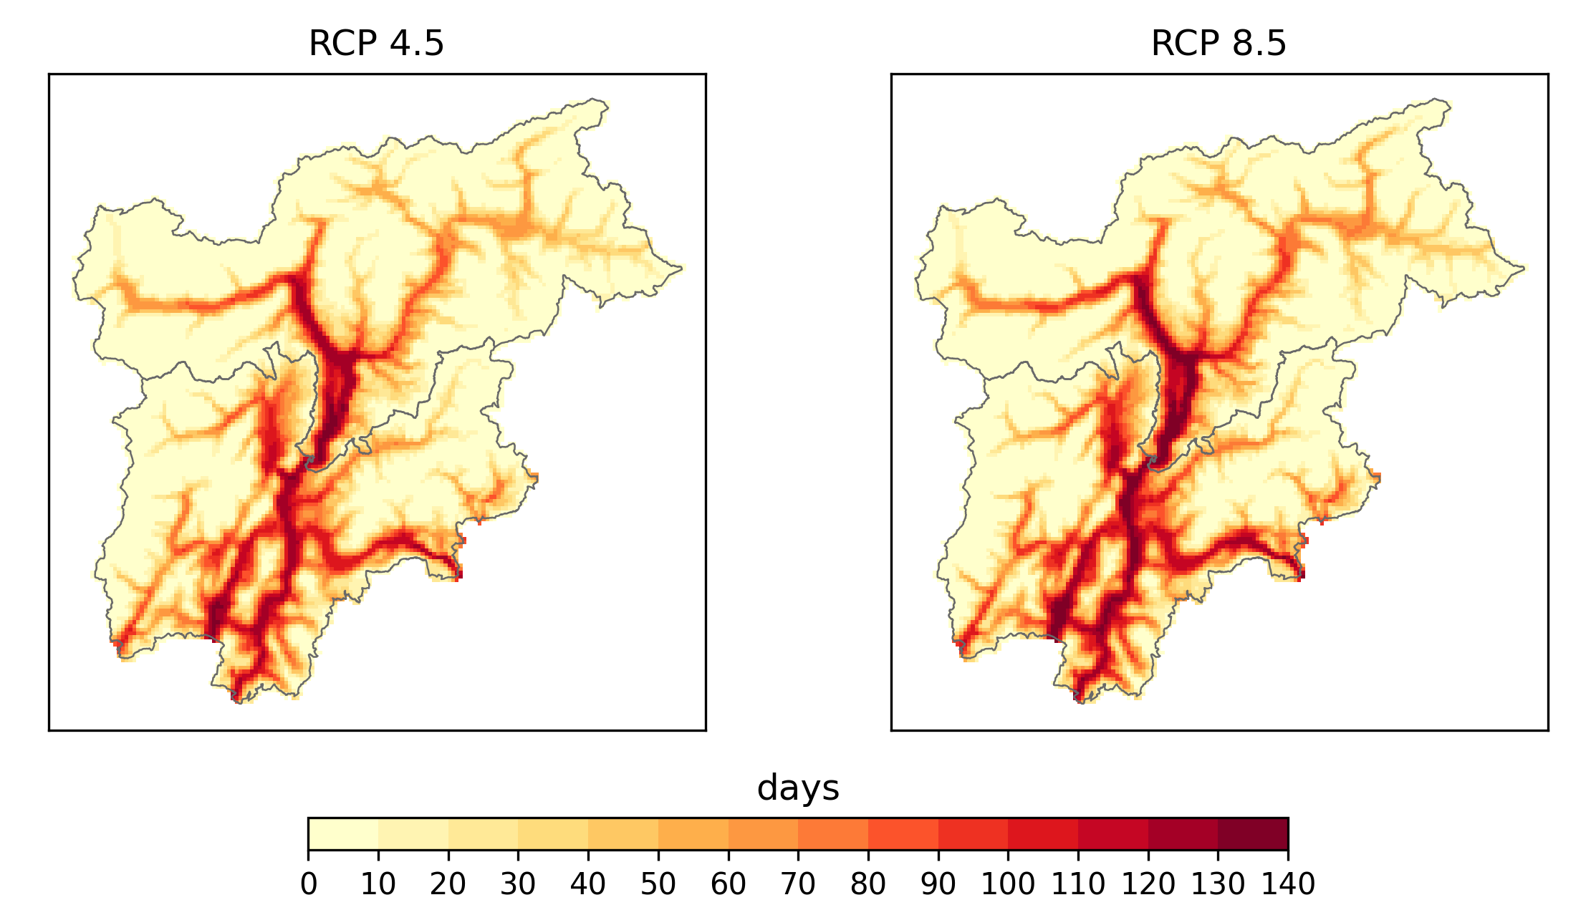
A. spatial maps
summer days in Trentino South Tyrol
multi-year aggregations
baseline comparisons
scenarios comparisons
ensemble aggregation
absolute values or changes
elevation filtering
…
Δ days
analyse
# days

Slide 20
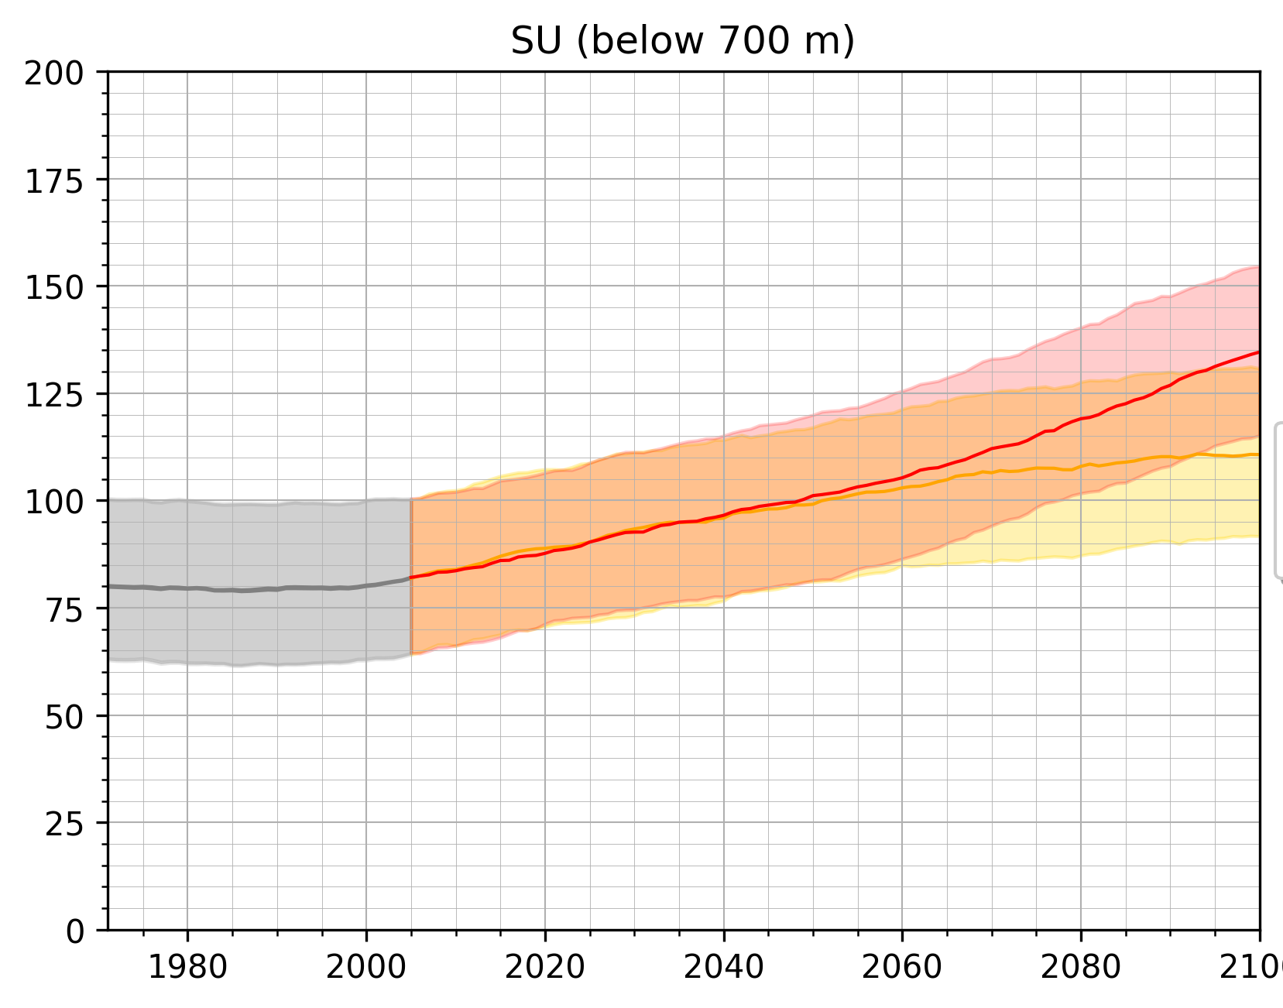
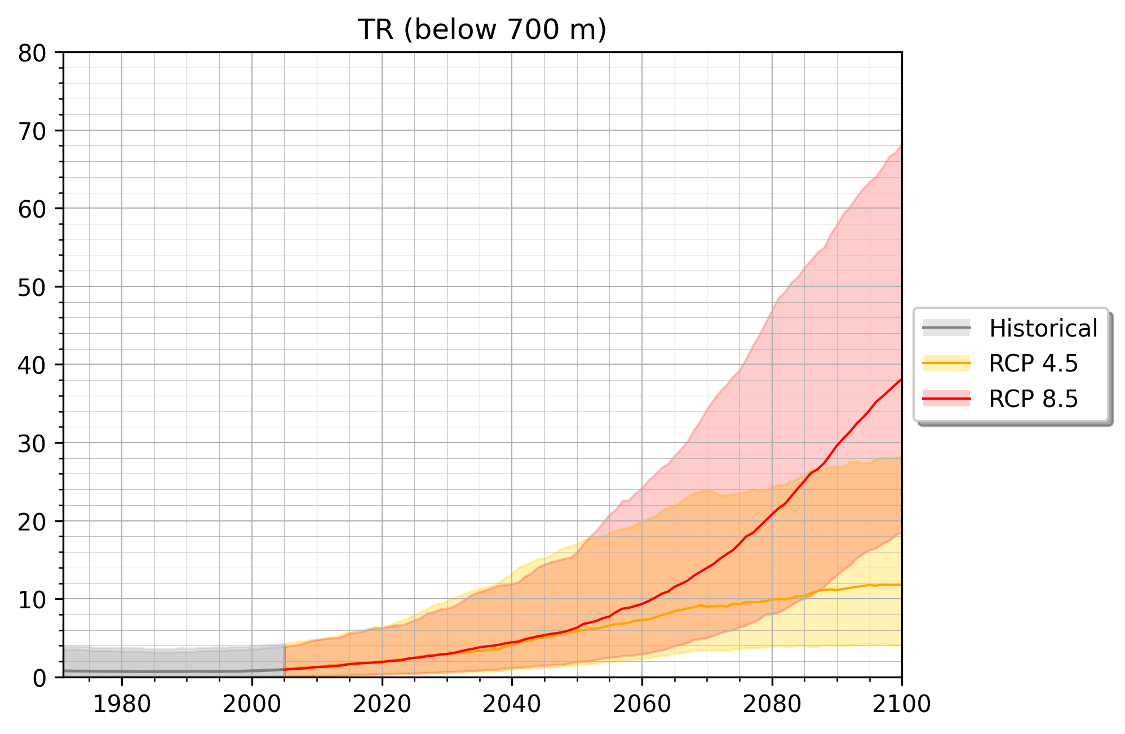
B. temporal evolution
single-pixel scan
spatial aggregations
transient signal
scenarios comparisons
ensemble spread
absolute values or changes
elevation filtering
…
analyse

Slide 21
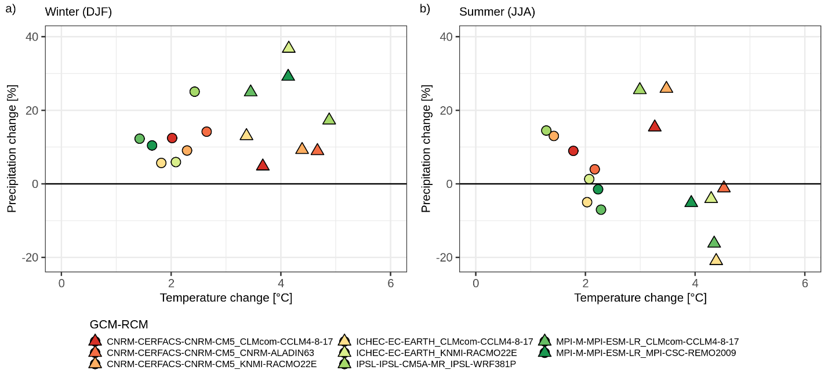
C. ensemble analysis
ensemble spread
model selection
statistical tests
spatial distributions
…
analyse
How many models agree on the sign of projected changes within the ensemble?
Are the future changes with respect to the baseline statistically significant?

Slide 22
Conclusions / Outlook

Slide 23
climdex-kit :
>>> FOSS Python toolkit for i) computing ii) publishing and \
. . . iii) analysing climate indices based on climate model projections
>>> promotes FAIR principles by making it easy to comply with open \
. . . standards (CF metadata conventions, public catalogues, \
. . . openEO datacubes, process replicability)
>>> initial set of ~40 customisable climate indices, plus natively extendible \
. . . to orchestrate additional backend libraries

Slide 24
what’s next
Add more functionalities to the capabilitiy of analysis, especially with regards to uncertainty.
Extend the domain of usage to other type of climate inputs: climate re-analysis datasets, climate forecasts, and observations.
Build an interactive online platform open to both the climate researchers and the public to help understand and do research on climate change in South Tyrol.

Slide 25
Links
climdex-kit on PyPI https://pypi.org/project/climdex-kit/
Software Hash Identifier (SWHID) swh:1:dir:fbd1523b31466681bd5de0712625d62757914ef9
Fact CLIMAX project Climate-related hazard indices for South Tyrol https://www.eurac.edu/en/institutes-centers/institute-for-earth-observation/projects/fact-climax
Environmental Data Platform (EDP) @ Eurac https://edp-portal.eurac.edu/home

Slide 26
Contact us
Piero Campalani
piero.campalani@eurac.edu
Alice Crespi
alice.crespi@eurac.edu

Slide 27
Thank you !
https://ror.org/01xt1w755

