Slide 1
Landscape analysis of research infrastructure practices and needs for green computing - GreenDIGIT survey findings
Gergely Sipos (EGI Foundation) GreenDIGIT Technical Coordinator

Slide 2
We need to understand the landscape
What did the RIs do so far? → Good practices
Where are they going? → Trends
Where could we help? → Opportunities
Other RIs with significant DIGITAL infrastructure
EGI
SoBigData
EBRAINS
SLICES
ELI Beamlines
GÉANT
…

Slide 3
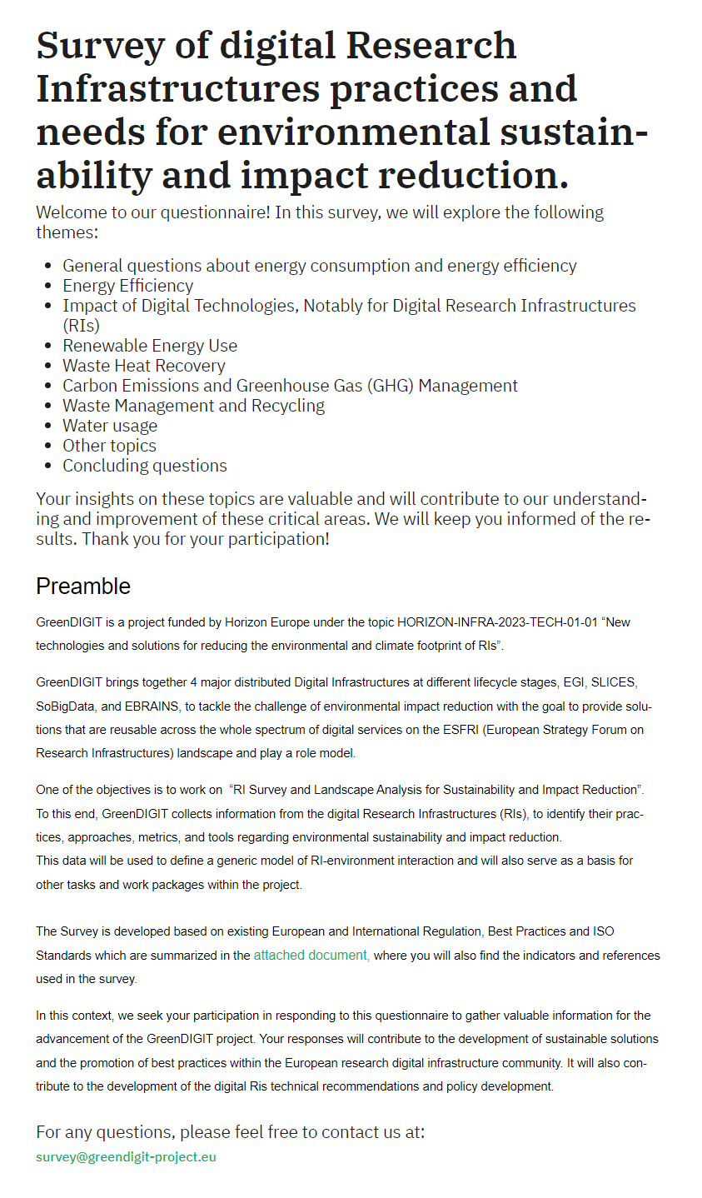
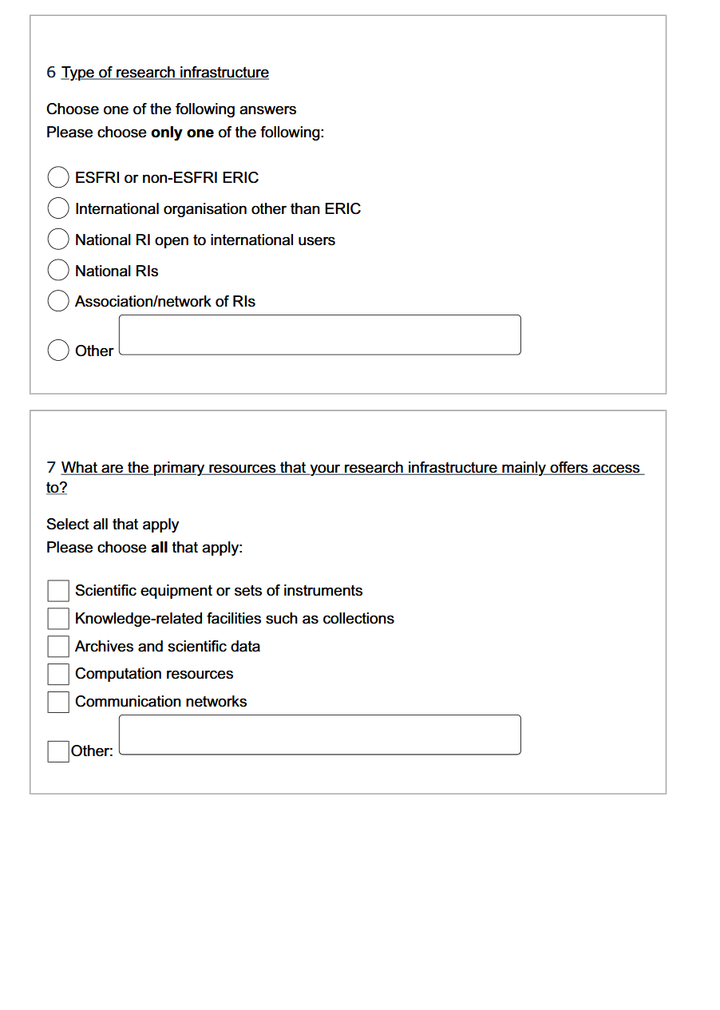
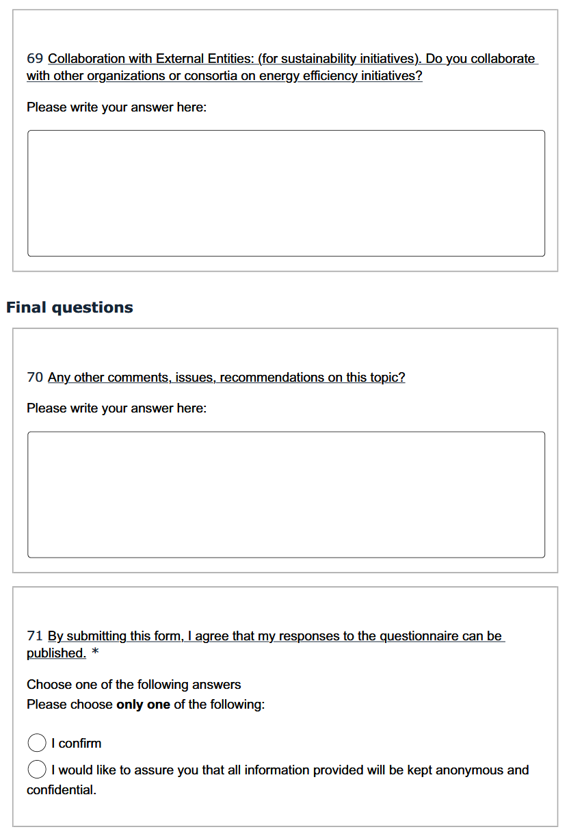
https://greendigit-survey.limesurvey.net/581735
. . .

Slide 4
PREPARATORY PHASE
PRE-PRODUCTION PHASE
PRODUCTION PHASE
ICT facilities at 14 sites (5G, Networks, Clouds)
6 Computational
25 Research facilities
3 HPC centers
~200 HTC sites
~30 cloud sites

Slide 5
EGI Methodology
Sent 20 invitations
4 GreenDIGIT members, Clouds with community SLAs, Largest sites, Geographical coverage
Received 15 responses (as of today. Expect a few more in Oct)
From 13 countries – HU, HR, FR, CH, RO, CZ, GR, LT, SK, UK, ES, TR, NL
6 distributed, 9 single sited
47 data centres represented
Between 30 and 10,000 servers managed at each site (20,000 servers in total)
→ Gaps to fill: IT, DE, Nordics

Slide 6
Who do these 15 EGI centres serve?
Serving somewhere between 80,000 to 110,000 users per year in total
WLCG users are served at multiple locations so hard to know exactly
Both national and international users are served at most of the sites
RIs served:
Data, Computing and Digital
SLICES (at SZTAKI)
Energy
EUROfusion
Environment
LifeWatch (via EOSC-Beyond)
Health & Food
ELIXIR, French Bioinformatics, Instruct + METROFOOD (via EOSC-Beyond)
Physical Sciences & Engineering
CTA, HESS, SKAO, LOFAR, WLCG, BELLE II, ESA, AGATA, FOCAL
Social Sciences & Humanities
CLARIAH, CESSDA (via EOSC-Beyond), ODISSEI (NL)

Slide 7
Most important findings from EGI survey
“We are primarily hosted in an outdated office building with evolutionary infrastructure”
Energy consumption is primary reason of environment impact
Tracking total energy consumption - 7 fully, 8 partially
Initiatives to lower energy consumption
Not trivial because of investment cost (modern HW, modern building)
Scientific workflow optimisation at few places, but not focused on energy consumption
11 use metrics to track energy efficiency
PUE most common (bw 1.1 - 1.7). Others: Watts/VM, Watts/GPU, Watts/vCPU, FLOPS/Watt
1 has formal green computing policy in place (IRES)
https://scigne.fr/resources/policies/green-computing-policy.pdf
Practices for waste heat reduction (heating offices/homes)
4 centres encourage/educate staff on energy saving practices
Switching lights or equipment off, reduce travel, cycling to work
Both staff operating the IT equip and the end users are targets
The total carbon footprint increased at 6 sites, decreased at 4 sites (in last 5 years)
Only 4 sites are properly measuring it. E.g. https://apps.labos1point5.org/ges-1point5
No programs in place to promote waste reduction

Slide 8
Possible framework/policy/recommendation for providers (and users?)
Objectives | How to achieve | How to measure | Tension (Submodels about these)
Use less | Modern building; Modern hardware (e.g. flash instead of disks); Optimised software (AI/workflow); Led lights, Less travel; Data centre in cold region | W / YEAR (energy) m³ (water) | Buy new vs. Use existing Convert/normalise everything to CO₂
Use for the right purpose | Higher A/C temp; Hot/cold aisles; Turn off lights | PUE
Use from renewable source | Change supplier; Deploy solar panel; Delay workload when energy is greener | Green % | Nuclear energy is CO₂ neutral, but… Delay workload vs. run immediately
Reuse your waste | Waste heat reuse (office heating); Repair; Circular economy recycling (paper, plastic, …) | Waste reuse %
Train people, support new ideas | Office training; Information dashboards | # training hours # new initiatives
Measure and improve | Regularly update metrics (see next column)
+1: Positive environmental handprint

Slide 9
Next steps
Additional surveys/interviews planned with
Federated EGI sites in IT, DE, Nordics
External infras - EuroHPC, SKA, EMBL, ECMWF
Complement with desk studies of institutional Annual Reports
Analyse Green500 (relevant for EBRAINS, EuroHPC)
Write up findings in a public deliverable (planned for public release in Jan 2025)
Feed input for GreenDIGIT deliverables of 2025-26 (Recommendations, Policies, Self-assessment surveys, etc.)

Slide 10
Thank you!
https://greendigit-project.eu

