Slide 1



Technical Requirements METROFOOD-RI
This work has received funding from the Swiss State Secretariat for Education, Research and Innovation (SERI)
Karl Presser
EGI Conference 2024
02•10•2024 – Lecce, Italy

Slide 2
Agenda
What is METROFOOD-RI
What is the Electronic infrastructure
Requirements for the central hub
Requirements for national node
Requirements for institute
Catalogues hierarchy

Slide 3
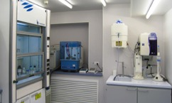
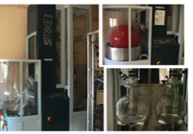

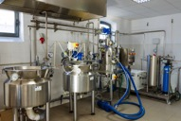
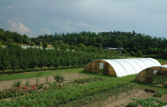



METROFOOD-RI
Metrology: Scientific field of measurement Food: Nutritious objects
Laboratories
Methods and devices
Fields, farms, and aquafarming
Distributed infrastructure

Slide 4

Electronic Research Infrastructure
Data and apps are distributed
There are bigger and smaller data repositories
Data needs be made FAIR

Slide 5
METROFOOD-RI Services
  Physical services
  Analysis of food, water, soils, air etc.
  Development of methods and devices
  Development of reference material
  Harmonisation and standardisation
  Food packaging
  Food production
  Food preparation
  …
  Electronic services
  Offer FAIR data
  Data collection and data management
  Data analysis (including AI, Blockchain, gpt)
  Software development (including AI, blockchain, gpt)
  data repository development
  website development
  Hosting
  Computing
  Virtual research environments
  …

Slide 6
Requirements for Central Hub
Authentication and Authorisation Infrastructure (AAI)
Standardisation and Harmonisation (data exchange format and API)
Administration Apps
Community Apps
Data apps and data repositories
Hardware
Membership app
CRM
website
Catalogues
RM app
Storage
File sharing
Access
Analytical value DB
Container
Facility repository
Helpdesk
Survey tool
Isotope DB
HPC
FoodCASE
E-meetings
E-learning
...
Accountingapp
Issue tracking
Digital library
Conference
VRE
Time tracking
E-mail
Open Calls
...
mandatory

Slide 7
Requirements for National Node
Authentication and Authorisation Infrastructure (AAI)
Standardisation and Harmonisation (data exchange format and API)
Administration Apps
Community Apps
Data apps and data repositories
Hardware
Membership app
CRM
website
Catalogues
Storage
File sharing
Access
Container
Facility repository
Helpdesk
Survey tool
Analytical value DB
HPC
E-meetings
...
Accountingapp
Issue tracking
E-learning
Conference
VRE
Time tracking
E-mail
Open Calls
...
mandatory
Not mandatory

Slide 8
Requirements for Institute
Authentication and Authorisation Infrastructure (AAI)
Standardisation and Harmonisation (data exchange format and API)
Administration Apps
Community Apps
Data apps and data repositories
Hardware
Membership app
CRM
website
Catalogues
Storage
File sharing
Access
Container
Facility repository
Helpdesk
Survey tool
Analytical value DB
HPC
E-meetings
...
Accountingapp
Issue tracking
E-learning
Conference
VRE
Time tracking
E-mail
Open Calls
...
mandatory
Not mandatory

Slide 9
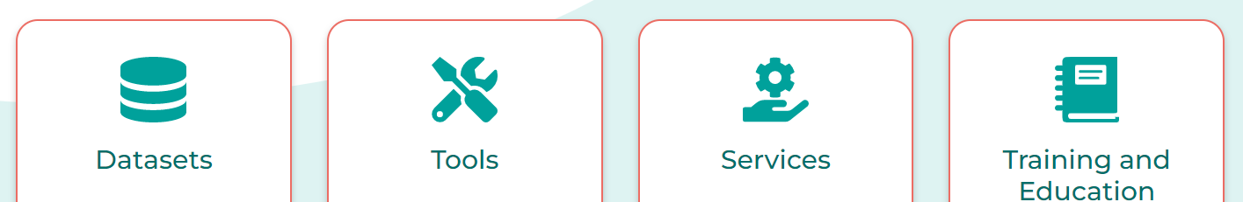
METROFOOD-RI Catalogues
EOSC Level
Central hub Level
National node Level
Institute Level

Slide 10

metrofood.eu
Thank you for your attention
This work has received funding from the Swiss State Secretariat for Education, Research and Innovation (SERI)

