Slide 1
EuroScienceGateway
Leveraging the European compute infrastructures for
data-intensive research guided by FAIR principles

Slide 2
Overview
The EuroScienceGateway project
Broadening the login options for EuroScienceGateway
BYOC: Bring Your Own Compute
BYOS: Bring Your Own Storage
Smart job scheduling across Europe

Slide 3
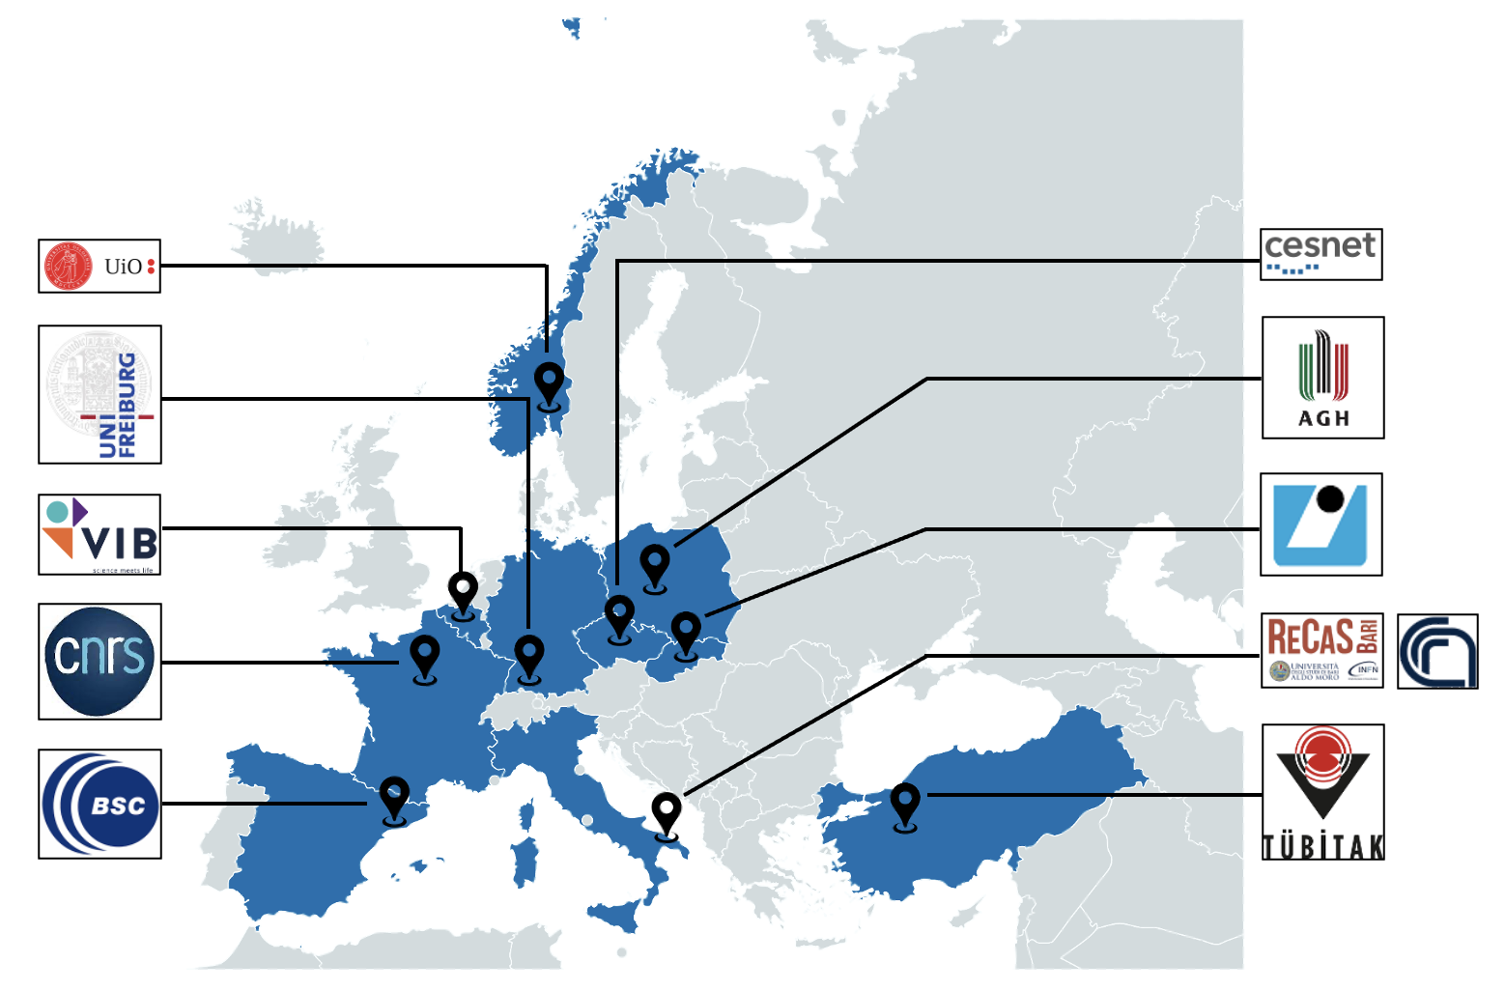
The EuroScienceGateway project
Motivation
National Cloud and HPC infrastructures have been established, with differences in
Hardware
Configuration
Software stack
Authentication and Authorization
Access typically targeted at local researchers
goal: provide efficient and structured access to data, tools and workflows supported by suitable IT infrastructures.

Slide 4
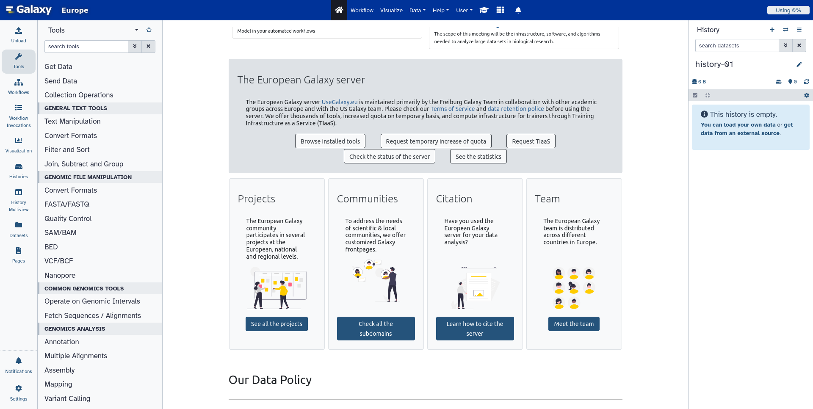
The EuroScienceGateway project
How?
Notes:
Galaxy is a free, open-source system for analyzing data, authoring workflows, training and education, publishing tools, managing infrastructure, and more
10K tools, with multiple different versions: 120K containers

Slide 5
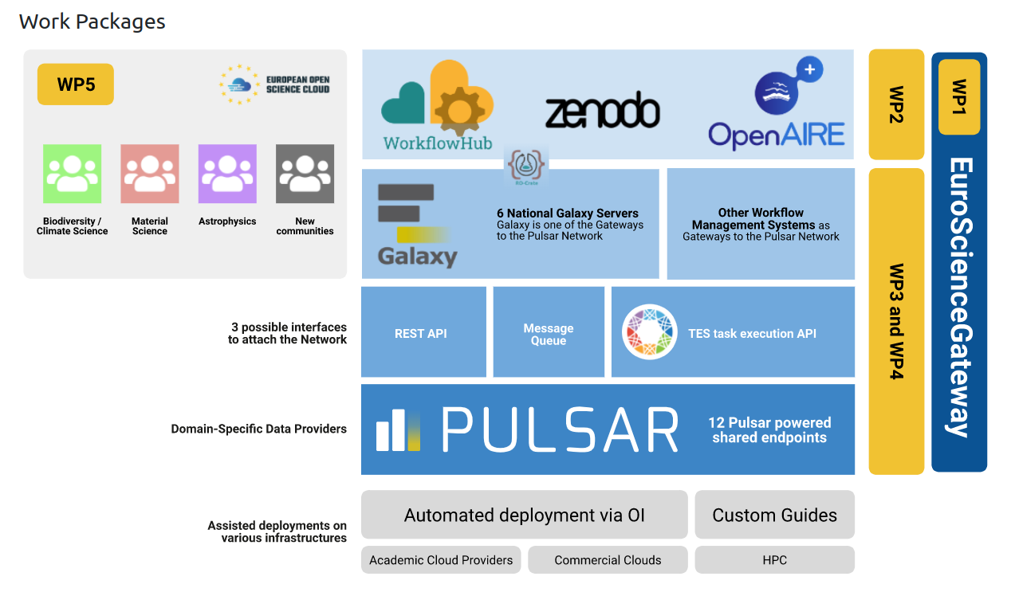
The EuroScienceGateway project
How?

Slide 6
Partners

Slide 7
Overview
The EuroScienceGateway project
Broadening the login options for EuroScienceGateway
BYOC: Bring Your Own Compute
BYOS: Bring Your Own Storage
Smart job scheduling across Europe

Slide 8
Broadening the login options for EuroScienceGateway
Integration with WLCG IAM
Integration with EGI Check-in

Slide 9
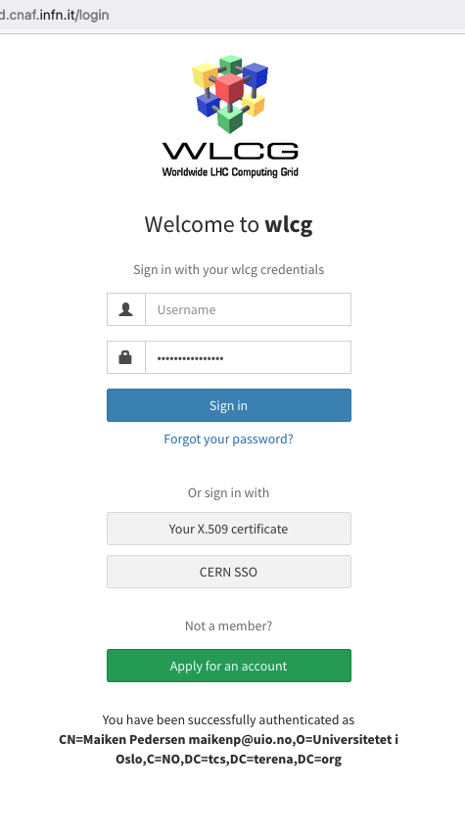
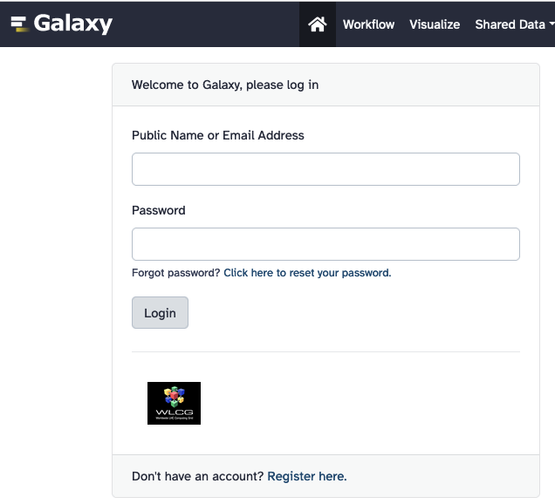
Broadening the login options for EuroScienceGateway
WLCG IAM: AAI solution for the Worldwide LHC Computing Grid
WLCG IAM can be added to Galaxy thanks to python-social-auth
Getting a token from WLCG IAM is one option in order to be allowed to submit jobs to ARC sites - IAM-services to trust are configurable in ARC

Slide 10
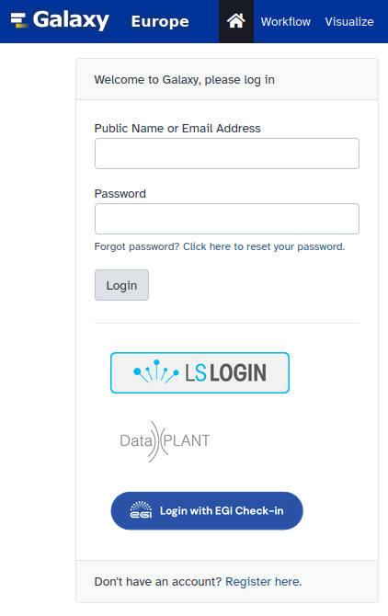
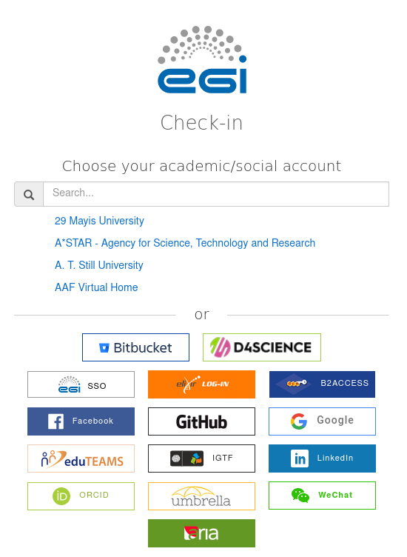
Broadening the login options for EuroScienceGateway
EGI Check-in: AAI solution for the EGI Federated Cloud
Use your existing credentials to log into Galaxy
With a token from EGI Check-in you can deploy compute and storage resources in the EGI Federated Cloud and connect them with Galaxy (more details later)
Can also be used to submit jobs to ARC

Slide 11
Overview
The EuroScienceGateway project
Broadening the login options for EuroScienceGateway
BYOC: Bring Your Own Compute
BYOS: Bring Your Own Storage
Smart job scheduling across Europe

Slide 12
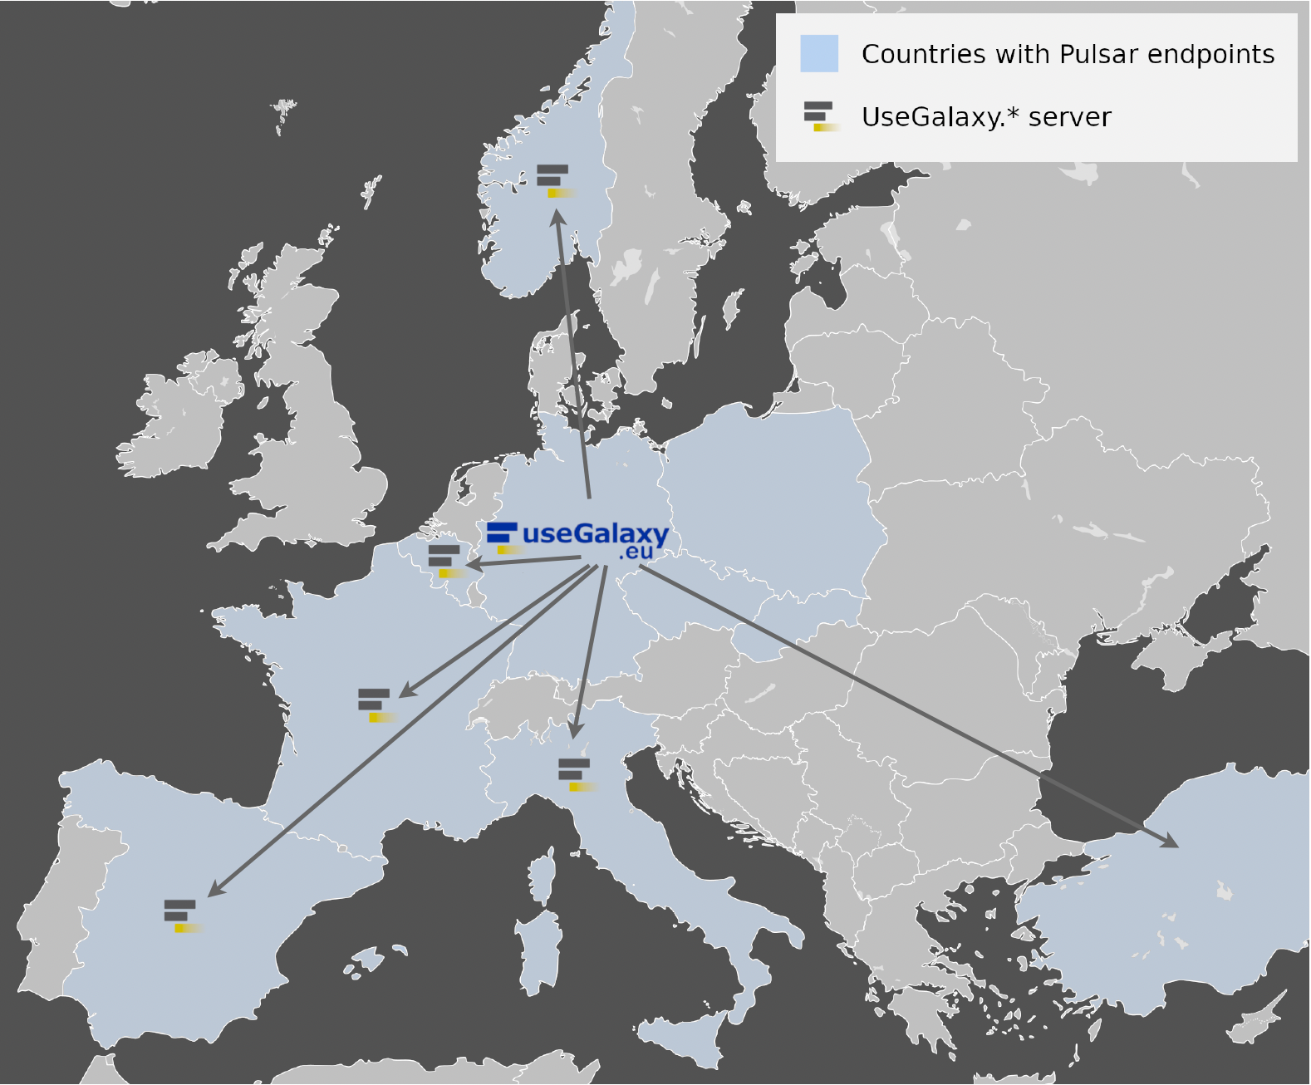
Bring Your Own Compute
Connecting Galaxy with Pulsar
Overview of Galaxy and Pulsar deployments in EU

Slide 13
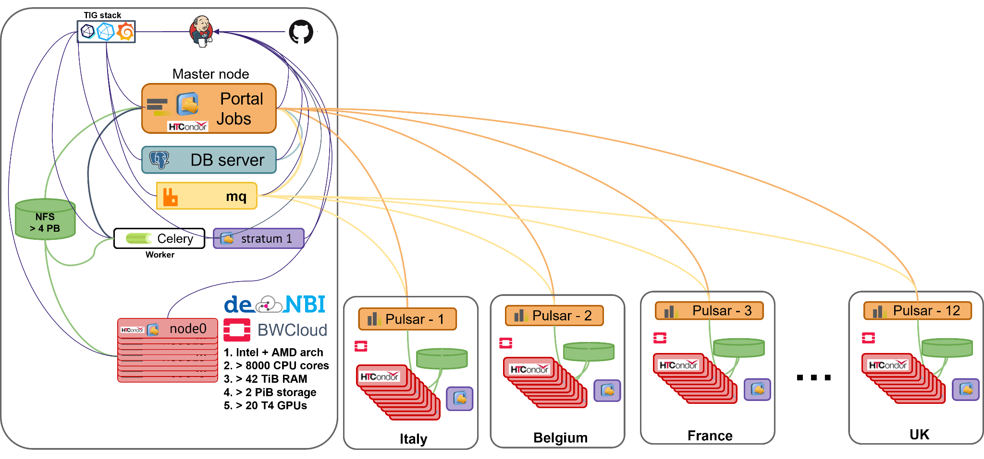
Bring Your Own Compute
Connecting Galaxy with Pulsar

Slide 14
Bring Your Own Compute
Connect Galaxy with computing resources in the cloud
Connecting Galaxy with a managed ARC site
ARC deployment in the cloud with Infrastructure Manager
Pulsar deployment in the cloud with Infrastructure Manager
work by INFN to automate the connection of pulsar with Galaxy

Slide 15
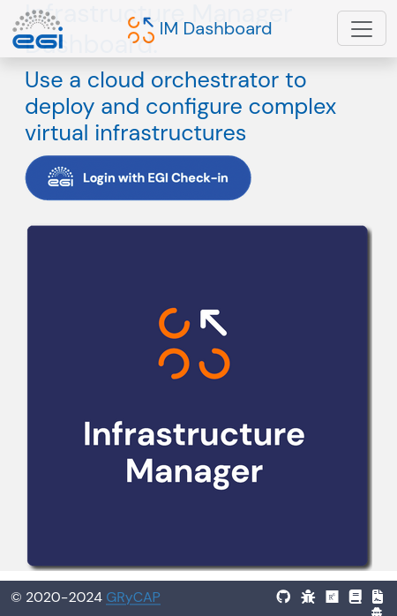
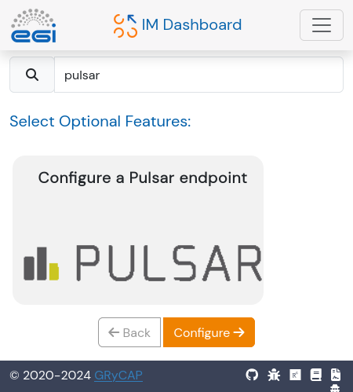
Bring Your Own Compute
Pulsar deployment in the cloud with Infrastructure Manager
Do have access to a cloud? Use Infrastructure Manager (https://im.egi.eu/) to deploy Pulsar and connect it to Galaxy

Slide 16
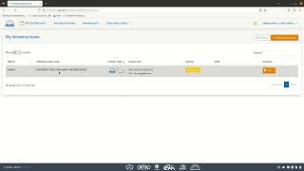
Bring Your Own Compute
Pulsar deployment in the cloud with Infrastructure Manager
See tutorial in https://galaxyproject.org/news/2023-10-31-esg-byoc-im/ and come to the booth to try it live!

Slide 17
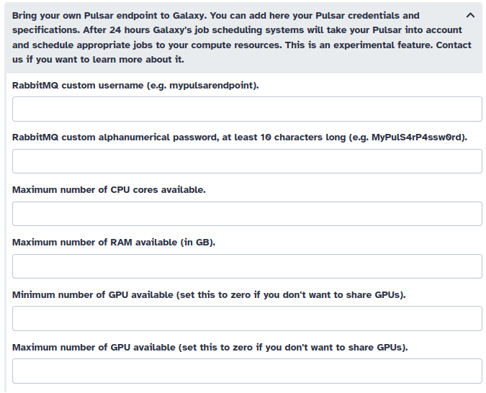
Bring Your Own Compute
Connecting Galaxy with Pulsar

Slide 18
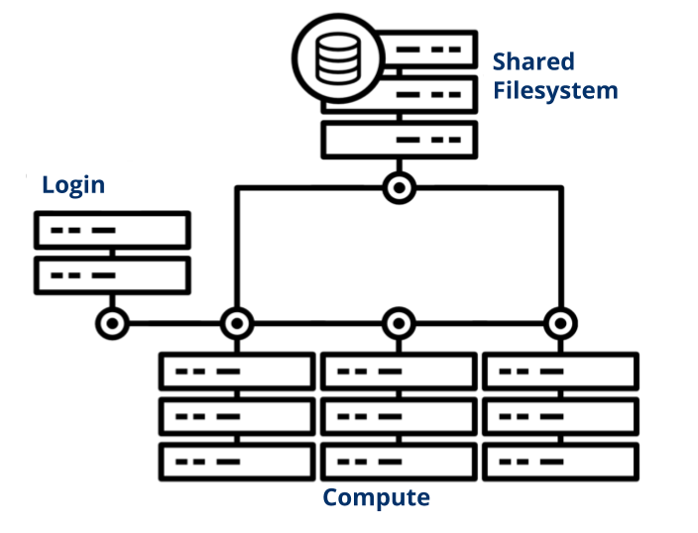
Bring Your Own Compute
Connecting Galaxy with a managed ARC site - testing only, not yet in production
Do you have access to a managed cluster with ARC? Log into Galaxy with WLCG IAM or EGI Check-in and configure the ARC endpoint in Galaxy
Galaxy can execute jobs in ARC sites thanks to the prototype job runner developed within the project

Slide 19
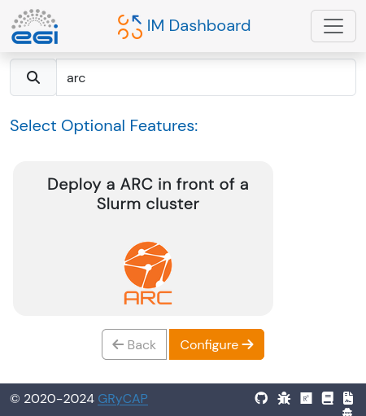
Bring Your Own Compute
ARC deployment in the cloud with Infrastructure Manager
Do have access to a cloud? Use Infrastructure Manager (https://im.egi.eu/) to deploy ARC and connect it to Galaxy

Slide 20
Overview
The EuroScienceGateway project
Broadening the login options for EuroScienceGateway
BYOC: Bring Your Own Compute
BYOS: Bring Your Own Storage
Smart job scheduling across Europe

Slide 21
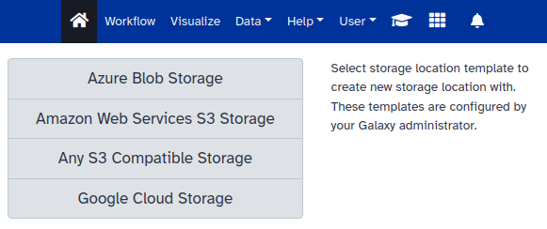
Bring Your Own Storage
Connect Galaxy with storage resources in the cloud
Do you have access to object storage? Here is how to connect it to Galaxy
Tutorial: https://galaxyproject.org/news/2024-09-20-esg-byos-im/
Select object storage type and provide
Name of the bucket / Container
Access (ID) key / Storage account
Secret key / Account key
“Any S3 Compatible Storage” will also require
URL to the API endpoint

Slide 22
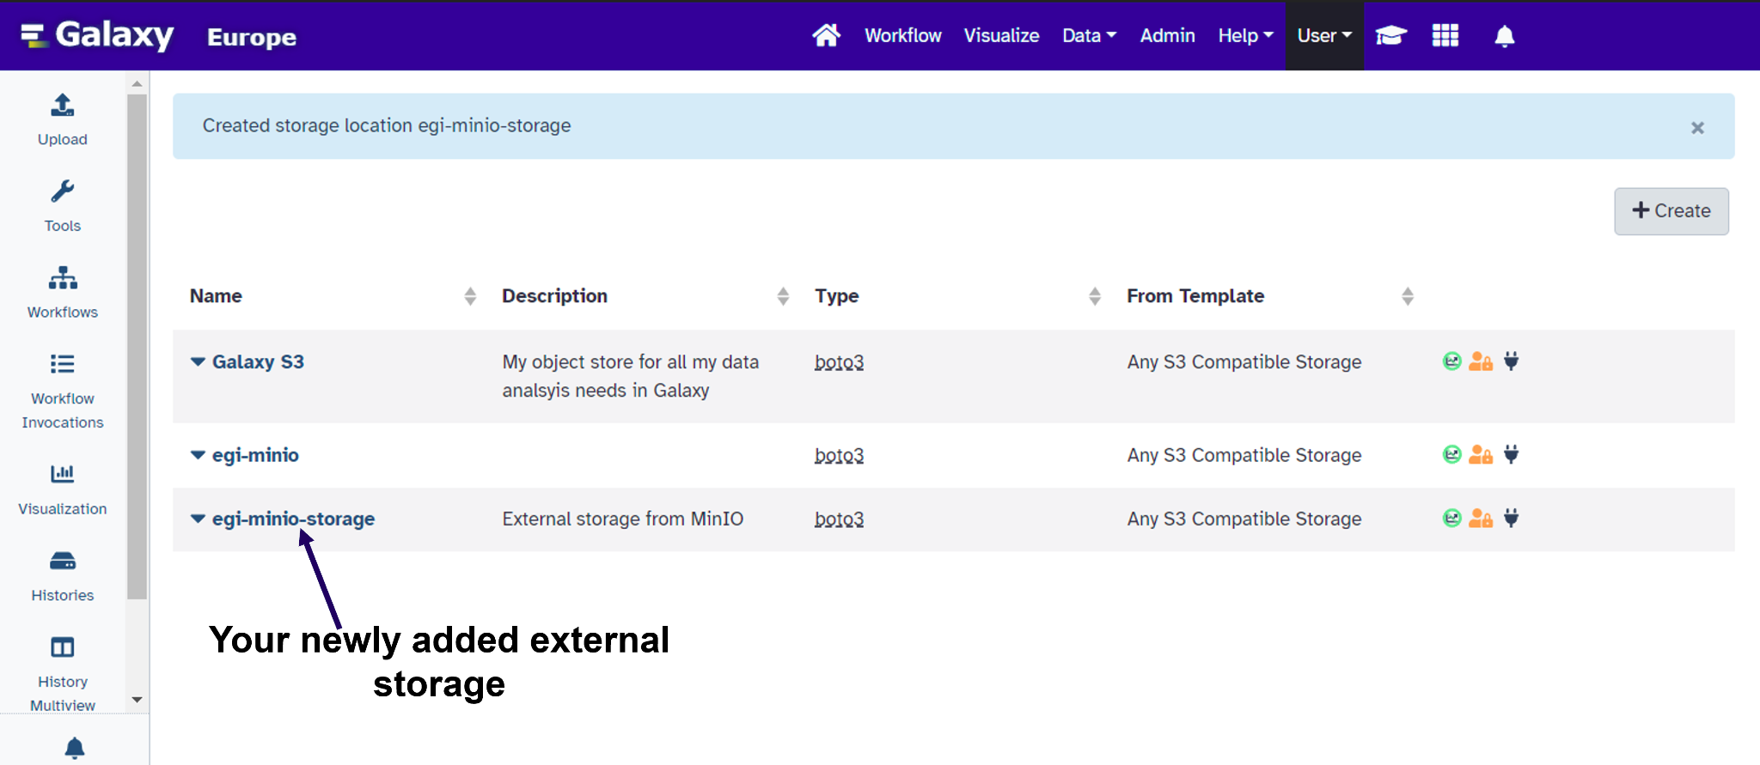
Bring Your Own Storage
Connect Galaxy with storage resources in the cloud
Do you have access to object storage? Here is how to connect it to Galaxy
Tutorial: https://galaxyproject.org/news/2024-09-20-esg-byos-im/
Select object storage type and provide
Name of the bucket / Container
Access (ID) key / Storage account
Secret key / Account key
“Any S3 Compatible Storage” will also require
URL to the API endpoint

Slide 23
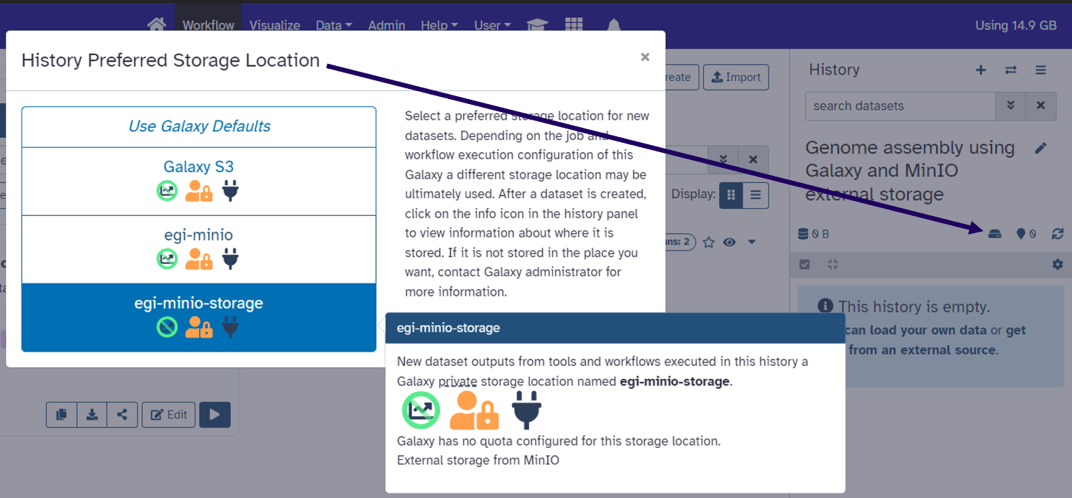
Bring Your Own Storage
Connect Galaxy with storage resources in the cloud
Do you have access to object storage? Here is how to connect it to Galaxy and a tutorial is available here.
The new storage can be used
per History
per Tool
per Workflow
or Default (for everything)

Slide 24
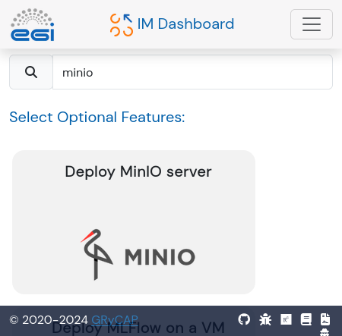
Bring Your Own Storage
Connect Galaxy with storage resources in the EGI Federated Cloud
Use Infrastructure Manager (https://im.egi.eu/) to deploy MinIO and connect it to Galaxy (see tutorial)

Slide 25
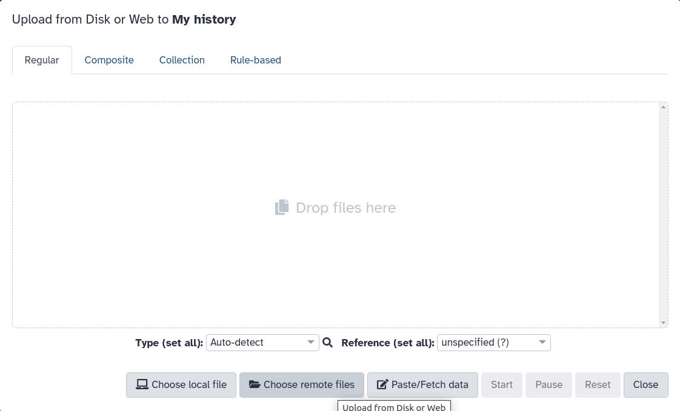
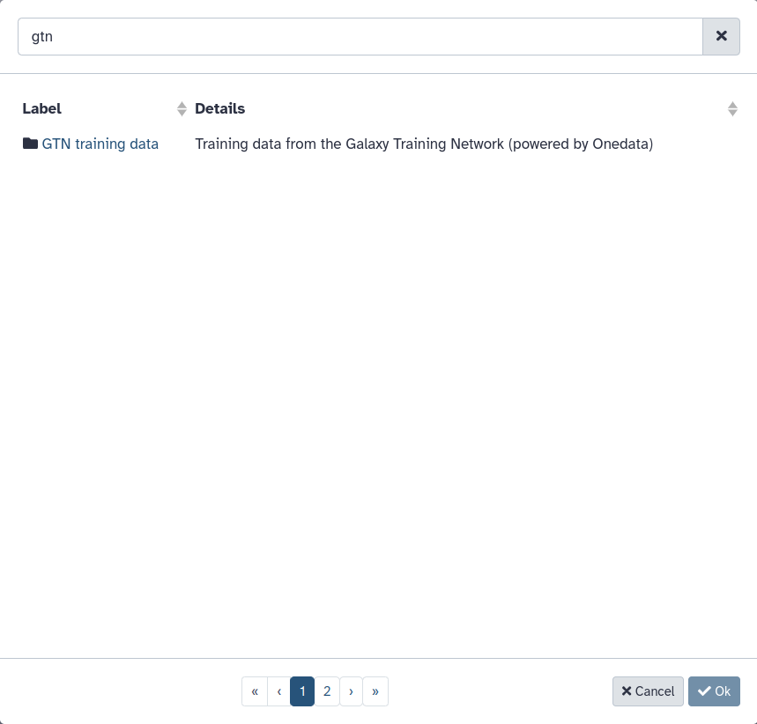
Bring Your Own Storage
Connect Galaxy with storage resources in EGI DataHub
1. GTN training data is now hosted in EGI DataHub and available on usegalaxy.eu for anyone to import.

Slide 26
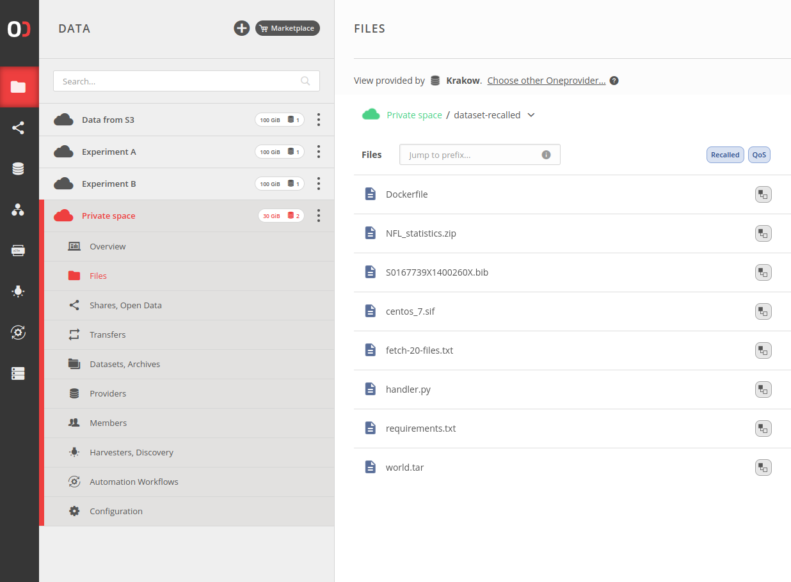
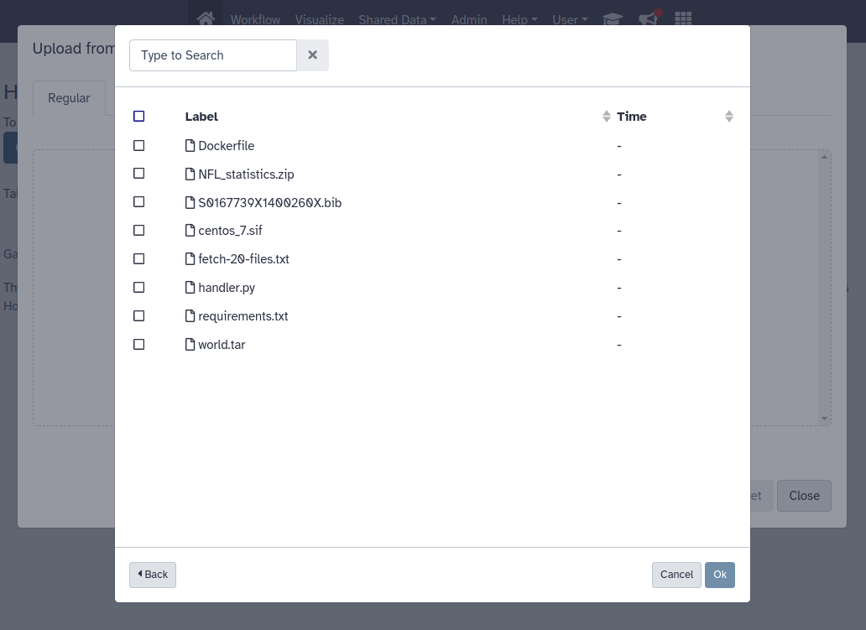
Bring Your Own Storage
Connect Galaxy with storage resources in EGI DataHub or any Onedata environment
2. Configure personal Onedata files source credentials to import or export your datasets.

Slide 27
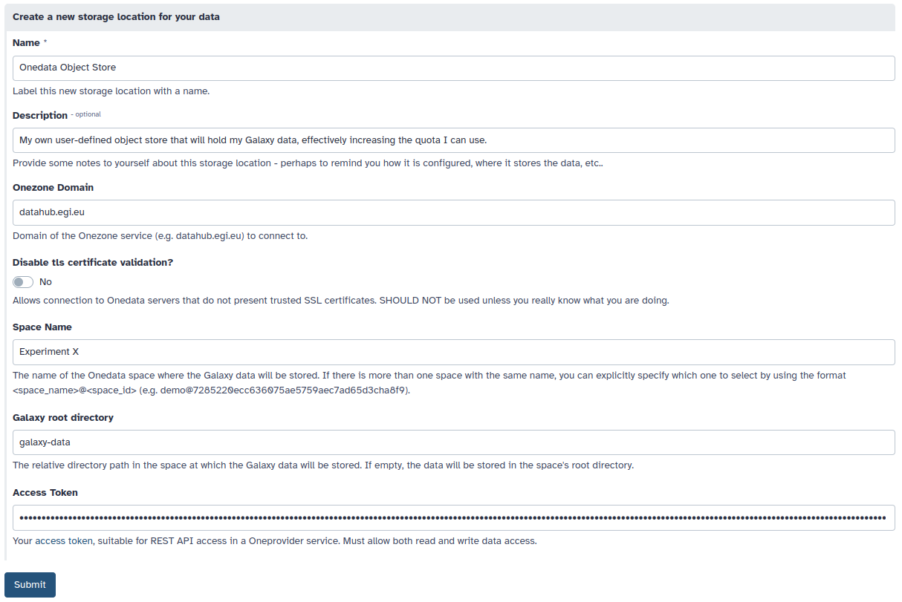
Bring Your Own Storage
Connect Galaxy with storage resources in EGI DataHub or any Onedata environment
3. Configure a personal Onedata storage location for Galaxy user data (Object Store) — available in an upcoming release.

Slide 28
Overview
The EuroScienceGateway project
Broadening the login options for EuroScienceGateway
BYOC: Bring Your Own Compute
BYOS: Bring Your Own Storage
Smart job scheduling across Europe

Slide 29
Smart scheduling
How do we efficiently schedule jobs?
Gather usage statistics from pulsar endpoints
TPV, metascheduling algorithm, and TPV metascheduler API
Visualization of jobs across Europe

Slide 30
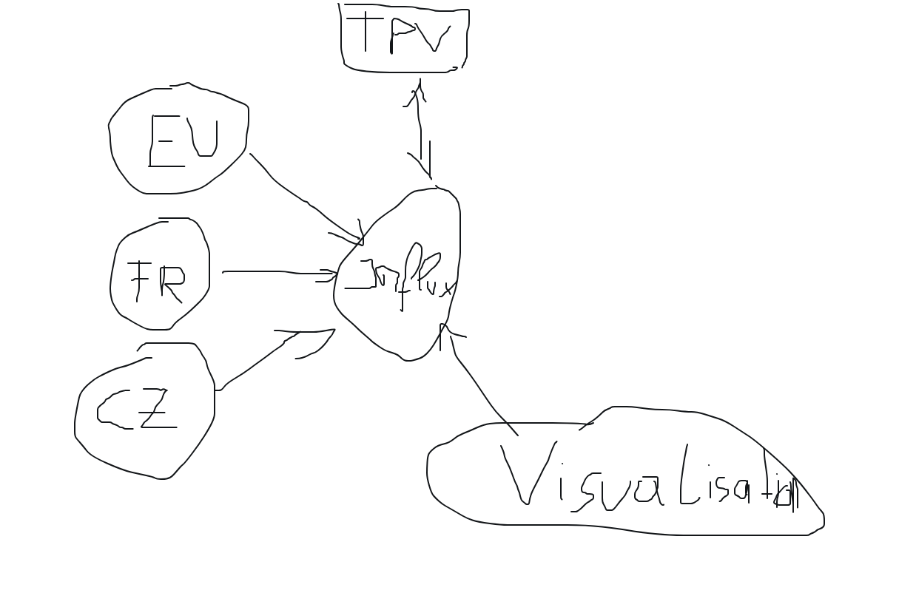
Smart scheduling
Brainstorming over Zoom :)

Slide 31
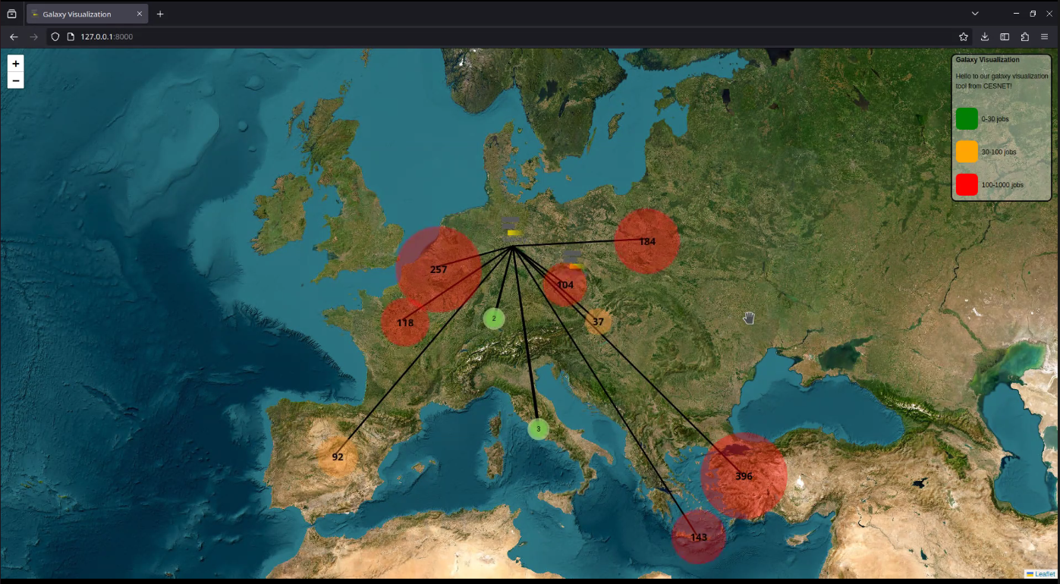
Smart scheduling
Job Visualization
Overview
TPV
Meta-scheduler

Slide 32
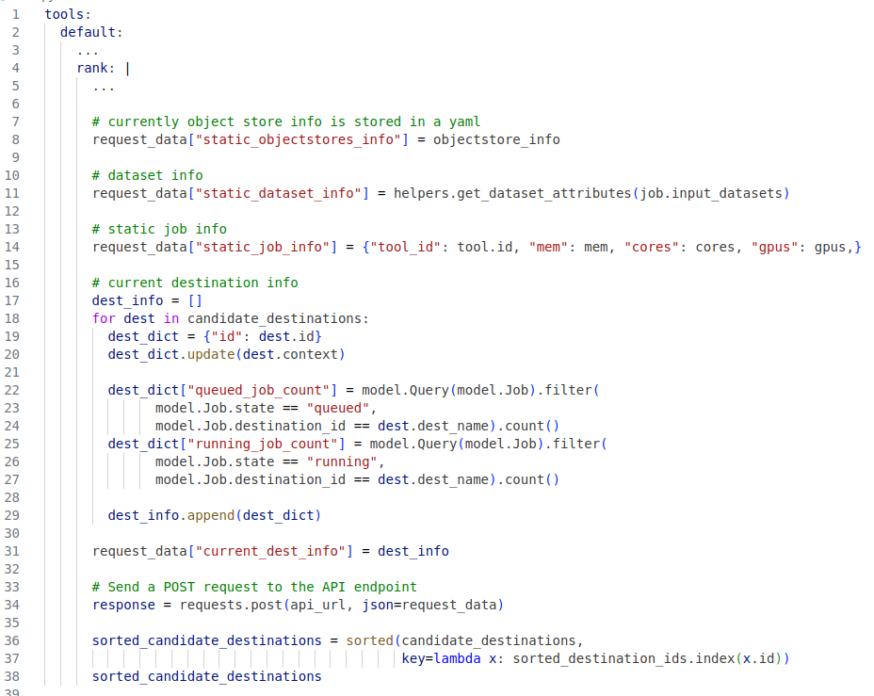
Smart scheduling
Central API endpoint
Implements matchmaking logic, ranking available pulsar destinations based on:
current - and historically collected (tool-destination) metrics
data locality (geolocation) of the objectstore/destination
Currently, simple weighting of the different metrics
Working on more advanced Fuzzy/Adaptive-based matchmaking algorithms

Slide 33
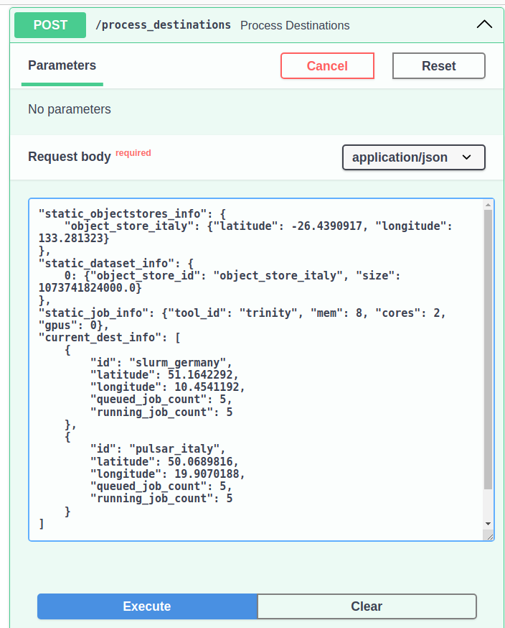
Smart scheduling
Central API endpoint
Implements matchmaking logic, ranking available pulsar destinations based on:
current - and historically collected (tool-destination) metrics
data locality (geolocation) of the objectstore/destination
Currently, simple weighting of the different metrics
Working on more advanced Fuzzy/Adaptive-based matchmaking algorithms

Slide 34
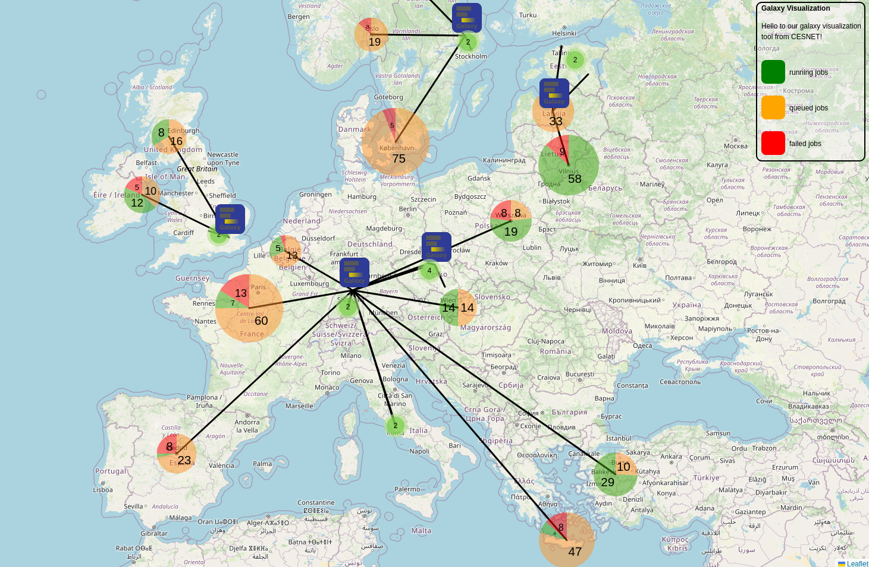
Smart scheduling
Visualization of jobs across Europe

Slide 35
Thanks!
All ESG members, specially:
Tomáš Vondrák

