Slide 1
AI Landscape and Roadmap in EGI
Marco Rorro
AI Solutions Architect
marco.rorro@egi.eu
TLP: GREEN Limited disclosure
EGI 2024 Conference - Lecce, Italy

Slide 2
Outline
Introduction
AI Landscape and Roadmap in EGI
Conclusions

Slide 3
Introduction
EGI 2024 Conference - Lecce, Italy

Slide 4
A brief history of …
GenAI already delivers real value to users
EGI Conference
1st AI Landscape Analysis Computer Vision & NLP
EGI Conference
Everyone went crazy for LLMs but few open source models were available
GPT-1 117M
EGI Conference
AI Landscape and Roadmap
AI Act
2018
2023
Jun
Nov
Oct
Apr
Sep
…
2017
Jun
Sep
Jun
2024
Jun
Oct
2022
Transformer
Attention is all you need
ChatGPT
GPT 3.5
175B
Dall-E 3 Multimodality
Llama 3
8,70, …405B
OpenAI o1
Agentic
EGI Federation strategy 2025-2029

Slide 5
AI Landscape and Roadmap in EGI
EGI 2024 Conference - Lecce, Italy

Slide 6
MLOps
Collection Cleaning Pre-processing Feature Engineering | Standardization Metadata Catalogue Governance | Frameworks (e.g. Pytorch, TensorFlow) Distributed Training (Pytorch DPP, Kubeflow operator) Federated Learning (e.g Flower, NVFlare) | Model Registry Metadata Catalogue Governance | Inference API (e.g. KServe, NVIDIA Triton) Governance
Repeat the Process
Data
Preparation
Feature Store
Model Development ML Train/Tune
Model
Storage
Model
Serving
Raw Data
Streaming and batch sources
Preprocessed Data
Compute Continuum
HPC HTC Cloud
Model Registry
Compute Continuum
HPC HTC Cloud

Slide 7
AI Architecture
Raw Data
Streaming and batch sources
Preprocessed Data
Compute Continuum
HPC HTC Cloud
Model Registry
Compute Continuum
HPC HTC Cloud

Slide 8
RI-SCALE

Slide 9
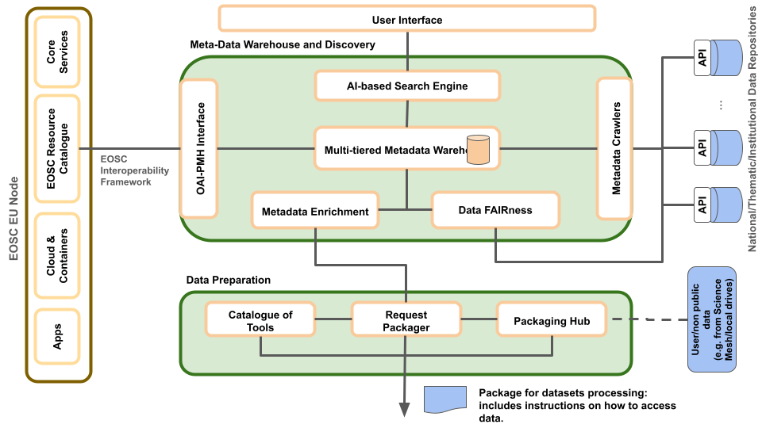
EOSC Data Commons

Slide 10
EGI AI infrastructure
Repeat the Process
Data
Preparation
Feature Store
Model Development ML Train/Tune
Model
Storage
Model
Serving
AI platforms (e.g. AI4OS, itwinAI, OSCAR, AI4Life, AIoD, Horovod, etc.)
EGI/science community
Data staging & replication | Storage and compute (GPU) |  | Cross-project model repository | Storage and compute (CPU)
Data/storage interoperability standards | Federator |  |  | Exploitation and service mgm
EGI community
EGI Foundation

Slide 11
Conclusions
EGI 2024 Conference - Lecce, Italy

Slide 12
Conclusions
Challenges
Shared instances of frameworks
Dynamic allocation and sharing of GPUs
Opportunities
NLP interfaces for infrastructure provisioning and documentation
Identifying patterns and predicting system threats
Trends
Agentic workflow, with LLM iterating over problems
Let’s share ideas and build it together!

Slide 13
Thank you!
marco.rorro@egi.eu

