Slide 1
Advancing Research Frontiers: NBIS's Impact on Sweden's Computational Infrastructure and European Bioinformatics Collaborations
Nanjiang Shu
2024-10-02

Slide 2
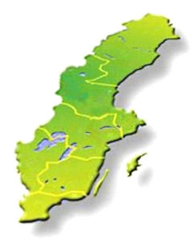
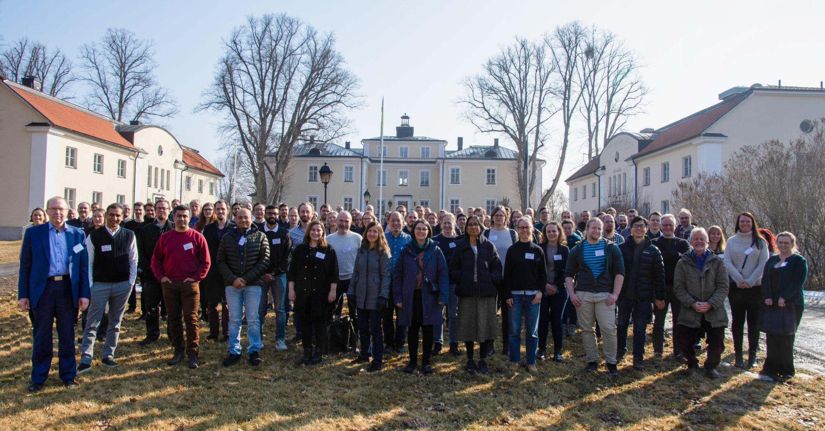
Introduction to NBIS
Distributed infrastructure at six major university towns across Sweden
~120 staff
SciLifeLab Bioinformatics Platform
The Swedish node in ELIXIR – the European infrastructure for biological information

Slide 3
Core activities of NBIS
Support
Genomics/NGS/Metagenomics
Genome annotation and assembly
MS-Proteomics and Protein bioinformatics
Systems biology and Metabolomics
Bioimage informatics and spatial omics
Integrative bioinformatics
Biostatistics
Data publication and FAIRification of data
Data management and Data stewardship (collaboration with SciLifeLab Data Centre)
Infrastructure
Services, computational resources, data management, tools and guidelines
Training
Training in advanced and applied bioinformatics

Slide 4
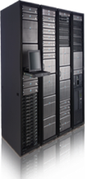
Overview of NBIS activities
Support
Training
Compute & Storage
700+ research groups
1000+ software
50+ databases
5000+ tickets
100+ consultations
200+ support projects
Weekly drop-in
20 national courses
5 international courses
600 students
Data Centre
UPPMAX
Berzelius
Bianca

Slide 5
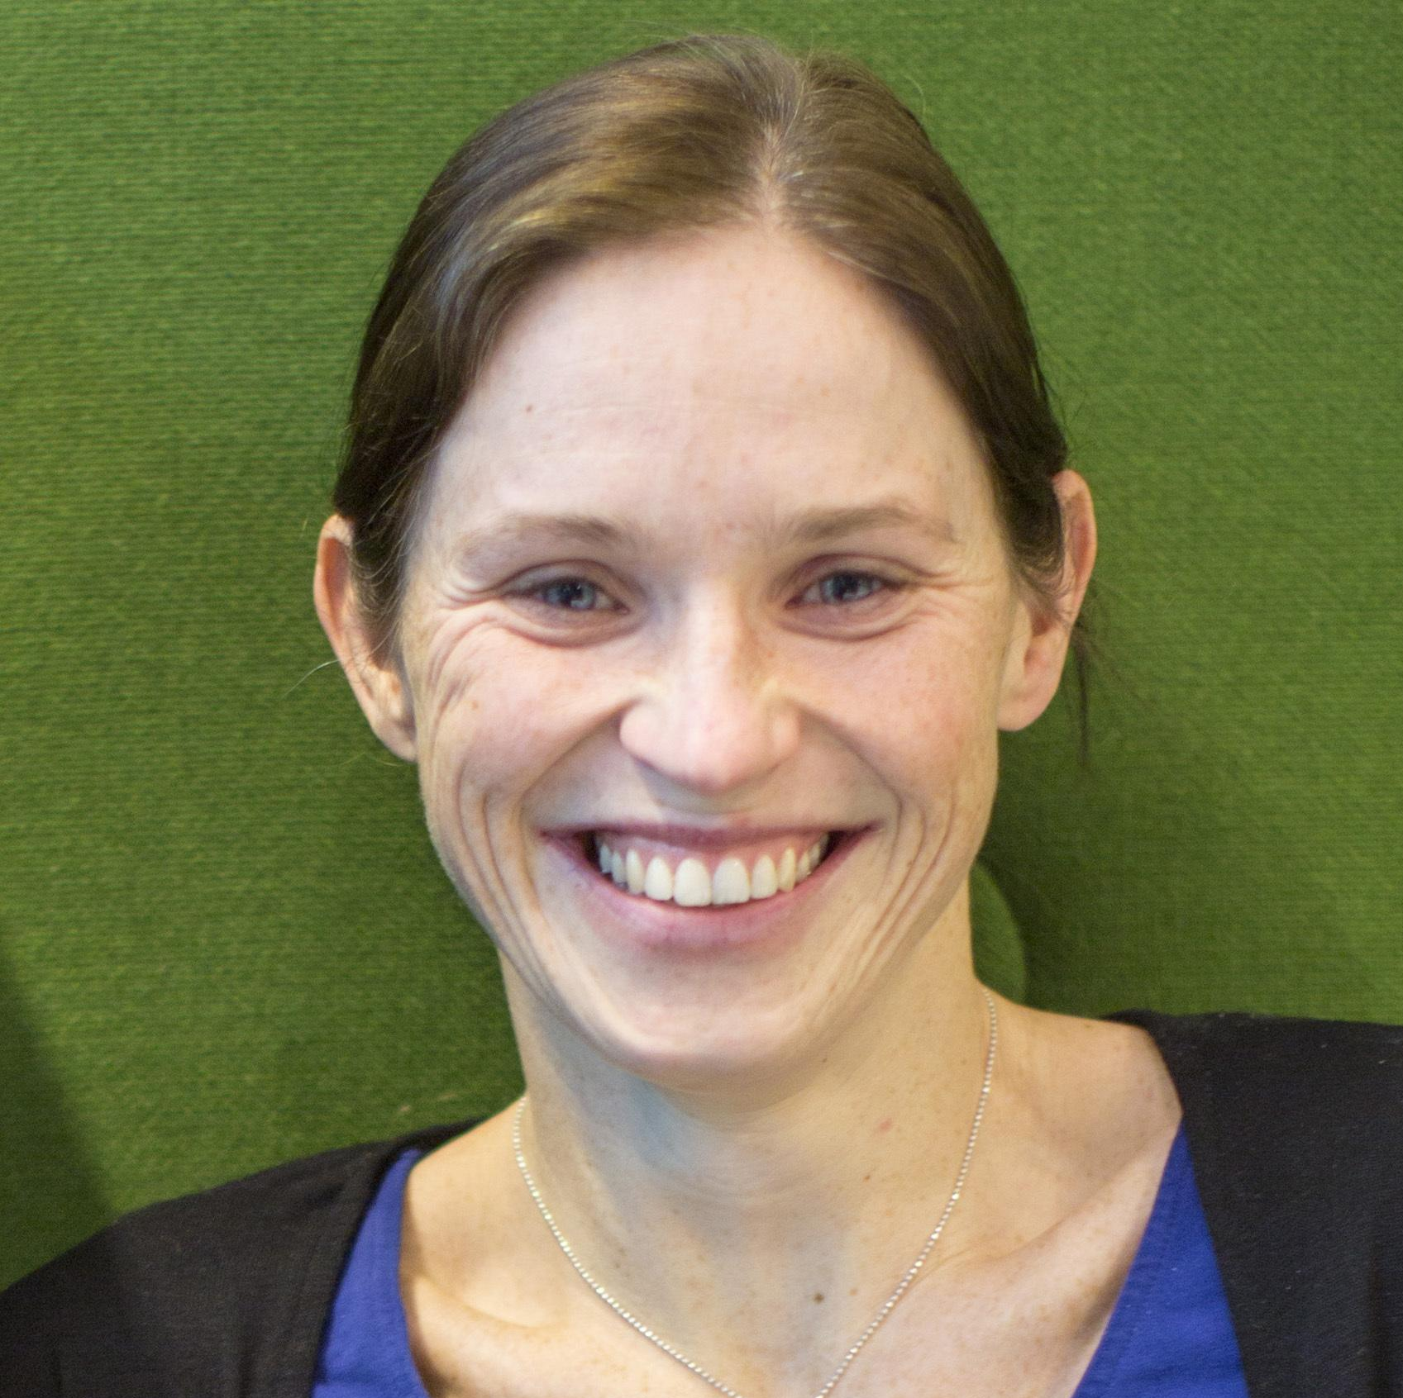
Support advanced research in life sciences
Support
Health & Clinical research
BioImage Informatics
Evolution & Biodiversity
Support
Cell & Molecular biology
Microbiology, Immunology & Structural biology

Slide 6
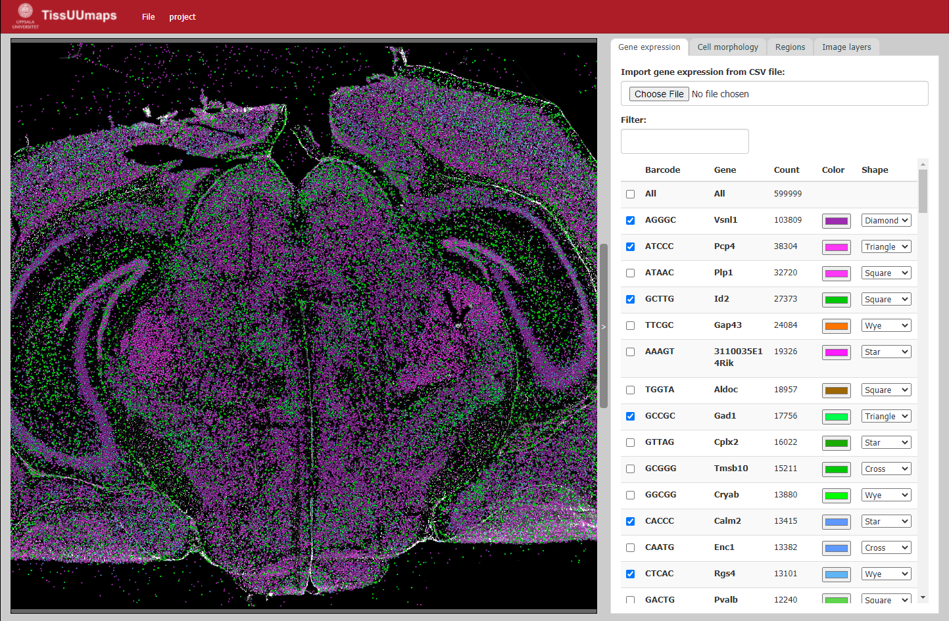
Bioimage informatics (BIIF)
Support
State-of-the-art analysis using computer vision, machine learning, and bioinformatics
Tracking of RBC in Zebrafish
TissUUMaps
Support and Training for
Image Data Analysis
Data: M. den Hoed
tissuumaps.github.io
Help to deploy computational methods
Velocity
(µm/sec)
Time (sec)
Anna

Slide 7
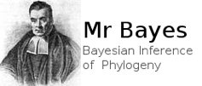
Systems development
Infrastructure
Hosting of national resources
Development of software, workflows and services
Infrastructure development and maintenance
Maintaining software
Dimitris

Slide 8
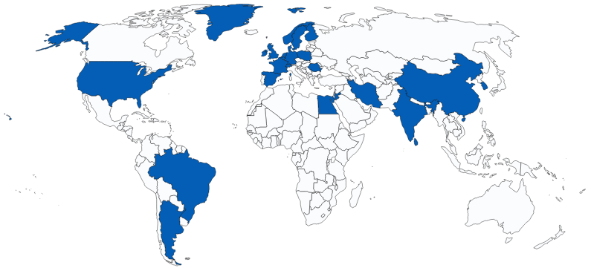
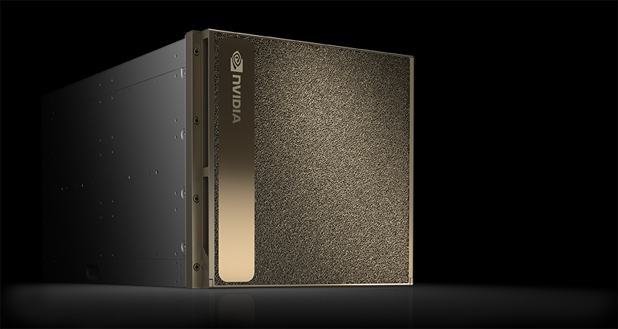
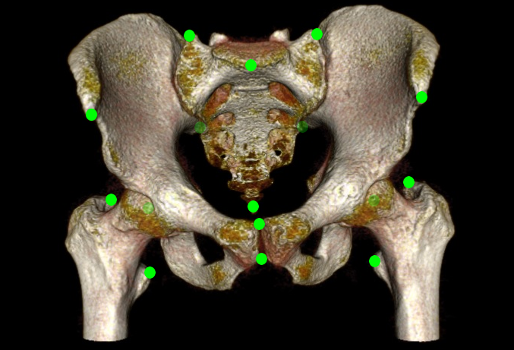
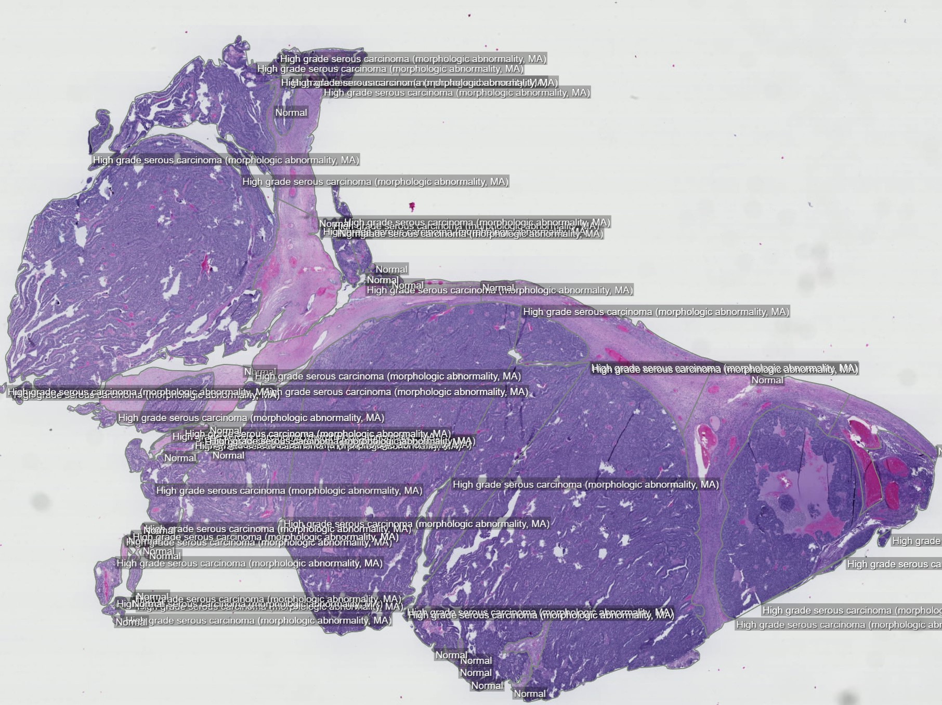
AIDA data hub
Infrastructure
Joel
Focusing on research and clinical innovation in data driven precision health
Providing compute services for sensitive personal data
Data sharing services for citable datasets

Slide 9
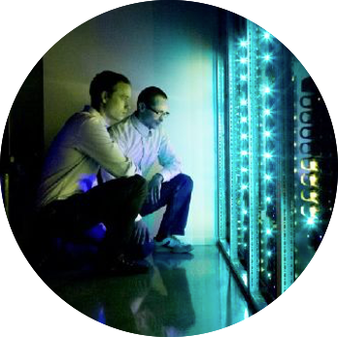
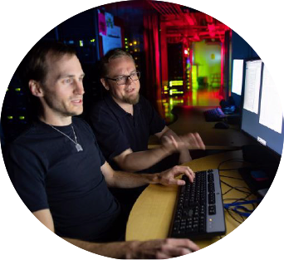
Support for Computational Resources (SCoRe)
Infrastructure
A bridge between NBIS and NAISS, i.e. UPPMAX
Provides a digital research environment for hundreds of researchers
Marcus
Application experts
help users with software and resources

Slide 10
International collaborations
Human data
Federated EGA, 1+MG, GDI, EHDS2 Pilot
Bigpicture, EUCAIM
Data management
ELIXIR-CONVERGE
Biodiversity
BGE
Training
PHENET
Integrative bioinformatics
EJP-RD

Slide 11
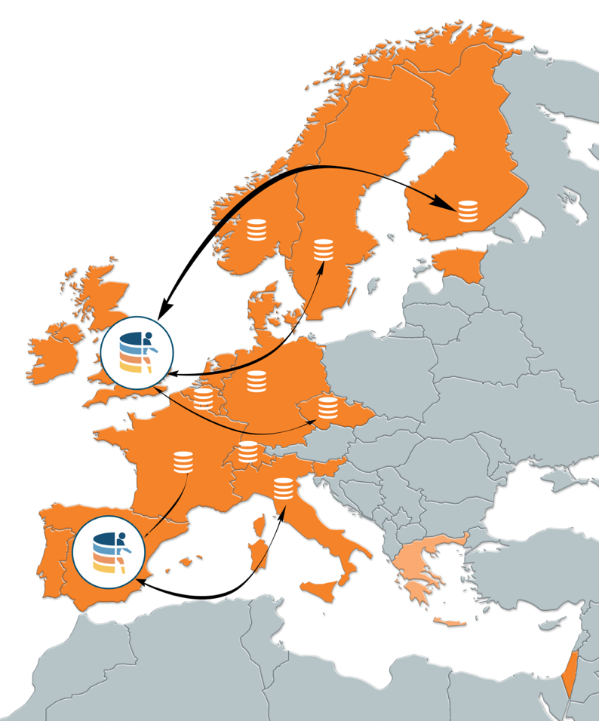
Federated EGA
EGA
EGA is a resource for permanent archiving and sharing of personally identifiable human genetic and phenotypic data - FAIR principle
EGA was launched in 2008 at EBI and further developed together with CRG from Spain since 2012
Tricky with sensitive data
Extend to federation
Sensitive data stored locally
Metadata stored centrally and shared internationally
Access of data is requested on a case-by-case basis from a Data Access Committée (DAC)
NBIS is one of the leaders in developing the Federated EGA (since 2016)

Slide 12
Genomic Data Infrastructure (GDI)
Aims to implement the infrastructure for the 1+ Million Genomes (1+MG) Initiative to enable secure access to genomic and clinical data across Europe
Sweden one of the first members of 1+MG since 2018
20 European countries with totally 54 partners
40 MEUR over 4 years (2022–2026)
NBIS together with ELIXIR-FI leads the work to deliver, deploy, operate and maintain the infrastructure and services defined by the 1+MG Proof of Concept that will provide the specifications and operational service model for federated national nodes
Upcoming European Health Data Space (EHDS) will hopefully provide a more clear regulation on access and secondary use of human data in healthcare, research and innovation

Slide 13
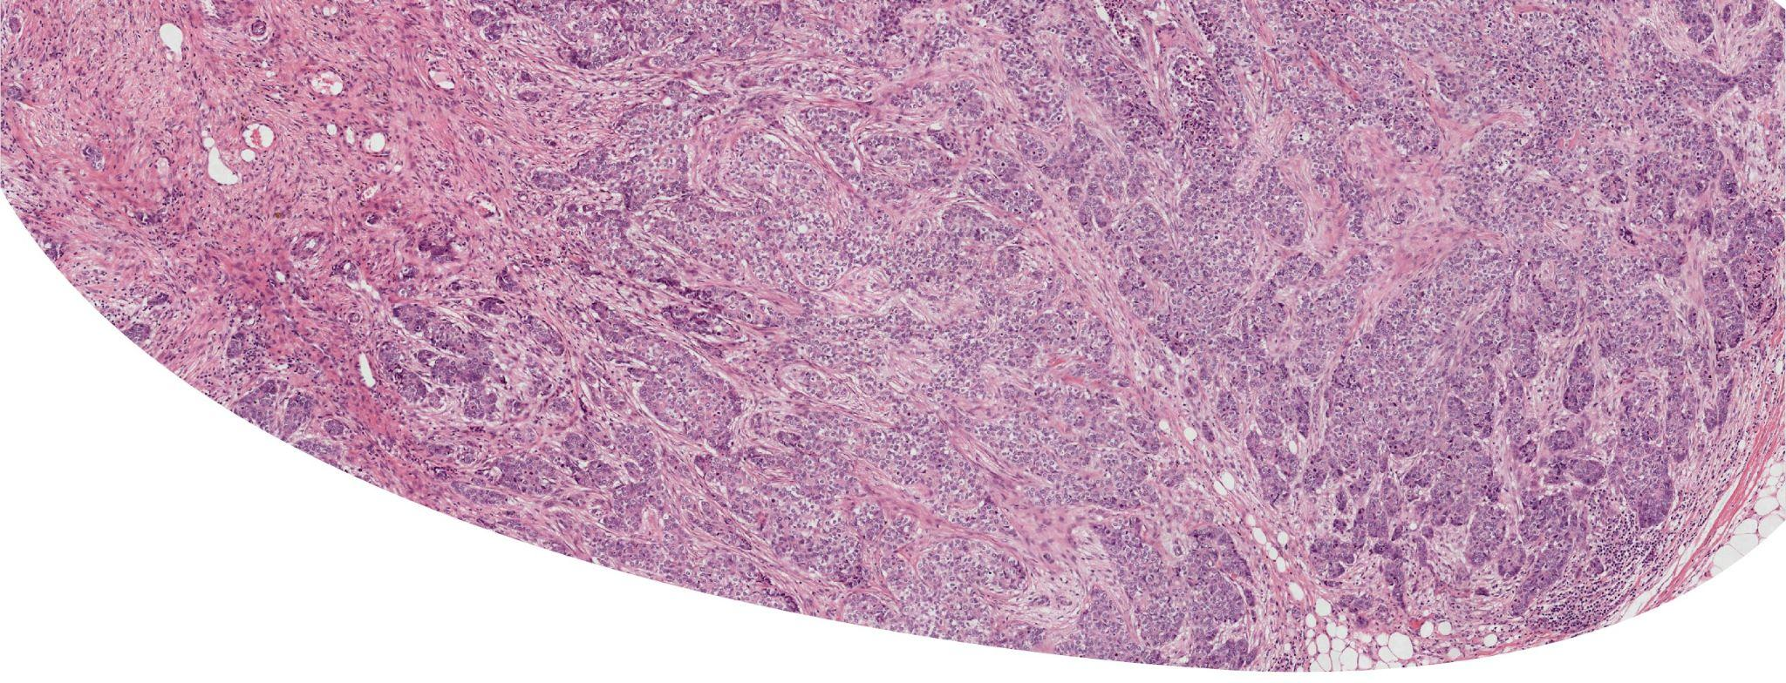
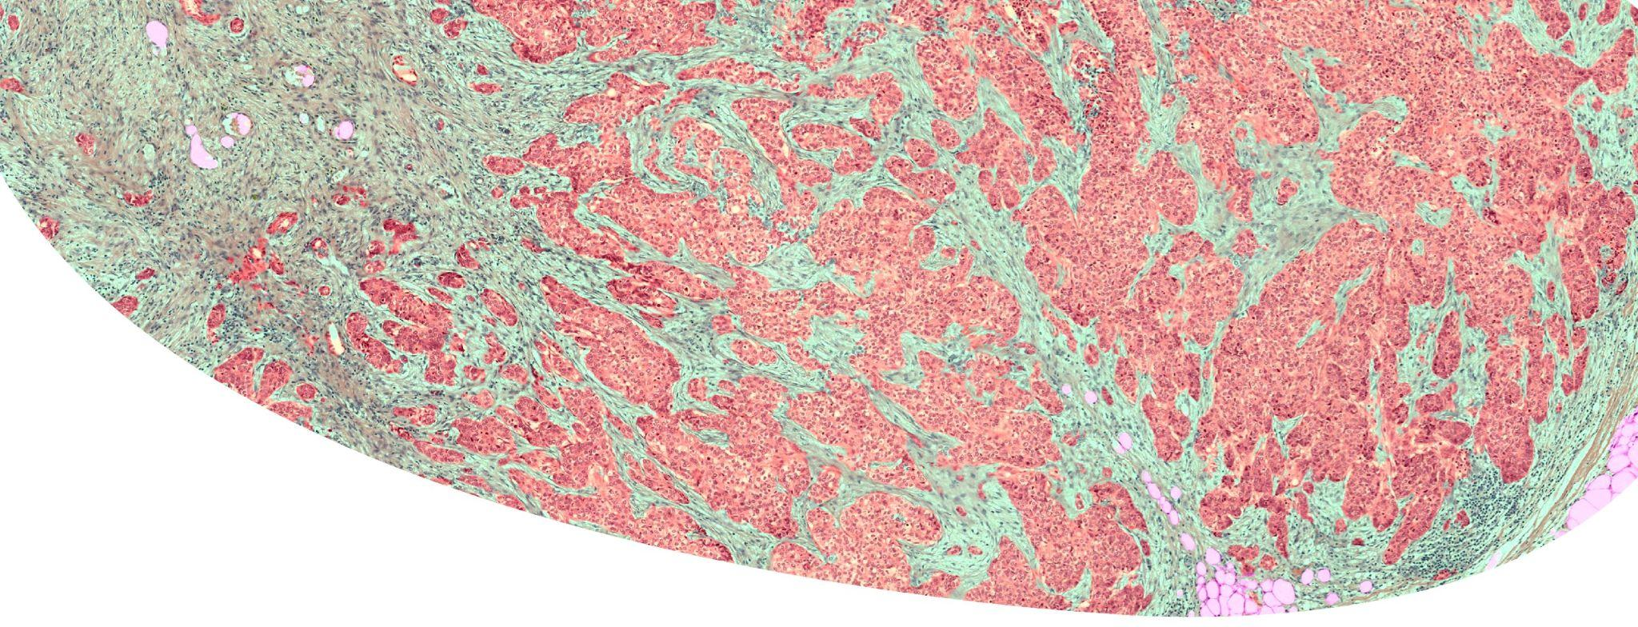
Bigpicture
Aims to create a central repository of digital pathology slides to boost the
development of artificial intelligence
Petabyte of data with 3 million whole-slide images including metadata
15 countries with 45 partners
70 MEUR over 6 years (2021 – 2027)
The underlaying system is developed and maintained by NBIS in collaboration with Elixir-FI based on a similar technology used for Federated EGA
⇒

Slide 14
Collaboration between NBIS and EGI
Started from January 2015
Became an associated participant of EGI since the end of 2022
NBIS develops and maintains web services using EGI cloud resources, e.g.
TOPCONS: a widely used membrane protein structure prediction server
NBIS Rshiny server
Resources provided by EGI
216 CPU cores and 768 GB RAM
1. RECAS-BARI (Italy): 68 CPU cores, 136 GB RAM
2. IN2P3 (France): 48 CPU cores, 96 GB RAM
3. TR-FC1-ULAKBIM (Turkey): 100 CPU cores, 533 GB RAM

Slide 15
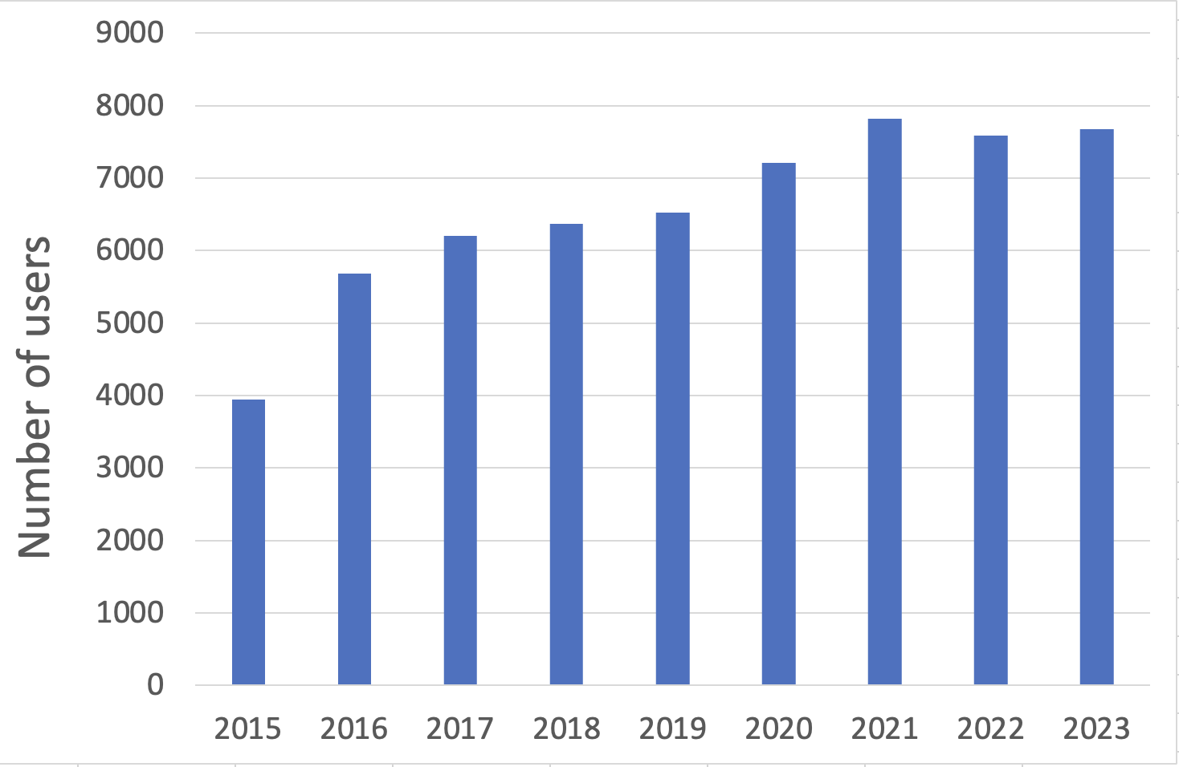
Impact of services using EGI resources
7 NBIS-services utilize the EGI resource
+7000 yearly users since 2020
9 publications
+1700 citations

Slide 16
Summary
NBIS is a distributed national infrastructure in Sweden
Bioinformatics support with expert knowledge and innovative data integration that makes bioinformatics easily accessible for life science researchers
Services and software development, efficient data publication for open science, and access to high-performance data analysis methods
Advanced training to boost the application of bioinformatics
Forming the Swedish node in ELIXIR and participating in relevant international projects
NBIS has a long-standing collaboration with EGI, which has yielded fruitful results

Slide 17
Thanks for your attention!

