Slide 1
European e-Infrastructures Assembly MoU Signature Ceremony
EGI 2024 Closing Plenary
Convenor: S. Andreozzi

Slide 3
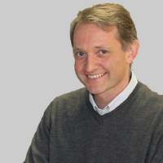
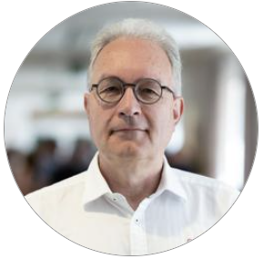
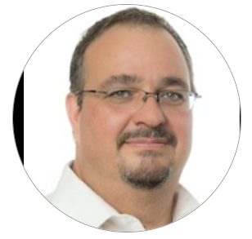
Position Statements
Serge Bogaerts
Managing Director PRACE
Tiziana Ferrari
Director EGI Foundation
Eric Huizer
CEO
GÉANT
Yann Le Franc Head of Secretariat
EUDAT Ltd.
Natalia Manola CEO
OpenAIRE AMKE

Slide 4
Providing high quality and FAIR enabling data management, storage and preservation services to research communities, RIs and NRENs
Continuously improving the service offer to better match user’s needs.
Providing researchers and research infrastructure with cutting-edge consultancy and training
Developing partnerships with relevant partners to increase the added value of our services
Contributing actively to build EOSC
Role in e-Infra Assembly
Extending existing service integrations to create a connected set of services to provide a smooth and simple user experience.
Explore potential for joint e-infra service offerings
Proposing joint activities e.g. common training activities, joint conference and communication activities
Identifying areas for co-development of innovative services to optimise use of resources and avoid duplication of efforts

Slide 5
GÉANT and the e-infra Assembly
Erik Huizer
CEO
www.geant.org

Slide 6
IDENTITY FEDERATION
NETWORK
COMMUNITY
Network Services
Cloud
Security
Trust & Identity

Slide 9
PRACE3 - Association of Users and HPC Centres in Europe
Acknowledging the gap in the new landscape to support users (Academia & Industry)
Independent and beyond political frontiers
Acknowledging the Infrastructure and Political leadership is with EuroHPC which PRACE wants to support as a successful and performing infrastructure
Pillars and Principles
PRACE adopts a user-centric approach
PRACE empowers User Communities
PRACE provides support for best utilization of European HPC Infrastructure
PRACE fosters International Collaboration
PRACE role in the e-Infrastructure Assembly
Collaboration with e-Infrastructures and and promote HPC
Work on e-Infra services for the scientific and industry communities in Europe
Update 2025

Slide 10
with the e-Infrastructure Assembly
Be a trusted service & technology partner
Deliver technical innovation to meet the needs of researchers
Improve skills of users and operators
Business models for better support of cross-border service provisioning
Be a recognised foundation of EOSC
1 2 3 4 5

Slide 12
Thank You

