Slide 1
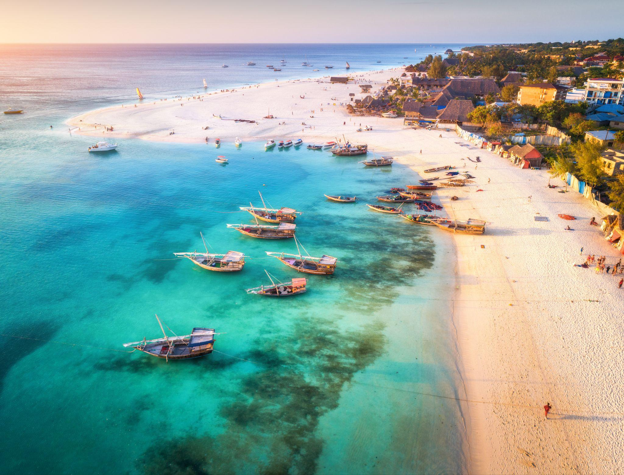
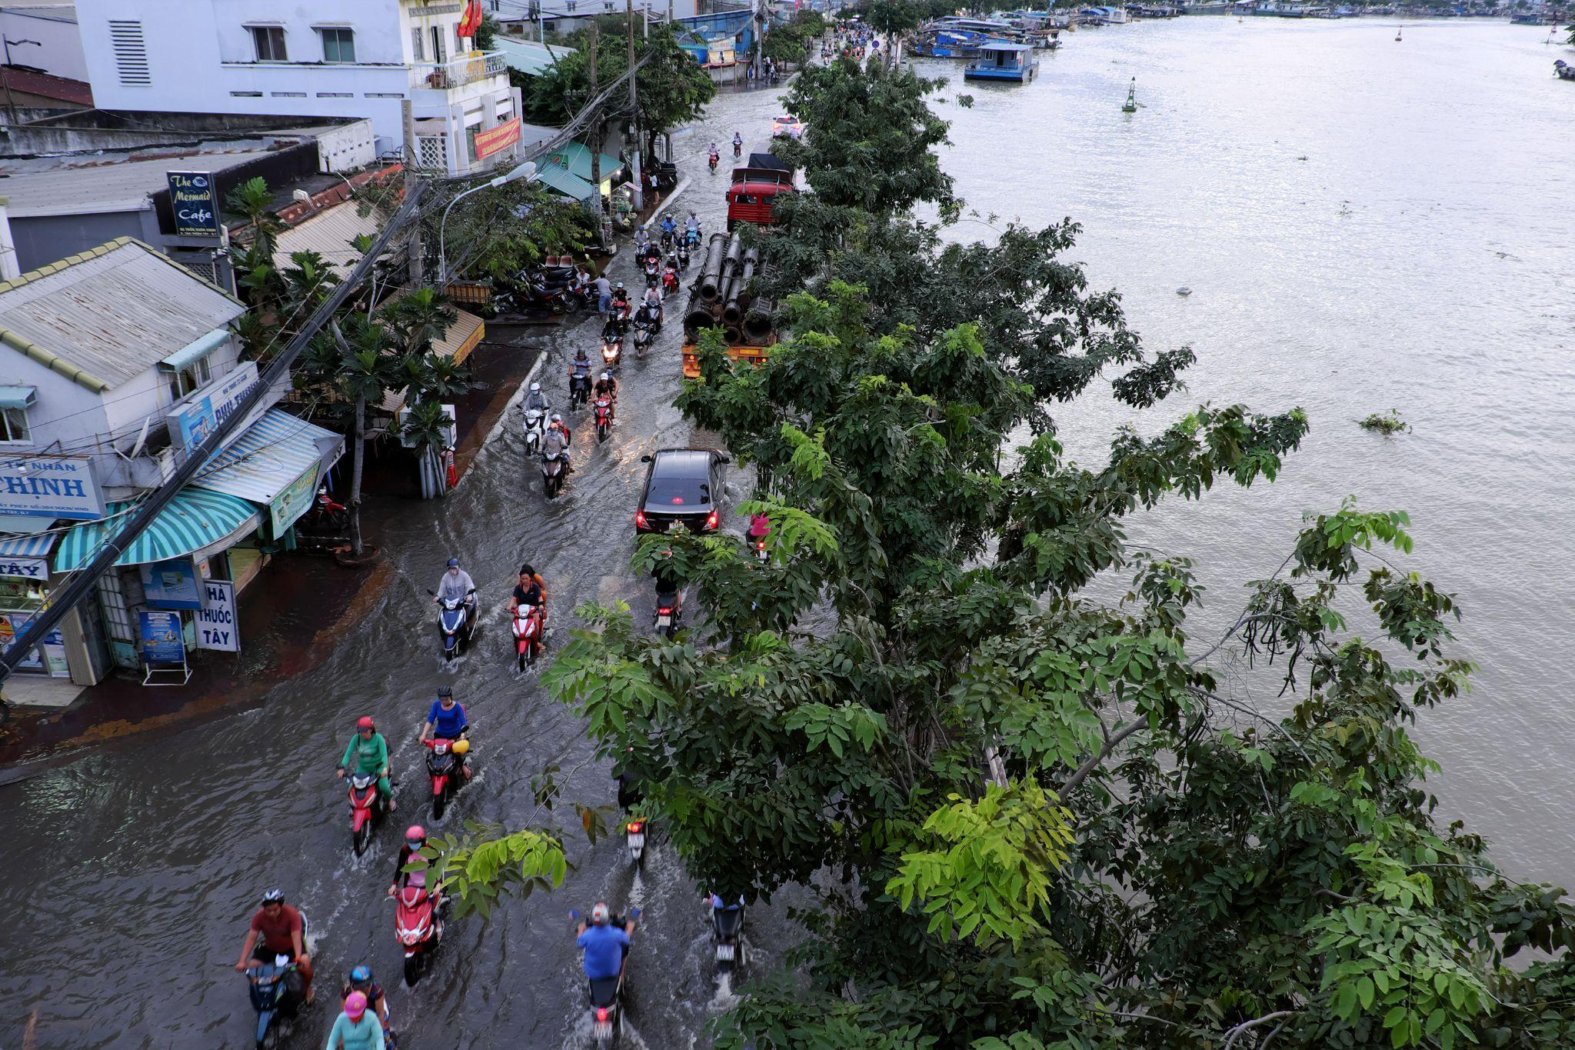
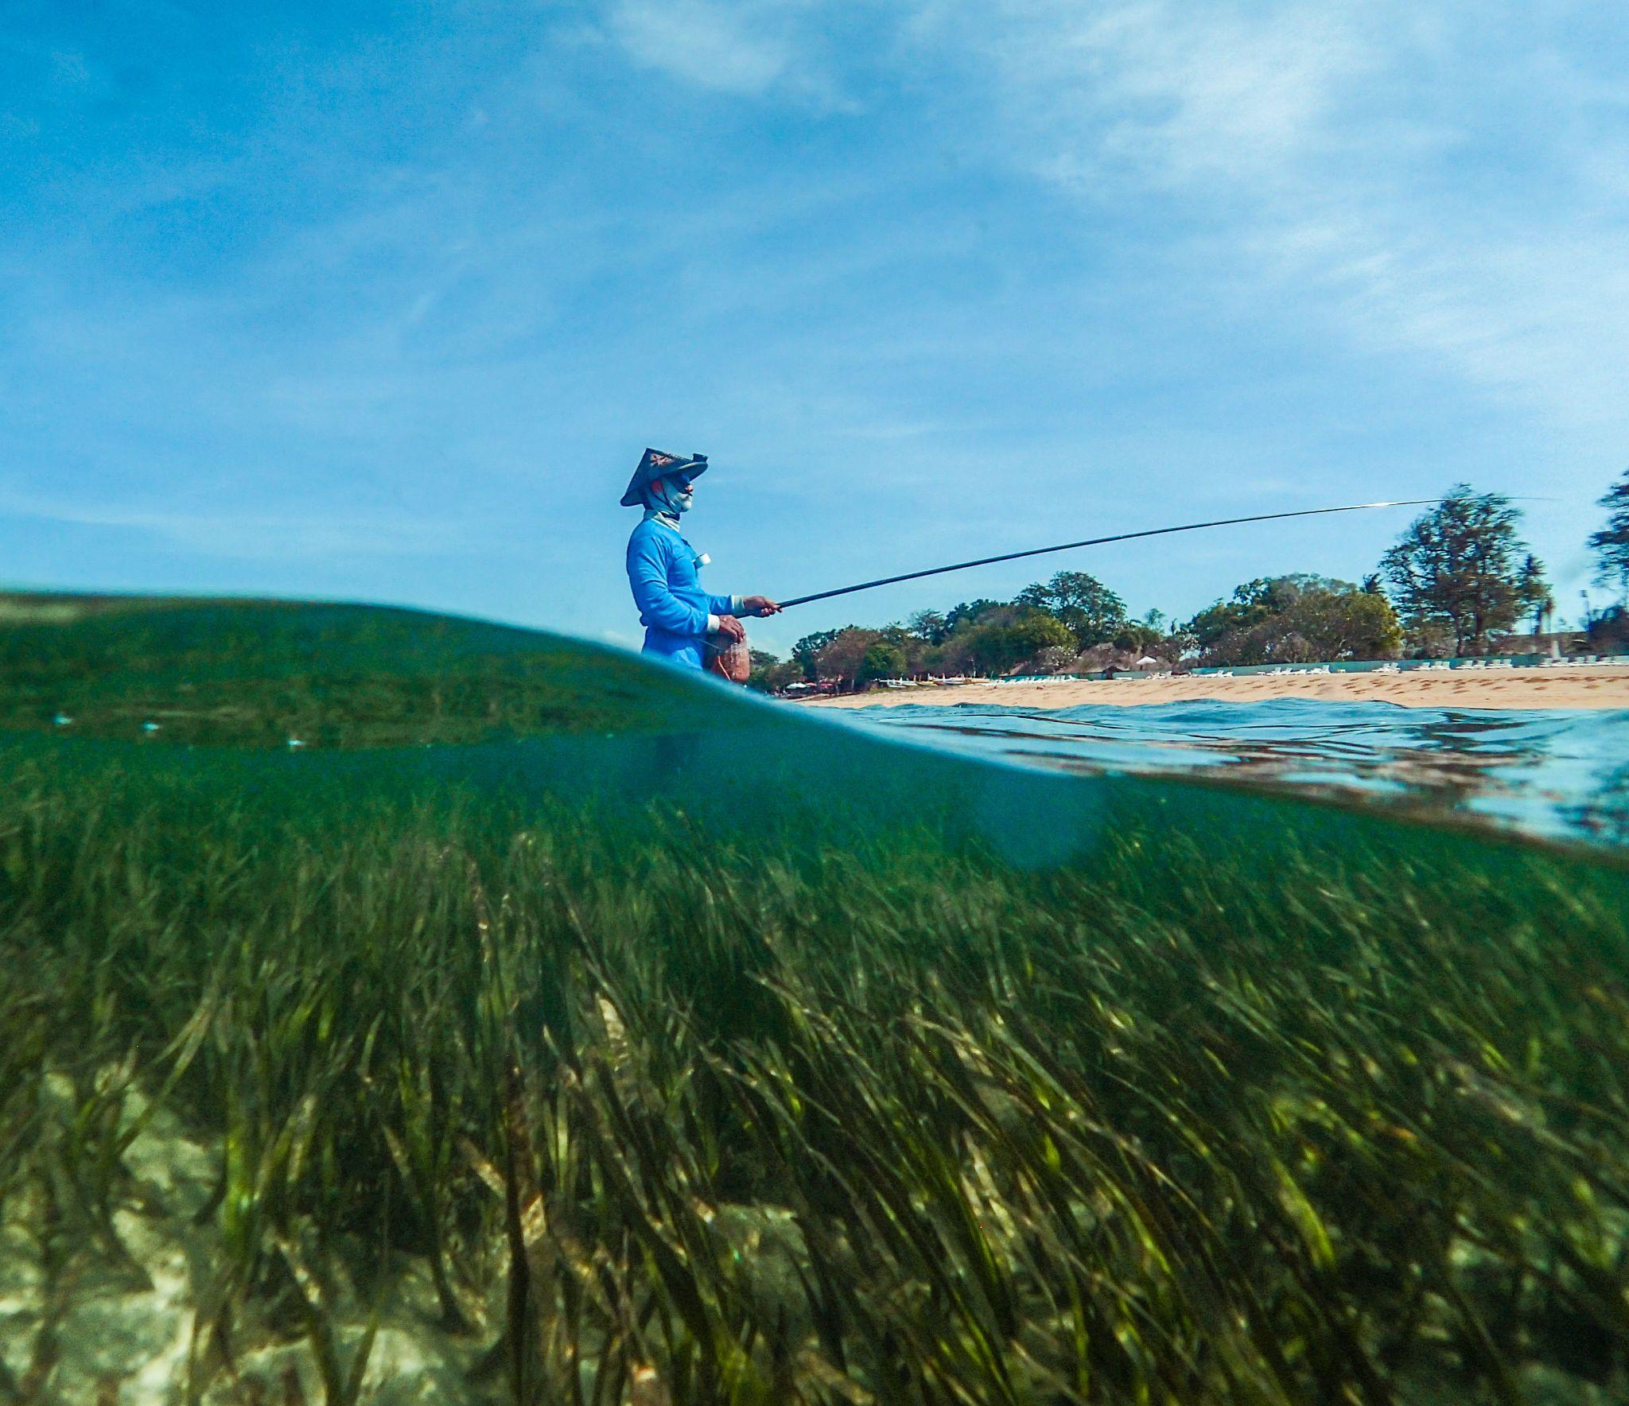
GlobalCoast Cloud: enabling equitable coastal resilience for the future
BOARD
Nadia Pinardi, University of Bologna
Villy Kourafalou, University of Miami
Joaquín Tintoré, SOCIB & IMEDEA, Palma de Mallorca
Emma Heslop, Global Ocean Observing System IOC/UNESCO
SECRETARIAT
Giovanni Coppini, Mairéad O’Donovan, Areeba Meiz
Euro-Mediterranean Centre on Climate Change, Lecce
This programme is endorsed by
Notes:
CoastPredict is one of the three GOOS Ocean Decade Programmes. The vision of the Programme is ‘A predicted global coastal ocean from events to climate’, this will require upgrade to a fit-for-purpose oceanographic information infrastructure that integrates latest technology and methods for coastal ocean observation and prediction.

Slide 2
Outline
Ocean science is at the core of climate change
The UN Decade CoastPredict program
The GlobalCoast Experiment
Conclusions and outlook
This programme is endorsed by
Notes:
CoastPredict is one of the three GOOS Ocean Decade Programmes. The vision of the Programme is ‘A predicted global coastal ocean from events to climate’, this will require upgrade to a fit-for-purpose oceanographic information infrastructure that integrates latest technology and methods for coastal ocean observation and prediction.

Slide 3
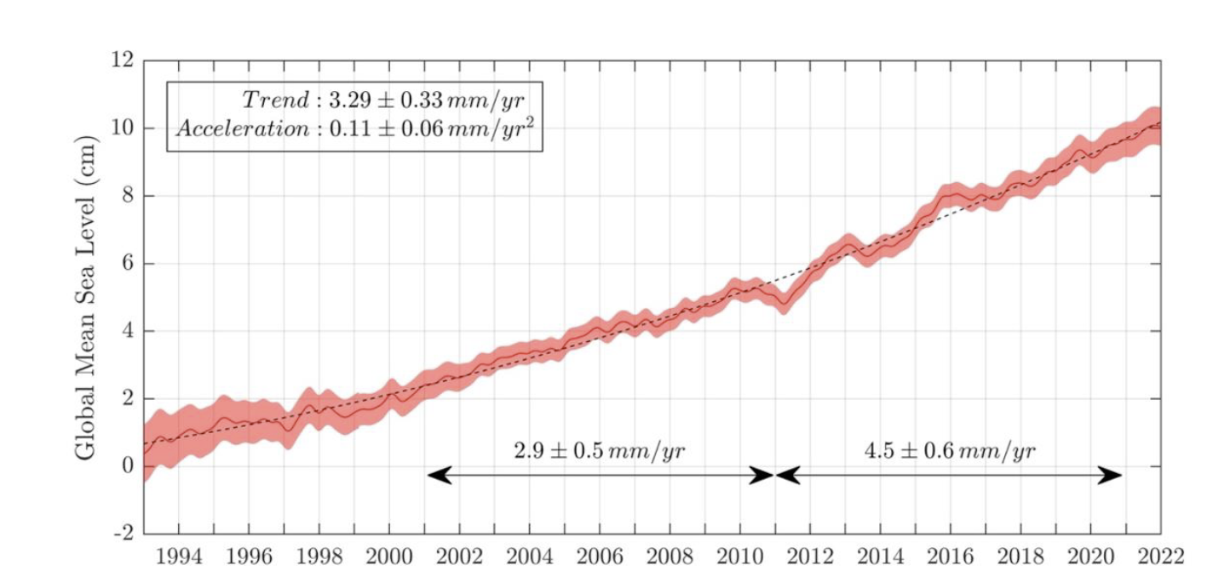
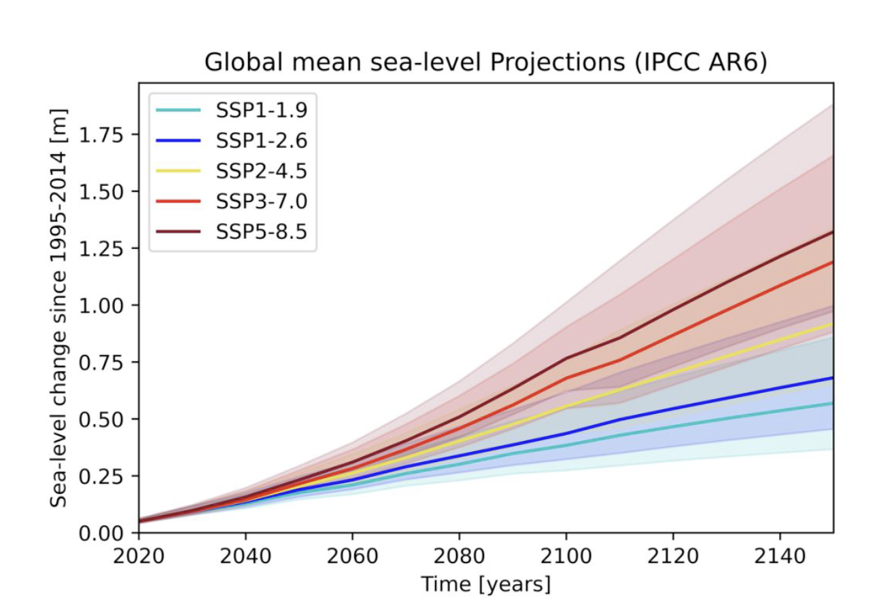
Oceanography is Central to Climate Change Impacts
satellite altimetry
From Melet et al., 2024, State of Planet
From AR6, Fox-Kemper et al.., 2021

Slide 4
Oceanography is at the core of risk science
Frequency of the 100 year storm surge event in 2100
10 years
1 year
From: Vousdoukas et al., Nature communication, 2018
Notes:
Advancing tech (interest to Fugro)
Advancing modeling, climate and extremes for the coast, coupling modeling for estuaries and coast
New accessible tech/community science
Delivery solutions (model data is huge) - cloud computing

Slide 5
2021-2030
Notes:
Advancing tech (interest to Fugro)
Advancing modeling, climate and extremes for the coast, coupling modeling for estuaries and coast
New accessible tech/community science
Delivery solutions (model data is huge) - cloud computing

Slide 6
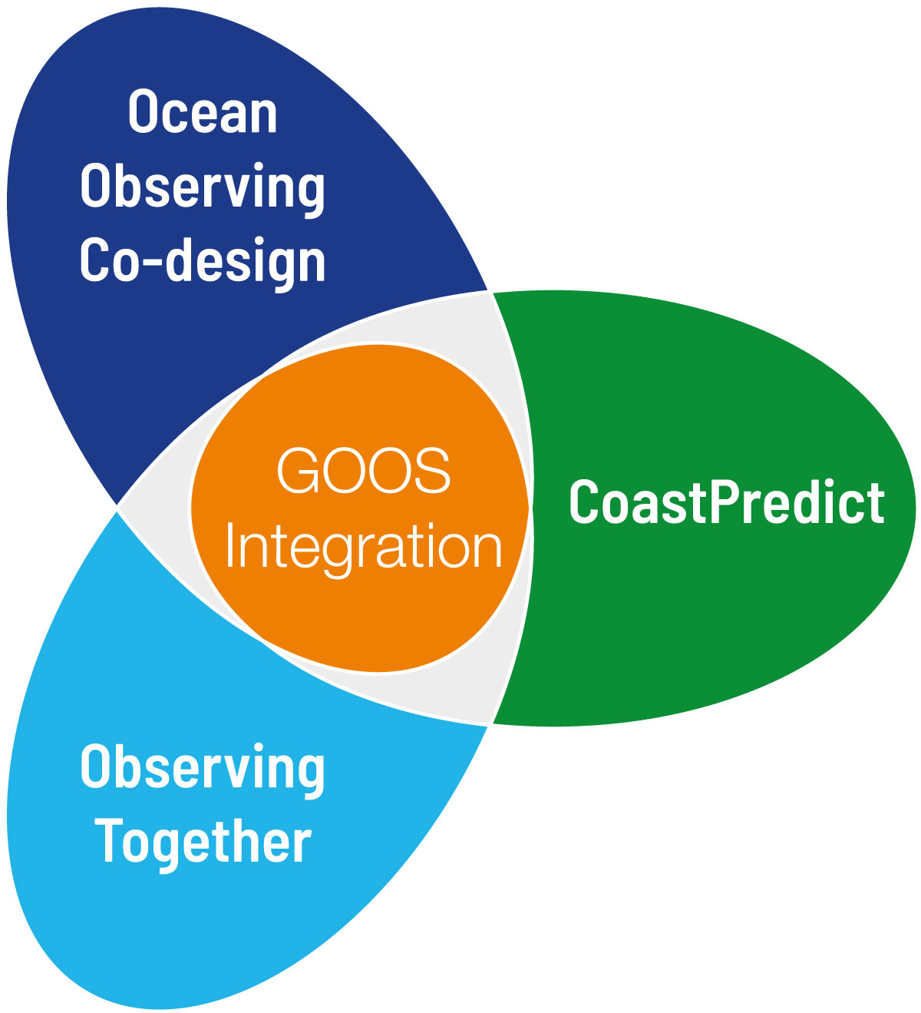
CoastPredict: a UN Decade Programme
Objective
Provide decision-makers and coastal communities with integrated observing and predicting systems to identify solutions for managing risk in the short-term and planning for mitigation and adaptation in the longer-term

Slide 7
The GAP: make accessible the Digital Ocean
Notes:
Advancing tech (interest to Fugro)
Advancing modeling, climate and extremes for the coast, coupling modeling for estuaries and coast
New accessible tech/community science
Delivery solutions (model data is huge) - cloud computing

Slide 8
The GAP: expand the Digital Twins for Nature Based Solutions
Are seagrass meadows
capable of attenuating waves?
Umesh et al., Sc. Total Env., 2022

Slide 9
The GAP: Recast the problem in terms of multi-hazard risk
Risk Assessment
RA.1 Multi-hazard evaluation frameworks
RA.2 Multi-level, multi-sector risk analysis
RA.3 Exposure and vulnerability analysis
Risk Reduction
RR.1 Early warning systems (multi-hazard)
RR.2 Warning Dissemination & Communication
RR.3 Preparedness & Response
RR.4 Long term planning
RR.5 Nature Based Solutions
RR.6 Digital twins
Governance /Social Transformation
GIS.1 Marine and Maritime Spatial Planning
GIS.2 Governance Framework
GIS.3 Disaster recovery planning
GIS.4 Equitable coastal resilience
GIS.5 investments, financing and insurance
GIS.6 Capacity building
GIS.7 Corporate responsibility
Pinardi et al, 2024
Notes:
Advancing tech (interest to Fugro)
Advancing modeling, climate and extremes for the coast, coupling modeling for estuaries and coast
New accessible tech/community science
Delivery solutions (model data is huge) - cloud computing

Slide 10
The solution: expand cloud-based computing and infrastructure to enhance accessibility
Dr. Richard Signell, Open Science Computing, LLC, Massachusetts, USA

Slide 11
GlobalCoast - An experiment to demonstrate CoastPredict Solutions
Demonstrate, at Pilot Sites, an integrated observing and predicting system that will solve many of the gaps
Design and use an innovative Cloud Computing Infrastructure for data exchange and analytics
Create globally replicable solutions and services that enhance coastal resilience

Slide 12
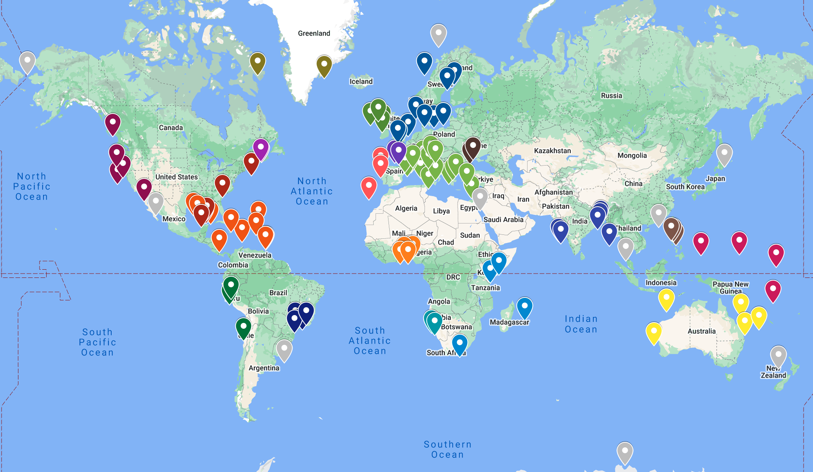
GlobalCoast Survey (July-October 2023) in numbers
130
Pilot Sites
30
Regions of the Global Coastal Ocean
270
institutions
in 64 countries

Slide 13
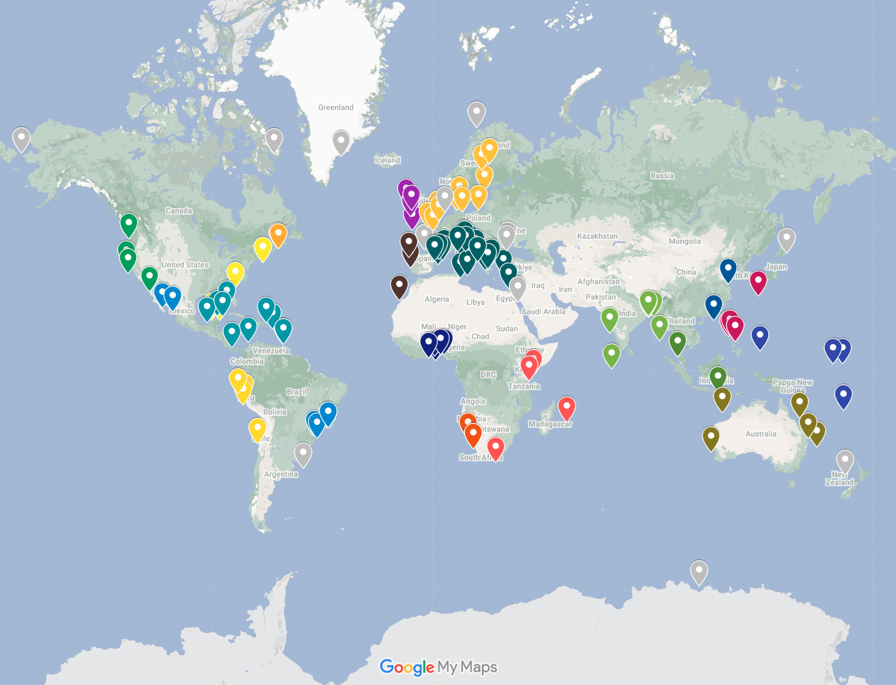
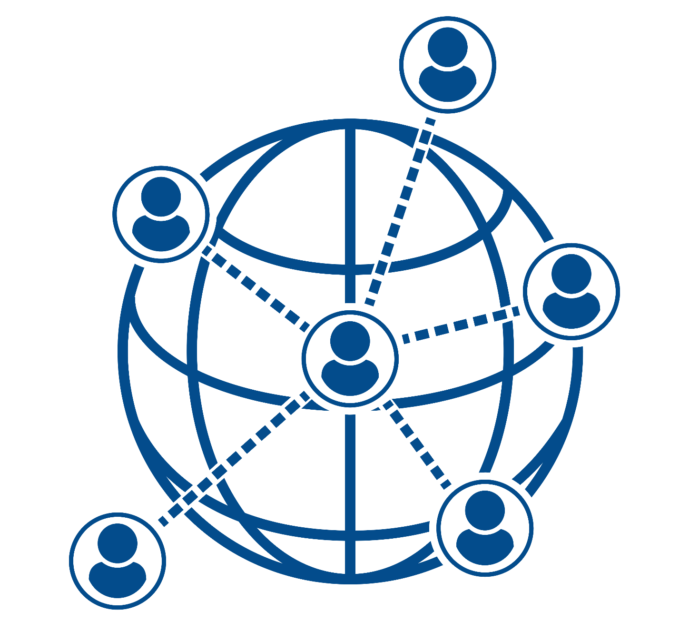
GlobalCoast Network
125 Pilot Sites
60 countries
Notes:
This is what we are here to talk about
Partnership in growing this capacity…

Slide 14
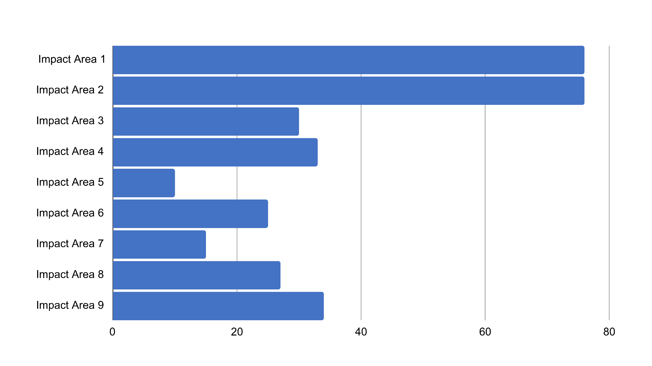
1
2
3
4
5
6
7
8
9
IMPACT AREA 1
Disaster risk reduction - real-time forecasting of extreme events
GlobalCoast: Focus on ‘Impact Areas’ What impact areas are most important for Pilot Sites?
Impacts of climate change on coasts
Pollution impacts
Climate & shorter-term impacts on morphodynamics
Impact Area
Urban oceanography science & planning
Nature Based Solutions, restoration, blue carbon monitoring / uptake
Sustainable food production
Operations at sea - maritime safety, Search and Rescue
Integrated Coastal Zone Management/Marine Spatial Planning
Notes:
Through the GlobalCoast survey we asked what the priority impact areas are for Pilot Sites, so we outlined 9 impact areas and sites could select up to three. And some of these on the next slide…

Slide 15
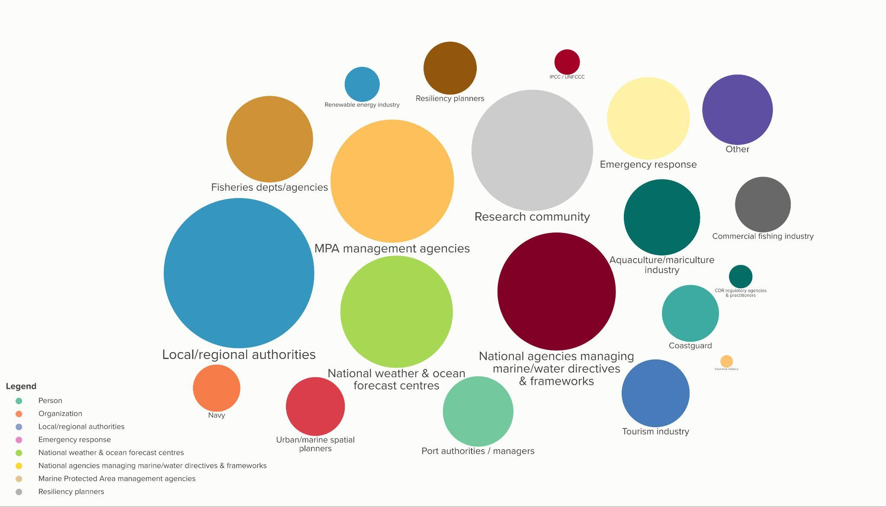
GlobalCoast: User focus Most common ‘stakeholder’
categories
326 engaged institutions
Insurance industry
326 engaged institutions

Slide 16
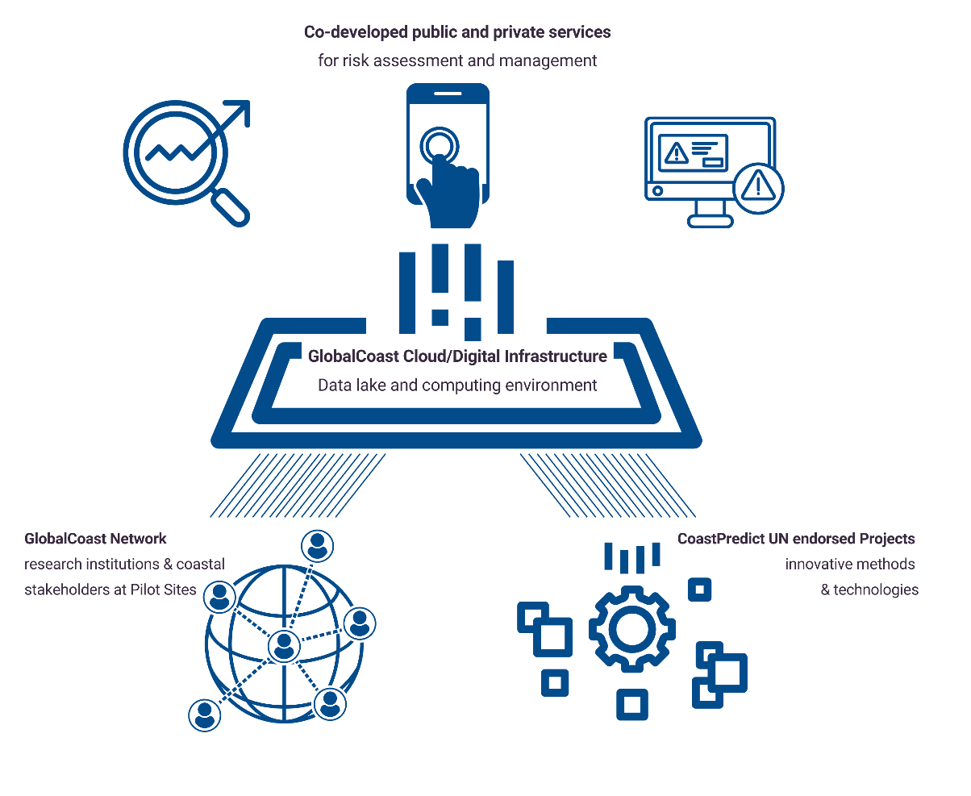
The GlobalCoast Cloud is the solution
overcome tech barriers
connect the work globally
enable public-private collaboration
replicable solutions
harness opportunities

Slide 17
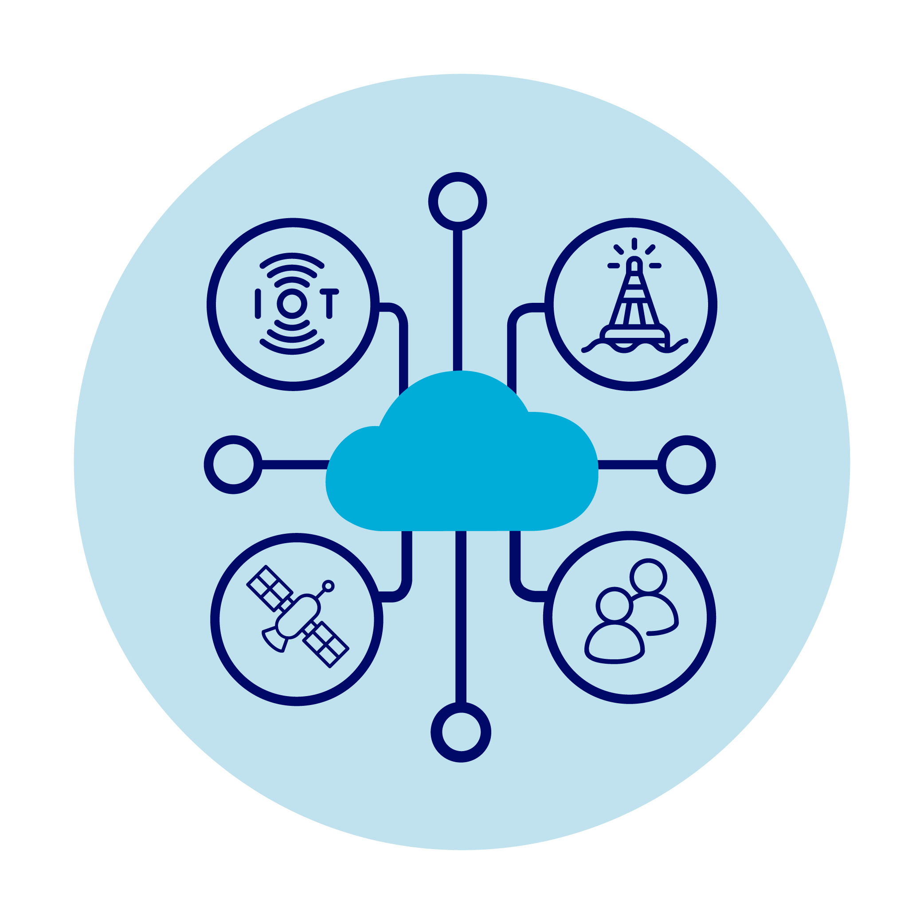
The GlobalCoast Cloud will contain all the pillars of the ocean value chain at Pilot Sites
Real time
Ocean Observing
Routine
multiscale ocean predicting
Customized applications
/Digital Twins
Requirements and feedbacks
Notes:
Advancing tech (interest to Fugro)
Advancing modeling, climate and extremes for the coast, coupling modeling for estuaries and coast
New accessible tech/community science
Delivery solutions (model data is huge) - cloud computing

Slide 18
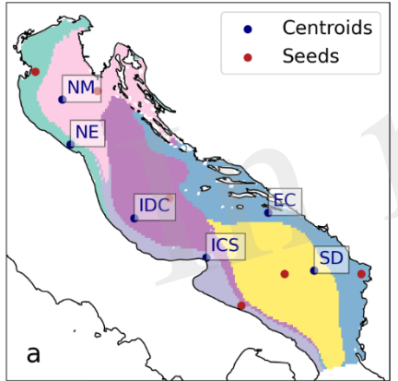
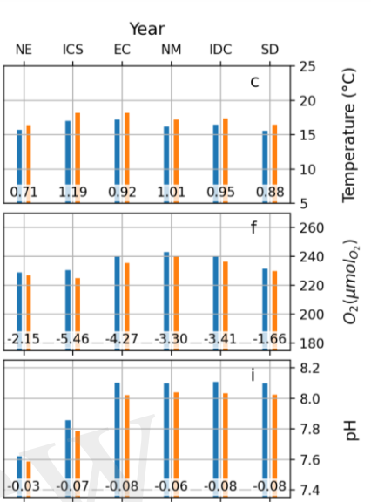
Customised Services and products for the GlobalCoast
Cloud (Impact Areas 1, 2)
IMPACT AREA 1
Multi-risk early warning system for coastal extreme events: storm surge, marine heat wave
Prototype: Savannah, Southeast US Continental Shelf
MVP components:
-SMART sea level sensors
-high-res satellite (40-60 m)
-limited area estuary-shelf models
To be expanded with T sensors & waves
IMPACT AREA 2
Downscaling for climate risk assessment
Prototype: Adriatic Sea
MVP Components:
-30-40 years limited area simulations for different CMIP scenarios uncoupled/coupled atmo-hydro-ocean-biochemistry simulations
-historical data bases for validation
-ERDDAP data store
To be expanded for multiple downscaling

Slide 19
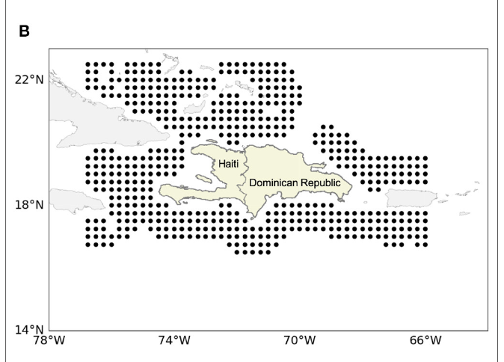
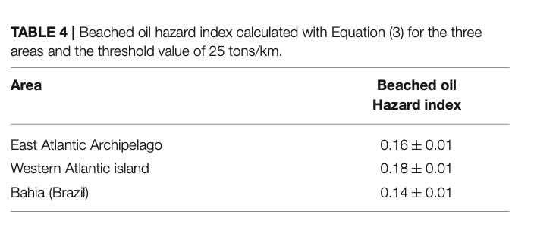
Customised services and Digital Twins for the
GlobalCoast Cloud (Impact Areas 3, 6)
IMPACT AREA 3
Oil spill pollution
forecasting and hazard mapping
Prototype: North Atlantic/global Ocean
MVP Components:
-Medslik II model coupled with CMEMS forecasts and analyses
-SAR imagery analysis
-hazard pollution index for coastal segments
To be re-formulated with AI for hazard mapping
IMPACT AREA 6
Digital Twinds for Seagrass Nature-Based Solutions
Prototype: Emilia-Romagna region / Civitavecchia
-MVP components:
-wave buoys
-limited area wave modelling for seagrass landscaping scenarios
To be expanded to mangroves

Slide 20
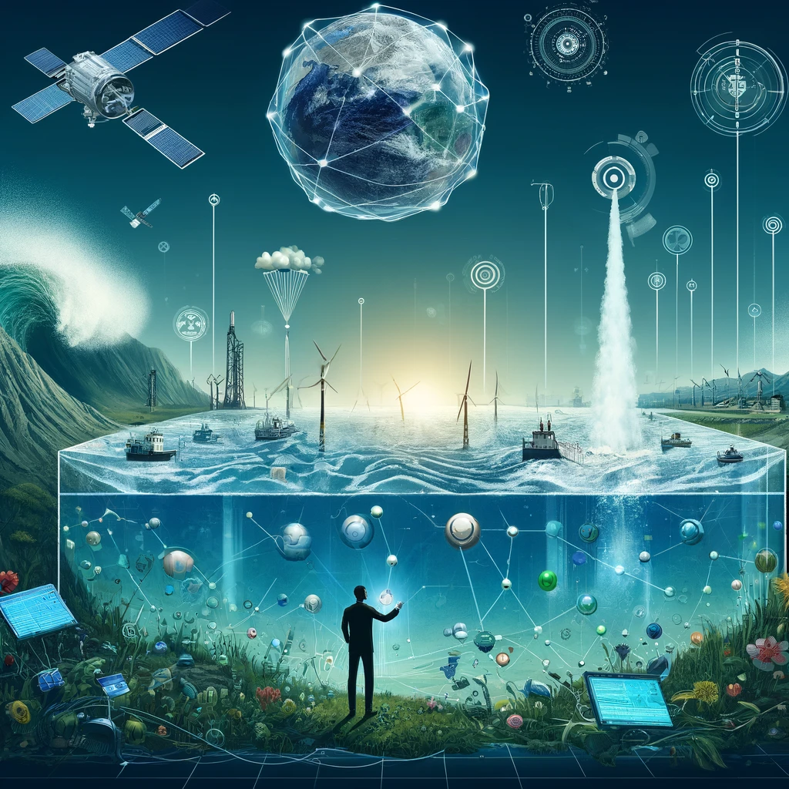
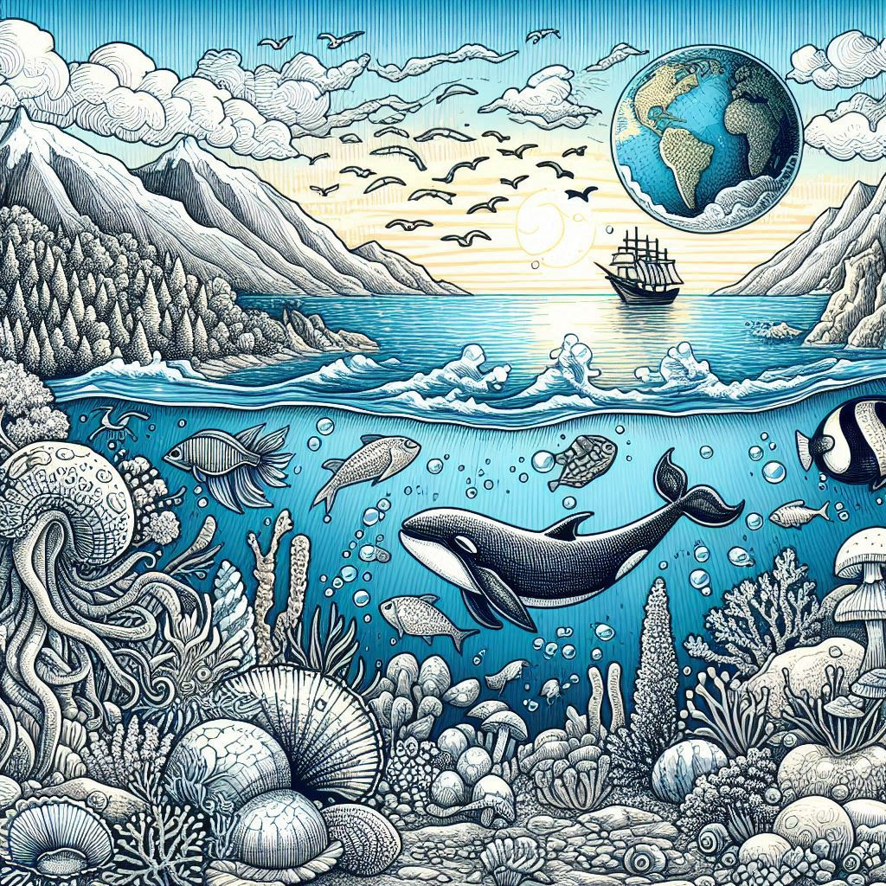
How do we get to the ocean we want?
CHOOSE TO ADAPT
DO MORE AND
EAT VEGGIES
BE CREATIVE AND
USE THE CLOUD
From Prof. Syders AR, Delaware University, June 2024

Slide 21
Thank you
This programme is endorsed by the UN Decade of Ocean Science
coastpredict.org

