Slide 1
Building Thematic Research Data Commons
2 Oct 2024
PRESENTED BY
Keith Russell, Director Outreach
About the ARDC
Notes:
https://whova.com/portal/webapp/egi_202410/Agenda/3970612
The Australian Research Data Commons (ARDC) is establishing 3 national-scale Thematic Research Data Commons to meet Australia’s future research needs with long-term, enduring digital infrastructure. Each Thematic Research Data Commons integrates the ARDC’s underpinning compute, storage infrastructure and services with data assets, analysis platforms and tools. Each is supported by our expertise, skills building activities and our work on developing community-agreed standards and best practices. These coordinated, structured, and complementary activities are building data assets, tools and skills that will constitute a national ‘knowledge infrastructure’ that enables Australian researchers to transform our lives and address the complex global challenges we are facing through Open Science. They are co-designed with the research community through extensive consultations and broad partnerships, they will enable us to achieve our goal of supporting the maximum number of researchers in strategic priority areas of research through a new approach to participation and organisation.
Global Landscape: How advanced computational resources—such as high-performance computing, cloud platforms, data repositories, and collaborative tools—are driving innovation, inclusivity, and progress in global scientific research.
Current Solutions: How EGI and worldwide infrastructures are breaking down barriers, fostering collaboration, and empowering researchers to address complex global challenges through Open Science.
Future Opportunities: What emerging trends and developments can further enhance Open Science and promote global research collaboration?

Slide 2
About the ARDC

Slide 3
About the ARDC
Notes:
The ARDC was established under the Australian Government’s National Collaborative Research Infrastructure Strategy or NCRIS in 2019.
This national research infrastructure could be a physical instrument like an electronic microscope, or a service like manufacturing of nano technology, or digital like the cloud compute and it tends to be bigger in scale than any single or group of universities could provide their researchers.
The ARDC was created from three earlier data-focused national digital research infrastructure organisations: Australian National Data Service (ANDS), NeCTAR, and Research Data Services (RDS).
It is now a not for profit company limited by guarantee, which along with the 25 other organisations supported by NCRIS that you can see here, provide national research infrastructure for Australian researchers.
Some of the NCRIS capabilities and supporting capabilities you might be familiar with for your research projects are AAF (who provide a Single Sign-on using Federated Access through research institutions), AARnet (provider of Cloudstor storage for institutions), NCI and Pawsey provide access to their supercomputers for Australian researchers. The other NCRIS capabilities are discipline specific. To find out more about their services, visit ncrisportal.org.au

Slide 4
About the ARDC
Notes:
The ARDC was established under the Australian Government’s National Collaborative Research Infrastructure Strategy or NCRIS in 2019.
This national research infrastructure could be a physical instrument like an electronic microscope, or a service like manufacturing of nano technology, or digital like the cloud compute and it tends to be bigger in scale than any single or group of universities could provide their researchers.
The ARDC was created from three earlier data-focused national digital research infrastructure organisations: Australian National Data Service (ANDS), NeCTAR, and Research Data Services (RDS).
It is now a not for profit company limited by guarantee, which along with the 25 other organisations supported by NCRIS that you can see here, provide national research infrastructure for Australian researchers.
Some of the NCRIS capabilities and supporting capabilities you might be familiar with for your research projects are AAF (who provide a Single Sign-on using Federated Access through research institutions), AARnet (provider of Cloudstor storage for institutions), NCI and Pawsey provide access to their supercomputers for Australian researchers. The other NCRIS capabilities are discipline specific. To find out more about their services, visit ncrisportal.org.au

Slide 5
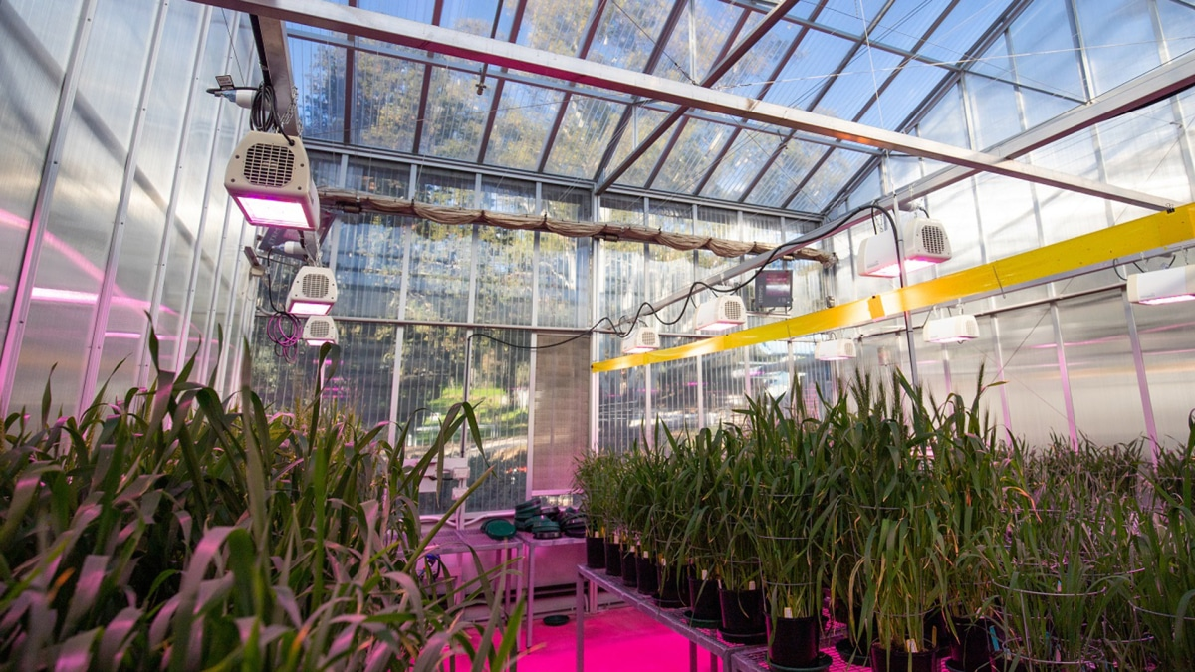
About the ARDC
Notes:
The ARDC was established under the Australian Government’s National Collaborative Research Infrastructure Strategy or NCRIS in 2019.
This national research infrastructure could be a physical instrument like an electronic microscope, or a service like manufacturing of nano technology, or digital like the cloud compute and it tends to be bigger in scale than any single or group of universities could provide their researchers.
The ARDC was created from three earlier data-focused national digital research infrastructure organisations: Australian National Data Service (ANDS), NeCTAR, and Research Data Services (RDS).
It is now a not for profit company limited by guarantee, which along with the 25 other organisations supported by NCRIS that you can see here, provide national research infrastructure for Australian researchers.
Some of the NCRIS capabilities and supporting capabilities you might be familiar with for your research projects are AAF (who provide a Single Sign-on using Federated Access through research institutions), AARnet (provider of Cloudstor storage for institutions), NCI and Pawsey provide access to their supercomputers for Australian researchers. The other NCRIS capabilities are discipline specific. To find out more about their services, visit ncrisportal.org.au

Slide 6
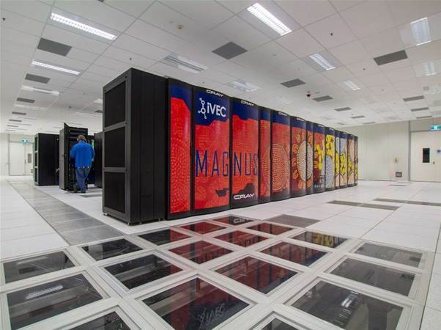
About the ARDC
Notes:
The ARDC was established under the Australian Government’s National Collaborative Research Infrastructure Strategy or NCRIS in 2019.
This national research infrastructure could be a physical instrument like an electronic microscope, or a service like manufacturing of nano technology, or digital like the cloud compute and it tends to be bigger in scale than any single or group of universities could provide their researchers.
The ARDC was created from three earlier data-focused national digital research infrastructure organisations: Australian National Data Service (ANDS), NeCTAR, and Research Data Services (RDS).
It is now a not for profit company limited by guarantee, which along with the 25 other organisations supported by NCRIS that you can see here, provide national research infrastructure for Australian researchers.
Some of the NCRIS capabilities and supporting capabilities you might be familiar with for your research projects are AAF (who provide a Single Sign-on using Federated Access through research institutions), AARnet (provider of Cloudstor storage for institutions), NCI and Pawsey provide access to their supercomputers for Australian researchers. The other NCRIS capabilities are discipline specific. To find out more about their services, visit ncrisportal.org.au

Slide 7
About the ARDC
Notes:
Started in 2006
The Australian Government has invested $4 billion over 12 years (from 2018 to 2029) to support important pieces of national research infrastructure and make sure Australian researchers can access them.
26 facilities

Slide 8
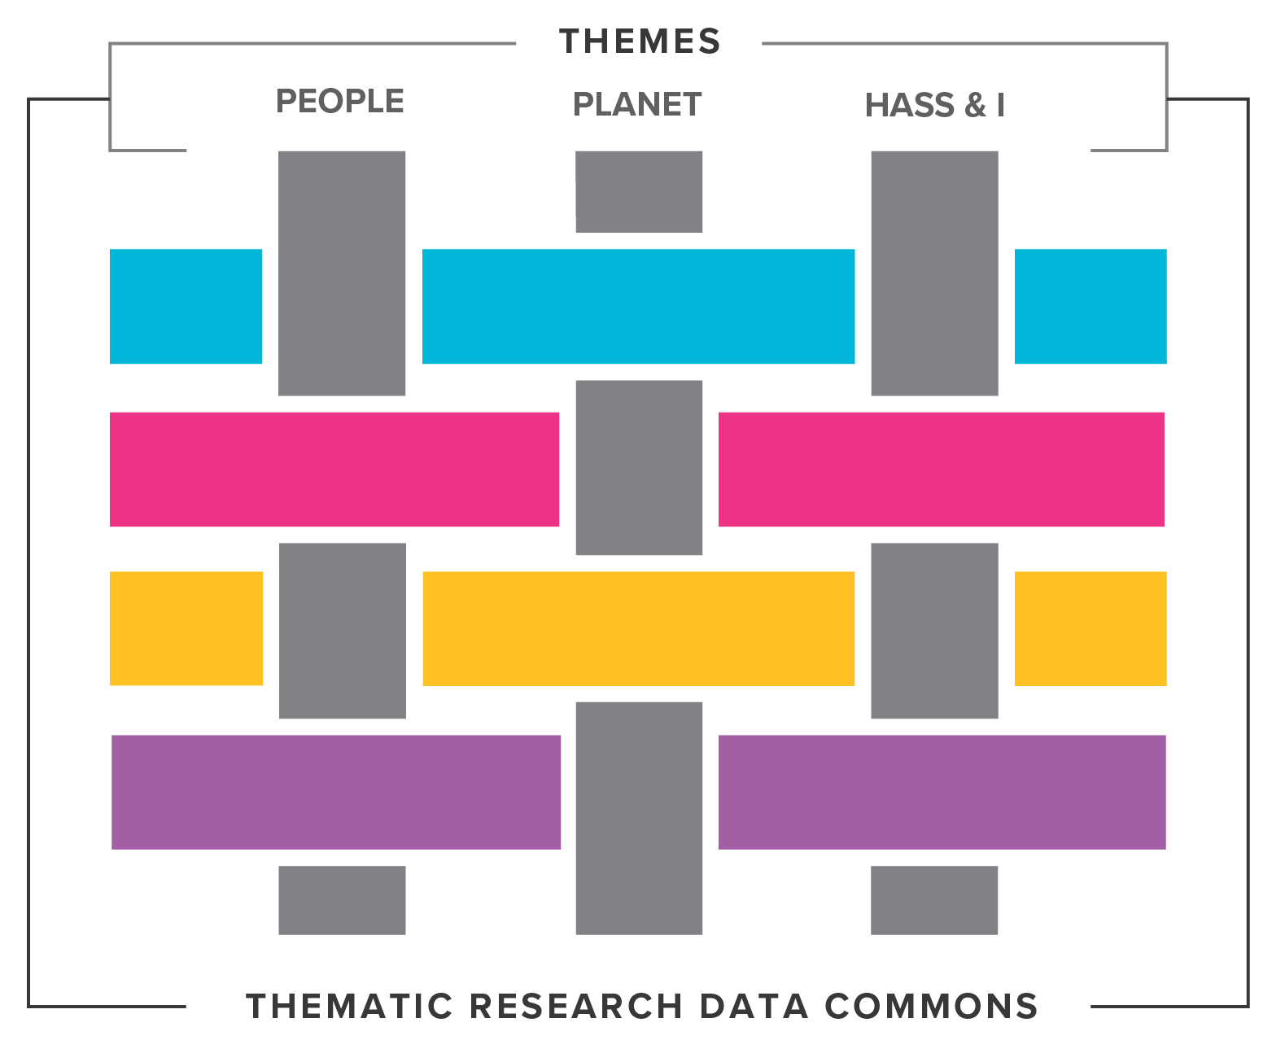
THE ARDC STRATEGY
OUR PURPOSE
To provide Australian researchers with competitive advantage through data.
OUR MISSION
To accelerate research and innovation by driving excellence in the creation, analysis and retention of high‑quality data assets.
Notes:
Notes –
Interim strategy slide
The ARDC’s purpose is to provide Australian researchers with competitive advantage through data.
We accelerate research and innovation by driving excellence in the creation, analysis and retention of high-quality data assets.
This is the current ARDC strategy. We operate a range of programs and services over four portfolios. The two main portfolios are Platforms & Software and Data & Services. Our Storage & Compute and People & Policy portfolios support the work that the two main portfolios undertake.
For the last two years, we have been running a range of open calls that have given us a unique insight into the digital research infrastructure needs of the Australian community and which has influenced our priorities.

Slide 9
WHAT WE DO
The ARDC runs programs and facilitates partnerships that ensure Australian researchers are internationally competitive through having access to high-quality data assets, platforms, infrastructure, policies, people and training to transform our lives.
About the ARDC
Notes:
The ARDC runs programs and facilitates partnerships.
It ensures Australian researchers are internationally competitive by having access to high-quality national data assets, platforms, infrastructure, policies, people and training to transform the lives of our community.

Slide 10
Notes:
In the past years through open calls we embarked on a multitude of projects with partners to establish significant data collections and platforms for researchers to analyse their data on.
A number of these projects are wrapping up now and are presenting at this conference.
That includes projects on Characterisation at Scale, secure platforms for analysing sensitive data, integrated national air pollution and health data, Restricted Access Species Data Pathways, Leveraging Data to Support Young People’s Education and Wellbeing and the Language Data Commons of Australia
This has resulted in a wide variety of data and tools for researchers to use.
Microscope: Australian Characterisation Commons at Scale (ACCS)
Ambulance: ERICA
Baby foot + hospital: National Transfusion Dataset
MRI: Australian Imaging Service
Air pollution: Integrated National Air Pollution and Health Data
Bird: Restricted Access Species Data Pathways From Decision Making to Research + Open Ecoacoustics + EcoCommons
Farm: Biosecurity Commons
Winery: AusTraits + Climate Atlas (run on Nectar)
Scuba divers: Ocean Data Repository
Waves: Catching Oz Waves
Kids: Leveraging Data to Support Young People’s Education and Wellbeing + Australian Child and Youth Wellbeing Atlas
Library: Transforming the Online Heritage Resource Management Tool to Describo Collections + Trove Researcher Platform for Advanced Research
Maps: TLC + LDaCA

Slide 11
Notes:
ARDC STRATEGIC PRIORITIES JANUARY 2024 - JUNE 2025 (18 MONTHS)
Between January 2024 and June 2025 we are conducting significant co-design activities for the Thematic Research Data Commons, as well as activities for the underpinning national cloud, national information infrastructure, skills and Research Link Australia and policy.

Slide 12
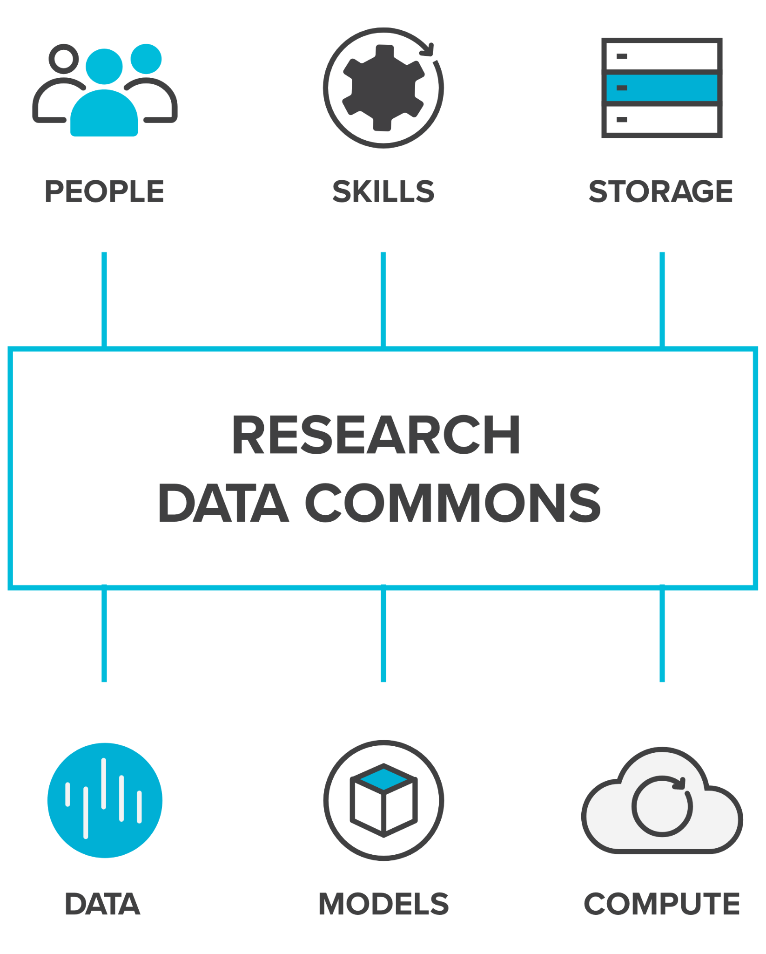
WHAT IS A RESEARCH DATA COMMONS?
A research data commons brings together people, skills, data, and related resources such as storage, compute, software, and models to enable researchers to conduct world class data-intensive research.
Notes:
We are called the Australian Research Data Commons, and we’re working to build national research data commons for Australia.
But what is a research data commons?
A research data commons brings together people, skills, data, and related resources such as storage, compute, software, and models to enable researchers to conduct world class data-intensive research.
We support open research, and specifically the FAIR principles which ensure that data is findable, accessible, interoperable and reusable for all researchers.

Slide 13
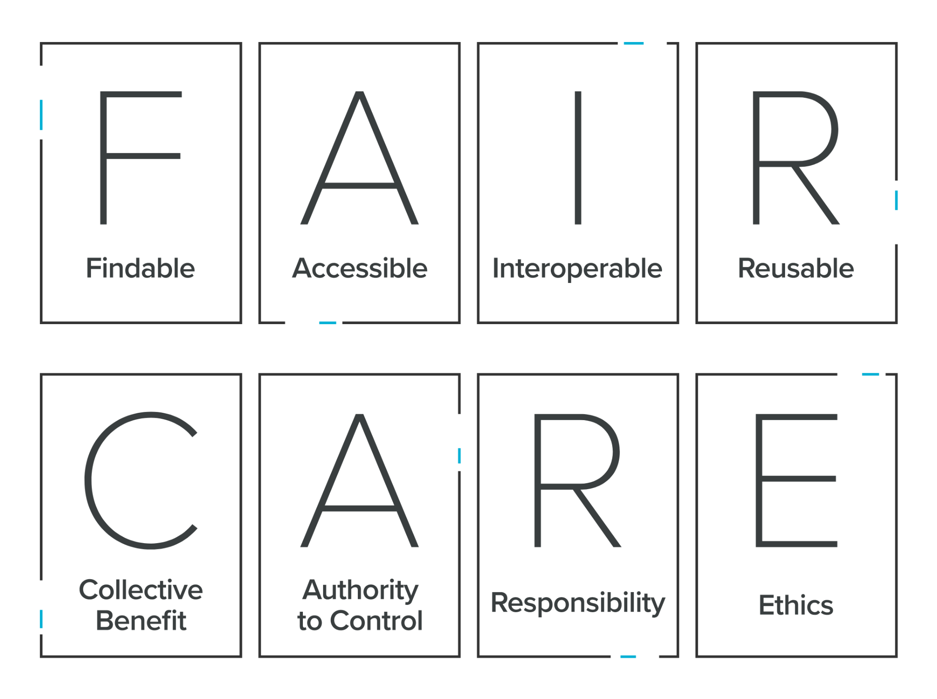
FAIR & CARE Principles
Notes:
FAIR AND CARE PRINCIPLES
The FAIR and CARE principles underpin everything we do.
The ‘FAIR Guiding Principles for scientific data management and stewardship’ were published in 2016 and relate to making digital assets findable (F), accessible (A), interoperable (I) (allowing data to work across different platforms) and also reusable (R).
We ask for research assets to be as easily accessible as possible because accessible research inputs and outputs drive research impact, quality, translation and innovation, which is great for research and society.
We recognise that translating the FAIR principles into practice will vary for each discipline.
In the context of the rise of the FAIR principles in the community of international data infrastructure builders, the Global Indigenous Data Alliance formulated the CARE principles, to address a clear deficit in FAIR regarding Indigenous peoples rights and interests.
‘CARE’ is the acronym for:
Collective benefits - Data ecosystems shall be designed and function in ways that enable Indigenous peoples to derive benefit from the data.
Authority to control - Indigenous peoples’ rights and interests in Indigenous data must be recognised and their authority to control such data be empowered.
Responsibility - Those working with Indigenous data have a responsibility to share how those data are used to support Indigenous peoples’ self-determination and collective benefit.
Ethics - Indigenous peoples’ rights and wellbeing should be the primary concern at all stages of the data life cycle and across the data ecosystem.
The CARE principles complement the existing FAIR principles.
While the FAIR principles are about making it easier to share and reuse data, the CARE principles ensure that data is used ethically and with appropriate governance.

Slide 14
Planet RDC
Notes:
For all the RDCs we have collected input in a large number of sessions, both from researchers and infrastructure providers. We have been looking at
What are the data infrastructure challenges we should address?
How will addressing these challenges impact research in your domain?
This resulted in a very rich tapestry of answers

Slide 15
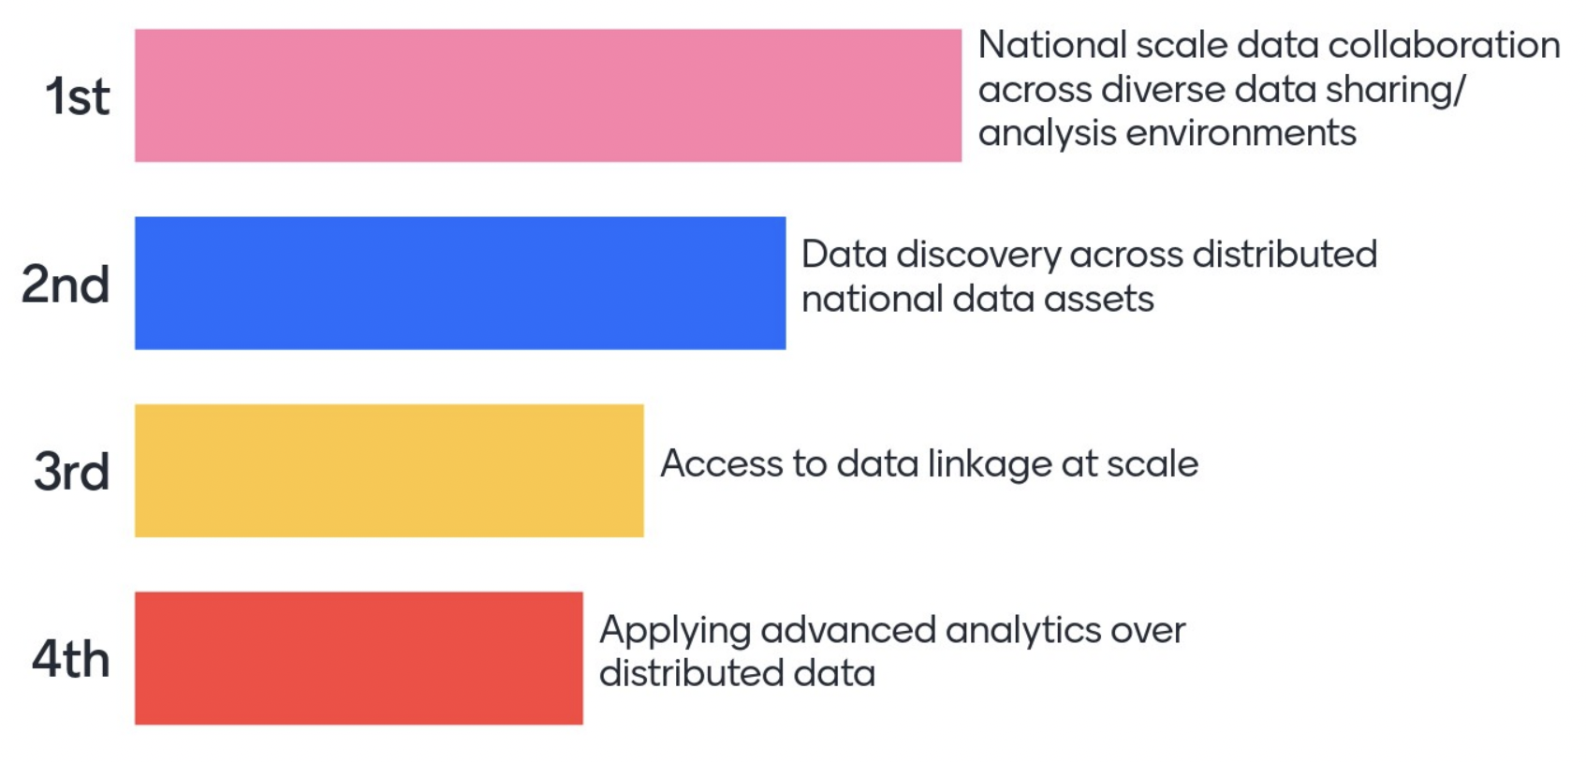
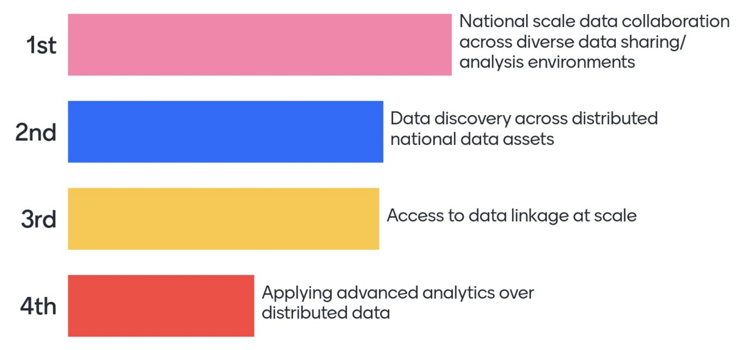
RANKING OF DATA CHALLENGES
(from public roundtables)
Notes:
This resulted in slight variations, but generally quite consistent responses. Here you can find the four key data challenges that arose out of consultations in our People Research Data Commons

Slide 16
PEOPLE RESEARCH DATA COMMONS
A national-scale data infrastructure for health research and research translation
Image — Gorodenkoff - 236237514 / AdobeStock.com
About the ARDC
Notes:
PEOPLE RESEARCH DATA COMMONS PROGRAM
The ARDC has launched a new digital research infrastructure program, called the People Research Data Commons.
It will support health and biomedical researchers in solving some of Australia’s biggest societal health and medical challenges for Australia.
The new program started with consultations with the health research community and is now consulting with national infrastructure organisations.
To get involved, visit our website.
https://ardc.edu.au/collaborations/strategic-activities/people-research-data-commons/

Slide 17
PEOPLE
Research Data Commons
Data Challenges
Data strategy and discovery
Secure Data Access
Data Integration
Advanced Analytics
Notes:
PEOPLE DATA CHALLENGES
The People RDC consists of 4 digital health research challenges identified in consultation:
FAIR Assets (Data strategy and discovery)
Secure Data Access (Trusted Research Environments and Data Governance)
Data Integration (Data standards, common models)
Advanced Analytics (Machine Learning, Natural Language Processing, Large Language Models applied to sensitive data)
For each challenge, national frameworks are developed through a co-design process.
Coordinated strategic implementation projects in each challenge area will then commence, focusing on data from three key sources: health studies (academic); the health system (government); and national facilities (NCRIS).
Once developed and implemented, the analytics infrastructure and the national capabilities built through [our 4 streams of program] will be brought together and applied to improve health services and address specific disease areas. By building these fundamental digital capabilities, the ARDC can meet the needs of diverse health and medical research communities throughout Australia in a strategic and comprehensive way.
Image credits clockwise
Gorodenkoff - 415824724 / adobestock.com
DC Studio - 574566575 / adobestock.com
Sharne T/peopleimages.com - 577006515 / adobestock.com
zinkevych - 155822173 / adobestock.com

Slide 18
PEOPLE RDC - PORTFOLIO DESIGN

Slide 19
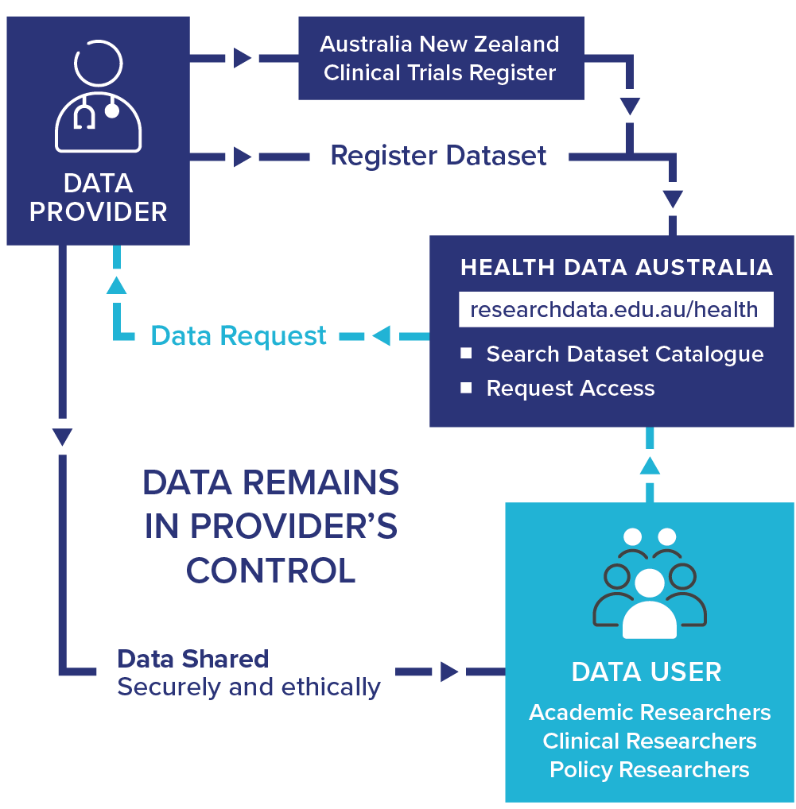
HeSANDA
Health Studies Australian National Data Asset
Mobilising data from clinical trials to provide new insights and improve clinical care
Notes:
EXAMPLE: Health Studies Australian National Data Asset (HeSANDA)
The People RDC builds on our experience creating national digital research infrastructure for health and medical researchers. One example is, HeSANDA, our Health Studies National Data Asset, which is a national research infrastructure that is enabling researchers to share, access and reuse health research data to increase research impact and integrity.
The first phase of HeSANDA has worked alongside the health research community to support the sharing of clinical trials data.
The program includes 91 collaborators from 72 organisations, including 18 universities, 10 medical research institutes, 19 health service operators and 16 clinical trials networks.
Potential Benefits of HeSANDA include:
Collaboration
New health and medical research
Reduce costs, duplication, saves time
Extends the life of initial research
Contributes to data integrity
The next phase of the program has started already to expand the coverage beyond clinical trials data to data from observational studies such as cohort studies, and will integrate technologies to enable secure analysis of data.
https://ardc.edu.au/program/health-studies-australian-national-data-asset/

Slide 20
PLANET RESEARCH DATA COMMONS
National-scale data infrastructure for environmental research and decision making
Image — themorningglory - 391783296 / STOCK.ADOBE.COM
About the ARDC
Notes:
PLANET RESEARCH DATA COMMONS PROGRAM
The ARDC has launched consultations for the Planet Research Data Commons.
It will deliver new digital research infrastructure to support environmental researchers and decision makers.
The Planet Research Data Commons will deliver shared, accessible data and digital research tools so researchers can tackle the big challenges for our environment, which include adapting to climate change, saving threatened species, and reversing ecosystem deterioration.
To get involved, please visit our website.
https://ardc.edu.au/collaborations/strategic-activities/planet-research-data-commons/

Slide 21
PLANET
Research Data Commons
Focus Areas
Trusted environmental data and information supply chains
Integrated FAIR datasets and services
Planet Infrastructure (networked modelling, analytics and decision support infrastructure)
Indigenous Data Governance and Skills.
Notes:
4 DATA CHALLENGE FOCUS AREAS
The Thematic RDCs are enduring initiatives, with the digital research infrastructure capabilities being sustained and enhanced over the long term.
The Planet RDC is applying ARDC capabilities and expertise in digital research infrastructure to national challenges in the earth and environmental science domains.
The Planet RDC has 4 focus areas, which were identified through our consultation process:
Trusted Environmental Data and Information Supply Chains
Integrated Fair Datasets and Services
Planet Infrastructure (Networked Modelling, Analytics and Decision Support)
Indigenous Data Governance and Skills.
These 4 data challenge areas are integrated through overarching use cases based on the data infrastructure needs of government, research and industry in selected regions of national interest and priority.
Image credits clockwise
benn-mcguinness - 9wBpPBwjf6E / unsplash.com
Kwest - 250159754 / adobestock.com
leelakajonkij - 168285012 / adobestock.com
Paul - 509331011 / adobestock.com

Slide 22
HUMANITIES, ARTS, SOCIAL SCIENCES (HASS) AND INDIGENOUS RESEARCH DATA COMMONS
National-scale data infrastructure for HASS and Indigenous research and decision making
Image — Mario Purisic - jG1z5o7NCq4 / unsplash.com
About the ARDC
Notes:
HUMANITIES, ARTS AND SOCIAL SCIENCES (HASS) AND INDIGENOUS RESEARCH DATA COMMONS
The third initiative is the Humanities, Arts and Social Sciences and Indigenous Research Data Commons (or HASS and I RDC).
The 4 activities in the HASS and Indigenous RDC were funded through the October 2020 Research Infrastructure Investment Plan.
ARDC held a number of workshops and roundtables to gauge researcher requirements and three activities are approved and underway.
By clustering the projects, we can engage deeply with the community to identify and build the capability and ensure that best practice is shared across the projects and to other domains.
A key consideration is identifying the activities that will benefit all four streams.
One example is the need for standard access and authentication for research communities to enable collaborations.
We anticipate that all 4 streams can leverage this and it can then be rolled out beyond the HASS and Indigenous RDC.
https://ardc.edu.au/program/hass-rdc-indigenous-research-capability/

Slide 23
HASS & INDIGENOUS Research Data Commons
Focus Areas
Improving Indigenous Research Capabilities: An Aboriginal and Torres Strait Islander Research Data Commons
The Language Data Commons of Australia
Media(ted) data
Creative arts
Social Sciences program
ARDC Community Lab
Notes:
PROGRAMS
The existing and ongoing projects include:
The Language Data Commons of Australia
Social Sciences program
Improving Indigenous Research Capabilities: An Aboriginal and Torres Strait Islander Research Data Commons
The HASS and Indigenous RDC is also supported by a number of integration activities that deal with specific technical and infrastructure challenges identified by the projects.
They are:
Open access to data beyond researchers
ARDC Community Data Lab
Rescuing high value historical collections
We are expanding into 2 new project areas in 2024:
media(ted) data
creative arts
Be part of the HASS and Indigenous RDC, visit bit.ly/HASSRDC
Image credits clockwise
ARDC D-Hannah - HASS Summer School Feb24 (person)
ARDC Renee Nowytarger - HASS Summer School Feb23 (person)
ARDC_Marc Grimwade__Bringing_Data_to_Life Aug22
ARDC Anthony McKee HASS Symposium Feb23 (person)

Slide 24
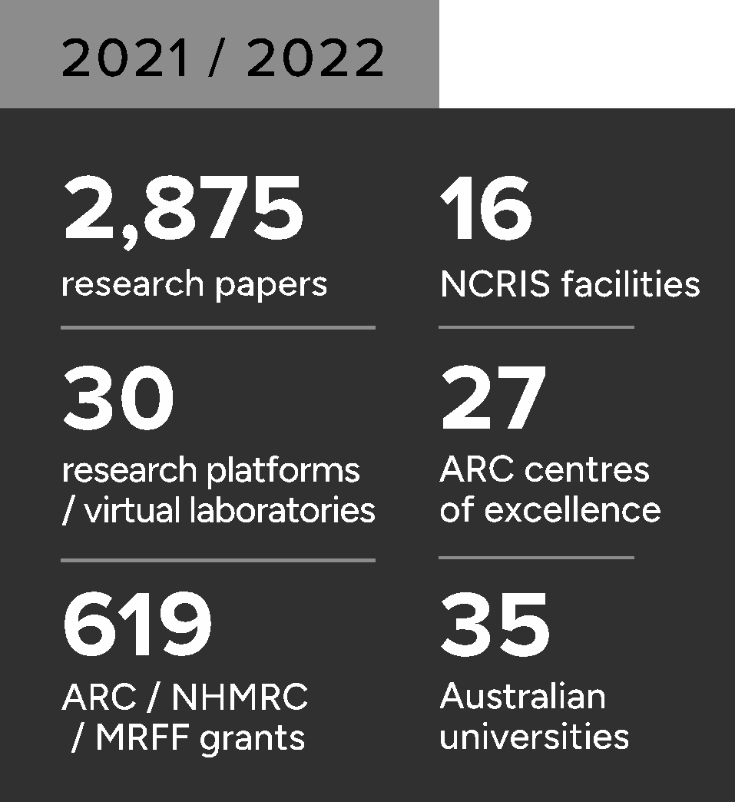
ARDC Nectar Research Cloud
is Australia’s federated national research cloud providing the research community with on-demand computing infrastructure and software
Notes:
ARDC NECTAR RESEARCH CLOUD
Australia’s national research cloud, is specifically designed for research computing and ARDC services powered by Nectar.
Launched in 2012, Nectar provides Australia’s research community with fast, interactive, self-service access to large-scale computing infrastructure, software and data.
A powerful platform for collaboration, it allows researchers and research support staff to access compute resources, software and data from their offices and homes and easily share them with collaborators at other institutions.
Image credits clockwise
Image —Loic Le Guilly / ARDC - The team behind the ARDC Nectar Research Cloud – team members from the nodes and the ARDC at a technical workshop in 2024
Image —Marc Grimwade / ARDC - Jake Yip from the ARDC with Michael Mallon from QCIF, a node of the ARDC Nectar Research Cloud, at a technical workshop in 2022
Image —Marc Grimwade / ARDC - Darcelle Malby and Sonia Ramza from the ARDC at an ARDC Nectar Research Cloud technical workshop in 2022

Slide 25
Services Powered by ARDC Nectar Research Cloud
Virtual Desktop Service
Jupyter Notebook Service
ARDC Nectar
Research Cloud
National GPU Service
Kubernetes Services
BinderHub Service
Compute & Storage
Notes:
SERVICES POWERED BY THE ARDC NECTAR RESEARCH CLOUD
As well as providing the ARDC Nectar Research Cloud for researchers to use for compute and storage, we also run a number of cloud services for researchers which are powered by Nectar.
Services powered by Nectar include:
Virtual Desktop Service
Jupyter Notebook Service
National GPU Service
Kubernetes Services
BinderHub Service

Slide 26
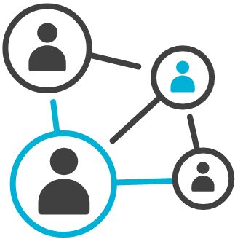
Research Data & Information Services
ARDC Research
Data Australia
ARDC Research Vocabularies Australia
Specialist platforms, including
Identifier
Services
Health Data Australia
Research Link Australia
Notes:
RESEARCH DATA AND INFORMATION SERVICES
ARDC provides a number of connected data and information services that support the discovery of data, software and tools with related information on grants, research activities, publications, authors and contributors.
Our information services support unambiguous identification of data, materials, projects, vocabularies, activities and services.
This facilitates the interoperability, use and reuse of the data assets created.
Services include:
Research Data Australia - an online data discovery portal
Specialist platforms, including:
Health Data Australia - a national catalogue of Australian health data, starting with clinical data
Research Link Australia - a portal for bridging the information gap between research, industry, business and government for impactful innovation
Grants
Research Vocabularies Australia - an online service for creating, managing, finding and accessing controlled vocabularies, which make the meaning of research data clear and explicit
Identifier Services - a range of services for research organisations to create and manage persistent identifiers
All of these services are hosted on the ARDC Nectar Research Cloud - Australia’s national research cloud service.

Slide 27
What are Persistent Identifiers (PIDs)
PIDs for People
PIDs for Research Grants
PIDs for Data & Research Outputs
Linking the elements of the research community
PIDs for Organisations & Institutions
PIDs for Instruments
PIDs for Research Projects & Activities
Notes:
WHAT ARE PERSISTENT IDENTIFIERS?
What are Persistent Identifiers?
Persistent identifiers have three main attributes.
First, they’re persistent, which means they are intended to be around, if not forever, then for a very long time.
Second, they’re unique.
You can use the same name to identify two different people or things, and one person or thing can have more than one name.
But a PID is a unique identifier, one that is used only for one person or thing, even if they have lots of different names, or those names change or get abbreviated.
A third quality is that they have open metadata — the metadata provides information about the person or thing it refers to.
Openness enables anything or anyone to have, use, and share their PIDs, for everyone’s benefit.
There are six types of PIDs that are in use or near production, which include:
PIDs for People - these are identifiers for researchers and include ORCID iDs. We support the promotion of these nationally to researchers.
PIDs for Organisations & Institutions - these are for research organisations and include ROR.
PIDs for Research Grants - Crossref offers Grant IDs, and DataCite is trialing their own version (both are DOIs).
PIDs for Instruments - DOIs for instruments are currently being trialed; RRIDs can be used to specify the type or model of instrument, or to reference facilities.
PIDs for Data and Research Outputs - these are for research outputs/inputs like publications, datasets, software, reviews, preprints, etc and include Crossref and DataCite DOIs, IGSNs, Handles, and more.
PIDs for Research Projects and Activities - RAiDs, developed by the ARDC, can be used to identify and relate projects, outputs, contributors, and other research activities.

Slide 28
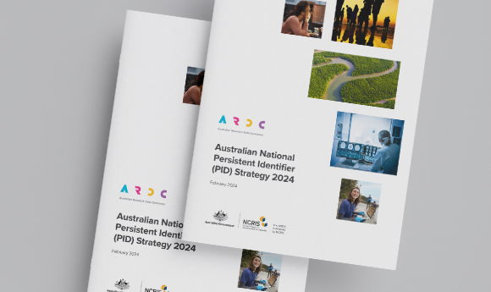
NATIONAL PID STRATEGY
After thorough consultation
Strategic Advisory Group
Strategy released Feb 2024
Roadmap being developed through Stakeholder Action Groups
https://pidroadmap.ardc.edu.au/pids/

Slide 29
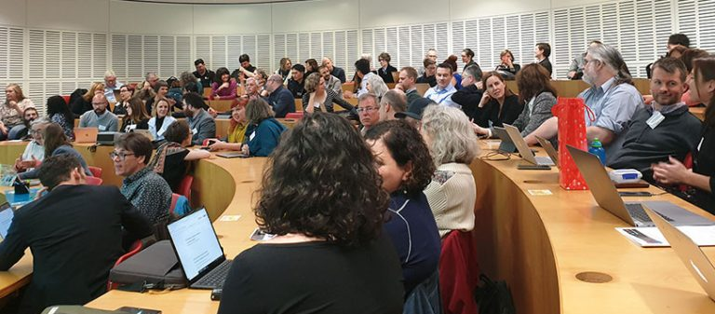
Skilled Researcher Workforce
Notes:
CREATING A SKILLED WORKFORCE FOR AUSTRALIAN RESEARCHERS
The ARDC is focused on making sure Australian researchers have access to advanced digital research skills to use and manipulate data to its full potential.
We bring together partners, lead agencies, peak bodies and other stakeholders to create and implement a National Digital Research Skills Agenda.
We partner with the people who train researchers at universities and institutions around Australia. Working together, we establish and nurture communities of practice around researcher training. The objective is to lead discussion and active planning to develop a national skills agenda that focuses on coordination, collaboration, partnerships and sustainable outcomes.
On the ground, our role is to boost skills development in strategically important areas like cloud computing, machine learning, and data modelling. Solid grounding in these areas are what will give Australian researchers a competitive edge through data.
Two initiatives are:
The Carpentries
The Carpentries is an international organisation that teaches foundational coding and data science skills to researchers worldwide.We've launched an exciting partnership between 10 Australian universities to teach essential coding and data science skills to researchers using The Carpentries. Our partners are:
ARDC (Coordinator)
AARNet
AIMS (Australian Institute of Marine Science)
Burnet Institute
Curtin University
Intersect
Monash University
National Computational Infrastructure (NCI)
Pawsey Supercomputing Centre
QCIF
University of New South Wales (UNSW)
University of Western Australia (UWA)
(NB. Partners for the ARDC Carpentries Partnership will change from year to year)
DReSA
Digital Research Skills Agenda or ‘‘DReSA’ is a digital portal for researchers, trainers and training providers to discover and organise digital research and data training materials, resources & events in Australasia.
Digital research training providers & trainers can use DReSA to:
Promote and share training events and materials
Contribute to the growing catalogue of materials
Establish collaborative training partnerships
Create provider and trainer profiles
Researchers & research support professionals can use DReSA to:
Find training and materials by topic, location, organiser, audience etc.
Subscribe to receive new events and materials

Slide 30
Communities of Practice
Sensitive Data Community
Data Repositories Community
Institutional Underpinnings Community
Australian Research Data Management Community
Data Management Plans Interest Group
Australian Research Containers Orchestration Service (ARCOS)
Notes:
COMMUNITIES OF PRACTICE
To support the research community, we run a range of Communities of Practice groups and interest groups to share knowledge, expertise and disseminate best-practice for tackling data challenges.
The communities on this slide are just a few of the communities we support, and we review these groups regularly to ensure they serve the wider community.
Currently we are reviewing these communities to ensure they align with the Thematic Research Data Commons.
Visit our website to learn more and see if one of the groups is relevant for you.
See a full list and join: https://ardc.edu.au/resources/communities-of-practice/
Image credits clockwise
Flamingo Images - 268793099 / adobestock.com
Prostock-studio - 256860388 / adobestock.com
WavebreakmediaMicro - 124980928 / adobestock.com
pressmaster - 107931662 / adobestock.com

Slide 31
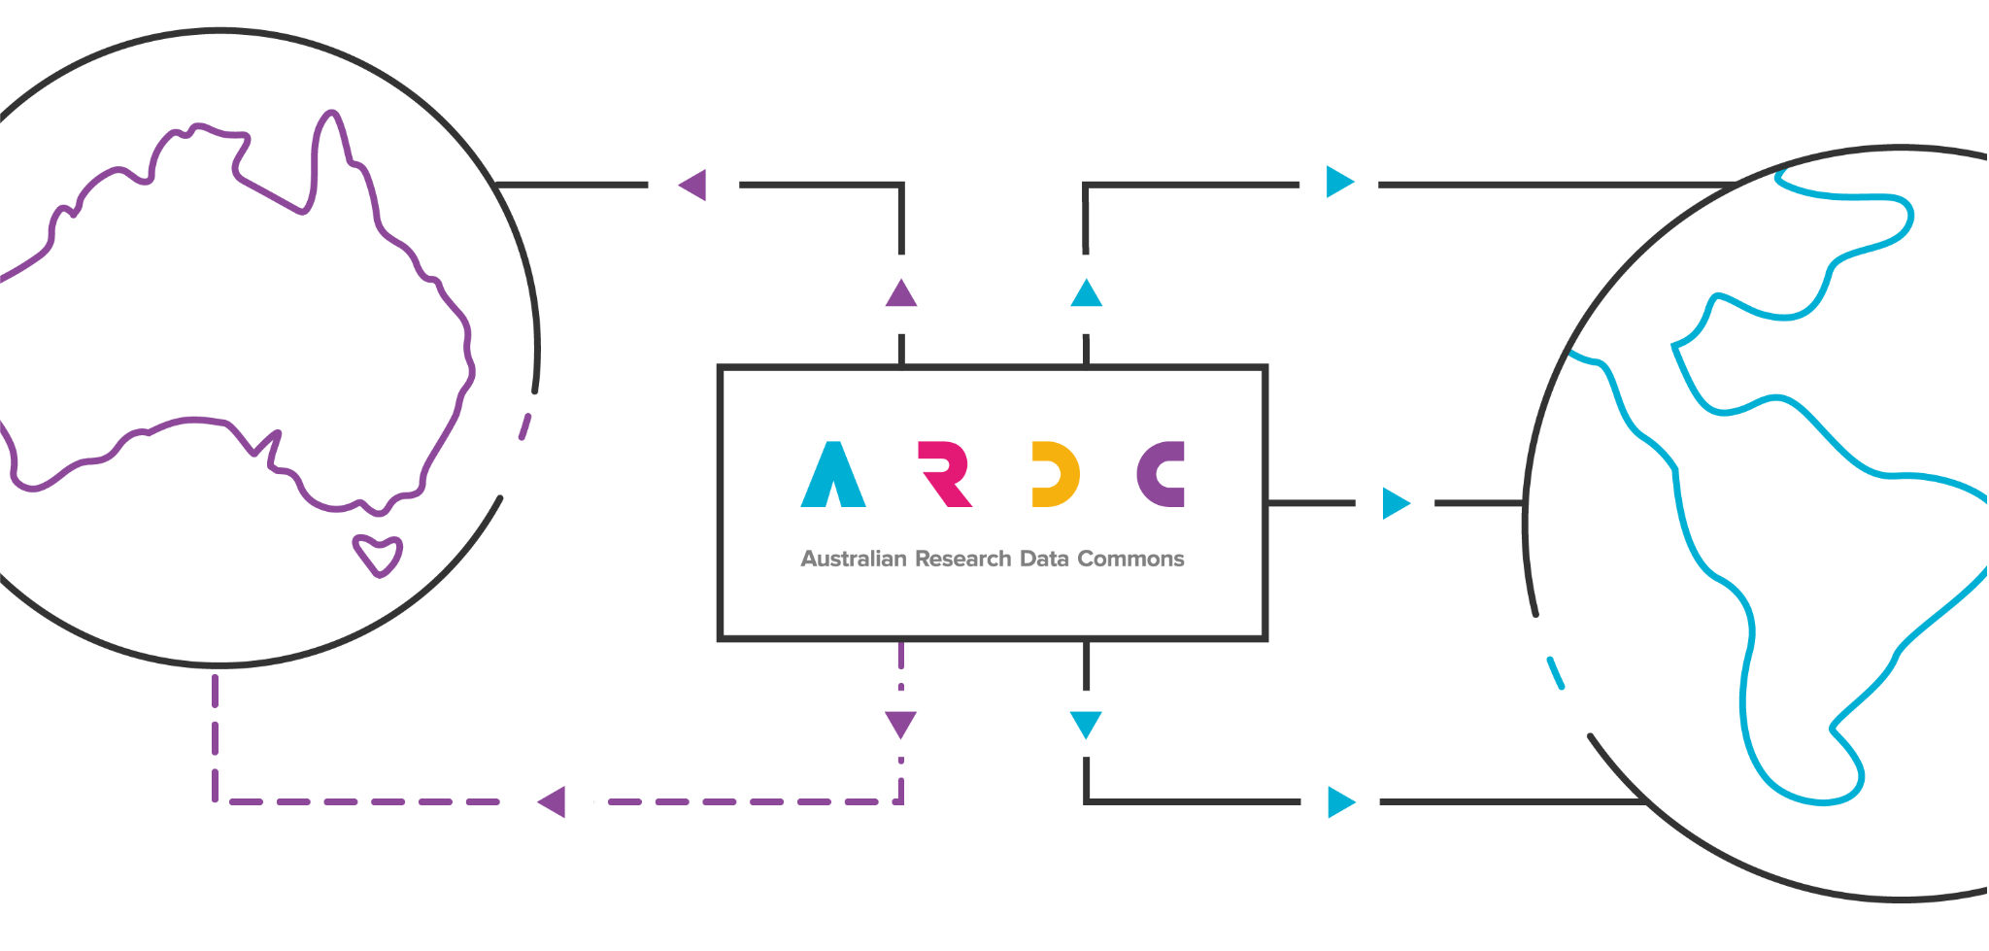
ARDC International Goals
Embed Practice
Empower Developments
Expand Networks
Enhance Reputation
Enhance Reputation
Notes:
ARDC International Goals
We want to increase our involvement internationally, but do it in a way that maximises our national leverage and move from a unidirectional flow of DRI IP and effort towards something more bidirectional.
Our four goals are to:
Enhance reputation through high-profile involvement
Empower through doing, not just talking
Expand networks to continue conversations that lead to convergence, not divergence
Embed good practice (ideally practice that we have helped shape) for national benefit
Note that these four goals all act to reinforce each other:
Enhanced reputation means that we will sought as network partners
Expanded networks give us earlier access to international developments
Empowered developments contribute to reputational enhancement
Empowered developments lead to more easily embeddable practice
Embedded practice increases national and international reputation of ARDC

Slide 32
Sign up for updates
Notes:
<PROMO for all audiences>
INTERNATIONAL DATA WEEK 2025
The ARDC will run International Data Week 2025 ARDC on behalf of RDA, CODATA and WDS
It will be held in Brisbane Australia 13-16 October 2025.
Save the date and start planning your visit.
Visit us at ardc.edu.au to sign up for updates
Image credit
Mel Campbell - 433531668 / adobestock.com

Slide 33
About the ARDC
Notes:
In summary, we’re here to provide Australian researchers with competitive advantage through data.
Please connect with us!
Keep up-to-date with the latest digital research news, events, resources, career opportunities and more.
You can also seek our advice on national digital research and data questions.
You can:
Visit us online
Subscribe to our newsletter
Connect on Twitter, LinkedIn and Youtube
Email us
Thank you.
Questions?

