Slide 1
Levente Farkas, EGI Foundation
EGI Conference 2024 – EOSC | Oct. 2
EGI's Technical Expertise to Fuel EOSC EU Node Development

Slide 2
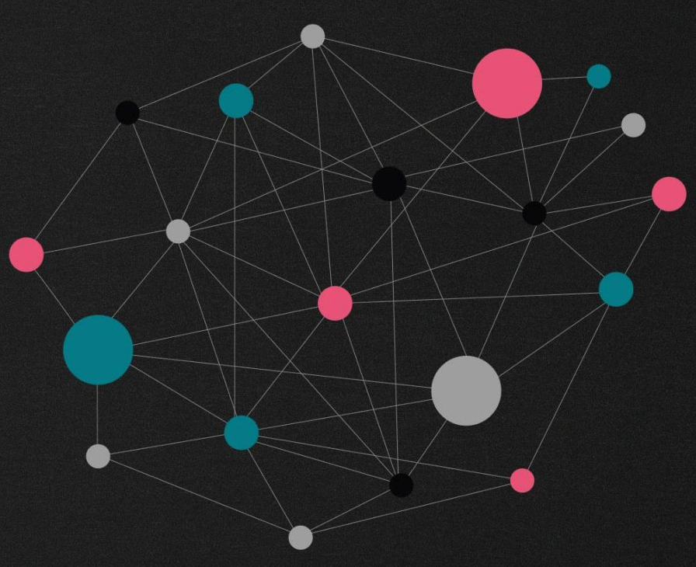
Reminder: what is European Open Science Cloud (EOSC)?
A “system of systems” of data and services (for research) -> Researchers can store, share, process, analyse, and reuse research outputs within and across disciplines and borders.

Slide 3
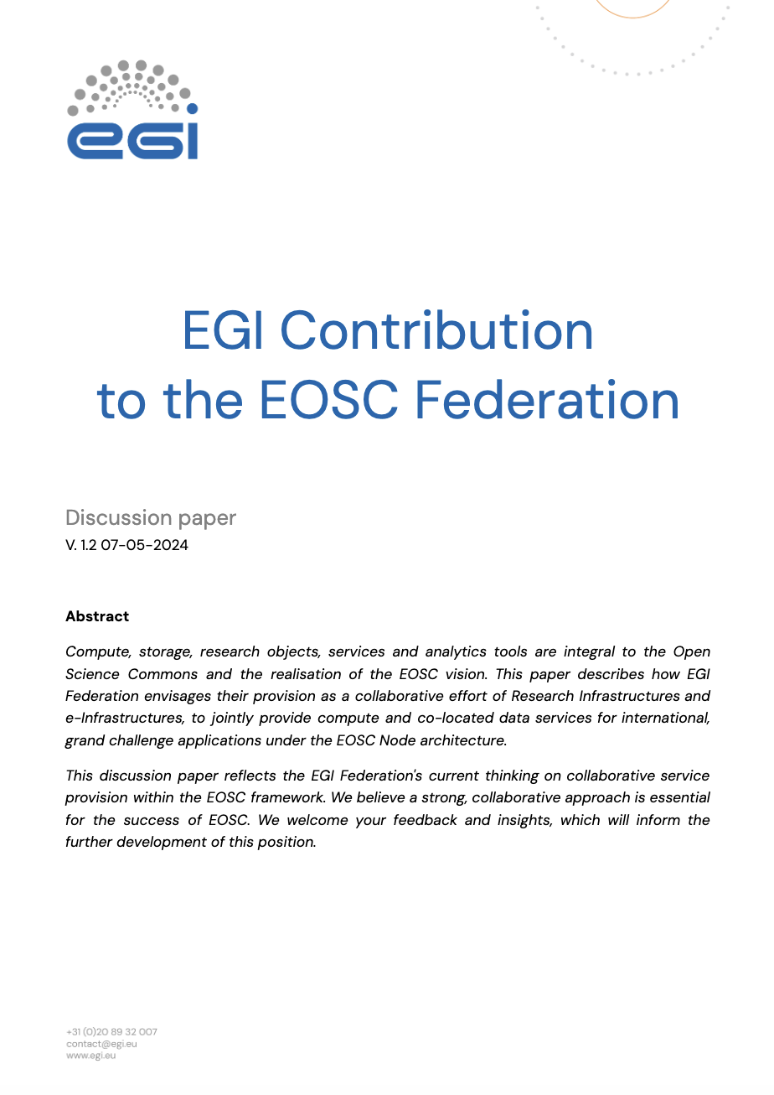
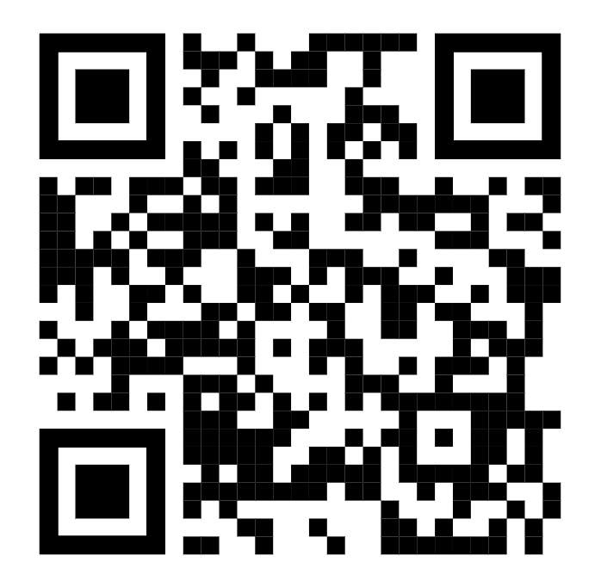
EOSC Federation and EOSC EU Node
EOSC Federation = a network between data repositories and services
Multiple interconnected “nodes” that can collaborate
The first node is the “EOSC EU Node”, promoted and funded by the EC via the Procurement project

Slide 4
EGI Federation and EOSC Federation - EOSC EU Node
The EGI Federation participates in the co-design, development, and provisioning of the EOSC Core, in collaboration with research infrastructures, e-Infrastructures and other EOSC stakeholders.
The EOSC EU Node is a platform for EGI to advertise and offer our services (even though it can also be a competitor for some of our services)
Scenario 1 EGI Foundation to scale up the cloud and storage back-end of the EOSC EU Node
Scenario 2 EGI Foundation to use EOSC EU Node to scale up its offer to existing user communities
The EGI Federation aspires to be part of the EOSC Federation as a Node contributing distributed compute and storage capacity from its members, to support the exploitation of research objects and services in EOSC.

Slide 5
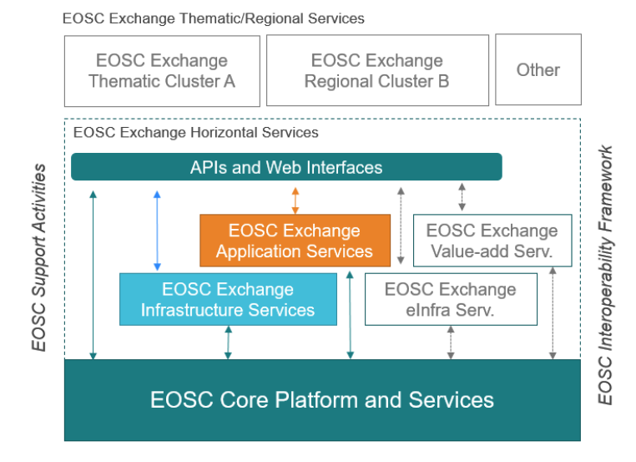
Procurement structure: 3 LOTs, 3 commercial contracts
LOT 3: Data Analytics Platform and Visualization Services
LOT 1: The Federated EOSC Core Platform and Services

Slide 6
EGI Contribution to the EOSC EU Node - LOT 1
led by EGI
The Front Office Web Portal
Resource Catalogues
Application Workflow Management
Content management, newsletter, outreach
Persistent Identifiers
Application Management Layer, Configuration Database
AAI
Monitoring, Accounting, Messaging, Order Mngt
Service Management System
Federated AAI, Support
Monitoring, Accounting, Messaging
The EOSC SMS, Onboarding, Security Coordination, Helpdesk, Quality Assurance

Slide 7
EGI Contribution to the EOSC EU Node - LOT 3
Deliver Jupyter Notebook
EGI and CESNET
Provide the Service Management System

Slide 8
EGI Achievements by end of Q2

Slide 9
Completed Work
What has EGI delivered after 6 months for LOT 1 and LOT 3
EGI and subcontractors have delivered (components) of core services:
MS2
PID services (GRNET, GWDG)
MS3
Configuration Management Database (GRNET)
Application Workload Management – IM (UPV)
MS4
Core Infra Proxy (GRNET)
IGTF Certificate Bridge (GRNET)
MS5
Monitoring (GRNET)
Accounting for Services (GRNET)
Messaging (GRNET)
MS6
SMS (EGI)
Helpdesk (KIT)
Quality Assurance and Validation (EGI)
Security (EGI)
And application-plane components:
Managed Interactive Notebooks Service
Support to CESNET for the setup of the Notebooks instances
New JupytetHub API wrapper to integrate with EOSC LOT1 API
New Authenticator to support JWT tokens
New Look & Feel to follow the EC branding guidelines
New extension to display a warning on memory consumption
Integration with EOSC Accounting
SMS plans

Slide 10
Looking forward

Slide 11
We are now heading to operation phase
Entering ‘production’ phase in October
The EOSC EU Node will be officially launched at the EOSC Symposium in Berlin
→ First users will arrive
Business as usual for the rest of the contract (until 2027)

Slide 12
Lessons learned
AAI is an essential glue
SMS improvements to ease operating our services commercially → Revised and simplified procedures → Automated change management → Better management of availability and continuity risks
QA framework → Triggered by changes to the services → Can be adopted in EGI and/or offered as a service

Slide 13
Thank you
Dedicated session to be organised for further discussion and recommendations

