Slide 1
Simpl and EOSC Feasibility Study
State of play and preliminary results
EGI Conference 2024 – EOSC | Oct. 2

Slide 2
European Single Market
Data legislation
Data Act
Data Governance Act
Open data directive
GDPR
NIIS Directive
Common European Data Spaces
High Value Datasets
from public sector
Health
Industrial & Manufact.
Agriculture
Finance
Mobility
Green Deal
Energy
Public
Admin.
Skills
EOSC
Tourism
Cultural heritage
Media
Language
European Data Innovation Board
Data Spaces Support Centre
Facilitate the sharing of best practices
Prioritisation of cross-sectoral interoperability standards
Development of blueprint, glossary, etc.
Support of data space projects
Technical infrastructure
Standards
Digital identity (eIDAS)
Smart Middleware solutions
(Simpl)
High-Performance Computing
Testing and Experimentation Facilities

Slide 3
What is Simpl?
middleware are software suites that enable applications and databases to work seamlessly together and provide a flawless user experience
open-source means built-in trust & security, flexibility to deploy, simplicity to customise
Simpl is the open-source smart middleware that enables cloud-to-edge federations and all major data initiatives funded by the European Commission
all major data initiatives, in particular the development of Common European Data Spaces modular and interoperable way.
cloud-to-edge federations put together resources across cloud and edge computing environments as a cohesive system, creating a seamless integrated infrastructure that combines the strength of both cloud and edge computing.

Slide 4
Simpl is made of three products
the open-source smart middleware itself
Simpl-Open
playground environment for Simpl-Open
+
interoperability test for existing data spaces
Simpl-Labs
European Health Data Space 2^{ary}
instances of Simpl-Open for common European data spaces
Public Procurement Data Space
Simpl-Live
Destination Earth
Language Data Space
Smart Communities

Slide 5
Simpl is deployed throughout data spaces
With centralised and decentralised components
Data space
Data catalogue
Identity authority
Legend:
Centralised services = services that provide capabilities through centralised system components.
Data, Infrastructure and application catalogues provide the cataloguing service for end users to discover shared services in the data space
Vocabulary providers provide the definition of metadata representation, vocabularies, and ontologies
Identity authorities manage the identities of the data space participants and provides proofs that other participants can use for authentication and authorization
Data provider α
Data space participant
Simpl
Simpl
Infra catalogue
Centralised service
Infrastructure provider x
End user A
Data communications
Simpl
Simpl
Communication to centralised services
Application catalogue
Application provider n
Vocabulary provider
Simpl

Slide 6
Simpl’s conceptual architecture is stable
Administration services
Data services
Governance
Federation management
Application sharing
Data sharing
Support
Contracts
Application discovery
Data discovery
CSIRT
Security
Distributed execution
Data governance
Data orchestration
Data processing
Access control & Trust
Audit
Infrastructure connector services
Reporting
Cloud & Edge computing
HPC
Monitoring
PaaS services
Distributed execution
Network
Infrastructure discovery
Infrastructure orchestration
Infrastructure providers (DC, public cloud, private cloud, etc.)

Slide 7
Simpl-Live methodology Simpl-Live study is facilitated through regular alignments with Simpl-Open.
Simpl-Live (Feasibility Study)
Collect
Assess
Map
Conclude
Define
Collect Simpl-Open specifications and specify assessment criteria for data spaces.
Assess individual data spaces characteristic and capabilities (including data privacy) depending on their maturity and status-quo.
Map status-quo of data spaces on Simpl-Open requirements (Fit-Gap Analysis) to identify fits, gaps and needs.
Consolidate and conclude results in feasibility study report for each data space
Feedback results back to Simpl-Open.
Define Simpl implementation roadmap for each data space based on assessment results.
Regular feedback / alignment¹
Simpl-Open baseline (Preliminary Study)
Simpl-Open
(Requirement definition)
¹Regular alignment with and feedback to Simpl-Open: (1.) to update the Simpl-Live assessment criteria if required, based on the simultaneously defined Simpl-Open requirements (M2-M4, M9), (2.) to refine Simpl-Open requirements definition based on (interim) assessment results (M2-M4).

Slide 8
EOSC I Overview: Business Processes In order to validate the relevance and operational significance of the Simpl-Open capabilities for EOSC, we analysed the presence and scope of the Simpl-Open business processes.
Preliminary results: Still under validation by the European Commission. Final study will be available later this year.
Relevance of Business Process for EOSC
Simpl-Open Business Processes
High
Medium
Low
Not Applicable
01 Setup of Data Space: Role of Governance Authority
07 Consumers establish a Contract with the Provider
02 Setup of ID/Trust, Catalogues and Vocabulary
12 Management and Operations of Data Space Business
03a Onboarding of a new Data Space Participant: Providers
13 IT Administration
03b Onboarding of a new Data Space Participant: Consumers
05 A provider adds a new Resource on the Catalogue
06 Consumers search Resources on Catalogues
Additional
Business Processes
Security and Privacy
Node Enrolment Process
Consumers decommission the Resource from the Provider
Application Management Service
Accounting
Consumers decide to extend the Catalogue ​
EOSC demonstrates a strong alignment with Simpl-Open's business processes, though the implementation of these processes may vary across future EOSC Nodes due to the high level of autonomy granted to the individual communities. The Node Enrolment and Application Management processes are unique to EOSC. The Node Enrolment process supports the expansion of the federation by onboarding new EOSC Nodes, while the Application Management process ensures repeatability in research, fostering consistency and reliability in scientific outputs.
Sources: European Commission Data Spaces Initiative, (2024), EOSC Business Process Design and Governance Workshop.
European Commission Data Spaces Initiative, (2024), EOSC Functional Architecture Workshop

Slide 9
EOSC I Preliminary Recommended Integration Scenario External data space integration
Preliminary results: Still under validation by the European Commission. Final study will be available later this year.
Objective for Integration
Recommended Integration Scenario
To ensure that Simpl-Open-enabled data spaces are fully interoperable with EOSC.
The Simpl-Open middleware may support the data space in the following areas:
Metadata Management & Discovery
Simpl-Open to ensure the presence and management for federated vocabularies of EOSC EU Node.
Security & Compliance
Simpl-Open to provide federated authentication and authorisation for ensuring that authorised users can access resources, GDPR compliance to ensure privacy and data protection.
Data ingestion & Transformation
Simpl-Open to reduce variety of data formats for data exchange and sharing.
Interoperability
Simpl-Open to provide standardised, reusable interfaces (APIs) for integration with EOSC Proxy agent.
Governance & Auditability
Simpl-Open to help the governance authority to enforce data-sharing agreements and monitor the use of resources between the communities and data spaces.
Personal Data Handling (Currently not in Scope of Simpl-Open)
Integration of Simpl-Open further extensions on personal data handling (consent management, GDPR rights management, GDPR connector, etc) will allow EOSC communities to import personal datasets from other data spaces (health, skills, mobility).
Key Considerations & Constraints
EOSC Proxy agent does not fully support of all image-related repositories.
Currently integration is only possible through EOSC EU Node.
Dependence on external data spaces that implement Simpl-Open.
Navigating complex legal requirements such as intellectual property rights and national data regulations in different regions.
Sources: European Commission Data Spaces Initiative, (2024), EOSC Business Process Design and Governance Workshop.
European Commission Data Spaces Initiative, (2024), EOSC Functional Architecture Workshop

Slide 10
Engaging with Simpl

Slide 11
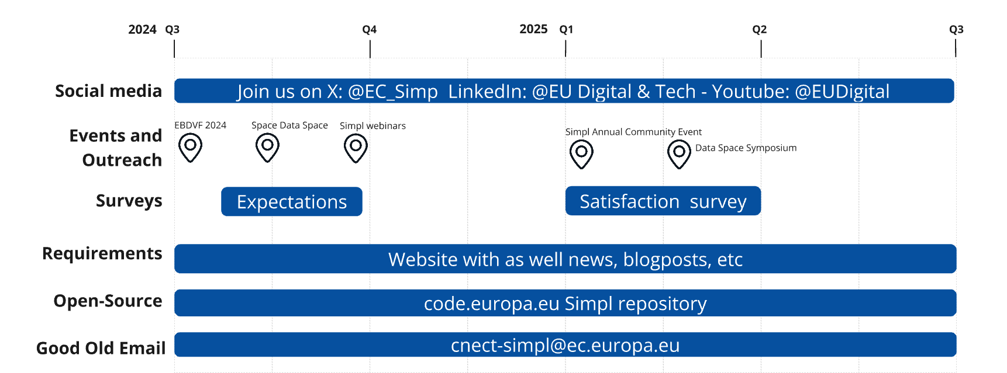
Engage with us
EGI 2024

Slide 12
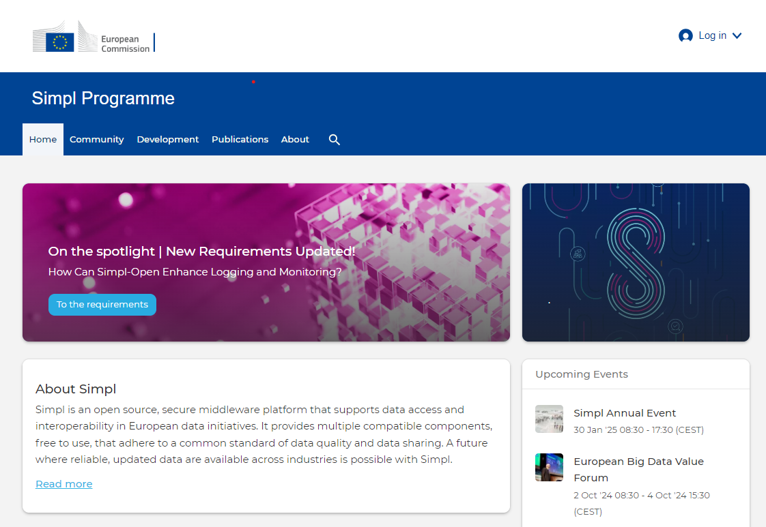
Breaking news: Simpl website is live
https://simpl-programme.ec.europa.eu

Slide 13
Thank you
© European Union 2024
Unless otherwise noted the reuse of this presentation is authorised under the CC BY 4.0 license. For any use or reproduction of elements that are not owned by the EU, permission may need to be sought directly from the respective right holders.

