Slide 1
Empowering Open Science for the German data infrastructure.
Introducing the German NFDI pilot node for EOSC

Slide 2
Summary
can be hidden, if u prefer
Scientific content 1 slide
Target community 1 slide
User stories (for each pilot) 1 slide
Integration (core, services)/ EOSC Beyond sandbox
Federation (views , pilot stand federations , offer , needs )

Slide 3
Target community
The National Research Data Infrastructure NFDI (Nationale Forschungsdateninfrastruktur)
With over 270 institutes organized in 26 scientific consortia as well as Base4NFDI which focuses on delivering horizontal services, NFDI is a large interdisciplinary union with all scientific disciplines ranging from humanities and social sciences over life science, engineering to natural sciences. Its common vision and goal is to provide an infrastructure for managing research data as a common good for excellent research organized by the scientific communities themselves.
The NFDI pilot node will primarily cater to the needs of the German scientists and their collaboration partners in order to make for more efficient use of commonly used resources and test the integration of services from and into the EOSC framework.
During the development of the pilot node, we are taking input from the consortia to find collaborative and scientific services that are valuable to the majority of scientists. With this approach we can provide a node with a hopefully large enough impact that it can serve as a blueprint for a candidate node to be developed on this foundation later on.

Slide 4
Scientific content
Useful collaborative and scientific services for everyone in NFDI
Service Catalogue
?
Data catalogues
Helpdesk
Jupyter Notebooks
Gitlab
Data Storage and Transfers
Terminology Service

Slide 5
User stories
What do we expect our scientists want to do in the beginning?
As a user I want to be able to log into any service offered by the node using either my institutional identity or a social login
This will be made possible by adopting an AARC-based AAI federation approach as demonstrated within e.g. EGI and HIFIS
As a user I want to discover services offered by the node, possibly also from other nodes' catalogues
A service catalogue capable of sharing its offers with other nodes will be made available to all node users
As a developer I want to store, version and share my code with others while being able to also publish it as a package or container
A gitlab instance will be provided for the node users including CI/CD pipelines and runners
As a researcher I want to find and explore published open datasets
Public data portals are part of the node’s service offerings including limited resources to explore the listed data sets without the need to download them or install any kind of software on your own computer
As a user I would like to reach out support of other nodes which services I could probably use. I reach out the support of the other nodes via support channel provided by my node.
We strive to have a helpdesk that is fully integrated with the EOSC EU node and others

Slide 6
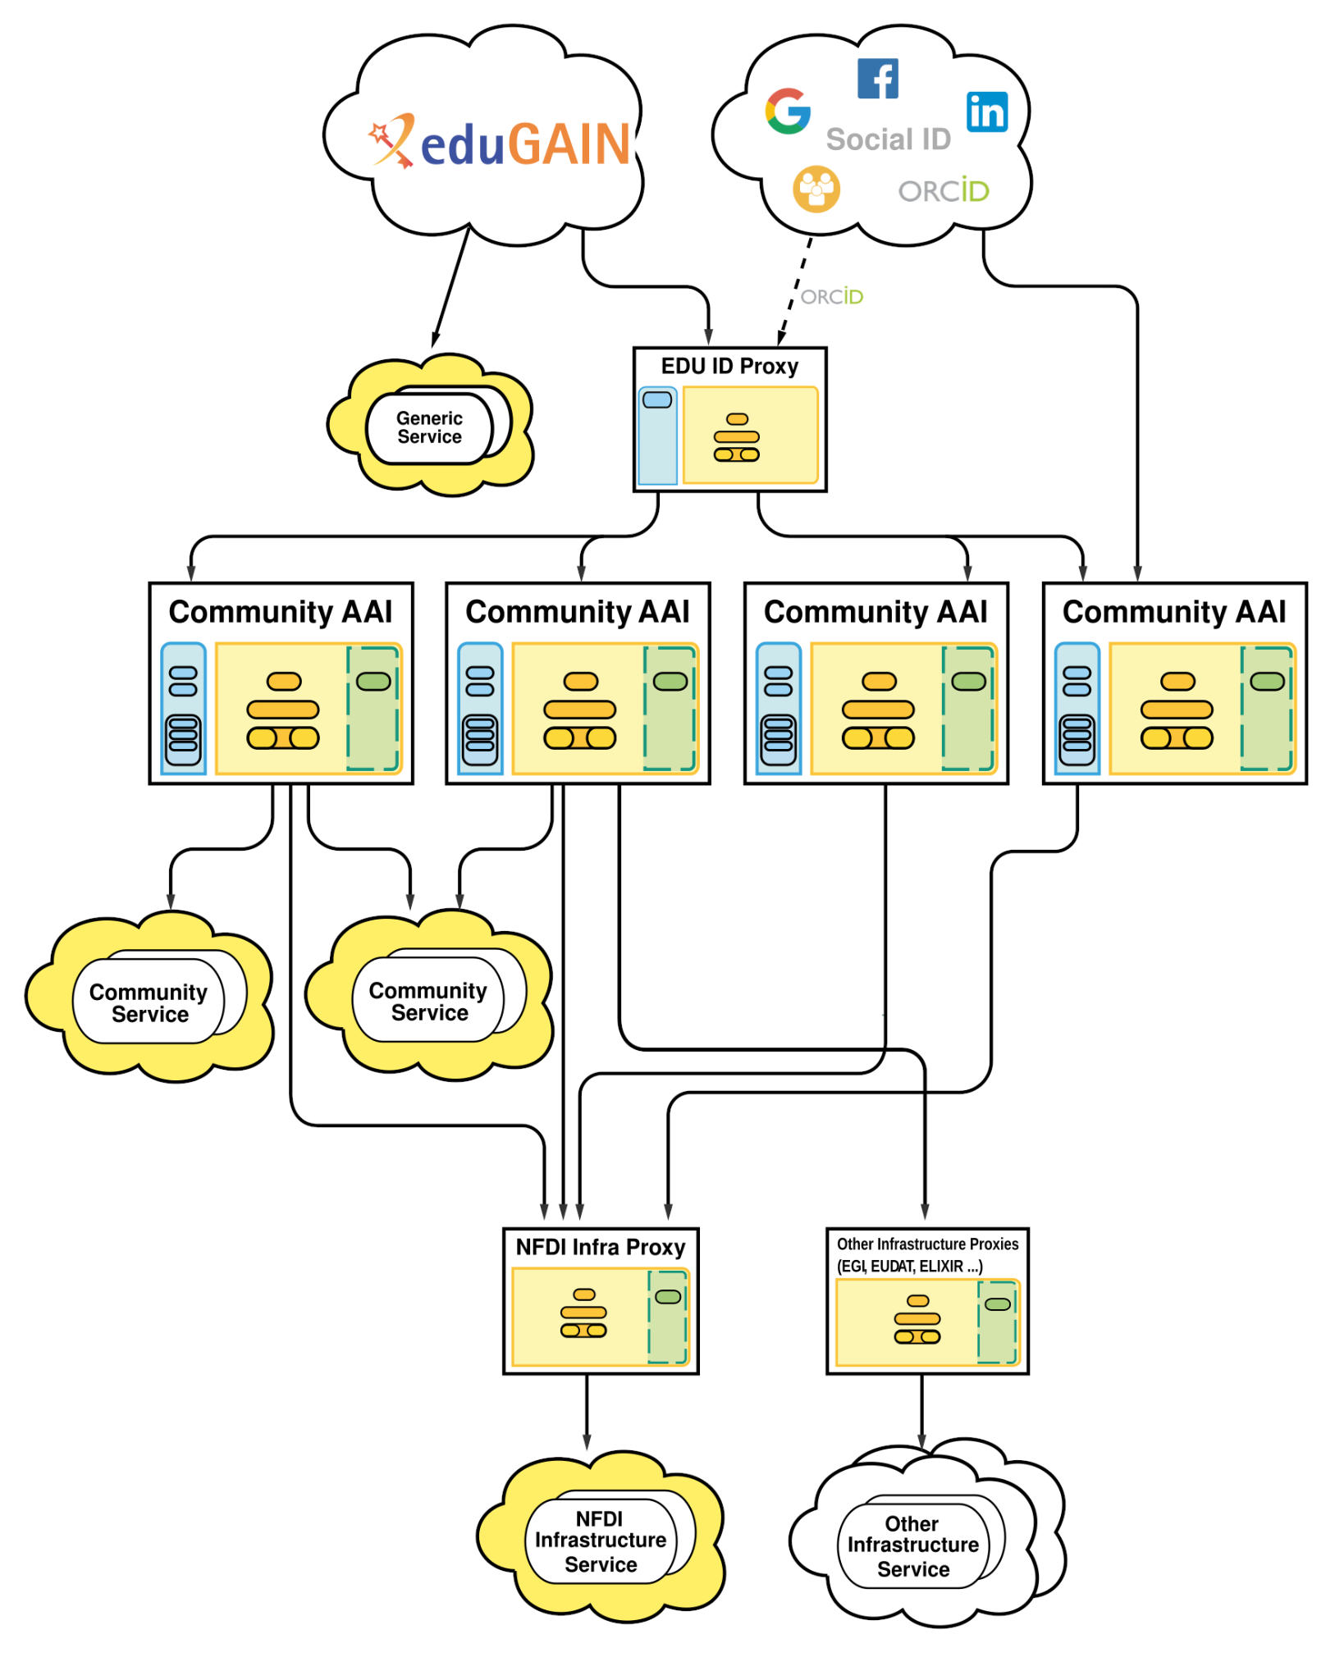
Integration
How do we make the node accessible?
1st step: requirements gathering (<M16)
2nd step: AAI integration (M16)
Realised via IAM4NFDI
AARC-compliant AAI architecture (as demonstrated by e.g. HelmholtzID)
Trust relationship between IdPs and AAI (community) proxies (see diagram on the right)
Institutional and Social IdPs allowed with different trust levels
3rd step: Service/Resource catalogue (M20)
Allows users to see offered service
Shows access routes and descriptions
Links to help & documentation
4th step: Helpdesk (M20)
Main contact point for users
Should be integrated with EU node
further steps: Monitoring, Accounting, Interoperability Framework (≥M22)
Exact plans still to be discussed with service providers
Source: https://doc.nfdi-aai.de/architecture/

Slide 7
Federation
Possible Input: https://confluence.egi.eu/pages/viewpage.action?pageId=275189566 and the https://zenodo.org/records/12819857

Slide 8
Questions
Put your name, if u want to answer one of the questions below during the session. This slide should be hidden
1 From the previous EOSC to the Nodes , tell us what you think about the transition (5) Tim
2 Expectations from the federation (wishes, crystal ball ) , what would you bring forward , what would you leave behind (5 min)
3 How to go beyond target communities (is this good /bad ) , how do you serve users that don’t know you. (5 min)

Slide 9
Contact email: tim.wetzel@desy.de
Team:
Sander Apweiler , Daniel Mallmann, Marvin Winkens(FZJ)
Patrick Fuhrmann, Armando Bermudez Martinez, Tim Wetzel (DESY)
Jos van Wezel (KIT)
York Sure-Vetter (NFDI)

