Slide 1
Trust as a foundational element for data sharing: the Gaia-X Trust Framework
Giuditta Del Buono- Gaia-X
EGI2024 – Lecce – 1st October 2024
Notes:
Yassir

Slide 2
Summary
01
What is Gaia-X?
02
The Gaia-X Compliance
03
The Gaia-X Trust Framework
04
Interoperability layers
05
Elements bringing trust to data sharing

Slide 3
What is Gaia-X?
The Gaia-X European Association for Data and Cloud AISBL is an international non-profit association under Belgian law.
Gaia-X mission: enable trusted decentralised digital ecosystems creating the de facto standard aligned with EU values by developing a set of policies, rules, specifications and a verification framework.

Slide 4





The Gaia-X Compliance
We don’t monitor/observe data but services processing/transferring/storing data
We don’t set access rights on data but on the services exposing data
Data doesn’t copy or transfer itself - we need processing and network services to copy and transfer data
To have control, visibility, traceability, … on your data, you need to have control, visibility, traceability, … on the services processing/storing/transferring your data.
The Gaia-X Compliance Document (ref. Compliance Document 24.06) contains criteria for Cloud Services and Data Exchange Services.
Gaia-X Compliance currently covers the following dimensions: Contractual Framework, Data Protection,
Cybersecurity, Portability, European Control, Sustainability, Data Exchange Services.

Slide 5
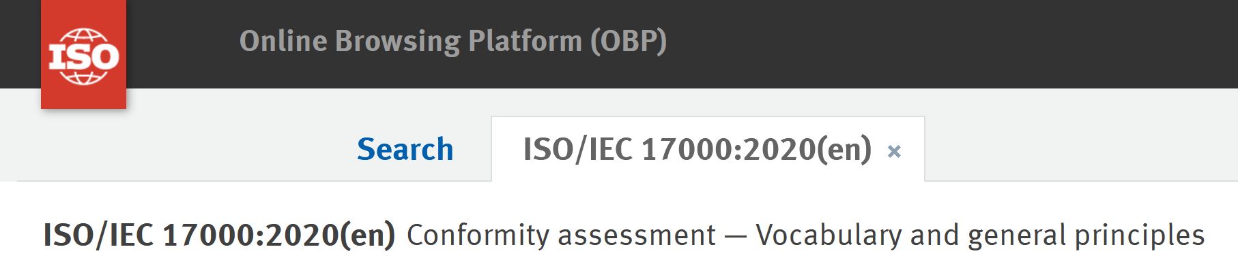
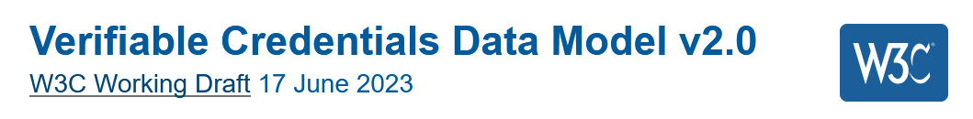
Gaia-X Compliance: 4 Assessment schemes (Gaia-X Standard Compliance, Gaia-X Label L1, Gaia-X Label L2, Gaia-X Label L3).
For each criterion, we specify:
  the claim: what needs to be said/claimed
  the evidence(s): which proofs are accepted
  the signee(s): who/what can sign the claims and evidences
ISO/IEC 17000:2020 (CASCO)
W3C Verifiable Credentials Data Model

Slide 6


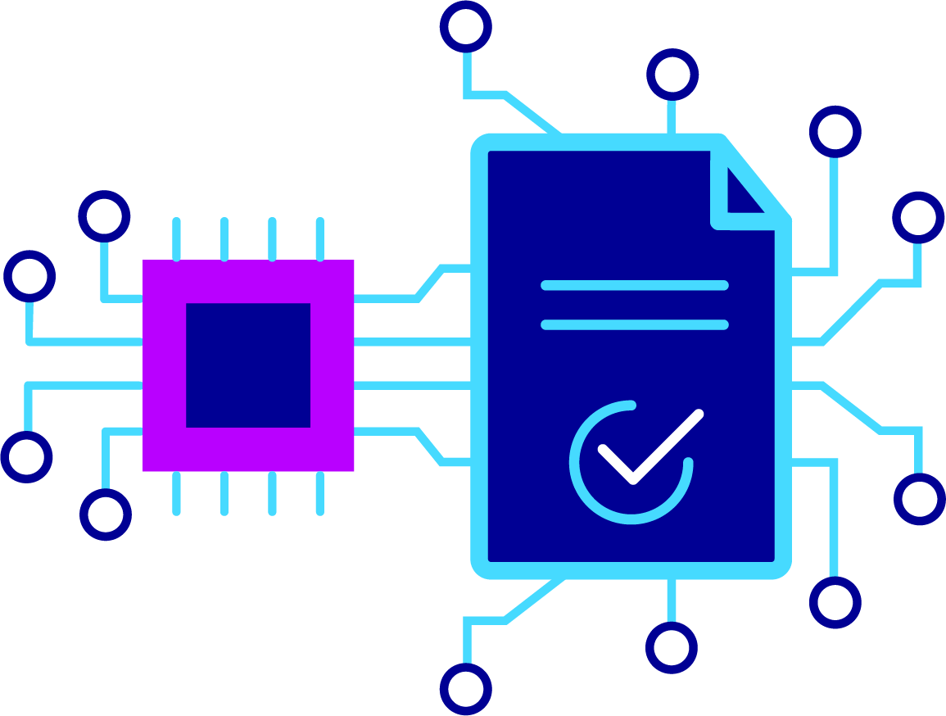
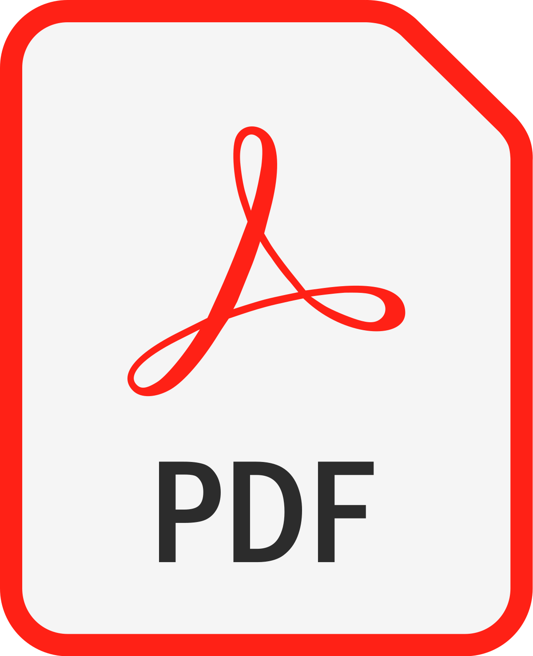

The Gaia-X Trust Framework
Conformity Schema
Gather Evidences
Compliance as Code
Conformity Result
“self-declaration”
“self-description”
GXDCH Validation & Verification process
signed digital declaration
Compliance engine
Gaia-X Standard Compliance
Gaia-X Label level 1
Gaia-X Label level 2
Gaia-X Label level 3
Gaia-X Standard Compliance
and/or
Gaia-X Label level 1
and/or
Gaia-X Label level 2
and/or
Gaia-X Label level 3
criteria
+
procedure
party
Digital Attestation
Registry
Attestation on individual or bundled Gaia-X criteria for ISO 27001/PCI-DSS/SOC/…
signed digital certification
3rd party impartial CAB
Gaia-X Digital
Verifiable Credential / Digital Attestation
Verifiable Presentation
Clearing House
Party: legal person, natural person, workload

Slide 7

Trust Framework for Tech
Defines “what” must be signed and “how” to demonstrate the fulfilment of the criteria.
Operates an instance of
Gaia-X Digital
Clearing House
Gaia-X Registry
Low level requirements
OWL / JSON-LD
Operates an instance of
EBSI API naming
Is trustworthy because the verifiers trust Gaia-X.
W3C SHACL
W3C SPARQL
Gaia-X Compliance engine
OIDC4VCI
Signed digital attestation
List of eligible “who” that can sign for a given “what”.
Trust Anchors
Validates/Verifies that:
“what” must be signed has been signed.
“what” is valid.
“what” is signed by an eligible “who”.
ETSI TS 119 612
PDF/A-3a / XMP
OIDC4VP
Presentation Exchange
Signed digital attestation
W3C VC

Slide 8




Interoperability layers
Gaia-X is not about legal enforcement
Legal interoperability
Organisational interoperability
Semantic interoperability
Technical interoperability
Gaia-X Compliance Document.
This document is
technology agnostic.
Gaia-X Architecture documents.
Those documents are
rule agnostic.
Ecosystem A
Ecosystem B
Layers from the European Interoperability Framework.
Gaia-X technical compatibility.

Slide 9
Elements bringing trust to data sharing
Description of participants (legal entity, natural person, machine) and services enabling data transactions
Validation and/or Verification of identities and other criteria for participants and services
Traceable and auditable means for participants to delegate rights
Policy reasoning (access rights, Terms&Conditions, contracts)
Trust Indexes - cross services and data products
Criteria (requirements) for participants (different roles) and services enabling data transactions - attributes that enhance transparency and trust
Gaia-X is contributing to the CEN/CENELEC Workshop on Trusted Data Transactions

Slide 10
Thank you
giuditta.delbuono@gaia-x.eu

