Slide 1
Real-World Authorisation: Case Studies from LETHE and EUreka3D
Ignacio Lamata Martinez
3rd October 2024
Community Support Specialist
EGI2024
TLP: GREEN Limited disclosure

Slide 2
Preliminaries

Slide 3
Preliminary: concepts
Check-in is an identity and access management system
Authentication: who the user is
Authorisation: what the user can do in the system

Slide 4
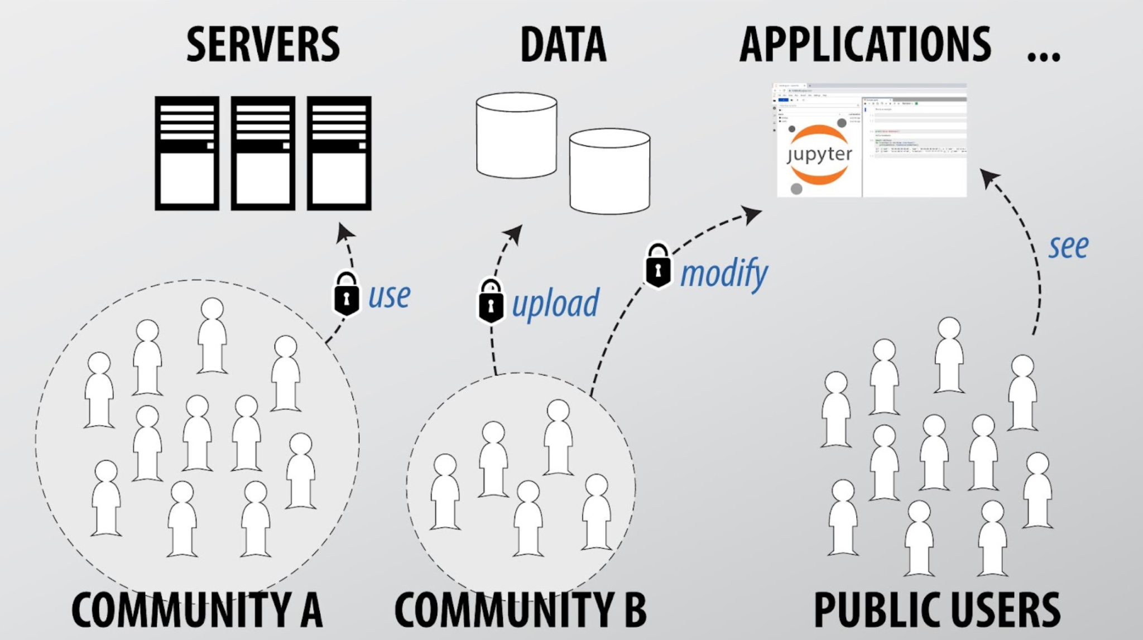
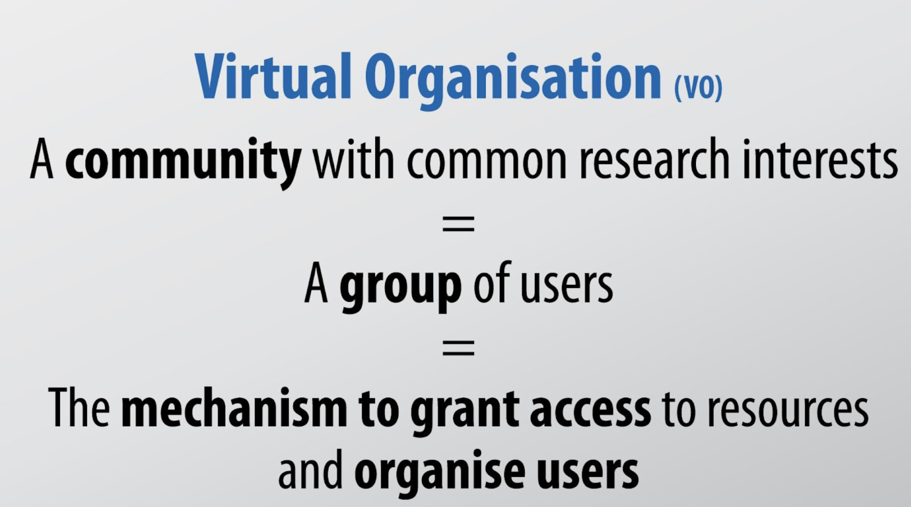
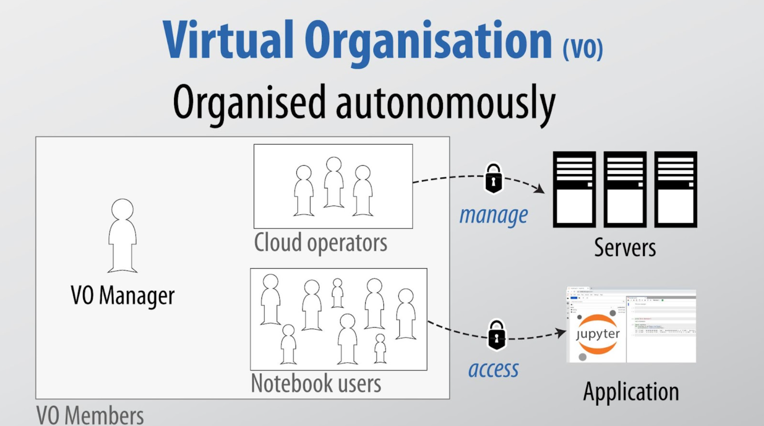
Preliminary: concepts
Typical case of Authorisation implemented through Virtual Organisations (VO)
Other authorisation models based on identity assurance, capabilities, affiliation.

Slide 5
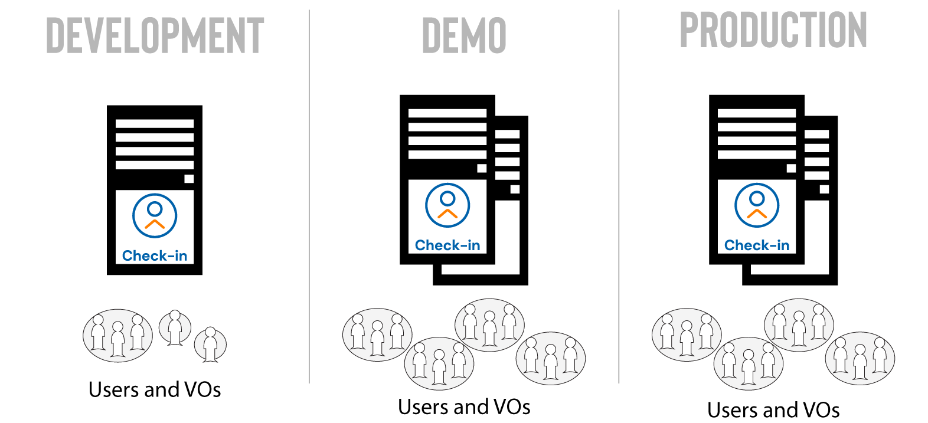
Preliminary: environments
Use Demo for testing
And Production for production
- For “development” of Check-in
- Latest features
- Not all idPs are available
- Mirror of production
- Suitable for testing

Slide 6
https://www.eureka3d.eu/
EUreka3D

Slide 7
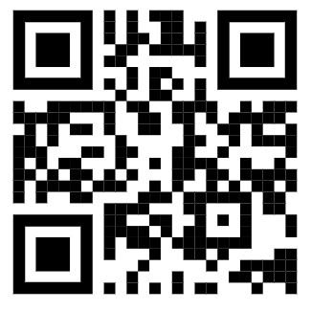
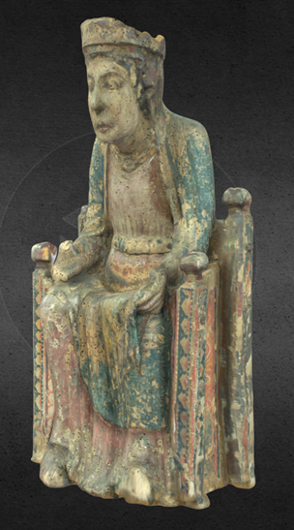
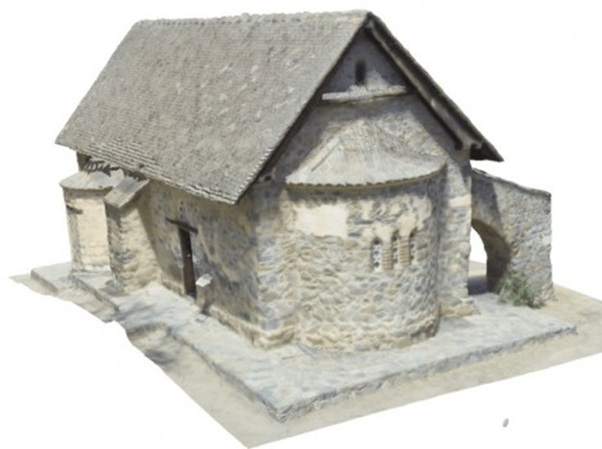
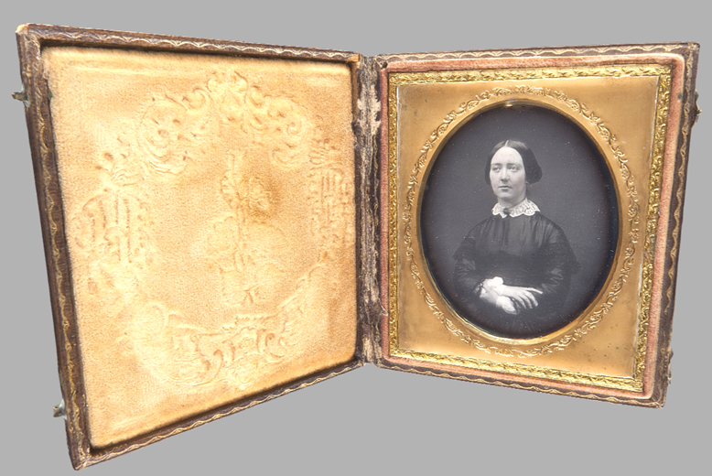
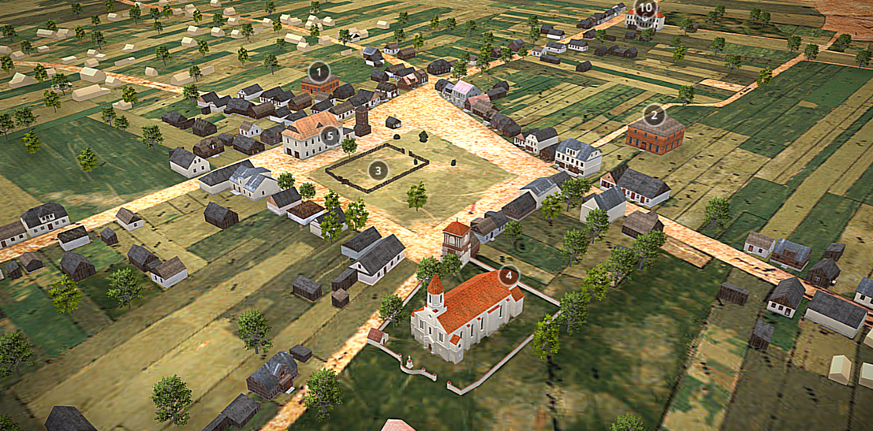
The EUreka3D project
European Union's REKonstructed content in 3D
Aims to conduct a comprehensive approach to the needs and workflow of high-quality 3D digitisation of Cultural Heritage (CH), contemplating EC’s Recommendations (2011/711/EU) on the digitisation and online accessibility of cultural material and digital preservation, in assets such as monuments, sites, museum objects and other tangible heritage, especially those at risk.
It will provide an innovative approach to the digital transformation of the CH field, based on the provision of services and tools, compliant with Europeana CSP, and powered by advanced computing and storage resources.

Slide 8
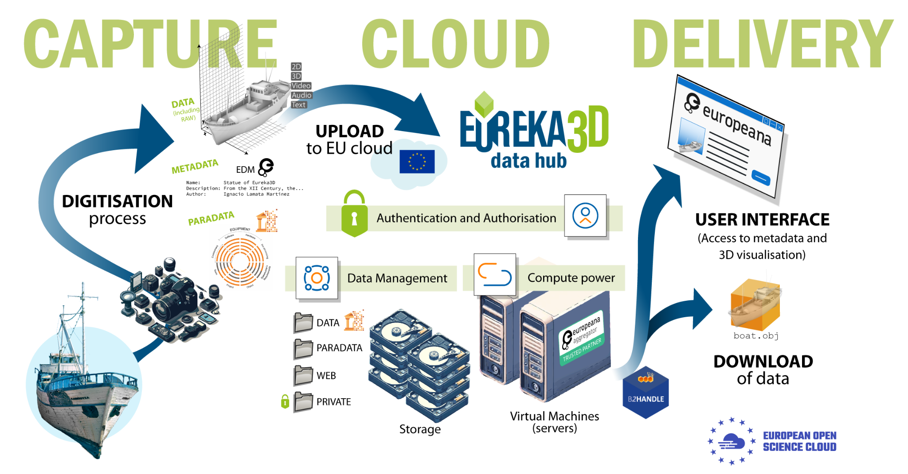
EUreka3D: General overview

Slide 9
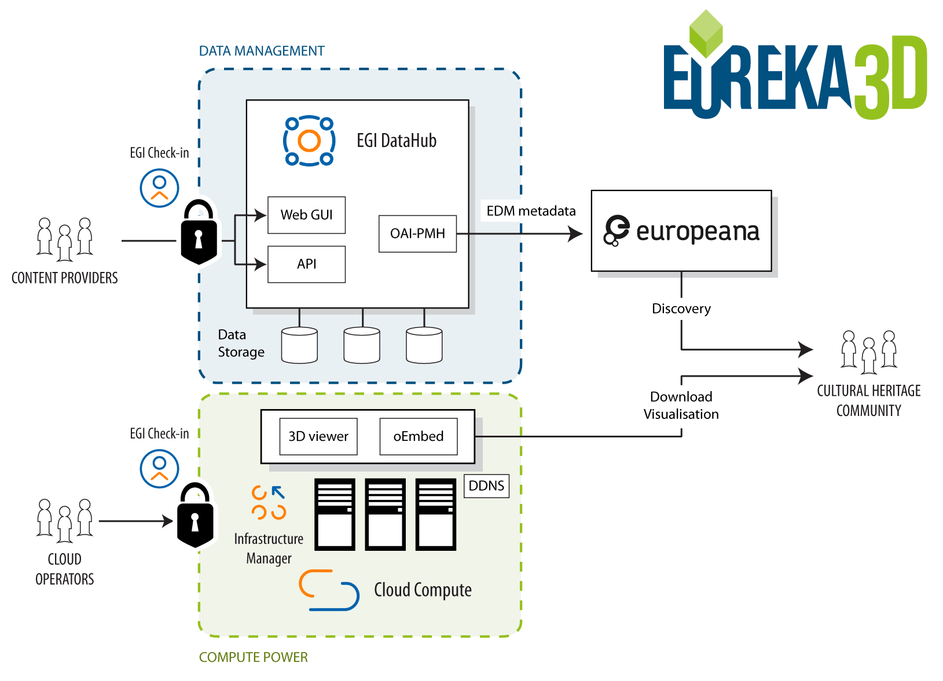
EUreka3D: General overview

Slide 10
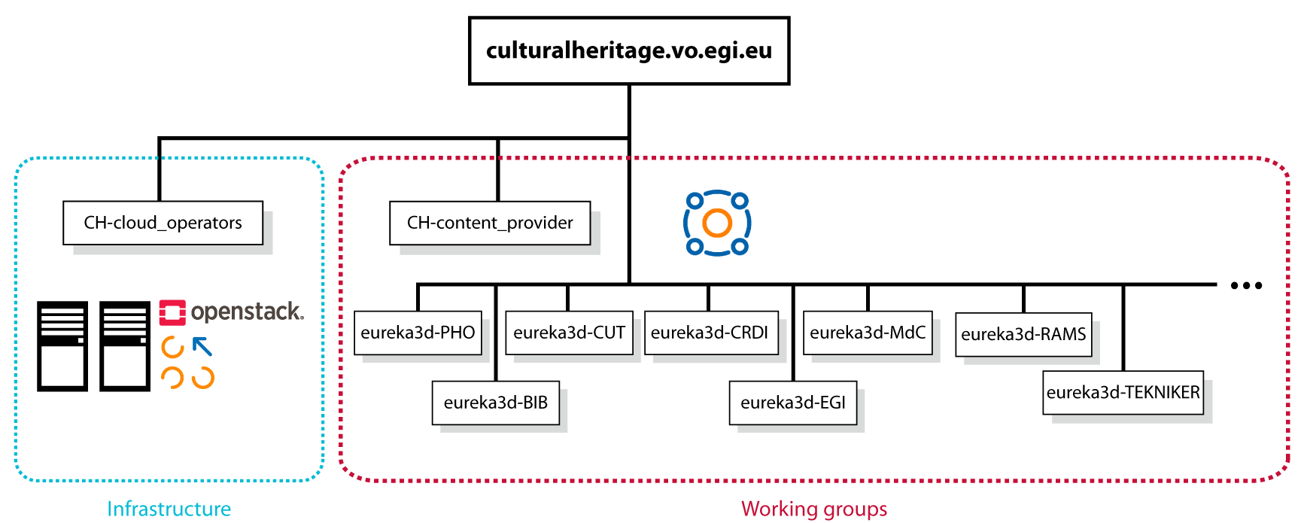
VO organisation

Slide 11
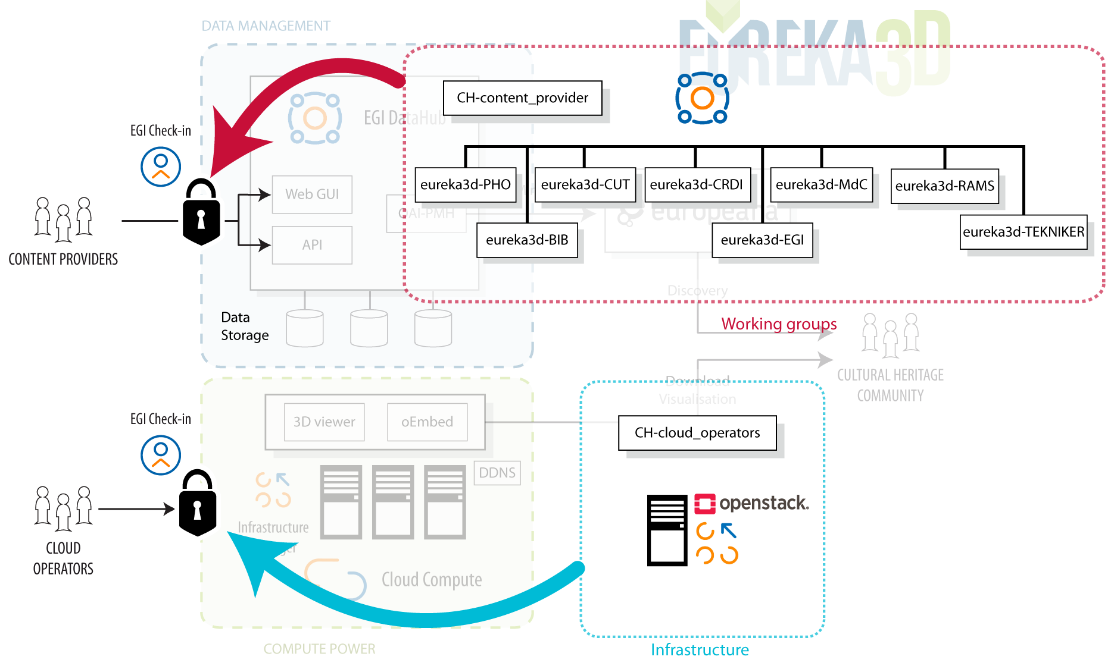
VO organisation

Slide 12
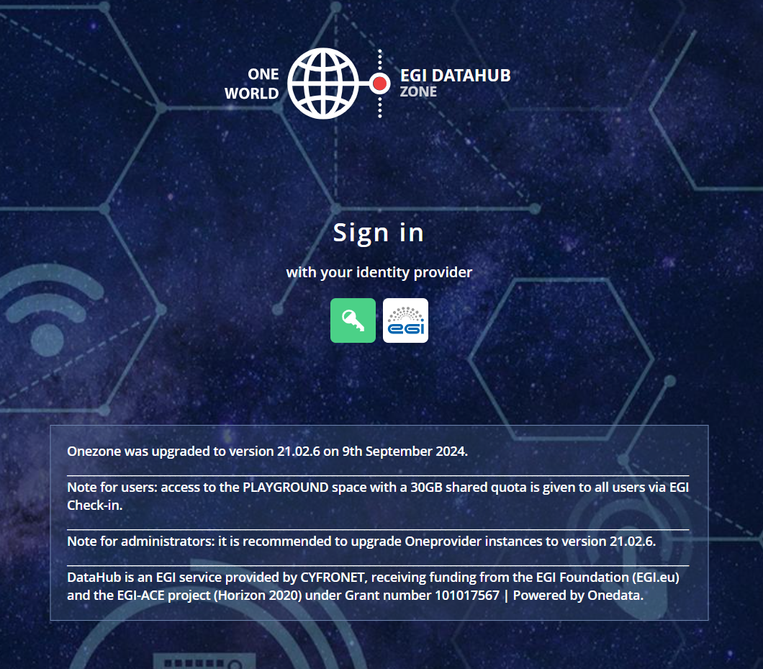
EUreka3D: DataHub - authentication

Slide 13
EUreka3D: DataHub

Slide 14
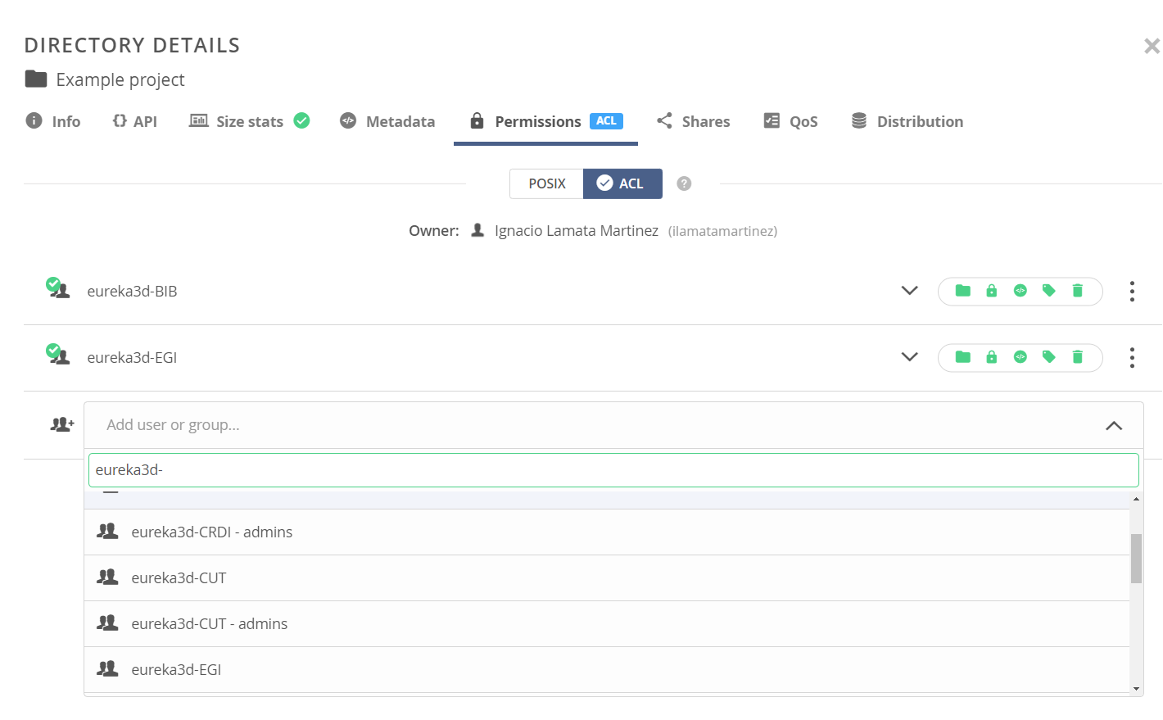
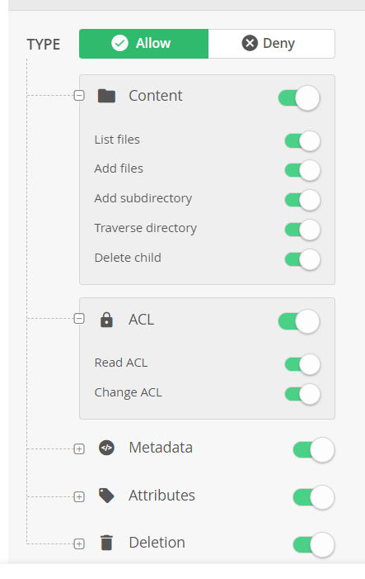
EUreka3D: DataHub: Authorisation via ACL

Slide 15
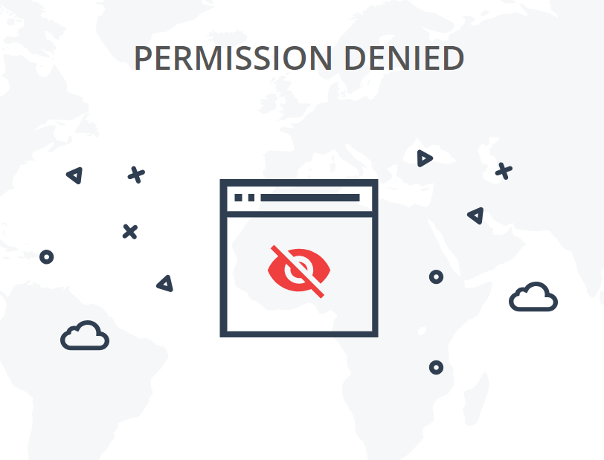
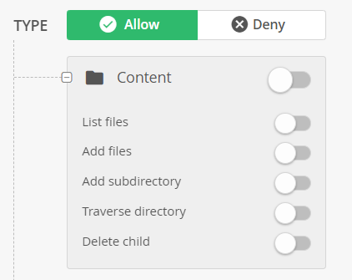
EUreka3D: DataHub: Authorisation via ACL

Slide 16
https://www.lethe-project.eu/
LETHE

Slide 17
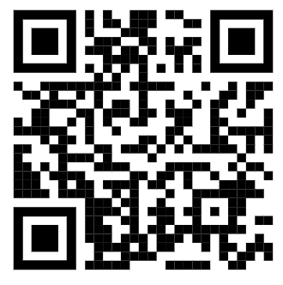
The LETHE project
https://www.lethe-project.eu/
Prevention in the whole spectrum of cognitive decline in the elderly population at risk.
LETHE prediction modelling of Dementia is built at the intersection of clinical and technological disciplines. The project is developing a data-driven risk factor prediction model for older individuals at risk of cognitive decline, novel digital biomarkers and a digitally enabled intervention.

Slide 18
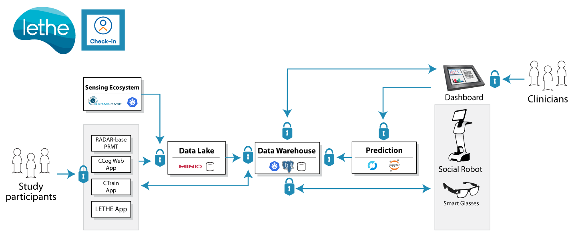
The LETHE platform (simplified)

Slide 19
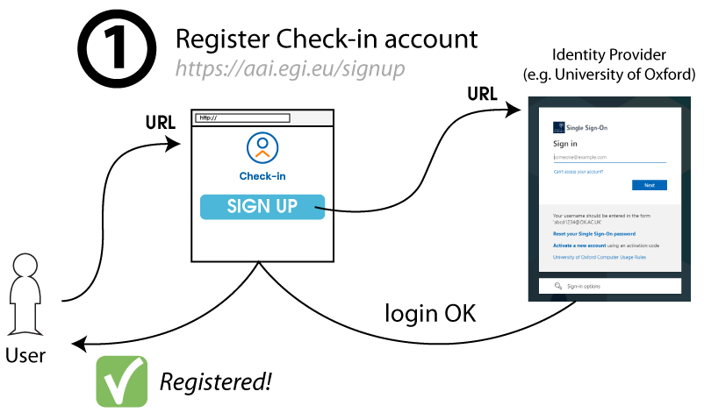
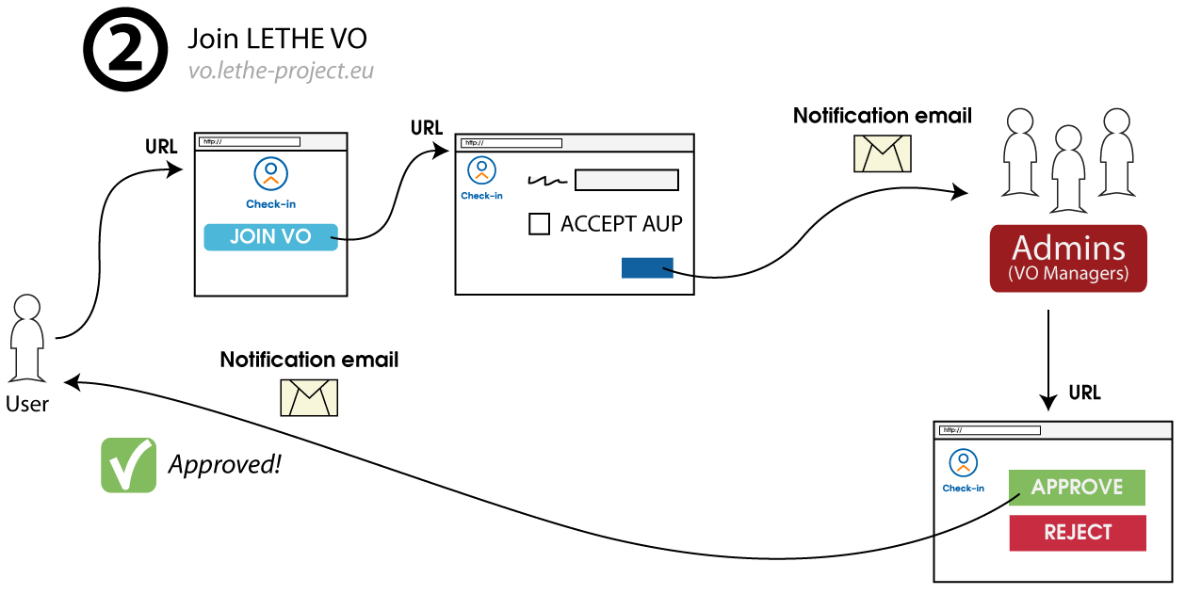
Obtaining access

Slide 20
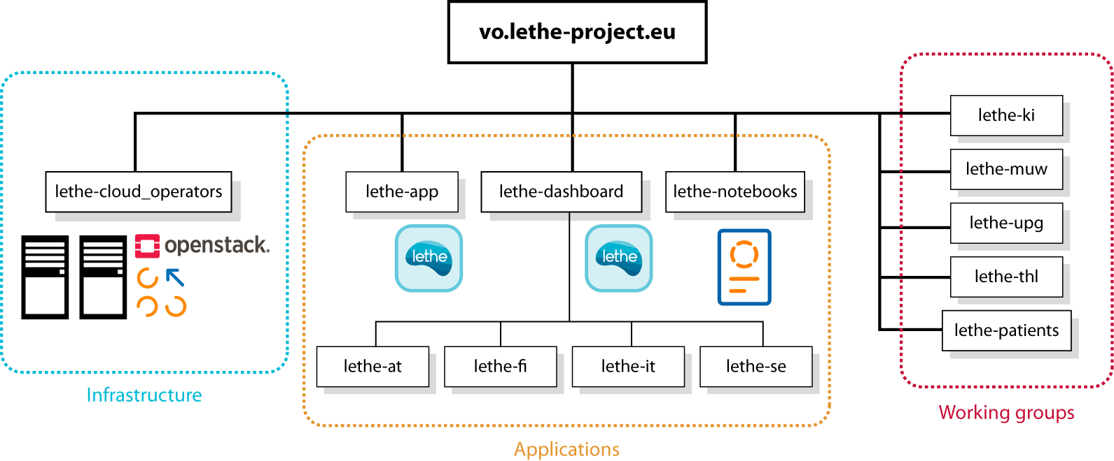
VO organisation

Slide 21
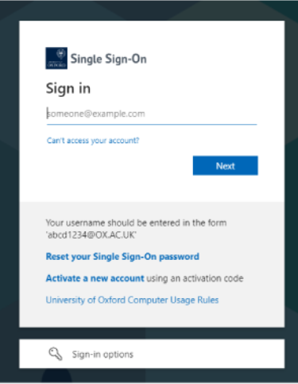
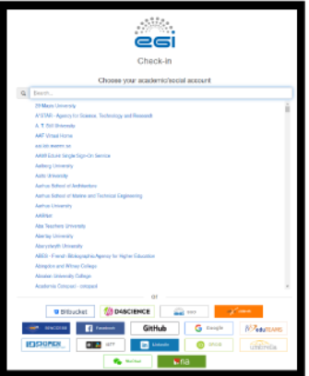
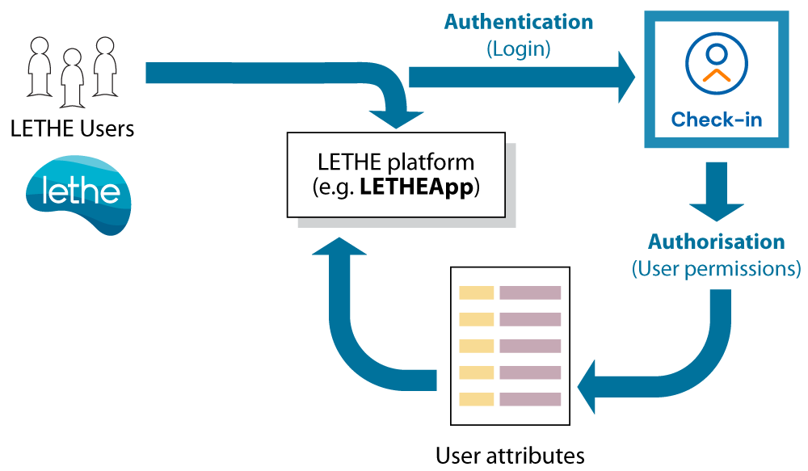
Authorisation flow

Slide 22
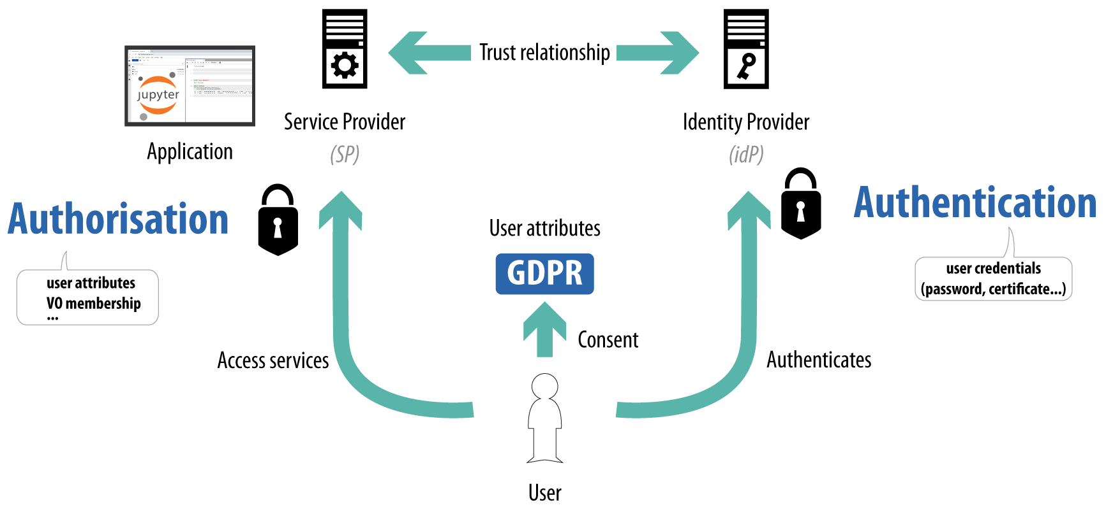
Registration of LETHE Services: Federation Registry

Slide 23
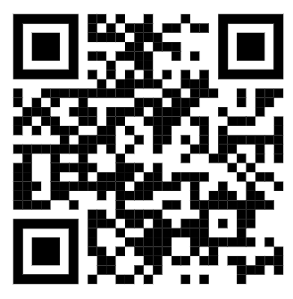
Registration of LETHE Services: Federation Registry
https://aai.egi.eu/federation/egi/home
DOCS
https://docs.egi.eu/providers/check-in/sp/
Registration and configuration of your services, within this trust relationship with EGI Check-in
Start in demo and move to production once it is mature and ready
Some types of services:
Applications running on servers (with a backend, so secrets can be kept)
Applications running on client machine (smartphone apps, Web apps running on user computer via JS, etc)
Machine to machine communication
LETHE uses (2) and (3) mainly, discussed in the next slides
(2)
(2)
(3)
(3)

Slide 24
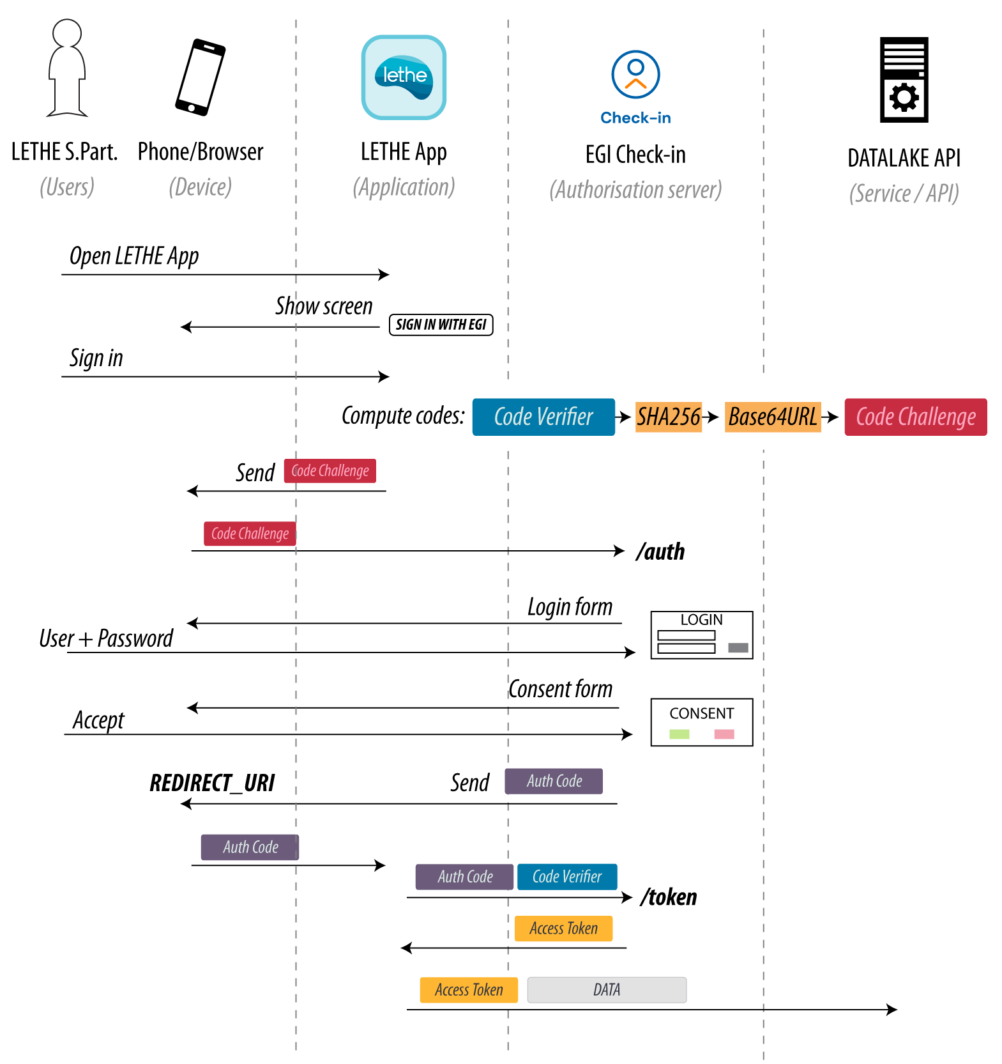
Users - Web and smartphone applications

Slide 25
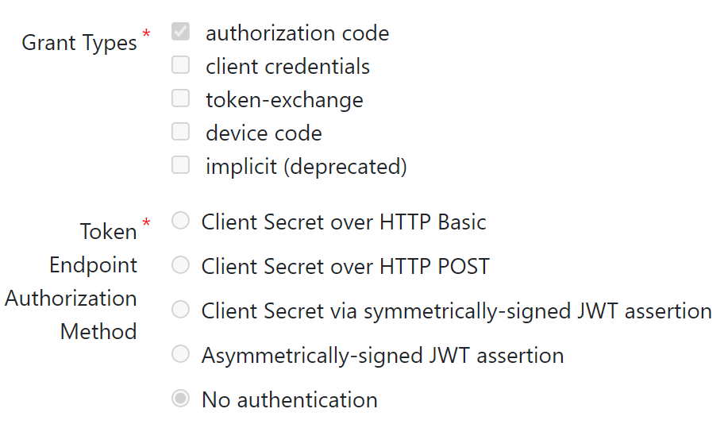
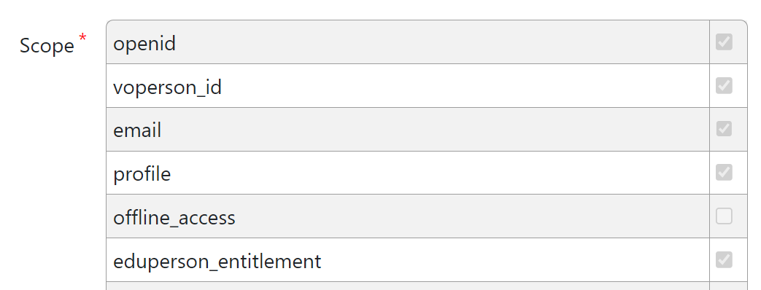
Users - Web and smartphone applications: How to

Slide 26
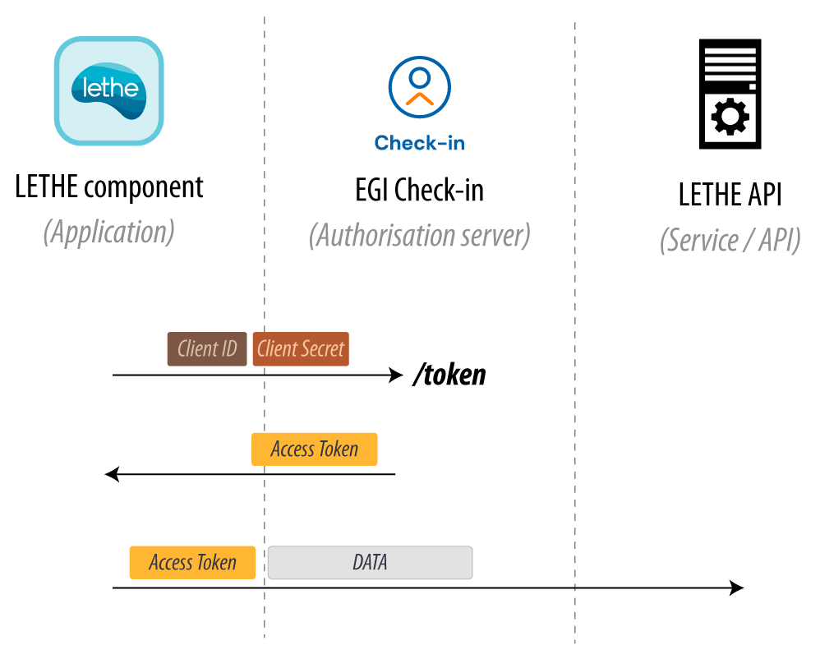
What about machines? Component intercommunication

Slide 27
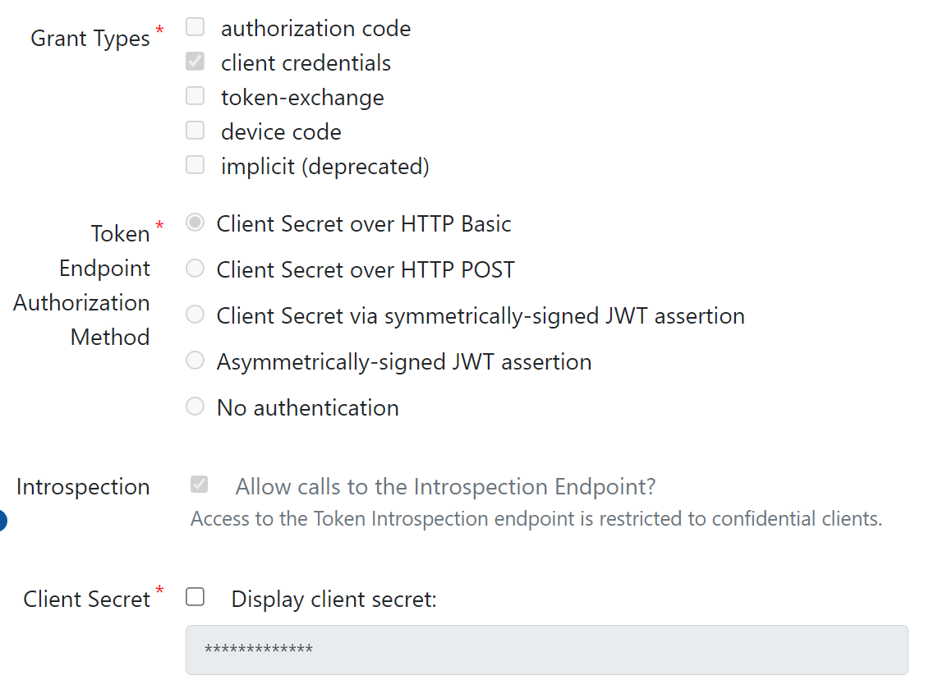
Component intercommunication: How to

Slide 28
Bonus: Check-in API
Manipulation of multiple records by the VO Manager → Tedious to do manually through the GUI and error prone
Solution: Use the API

Slide 29
Contact us
contact@egi.eu
Let's talk. Or
meet in person
Get in touch with us

