Slide 1
EGI Check-In: Evolving the Infrastructure for European Research
Advancing Identity and Access Management for Researchers
Nicolas Liampotis
Oct 3, 2024
GRNET
EGI Conference 2024

Slide 2
Check-in
Introduction
Single Sign-On (SSO): Access services using existing credentials
Academic (eduGAIN, ORCID)
Social media (Google, LinkedIn)
Community identities (Research Infrastructures)
Federated Access to Diverse Services
Web and non-web services using SAML, OpenID Connect/OAuth 2.0, X.509
User Attribute Aggregation & Harmonisation
Aggregate & harmonise groups and roles from multiple sources
Identity Linking
Link multiple authentication providers for accessing resources using different login credentials (institutional/social)
Trust & Assurance
Express trust levels and assurance in identity assertions

Slide 3
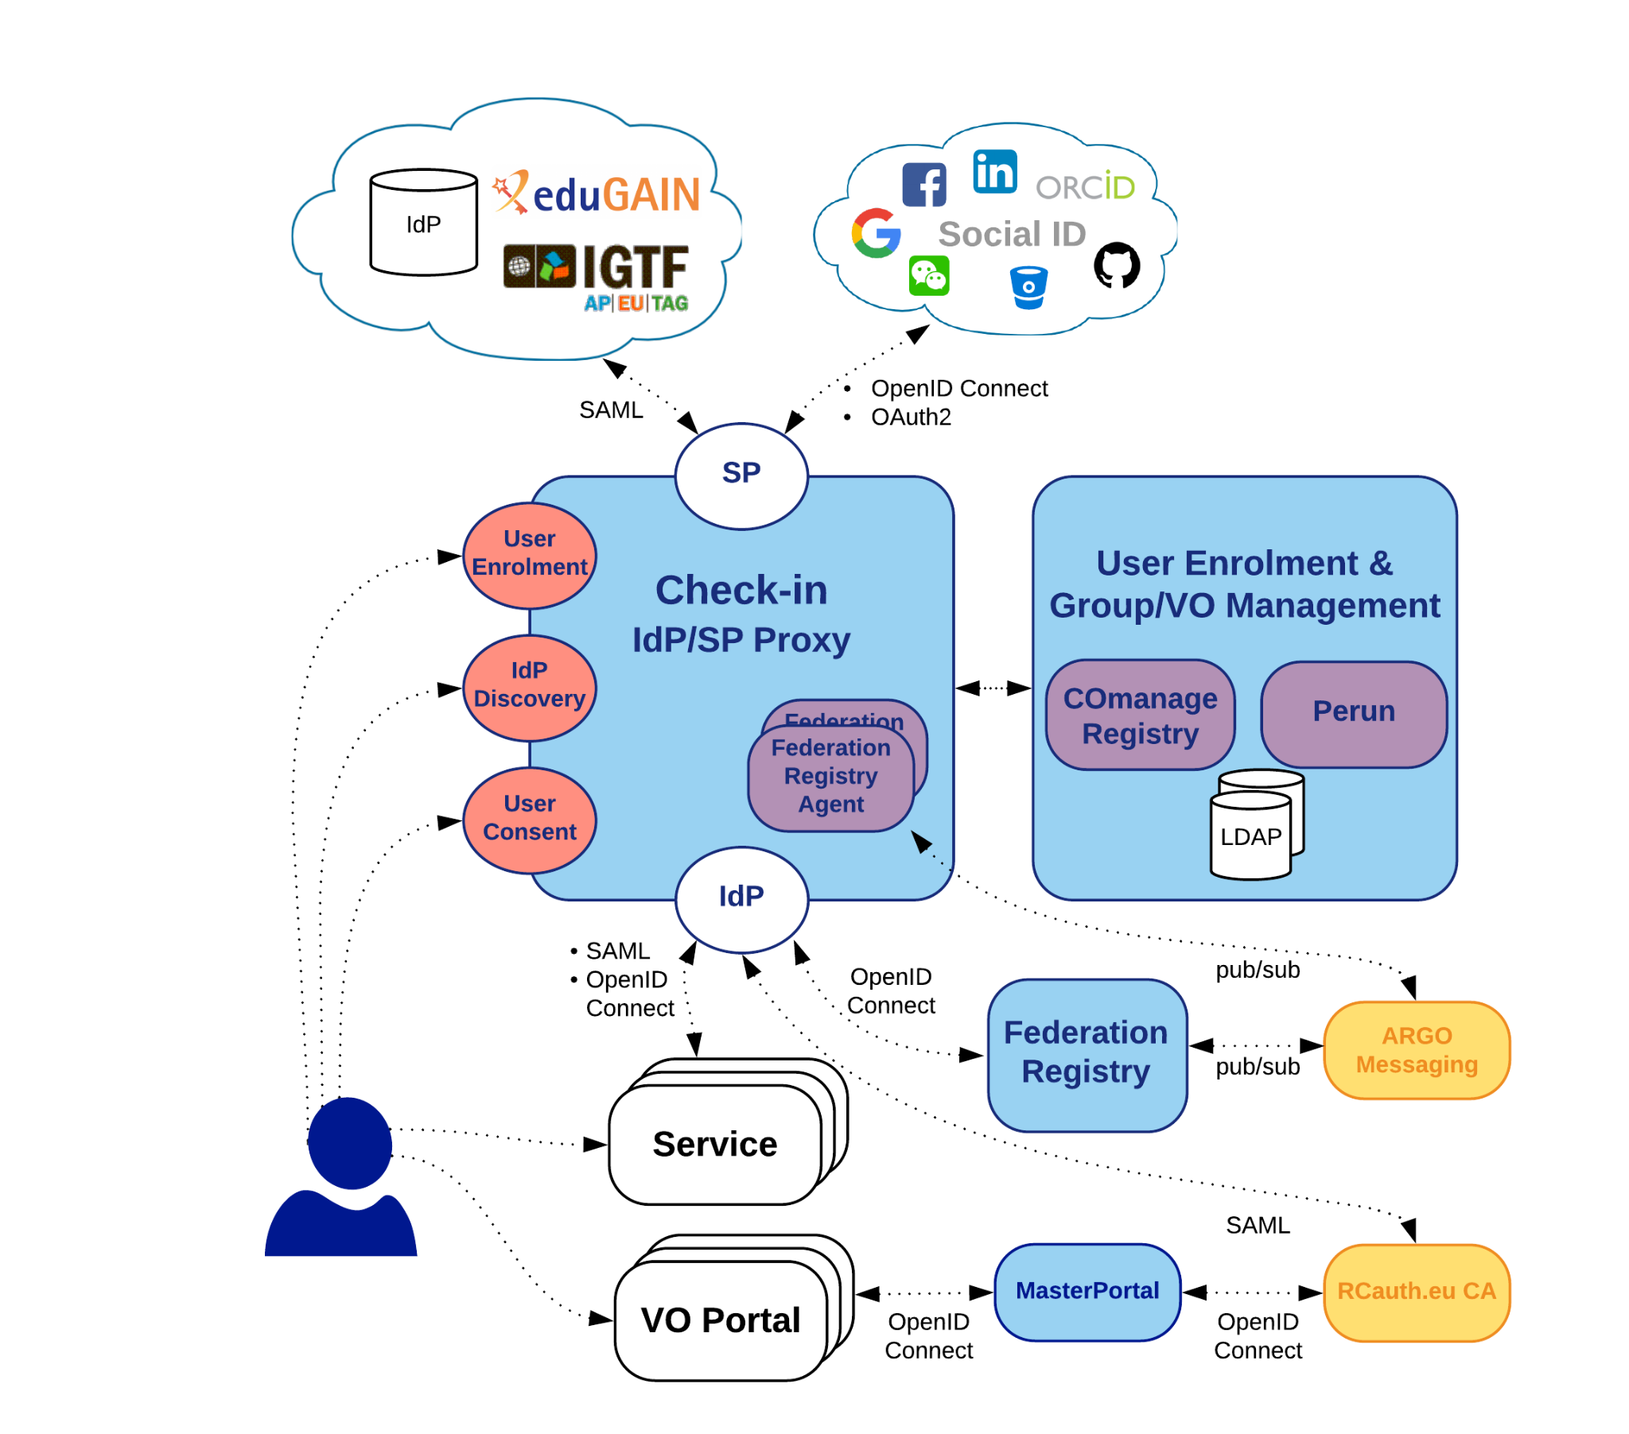
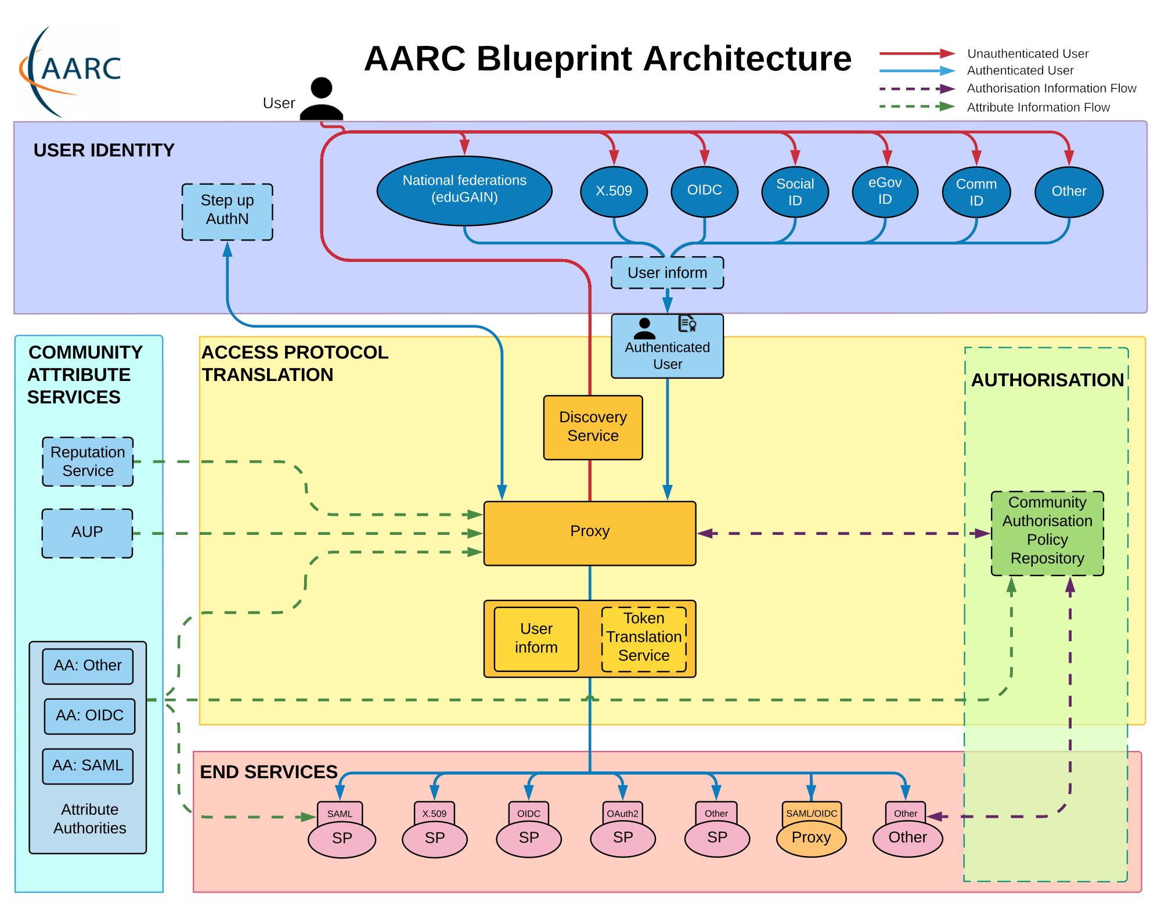
Check-in
Implementation of the AARC Blueprint Architecture
Architecture

Slide 4
Federations
Challenges & Opportunities

Slide 5
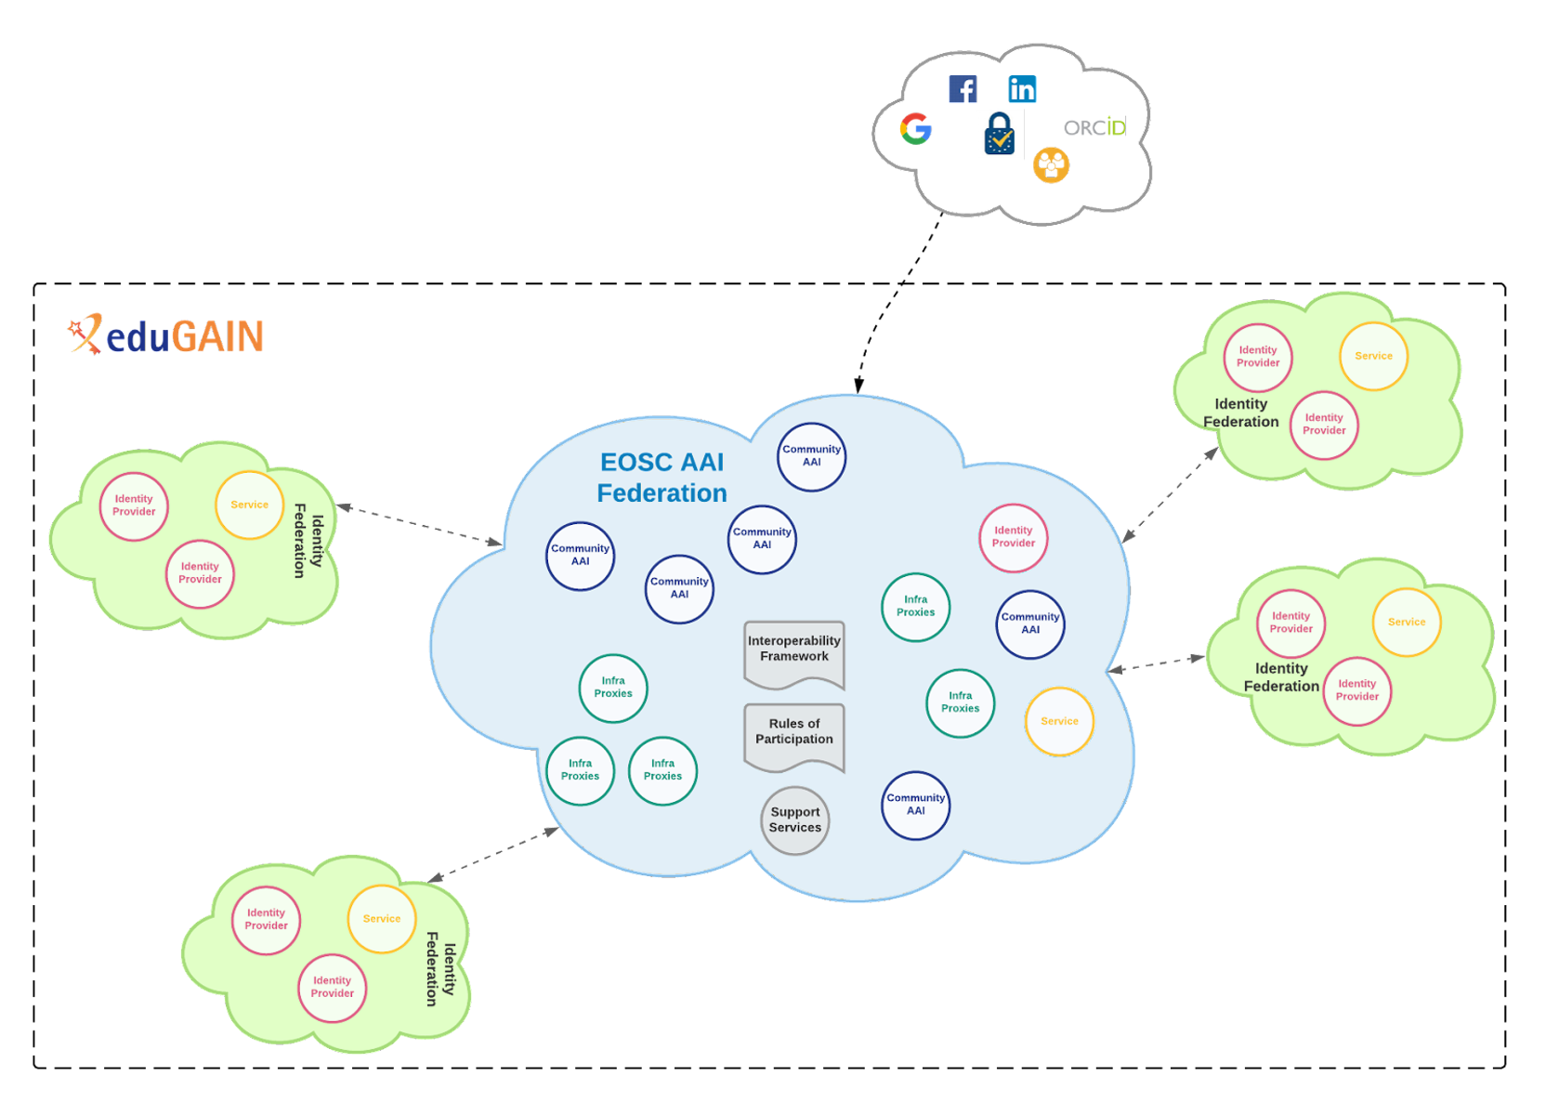
Support for Federations
SAML Federations with Keycloak
Support for SAML IdP Federations (e.g. 5700+ IdPs from eduGAIN)
Support for SAML SP Federations (e.g. EOSC AAI Federation)
Check-in

Slide 6
Federation Support
SAML Federations with Keycloak
Built-in Federation Support in our Keycloak Fork
Enables integration with SAML Federations (e.g. eduGAIN, EOSC)
Upstream Keycloak (v26) Enhancements
Improves scalability for thousands of Identity Providers
Challenges & Solutions
No upstream plan for full SAML Federation support
Custom extensions maintained alongside upstream
External plugin for IdP discovery via email for upstream v26
Our custom theme enables search by IdP name

Slide 7
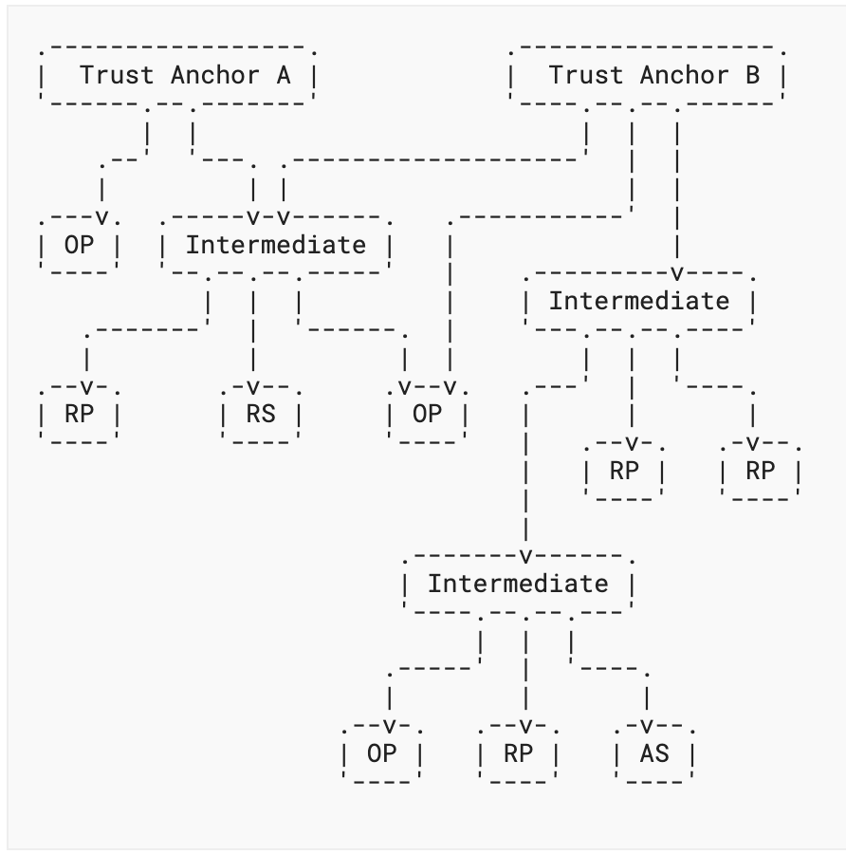
Federation Support
OpenID Federations
Motivation for OIDFED:
Simplified Federation Connections
No need for SAML to OAuth 2.0 proxy layer
OpenID Federation as the Trust Infrastructure for Decentralised Identity
Already used for National eID in Italy
Considered for other major initiatives like the EU’s EUDI Wallet
https://openid.net/specs/ openid-federation-1_0.html

Slide 8
Federation Support
OpenID Federations with Keycloak
Upstream Keycloak OAuth SIG Team Interest
Active discussion on supporting OpenID Federation
Existing PoCs:
Our early implementation as a keycloak extension based on a previous OIDFED draft
Updated version based on Keycloak 25
Looking ahead:
Start development of OIDFED as a core Keycloak component
ETA: August 2025
https://openid.net/specs/ openid-federation-1_0.html

Slide 9
Decentralised Identities & Identity Wallets
Challenges & Opportunities

Slide 10
Decentralised Identities & Identity Wallets
Current Federated Identity Model vs Decentralized Identities
Relies on Identity Providers (IdPs) to authenticate users for multiple Service Providers (Service Proxies or End- Services)
Identity attributes and authentication are passed through OIDC claims or SAML attribute assertions
Users control their identity data and manage it via wallets.
Verifiable Credentials (VCs): Credentials are issued by trusted entities and presented by users without central authentication
Identity Provider
Service Provider
Issuer
Issues VCs
Holder
Acquires, stores, presents VCs
Verifier
Verifies VCs
Trust Relationship
Issue Credentials
Send Presentation
Verify Identifiers and use Schemata
Register Identifiers and use Schemata
Verify Identifiers and Schemata
Authenticate
Access
Verifiable Data Registry
Maintains identifiers and schemata
Verifiable Credentials Data Model v2.0

Slide 11
Support for Decentralised identities / wallets
Keycloak status
Experimental support for OpenID for Verifiable Credential Issuance (OID4VCI) in Keycloak 25 (see epic) → Enables Keycloak to act as an issuer of Verifiable Credentials (VCs).
Used by FIWARE Data Space Connector
Reference Implementation of GAIA-X Authentication & Authorization Service (decentralised, self-sovereign identity infrastructure)
Next steps
Understand Check-in’s role in this new identity paradigm
Feed into AARC TREE architecture task dedicated to Decentralised Identities & Wallets
Implementation e.g. RI-SCALE starting March 2025

Slide 12
Migration to Keycloak

Slide 13
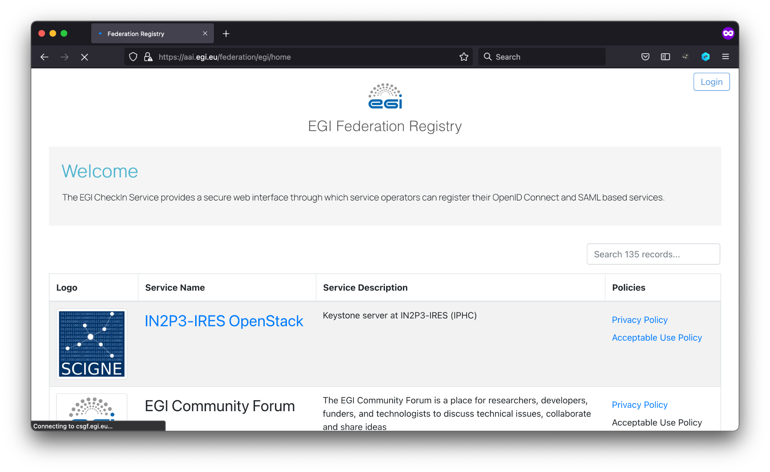
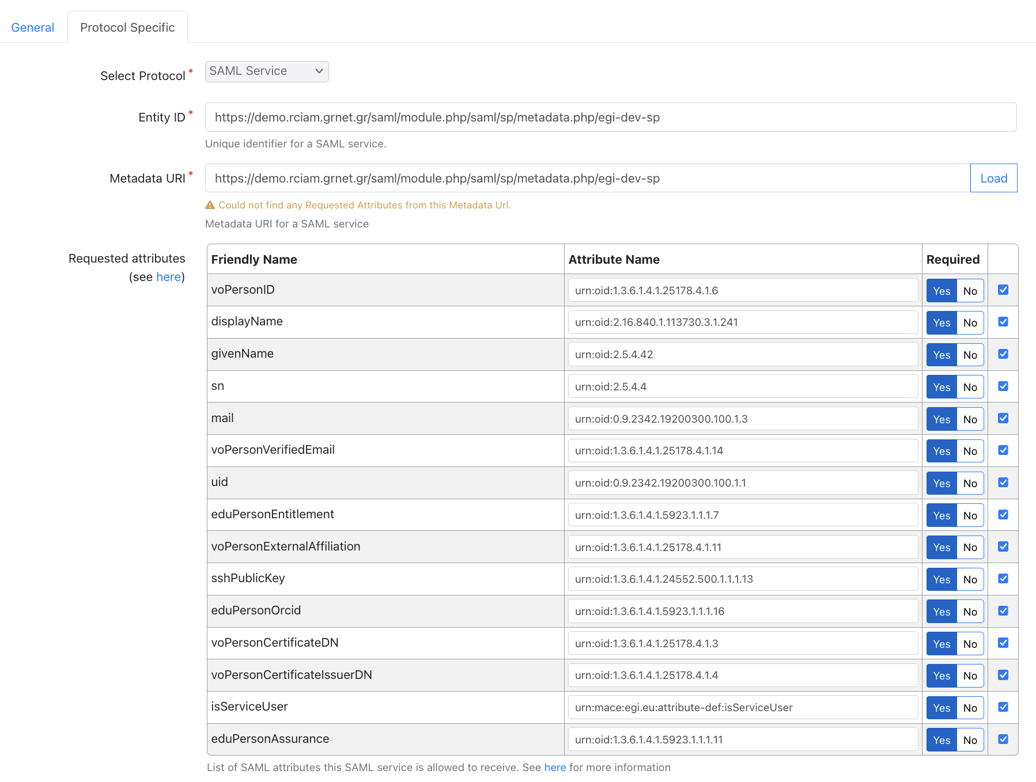
Migration to Keycloak
Service Registration & Configuration Management
Support for managing the registration & reconfiguration of OIDC & SAML Service Providers in Keycloak through the Federation Registry
New features:
Improved Self-Review Flow: Simplified process for service owners to review and update their own configurations
Enhanced Support for New Deployments: Streamlined onboarding for new tenants and instances
SAML SP Migration progress:
Demo SAML SPs migrated to Keycloak ✔
Production SAML SPs migrated to Keycloak [12 out of 13]
NEW
https://aai.egi.eu/federation

Slide 14
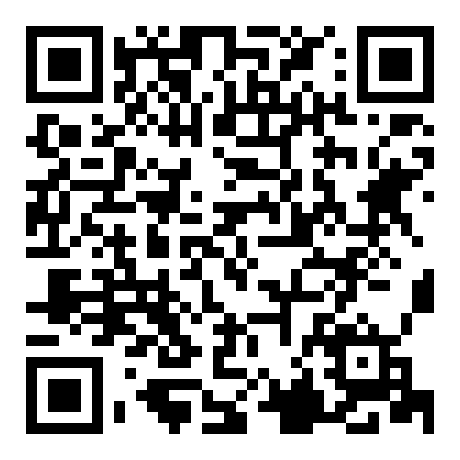
Migration to Keycloak
Advanced Group Management
User-driven group enrollment flows:
Users can request membership in groups
Accept group Terms & Conditions
Provide comment/justification
Admin-reviewed enrollment requests
Time-based group membership:
Automatic expiration of group membership
Support for scheduled activation of membership
Group Management Tools:
Invite group members or admins
Edit group details and roles
Suspend, activate, or remove members
Edit individual memberships
Group Hierarchy Management:
Create and manage group hierarchies
Manage memberships through top-level groups
https://github.com/rciam/keycloak-group-management

Slide 15
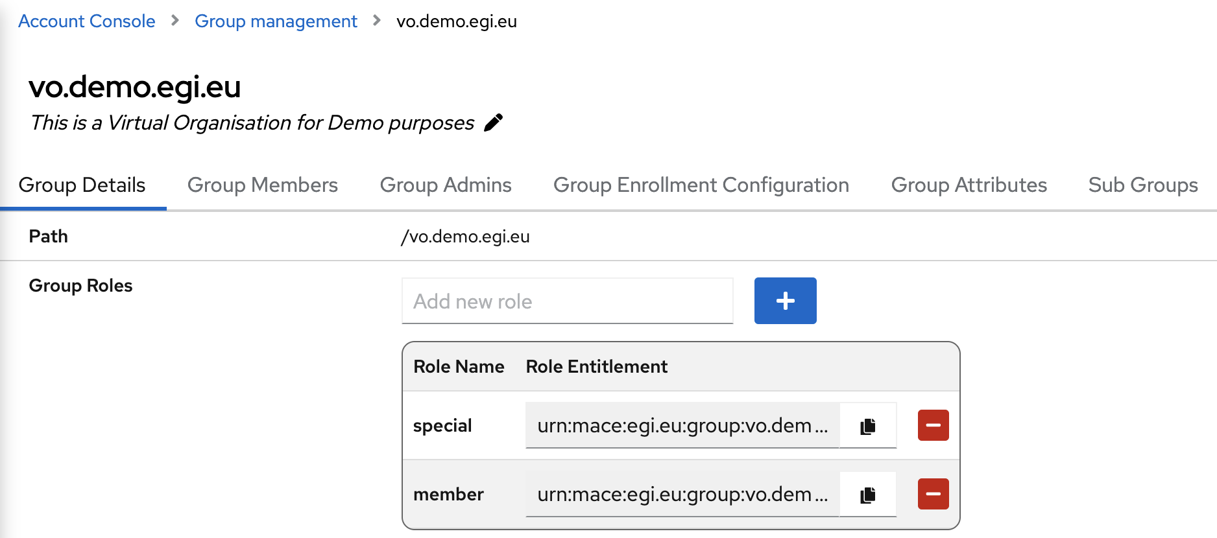
Migration to Keycloak
Advanced Group Management - Editing group details and roles
URN entitlements compatible with AARC-G069 Guidelines for Expressing Group Membership and Role Information

Slide 16
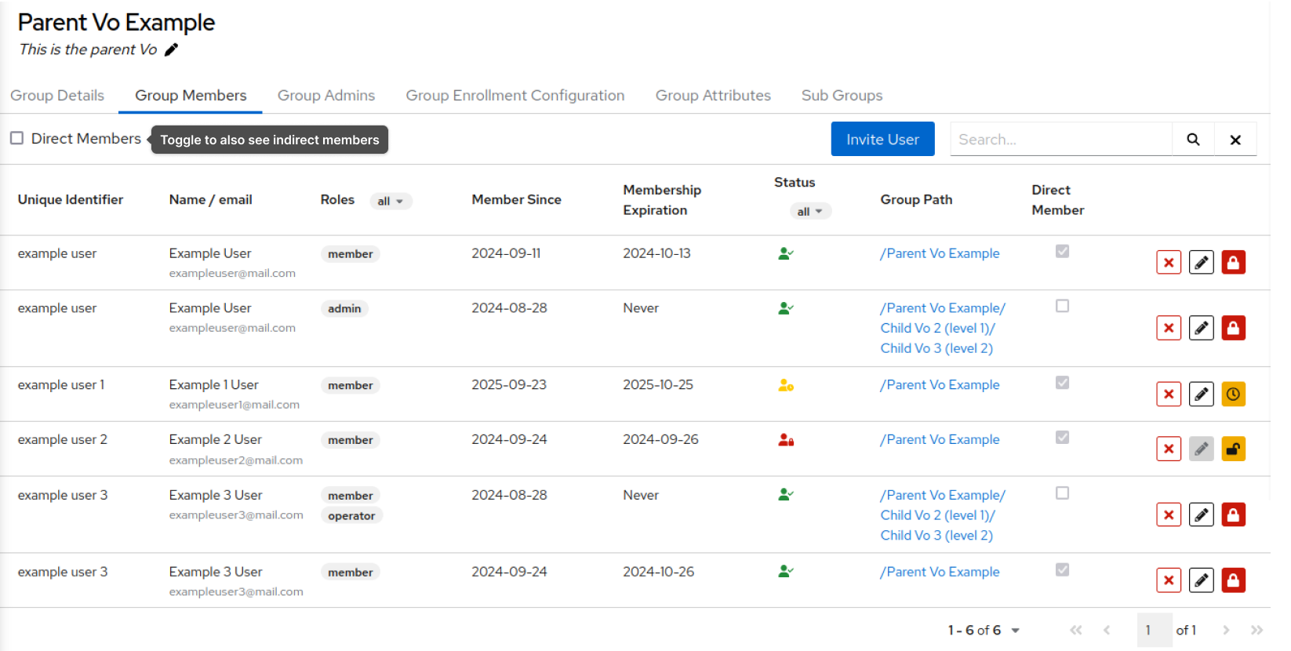
Migration to Keycloak
Advanced Group Management - Viewing VO Members

Slide 17
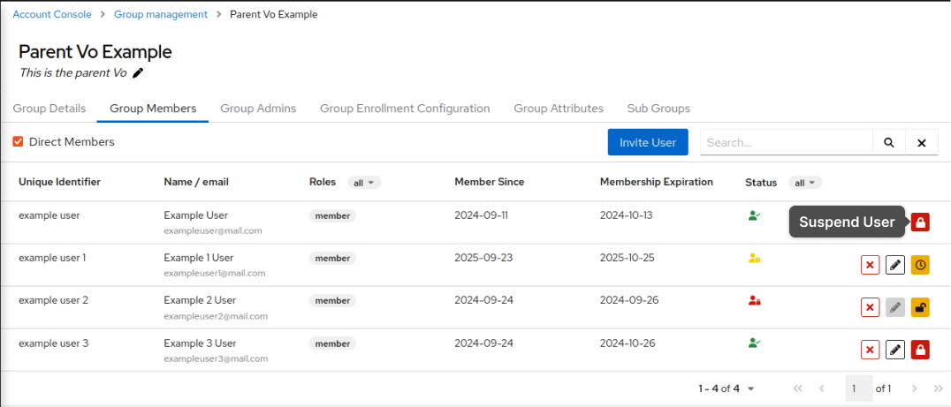
Migration to Keycloak
Advanced Group Management - Managing Memberships

Slide 18
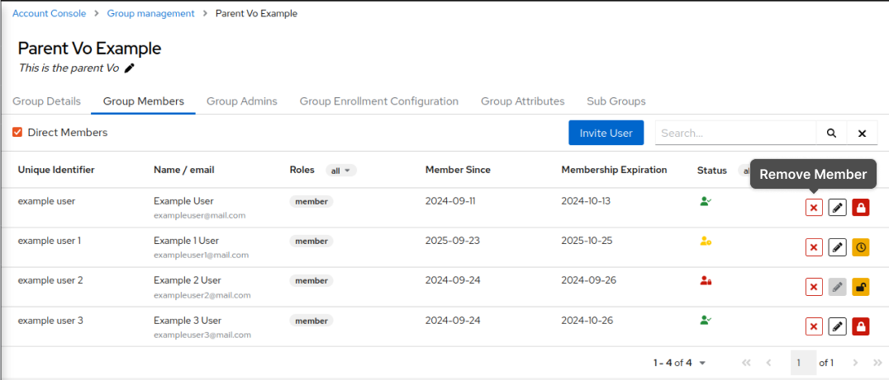
Migration to Keycloak
Advanced Group Management - Managing Memberships

Slide 19
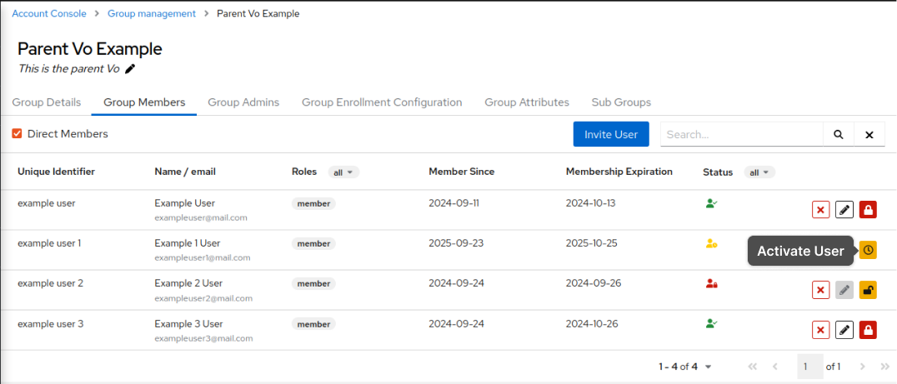
Migration to Keycloak
Advanced Group Management - Managing Memberships

Slide 20
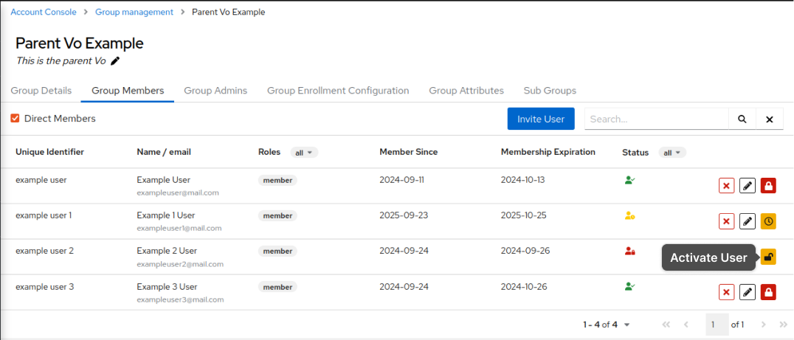
Migration to Keycloak
Advanced Group Management - Managing Memberships

Slide 21
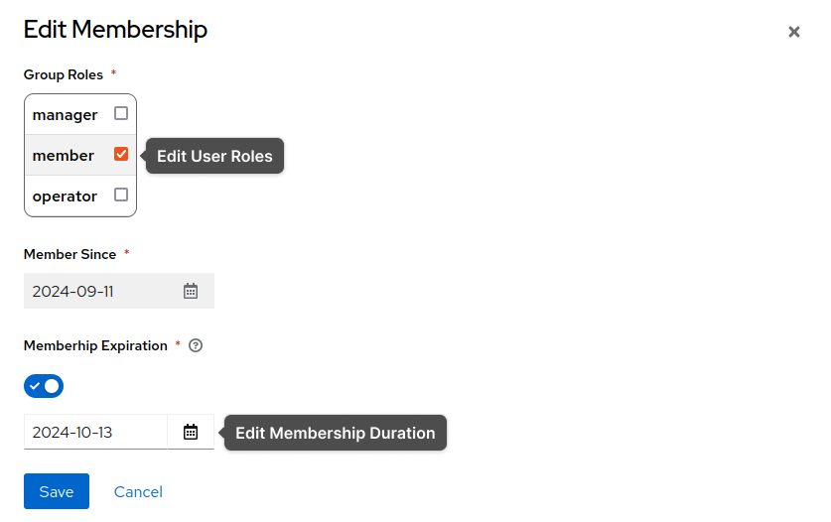
Migration to Keycloak
Advanced Group Management - Managing Memberships

Slide 22
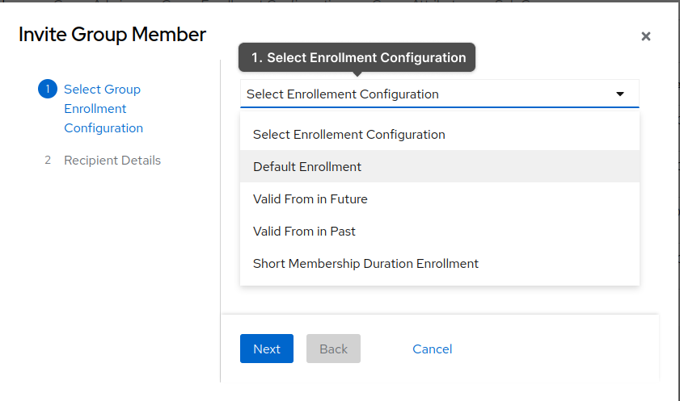
Migration to Keycloak
Advanced Group Management - Inviting New Members

Slide 23
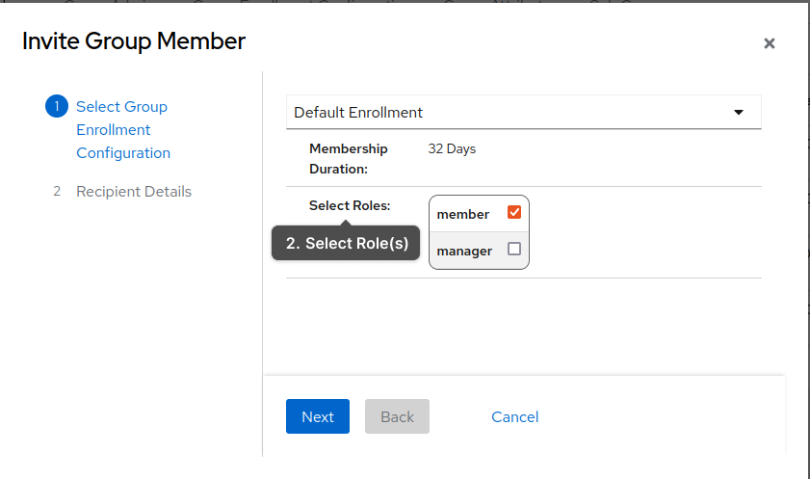
Migration to Keycloak
Advanced Group Management - Inviting New Members

Slide 24
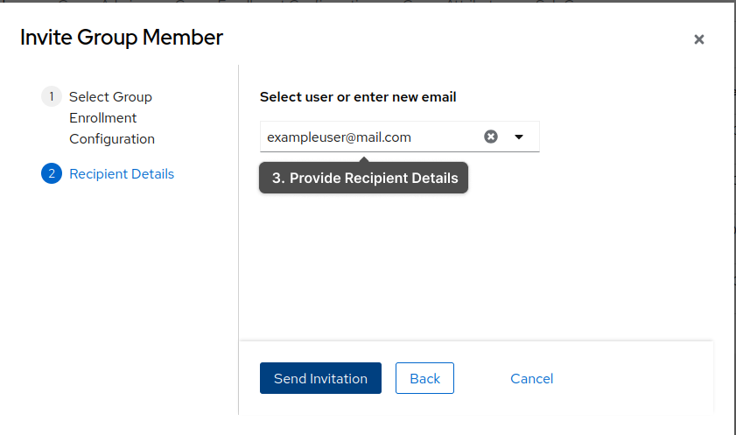
Migration to Keycloak
Advanced Group Management - Inviting New Members

Slide 25
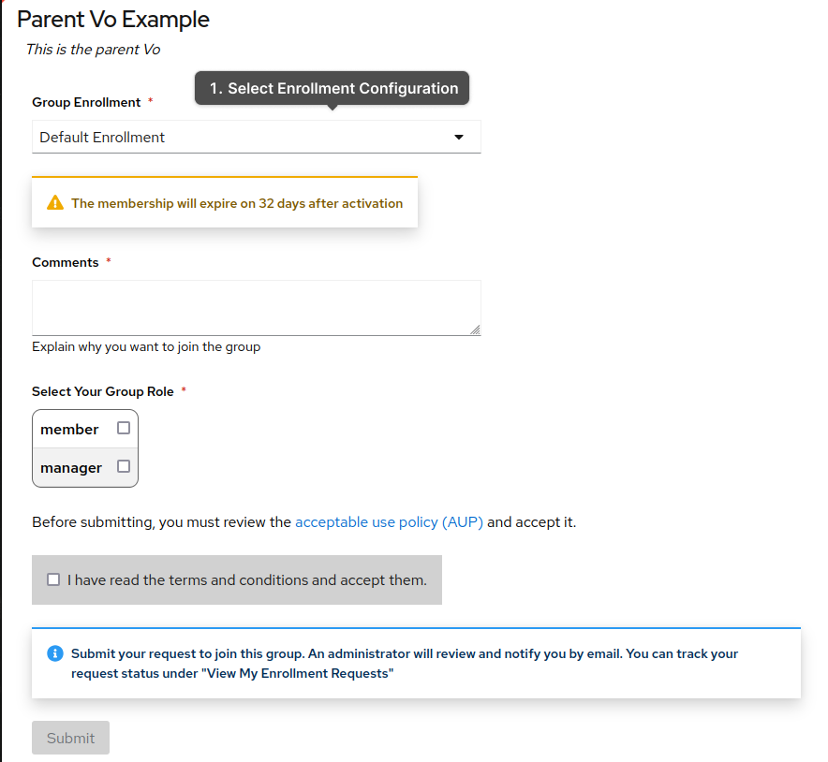
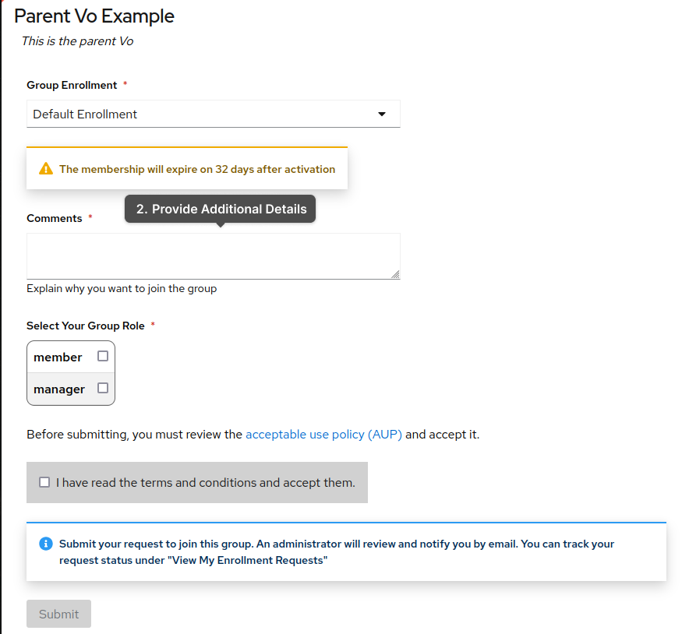
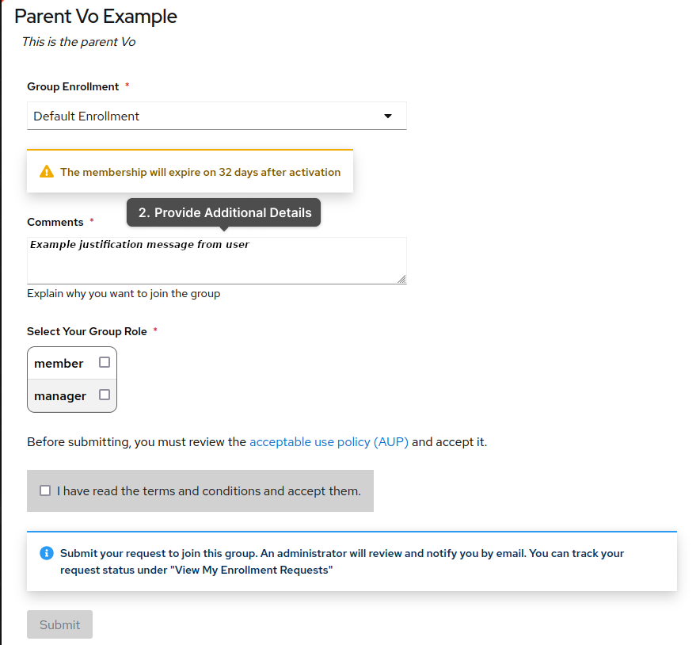
Migration to Keycloak
Advanced Group Management - Submitting Enrollment Requests

Slide 26
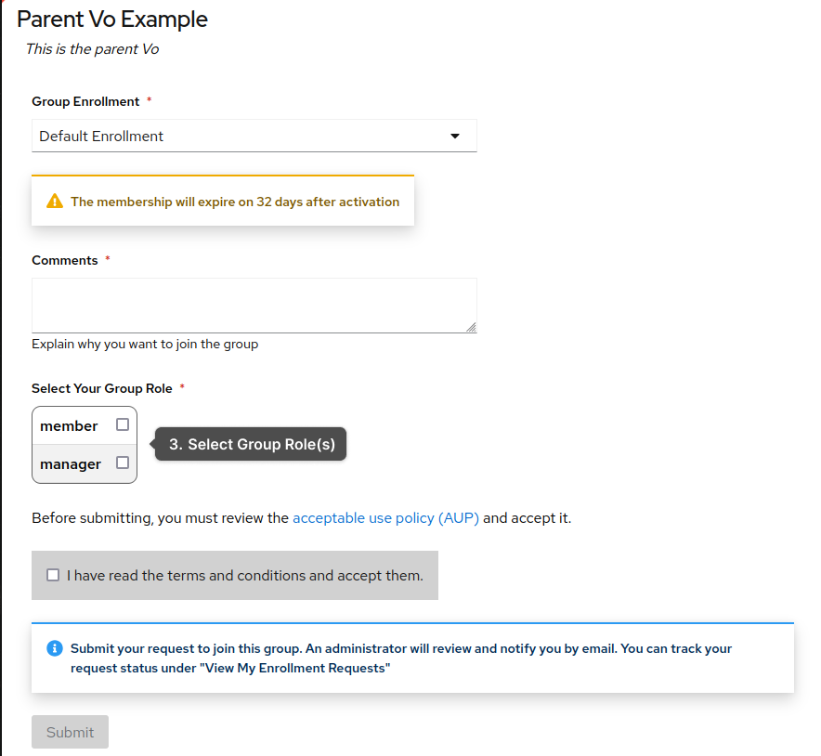
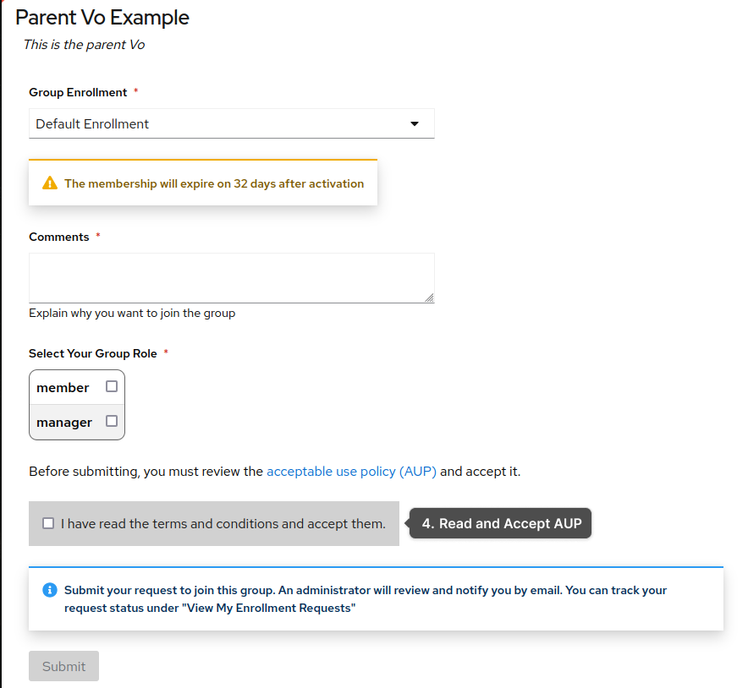
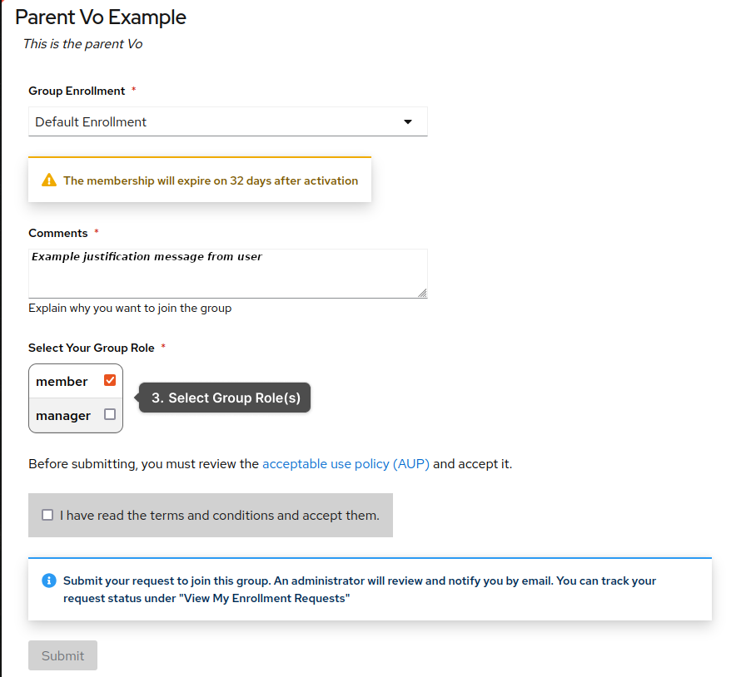
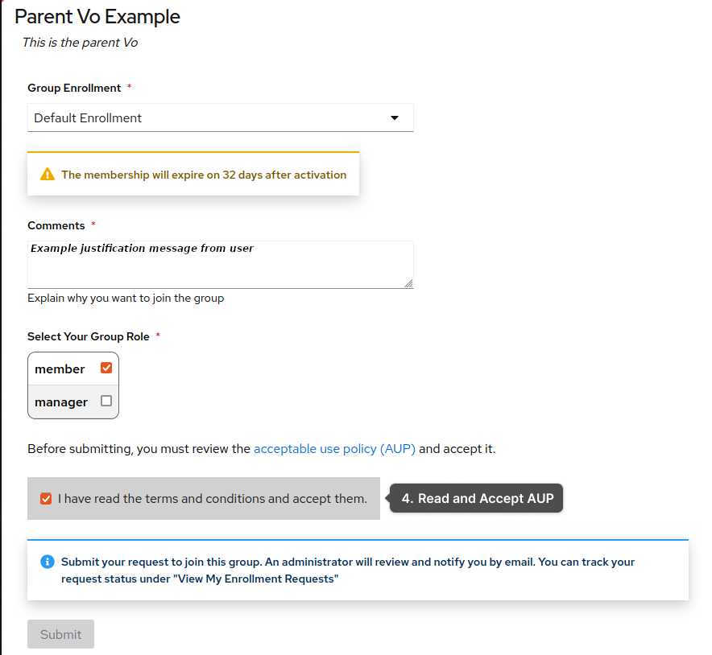
Migration to Keycloak
Advanced Group Management - Submitting Enrollment Requests

Slide 27
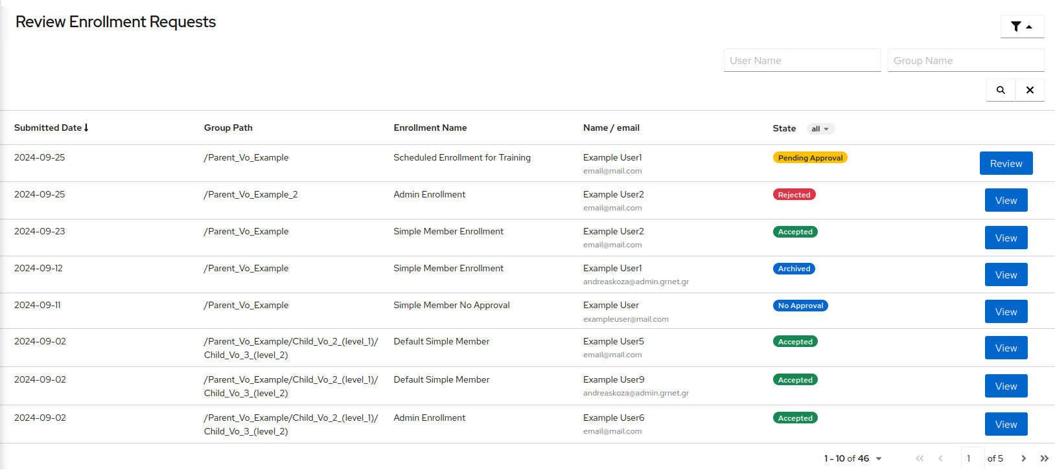
Migration to Keycloak
Advanced Group Management - Reviewing Enrollment Requests

Slide 28
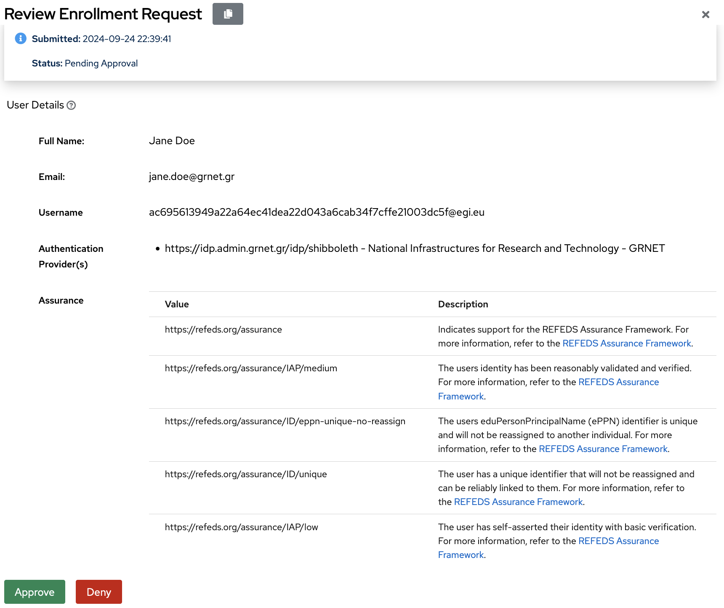
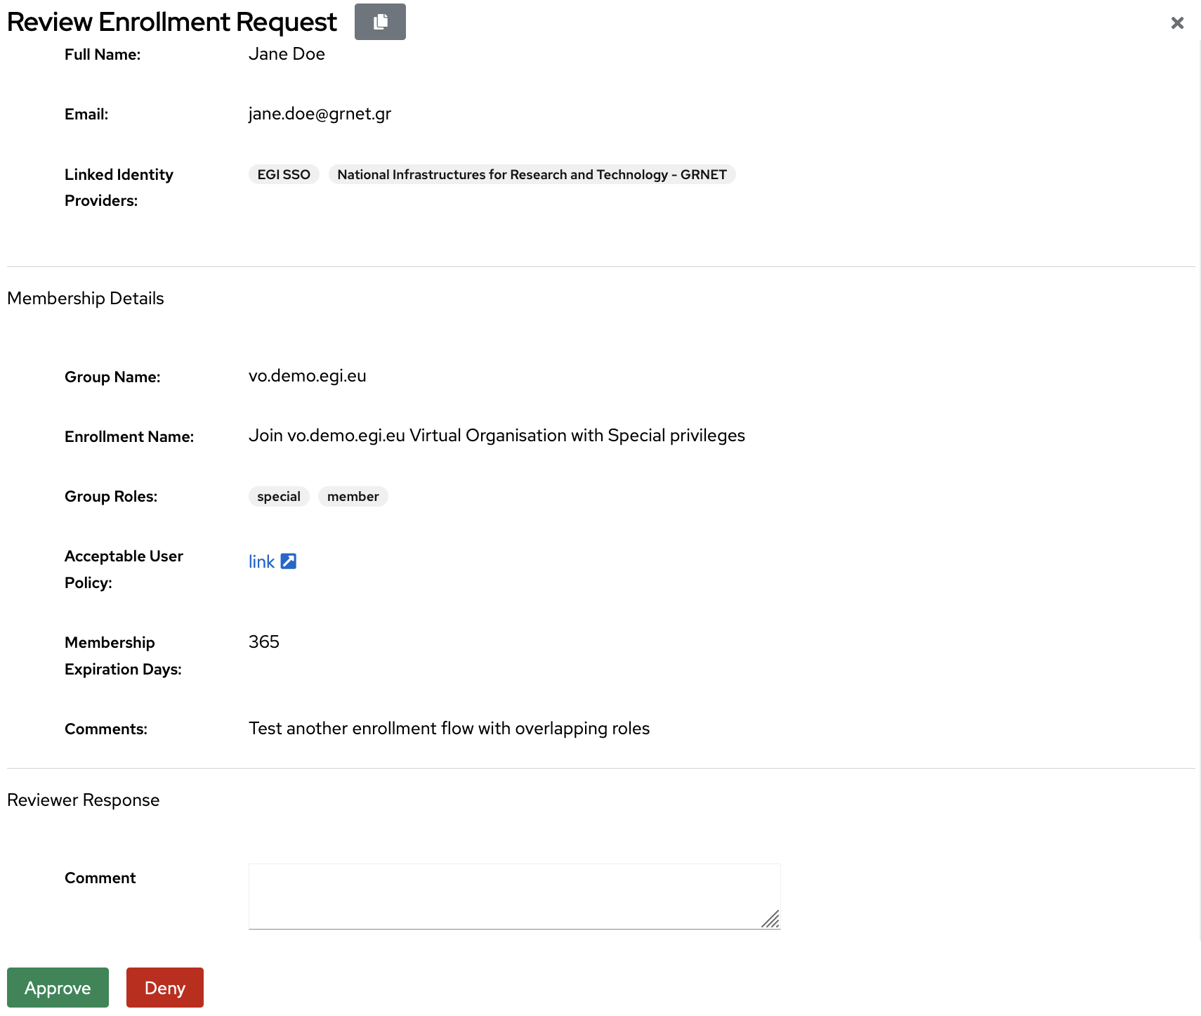
Migration to Keycloak
Advanced Group Management - Reviewing Enrollment Requests

Slide 29
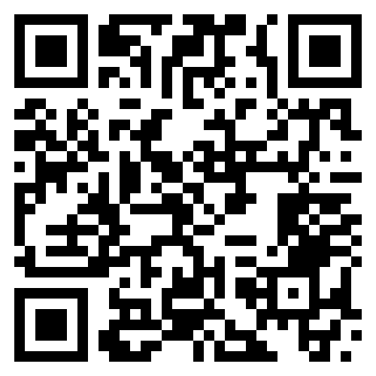
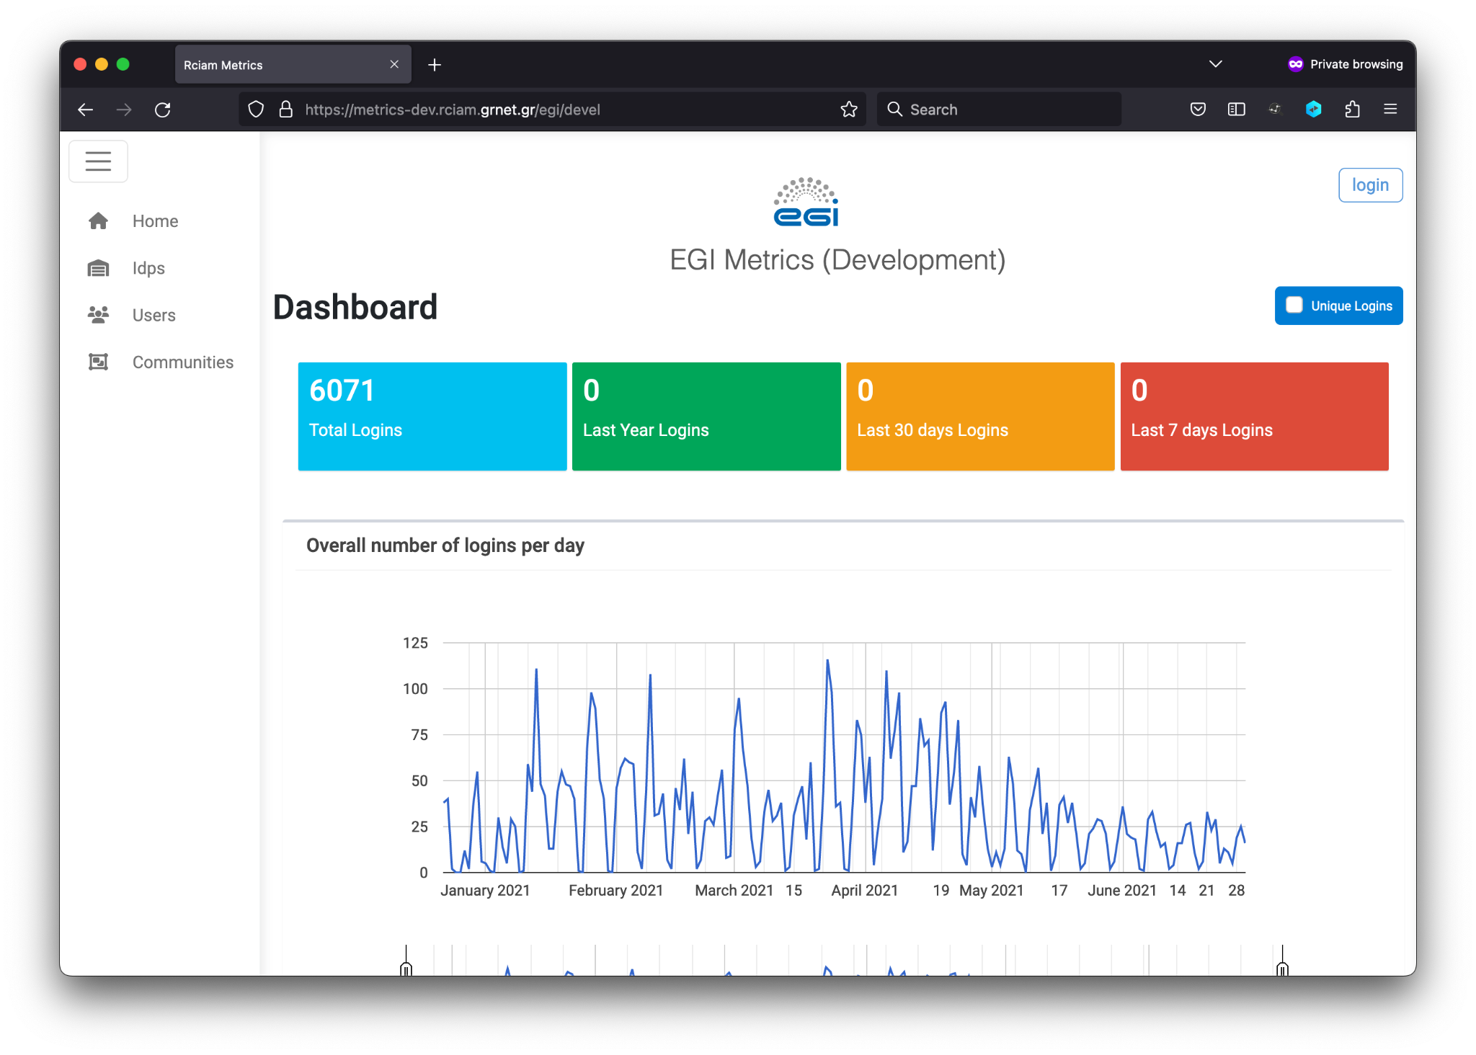
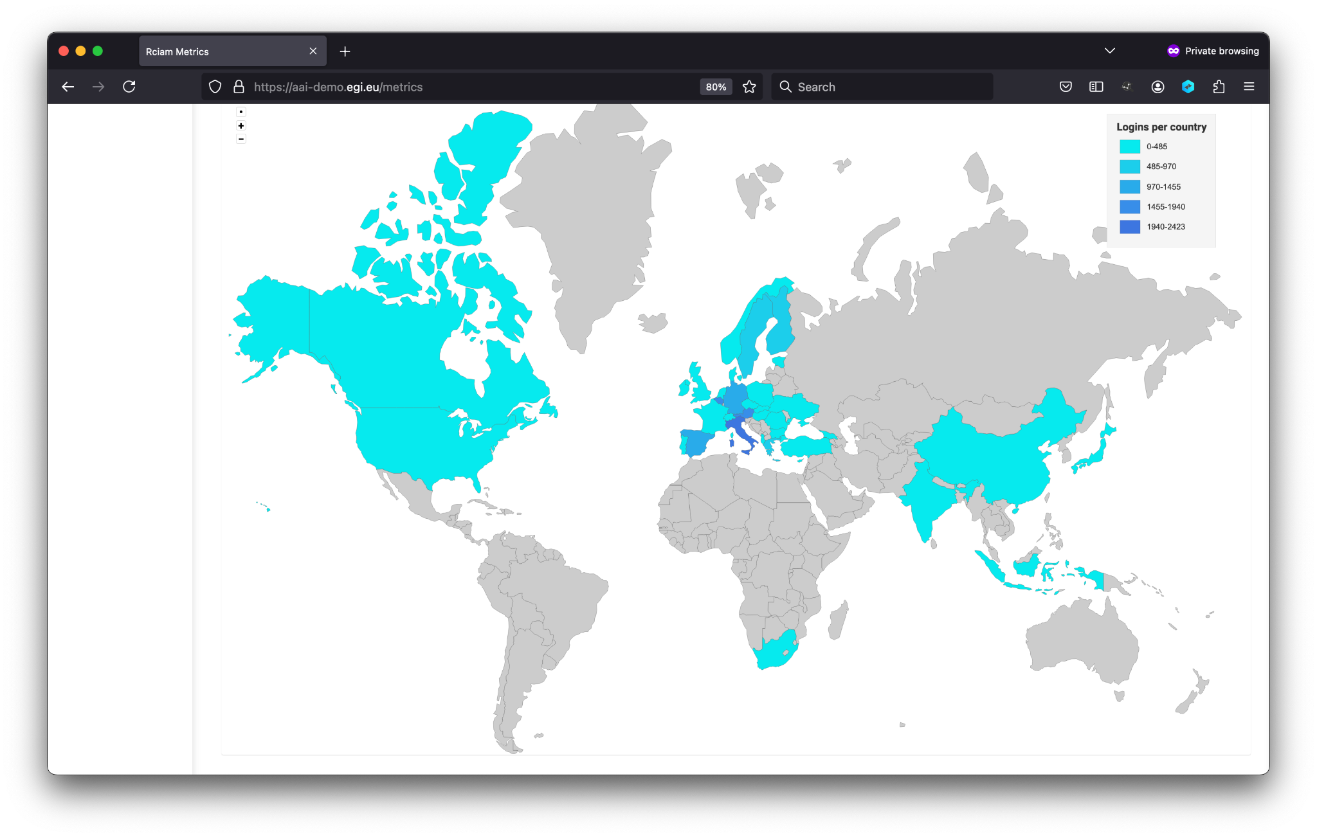
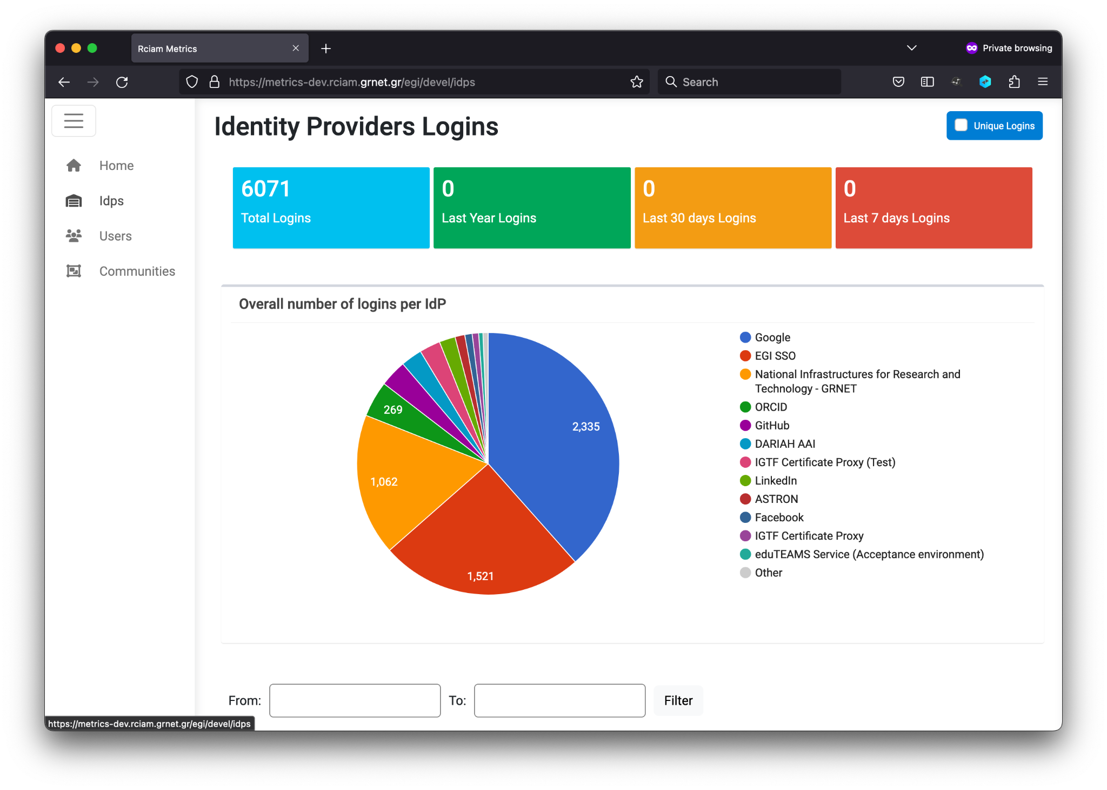
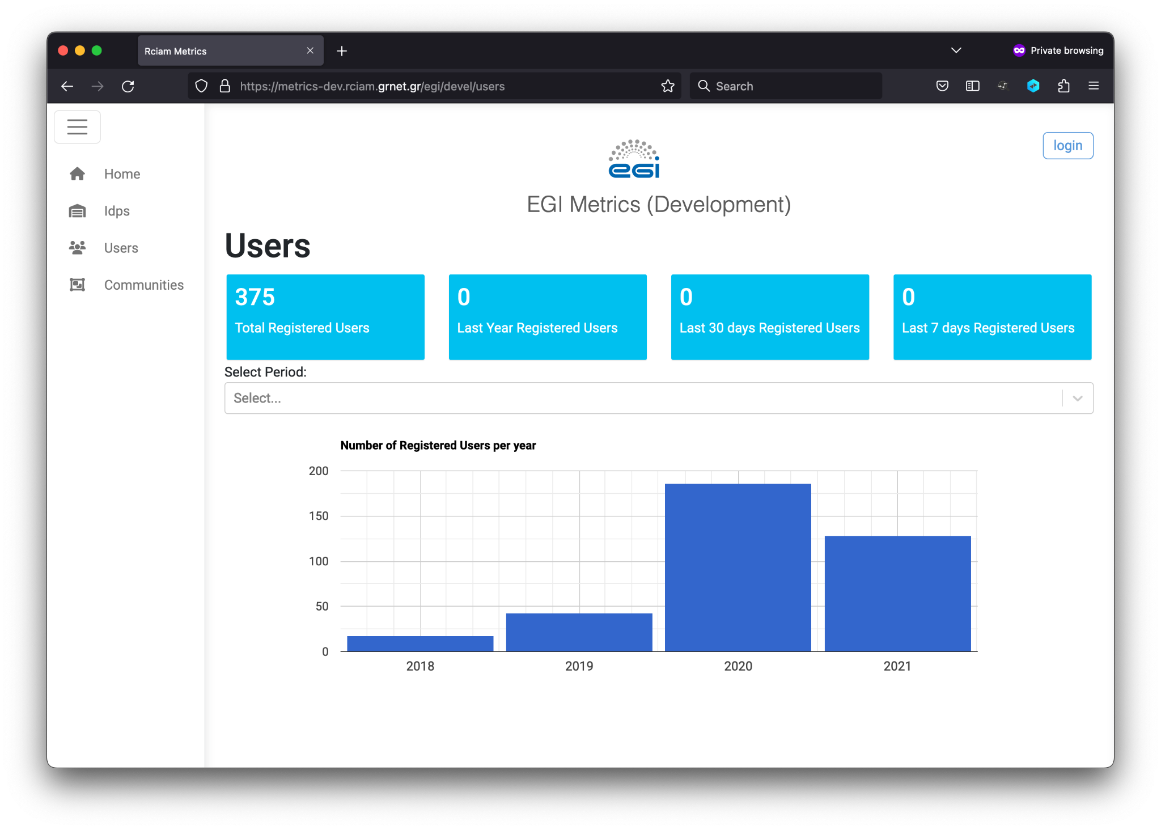
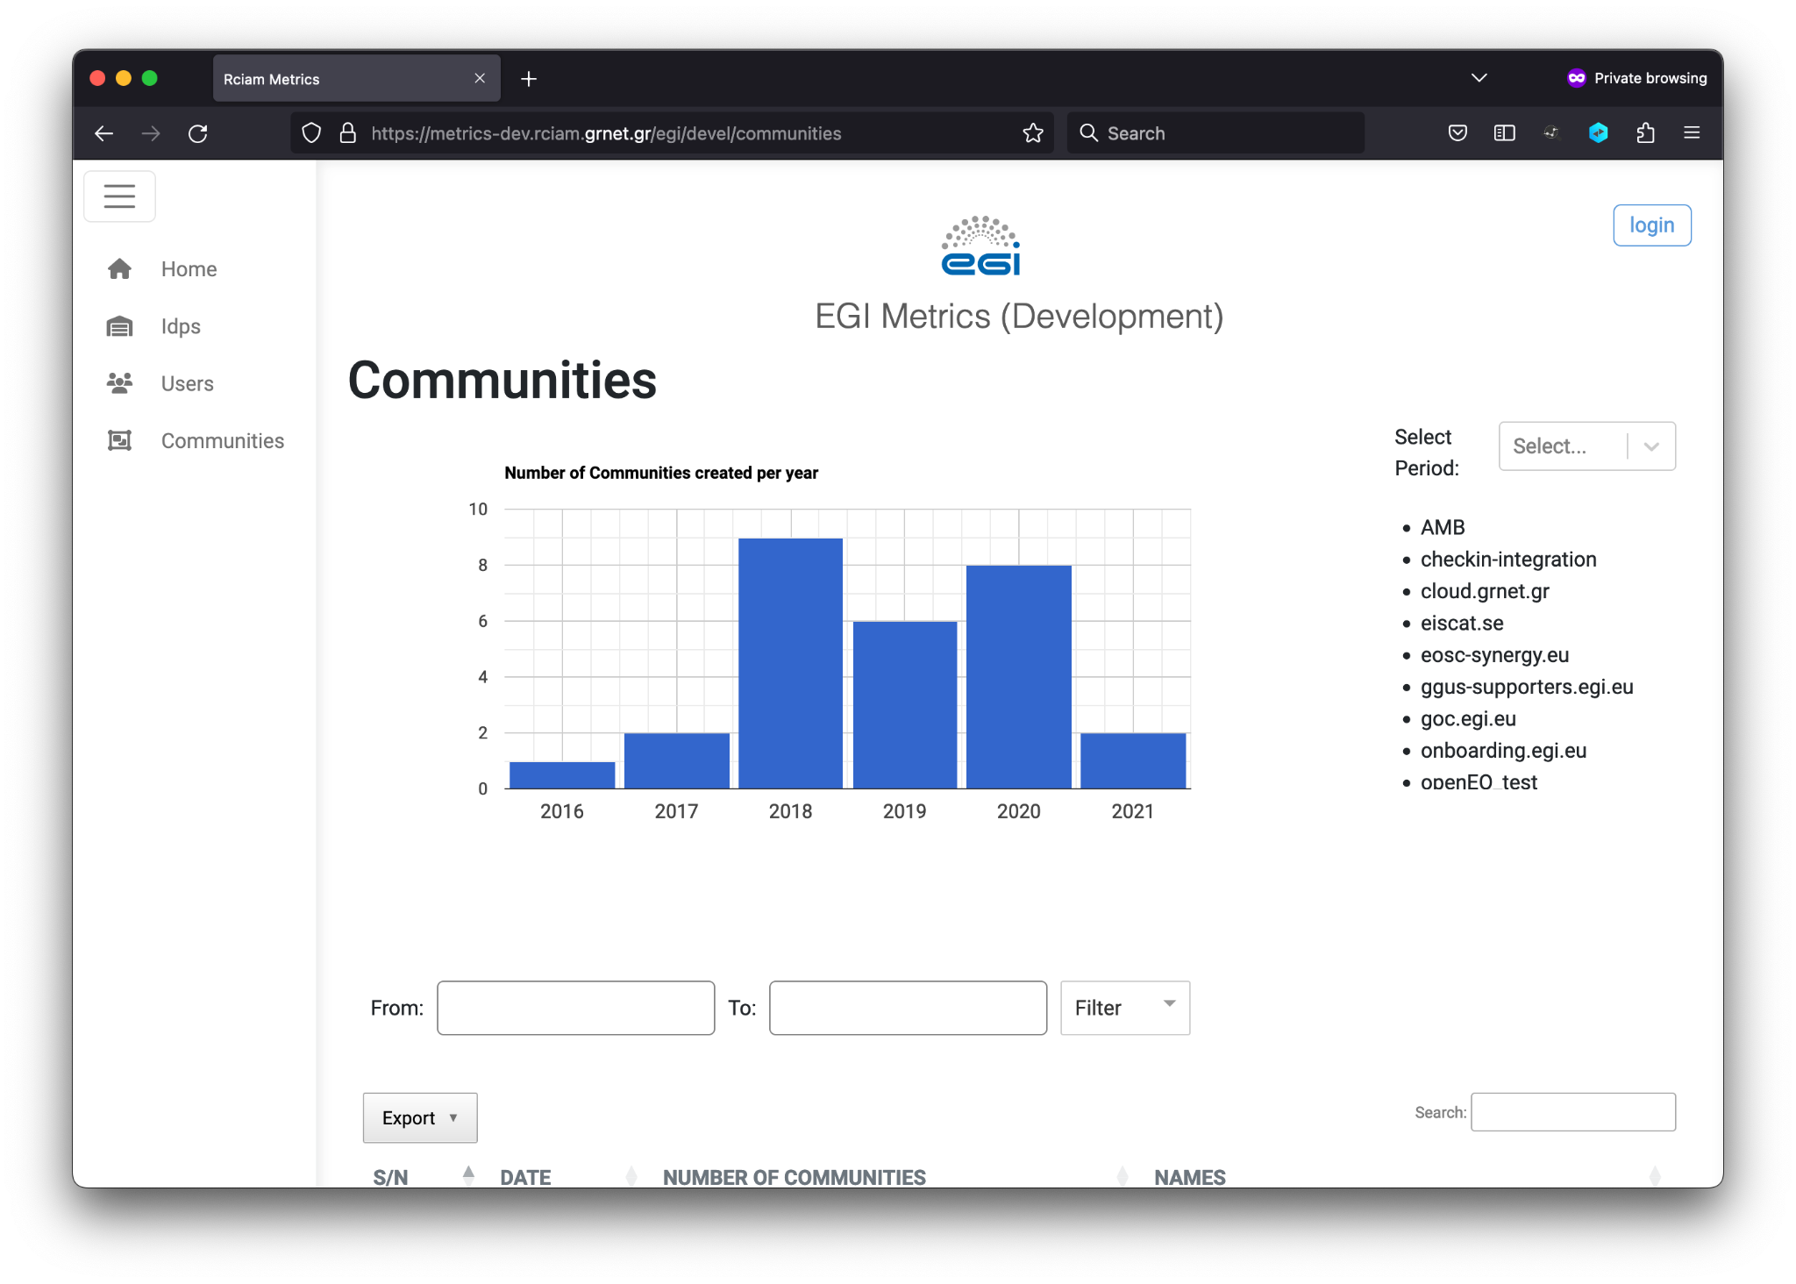
Migration to Keycloak
Metrics Engine & Dashboard
https://github.com/rciam/rciam-authmetrics
Logins
Total
Unique
Per Identity Provider & Service
Geographic distribution
User registrations
Communities/groups created
Member status
Geographic distribution
Migration Status
Development ✔
Demo ✔

Slide 30
Looking Ahead

Slide 31
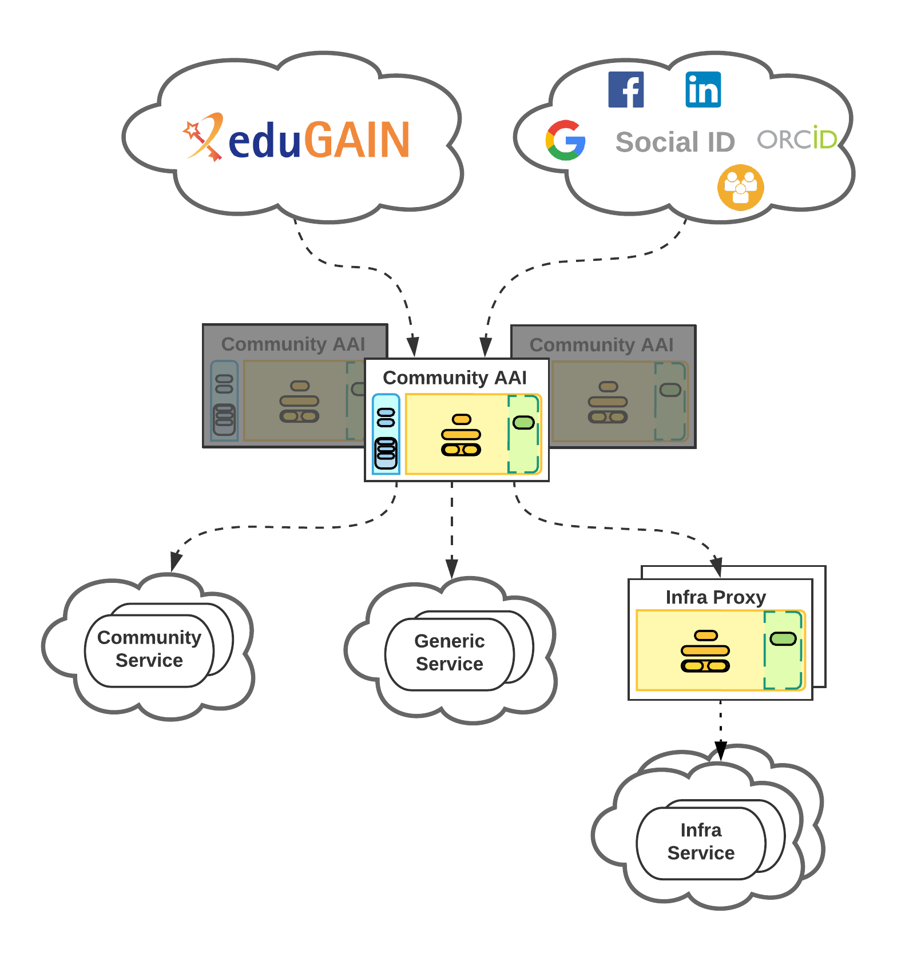
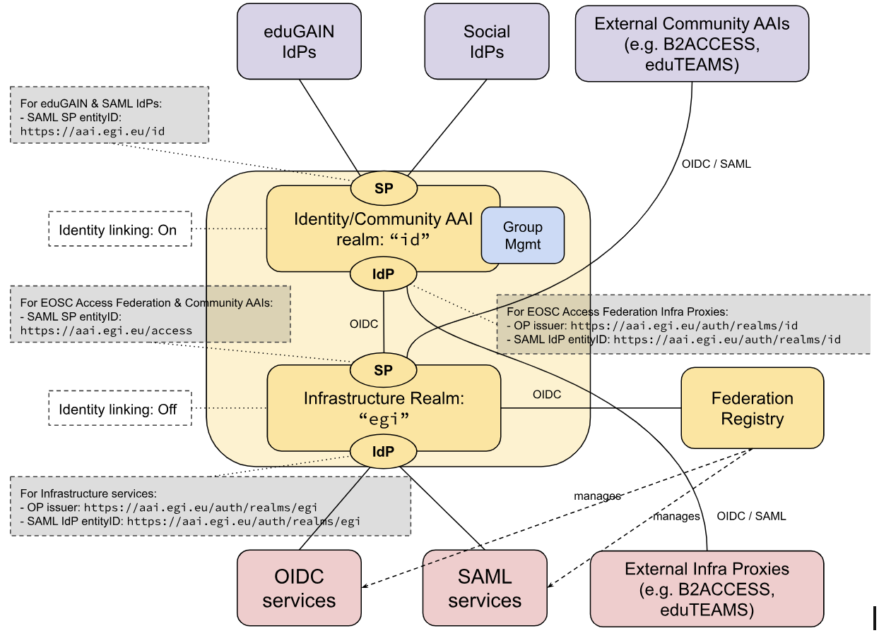
Looking Ahead
New Check-in Architecture

Slide 32
Looking Ahead
Roadmap
Support Multi-Factor Authentication (multi-proxy environment)
Support OpenID Federation (AARC Profile)
Support Identity Wallet
Q2 2025
Q4 2025
Q4 2026
Q3 2025
Q2 2026
Complete Migration to Keycloak
Integrate Advanced Authorisation Framework (e.g. Open Policy Agent - OPA)

Slide 33
Thank you
Nicolas Liampotis
nliam@grnet.gr | check-in@egi.eu
www.egi.eu

