Slide 1
Copernicus Data Stores as part of the streamlined Cloud-based services at ECMWF
EGI 2024 (Lecce Italy)
Gionata Biavati, Angel Lopez Alos
ECMWF HQ (Reading UK)
Gionata.Biavati@ecmwf.int

Slide 2
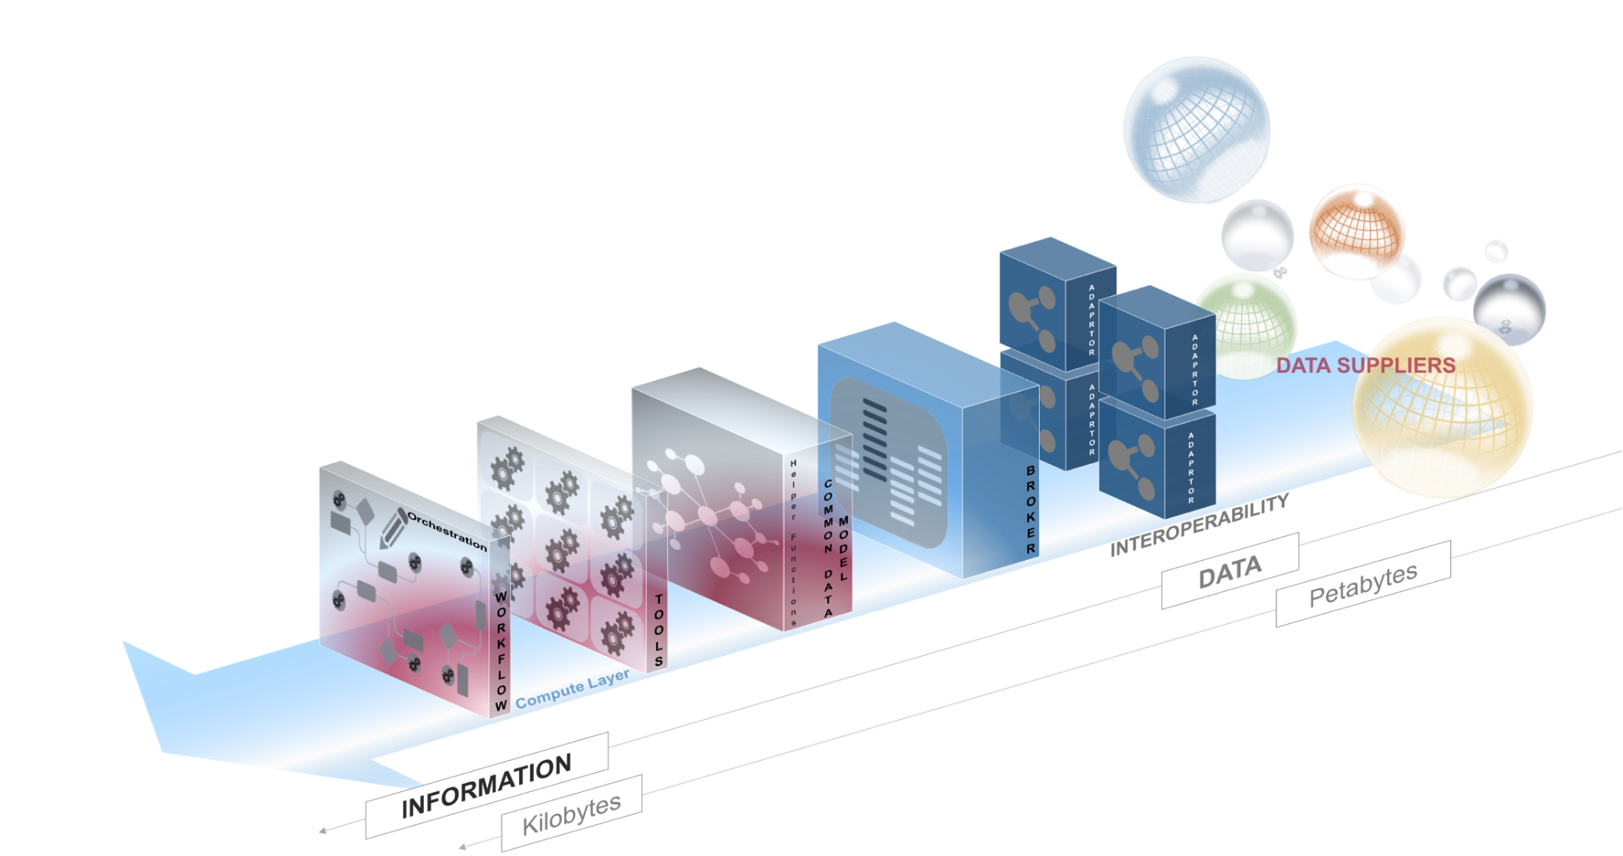
Introduction (Part 1) – Overview
ECMWF along with medium range weather forecast provides state of the art reanalysis (global fields obtained merging all available data) for meteorological data (ERA5, ERA5-Land) and atmospheric composition, seasonal forecasts and atmospheric composition forecasts.
Copernicus Data Stores (CDS) capitalize 5 years of experience gained with Climate and Atmosphere Data Stores serving data from various data providers with an average of 160 TB/day
The aim of this presentation is to introduce the scope and plans of the modernized Copernicus Data Stores (CDS) service, and to explain how it integrates within ECMWF’s streamlined services, hosted on the ECMWF Common Cloud Infrastructure (CCI).

Slide 3
Introduction (Part 2) – Key Terminology
ECMWF Common Data Stores Service (CDS*): Generic name for the set of layers (Business, System, Data) that support the operational implementation of Copernicus Data Stores at ECMWF (C3S, CAMS, CEMS-EW).
ECMWF Common Cloud Infrastructure (CCI): In-house cloud infrastructure at ECMWF’s Bologna Data Center that hosts CDS services and others like the European Weather Cloud (EWC).
earthkit: ECMWF’s open-source Python repository optimized for working with ECMWF and CDS data.
Common Cloud Infrastructure

Slide 4
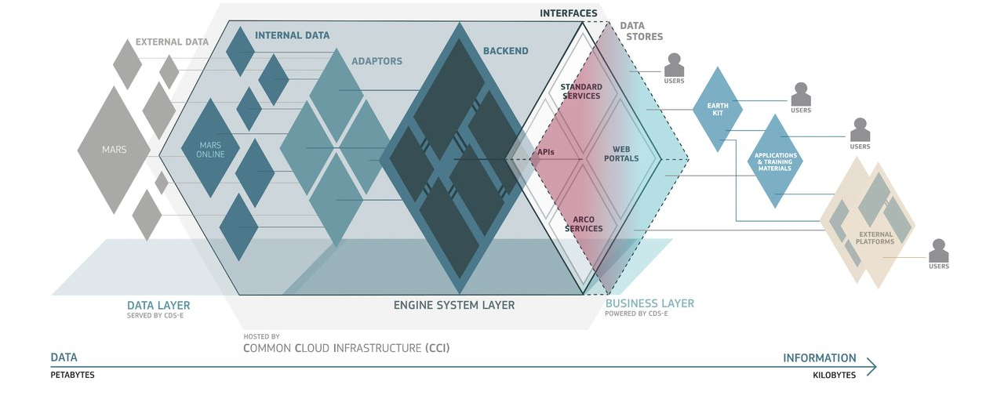
Introduction (Part 3) – Data Stores Service Structure
Data Stores Public Interfaces: Branded interfaces (UI, APIs, endpoints) exposed to users, populated with catalog resources (metadata + configuration).
System Layer: System built from software components that share interfaces and support the functionality of CDS.
Data Layer: Data repositories served by CDS, both external (hosted outside CDS) and internal (managed within CDS and optimized for CDS-System components).

Slide 5
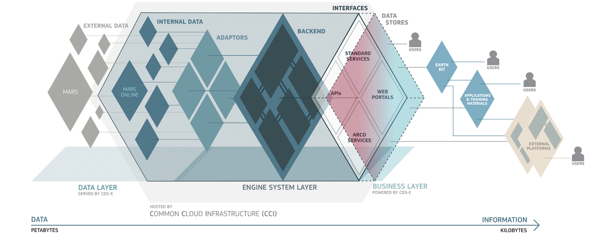
Introduction (Part 4) – Why Cloud Matters
Scalability of resources
Plug-in (Modular) architecture
MARS
Era6
FAIR Principles
Simplicity and consistency
Automatization
Configurability
Synergies with other platforms
Open and Collaboration
Evolving tools and functionalities
ECMWF DS Services will break barriers to scale up and evolve accordingly to our environment

Slide 6
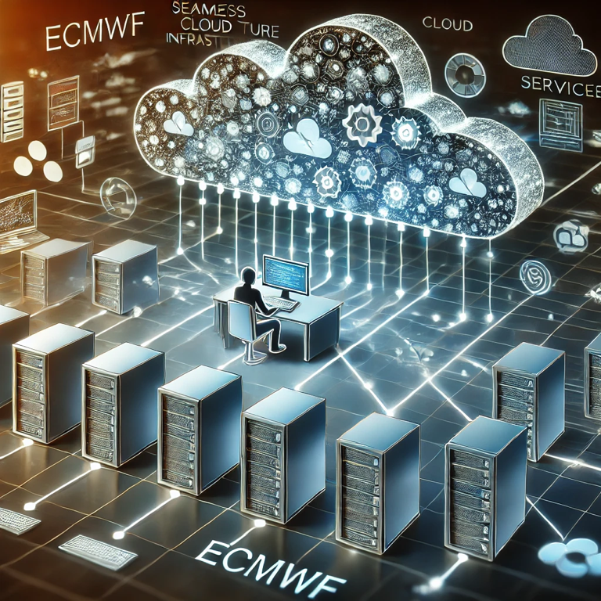
Common Datastore Service Cloud Strategy
CDS is designed so that each software component can run on any cloud platform (CCI, WEkEO, CDSE, AWS, etc.), supporting distributed deployment where multiple instances of components can operate across different clouds. This design integrates seamlessly with the Common Cloud Infrastructure (CCI), is the optimal cloud for serving ECMWF data. It provides users with smooth and uninterrupted access to services like data storage, processing, and software tools. It simplifies access to resources such as Copernicus data and the European Weather Cloud (EWC), allowing users to interact with ECMWF’s systems efficiently, without concern for the underlying complexity. Essentially, users experience all services and data as unified in a single, user-friendly environment, while still being able to generate standalone applications that can run anywhere.

Slide 7
Evolution of Copernicus Data Stores (CDS/ADS)
In earlier versions, the Climate Data Store (CDS) and Atmosphere Data Store (ADS) operated independently, each accessing the same data repository through separate infrastructures. This led to inefficiencies, bottlenecks, and the need for users to maintain accounts on different portals.
Now, CDS and ADS and EWDS (Ealy Warning Data Store) fully share the same infrastructure, optimizing data access, reducing bottlenecks, and allowing users to access both services seamlessly through a unified system without needing separate accounts.
https://cds.climate.copernicus.eu
https://ads.atmosphere.copernicus.eu
https://ewds.climate.copernicus.eu

Slide 8
Data Store Growth and Capabilities
Personalized Access for Data Providers: New features allow data providers to have personalized access points, offering better control and enhanced descriptions for their datasets, improving the user experience and data clarity.
Scalability for Future Datasets: Data hosted on fast-access infrastructure can easily scale to accommodate future large datasets, such as the upcoming ERA6 reanalysis, which is currently in preparation
Enhanced Data Delivery through S3-like Object Storage: The use of S3-like object storage improves data serving options, offering increased flexibility, scalability, and performance in data distribution.
Service Layer Scalability with Kubernetes: The adoption of Kubernetes in the service layer ensures automatic scaling, allowing the system to accommodate an ever-growing number of users while maintaining high availability and performance.

Slide 9
Cloud-Based Data Repositories
Data repositories serve as the foundational base for Data Services (DSs), providing essential storage and management for diverse datasets.
Diversity and Distribution: These repositories are distributed across various locations and come in different sizes, formats, and scopes. They include:
CDS-MARS Archive: A comprehensive archive of climate and weather data.
Modernized Observations Repository: A contemporary storage solution for observational data, enhancing accessibility and usability.
Smaller On-Disk Datasets: A variety of specialized datasets tailored for specific applications or research needs.

Slide 10
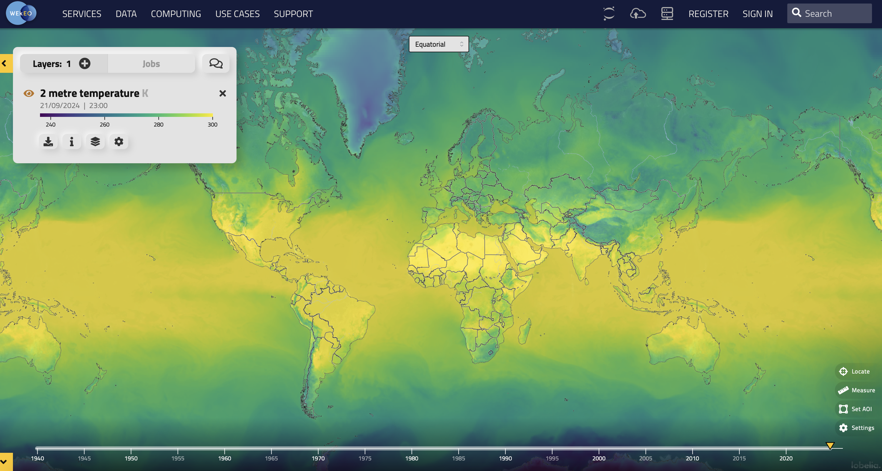
ARCO Data Lake
ARCO (Analysis Ready, Cloud Optimized) Data Lake was implemented in first place to provide Visual maps to our partner WEkEO (https://www.wekeo.eu/)
This initiative aims to:
improve the visualization and interactivity of C3S (Copernicus Climate Change Service) and CAMS (Copernicus Atmosphere Monitoring Service) data.
Address the needs of demanding machine learning (ML) and artificial intelligence (AI) solutions.

Slide 11
Software Services Layer
The elastic resource provided by ECMWF’s CCI facilitate the operational management of Public facing interfaces like
The Climate Data Store (CDS) for C3S. https://cds.climate.copernicus.eu
The Atmosphere Data Store (ADS) for CAMS. https://ads.atmosphere.copernicus.eu
The Early Warning Data Store (EWDS) for CEMS. https://ewds.climate.copernicus.eu
The operational management of these services relies heavily on:
Automatic Deployment: Streamlining the setup of multiple instances to enhance efficiency.
Configuration Management: Ensuring that all instances are consistently configured for optimal performance.

Slide 12
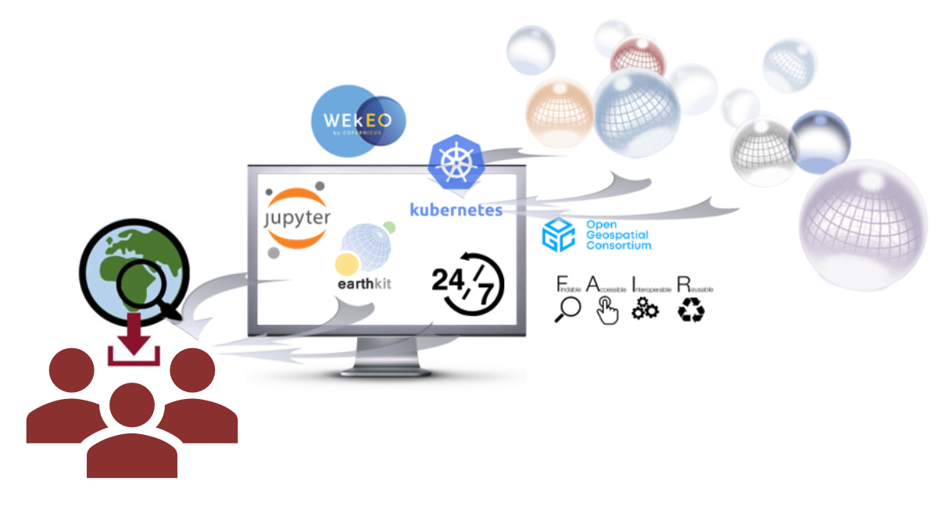
JupyterHub Beta for User Computation
As we launch the JupyterHub service, we are aware of the significant interest and high demand it is likely to attract, especially due to its proximity to the data. It will offer:
Launch temporal sessions for data analysis.
Allocate computing and storage resources dynamically.
Perform computations and visualizations on data.
Utilize a set of preconfigured expert tools, primarily provided by earthkit, to enhance data interaction and analysis capabilities.
To ensure a smooth and efficient experience for all users, the rollout will be gradual. This phased approach allows us to carefully monitor resource allocation and performance, ensuring that the infrastructure remains robust and responsive.

Slide 13
Future Directions of Common Data Store Service
More tuning, balancing and extension of the resources will improve user experience
Simple post processing of the data will allow data reduction with one click (time and spatial averages and other statistics)
The ARCO service will be used for serving data and provide preview tools for the data present in the data stores
ARCO services will provide optimized datasets for training ML
A JupyterHub will allow users to perform data processing directly in the cloud.

Slide 14
Conclusion
ECMWF CCI provides a versatile and robust platform, supporting a wide range of cloud-based activities with high performance and scalability.
The new Common Datastore Service leverages cutting-edge technologies, enhancing efficiency and accessibility for users.
Proximity to the data layer unlocks opportunities for real-time data interaction and more active data operations.
The user experience will significantly improve through seamless, integrated access to all services, ensuring a more cohesive and intuitive workflow.

Slide 15
Copernicus Data Stores as part of the streamlined Cloud-based services at ECMWF
?
Thank You!
We appreciate your attention.
Looking forward to your feedback and thoughts.

