Slide 1
Experience from Blue-Cloud and SeaDataNet
Dick M.A. Schaap, MARIS, Blue-Cloud 2026 Technical Coordinator and SeaDataNet Technical Coordinator
EGI 2024 Conference – Lecce – 2 October 2024

Slide 2
EU H2020 Blue-Cloud project (2019 – 2023)
To explore and demonstrate the potential of cloud based open science supporting research for ocean sustainability, and UN Decade of the Oceans and G7 Future of the Oceans
To deploy a cyber platform with smart federation of multidisciplinary data repositories, analytical tools, and computing facilities
To develop a marine thematic European Open Science Cloud (EOSC) serving the blue economy, marine environment & marine knowledge agendas

Slide 3
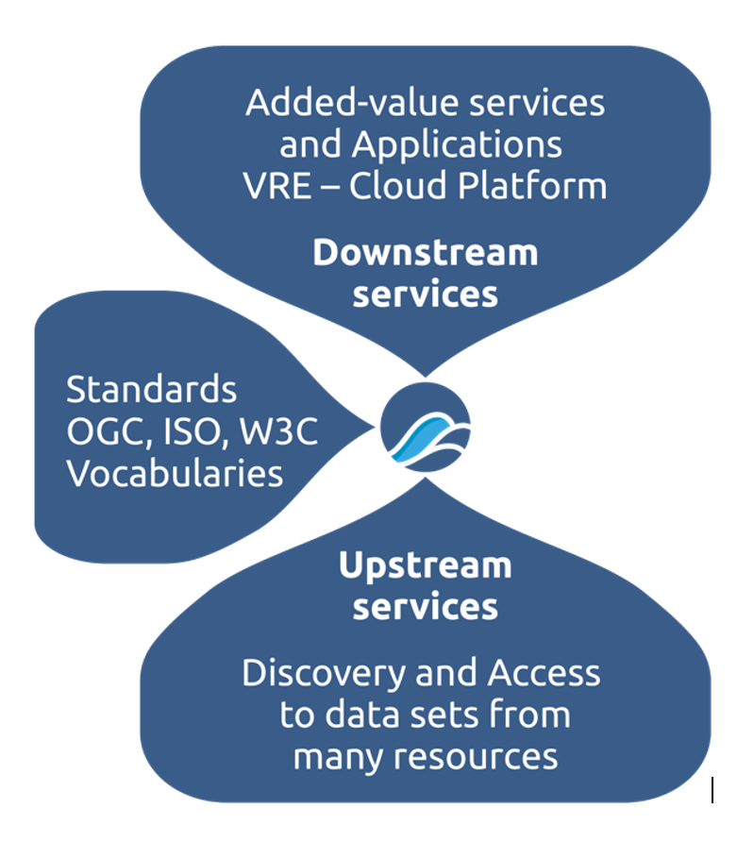
Blue-Cloud overarching concept
Developing and deploying a Virtual Research Environment (VRE) with an array of services for configuring and running virtual labs for specific analytical workflows, use cases and demonstrators
Applying common standards and interoperability solutions for providing harmonized metadata and data
Developing and deploying harmonized discovery and access to established European marine data management and processing infrastructures

Slide 4
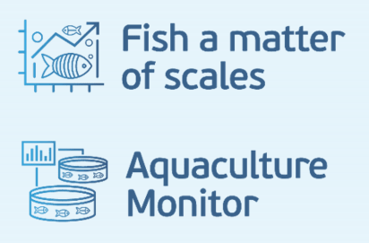
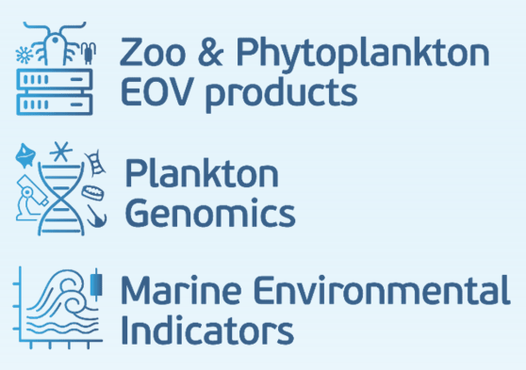
Blue-Cloud key products and services
Blue-Cloud Data Discovery & Access service, federating key European data management infrastructures, to facilitate users in finding and retrieving multi-disciplinary datasets from multiple repositories
Blue-Cloud Virtual Research Environment infrastructure to provide a range of services and to facilitate orchestration of computing and analytical services for constructing, hosting and operating Virtual Labs for specific applications
Blue-Cloud Virtual Labs, configured with specific analytical workflows to serve as Demonstrators, which can be adopted and adapted for other inputs and analyses

Slide 5
Blue-Cloud 2026 (2023 – 2026)
Develop a Federated European Ecosystem to deliver FAIR & Open data and analytical services, instrumental for deepening research of oceans, EU seas, coastal & inland waters.
Develop a thematic marine extension to EOSC for open web-based science, serving the needs of the EU Blue Economy, Marine Environment and Marine Knowledge agendas.
Blue-Cloud 2026 is expanding the federated approach, involving more aquatic data stakeholders and integrating a semantic broker
Blue-Cloud 2026 is upgrading and expanding the VRE with a new Cloud Computing Platform, uptake of GALAXY VRE technology, and others
Blue-Cloud 2026 is upgrading existing Virtual Labs and adding new Virtual Lab developments
Blue-Cloud 2026 is developing WorkBenches for generating EOV data collections for T&S and Eutrophication, combining expertise from CMEMS, EMODnet, and SeaDataNet, and for plankton with expertise from VLIZ, ETHZ, and EBI-EMBL
interacting with EOSC developments, in support of the EU Green Deal, UN SDG, EU Destination Earth, and the EU Mission on healthy oceans, seas, coastal and inland waters, ultimately to provide a core data service for the Digital Twin of the Ocean.
5

Slide 6
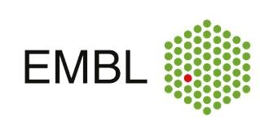
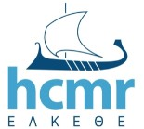
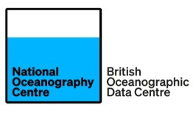
Blue-Cloud 2026 Consortium
Scientific and Administrative Coordinator
Project Coordinator
Technical Coordinator
6

Slide 7
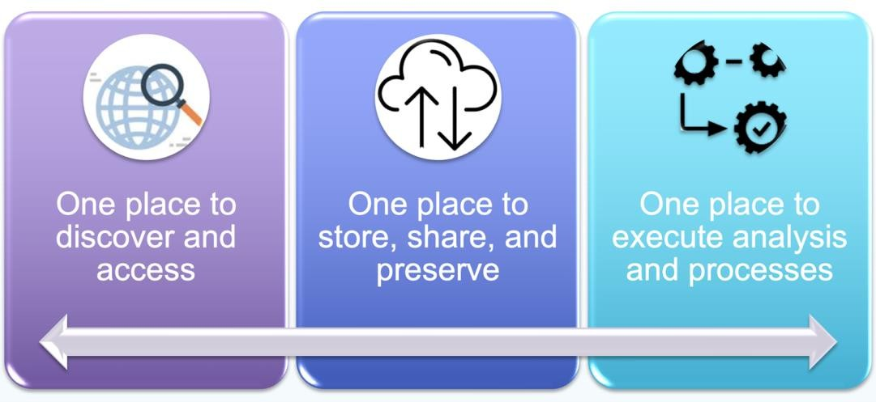
Blue-Cloud 2026 core services: Virtual Research Environment - status today
Virtual Laboratories

Slide 8
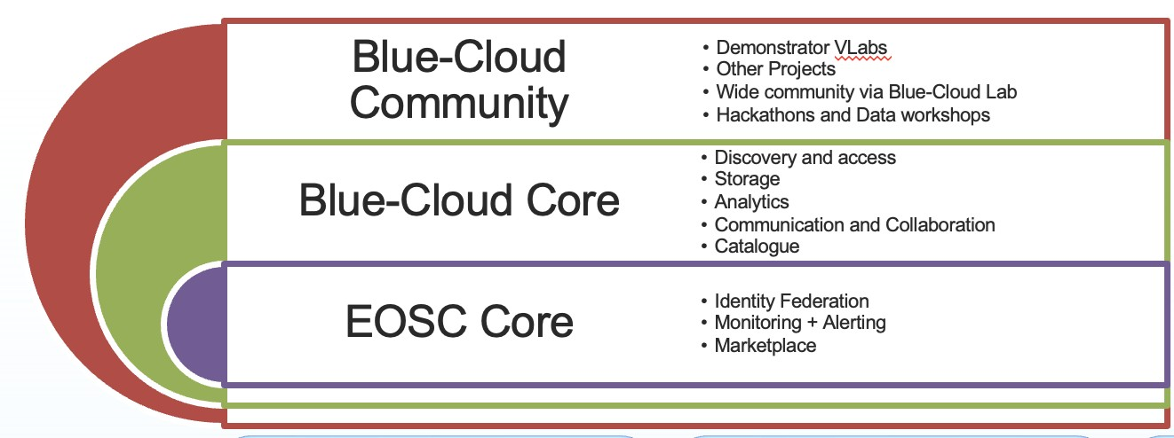
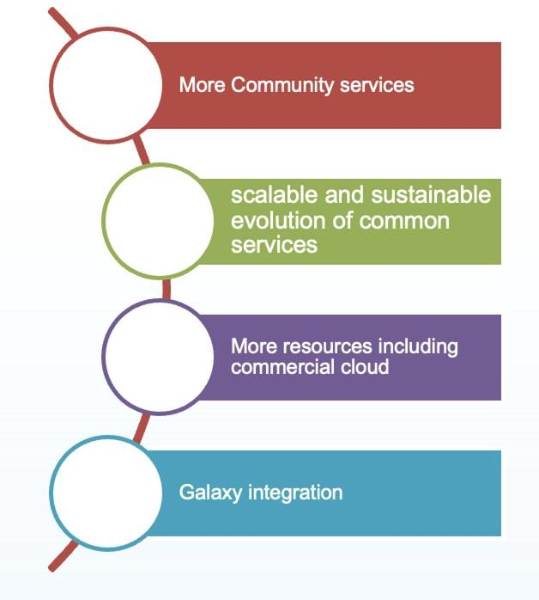
It is implemented as a System of Systems promoting Open Science
Blue-Cloud 2026 core services: Virtual Research Environment - planned developments

Slide 9
VRE – D4Science
The Blue-Cloud Virtual Research Environment infrastructure is based upon the D4Science e-infrastructure as built, maintained, and operated by CNR-ISTI
EGI is partner in Blue-Cloud 2026 and provides the Jupyter Hub service on which the various i-Notebooks are deployed for the Blue-Cloud Virtual Labs
Moreover EGI contributed its AAI expertise for the Blue-Cloud AAI which is federated through EGI-Checkin

Slide 10
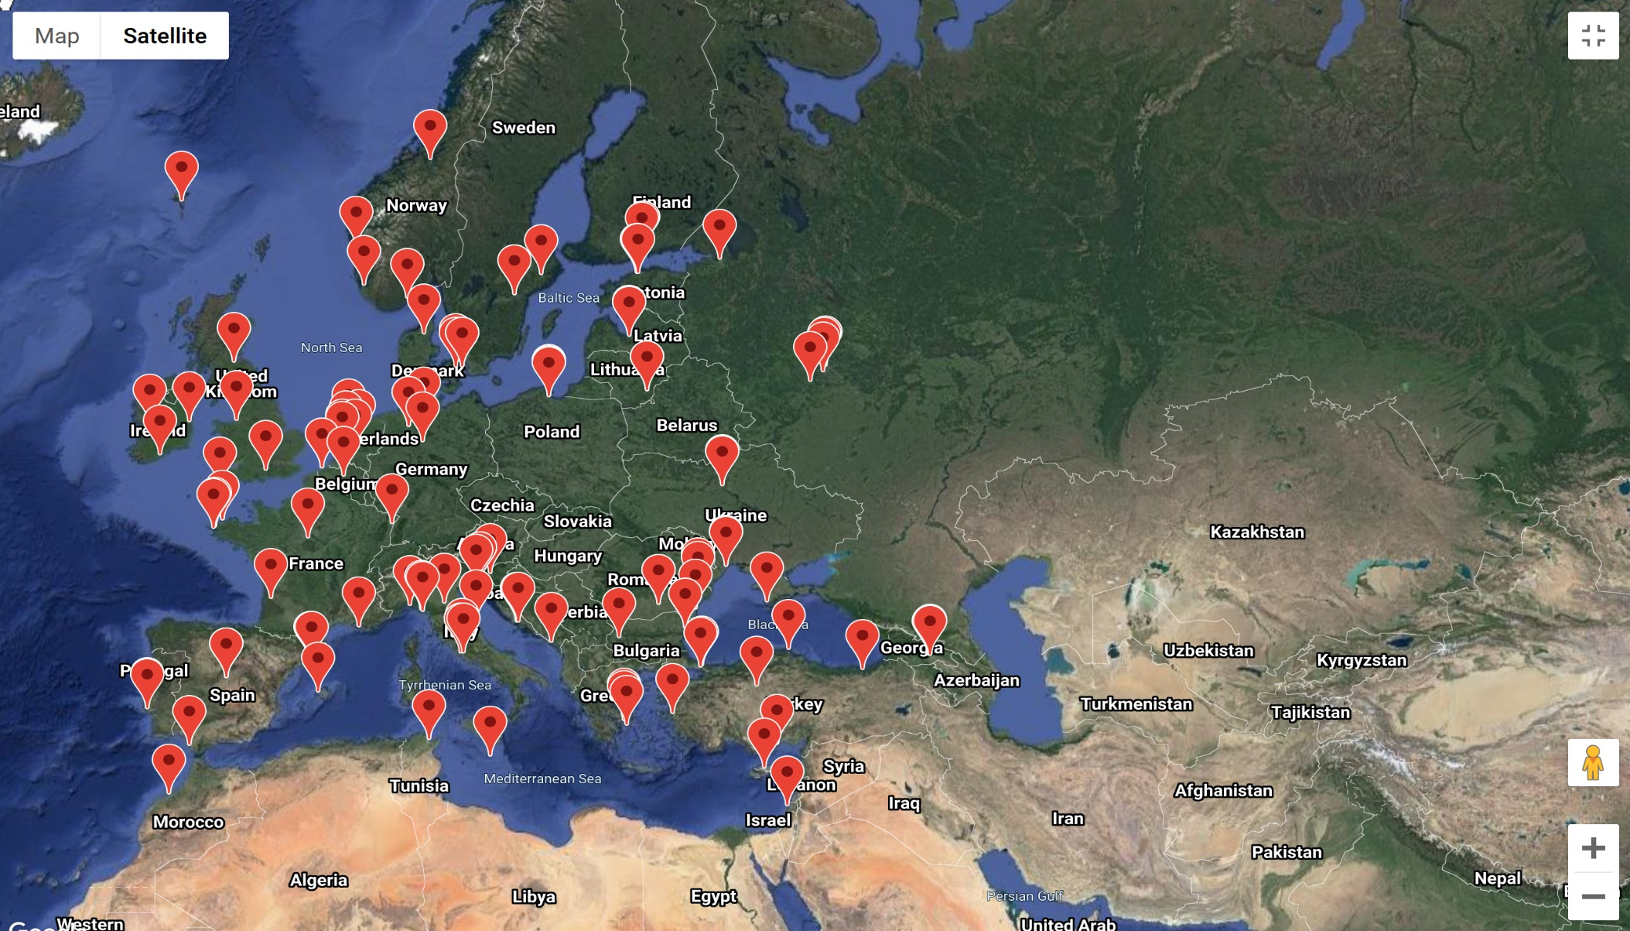
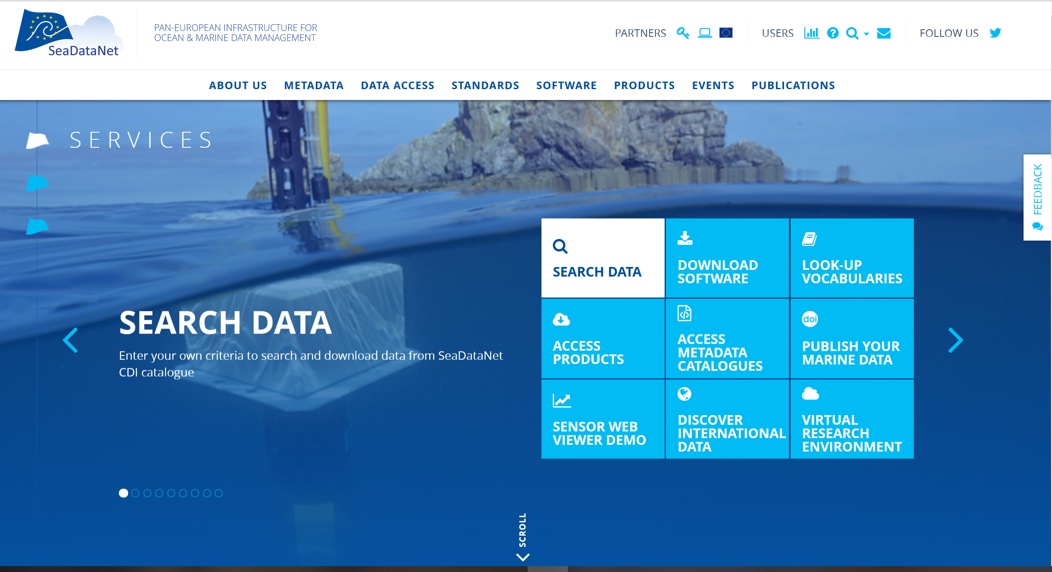
Pan-European infrastructure for Marine Data Management
https://www.seadatanet.org
Giving access to
standards, tools, and services
for metadata, data and products
for data centres and users
90s | Metadata directories Medar/MedAtlas
1998-2001 | EuroNODIM (FP3)
2002-2005 | Sea-Search (FP5)
2006-2011 | SeaDataNet (FP6)
2011-2015 | SeaDataNet II (FP7)
2016-2021 | SeaDataCloud (H2020)

Slide 11
CDI Data Discovery & Access Service
Providing harmonized discovery and access to marine and ocean data sets for physics, chemistry, geology, bathymetry, biology, and geophysics
https://cdi.seadatanet.org/search

Slide 12
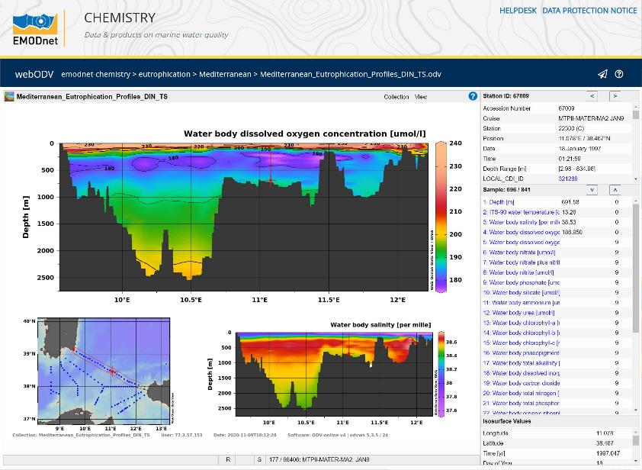
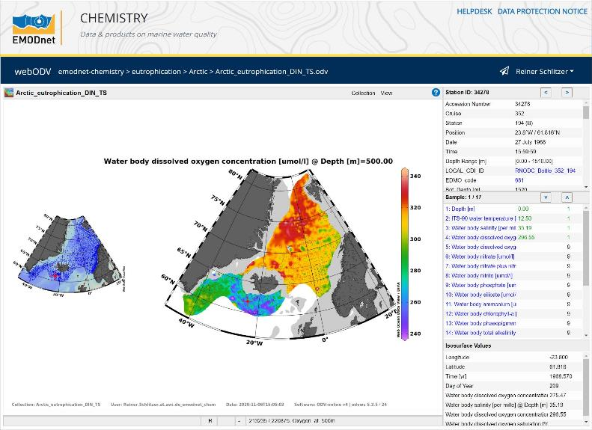
Blue-Cloud Virtual Research Environment
EGI-ACE project – WebODV service
Powerful application for scientists to explore ocean data collections and to generate maps
and graphics

