Slide 1


From Jupyter notebooks to a digital twin-oriented Virtual Research Environment
Dr. Zhiming Zhao
z.zhao@uva.nl
University of Amsterdam
LifeWatch ERIC Virtual Lab & Innovation Center (VLIC)

Slide 2
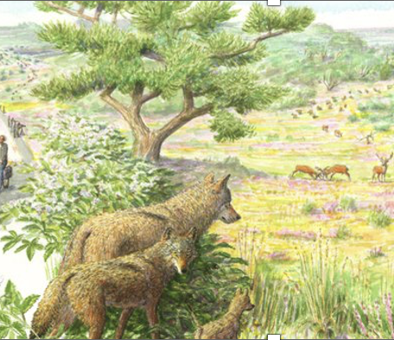
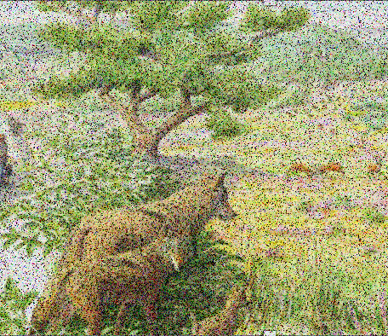
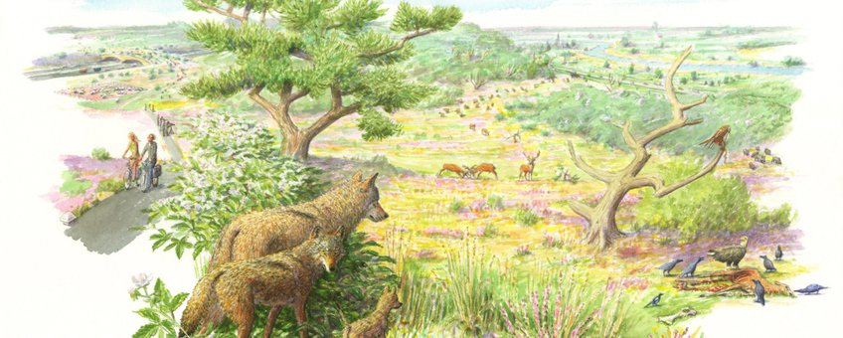
Complexity of ecosystem
Digital Twins

Slide 3


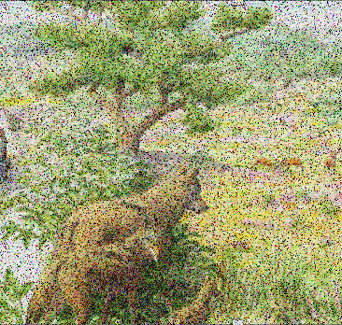

Digital twins for predictive studies
Understanding ecosystems
Scenario studies

Slide 4
The development is challenging
?
Notes:
Some things we ‘know’ , other things we do not know

Slide 5










LTER-LIFE: A research infrastructure to develop Digital Twins of ecosystems in a changing world
Funded by Dutch Research Council (NWO), 20M, 2022-2031.
https://lter-life.nl/
Notes:
It is our pleasure to introduce LTER-LIFE to you: a research infrastructure to develop Digital Twins of ecosystems in a changing world.

Slide 6
Outline
Requirements and Challenges
From Jupyter to a Digital Twin-oriented VRE
Summary

Slide 7


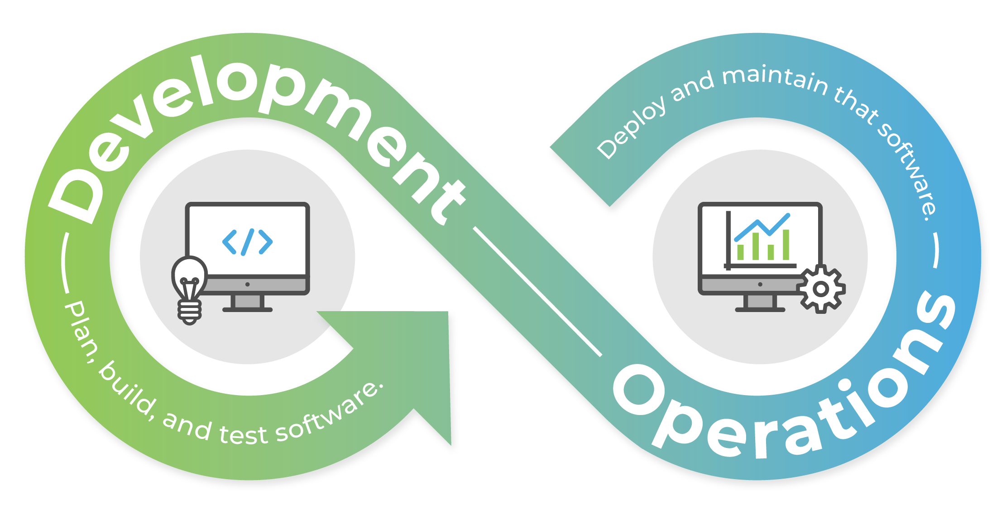

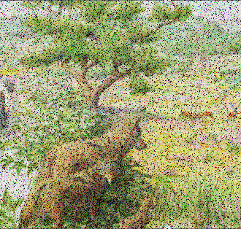
1. Requirements and challenges
1. Data
6. Quality critical Scheduling
2. Model
7. collaborative interaction
3. Composition
8. Performance guarantee
4. Integration
9. Knowledge discovery
5. Infrastructure

Slide 8
Remote assets (data, model, etc.)
Remote infrastructures
Remote Collaborators
Make hypothesis
Analyze results and publish results
Experiments
Design experiment
Execute workflow
Virtual Research Environments (VREs) provide user-centric support for discovering and selecting data and software services from different sources and composing and executing application workflows, … (Jeffery et al., 2020)

Slide 9

2. Notebook-as-a-VRE
NaaVRE
Client side (e.g. Jupyter environment)
VRE knowledge base
Distributed Workflow bus
Distributed VRE ledger
Notebook-as-a-VRE dashboards
A
Semantic search engine
E
I
K
Provenance/ Log explorer
eScience DevOps
NaaVRE Services Market place
B
Remote infrastructure automator
J
F
AAAI
L
Component Containerizer
…
C
Experiment manager
G
Distributed Data mesh
D
H

Slide 10
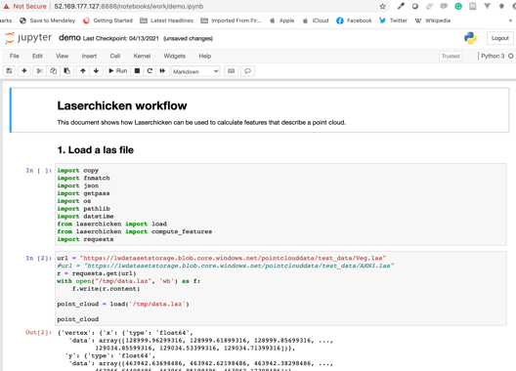
Notebook as a VRE (NaaVRE)
Develop-ment
Develop and test a model or algorithm using Jupyter

Slide 11
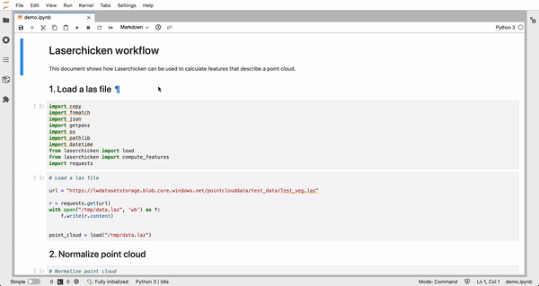

Notebook as a VRE (NaaVRE)
Develop-ment
Develop and test a model or algorithm using Jupyter
Container-ization
Parse input/output of a selected cell
Containerization

Slide 12
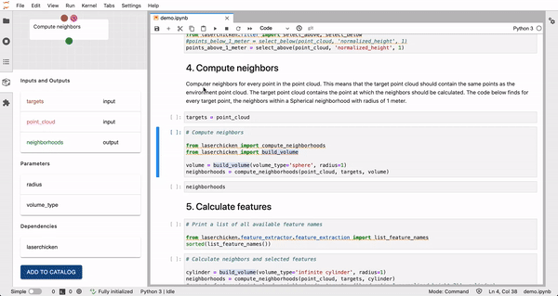
Notebook as a VRE (NaaVRE)
Develop-ment
Develop and test a model or algorithm using Jupyter
Container-ization
Parse input/output of a selected cell
Containerization
Workflow
Compose workflow

Slide 13
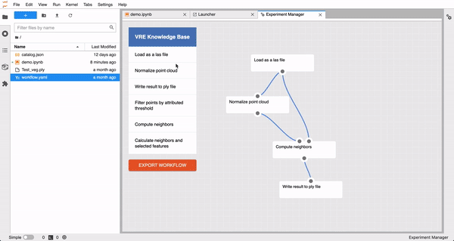
Notebook as a VRE (NaaVRE)
Develop-ment
Develop and test a model or algorithm using Jupyter
Container-ization
Parse input/output of a selected cell
Containerization
Workflow
Compose workflow
Execution
Configure, deploy and execute the workflow in cloud

Slide 14
3. How to support DT based problem solving?

Slide 15
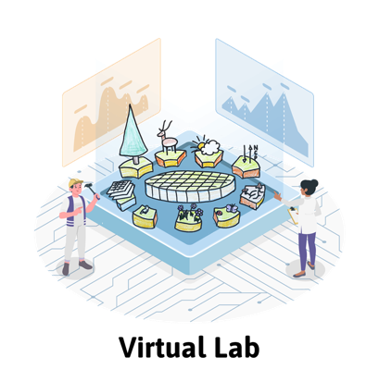
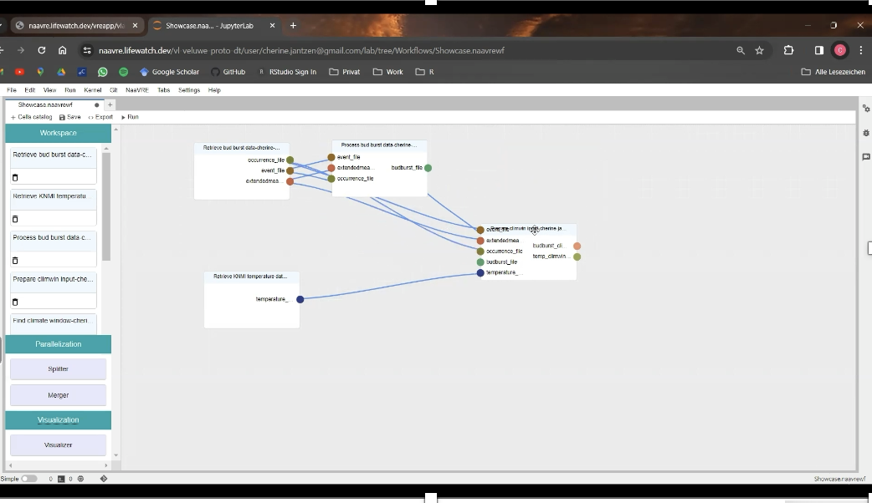
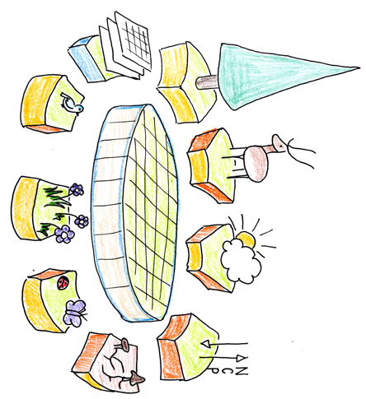
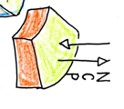


Slide 16
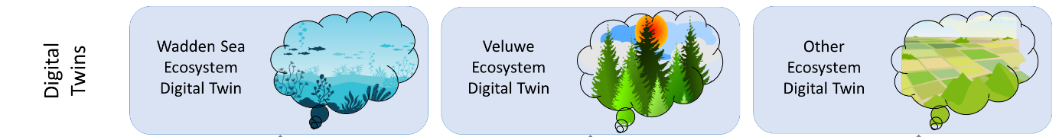
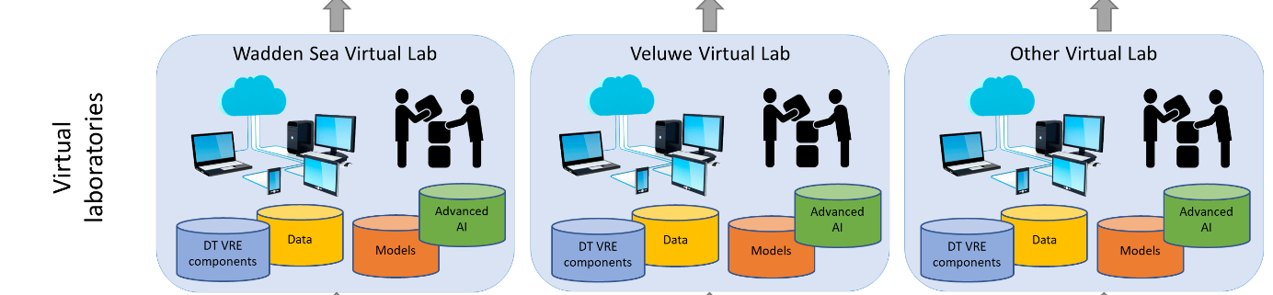
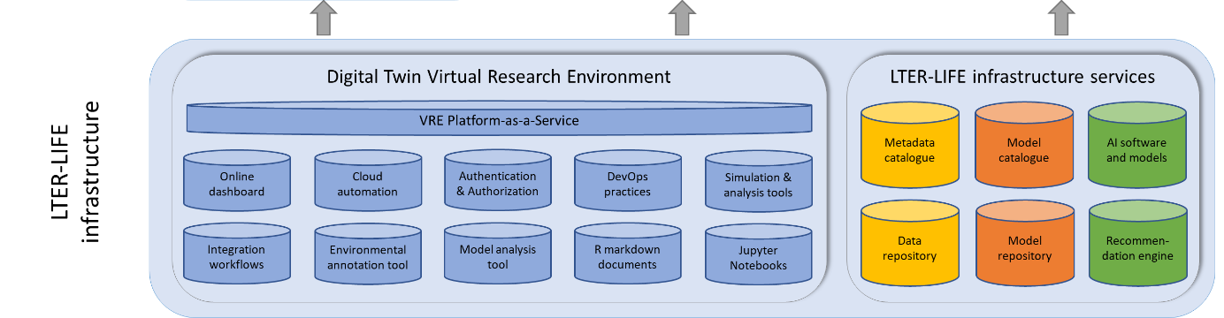
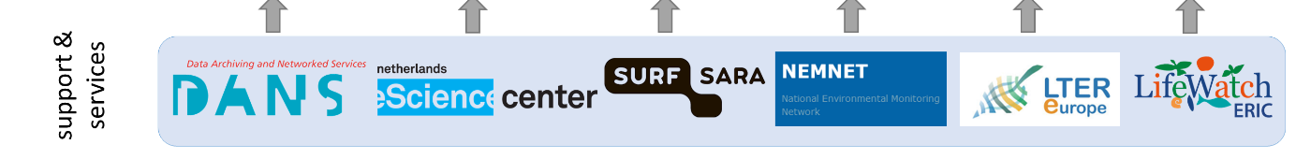

Slide 17
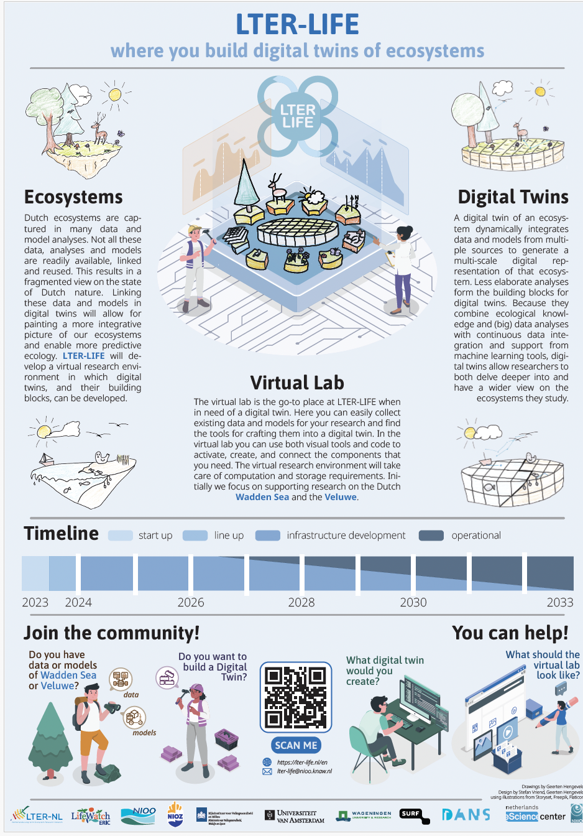


Summary
LTER-LIFE enters its second year.
Open challenges
  Data/Model FAIRification
  Model composition and integration
  Community engagement
  Software quality
  …

