Slide 1
The EGI Trusted Research Environments landscape report
- an overview
EGI2024
Ville Tenhunen
1.10.2024
Data Solutions Architect
EGI Foundation

Slide 2
Agenda
EGI WG on Trusted Research Environments and Sensitive Data Management
The Landscaping report
Definitions
Basic architectures and requirements
Discussion - Where are we going?

Slide 3
EGI’s WG on Trusted Research Environments and Sensitive Data Management - in nutshell
Focus of the Working Group will be driving the technical evolution in the areas of trusted research environment and sensitive data management, scouting the technology landscape and interacting with relevant stakeholders.
WG started on October 2023 and have had monthly meetings discussing news and updates from communities and landscape report on TREs.
The WG has a duration of one year (which can be extended)
34 members from 17 organisations

Slide 4
There is no unequivocal definition of TRE
Example from ADR (UK): “Trusted Research Environments (TREs) (also known as secure data environments) are highly secure computing environments containing de-identified data. Many operate under the principles of the Five Safes framework. Researchers and their projects must go through the TRE's rigorous accreditation process to access and use this data.”
Some other terms are also used in this context:
Secure processing environment (EU), Secure Research Environment, Secure Data Environment, Data visiting, Virtual Research Environment (VRE) etc.
In the report “Trusted Research Environment” defined characteristics are
Computing and data management environments are highly secure and controlled
Environments allow approved users such as researchers access store, and analyse sensitive data remotely
Data is held within a secure environment and does not leave that environment
User management (including aggregation in some cases) based on trusted AAI

Slide 5
Five Safes vs. Governance vs. Technology
Five Safes - a framework for helping make decisions about making effective use of data which is confidential or sensitive
Safe | Example | Governance | Technical aspects
Safe projects | Is this use of the data appropriate? Is the data minimised? | Data is treated to protect any confidentiality concerns; GDPR, DMP, ISM, SMS | AAI (access), monitoring, reporting
Safe people | Can the users be trusted to use it in an appropriate manner? | Research projects are approved by data owners; ISM, accreditation, agreements | Virtual organisations, AAI (authorization), logging
Safe settings | Does the access facility limit unauthorised use? Are actions logged? Can the user see the data? Is the system encrypted? | Researchers are trained and authorised to use data safely; DMP, metadata, agreements, training. Logging | Data in use (processing environments), data in transit (networking), data at rest (storages, back-up), encryption, catalogues, AAI, physical security of environments
Safe data | Is there a disclosure risk in the data itself? | A processing environment prevents unauthorised use; ISM, data de-identification i.e. (pseudo)anonymization | Data in use (processing environments), data at rest (storages), encryption, de-identification, data disposal, AAI
Safe outputs | Are the results non-sensitive? | Approved outputs that are non-disclosive; reviews, metadata, PIDs, (pseudo)anonymization, agreements, FAIR principles | Processing environments, repositories, catalogues

Slide 6
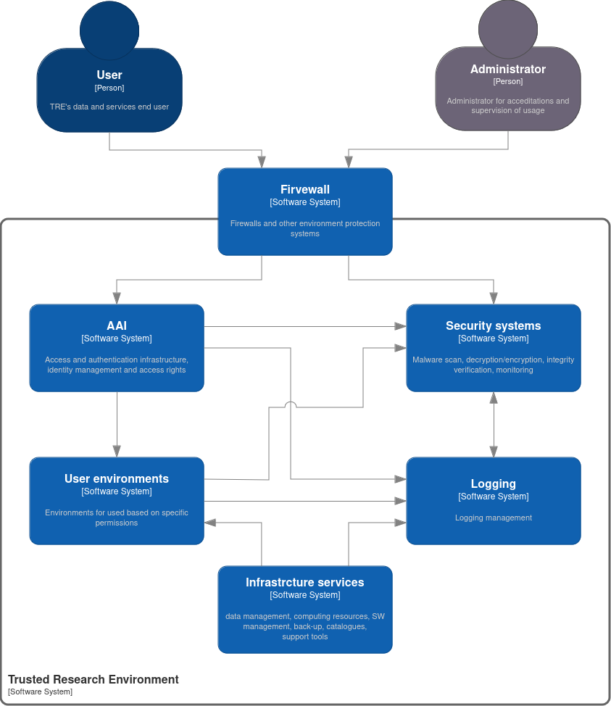
Typical components of the TRE
TRE Components:
Restricted and controlled access to the environment and to all components
Secure infrastructure solutions (hardened servers, networking, firewalls)
Permission management
Activity monitoring
Activity and operation logging
Data back-ups
Data management services
De-identified data, decryption and encryption
Data, software and AI model sharing
Data long term preservation
Metadata services
Computing services
Analysing services and SW
Visualisation services

Slide 7
Basic concepts of the TRE/SRE
Institutional
Classic architecture where researchers process and manage data in their own environments. Only results or snapshots of the data is shared.
Researchers share only results or preprocessed and (pseudo)anonymised data
Quite typical institutional solution
Various policies and principles in institutions
Various technical solutions
No common integrations
FAIR data based on manual work
Local security and privacy measurements
Organisation 1
Organisation 2
Organisation 3

Slide 8
Basic concepts of the TRE/SRE
Private Cloud TRE
ISP model or cloud model where services and resources are delivered by SP for all users. SP have own policies and providers have their own.
Typical for projects (such as LETHE).
Secure measurements vary by organisation.
Centralised technical solutions and procedures are needed.
FAIR data based on common agreements of data owners.
Organisation 1
Organisation 2
Organisation N
Service provider

Slide 9
Basic concepts of the TRE/SRE
Federated
Federated
Federated model contain several service providers and users. Access and authentication management based on the federated AAI solution. This conceptual model gives possible to build services across national or organisational borders
Features:
Common principles, rules and standards
Shared services, resources and usage across borders
Common security and privacy arrangements and implementation
Common API definitions and protocols to move data
FAIR data based on common agreements and measures
Organisation 1
CPU
Data
Data
Service provider
Organisation 2
Storage
CPU
DB
GPU
SW
Data
Repo

Slide 10
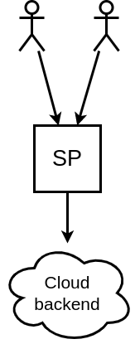
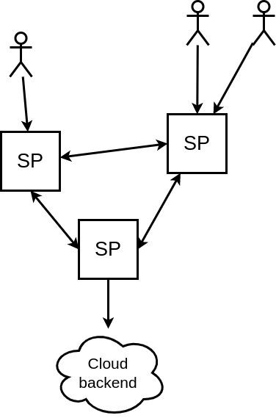
Integration scenarios in the EGI infrastructure
Integration scenarios will be discussed in more detail in the next phase of the WG. Some preliminary directions:
 | Institutional | Private Cloud | Federation
EGI Foundation | Promotion, visibility, knowledge sharing | Facilitation of deployment | Federation (protocols, SLA/OLA etc.)
EGI sites | Granular solutions | Cloud backend | SP, cloud provisioning

Slide 11
Related activities and initiatives
Some ongoing examples
Federated approach
HORIZON-INFRA-2023-EOSC-01-06 projects (Trusted environments for sensitive data management in EOSC):
SIESTA (Secure Interactive Environments for SensiTive data Analytics)
TITAN (Trusted envIronments for confidenTiAl computiNg and secure data sharing)
EOSC-ENTRUST (A European Network of TRUSTed research environments)
European Health Data Space (EHDS) will be a key pillar of the strong European Health Union and is the first common EU data space in a specific area to emerge from the European strategy for data.
The EOSC Association Health Data TF; Themes of the task force are at least somehow related to the sensitive data management and European wide trusted research environment development
Generic approach
GÉANT Digital Health Data SIG aims primarily at enhancing coordination, exchange of best practices and sharing knowledge among the National research and education networks (NRENs) and their implied eHealth institutions & projects
RDA TRESD WG initiative; “Trusted Research Environments for Sensitive or Confidential Data: FAIRness for Controlled Data and Processes” (for Blueprints, Interoperability and Risks)

Slide 12
Conclusions
Drivers:
EHDS + Health sector projects and initiatives
EOSC development (incl. EOSC EU Node)
Ongoing TRE projects
Mature requirements sets
SATRE
TEHDAS
National requirements for secondary usage of social and health data
Numerous TREs exists already
Institutional
National (NRENs)
Next level challenges
Cross border interoperability
Federative operation models are next challenges
Next steps: Integrations with EGI infrastrcture

Slide 13
Thank you!
Nb! Open meeting of the TRE WG will take place Thursday 3.10.2024 16:45 in Badisco (1st floor).
ville.tenhunen@egi.eu

