Slide 1
OPENCOastS⁺: overview and new features
Anabela Oliveira¹, Marta Rodrigues², André Fortunato², Gonçalo de Jesus¹, Ricardo Martins¹
¹ Information Technology and Computer Infrastructure division
² Estuaries and Coastal Zones Division
LNEC

Slide 2
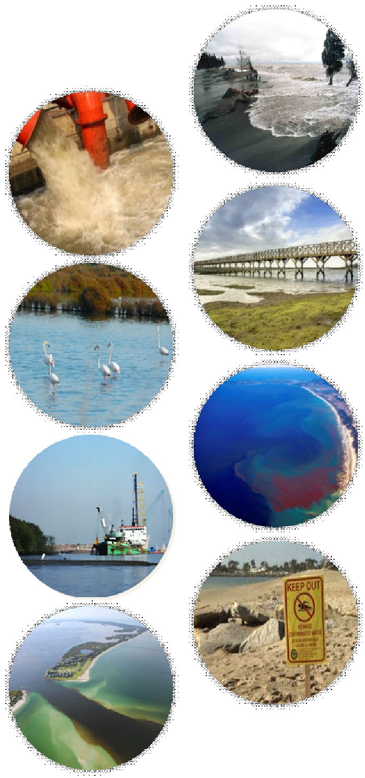
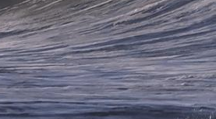
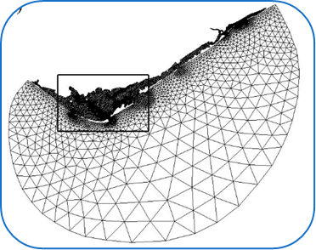
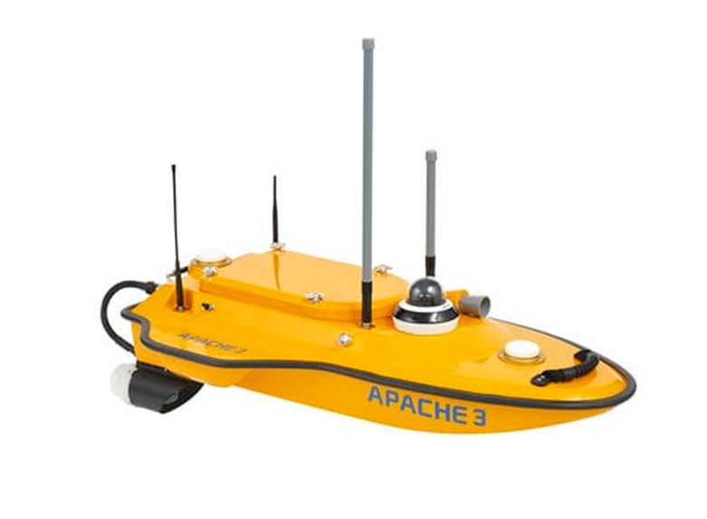
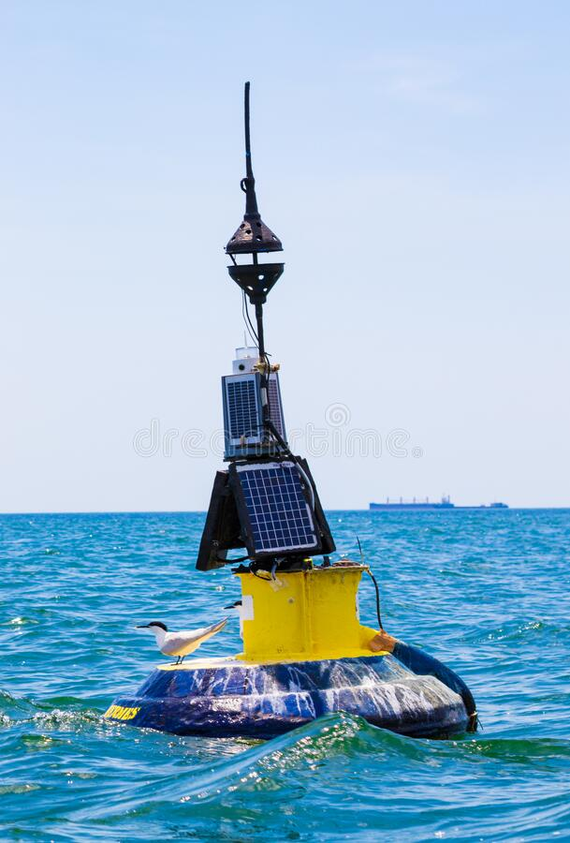
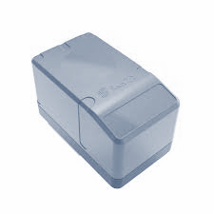
Digital Twins for coastal areas
Digital infrastructures
Managers
Private companies
Researchers
Citizens
….
WIFF
Services
Models
Observations

Slide 3
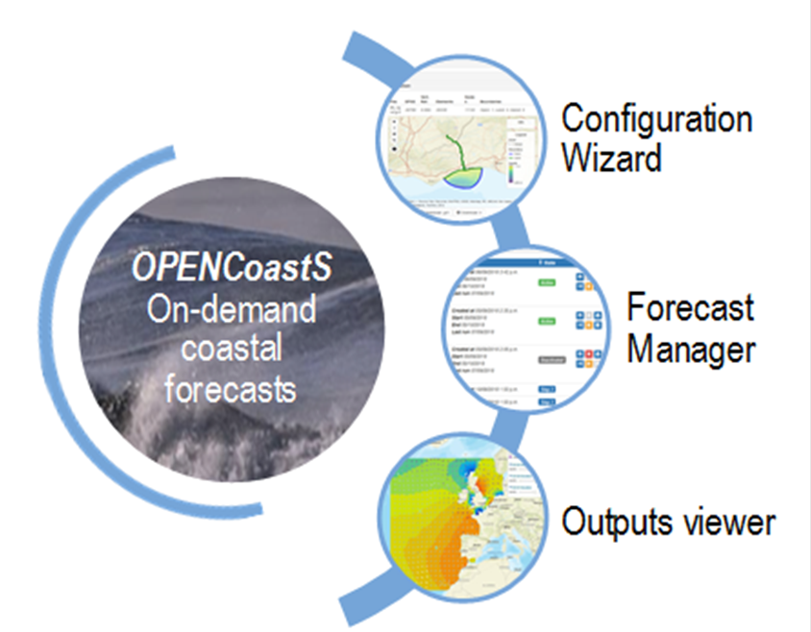
OPENCoastS computational service
Create and maintain an operational forecast for the user selected coastal area
Interaction with a simple Web interface
Allow choice of model, forcings, parameters and data sources
Integrate with external forecasts (e.g., river flow)
Easy replication of deployments for fast calibration
Whole forecast cycle: create grid, configure, manage, outputs viewer
External link to tailor-made AI forecast engines for boundary conditions
Grid generation

Slide 4
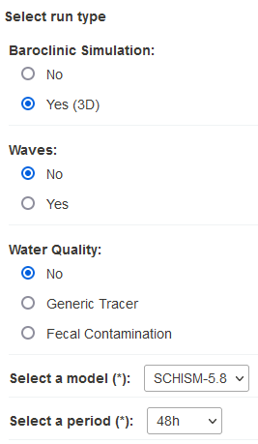
Generate a 3D forecast in OPENCoastS
Step 1: Select the configuration, model version and duration
Step 2: Load and validate horizontal and vertical grids
Step 3: Specify the boundary conditions
Step 4: Define stations for time series
Step 5: Define physical and numerical parameters
Step 6: Define spatially-varying parameters
Step 7: Define initial and boundary conditions for water quality*
Step 8: Review and submit
*Step 7 is applied only in water quality applications

Slide 5
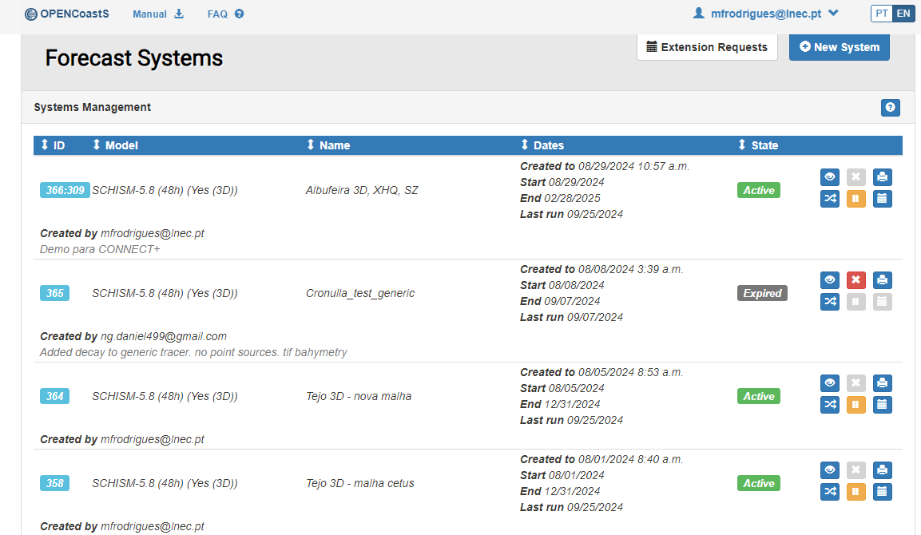
Monitor and manage forecasts
Dates
State of the forecast system
View deployment’s configuration
Pause system
Delete system
Clone system
Request extension

Slide 6
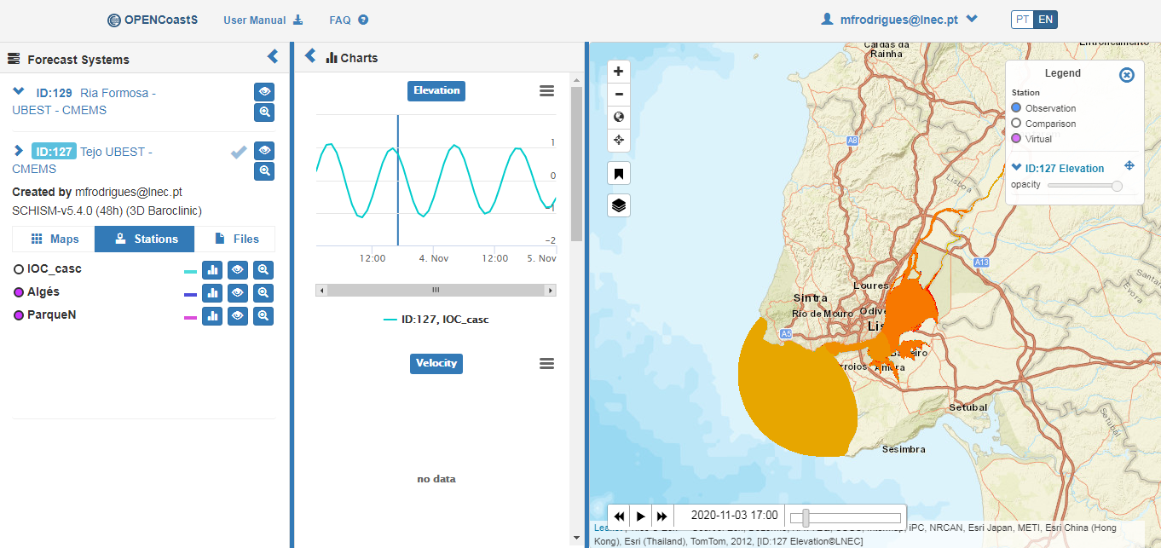
Output viewer main products
List of forecasts
Time series
Maps and animations results

Slide 7
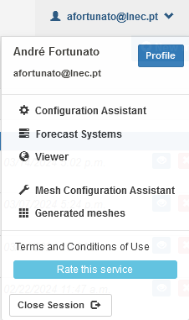
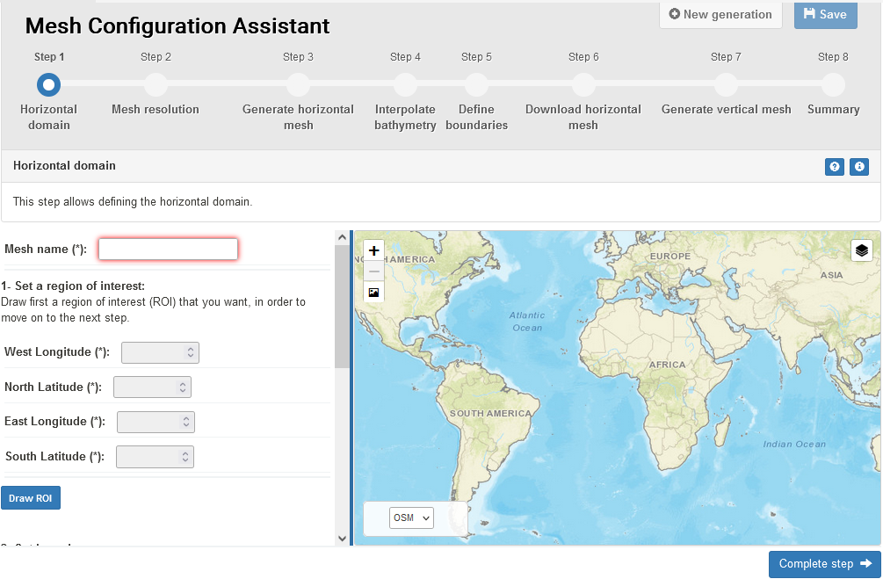
Grid generation: Accessing OPENMeshS
Access OPENCoastS (https://opencoasts.ncg.ingrid.pt)
Login or register
Click on Mesh Configuration Assistant

Slide 8
OPENMeshS interface
1. Define region of interest
Define data sources
Define domain
WEBGIS
3. Generate nodes
Triangulate nodes
Optimize grid
JIGSAW and NICEGRID
5. Define boundaries
OCSMesh or manually
7. Generate vertical mesh
2. Define min and max resolution
Define resolution functions
OCSMesh
4. Interpolate bathymetry
OCSMesh
6. Download mesh
8. Verify
Archive grid

Slide 9
OPENMeshS steps

Slide 10
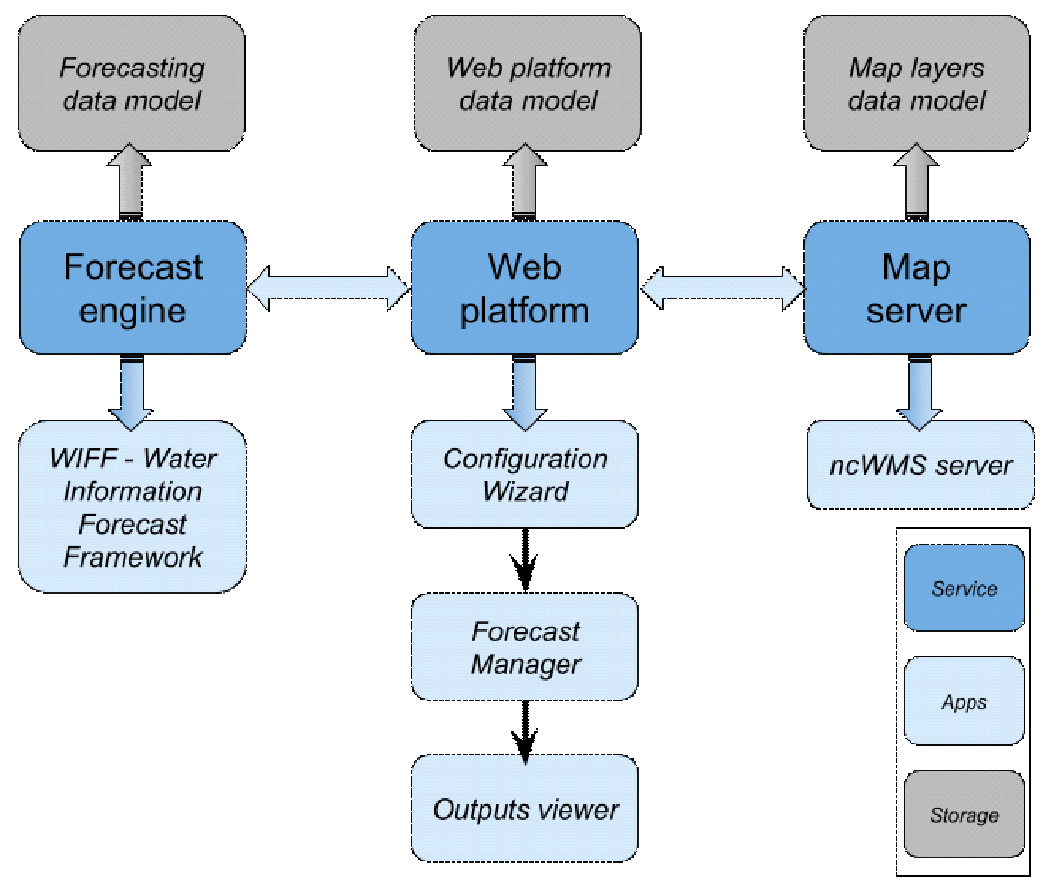
OPENCoastS Platform Overview
OPENMesh
Grid generation
Notes:
Opencoasts multisite deployment support
EGI Data Transfer using StoRM WebDAV with OAuth support
EGI Online Storage with EGI block storage for cloud and EGI file storage for GRID
EGI Cloud Compute to deploy the required Virtual Machines
EGI Cloud Container Compute for HPC computations that require dedicated hardware
EGI Workload Manager to submit less urgent jobs to EGI HTC infrastructure
Opencoasts service deployment now is only using VMs provided from EGI Cloud Services. In the scope of EGI ACE, OPENCoastS platform is being improved to offload the resources demand on computation to dedicated HPC infrastructure.
The deployment of OPENCoastS platform also aims to be easily deployed on EGI using Infrastructure Manager and kubernetes receipts and EGI Check-in.

Slide 11
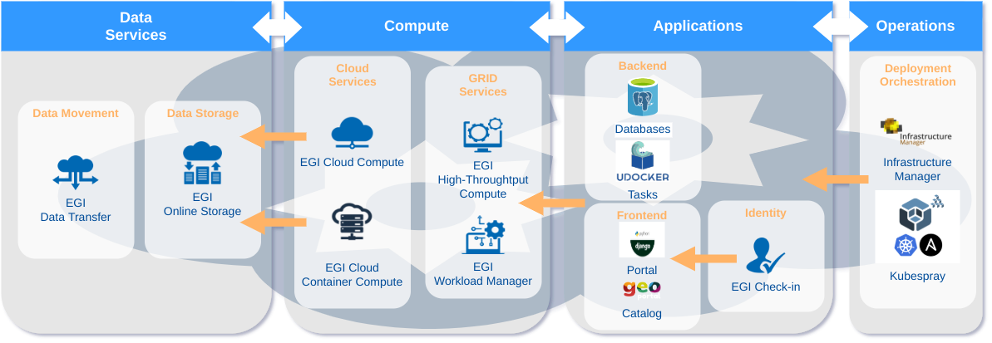
OPENCoastS deployment over EGI resources (@INCD)
Notes:
Opencoasts multisite deployment support
EGI Data Transfer using StoRM WebDAV with OAuth support
EGI Online Storage with EGI block storage for cloud and EGI file storage for GRID
EGI Cloud Compute to deploy the required Virtual Machines
EGI Cloud Container Compute for HPC computations that require dedicated hardware
EGI Workload Manager to submit less urgent jobs to EGI HTC infrastructure
Opencoasts service deployment now is only using VMs provided from EGI Cloud Services. In the scope of EGI ACE, OPENCoastS platform is being improved to offload the resources demand on computation to dedicated HPC infrastructure.
The deployment of OPENCoastS platform also aims to be easily deployed on EGI using Infrastructure Manager and kubernetes receipts and EGI Check-in.

Slide 12
Acknowledgements
Project ATTRACT-DIH
Digital Innovation Hub for Artificial Intelligence and High-Performance Computing
Project CONNECT
Copernicus Marine Service National Collaboration Programme 2022-2028
More info here:
opencoasts.lnec.pt
Thank you for your attention!
aoliveira@lnec.pt

