Slide 1
developing and deploying sub-setting services by means of Blue-Cloud Data Lakes for leading marine repositories
Dick M.A. Schaap, MARIS, Blue-Cloud 2026 Technical Coordinator
EGI 2024 Conference – Lecce – 2 October 2024

Slide 2
EU H2020 Blue-Cloud project (2019 – 2023)
To explore and demonstrate the potential of cloud based open science supporting research for ocean sustainability, and UN Decade of the Oceans and G7 Future of the Oceans
To deploy a cyber platform with smart federation of multidisciplinary data repositories, analytical tools, and computing facilities
To develop a marine thematic European Open Science Cloud (EOSC) serving the blue economy, marine environment & marine knowledge agendas

Slide 3
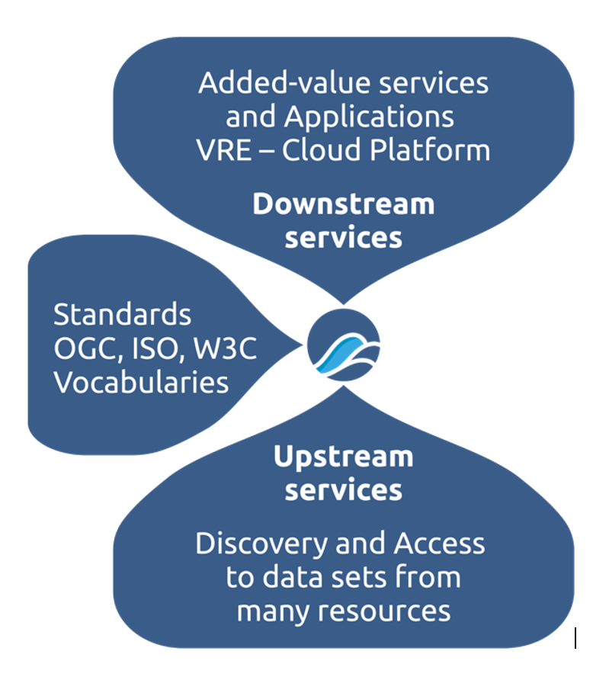
Blue-Cloud overarching concept
Developing and deploying a Virtual Research Environment (VRE) with an array of services for configuring and running virtual labs for specific analytical workflows, use cases and demonstrators
Applying common standards and interoperability solutions for providing harmonized metadata and data
Developing and deploying harmonized discovery and access to established European marine data management and processing infrastructures

Slide 4
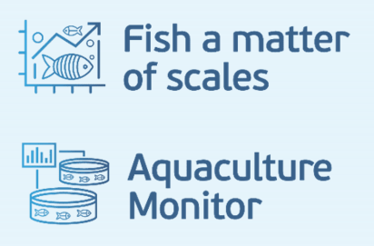
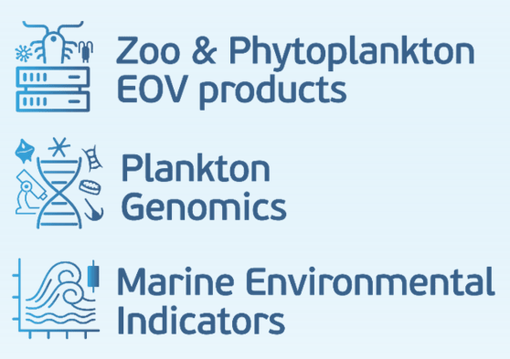
Blue-Cloud key products and services
Blue-Cloud Data Discovery & Access service, federating key European data management infrastructures, to facilitate users in finding and retrieving multi-disciplinary datasets from multiple repositories
Blue-Cloud Virtual Research Environment infrastructure to provide a range of services and to facilitate orchestration of computing and analytical services for constructing, hosting and operating Virtual Labs for specific applications
Blue-Cloud Virtual Labs, configured with specific analytical workflows to serve as Demonstrators, which can be adopted and adapted for other inputs and analyses

Slide 5
Blue-Cloud 2026 (2023 – 2026)
Develop a Federated European Ecosystem to deliver FAIR & Open data and analytical services, instrumental for deepening research of oceans, EU seas, coastal & inland waters.
Develop a thematic marine extension to EOSC for open web-based science, serving the needs of the EU Blue Economy, Marine Environment and Marine Knowledge agendas.
Blue-Cloud 2026 is expanding the federated approach, involving more aquatic data stakeholders and integrating a semantic broker
Blue-Cloud 2026 is upgrading and expanding the VRE with a new Cloud Computing Platform, uptake of GALAXY VRE technology, and others
Blue-Cloud 2026 is upgrading existing Virtual Labs and adding new Virtual Lab developments
Blue-Cloud 2026 is developing WorkBenches for generating EOV data collections for T&S and Eutrophication, combining expertise from CMEMS, EMODnet, and SeaDataNet, and for plankton with expertise from VLIZ, ETHZ, and EBI-EMBL
interacting with EOSC developments, in support of the EU Green Deal, UN SDG, EU Destination Earth, and the EU Mission on healthy oceans, seas, coastal and inland waters, ultimately to provide a core data service for the Digital Twin of the Ocean.
5

Slide 6
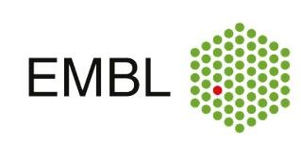
Blue-Cloud 2026 Consortium
Scientific and Administrative Coordinator
Project Coordinator
Technical Coordinator
6

Slide 7
Introducing Beacon – a powerful data lake technology
EGI 2024 Conference – Lecce – 2 October 2024

Slide 8
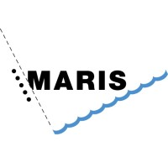
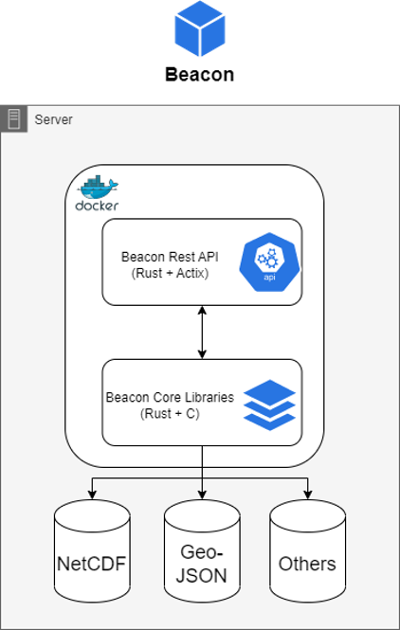
Beacon in a nutshell
Written in Rust + C
High Performance Data Lake
Runs on:
Linux
Windows
Docker Containers
Consists of:
Rest API
Core Libraries
Real-Time sub-setting
Data harmonization (single output file)
Dynamic Chunking
Produces different output formats:
NetCDF
CSV
JSON
IPC (Apache Arrow)
GeoJSON
Parquet
BBF (Beacon Binary Format)
Handle any NetCDF Structure (E.g. Timeseries, Cruises, Gridded)
Powerful query capabilities
Filter on:
Ranges
Polygons
Metadata
Union/Aggregation Queries
Federated Queries
October 2024 – EGI 2024
8

Slide 9
Performance
Beacon System Usage
Loaded into beacon all SDN CDI records:
2.5 millions datasets
> 4 billion data points
200GB of NetCDF Data
Query:
Longitude from -8 to 12
Latitude from 50 to 61
Depth from 0 to 50
Time from 2010 to 2012
All the temperature parameters aggregated and harmonized in degrees Celsius
Result: 12M points!
Can run on Laptops, Home PC’s and Servers
Only uses what’s necessary to process the query
Beacon ERA5
11TB of Data
11K daily 0.05 gridded SST datasets.
260 Billion measurements
Resource Usage:
1.2GB of RAM,
250GB of Disk Space
Beacon SeaDataNet
250 GB of NetCDF Data.
2.8M datasets.
Resource Usage:
1.8GB of RAM
60 GB of Disk Space
Beacon Argo Data 600GB of NetCDF Data. 3.3M datasets. Resource Usage: 600MB of RAM 50 GB of Disk Space
October 2024 – EGI 2024
9

Slide 10
Beacon instances/nodes
Euro-Argo data
retrieved from S3 bucket
CORA Profile data
retrieved from CMEMS, product: INSITU_GLO_PHY_TS_DISCRETE_MY_013_001
CORA Timeseries data
retrieved from CMEMS, product: INSITU_GLO_PHY_TS_DISCRETE_MY_013_001
EMODnet Chemistry data
retrieved from EMODnet Chemistry WebODV (Eutrophication_Atlantic_profiles_2023_unrestricted.odv)
WOD data
retrieved from ncei.noaa.gov
SeaDataNet CDI TS data
retrieved from EGI-ACE webODV
SeaDataNet CDI Incremental
CMEMS BGC data
retrieved from CMEMS, product: INSITU_GLO_BGC_DISCRETE_MY_013_046
Soon these Beacon instances are also available at the Blue-Cloud VRE
for free use by everybody, registered as Blue-Cloud user
October 2024 – EGI 2024
10

Slide 11
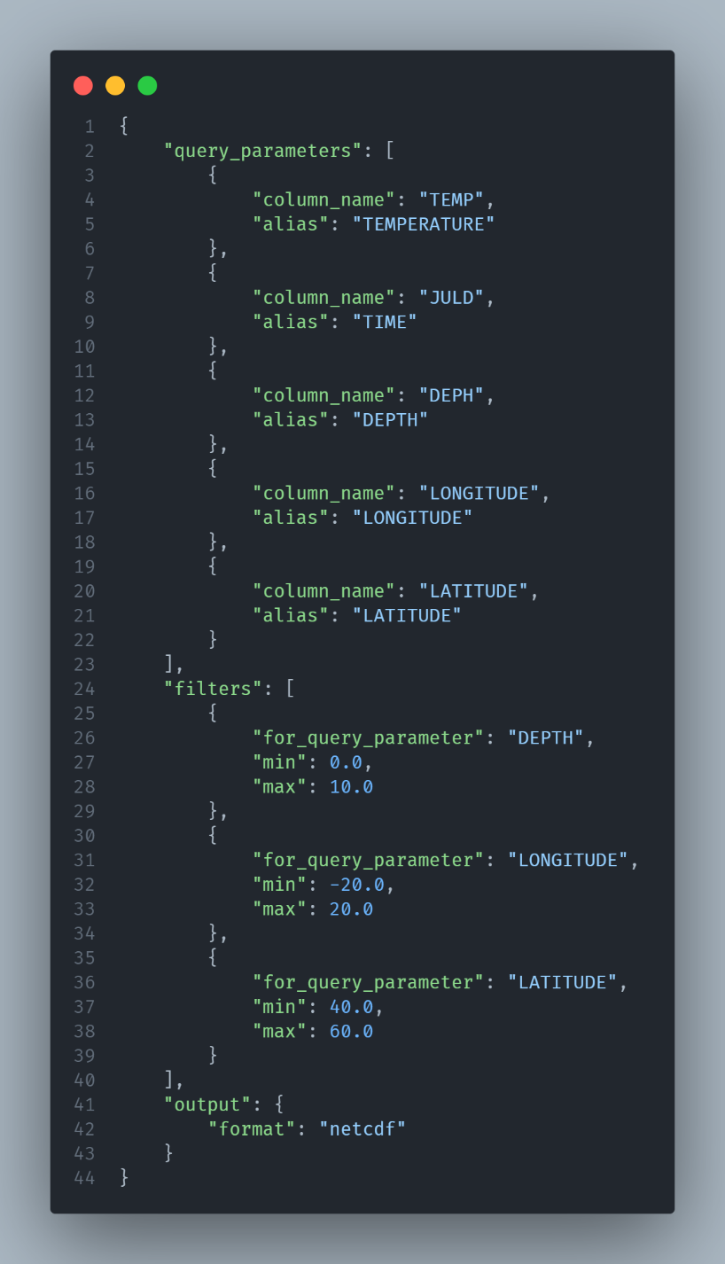
Querying Beacon
Allows you to retrieve specific data based on your requirements
JSON query object and sending a POST request to the query endpoint
Select Columns
Define filters for the columns
Select the output format
Query!
Retrieve data that matches your specified parameters, units, filters, and other criteria
October 2024 – EGI 2024
11

Slide 12
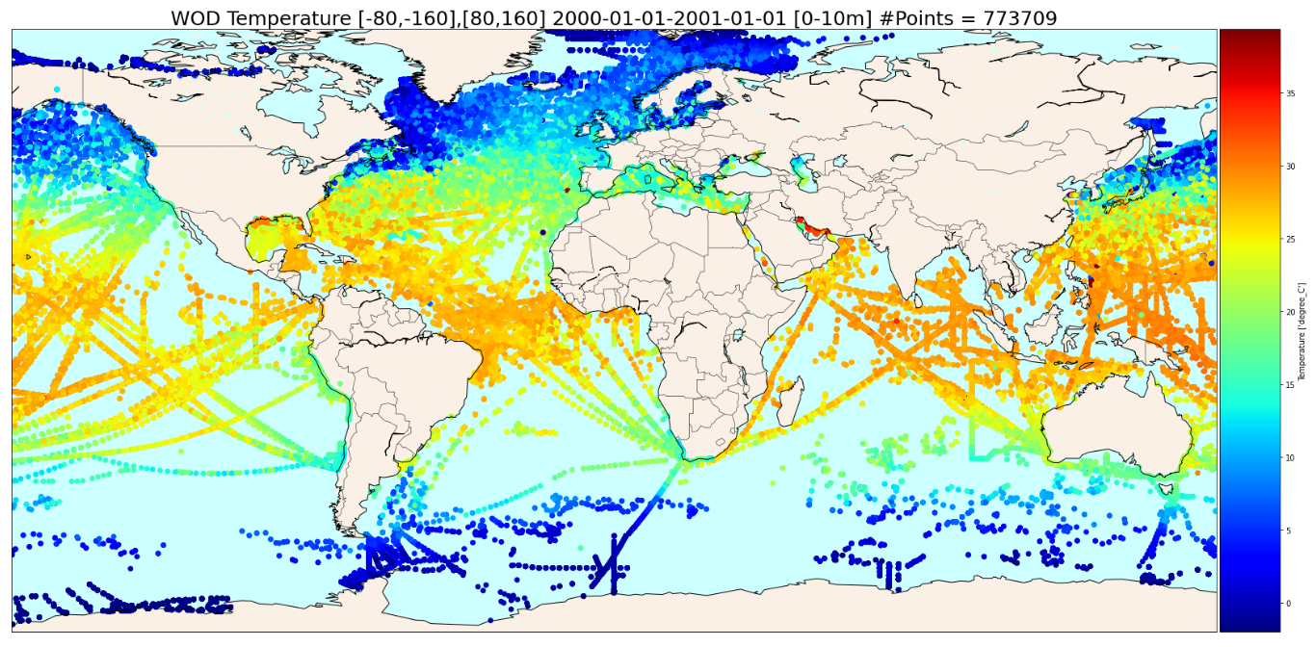
Notebook implementation example
World Ocean Database (WOD)
October 2024 – EGI 2024
12

Slide 13
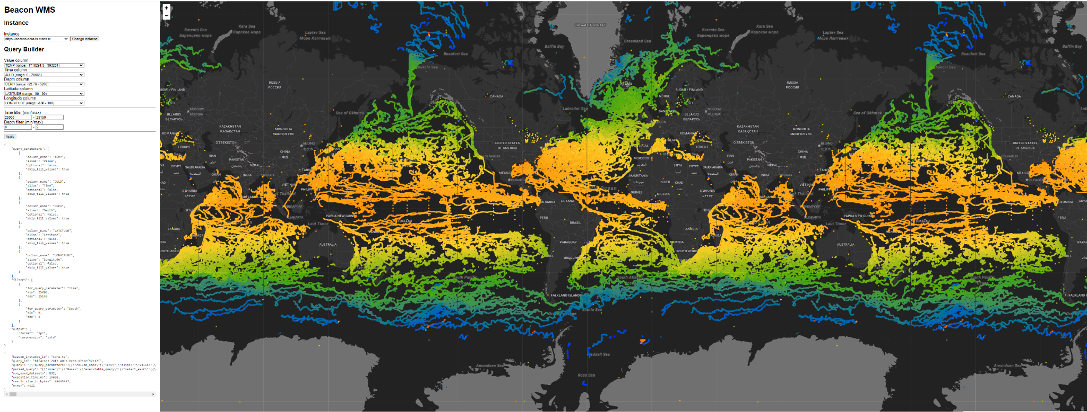
Example: (drawing 20M temperature points from CMEMS CORA)
October 2024 – EGI 2024
13

Slide 14
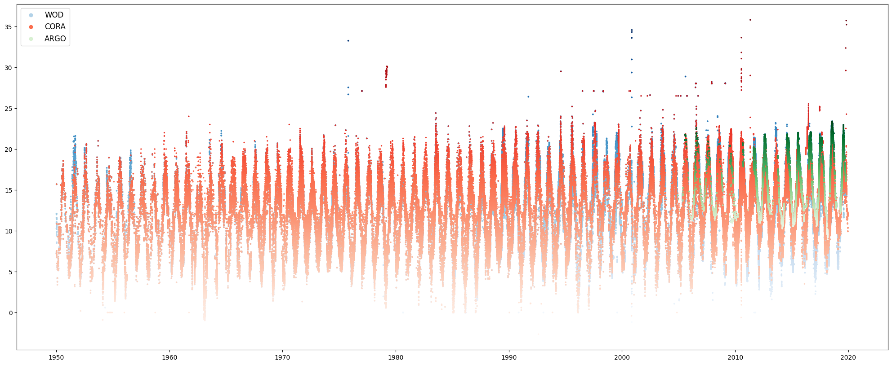
Example: 1950 - 2020 North Sea Temperature
October 2024 – EGI 2024
14

Slide 15
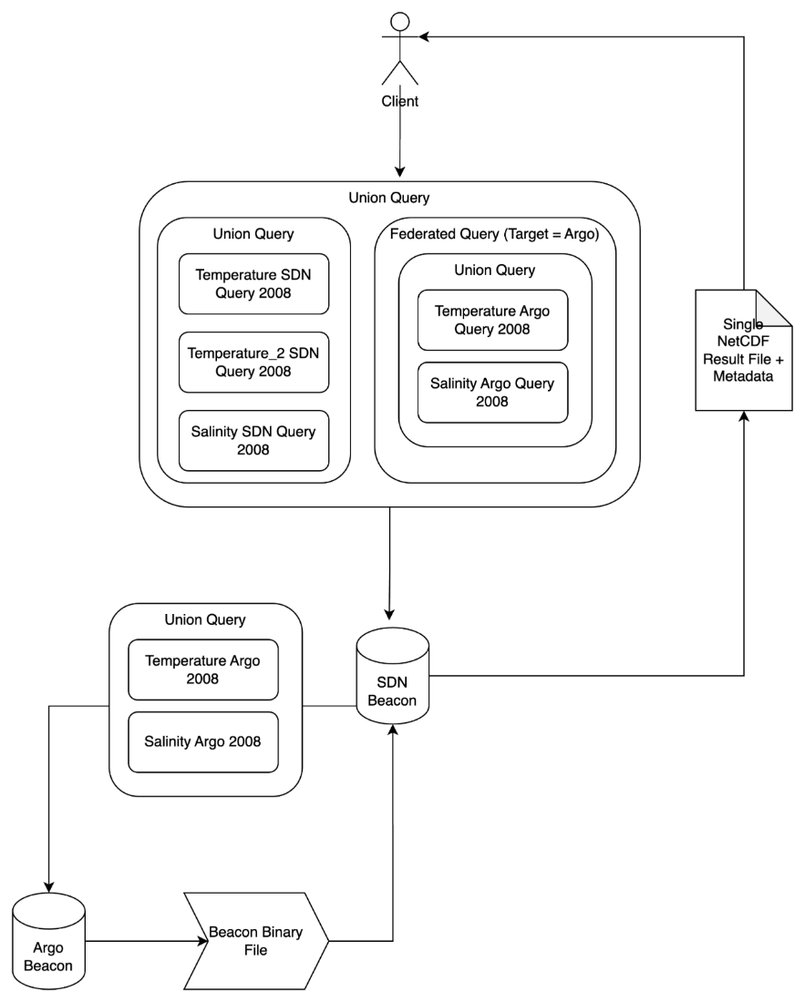
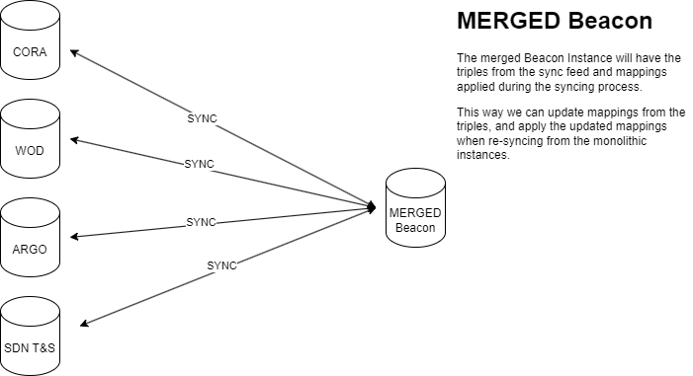
From monolithic nodes to merged Beacons
Semantic mapping
Combine results from different beacon nodes
E.g. Beacon-Argo + Beacon-SDN
SQL-like union but with Beacon Performance
Distribute Workload
More Performance
Seeking harmonisation with common metadata profile
October 2024 – EGI 2024
15

Slide 16
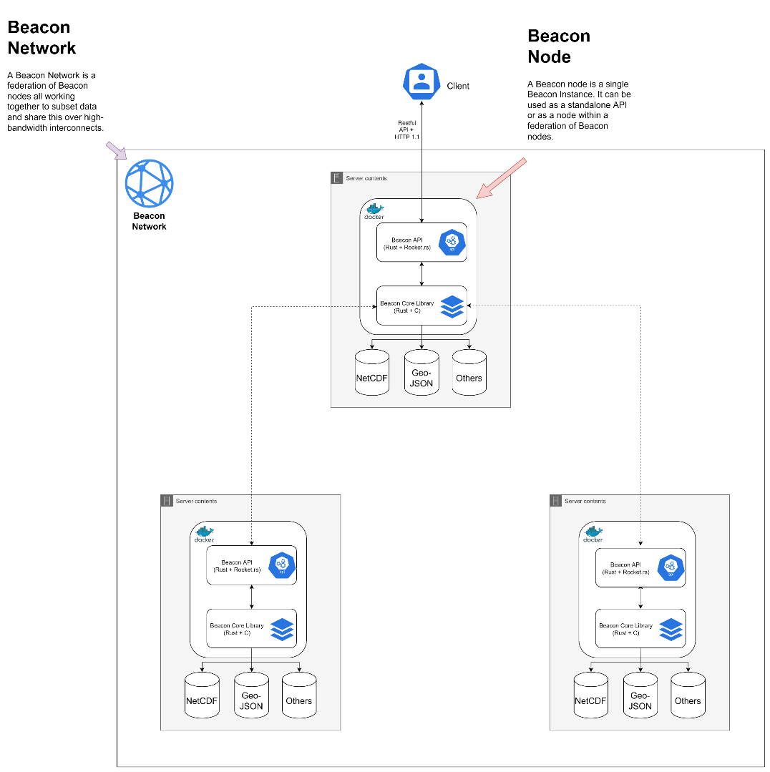
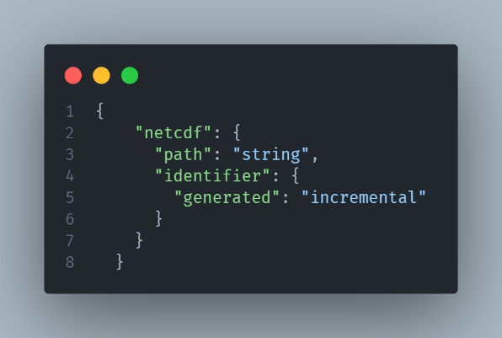
Next steps
Working towards 1.0.0 release end of this year
Will make it possible to set-up your own Beacon node
Start a Docker Container
Import your datasets
Ready for querying
Cloud data support (e.g. AWS S3)
High Performance Data Distribution Network
More extendable query possibilities
Community Driven
October 2024 – EGI 2024
16

Slide 17
Synergy opportunity
As Blue-Cloud 2026 we seek synergy with interesting projects and networks
Blue-Cloud 2026 has applied to recent EOSC survey for becoming a Blue Node in the EOSC ecosystem, bringing together marine actors and open science, supported by powerful and flexible e-infrastructure
Blue-Cloud 2026 is very interested in contributing to the UN Ocean Decade and certainly contributing to the GlobalCoast initiative, first of all with Beacon, but possibly wider

