Slide 1
Technical design of the GlobalCoast cloud-based Infrastructure
Giovanni Coppini (CMCC), Jay Perlman (IEEE France), Miguel Charcos (Socib), Giuseppe La Rocca (EGI), Nadia Pinardi (UNIBO) and many more!
This programme is endorsed by the UN Decade of Ocean Science

Slide 2
GlobalCoast’s mission
implement CoastPredict projects across diverse coastal regions to showcase the value of an integrated and fit-for-purpose coastal observing and prediction system. By collaborating with local stakeholders, the initiative will provide innovative products and services for coastal resilience.
GlobalCoast will build a cloud-based infrastructure with these key objectives:
Accelerate data collection and standards for sharing of coastal oceanography data
Make global and local analyses and forecasts available in an accessible way
Develop new public-private services on the cloud

Slide 3
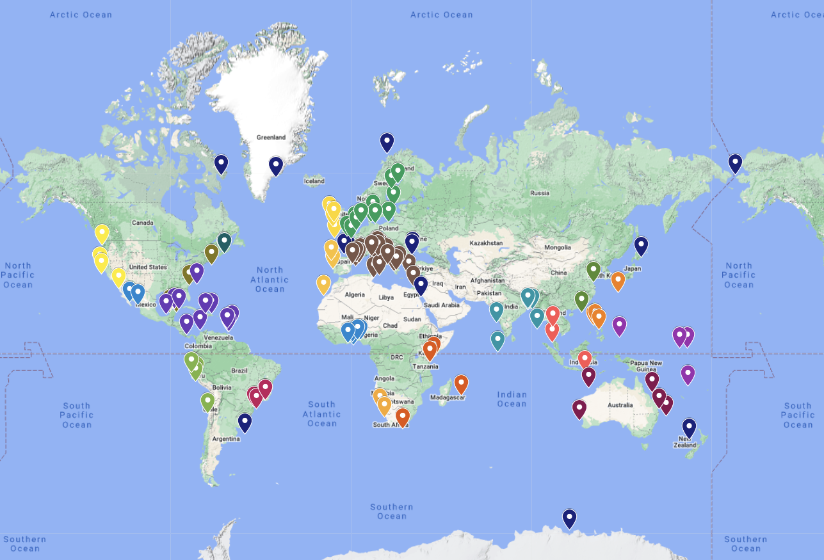
Pilot Site locations
30 Regions
> 125 Pilot Sites
225 institutions in
65 countries

Slide 4
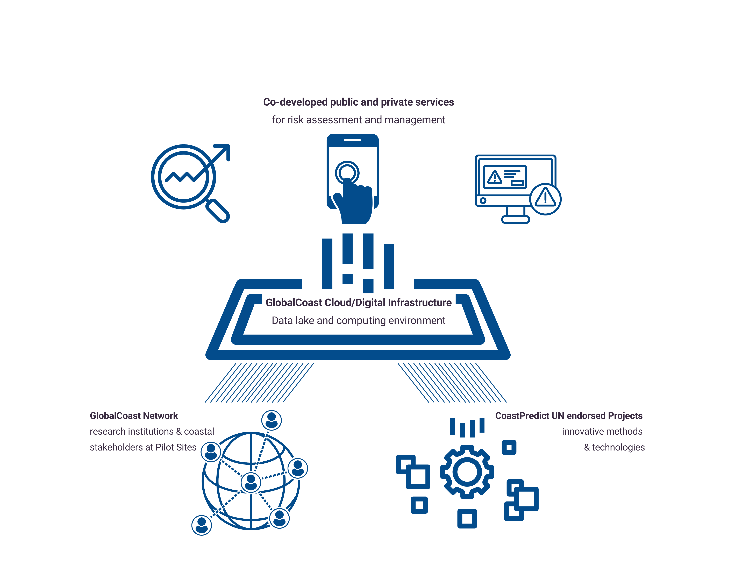
GlobalCoast infrastructure
Technical design of GlobalCoast cloud-based infrastructure consists of these key layers:
Authentication and Authorization
Computing Infrastructure (CPU and GPU)
Data Lake Infrastructure
Interoperable Regional Clouds (RC) to share data and services
>> To support the co-design and implementation EGI can leverage its resources and provide tailored solutions across these core layers

Slide 5
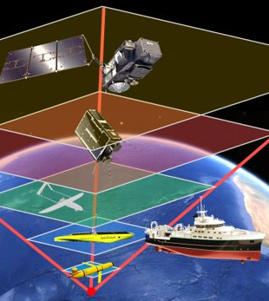
Coast Predict Regional Infrastructure
Observations (insitu + satellite) and Models
CP Regional Cloud 2** with N Pilots
CP Regional Cloud 1** with N Pilots
APIs
Semantic
Interoperability
Harmonisation
Workflow
Engine (orchestrator)*
Visualization
and control*
Services*
Final End Users
APIs
APIs
Stream Handler
APIs
Tools*
User authentication and management
Data Lake of diverse data spaces***
Cloud CORE* (computing)
Copernicus
EMODnet,
SeaDataNet
APIs
AI/ML Services
CP Regional and Pilot
Models
CP Pilot1
Data Space
CP Pilot 2
Data Space
Expert Pilot User
*architecture interoperable, similar security structures, common tools, dockers, etc
Best Practices/ Methods & Standards
Sensors-Edge-Fog-Cloud-HPC Continuum
**each region has its admin, etc
*** includes caching, etc

Slide 6
Information Infrastructure Attributes
Workflow management;
visualization, common catalogue;
users authentication and management,
brokering and sharing of space and computing resources among nodes;
caching system to share data
(federation at the level of the storage);
software easy to be moved between nodes (moveable docker containers);
orchestration of services;

Slide 7
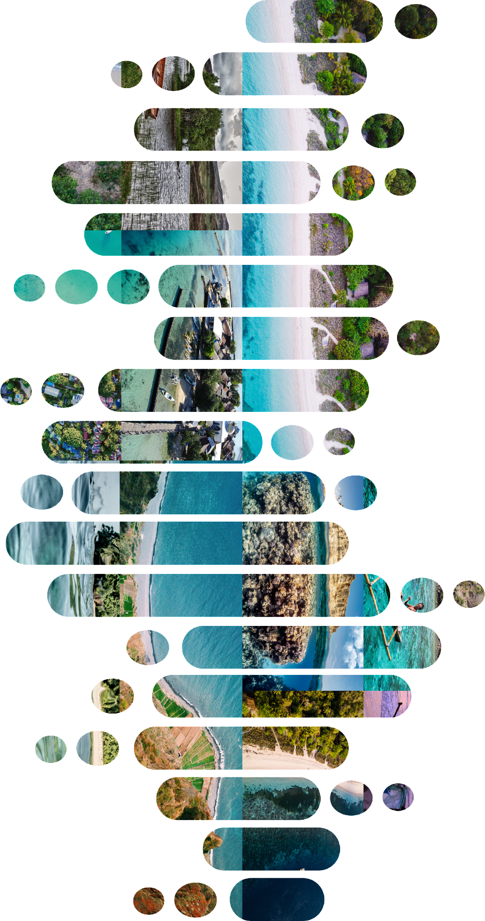
Authentication and Authorization Infrastructure
users authentication and management will be keen to allow single sign on but also have management at regional and Pilot level
See presentation later by Valeria Ardizzone, EGI F.

Slide 8
Computing Infrastructure
EGI computing services that could support to expand the computing power of GlobalCoast Infrastructure
Cloud Compute: VM-based computing with associated storage, delivers customisable resources allowing users full control over software and computing capacity. Ideal for data or compute-intensive workloads like user gateways or portals and interactive computing platforms.
Container Compute: Enables running containerized applications with Docker or Kubernetes on top of Cloud Compute, ideal for scalable, multi-tenant, microservices-based applications.
Compute Orchestrator: Supports deploying and configuring virtual and tailored clusters across multiple cloud infrastructures, including the EGI Federated Cloud Compute Infrastructure and commercial clouds such as: AWS, GoogleCloud, Azure, etc.
Success story: Riding the waves of success: How OBSEA leveraged EGI Cloud Comput

Slide 9
Computing resources requirements
Three temporal phases of development are foreseen:
Phase 1: Data (Copernicus models, in situ, satellite) is available on the cloud for Pilot experts to analyze and visualize using Notebooks.
Phase 2: Pilot experts can produce model simulations and perform real-time forecasting on the cloud.
Phase 3: AI applications developed on the Cloud and run operationally
Phase 4: Opening the cloud services to the external users

Slide 10
Regional Cloud Infrastructure Requirements
Table presents the computing and storage requirements for a Regional Cloud (RC) infrastructure which includes as an example 10 Pilots of GlobalCoast.
PHASE |  | Development and Training |  | Production
1 |  | GPU per Pilot | CPU Core | GPU per Pilot | CPU Core per Pilot | Total Regional (10 Pilot)s for 2 AI experts
2 | Cloud Computing (CPU) |  | 160*2 researchers= 320 |  | 200 (Phase 2 onward) | 3200 dev; 2000 prod CPU
3 | AI-based services (GPU) | 40 (Phase 3 onward) |  | 2-4 (Phase 3 onward) |  | 80 dev and training; 40 prod GPU (A100 or higher)

Slide 11
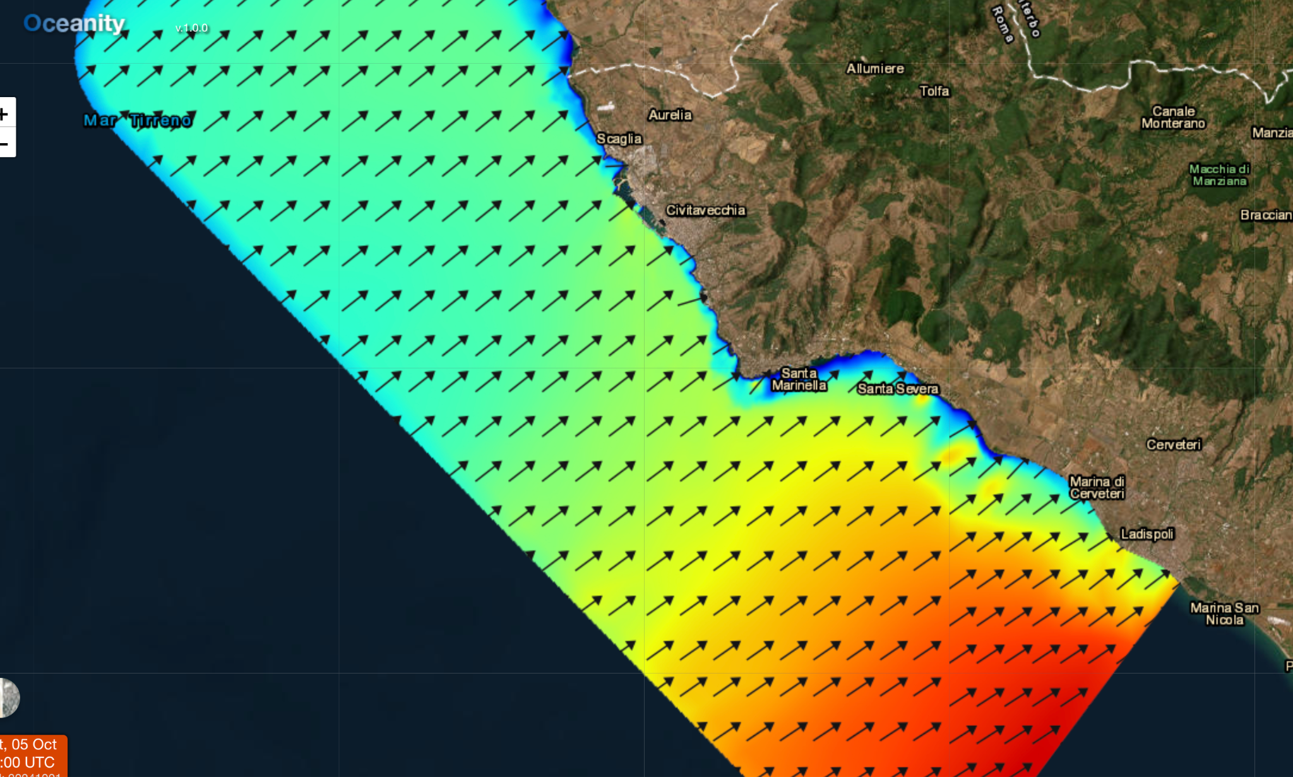
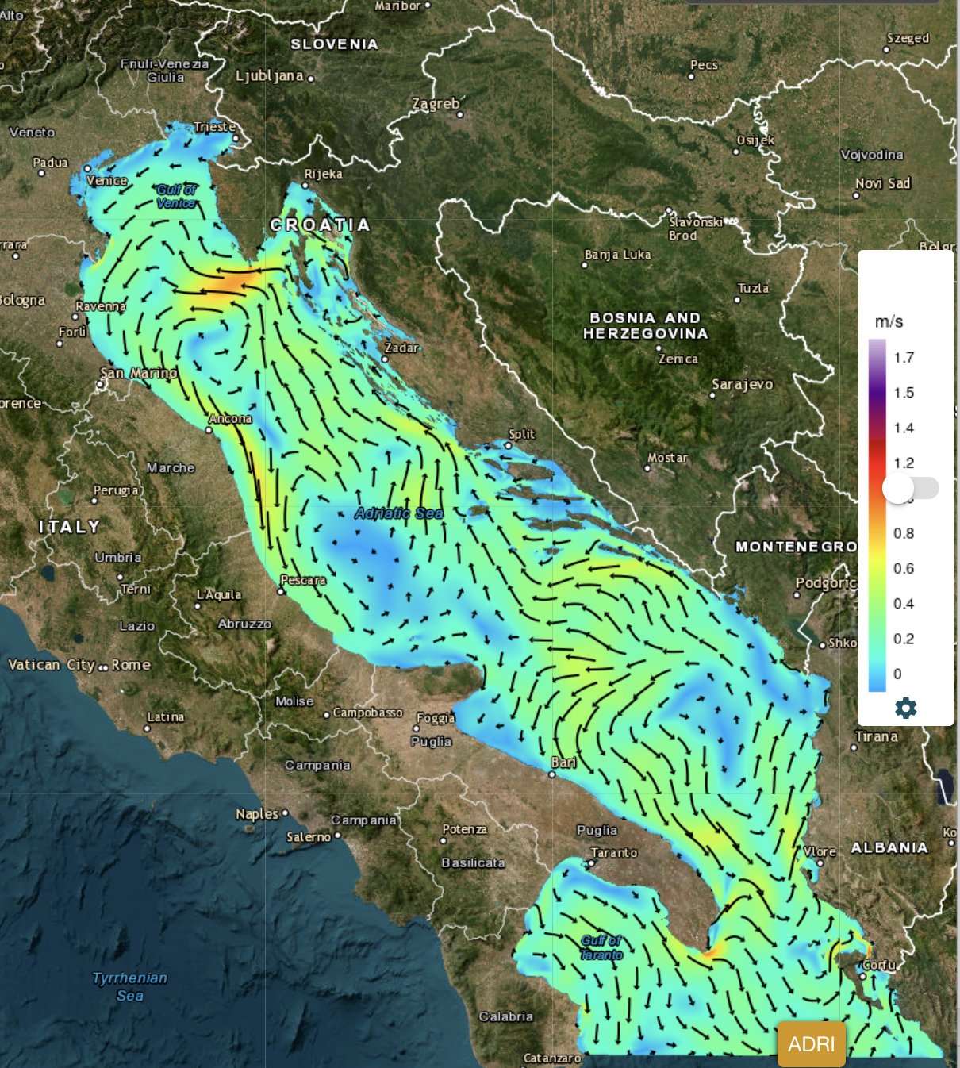
Data Infrastructure and data lake
The domain of Civitavecchia modelling and forecasting system (Italy) has been used to estimate the Pilot modelling products. In the map a wave direction and wave forecast is presented
Dataset for each Pilot Site will consists of:
Modelling products
Observations 1. In situ 2. Satellite
Modelling products:
Reanalysis or simulation
Climate projections
Analysis and forecast in Near Real Time (NRT)
Observational products:
Reprocessed
NRT
For the climate projection products at regional scale the Adriaclim example has been used to estimate the data archiving requirements.

Slide 12
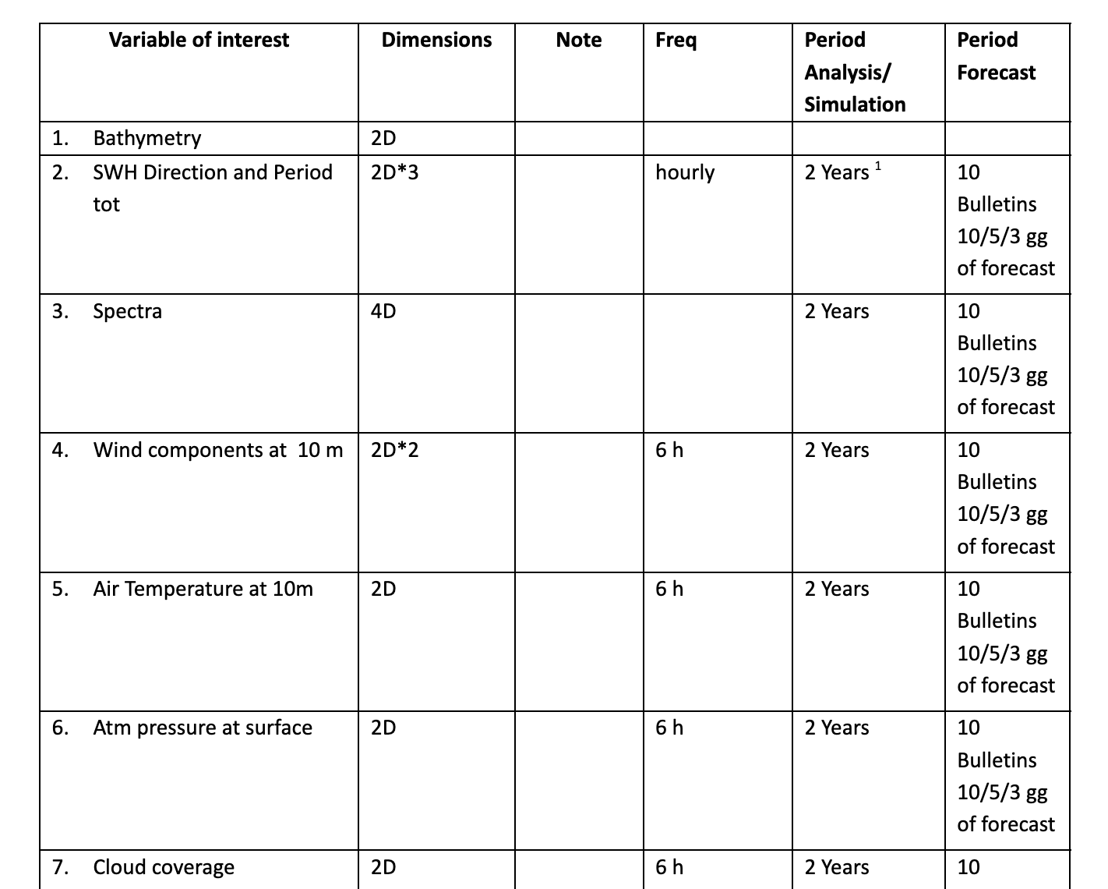
Data Identified Table

Slide 13
Data Lake
The resources needed for the Data Lake are:
VAR | # | Providers | 1 day [Gb] | 1 Month + Bollett. FCST [Tb] | 2 Years [Tb] | TOT [Tb]
2D-H (waves) | 4 | 10 | 33,6 | 1,176 | 24,528 | 25,707
2D-6H (atm) | 7 | 4 | 0.28 | 0.20 | 0.82 | 1.02
2D-Daily (e.g. satellite) | 4 | 10 | 0.08 | 0.06 | 0.24 | 0.30
3D-H (e.g currents) | 4 | 10 | 0,672 | 0,023 | 0,49 | 0,51
TOTAL |  |  |  | 1,46 | 26,08 | 27,54

Slide 14
Data Lake
VAR | # Providers | 1 Day [Gb] | 25 Years [TB]
2D-H (e.g. waves) | 10 | 8,4 | 76
2D-Daily (e.g obs) | 10 | 0.4 | 3,7
3D-Daily (e.g currents) | 10 | 0,07 | 0,64
Total |  | 8,87 | 80,34

Slide 15
Data Lake
VAR 30y in the past and 30 in the future- Adriatic sea scale | # Providers | 60 Years [TB]
Nemo T, U, V 3D; 3h + 1D | 1 | 14
WRF | 1 | 55
WRF-Hydro | 1 | 22
Total |  | 91
The total amount of disk space needed would be approximately 200 TB for 1 Region and 10 Pilots.

Slide 16
Cloud Infrastructure Requirements for Interpolation and Data Access
Computational resources for the development of Cloud interpolation software and specific outputs
A Python environment is required to run notebooks for processing near real-time forecast data. A 'working space' is needed to perform data interpolation from providers.
Request for setting up a Cloud Web interface connected to the Data Lake
The infrastructure must allow access to interpolated archived data and provide high-fidelity representation of the state of Italian coastal areas, considering ocean currents, wave motion, hydrology, biogeochemistry, and atmospheric conditions. Users will be able to view and download data and its subsets for specific applications.
Requirements to be considered for definition of the infrastructure:
Overall data volumes and volumes needed for end-user applications
Frequency of data generation from the different pilots
Access mode centralised vs decentralised architecture
Data formats to be supported
Metadata standards, vocabularies

Slide 17
User Stories
1) User 1 needs to visit the catalogue and display and analyze selected datasets on Regional Cloud 1 and Regional Cloud 2
2) User 2 wants to upload its citizen science data into the Regional Cloud on its pilot data space
3) User 3 wants to upload model data to work together with a private company to develop a service
4) User 4 wants to map wave hazard with the available data on Regional Cloud
5) User 5 wants to use the computing nodes to run available

Slide 18
Priorities
Data management ‘prescription’ that will ensure interoperability based on consistency of observations, standardisation of data and availability of metadata to have a ‘known quality’ of data
Alignment on Operational Readiness Level data, model and forecasting
Alignment on most relevant EOVs in coastal areas

Slide 19
Ocean Best Practices Workshop Session | ONLINE
Discuss priorities for new practices and highlight existing standards that could be integrated and evolved, to facilitate more efficient, transparent, and impactful coastal ocean science.
Consider how we align on standards for interoperability and exchange for a paradigm of coastal ocean observing and forecasting where data and information are more accessible, analysis tools are open and reproducible, and collaborations are more seamless.

Slide 20
Appendix II - The EGI Federated Cloud Compute
The EGI Federated Cloud Compute Infrastructure offers a multi-cloud IaaS federation that brings together research clouds as a scalable computing platform for data and/or compute driven applications and services for research and science.
Features of the EGI Federated Cloud:
Single Sign-On via EGI Check-in, users can log into every provider with their institutional credentials and use modern industry standards like OpenID Connect.
Global VM image catalogue at AppDB with pre-configured Virtual Machine images that are automatically replicated to every provider based on your community needs.
Resource discovery features to easily understand which providers are supporting your community and what are their capabilities.
Global accounting that aggregates and allows visualisation of usage information across the whole federation.
Monitoring of Availability and Reliability of the providers to ensure SLAs are met.
Documentation: https://docs.egi.eu/users/compute/

