Slide 1
OMB Mar 2024
Matthew Viljoen,
Operations Manager
EGI Foundation

Slide 2
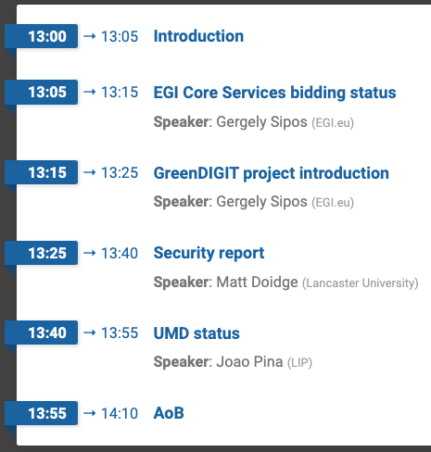
Agenda

Slide 3
Training for NGIs
Central ops team creating new training video covering:
Requirements for being an NGI within EGI (uptime, OLAs, security)
FitSM requirements and resources
Common procedures (sites joining, suspension)
Roles (central ops team, NGI manager, security contacts,…)
Operations Tools basics (Ops Portal, Accounting Portal, Helpdesk, Monitoring, etc.)
Brief 15min recorded presentation with pointers/links

Slide 4
Next OMB
Thu 23 May 1pm (provisional)
To be confirmed on ML

