Slide 1
EGI Core Services bidding status
Gergely Sipos
04/Jul/2024
Head of Services, Solutions and Support department
EGI OMB

Slide 2
Timeline and funding
https://confluence.egi.eu/display/EGIBID/Call+January+2024-December+2026
Consultations with previous providers | October - November 2023
Publication of call | 06 December 2023
Deadline for non-binding submission of expressions of interest | 31 December 2023
Expressions of interests are negotiated into provisioning agreements with the proposed providers | January - April 2024
Report to the council, discussion in council meeting | 9 May 2024, 23 May 2024
Obtaining explicit approvals from providers | June 2024
Open proposal for online council vote | 27 June 2024
Deadline for council vote | 5 July 2024
List of providers for 2024-2026
Funding composition for 2024
Contributions from the EGI Foundation (which is sourced from Council membership fees, EC project overheads, Profit from contracts)
EC projects and contracts (funding going directly/subcontracted to the providers)
Provider in-kind contributions

Slide 3
List of providers 1. - Services for the Federation
Service/Activity | Relation to EGI Service Management System | Selected partners
Accounting Repository and Portal | This service supports the Capacity Management (CAPM) and Service Level Management (SLM) processes in the EGI Federation | STFC/UKRI (Repository) CESGA (Portal)
EGI AAI | These services support all the Service Management System processes in general | GRNET (Check-in) CESNET (PERUN)
Collaboration tools | This service supports all the Service Management System processes in general | EGI Foundation
Configuration database | This service supports the Configuration Management (CONFM) and Supplier, Federation Member Relationship Management (SFRM) processes in the EGI Federation | STFC/UKRI
EGI Software Validation and Infrastructure | This service supports the Change Management (CHM) and Release and Deployment Management (RDM) processes in the EGI Federation | CSIC LIP
Helpdesk Human support | This service supports the Incident and Service Request Management (ISRM), Problem Management (PM), and Change Management (CHM) processes in the EGI Federation | 1st level support: CESNET 2nd level support: MARGI - New
Helpdesk service | This service supports the Incident and Service Request Management (ISRM), Problem Management (PM), and Change Management (CHM) processes in the EGI Federation | KIT
Messaging Service | This service supports the Capacity Management (CAPM) and Service Availability and Continuity Management (SACM) processes in the EGI Federation | GRNET
Operations Portal | This service supports all the Service Management System processes in general | CNRS - have to be handed over for 2025 - Anyone interested?
Security Coordination and Tools | This service supports the Information Security Management (ISM) process in the EGI Federation | UKRI, CERN, CESNET, GRNET, IJS, Nikhef
Service Monitoring | This service supports the Service Availability and Continuity Management (SACM) process in the EGI Federation | GRNET and SRCE

Slide 4
List of providers 2. - Services for Research
Service/Activity | Description | Selected partners
Cloud Compute (AppDB) | A catalogue and staging platform for Virtual Machines on the EGI Federated Cloud. The current provider is IASA (Greece) who would like to hand over AppDB to another partner. | MUNI - New
Cloud Compute (Dynamic DNS) | This service supports the registration of memorable hostnames for services running on EGI Cloud. | IISAS
Cloud Compute (fedcloudclient) | The fedcloudclient provides a user-friendly CLI for interacting with the EGI Cloud providers. | IISAS
Cloud Container Compute (Kubernetes managed platform) | The Kubernetes managed platform supports the execution of container-based workloads on Kubernetes clusters. | MUNI
Secrets Store | The Secrets Store helps users protect secrets needed to access their applications, services, and other resources. | IISAS
Software Distribution | Software Distribution allows Research Communities and Infrastructures to deploy software on worldwide-distributed computing infrastructures thanks to CernVM-FS (CVMFS) | UKRI
Complementary services in the same portfolio, WITHOUT EGI Foundation funding - not in scope of Council vote: DataHub (onedata), Data Transfer (FTS), Infrastructure Manager, Notebooks & Replay, Workload Manager, Computing and Storage resources (Cloud or HPC), Technical support and training for users, Community Services
How should we promote these and to which communities? - Capacities are still in discussion

Slide 5
Service delivery timeline
A big thank you!
Unfunded operation | since July 2023 (!)
New OLAs New development roadmaps (where relevant) | 1 July 2024
Partners are fixed (unless they opt out) | 2024-2026
Progress reviews and effort reporting | Every 6 months (Jan-Jun 2024 first. New forms are under preparation)
Review of annual performance, preparation of annual funding plan | Every 12 months (Q4 2024 next)
Retrospective payment for Jan-Jun 2024

Slide 6
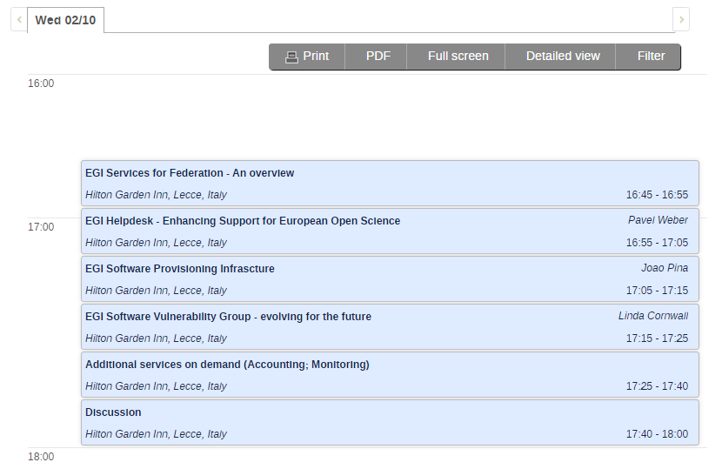
Area of improvement: Roadmapping & Development
Roadmaps (Work in progress): https://confluence.egi.eu/display/EGIBG/Steering+Group%3A+Evolving+the+EGI+Services
Roadmap presentations and discussions with user communities at EGI2024:
https://indico.egi.eu/event/6441/sessions/5191/#20241002
Suggestions on communities to invite? (Already invited: WLCG, EMSO, Juno, SKA, PITHIA, ENES, Belle-2)
EC calls for service improvements. E.g.
HORIZON-CL3-2024-CS-01-01 - Approaches and tools for security in software and hardware development and assessment
EGI Software Validation and Infrastructure
Security Coordination and Tools

Slide 7
Contact us
Thank you!
Get in touch with us

