Slide 1
EOSC Questionnaire for pilot EOSC Nodes
EGI Node consultation with Thematic Service providers
Gergely Sipos
2024.07.15.
EGI Foundation

Slide 2
Questionnaire for the build-up phase of the EOSC Federation
1st of July: Consultation with ‘Community Managers’
Today: Consultation with Thematic Service Providers
Introduction to the EOSC Questionnaire - Dale Robertson
EGI Contribution to the EOSC Federation - Gergely Sipos
Discussion of an EGI Node response
16th and 18th of July: Consultation with EGI Council
Deadline for Questionnaire: 18/Aug

Slide 3
Slide: from EOSC Association

Slide 4
Slide: from EOSC Association

Slide 5
Slide: from EOSC Association

Slide 6
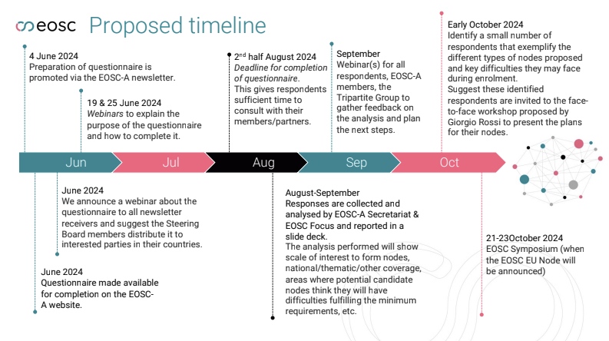
Slide: from EOSC Association

Slide 7
Minimal requirements for ‘candidate EOSC Nodes’
…and how the EGI Node will meet these
The legal entity representing the candidate EOSC Node must have the authority to establish agreements. → EGI Foundation
The legal entity responsible for the candidate EOSC Node should commit to providing sufficient resources to ensure its operation for at least 24 months, ideally for 5 years or more. → Fulfilled
The candidate EOSC Node must have sufficient capacity and expertise to be able to ensure that the data and services it includes can be operated at a sufficiently high Technology and Readiness Level ensuring robust, reliable and secure performance. → TRL7+ services
Data and Services must be at least findable and accessible to registered EOSC users and fulfil the FAIR principles in general, while services such as compute and storage capacity should be available in sufficient quantities to multiple user groups. → EGI Service catalogue complemented by Thematic Services/Data catalogue

Slide 8
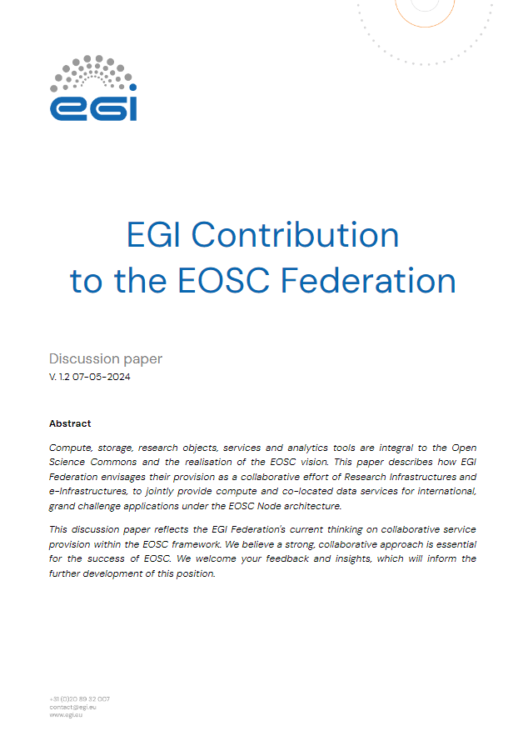
EGI Contribution to the EOSC Federation
Position paper published on 7/May/2024: https://zenodo.org/records/11128540
EGI recognises EOSC as the European initiative to support the implementation of the Global Open Research Commons across Europe (RDA GORC)
The EGI Federation has provided many of the essential elements identified by GORC
EGI Federation aspires to be part of the EOSC Federation as a Node with services and data available for transnational access to
Users and services operated within the EGI Node
Services operated within the other EOSC Nodes (acting as a horizontal node) (EU Node; Future other nodes including those emerging in EOSC-Beyond)
Recommendations for EOSC:
EOSC should be focused on grand challenges that require the integration of research data, computing, storage, services and tools, knowledge and user support from multiple disciplines
Increase adoption of AI/ML solutions
EGI aspires to be part of the EOSC Federation as a Node AND in the EOSC Core
EU Commission funding should catalyse Member State funding
Research Infrastructures and e-Infrastructures need EU support for Transnational Access to overcome limitations of national funds and short-lived projects

Slide 9
Draft response
https://docs.google.com/document/d/1y0fb4xQSWrEU0GStlyxaQMFvd4P5DvYcgKMkuzuWdcw/edit?usp=sharing
Services included:
EGI “Services for Research” portfolio
Infrastructure services
Generic platform services
Ability to take over ‘federation services’ from the EU Node
Procurement still runs these for the next 2.5+ years
Thematic services
Those that rely on EGI services AND do not have a natural place in other Nodes - E.g. Communities of practices

Slide 10
Discussion

Slide 11
Thank you
Person name
+31 (0)20 89 32 007
contact@egi.eu
www.egi.eu

