Slide 1
Information System usage by the EGI Operational Tools
D.Cesini (INFN/IGI)
On behalf of the EGI-JRA1 activity
Towards an Integrated Information System Workshop
Amsterdam 01/12/2011
Towards an Integrated Information System Workshop
Amsterdam 01/12/2011

Slide 2
Outline
The EGI-JRA1 Activity
  Developed tools and other tasks
The GOCDB
  Tool presentation
  Tool usage statistics
The ops current usage of the Information System and GOCDB
Conclusion

Slide 3
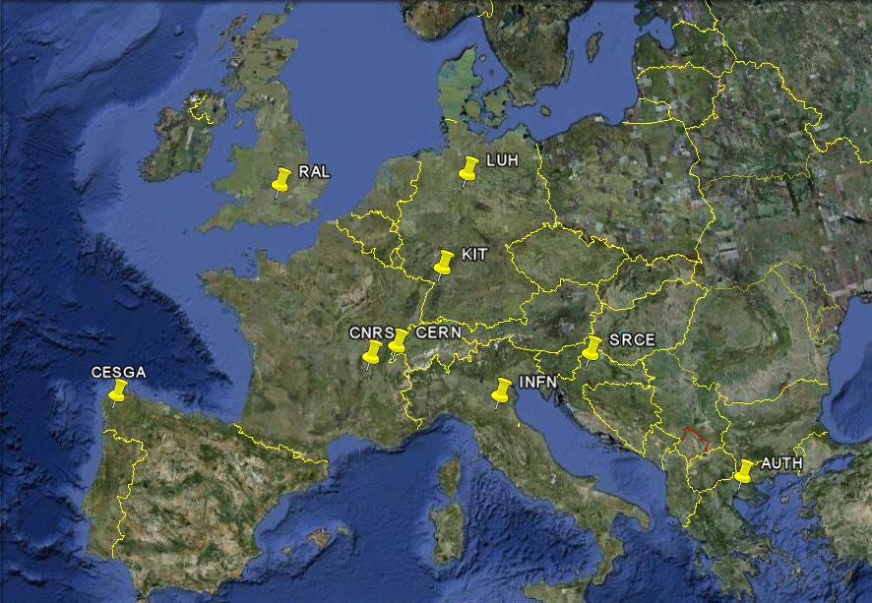
Tools developed by EGI-JRA1
Operation Portal (CNRS)
EGI Helpdesk (KIT)
GOCDB (RAL)
Accounting Repository (RAL)
Accounting Portal (CESGA)
SAM/MyEGI (CERN/SRCE)
Metrics Portal (CESGA)

Slide 4
Other activity tasks
Message Broker Configuration to support tools and operation (AUTH)
Accounting for different resource types (LUH/INFN/RAL)
  Billing
  Accounting of application usage
  Accounting of data usage
  Accounting of capacity and cloud computing usage

Slide 5
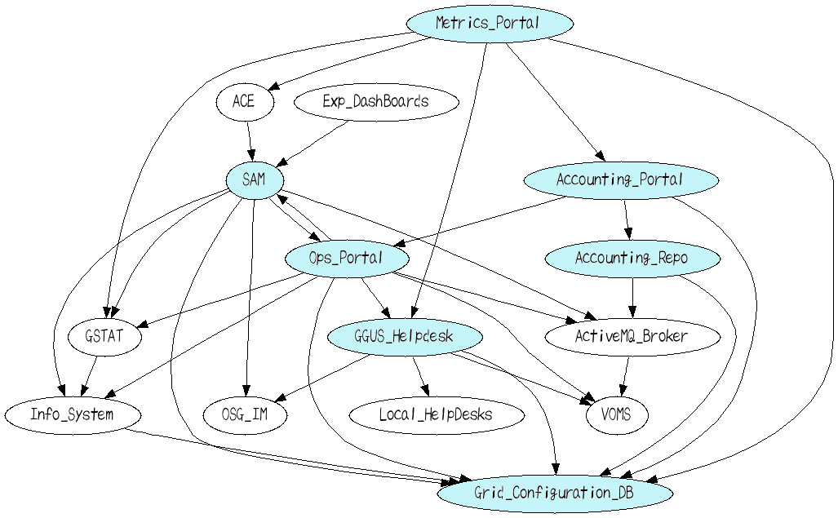
JRA1 Tools & Dependencies
EGI-JRA1 Tool
Depend ON InfoSYS
Depend ON GOCDB
Source MS704 + fixes

Slide 6
GOCDB

Slide 7
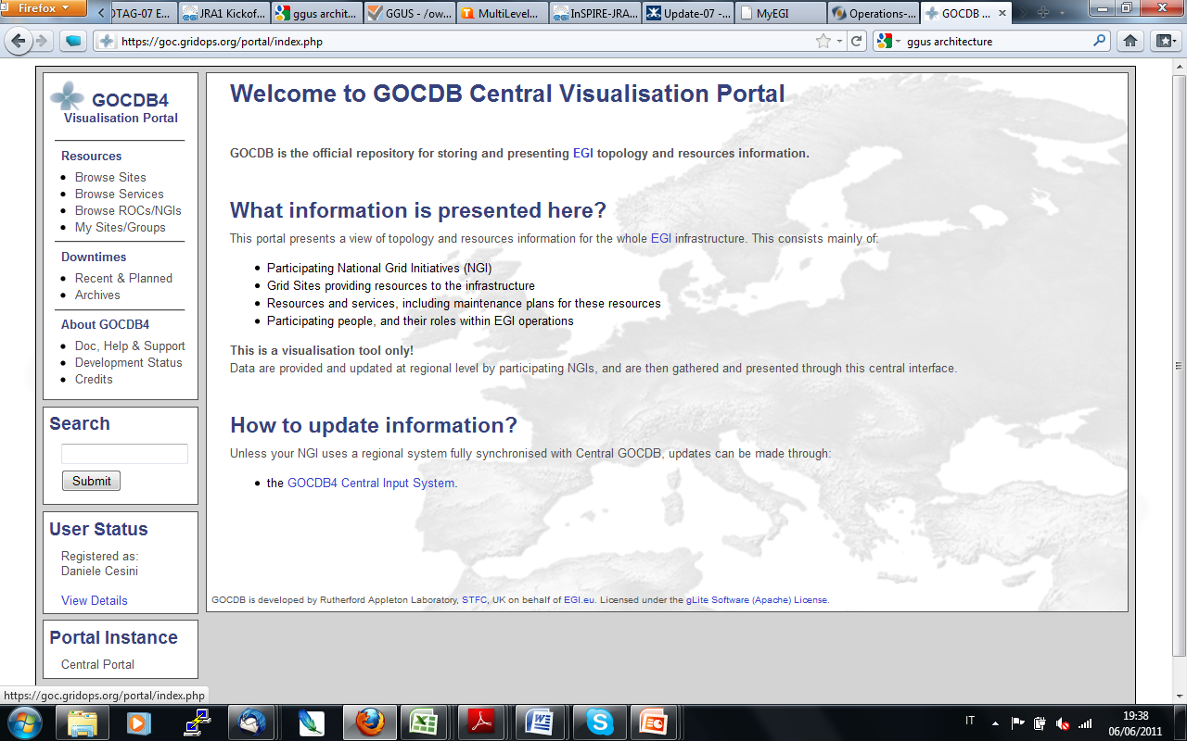
GOCDB
EGI relies on a central configuration database to record “static” information
Contributed by the resource providers
  service instances that they are running
  the individual contact, role and status information for those responsible for particular services

Slide 8

GOCDB
GOCDB is currently hosted centrally and can store both EGI data and Locally scoped data not intended to be visible to EGI
  Regional Standalone GOCDB available/maintained for NGI willing to install it
  Regional Publishing GOCDB not available - is a long term development
GOCDB comes along in two flavors, a read-only “Central Visualisation Portal” and a writeable “Input System”
https://wiki.egi.eu/wiki/GOCDB/Release4/Architecture
Read only
Read/Write
REGION / NGI
central users
EGI tools
Local users
GOCDBPI_v4
CENTRAL GOCDB4
INPUT GOCDB4
GUI
WS
WS
GUI
GOCDB module
GOCDB module

Slide 9
GOCDB Architecture
A three tiered web application
  a web GUI for manually recording Grid topology information
  a REST style API for querying that data in XML
  Data stored in an Oracle database
GOCDB does not provide a writable programmatic interface for create/update/delete
  Rather, the main CRUD interface is the web portal which provides control to users in defining their topology

Slide 10
GOCDB Data Model
GOCDB records topology information and also its associated state
  i.e. recording what sites/services/downtimes are meant to be functioning at a particular snapshot in time
The information is largely hierarchical;
  a parent NGI (group object) aggregates many child Site objects which in turn aggregate child Service Endpoints.
Downtime objects are linked to individual service endpoints (not sites)
  If all of the site’s services are in downtime, then the whole site is effectively in downtime.
  Each of the different entity types have relevant attributes, including people memberships, contact information, service types, downtime start/end dates etc.

Slide 11
GOCDB Permission & Role Model
The permissions model is hierarchical
  users with higher level permissions on parent objects (e.g. NGIs) can grant permissions to other users over sibling and child objects (e.g. Sites)
  following the creation of a user with a top level ‘NGI manager role,’ NGIs can manage and propagate their own users, Sites, and Service Endpoints without involving the GOCDB administrators
  the roles/permissions model is currently being re-developed to facilitate finer grained permissions
    In the newly evolving AAA model, the hierarchical permission model is less obvious
      https://wiki.egi.eu/w/images/b/b7/FinerGrainedGOCDB_rolesVeraProposal2.xls

Slide 12
GOCDB Stateful Data and State Transition Rules
GOCDB has predefined state transitions rules
  sites have an associated ‘Production’ and ‘Certification’ status.
  A Site would normally moves from ‘Candidate -> Uncertified -> Certified’ during the certification process
  other transitions are strictly forbidden.
    Similar state transition rules also exist when declaring and editing downtimes and when granting/revoking roles
https://wiki.egi.eu/wiki/GOCDB/Input_System_User_Documentation

Slide 13
GOCDB Historical Data and Auditing
Data are never actually deleted from the DB
  Instead, objects have an associated timestamp which indicates whether that object is currently ‘live’ or is deleted
  By providing timestamp parameters to the PI methods, the PI can be used to query for historical/audit data
    e.g. list a site’s certification status history
    who, why and when those changes were applied

Slide 14
GOCDB Usage Statistics (1/3)
PI Statistics on Visualization Portal
In October 2011 there were nearly 6 million separate queries for the PI:
  which averages ~2.3 queries per second
  The query rate has a background steady state averaging 0.4 MB/sec
  cyclic daily peaks
    reflecting requests from automated scripts
Given this high usage, caching the results of popular and expensive queries is essential
  Selected queries are executed every 30mins or so and the XML results are cached and served by Apache.

Slide 15
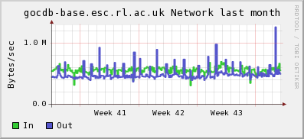
GOCDB Usage Statistics (2/3)
The number of valid PI queries starting with URL fragment ‘/gocdbpi’:
  Sep=4.3M
  Oct=5.9M

Slide 16
GOCDB Usage Statistics (3/3)
User interactions on the read/write input portal
Usage of the read/write input portal can also be considered as high
  The total number of separate page requests, excluding noise such as css and image file requests is:
    Sep=8566
    Oct=8974 (for Oct, this averages 289 user interactions per day).
  A partial selection of different page requests for October and September are:
  # TOTAL GET/POST requests (excluding noise) (Sep=8566, Oct=8974)
  # POST new downtimes (Sep=391, Oct=457)
  # POST edit downtimes (Oct=175, Sep=148)
  # View object (Sep=3854, Oct=3975)

Slide 17
GOCDB Documentation
Main Entry Point: https://goc.egi.eu
https://wiki.egi.eu/wiki/GOCDB
https://wiki.egi.eu/wiki/GOCDB/Documentation_Index
https://wiki.egi.eu/wiki/GOCDB/Release4

Slide 18
GOCDB BACKUP

Slide 19
GOCDB PROM (1/3)
PROM is a proprietary Object Relational Mapping (ORM) style solution for persisting data as objects in a relational database, and importantly, for recording parent/child relationships (links) between those objects without defining DDL schema constraints at the database-schema level (relationships are traditionally enforced in a relational database using PK/FK constraints).
By excluding DDL schema constraints, a PROM database can accommodate schema changes without affecting existing software or data.
For GOCDB, the intention is to allow NGIs to add their own custom data objects to a local installation whilst leaving the core GOCDB objects intact.
While the PROM methodology certainly does provide flexibility, it also increases complexity. This is especially true when querying for object relationships. This is because queries must repeatedly join across the core ‘admin’ PROM tables in order to determine those relationships before those objects can be returned as linked object-graphs.

Slide 20
GOCDB PROM (2/3)
A PROM database requires a standard set of core ‘admin’ tables that are specifically used to record information about the different types of data objects, and which of those objects are related (linked). For example, for every new data object, a new entry is recorded in the PROM ‘object list’ table (recording the object id and other meta-data such as the object’s table name).
Similarly, parent/child relationships between objects are stored as individual entries in the PROM ‘object link’ table (each link entry associates a parent object of a particular type to a child object of a particular type).
The rules for linking objects are defined in a separate ‘link type’ table. The core PROM admin tables include TOBJECTS, TOBJECTTYPES, TOBJECTLINKS, and TLINK_TYPES. For GOCDB, the custom ‘data’ tables include USER, SITE, SERVICE_ENDPOINT, DOWNTIME GROUP etc (see the logical and physical entity model diagrams).

Slide 21
GOCDB PROM (3/3)
To ease working with a PROM database, a database agnostic ‘IPromAPI’ interface has been defined (introduced in GOCDB v4.2) which can be implemented for different databases as required (currently only implemented in PHP for Oracle).
The IPromAPI interface is a CRUD style API and simplifies insertion/deletion/linking/updating of objects. Importantly, it also enforces the relationship rules as defined in the ‘link type’ table.
Since object relationships are not defined in DDL, the ‘Physical PROM DDL’ is distinctly different from the ‘Logical Object Model.’ For more details on PROM see: https://wiki.egi.eu/wiki/GOCDB/PROM

Slide 22
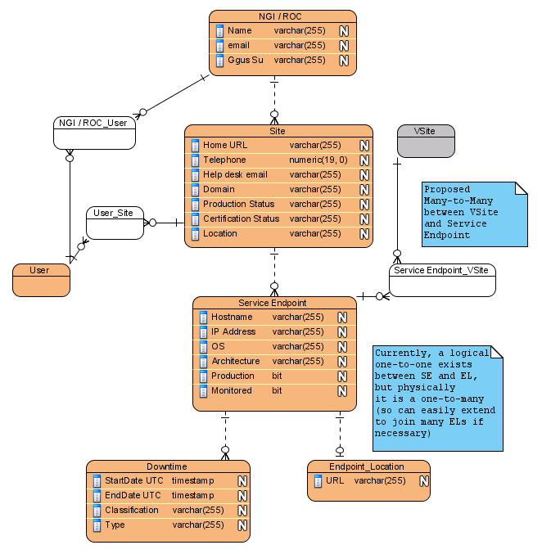
Logical GOCDB Object Model (simplified)
The relationships shown here are logical – they are not actually defined in a DDL schema with PK/FK constraints.
In a PROM database, relationships are enforced by the PROM API and the available link types recorded in the PROM admin tables (admin tables not shown, see the GOCDB physical entity model).

Slide 23
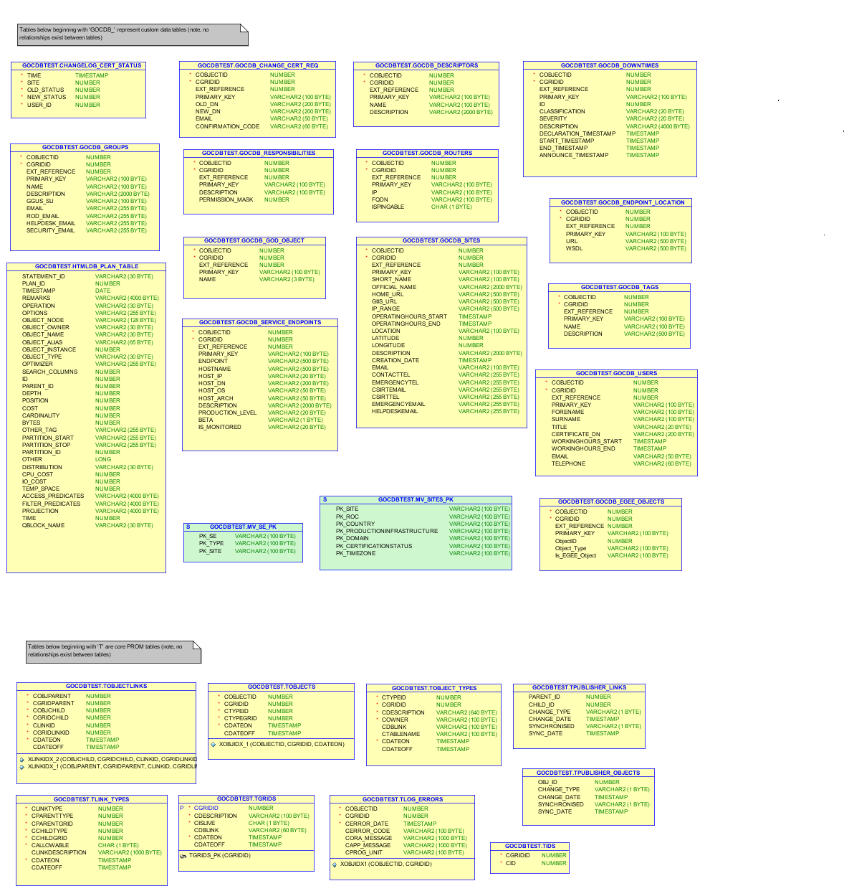
Physical GOCDB Entity Model (1/2)
Note, PK/FK relationships do not exist between tables in a PROM database. Instead, they are enforced by the application using the PROM API.
The tables in the upper half of the diagram are the GOCDB specific data tables, while the tables in the lower half are the PROM admin tables.

Slide 24
Physical GOCDB Entity Model (2/2)

Slide 25
GOCDB PI
The PI is a set of RESTful GET request methods for querying GOCDB data formatted in XML over HTTPS
Each method can be parameterized in order to narrow the search results, e.g.:
  select all SEs belonging to Site X
  show all sites belonging to NGI X
Some popular methods can be scoped, i.e.
  https://goc.egi.eu/gocdbpi/private/?method=get_site&scope=Local (returns all Local scoped sites)
https://wiki.egi.eu/wiki/GOCDB/PI/Technical_Documentation

Slide 26
GOCDB PI Methods
get_site | Returns site information including contacts, grouped by site
get_site_list | Returns a list of sites with minimal associated information
get_site_contacts | Returns a list of persons (and associated info) having a role at site level, grouped per site
get_site_security_info | Returns security contact information for sites
get_roc_list | Returns a list of NGIs with minimal associated information
get_subgrid_list | Returns a list of Subgrids (i.e. registered sub-parts of an NGI) with minimal associated information
get_roc_contacts | Returns NGI contact details, including NGI contact mail address and list of NGI staff
get_egee_contacts | Returns a list of contacts for staff that have a role a EGI level
get_downtime | Returns a list of EGI downtimes for sites and nodes
get_service_endpoint | Returns a list of service endpoints (single node x single service) and associated information
get_service_types | Returns a list of valid service types and associated description
get_user | Returns a user or a list of users with associated details and roles
get_downtime_to_broadcast | Returns the list of downtimes recently declared with notification settings for CIC portal downtime notification service
get_cert_status_changes | Returns a list of changes to certification statuses
get_cert_status_date | Returns a list of current certification statuses for Production sites and the date they entered that status

Slide 27
Status of Regionalisation Developments
GOCDB developments in 2011 have focused on
  a significant amount of re-development/refactoring
  addressing new requirements for the central instance that have emerged throughout the year.
  (more info on https://wiki.egi.eu/wiki/GOCDB/Release4/Development)
Fixing the Atomic PROM API and addition of data-scoping/tagging are essential for the regional-publishing model described at: https://wiki.egi.eu/wiki/GOCDB/Release4/Regionalisation
There are still three outstanding developments to be tackled before we can really start in earnest on regionalization:
  Virtual Sites
  a finer grained permission/authorization model
  replacing the current XML output module as it cannot create nested XML collections (is necessary)
  These are detailed at: https://wiki.egi.eu/wiki/GOCDB/Release4/Development#Development_Roadmap

Slide 28
Operations Portal

Slide 29
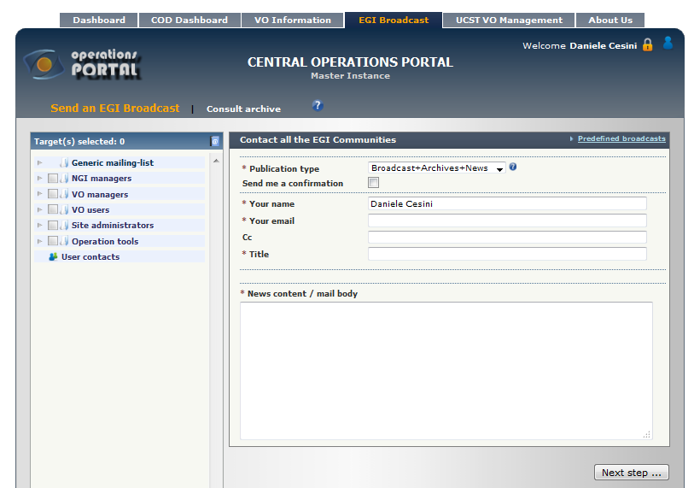
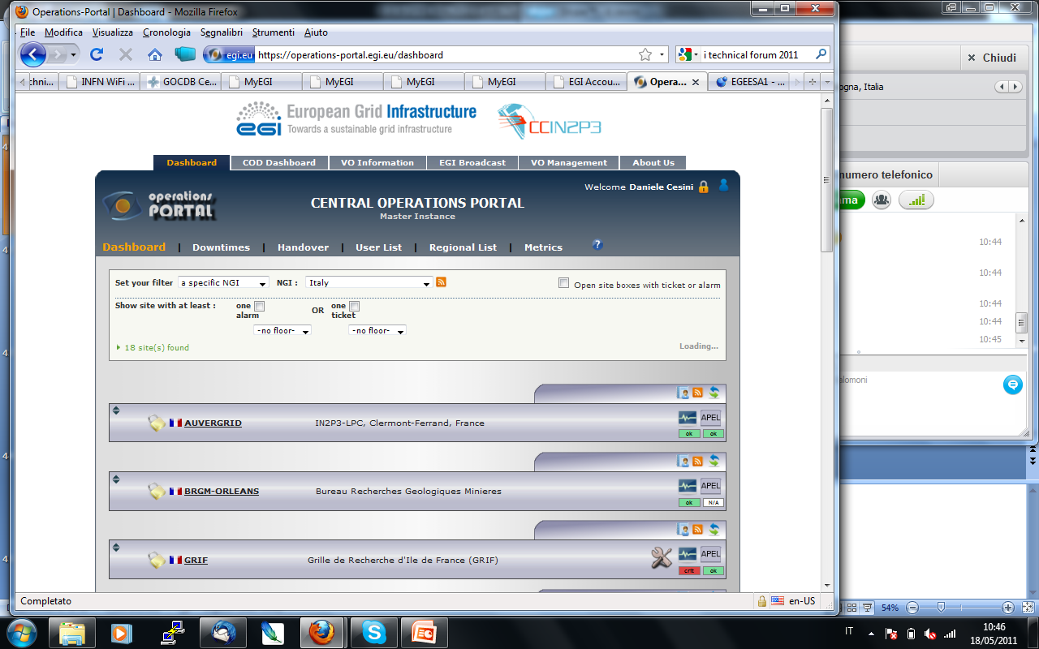
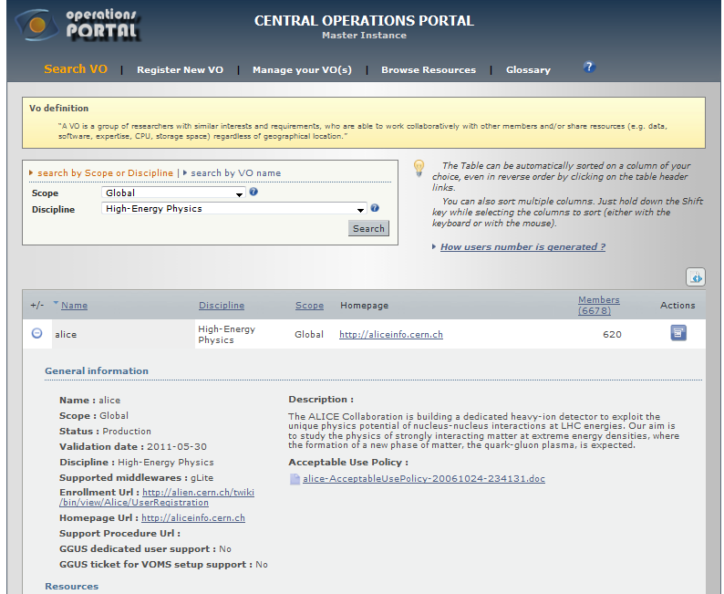
Operations Portal
Single access point to almost all operational information. Widely used in the day-by-day run of the GRID.
Broadcast tool
Operational Dashboard
VO Information
  IDCard
  User Traking
  Resources
USCT Management Dashboard
Security Dashboard
COD Dashboard
VO Oriented Dashboard (in progress...)

Slide 30
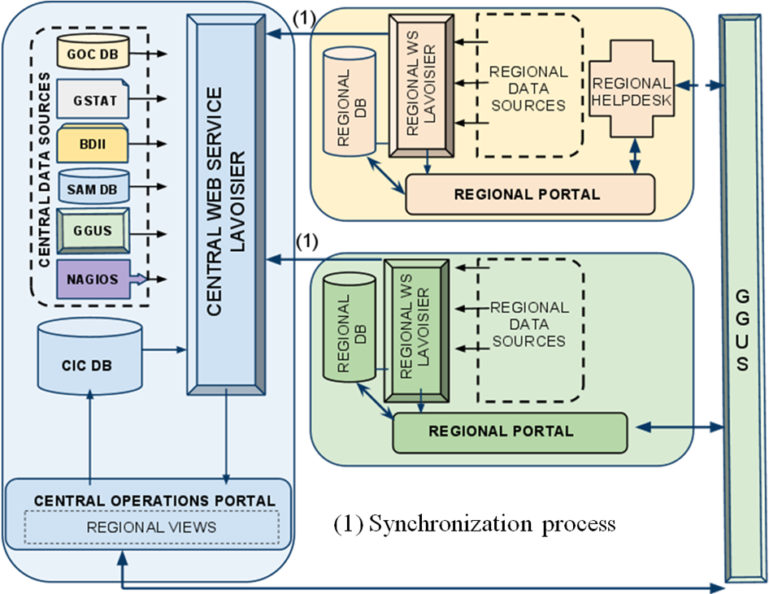
Operations Portal Architecture
Regional and Central Instances synchronized though Lavoisier
More info:
MS701 : https://documents.egi.eu/document/39
MS705:
https://documents.egi.eu/document/27

Slide 31
Ops Portal and Infosys
Direct ldap queries to one Top-BDII
  Service topology: where ? What ? And which VO ?
  Every 2 hours
  Cache mechanism: not replaced in case of failure
  GOC DB information insufficient (VO Information)
Query to GSTAT (per site and per VO)
  status of the sBDII - CPU (site, vo) - Jobs (site, vo) - Storage (site, vo)
  Every 6 min
  Cache mechanism: not replaced in case of failure

Slide 32
Ops Portal and Infosys
Information coming from BDII is used
  By Downtime Notification System
  Into the Resource Distribution browser
    site and VO view
Information coming from GSTAT is used
  By the VO Module
  By the Dashboard

Slide 33
Ops Portal and GOCDB
GOCDB as official source of the following information:
  services/sites/ngi topology
  contact info
  production status
This information is enhanced by GSTAT or BDII queries

Slide 34
Ops Portal Requirement to InfoSys
Continue to offer the same level of information available today by the three tools
Enhance this information if possible
  more information at the service level
    storage distribution on specific SE
More APIs
  To query the BDII ldap commands are not enough flexible and easy usable
  in GSTAT not possible to have a global view (egi_ngi , egee_roc, wlcg_tier )

Slide 35
SAM Framework

Slide 36
Service Availability Monitoring (SAM)
SAM monitoring framework for RCs and services
one of the main data sources for the Operations Portal
data source to create Availability/Reliability statistics
components:
  test submission framework: based on the NAGIOS system set up and customized by the NAGIOS Configurator (NCG)
  databases for storage of information about topology, metrics and results
  visualization tool GUI: MyEGI

Slide 37
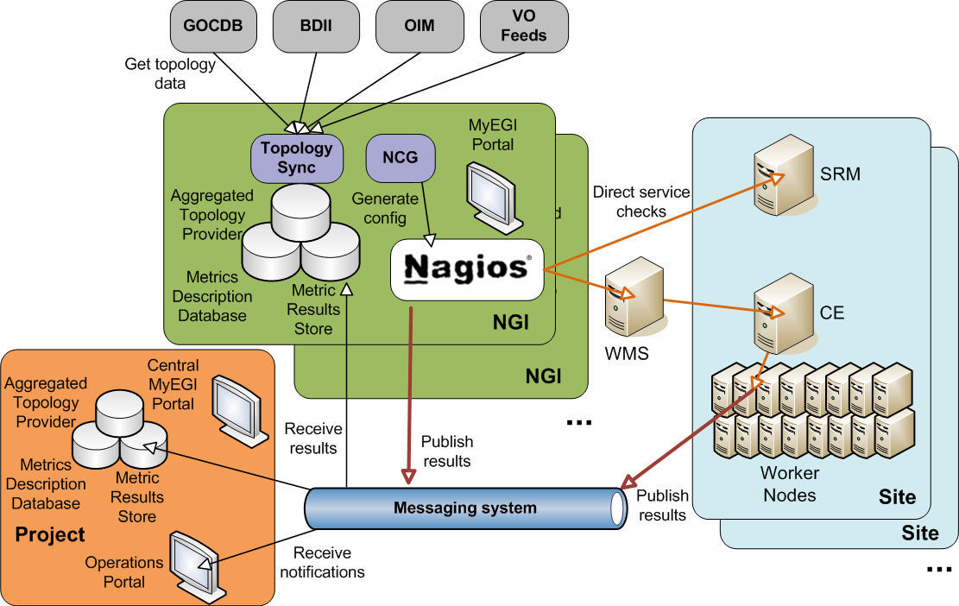
SAM architecture

Slide 38
SAM and The Information System
BDII, GSTAT and REBUS are used by SAM
From BDII (direct ldap queries):
  service URIs
  supported VOs for each service
  services supporting different MPI implementations;
From GSTAT:
  CPU information (PhyCPU, LogCPU, ksi2k, HEPSPEC06);
From REBUS:
  Tier and federations (Tier, Federation, FederationAccountingName, Site, Infrastructure, Country).

Slide 39
SAM and GOCDB
SAM uses the GOCDB by querying the following feeds:
  https://goc.egi.eu/gocdbpi/private/?method=get_site
  https://goc.egi.eu/gocdbpi/private/?method=get_service_endpoint
  https://goc.egi.eu/gocdbpi/private/?method=get_downtime
  https://goc.egi.eu/gocdbpi/private/?method=get_service_types
The Information System is needed to get extra information not provided by GOCDB
  which VOs support each service and services supporting MPI implementations

Slide 40
SAM and Configuration
Frequency of information retrieval = 30mins (configurable)
A caching mechanism is used internally
  Information is stored and updated every time it is modified.
Infosys endpoints are in the configuration files (there is no discovery)

Slide 41
SAM Requirements to the InfoSys
Current InfoSys provides sufficient information and we have no new requirements
All the information provided is needed by SAM
  Replacing one of the InfoSys would require getting the respective information from elsewhere
It would be convenient to have a single place for all the information
Also we would benefit if each InfoSys tool has a well defined scope (avoiding overlaps)

Slide 42
EGI Helpdesk (GGUS)
EGI Helpdesk
  distributed helpdesk with
  central coordination: Global Grid
  User Support (GGUS)

Slide 43
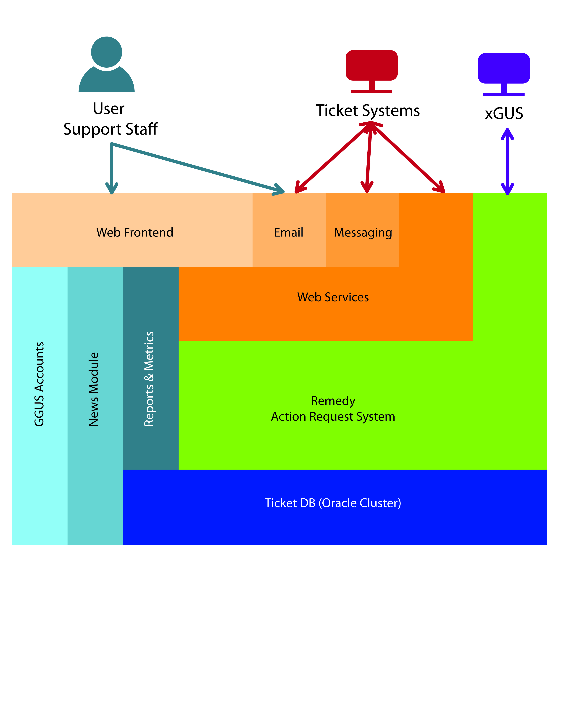
GGUS Architecture

Slide 44
GGUS and GOCDB
GGUS has NO dependencies on the Information System
Has dependencies on GOCDB
  Information retrieved every night through a Cronjob:
    site data
    contact mail address
    site names

Slide 45
Accounting in EGI-JRA1

Slide 46
Accounting

Slide 47
Accounting Repository and Portal
Accounting Repository (STFC)
usage of compute resources within the production infrastructure
based on gLite-APEL
Accounting Portal (FCTSG)
- GUI for access to data from the Accounting Repository

Slide 48
Accounting Repository and Infosys
APEL retrieves batch scaling or benchmark values for a cluster from the BDII
Uses them to normalize CPU accounting data
Two ldap queries:
  First search is the highest priority search.
  If both searches return a SpecInt value for a cluster, the value from the first search is used; the second is disgarded.

Slide 49
Accounting Repository and Infosys
First search
Second search
Find a GIIS entry where “objectclass=GlueCE” (GlueCEUniqueID=lcgce06.gridpp.rl.ac.uk:2119/jobmanager-lcgpbs-grid1000M)
Get the “GlueForeignKey” attribute (GlueClusterUniqueID=sl5-1000.gridpp.rl.ac.uk)
Remove “GlueClusterUniqueID=“ from the start
(sl5-1000.gridpp.rl.ac.uk)
Extract “SpecInt” from “GlueCECapability” (CPUScalingReferenceSI00=1000)
Find a GIIS entry where objectclass=GlueSubCluster (GlueSubClusterUniqueID=lcgce06.gridpp.rl.ac.uk)
Get the GlueChunkKey (GlueClusterUniqueID=lcgce06.gridpp.rl.ac.uk)
Get the GlueSubClusterUniqueID (lcgce06.gridpp.rl.ac.uk) Get SpecInt from
GlueHostBenchmarkSI00
(1000)

Slide 50
Accounting Repository and Infosys
At most sites the accounting records are built locally
  Normalization information could probably be stored elsewhere by APEL configuration
At a few sites (eg France) accounting is published by one site for many
  In this case the normalization values are retrieved remotely using the BDII.
  Any alternative to this would either have to gather normalization data during the parsing phase on the CE, or establish some other remote publishing technique.

Slide 51
APEL and GOCDB
APEL’s uses GOCDB to retrieve information necessary to build
  the EGI topology information for summaries
  the ACLs for the APEL AMQ broker.

Slide 52
Accounting Portal and Infosys/GOCDB
BDII is not used by the Accounting Portal
GOCDB is used to retrieve topological information:
  site information
  tier status
  country/ngi mappings, etc..
  This information is gathered every 3 hours.

Slide 53
Metrics Portal

Slide 54
Metrics Portal
Collects a set of metrics from different resources to help in measuring project performance
Keeps track of the project evolution by displaying historical values of the metrics in a single place.
It also provides web interfaces to inject the metrics into the database

Slide 55
Metrics Portal and Infosys
The metrics portal was supposed to get information from GSTAT, but resulted to be not flexible
  the first problem was separating EGI+EGEE nodes
  there are metrics not covered by GSTAT
  unnecessarily strict with the publication
  and many sites disappear
Now use BDII directly
Information is collected for all EGI sites and then aggregated by NGI based on GOCDB
  some NGIs are further partitioned into countries

Slide 56
Metrics Portal and Infosys
For each site it gets weekly:
  Sites using MPI
  Disk and Tape Storage
  Logical CPUs
  HEPSPEC06 capacity
    get SI2K, since HEPSPEC06 is reported with issues and inconsistencies
No caching is used
  If the infosys is not reached, the script sends an email to the maintainer
  The update can be then done manually later

Slide 57
Metrics Portal and GOCDB
Many of the above metrics are not usually covered by GOCDB, but if GOCDB carried all the needed information sufficiently updated the Metrics Portal would probably use it instead of BDII
From GOCDB retrieves data for mapping sites to NGIs
  for some NGIs the mapping is refined to countries
    e.g. Ibergrid -> Spain+Portugal
    NGI_NGDF -> Finland, Denmark, Sweden and Norway

Slide 58
Metrics Portal future Usage of the InfoSys and Requirements
The future uses depend on the metrics evolution
If NGI wide BDIIs are available it would be possible to use them
Requirements:
    Better coverage for HEPSPEC06 information
    Info on Cloud resources should be made as seamless as possible to have a unified view of the total composition the infrastructure (Grid+Cloud)

Slide 59
Summary Table
 | BDII | GSTAT | GOCDB | BDII query Frequency | Cached | IS Clients
SAM | Yes | Yes | Yes | 30 mins | Yes | BDII: ldapsearch (will use ARC Lib and Unicore CLI) GOCDB PI
Ops Portal | Yes | Yes | Yes | BDII: 2hrs GSTAT: 6mins | Yes | BDII: ldapsearch GOCDB PI
Acc Repo | No | No | Yes | - | - | GOCDB PI
Acc Portal | No | No | Yes | GOCDB: 3hrs | - | GOCDB PI
Metrics Portal | Yes | Yes | Yes | weekly | - | BDII: ldapsearch GOCDB PI
GGUS | No | No | Yes | Every night | - | GOCDB PI
GOCDB | No dependecies

Slide 60
Conclusion
From an EGI-JRA1 perspective BDII, GSTAT and GOCDB are all needed as source of information
  BDII and GSTAT are mainly used to complement GOCDB info for VO mapping
No big requirements on the Information System
  Improvement of some features, i.e.:
    better coverage for HEPSPEC06 information
    More information at service level (SE)
  APIs to query the BDII would be great
  Stability of information could be improved but is obtained with internal caching mechanisms
  Accounting data punctual normalization can provide new requirements depending on how it is implemented
It would be convenient to have a single place for all the information

