Slide 1
A flexible zone model for data privacy and confidentiality in medical research
Wolfgang Kuchinke¹,Christian Ohmann,¹ Evert-Ben van Veen², Robert Verheij³, Adel Taweel⁴, Brendan Delaney⁴
¹University of Duesseldorf and ECRIN, ²MedLawConsult DenHaag, The Netherlands, ³NIVEL, The Netherlands, ⁴King’s College London, UK
Workshops on e-Science Workflows
09 Feb. 2012 - 10 Feb. 2012, Budapest

Slide 2
ECRIN
European Clinical Research Infrastructures Network
Is based on the connection of coordinating centres for national networks of clinical research centres and clinical trials units
Pan-European, distributed infrastructure providing integrated services to multi-national clinical research in the EU
Clinical trials services are coordinated by the ECRIN European correspondents and provided by national ECRIN partners

Slide 3
Objectives of ECRIN
Integration of EU clinical research capacity
  support to investigators
  support to sponsors in multinational studies
  unlocking latent potential: scientific, patients , …
Harmonisation of tools, training and practice
  improved quality, credibility, transparency
  ECRIN Data Centre Certification Program
  requirements of GCP-compliant data management in multinational clinical trials
Harmonisation of legislative systems (new EU Directive)

Slide 4
NNC
CRC
NNC
NNC
CRC
EC
EC
EC
CRC
CRC
NNC
NNC
ECRIN Management
Office
EC
EC
Coordination
DM
NNC
EC
EC
NNC
CRC
EC
NNC
CRC
Data management infrastructure implementation
GMP
CRC
CRC
CRC
CRC = Clinical research centre
DM = Data centre EC = European Correspondent
GMP = GMP facility for biotherapy NNC = National Network Coordination

Slide 5
Projects with ECRIN participation
EU FP7 Project | Type of data | Use cases | collaboration
TRANFoRm | GP care data / EHR, patient data registries, death registries, cancer registries | genotype-phenotype relationships for the prediction of risk of complications in type II diabetes mellitus quality of care and evidence for treatment of gastroesophageal reflux disease (GORD) | GPRD, NIVEL, ePCRN, …
EHR4CR | HIS data / EHR | Feasibility, patient recruitment, study conduct, safety | CDISC, i2b2, …
p-medicine | Imaging, biobank data, VPH modelling data (oncosimulator) | ALL, breast cancer, Wilms tumour | VPH SHARE, …

Slide 6
TRANSFoRm project
Translational Medicine and Patient Safety in Europe
Development of a ‘rapid learning health-care system’ driven by advanced computational infrastructure that can improve both patient safety and clinical research in Europe
Providing interoperability between different clinical systems, across national boundaries, and systems
Translational Medicine and Patient Safety in Europe

Slide 7
Health information
Access and sharing of large amounts of heterogeneous distributed data
Inclusion of sensitive private data
Privacy violation is irreversible and a social problem (trust problem)
Increasing role of patient empowerment (suitable form of consent)
Privacy Enhancing Technologies (PET) exist, necessity for integration in workflow
Translational Medicine and Patient Safety in Europe

Slide 8
Example for care data registry
Translational Medicine and Patient Safety in Europe

Slide 9
Example for care data registry
Translational Medicine and Patient Safety in Europe

Slide 10
Data flow example
Use case „Extract data“ with database search by GP and researcher

Slide 11
Requirements for a privacy framework
Applicable across medical care and clinical research
Consideration of:
  different data sources (primary, secondary)
  different fields (phenotype, genotype data)
  different diseases (diabetes, gastro-oesophageal reflux disease, cancer)
  variations between countries and regions in Europe (legal, ethical, practice related)
Translational Medicine and Patient Safety in Europe

Slide 12
Requirements for a privacy framework
Should satisfy the different privacy needs for research access:
  Primary Care databases (e.g. GPRD, LINH)
  EHRs, Family Practice EHR, Hospital EHR
  clinical research databases (e.g. clinical trials, cohort studies)
  registries (e.g. cancer) and repositories
  genetic databases
Translational Medicine and Patient Safety in Europe

Slide 13
Background
Privacy frameworks for cancer research or biobanking already exist (e.g. ACGT, GenoMatch, caBIG)
  mostly privacy frameworks apply the most stringent approach to their data flow and interpret “anonymisation” in a restrictive way
A more flexible approach is needed
  to guarantee privacy of patient data
  to enable unhindered research
  to align the framework to data flow requirements (data chain) and research workflow
Translational Medicine and Patient Safety in Europe

Slide 14
Methods
Exploration of national and European legal requirements, and access policies
Creation of data privacy profiles
Definition of zones, filters and linkers
Analysis of privacy requirements associated with the data flow and workflow for research access and linking of different data sources:
  primary care data repositories
  electronic health records (EHR)
  clinical research database, genetic and cancer registries
Translational Medicine and Patient Safety in Europe

Slide 15
Building blocks
Zone
Areas of low, middle and high risk of identification of patients
Areas of similarity in regard to purpose, policies and regulations
Sub-Zone
Comparable areas; data can be used for same or similar purposes
Data privacy filter
Tools for anonymisation, pseudo-nymisation, coding and data aggregation
PET
Data linker
Enables connections within or between zones and sub-zones
One-way coding or two-way coding
Translational Medicine and Patient Safety in Europe

Slide 16
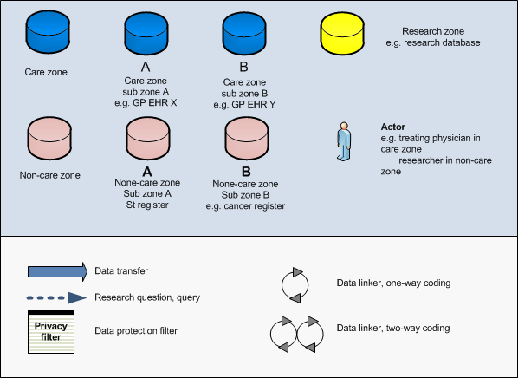
Notation
Translational Medicine and Patient Safety in Europe

Slide 17
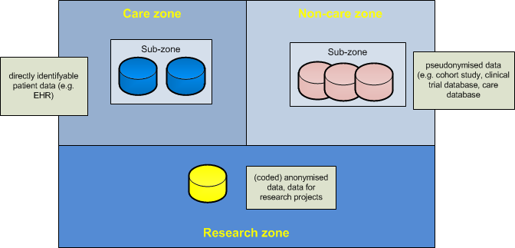
Risk gradient
high risk
identification
low risk
Translational Medicine and Patient Safety in Europe

Slide 18
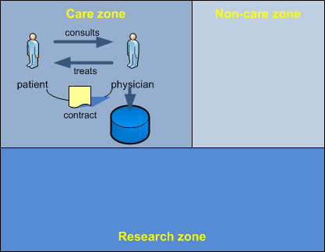
Care scenario
Care example :
Special trust relationship between patient and physician
Patient data is collected in physician’s EHR database
Translational Medicine and Patient Safety in Europe

Slide 19
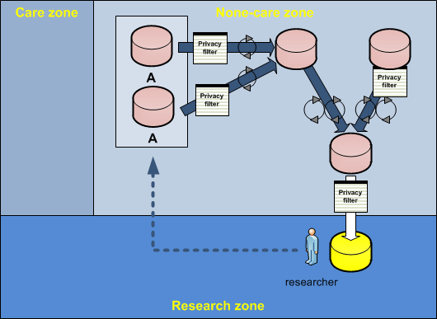
Research scenario
Research Example 1:
Two databases located in the same sub-zone of the non-care zone (e.g. cancer registries, administrative registers)
Connected through data privacy filters with other databases
Translational Medicine and Patient Safety in Europe

Slide 20
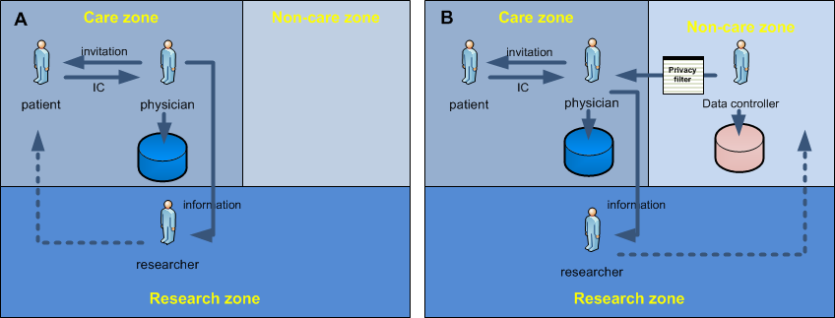
Patient recruitment
Use Case A: recruitment of patients by treating physician in the care zone
Use Case B: recruitment using a database in the non-care zone
Translational Medicine and Patient Safety in Europe

Slide 21
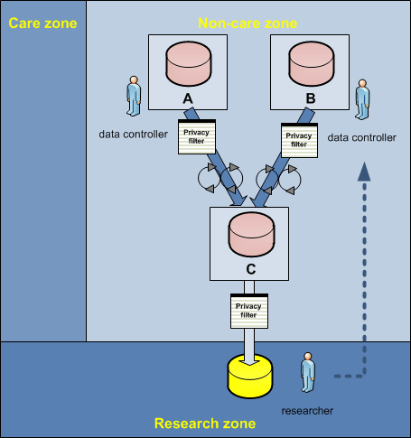
Linking of databases
Linking scenario 1:
Linking of data-bases in the non-care zone
Researcher receives pseudo-nymised (or coded anonymised) data or completely anonymised data in response to his research question and authorisation
Translational Medicine and Patient Safety in Europe

Slide 22
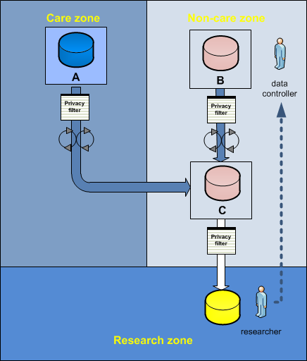
Linking of databases
Linking scenario 2:
Linking of a data-base in the care zone with a database in the non-care zone
Researcher receives pseudonymised (or coded anonymised) data or completely anonymised data in response to his research question and authorisation
Translational Medicine and Patient Safety in Europe

Slide 23
Results
A data privacy framework was developed that is based on two complementary components
  Principles that give guidance for the treatment of questions about data security and confidentiality
  Formal description that allows, with the help of a zone model, a risk gradient and data flow structures, the creation of a structural represen-tation of complex relations between data security and confidentiality that can be found in health research
Translational Medicine and Patient Safety in Europe

Slide 24















TRANSFoRm
members

Slide 25
Contact
Wolfgang Kuchinke
ECRIN
KKS Duesseldorf, Heinrich-Heine University Duesseldorf,
Medical Faculty, Moorenstr. 5, 40225 Duesseldorf, Germany
kuchinke@med.uni-duesseldorf.de
www.transformproject.eu
www.ecrin.org

