Slide 1
WP1: Policy, Impact and Sustainability
Manisha Lalloo
WP1 Leader, QMUL
www.e-sciencetalk.eu

Slide 2
WP1 Overview
3 Beneficiaries
46 PMs
1.4 FTEs
Participant no. | Name | Effort (PM)
2 | QMUL | 28
3 | APO | 5
5 | CERN | 13
Task 1.1 Production and distribution of grid policy articles and reports (QMUL and APO)
Task 1.2 Impact and sustainability of iSGTW and GridCafé (QMUL with CERN and APO)
Task 1.3 Events attendance and media impact event organisation (QMUL with CERN and APO)

Slide 3
WP1 Objectives
Provide reporting targeted at policy makers in government and businesses to illustrate the scientific results and impacts from grid computing, e-Infrastructures and other forms of distributed computing.
Expand the audience and distribution lists for these targeted reports to regions outside Europe eg the US, Asia, South America, Africa.
Assess the impact of long running products such as iSGTW and the GridCafé and explore options for the sustainability of all e-ScienceTalk’s products beyond the end of the project.
Identify and attend a series of events in order to influence policy makers and journalists and to distribute the e-ScienceBriefings.
Assume a key leading and coordinating role in the concertation activities and meetings related to the e-Infrastructure area, maximising media impact.

Slide 4
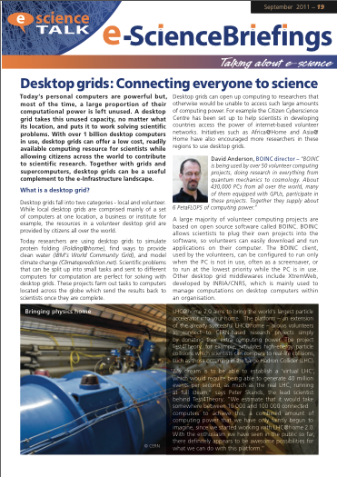
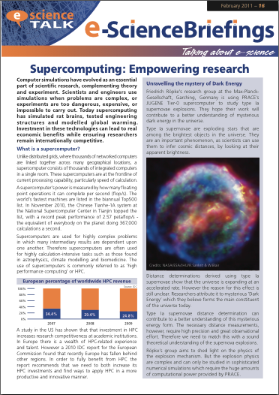
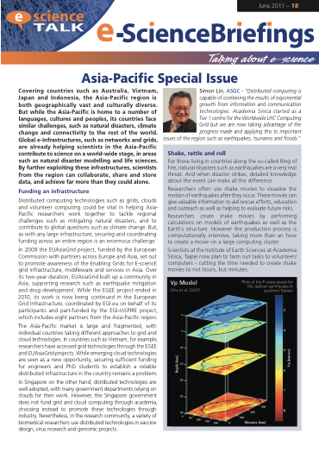
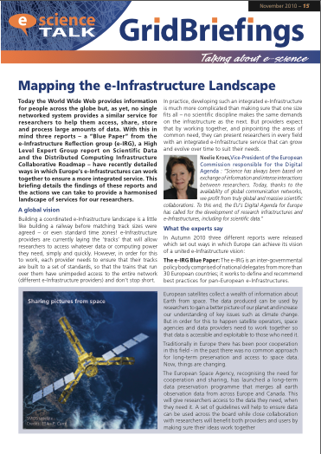
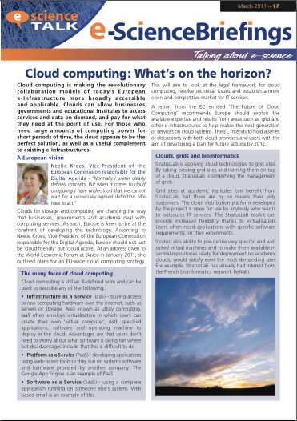
WP1 Major achievements
e-ScienceBriefings
Distribution
Events
eConcertation
Impact assessment

Slide 5
WP1 Major achievements
e-ScienceBriefings
Mapping the e-Infrastructure Landscape – Nov 2010
The World Wide Web provides information on a global scale but no single networked system provides a similar service for researchers. How Europe’s e-Infrastructures can work together to ensure an integrated service.
Supercomputing – Feb 2011
Supercomputing has simulated rat brains, tested engineering structures and modelled global warming. How investment in HPC technologies can ensure researchers remain internationally competitive.

Slide 6
WP1 Major achievements
e-ScienceBriefings
Cloud Computing – Mar 2011
Cloud computing is making today’s European e-Infrastructure more broadly accessible and applicable. How clouds can complement existing e-Infrastructures.
Asia-Pacific Special Issue – Jun 2011
Exploring how global e-Infrastructures, such as networks and grids, are helping scientists in the Asia-Pacific contribute to world-wide science, in areas such as natural disaster modelling and life sciences.

Slide 7
WP1 Major achievements
e-ScienceBriefings
Desktop grids – Sep 2011
With over 1 billion desktop computers in use, desktop grids can offer a low cost, readily available computing resource for scientists while allowing citizens across the world to contribute to scientific research. Together with grids and supercomputers, desktop grids can be a useful complement to the e-Infrastructure landscape.

Slide 8
WP1 Major achievements
Systems of review
Briefing topics are decided and agreed by the e-ScienceTalk PMB with suggestions from our Policy Advisory Board
Briefings are reviewed by:
Contributors
e-ScienceTalk PMB
e-IRG representatives
EC
Policy advisory board
Helps to ensure articles are reliable and balanced
Notes:
PAB is Matti, Deiter, Leif, Florida, Silvana, Paul.

Slide 9
WP1 Major achievements
Distribution
Renamed and rebranded
Available online and in print
Later versions available in html format, with added links and media
Disseminated through iSGTW, GridCast, Twitter, selected briefings in GridCafé and e-IRG newsletters.
Distributed to:
All contributing organisations
EGI mailing lists??
e-Science briefing mailing list set up in Sep 2011, currently has 97 names
Conferences (e.g. ICT2010, ISGC 2011, Cloudscape –III, Fet11, British Science Communication Conference, EGI User Forum 11, HealthGrid11, EGI Technical Forum 11, Frankfurt Book fair, e-IRG workshops)
Notes:
PAB is Matti, Deiter, Leif, Florida, Silvana, Paul.

Slide 10
WP1 Major achievements
Events
Euro-Africa e-Infrastructures Conference: e-ScienceTalk reported on the event on GridCast and iSGTW.
e-IRG workshops: in Brussels, Budapest, Poznan.
eChallenges: in Budapest (2010) and Florence (2011). Shared a stand with EGI.
ICT2010: exhibited on a stand with EGI and infrastructures on climate change.
Presentation of the Report of the High-Level Group on Scientific Data: reported on the event in iSGTW.
Notes:
Just pick the policy related ones
Euro-Africa e-Infrastructures Conference
(Citizen Cyberscience Centre Summit)
e-IRG workshops: in Brussels, Budapest, Poznan
eChallenges: in Budapest (2010) and Florence (2011)
EGI Technical Forum 2010 and 2011
ICT2010
Presentation of the Report of the High-Level Group on Scientific Data
(British Science Communication Conference)
Cloudscape-III
EGI User Forum 2011
Fet11
HealthGrid 2011
Role of e-infrastructures for Climate Change Research
ISGC2011
London Cyberscience Workshop
(TNCPR)
TNC2011

Slide 11
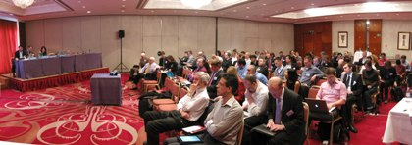
WP1 Major achievements
Events
Cloudscape-III: launched cloud computing briefing.
Fet11: exhibited at the conference and ran a GridCast from the event.
Role of e-infrastructures for Climate Change Research: Ran a GridCast from the event.
TNC2011: reported from the event on GridCast and the EGI blog.
Notes:
Just pick the policy related ones
Euro-Africa e-Infrastructures Conference
(Citizen Cyberscience Centre Summit)
e-IRG workshops: in Brussels, Budapest, Poznan
eChallenges: in Budapest (2010) and Florence (2011)
EGI Technical Forum 2010 and 2011
ICT2010
Presentation of the Report of the High-Level Group on Scientific Data
(British Science Communication Conference)
Cloudscape-III
EGI User Forum 2011
Fet11
HealthGrid 2011
Role of e-infrastructures for Climate Change Research
ISGC2011
London Cyberscience Workshop
(TNCPR)
TNC2011

Slide 12
WP1 Major achievements
e-Concertation meeting 2010
Took place at the Globe in CERN, Geneva on 4 and 5 November 2010 and attended by 110 delegates.
Discussions included:
socio-economic evaluation of e-Infrastructures.
e-Infrastructure for simulation software.
presentations from the new projects funded in Call 7.
training session on OpenAIRE.
Publicised on GridCast, iSGTW and a dedicated event website.
Reported from the meeting on GridCast and Twitter, using the hashtag #concertation
An area for online discussions was made available on the GridCafé forum
Live webcast attracted 80 viewers (day 1), 73 viewers (day 2).
Notes:
Along with the logistical organisation of these meetings e-ScienceTalk put together a communications strategy to highlight the projects and discussions coming out of the meeting. This included the following:
A website for the event was set up on the e-ScienceTalk site, http://www.e-sciencetalk.org/e-concertation/index.php The event was also publicised on the e-ScienceTalk homepage http://www.e-sciencetalk.org and in iSGTW http://www.isgtw.org/?pid=1002817
The event was webcast online for those who were not invited or could not attend in person, http://webcast.cern.ch/
Projects had the opportunity to disseminate paper publications on site as well as electronically through an online virtual goody bag, http://www.e-sciencetalk.org/e-concertation/e-concertation-goody-bag.php
The e-ScienceTalk team, plus colleagues covered the event on our blog, GridCast, through written posts and web videos, http://gridtalk-project.blogspot.com/search/label/8th%20e-concertation
An area for online discussions was made available on the GridCafé forum, http://www.gridcafe.org/SMF/index.php
The tag #concertation was chosen for use on Twitter, so delegates and followers could track news from the conference online.
From 3 to6 November there were 83 visits from 42 unique visitors to the e-ScienceTalk website, which contained information on the e-Infrastructure Concertation meeting. 30% of these visits were from new visitors to the site.
A total of 17 posts were uploaded to the GridCast blog over the two-day conference. These were contributed by four members of the e-ScienceTalk team as well as Owen Appleton from Emergence Tech Ltd and Sara Coelho from EGI. Posts gave brief summaries and opinions on the discussions from the conference as well as announcing the release of the latest e-ScienceTalk GridBriefing and a new competition from iSGTW. There were also photos of the conference posted to the blog as well as four video interviews with delegates at the conference.
From 3 to 6 November there were a total of 248 visits to the GridCast blog, from 165 unique visitors. On average visitors spent 3.5 minutes on the site when visiting. 57% of these visits were from new visitors.
From 3 to6 November there were 83 visits from 42 unique visitors to the e-ScienceTalk website, which contained information on the e-Infrastructure Concertation meeting. 30% of these visits were from new visitors to the site.
A total of 17 posts were uploaded to the GridCast blog over the two-day conference. These were contributed by four members of the e-ScienceTalk team as well as Owen Appleton from Emergence Tech Ltd and Sara Coelho from EGI. Posts gave brief summaries and opinions on the discussions from the conference as well as announcing the release of the latest e-ScienceTalk GridBriefing and a new competition from iSGTW. There were also photos of the conference posted to the blog as well as four video interviews with delegates at the conference.
From 3 to 6 November there were a total of 248 visits to the GridCast blog, from 165 unique visitors. On average visitors spent 3.5 minutes on the site when visiting. 57% of these visits were from new visitors.

Slide 13
WP1 Major achievements
e-Concertation meeting 2011
Took place during the EGI Technical Forum in Lyon on 22- 23 September 2011.
Discussions included:
-Scientific Data
-e-Science Environments
-eHPC State of Play
-Infrastructures Future prospects under Horizon 2020
Event was publicised on GridCast and iSGTW
The live webcast attracted:
Day 1 - 305 unique visits from 36 different countries
Day 2 - 149 unique visits from 21 different countries

Slide 14
WP1 Major achievements
Impact
Only one year in, the impact of each e-ScienceTalk product is encouraging and each product is reaching its intended audiences.
iSGTW has increased its sphere of influence (a 21% increase in subscribers) and scope. For Yr 2 measure the social media trends, reach and influence.
GridCast blog team is growing in popularity within the community. For Yr 2 examine level of engagement i.e. quality and quantity of commentary
e-ScienceBriefings have covered a third more projects than initially targeted and increased its reach to a wider international audience (i.e. 36 countries). In Yr 2, use a more qualitative approach to measure the influence on its intended audience.

Slide 15
WP1 Major achievements
Impact
GridCafé has widened its scope (clouds, supercomputers, e-science) and is reaching a wider audience (five languages). The site is very popular, raising the general public’s awareness and is referenced widely (134 projects). For Yr 2 measure the impact of the 3-D virtual world e-ScienceCity and CloudLounge.
GridGuide has the broadest intended audience (policy makers, general public and researchers). RTM successfully demonstrates what the grid does, and continues to be widely used as a visualisation tool by the community. For Yr 2 integrating the technical and personal aspects of RTM and GridGuide, and exploring their potential.
e-ScienceTalk will develop a sustainability plan for each
product at the end of Yr 2.

Slide 16
WP1 Issues
Ensuring editorial balance in e-ScienceBriefings
Included a total of 38 projects
Close relations with e-IRG
Reaching appropriate audiences
Online distribution increased from GridTalk
Tracing downloads
Determining impact factors
Implementing new methods in year 2

Slide 17
WP1 Summary
e-ScienceTalk has engaged policy makers in a number of ways.
Printed and online publications
Attending and organising events
Collaborations with other projects
Briefings have covered a total of 38 projects and been distributed to 36 different countries, including via a new mailing list.
Feedback is positive, stakeholders remark that the articles are useful and often print or link to briefings.
Impact of e-ScienceTalk products looks promising, and we are exploring new ways of tracking this in the second year.

