Slide 1
WP3: International Science Grid This Week
Jacqui Hayes
WP3 Leader, CERN
www.e-sciencetalk.eu

Slide 2
WP3 Overview
3 Beneficiaries
52 PMs
1.6 FTEs
Participant no. | Name | Effort (PM)
5 | CERN | 39
2 | QMUL | 8
3 | APO | 5
Task 3.1 Weekly publication (CERN with QMUL)
Task 3.2 New media outlets eg Twitter, Nature Networks (CERN with APO and QMUL)

Slide 3
WP3 Objectives
Produce a weekly electronic newsletter in partnership with the US editor to disseminate information about grid-related projects and other e-Infrastructure projects around the world, including EGI and its collaborating projects.
Expand the coverage of iSGTW to report from geographic regions outside Europe and the US, particularly Asia and Latin America.
Expand the coverage to other forms of distributed computing, such as clouds, volunteer grids and to supercomputing, networks and data.
Draw from the other e-ScienceTalk products and events for sources of stories and to maximise the impact of the work.

Slide 4
WP3: Partnership with US
Two editors: one at Fermilab in US, one at CERN
Previously, iSGTW advisory board had 8 members: 4 EU and 4 US members. Now, we’re moving towards a two-tiered advisory board. Top tier made up of members who cover costs:
2 positions in the US (Open Science Grid and Fermilab)
3 positions in the EU (CERN, EGI)
Second tier is editorial contributors
PRACE in EU
XSEDE in US
Formed a new collaborations with Academia Sinica Grid Computing Centre (ASGC) in Taiwan. ASGC are currently searching for a part-time editor to contribute to iSGTW.

Slide 5
A typical issue
5 weekly elements:
3 feature articles 500 - 2000 words
EU or US focus
Visual
Nice picture or an infographic
Shorter, 500 words
Worldwide
Spotlight
Fun topic or link to report
Shorter, 500 words
Worldwide
Notes:
This is what we see in the newsletter and on the homepage of the website.

Slide 6
Lists of the latest stories, most popular (user ratings), and editor’s pick
Job adverts
Twitter feed from iSGTW and others
Calendar with events from by organisations

Slide 7
WP3: A typical issue
In the news News from other publications
Blogs
Other blogs about science or computing
Announcements
Press releases from other organisations
which they can upload themselves
Notes:
In the news: such as HPC Wire, HPC in the cloud,
AUTO-POPULATE

Slide 8
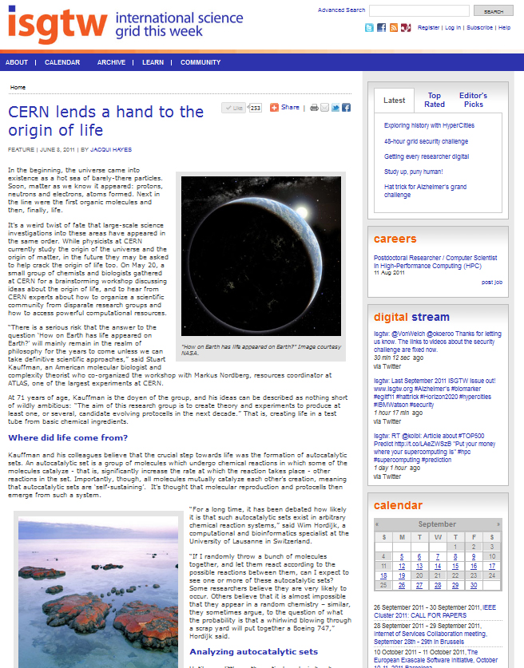
WP3: Top stories
Top story from the last year:
“CERN lends a hand to the origin
of life”
The Origin of Life group of researchers used the WLCG to perform basic calculations and had a conference at CERN
More than 10,000 people have read it and the average time they spend on the page is 4:54
Notes:
The OOL group is comprised of researchers from all over the world. Mentioned in this article was the University of Lausanne, Harvard University, the ATLAS experiment, CERN OpenLab,

Slide 9
WP3: Top stories
Another top story:
“The evolution of words”
Researchers from the University of Würzburg in Germany digitized texts (in German) from the last 500 years, using the TextGrid digital repository
About 3,000 people have read it and they spent 4:22 on page
Notes:
University of Würzburg in Germany; International Symposium on Grids and Clouds and the Open Grid Forum in Taipei, Taiwan; TextGrid digital repository

Slide 10
WP3: A new iSGTW
Relaunched the iSGTW website in January 2011

Slide 11
A new iSGTW
Cleaner design and new logo
New content management system, making it easier for staff
Users can upload announcements, jobs, and calendar items
Auto-populate with blogs, and our digital feeds
‘SHARE’ buttons for readers to share articles on social media
User interaction: commenting and rating articles out of five stars
Expanded coverage to include other forms of distributed computing

Slide 12
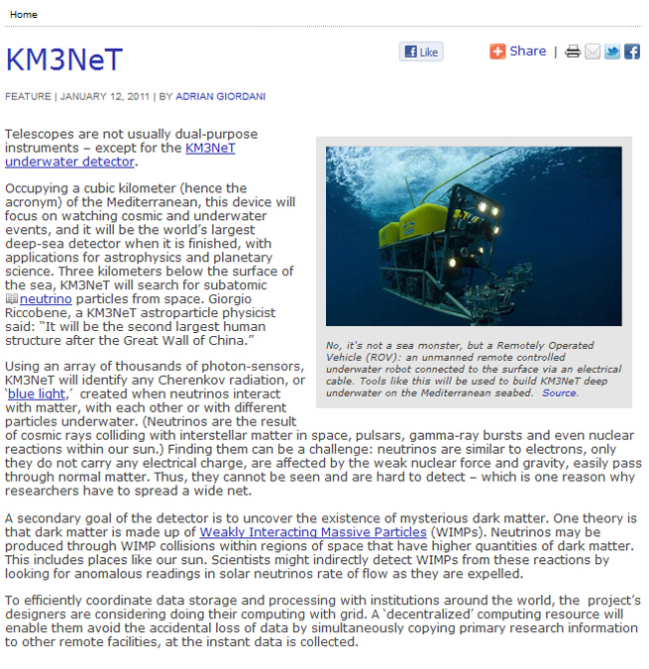
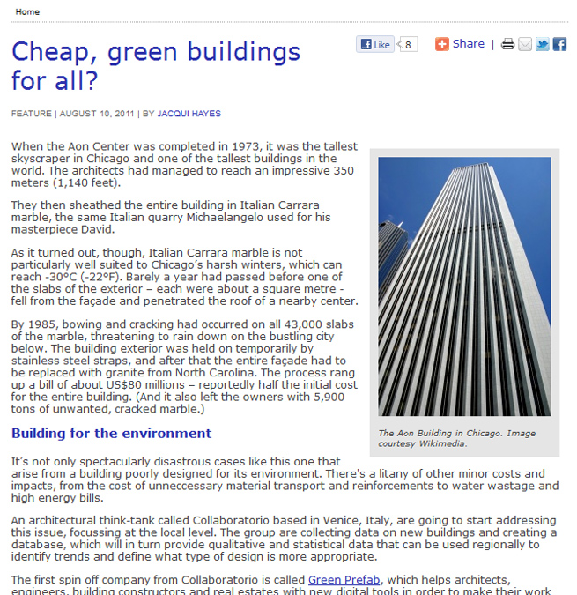
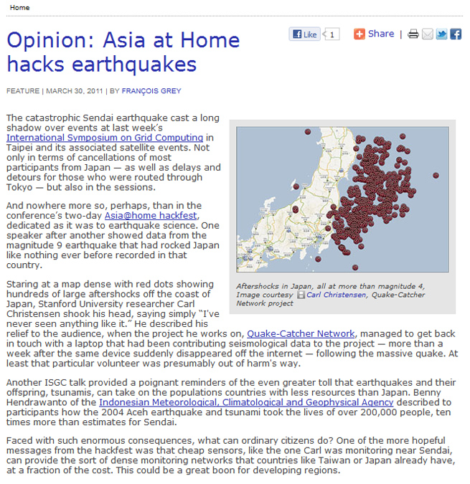
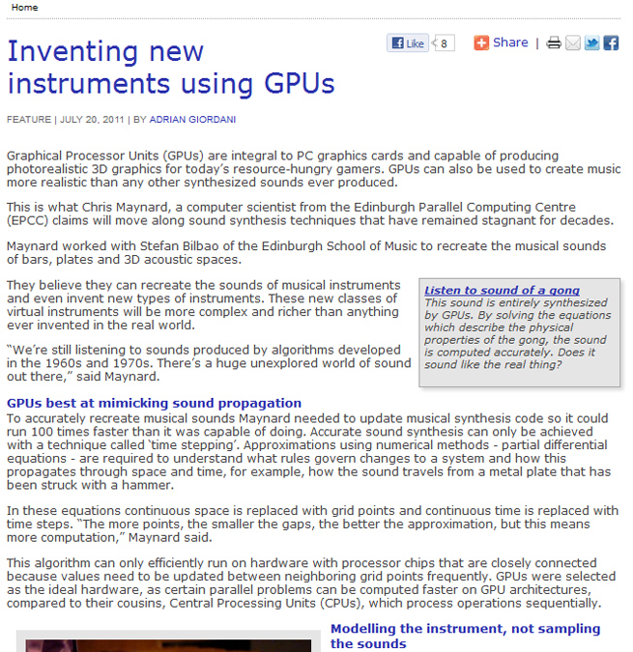
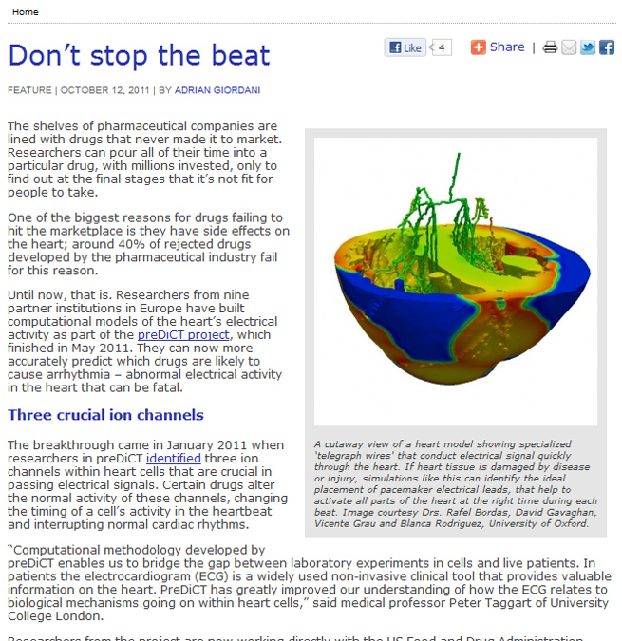
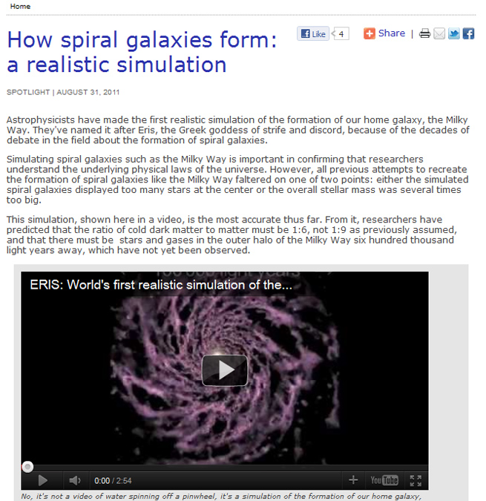
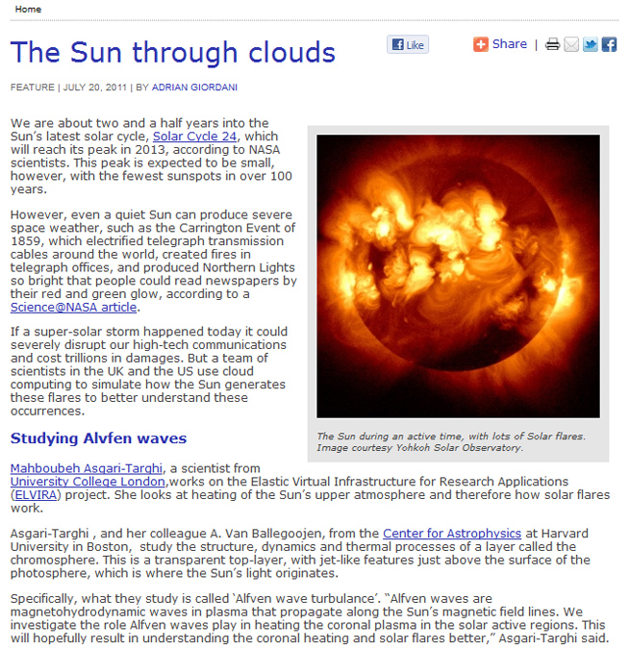
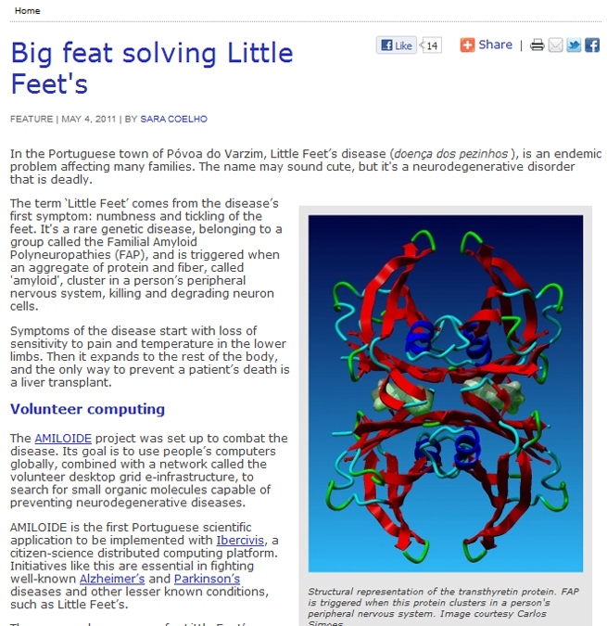
Expanded coverage
Cloud computing
Volunteer computing
HPC
Complex projects
Notes:
Expansion of scope of publication beyond grids means there is potentially a larger audience and list of contributing organisation/projects to the costs. These organisations/projects (PRACE, XSEDE, GEANT, volunteer grid projects, cloud projects etc.) submit stories since it means they can value isgtw as a dissemination channel but are not contributing to the costs of operation/editoral responsibilities
Also, increasingly, the large projects in Europe require many different types of e-infrastructure to perform different tracks for the wider project. iSGTW is covering this natural trend in e-Science by covering these large projects and their requirements.

Slide 13
Metrics & Analysis
Newsletter subscriptions
7,800 subscribers
Already exceeded MS8
(7,545 by Feb 2012)
Growth of subscriber numbers is slowing down
Notes:
ALREADY SUBSCRIBED: For example, registration for the EGI Technical Forum in Lyon had an opt-in option to receive iSGTW. However, of those people who opted in, several were already subscribed.
Growth of subscriber numbers is slowing down, this reflects the fact that many of our core audience is already subscribed and that people are now choosing to get their news through social media rather than subscribing to a newsletter.

Slide 14
Readers’ survey
In July 2011, iSGTW conducted a readers’ survey in which 137 readers, 1.7% of our readership, filled in a multiple choice survey and provided comments.
This number was much lower than usual, at least partly due to the timing of the survey during summer holidays in Europe and the US. However, the cross-section of our readership was similar to previous years.
The most common reader is male, is a scientist or IT professional, involved in an e-infrastructure project as a user or an administrator and is between the ages of 31 and 40.

Slide 15
Readers’ survey
There were two key point we wanted to ask our readers about this year: whether the expansion of our coverage corresponded to our audience, and whether our readers were happy with the new look of the website.
Expanded coverage: 54% of our readers said they were involved with grids, but our readers are also involved in all other distributed computing in large percentages, including clusters (47%), clouds (42%), HPC (44%) and volunteer computing (31%)
New website: 73% of respondents saying they liked the new look and 77% said they found it easy to navigate. However, only 41% of respondents agreed with the statement “I know that I can use iSGTW to post jobs, events and announcements” with 25% disagreeing and 28% unsure.

Slide 16
Social media
In May 2011, we started a more aggressive campaign to promote iSGTW through branded social media and news aggregators
Twitter: increase from 80 to 500 followers, including prominent organisations such as @CERN and @NatureNews
Facebook: increase from 130 to 500 followers
42,000 visitors arrived at iSGTW site traffic between May and October (source: Google analytics) from referral sites such as Stumbleupon, Twitter, Facebook, Reddit and Slashdot. Increased from 32,000 in 2010.
We continue to monitor the impact of these strategies in attracting our target audiences and promoting iSGTW. From year 2, we will record social media metrics in our reporting.

Slide 17
Conference posters

Slide 18
Conference posters

Slide 19
WP3 Issues
During the relaunch in January, iSGTW was renamed. However, due to a legal challenge, the team quickly reverted to iSGTW.
Took further steps to protect the publication: we are in the processes of transferring the hosting of the iSGTW site from Chicago to London; securing trademark and domain names for iSGTW.
The iSGTW editors and board members are still seeking an appropriate name, without legal restrictions
OSG/Fermilab contributions have decreased and are unlikely to be restored. European part of the team has taken over publishing duties, all online promotion, and produces more content.
Notes:
FROM BOB: An issue for WP3 is the budget restrictions we have at CERN due to the euro/chf exchange rate. This has meant CERN has had to make a far higher contribution to the costs of the project than originally foreseen.
The project and partners reacted rapidly to the “cease and desist” request from the US company (closing of site, reverted to old name, securing trademark and domain names for isgtw, etc.).
We have been operating under the name iSGTW for 5 years – but after the legal challenge we took further steps to protect the name. We secured the domain name again and we did a search throughout Europe and the US for other publications that might operate under a similar name and then trademarked the name in Switzerland.
Though US contributions have decreased, we are seeking out new contributors, such as Asian partners and also partners in high performance computing, to help cover costs and contribute editorially.

Slide 20
WP3 Summary
The redesign went well, and the team rebounded well from the issues that followed. Transition to the new editor went well.
Expanded the coverage of the publication to include other types of e-infrastructure.
US contributions are decreasing and the EU team has taken on more responsibility for the publication. Seeking new partners in Asia as well as in other areas of distributed computing, in line with out expanded coverage.
Metrics indicate the audience is growing. Brand presence online is increasing with the new emphasis on marketing and social media, and numbers of followers in social media continues to increase rapidly.
“iSGTW is great newsletter which links together the technology and science. Well done!”
“Keep up the good work.”
“Exciting in all respects”
“Best paper in the business, only one with a variety of science stories”

