Slide 1
WP2: GridCafé, GridCast and GridGuide
André-Pierre Olivier
WP2 Leader, APO
www.e-sciencetalk.eu

Slide 2
WP2 Overview
4 Beneficiaries
72 PMs
2.2 FTEs
Participant no. | Name | Effort (PM)
3 | APO | 23
2 | QMUL | 10
4 | Imperial | 25
5 | CERN | 14
Task 2.1 GridCafé (APO and CERN)
Task 2.2 Real Time Monitor and GridGuide (Imperial with APO, CERN and QMUL)
Task 2.3 GridCast (QMUL with APO and CERN)

Slide 3
WP2 Objectives
Keep the GridCafé at the cutting edge of grid and e-Science dissemination by refreshing the look and feel and keeping it constantly updated with new material, expanding the content to cover other forms of distributed and high performance computing.
Explore interactive environments and new web tools to ensure that GridCafé and GridCast have impact on their audiences and are easy to use.
Update the GridCast website and expand the marketing of the GridCast site to the grid and e-Infrastructure community and beyond.
Expand the GridGuide to cover more sites, improve its impact and develop further interactive functionality between the GridGuide and the Real Time Monitor.
Explore the continuation of the BELIEF Digital Library and support the e-concertation meetings.

Slide 4
Web statistics
e-sciencetalk.org | Gridcafe.org | Gridguide.org | Gridcast blog
2810 visits 1339 unique views 4850 pages viewed 00:01:30 time on page 72.03% bounce rate 47.65% new visits | Coming from CERN: 132,578 visits 2360 unique views 139,368 pages viewed 1.57% new visits Coming from generic domain: 18,010 visits 13,868 unique views 26,844 pages viewed 00:01:24 time on page 71.68% bounce rate 76.12% new visits | 2040 visits 1549 unique views 2685 pages viewed 00:00:57 time on page 79.31% bounce rate 74.80% new visits | 12,574 visits 8293 unique views 20,373 pages viewed 00:02:23 time on page 73.48% bounce rate 64.59% new visits

Slide 5
WP2 Major achievements
E-SCIENCETALK WEBSITE
Creation of the website (original design, html construction)
Creation of a simple administration in order to quickly update e-science briefings
Continuously updating content (events, e-science briefings, documents, etc…)
Created an event website for the 8th e-Infrastructure Concertation meeting

Slide 6
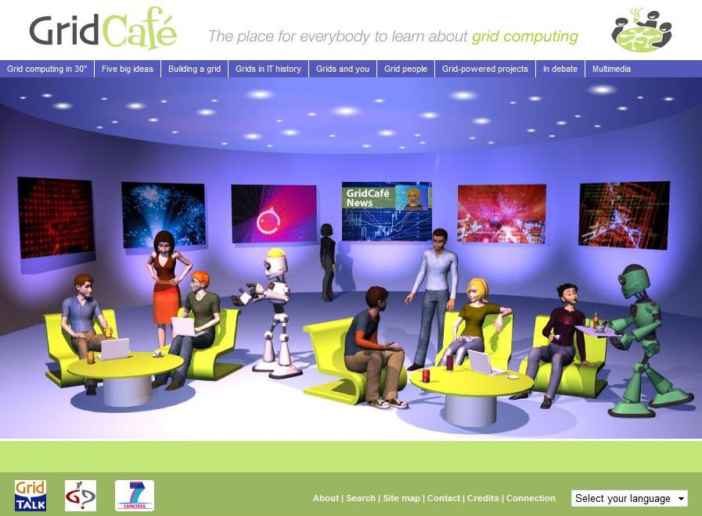
WP2 Major achievements
GRIDCAFE
The GridCafé content has been updated (grid projects list, minor changes)
The administration has been updated (bug corrections)
The CMS has been upgraded: Cyrillic alphabet is now supported
The Russian language has been added.

Slide 7
WP2 Major achievements
E-SCIENCECITY
Creation of a new concept of website: design and technology:
New ways to navigate through the website, which is a literally an e-science city, with several major sections,
Hybrid technology: unique dynamic menu, with static html content, in order to:
Simply update content with standard tools,
Avoid technologic problems like the use of Cyrillic alphabet,
Simple maintenance for the future
Addition of the Cloud Lounge website – launched in September (Y2) but the bulk of the work done in Y1.

Slide 8
WP2 Major achievements
GridCasts
Citizen Cyberscience Summit: London, 2-3 September 2010
EGI Technical Forum 2010: Amsterdam, 14-17 September 2010
ICT2010: Brussels, 27 – 29 September 2010
eChallenges 2010: Warsaw, 27-29 October 2010
8th e-infrastructure concertation meeting: Brussels, 4-5 November 2010
Cloudscape-III: Brussels, 15-16 March 2011
ISGC2011: Taipei, 19-25 March 2011
EGI User Forum 2011: Vilnius, 11-14 April 2011
FET11: Budapest, 4-6 May 2011
Role of eInfrastructures in Climate Change: Trieste, 16-20 May 2011
HealthGrid11: Bristol, 27-28 June 2011
Notes:
GridCasts

Slide 9
WP2 Major achievements
Mini GridCasts
DEISA-TeraGrid Summer School: 4-7 Oct 2010
Euro-Africa e-Infrastructures Conference: 9-10 Dec 2010
PRACE/LinkSCEEM Winter School: 24-27 January 2011
TeraGrid2011, Salt Lake City: 18-21 July 2011
In total this represents 192 posts and 66 webcasts.
A video filmed by WP2 about a humanoid robot at FET’11 has been viewed more than 50,000 times (http://www.youtube.com/watch?v=1dpB1yHxkuA)
Notes:
GridCasts

Slide 10
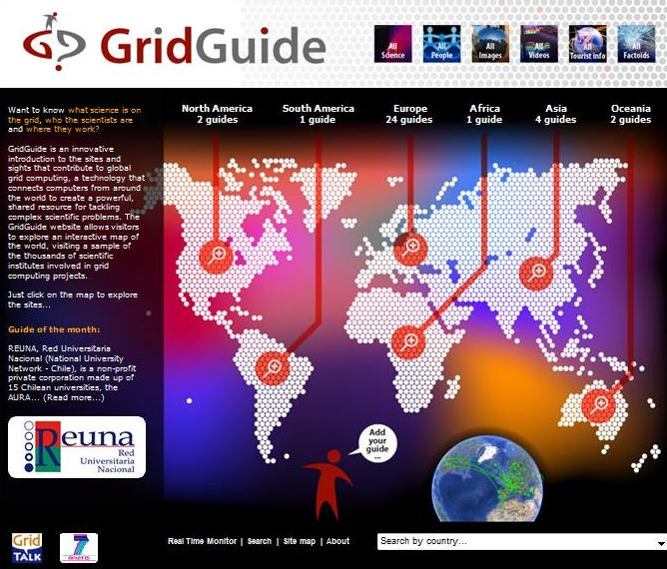
WP2 Major achievements
GRIDGUIDE
7 new guides (sites) have been added, with new content.
These 7 new guides are based on 4 different continents: Oceania, Asia, South America, Europe.
Users can listen to podcasts from grid sites worldwide, read about the ongoing work and watch interviews with researchers.
There are currently 38 sites on the GridGuide, including 28 EU sites and 11 non-EU in the US and the Asia-Pacific region. Of these, 34 are also currently included in the Real Time Monitor.

Slide 11
WP2 Major achievements
REAL TIME MONITOR
Visualisation of activity on the grid computing infrastructure, using the NASA World Wind virtual globe, which is based on OpenGL and Java.
The RTM overlays the movement of site activity and job transfers onto the 3D globe.
Development has focused on four areas; the website, maintenance, user support and extending the application’s functionality.
In PY1, 64 countries are included in the RTM and the team has visited 16 events where the RTM has been demonstrated.
Website: easier to navigate, improved design.
User support: Contact with users has been improved, and the RTM is now easier to use by non-experts.

Slide 12
WP2 Major achievements
REAL TIME MONITOR
Functionality: Application calls up the computer’s default browser and redirect the user to the GridGuide - over 30 sites have a GridGuide entry.
New users: Jobs from the LHC experiments, including ATLAS, represent more than 90% of the traffic on the grid.
ATLAS moved to PANDA from the WMS/L&B combinations service provided by gLite. The RTM team was unable to get access to the PANDA system to query it directly and so needed to go via the CERN dashboard, which monitors and publishes data from all the LHC experiments.
The RTM has been extended to give increased integration with the CERN dashboard. PANDA and “normal” jobs are displayed on separate animation layers of the RTM and can be turned on and off easily by the user.

Slide 13
WP2 Issues
Adding non-Cyrillic languages to the websites
Travel costs to events
Slow addition of GridGuide sites during the year
Digital Scientist branded materials not used

Slide 14
WP2 Summary
Project website launched and branding rolled out to templates eg posters, templates
GridCafé website updated
New e-ScienceCity site and Cloud Lounge sites launched
3D pilot of the e-ScienceCity available in NewWorldGrid
38 sites on the GridGuide, including 28 EU sites and 11 non-EU in the US and the Asia-Pacific region (34 in the RTM).
7 new sites added to the GridGuide in 4 continents
RTM upgraded to show PANDA jobs and webstart version available
GridCasts at 11 events, and 4 mini GridCasts
Total of 192 posts and 66 webcasts – one video viewed 50,000 times

