Slide 1
Innovation Management and Communication
Ilaria Fava (EGI Foundation)
Communication Manager
iMagine RP2 Project Review
Dissemination level: Public
November 21st 2024

Slide 2
Work Package 2
Introduction
T2.1
Innovation Management and Exploitation
Implements an operational innovation management process that ensures all project results and Key Exploitable Results (KERs) are systematically captured, assessed for exploitation readiness and validated.
Managing project’s innovation, communication, dissemination and event management activities along with liaising and integration into EOSC and AI4EU.
T2.2
Communication, Dissemination activities and Events
Coordinates communication, project outreach and service promotion activities. Organises webinars, annual workshops, online and face-to-face events
T2.3
EOSC and AI4EU liaison and integration support
Leads the technical and procedural integration and interfacing activities that iMagine activities and services require to make best use of EOSC and AI4EU initiatives
Notes:
Just a quick overview of what WP2 and its tasks. WP2 tasks covers innovation management, dissemination, exploitation, communication and integration activities. Integration activities mainly deal with EOSC and AI4EU initiatives but within this presentation we will also cover the collaboration of iMagine project with other initiatives.

Slide 3
Work Package 2
Work Done
T2.1
T2.2
T2.3
First version of Horizon Results platform template for the Key Exploitable Results; Updated Innovation Management and Exploitation deliverable.
Sustainability workshop for mature use cases; Sustainability plan as a deliverable
Value Proposition workshop for UC2
Documentation for the various forms IP related to the project.
Updated Communication, Dissemination and Engagement Plan.
Thematic Service Catalogue available.
Website updated and enriched.
Supported the Second Competence Centre Workshop execution.
Coordination of project participation in external events.
Collaboration with ENVRI
Monitored developments of the new EOSC EU node and Federated Nodes.
Explored collaboration opportunities with EOSC related projects.
Tracked AIoD platform updates to enable future integration and exploitation.
Supported the mapping of iMagine metadata assets to align with AIoD metadata standards.
Notes:
Here is quick summary of the main activities carried out under each task. T2.1 has focused on collecting information related to the results and IP along with collecting sustainability requirements. T2.2 focused on enriching the various dissemination materials along with ensuring good participation at relevant events. Finally T2.3 has been monitoring the developments within the EOSC and AI4EU ecosystems to explore the possible integration opportunities.

Slide 4
T2.1 & T2.2
Exploitation and Dissemination Effectiveness

Slide 5
Key Exploitable Results (KERs)
1
Marine litter assessment service
1
iMagine
5
Flowcam plankton identification service
Zooscan-EcoTaxa Pipeline service
2
6
Prototype Marine Imaging services
Marine ecosystem monitoring service
3
7
The iMagine-AI Platform
Oil spill detection service
4
8
Best Practices emerging from iMagine project
Notes:
The project has 8 Key Exploitable Results or KERs. The first five relate to the mature thematic services; the sixth relates to the prototype services including the external use cases; the seventh is about the iMagine AI platform, and the eight one covers the Best Practices emerging from various activities of the project.

Slide 6
Intellectual Property Assets
26*
Foreground IP Assets
Identified
52
4
Background IP Assets
Identified
Sideground IP Assets
Identified
Notes:
Related to the 8 KERs, we have already 26 assets documented as the Foreground Intellectual Property generated by the project. These are mainly datasets and software code, excluding the deliverables, which are also another form Foreground IP assets.
The project has also documented 4 pieces of Sideground IP coming from AI4EOSC related to the development of new features in the iMagine AI platform
Here and in the next slide, numbers marked with a star indicate that these will increase in the final period of the project.

Slide 7
Datasets Made Available
2*
300+*
1
Datasets Shared Publicly
Total number of dataset downloads
6
5,000*
Annotated images in data repositories
6
Million*
Images integrated and shared with iMagine framework
Notes:
Most importantly from all the IP assets, we would like to highlight the 12 datasets that the project has already made available via the project website and zenodo.
These datasets make available more than 65K annotated images and have already been accessed more than 300 times.
Furthermore, more than 6 million images have been integrated and shared with iMagine framework.

Slide 8
Communication, Dissemination & Events Overview
15 (+114%)
1,700+
Establishing the framework for future growth and impact
Presentations at events (including posters)
Attendees (+142%)
19
55
Deliverables in Zenodo
Average downloads each
3
>3,700
New use cases
Unique visitors on Website (+85%)
Notes:
4,502 unique views
2,172 unique downloads
Call for use cases: in discussion with two more initiatives (in the UK and PT)

Slide 9
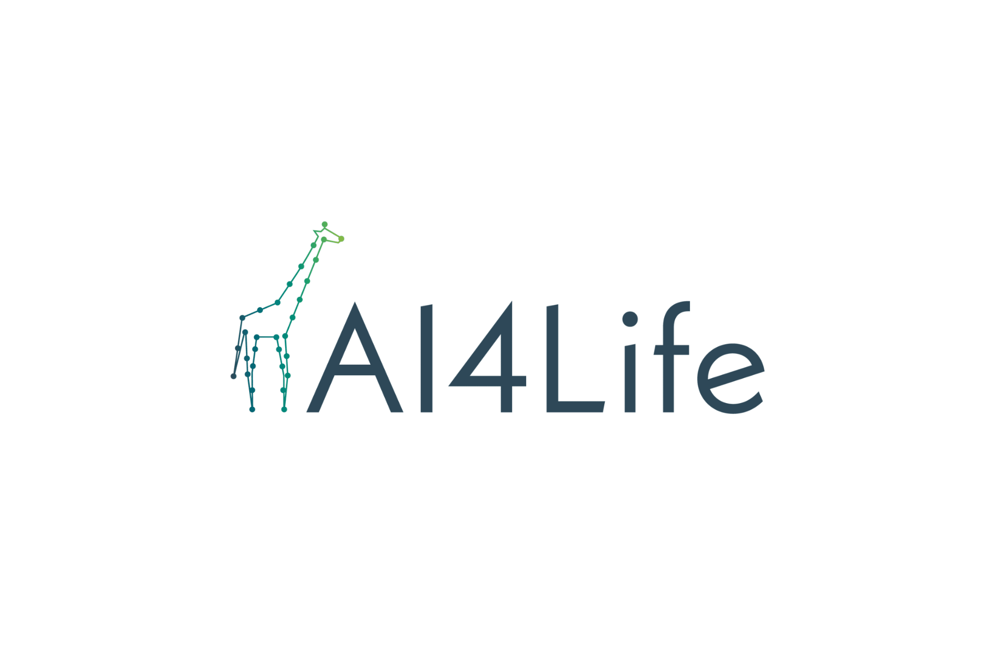



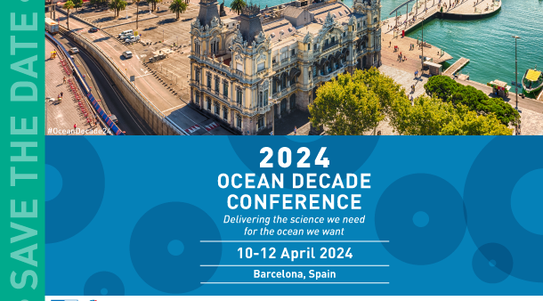








Events in Y2 (including September 2024)

Slide 10
WP2
Collaboration with Initiatives

Slide 11
Mapping iMagine Collaboration Activities
Technical
Exploitation
Dissemination
Sustainability
EOSC and related Projects
AIoD
AI4EOSC
AI4Life
ANERIS
Blue Cloud
Zenodo
OBPS
Notes:
This slide provides an overview of the nature of collaboration of the iMagine project with the various initiatives. As can be seen, most of these initiatives provide an avenue for dissemination of iMagine project and its results.
There have been some technical collaboration, for example with AI4EOSC, which has developed new features in the iMagine AI platform based on the feedback from the iMagine use cases.
The other technical collaborations revolve around exploring the integration of platform from AI4Life and BlueCloud projects with the iMagine platform.
AIoD and EOSC represent great channels for funneling new users for the thematic services towards the project, however the changes to the ecosystem in both these initiatives have made integration difficult. We will come to that in the next couple of slides.
Finally, the concept of creating an EOSC node along with the application by EGI and Blue Cloud to become one of the nodes represents a potential opportunity to sustain the services developed under iMagine.
Zenodo on the other hand provides a stable long term repository for sustaining other outputs of the project.

Slide 12
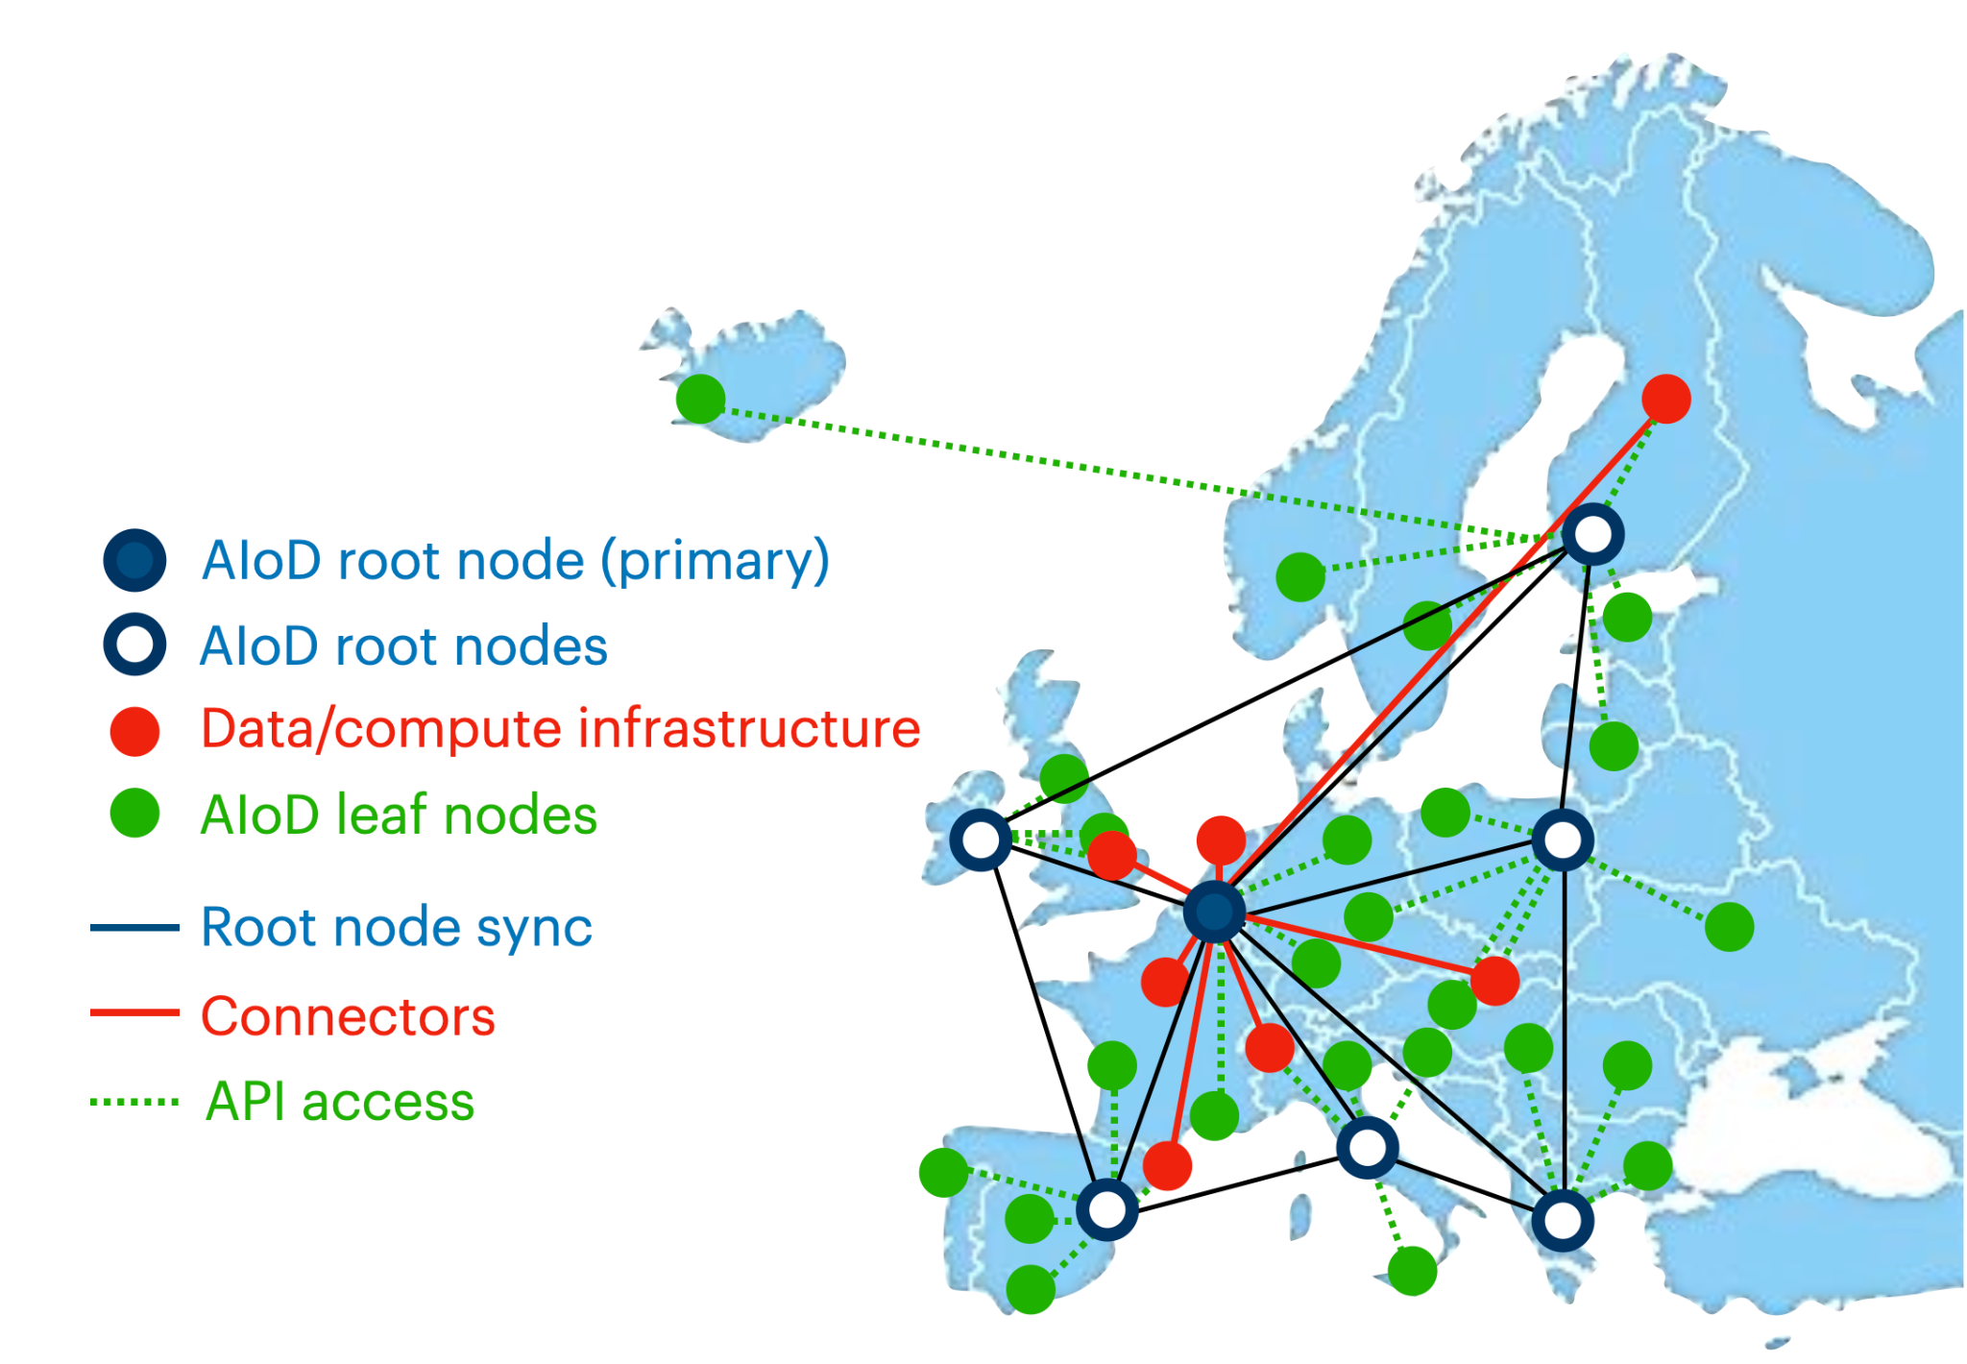
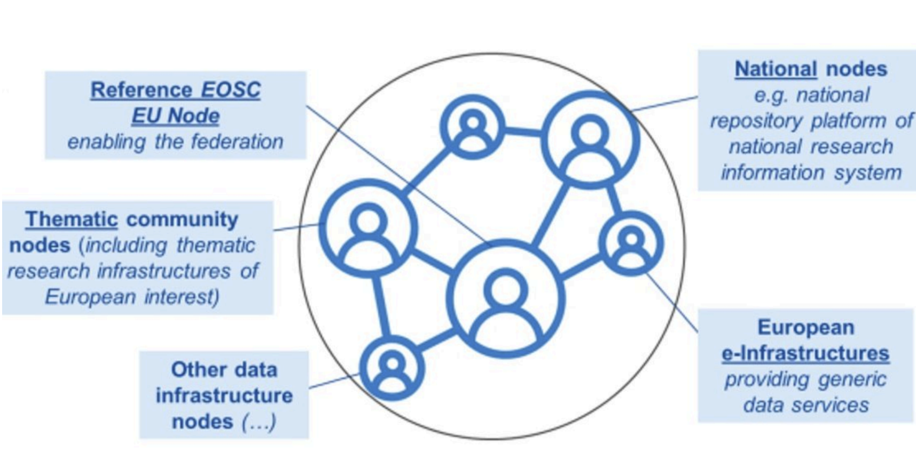
EOSC and AIoD Future Architecture
System of Systems
EOSC EU node has just launched and includes 6 services under User Access Policy
The Tools Hub enables publishing and running tools (TOSCA templates) compatible with the AI4OS software stack, empowering the deployments of AI4EOSC and iMagine
The Resource Hub provides access to the iMagine platform and other assets
Ongoing synergies between Blue-Cloud 2026, AI4EOSC, and iMagine are promising for expanding access to marine data, e-infrastructures and EOSC offerings
AIoD platform envisions a federated infrastructure, similar to EOSC
A comparable Tools Hub is planned to enable running tools (TOSCA templates)
The Metadata Catalogue allows publishing and accessing metadata for datasets, experiments, models, publications, services, projects, computational assets, news, events, educational resources, case studies, persons, teams, and more
Notes:
Both platforms are moving towards a system architecture of systems.
EOSC: Resource Hub continues to provide access to the iMagine project, platform and other assets published on Zenodo and harvested through OpenAIRE
AIoD: The platform is still under development and not yet fully mature, however, we are working on integrating iMagine asset into the AIoD metadata catalogue.

Slide 13
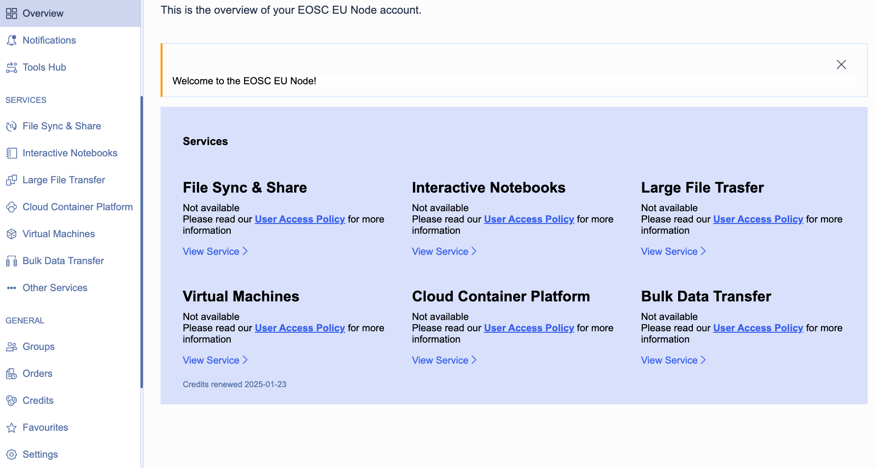
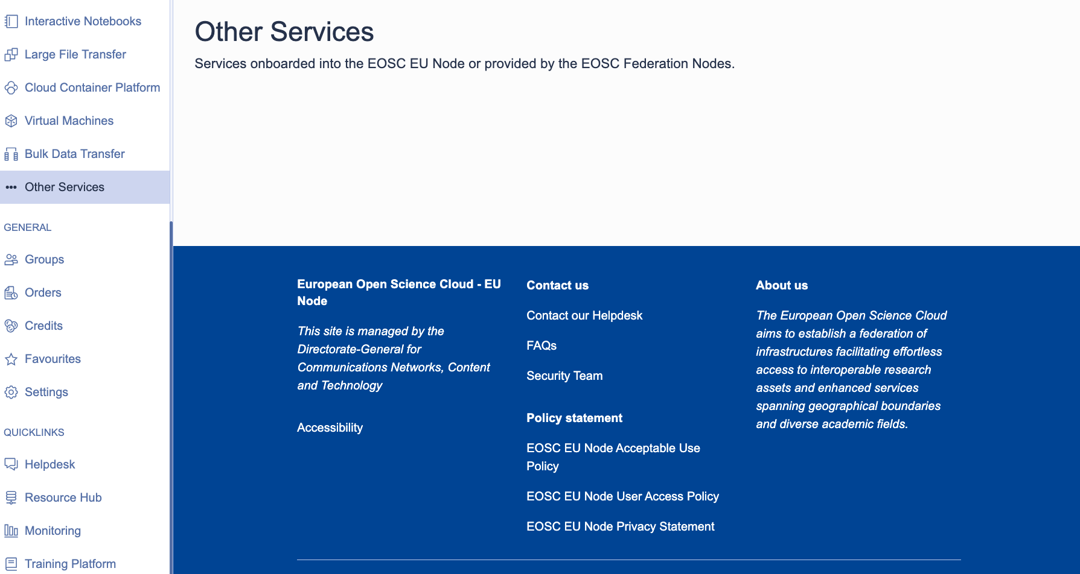
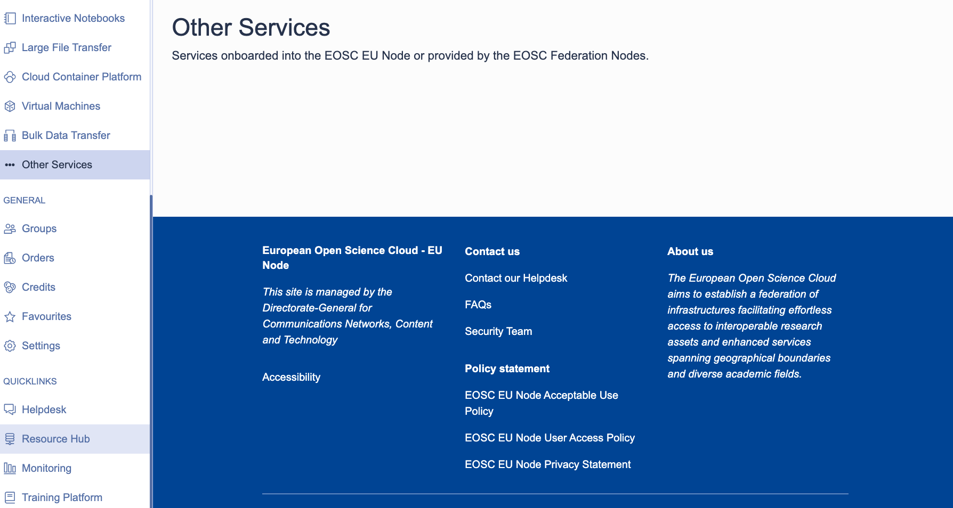
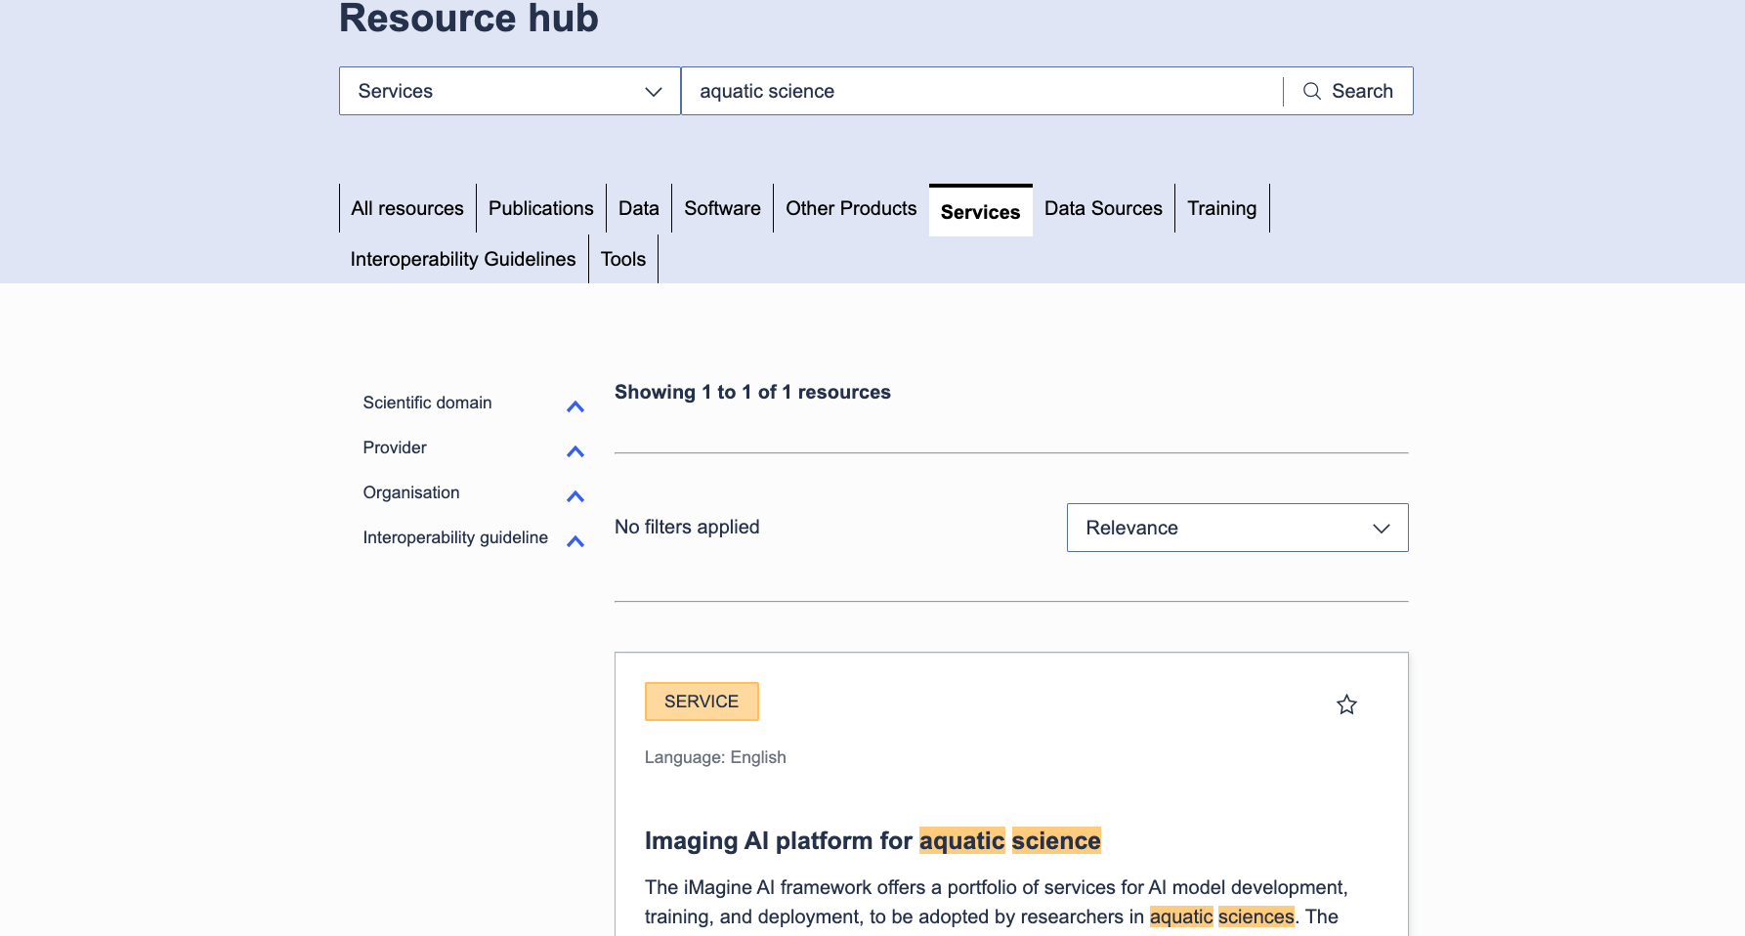
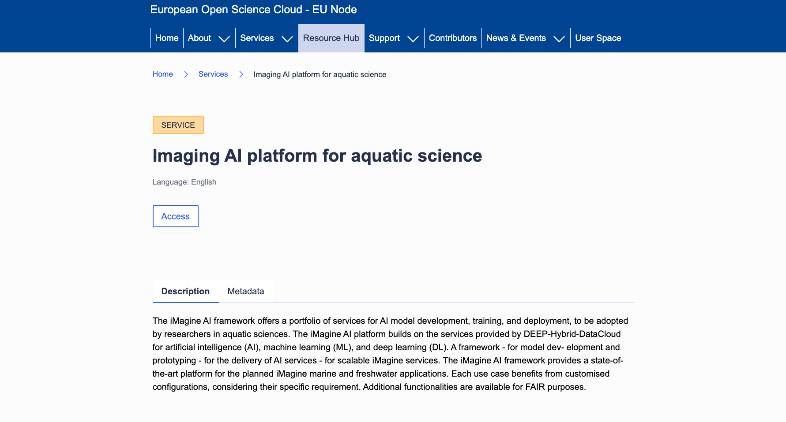
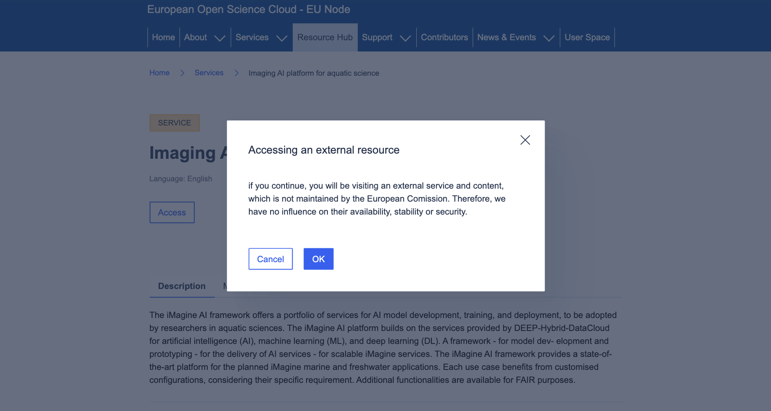
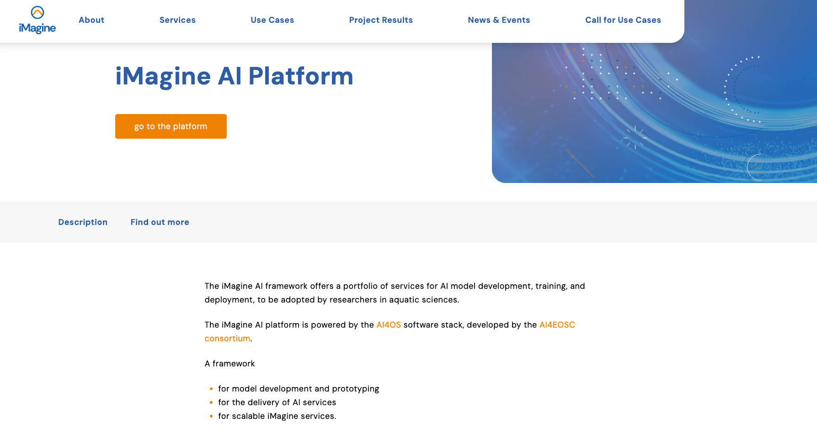
Updates from EOSC
Notes:
EOSC EU node has just launched and includes 6 services under User Access Policy
Unclear how additional services can be onboarded
Resource Hub continues to provide access to the iMagine project, platform and other assets published on Zenodo and harvested through OpenAIRE
In the upcoming period we’ll continue working towards the full integration of iMagine within EOSC

Slide 14
WP2
Looking Ahead

Slide 15




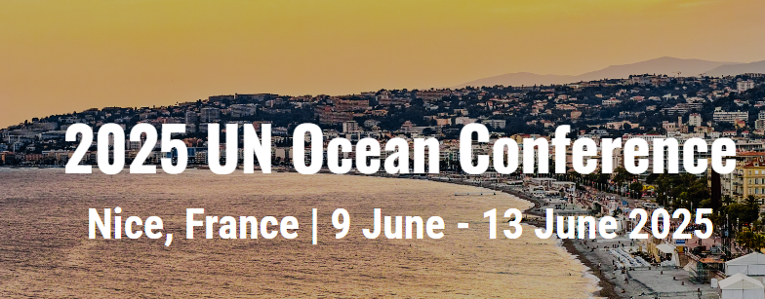

Project Promotion and Event Plan for Y3 (more to come)
More under identification
March 2025
March 2025
April 2025
May 2025
EGI2025
June 2025
June 2025
June 2025

Slide 16
Sustainability
Requirements
Best Case
Scenario
Bare Minimum Scenario
Local
Instance
Serving increasing amount of external and internal users
Delivery, Maintenance and Development of service
Serving limited external users and local users
Limited Delivery and Maintenance of service
Only serving local users
All UCs have indicated that they can run an instance just for themselves.
Notes:
Moving on to the key aspect of the third year of the project which is looking into ensuring that the services developed in the project can be sustained beyond the project. A workshop was carried out in mid September to understand what each of the mature use case needs to sustain themselves beyond the project and keep delivering service to user. Requirements were collected for two scenarios. First is the Best Case scenario which assumes delivery, maintenance and development while the Bare Minimum scenario only covers delivery to (limited) external users and maintenance. Finally it was also determined that all the use cases have indicated that at the very least they can run a local instance for themselves.

Slide 17
Sustainability
Requirements
 | Best Case Scenario |  | Bare Minimum Scenario
 | Human | Technological | Human | Technological
UC1 | 1 FTE for maintenance and to update and improve the software | 1 GPU 1 CPU | 0.25 FTE for maintenance and to update and improve the software | Local CPU
UC2 | 0.1 FTE for maintenance 0.25FTE to update and improve the software | 1 CPU (50% capacity) | 0.25FTE to update and improve the software | N/A
UC3a | 1 FTE for maintenance and to update and improve the software | 1 GPU 1 CPU Disk space | 0.25 FTE for maintenance | Local GPU and CPU
UC3o | 2 FTE for maintenance and to update and improve the software | 2 GPUs CPUs Disk Space | 0.5 FTE for maintenance | 1 GPU
UC3s | 2 FTE for maintenance and to update and improve the software | 2 GPUs CPUs Disk Space | 0.5 FTE for maintenance | 1 GPU
UC4 | 1 FTE for ensuring that data is being downloaded and used correctly. 1 FTE working on the solution to create a full AI oil spill forecast | 4 CPUs | 0.25 FTE for maintenance | 1 CPU
UC5 | 0.5 FTE for continuous data provision and maintenance code | 4 CPUs 5GB disk space | 0.25 FTE for data provision and code maintenance | 1 CPUs 10 GB disk space
Notes:
This slide shows the requirements as delineated by the use cases in the workshop along the two scenarios as showcased in the previous slide. Not going into too much detail, each use case outlined for both scenarios what they need in terms of manpower and technological resources. Based on the requirements, discussion with use cases and other inputs, a few mechanisms to sustain the services and other outputs beyond the project were identified. These are presented in the next slide.

Slide 18
Sustainability
(Possible) Mechanisms
Future Proposals and EOSC
Institutional Funding & Ongoing Projects
Secure funding for future development of services.
Research Infrastructure Calls - EOSC 01; EOSC 04
European Digital Twin Ocean Calls - New ones to be published soon
EOSC Thematic Node - BlueCloud
Ensure continuous delivery of services between the end of iMagine and start of new potential projects.
iMagine AI Platform: Institutional Funding
UC5: DTO-BioFlow
UC6: AXOLOTL
Industry Funding
Other Mechanisms
Attract funding from the Industry to continue development and delivery.
UC4: Explore pay for use scenarios with these users.
UC2: Possibility of receiving direct funding from the instrument manufacturer
Infrastructure Providers: To secure computing resources to continue delivering services to users.
Research Infrastructure: Explore securing potential sustainability pathways for the services.
Notes:
This slide presents the various possible mechanisms for sustainability and the outputs for whom they are applicable.
Infrastructure Providers in the project consortium and additional ones from the EGI Federation could fulfil certain amount of technological resources to continue deliver the services to users. EGI Foundation will facilitate this matchmaking taking into account both the requirements of the services and the national and institutional priorities of the providers. This potential collaboration will then be sealed with a Service Level Agreement.
The primary customers for most of the Thematic application services of iMagine are Research Infrastructures that work in the aquatic/marine sciences domain. The project is already liaising with these RIs (some are beneficiaries in the consortium), and this liaison work will intensify in the next year to secure potential sustainability pathways for the services based on the requirements collected from the service.
UC2 and UC4 have the potential to attract funding from the Industry. UC4 has had previous collaborations with oil spill risk management companies to run simulations and will explore pay for use scenarios with these users. UC2 will explore the possibility of receiving direct funding from the instrument manufacturer as the service developed by them adds enormous value to the usage of the instrument.
The use cases of the project rely on a common software service platform consisting of AI4OS and OSCAR. Both of these technologies are currently supported by a stream of EC-funded projects. Some of these projects are running longer than iMagine, so the technologies are to be sustained at least for approx. one year after iMagine.
Longer-term sustainability will require new funding, which is expected in the form of future projects. The competence centre, the advisory and support group for the use cases will deserve sustainability. The most reasonable sustainability path for this is also through future R&D projects, where the competence centre can be closely linked to use cases/communities/applications that need their support. The draft for the next set of calls in 2025 is yet to be published, however, T2.1 and the ASB will keep a close eye on the developments in this space and flag potentially valuable calls to the consortium.
Finally, EOSC may provide an avenue for sustaining various results. Both EGI and Blue Cloud have applied to become a potential node in the EOSC Federation of Nodes. Though the outcome of this application is currently unknown, these nodes and future funding that may be available to the nodes may provide some resources for sustaining various results. Furthermore, the delivery of computing resources through the EOSC EU Node which was unveiled in October may also reduce infrastructure demands at least over the short term.

Slide 19
Activity Plan for Y3
T2.1
T2.2
T2.3
Business Model Workshop for other mature use cases
Second Sustainability workshop
Sustainability analysis; Final report on Sustainability
Final Innovation Management and Exploitation Report
Impact analysis
Webinar Series with Use Cases
Impact Demonstration Campaign
Continuous Promotion and Publication
Event participation strategy
Continue collaboration with ENVRI
Final project event
Monitor the EOSC and AIoD ecosystems to identify collaboration opportunities for iMagine
Support the integration of iMagine assets into the EOSC and AIoD platforms
Notes:
Therefore, the main focus of WP2 will continue to ensure that the results are consistently communicated and disseminated in order to increase their exploitation. Looking into sustainability of these results will be key activity in the third year along with monitoring and integrating results with EOSC, AIoD and other such initiatives.

Slide 20
Thank you

Slide 21
Backup Slides

Slide 22
Sustainability
UCX: Use Case
PS: Prototype Services
IAP: iMagine AI Platform & OSCAR
CC: Competence Center
(Possible) Mechanisms
Infrastructure Providers
UC1
UC2
UC3
UC4
UC5
PS
IAP
CC
Research Infrastructures
UC1
UC2
UC3
UC4
UC5
PS
IAP
CC
Industry Funding
UC1
UC2
UC3
UC4
UC5
PS
IAP
CC
Ongoing Projects
UC1
UC2
UC3
UC4
UC5
PS
IAP
CC
Future Proposals
UC1
UC2
UC3
UC4
UC5
PS
IAP
CC
?
EOSC
Notes:
This slide presents the various possible mechanisms for sustainability and the outputs for whom they are applicable.
Infrastructure Providers in the project consortium and additional ones from the EGI Federation could fulfil certain amount of technological resources to continue deliver the services to users. EGI Foundation will facilitate this matchmaking taking into account both the requirements of the services and the national and institutional priorities of the providers. This potential collaboration will then be sealed with a Service Level Agreement.
The primary customers for most of the Thematic application services of iMagine are Research Infrastructures that work in the aquatic/marine sciences domain. The project is already liaising with these RIs (some are beneficiaries in the consortium), and this liaison work will intensify in the next year to secure potential sustainability pathways for the services based on the requirements collected from the service.
UC2 and UC4 have the potential to attract funding from the Industry. UC4 has had previous collaborations with oil spill risk management companies to run simulations and will explore pay for use scenarios with these users. UC2 will explore the possibility of receiving direct funding from the instrument manufacturer as the service developed by them adds enormous value to the usage of the instrument.
The use cases of the project rely on a common software service platform consisting of AI4OS and OSCAR. Both of these technologies are currently supported by a stream of EC-funded projects. Some of these projects are running longer than iMagine, so the technologies are to be sustained at least for approx. one year after iMagine.
Longer-term sustainability will require new funding, which is expected in the form of future projects. The competence centre, the advisory and support group for the use cases will deserve sustainability. The most reasonable sustainability path for this is also through future R&D projects, where the competence centre can be closely linked to use cases/communities/applications that need their support. The draft for the next set of calls in 2025 is yet to be published, however, T2.1 and the ASB will keep a close eye on the developments in this space and flag potentially valuable calls to the consortium.
Finally, EOSC may provide an avenue for sustaining various results. Both EGI and Blue Cloud have applied to become a potential node in the EOSC Federation of Nodes. Though the outcome of this application is currently unknown, these nodes and future funding that may be available to the nodes may provide some resources for sustaining various results. Furthermore, the delivery of computing resources through the EOSC EU Node which was unveiled in October may also reduce infrastructure demands at least over the short term.

Slide 23
EOSC and AIoD Future Architecture
System of Systems
EOSC EU node has just launched and includes 6 services under User Access Policy
The Tools Hub enables publishing and running tools (TOSCA templates) compatible with the AI4OS software stack, empowering the deployments of AI4EOSC and iMagine
The Resource Hub provides access to the iMagine platform and other assets
AIoD platform envisions a federated infrastructure, similar to EOSC
A comparable Tools Hub is planned to enable running run tools (TOSCA templates)
The Metadata Catalogue allows publishing and accessing metadata for datasets, experiments, models, publications, services, projects, computational assets, news, events, educational resources, case studies, persons, teams, and more
Notes:
Both platforms are moving towards a system of systems architecture
EOSC: Resource Hub continues to provide access to the iMagine project, platform and other assets published on Zenodo and harvested through OpenAIRE
AIoD: The platform is still under development and not yet fully mature, however, we are working on integrating iMagine asset into the AIoD metadata catalogue.

Slide 24
Collaboration with EOSC-related Projects
Towards full Integration with EOSC
EOSC Federated Nodes: establishing connection with potential infrastructure node candidates
EOSC Beyond: exploring services and possible collaboration
EOSC upcoming calls: Identifying partnership opportunities

Slide 25
Updates from EOSC
Notes:
EOSC EU node just launched and includes a few services (6) under User Access Policy
No clear yet how other services can be onboarded
Resource Hub still provide access to the iMagine platform and other project assets published to Zenodo and harvested through OpenAire
In the upcoming period we will continue to work towards a full integration of iMage in EOSC

Slide 26
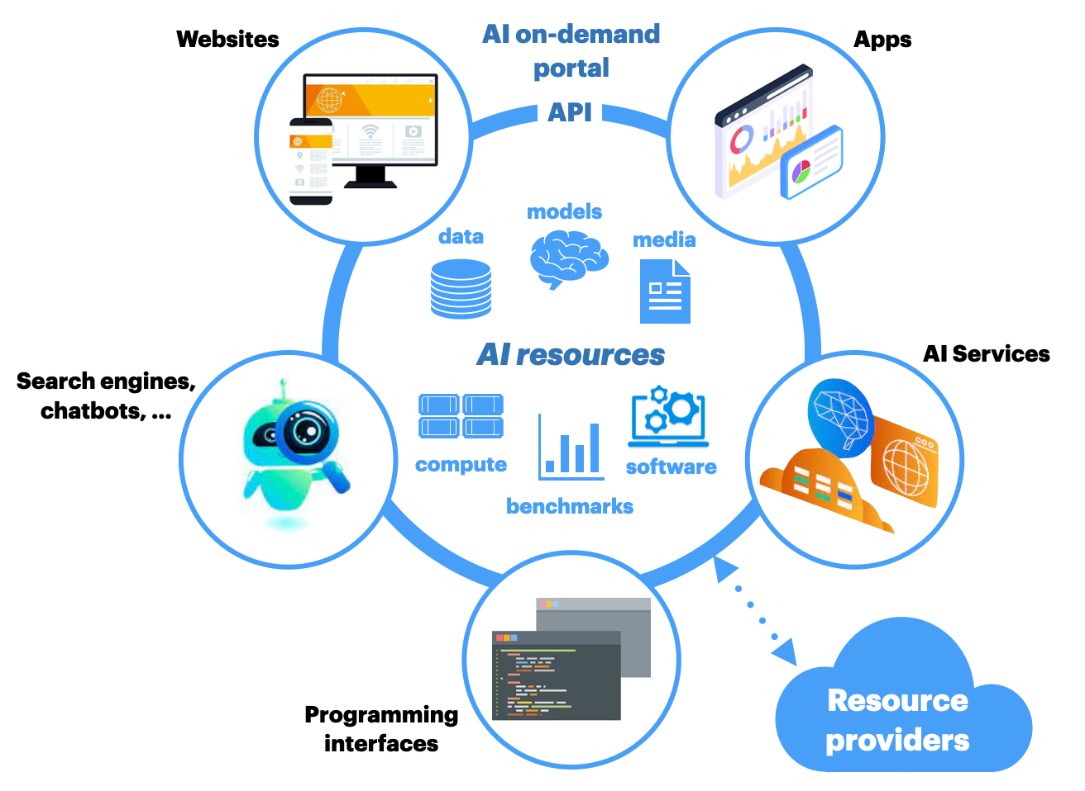
Updates from AIoD
Notes:
Similar to EOSC, AIoD envisions a federated infrastructure or system of systems (left), with a central metadata catalogue that will serve as a foundation for other services.
The platform is still under development and the mechanisms to contribute are not yet fully defined.
Nevertheless, we are working on integrating iMagine asset into the AIoD metadata catalogue.
similar to EOSC datasets and publications should be automatically harvested from Zenodo.

Slide 27
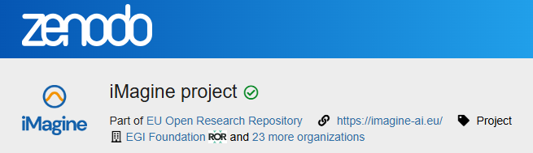
Collaboration with Zenodo
Part of the Horizon ZEN Pilot
and of the EU Open Research Repository

Slide 28



Collaboration with Projects
The requirements from the iMagine use cases for (new) features related to the platform are collected and the technological developments of these features are carried out in the AI4EOSC project.
Technical integration activities involved exploring automated data ingestion from the AI4Life BioImage Archive into the platform. We also focused on achieving interoperability at the AI model level, enabling the consumption and deployment of AI4Life-developed models within the platform, and vice versa.
ANERIS and iMagine share a common goal of developing innovative tools for marine research. The projects collaborate closely, leveraging shared resources like the Innovation Manager and coordinated communication strategies. This synergy allows for mutual promotion and potential future collaborations, as evidenced by joint conference participation and planned discussions to explore further opportunities.

Slide 29


Collaboration with Projects
To facilitate collaboration within the aquatic science community, joint workshops were held in 2024. Additionally, the successful integration of iMagine services into the d4science platform demonstrates the potential for interoperability between different platforms. The two projects aims to leverage each other's strengths to advance aquatic research and innovation.
Blue-Cloud also offers a gate to EOSC.
iMagine is collaborating with OBPS to highlight the project best practices and the achievements of the Use Cases. This collaboration will be achieved with the availability of the iMagine best practices in the OBPS repository on the one hand and with the promotion of some use cases in the OBPS News Flash

Slide 30
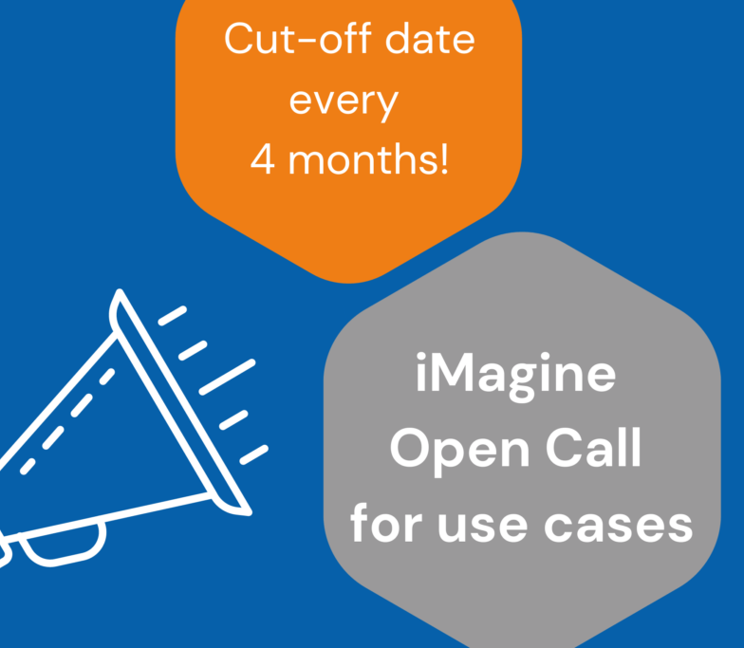
Open Call for Use Cases
6 applications received in the first cutoff

Slide 31






Innovation Management Framework
Innovation Management Framework is built on six building blocks.
Stakeholder
Analysis
Key Exploitable Results
IPR Management
Exploitation Strategy
Business Modelling
Impact Analysis

Slide 32
Stakeholder analysis
 | Legend
 | C | Current State
 | D | Desired State
Stakeholder Group | Unaware of the project | Aware of the project |  |  |  | Flag | Actions to Improve Awareness
 |  | Resistant | Neutral | Supportive | Actively Engaged
Users | C |  |  |  | D |  | Marketing plan ready to reach out to users?
Service and Content Providers |  |  | C |  | D
Infrastructure Providers |  |  | C |  | D
Similar AI initiatives | C |  |  | D
Suppliers | C |  | D
Organisations/Agencies from different disciplines |  |  | C | D
Policy Makers |  |  |  | C | D
Decision Makers | C |  | D
General Public | C |  | D

