Slide 1
iMagine RP2 Project Review 21 Nov 2024
UC5 - FlowCam phytoplankton identification
Rune Lagaisse & colleagues
Flanders Marine Institute (VLIZ)

Slide 2
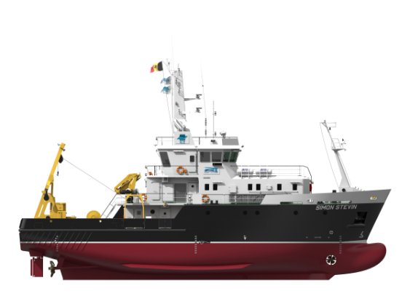
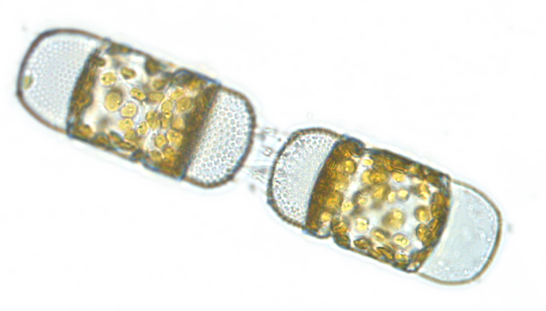
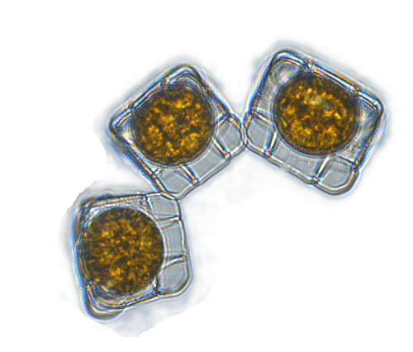
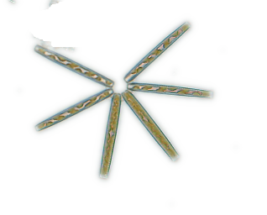
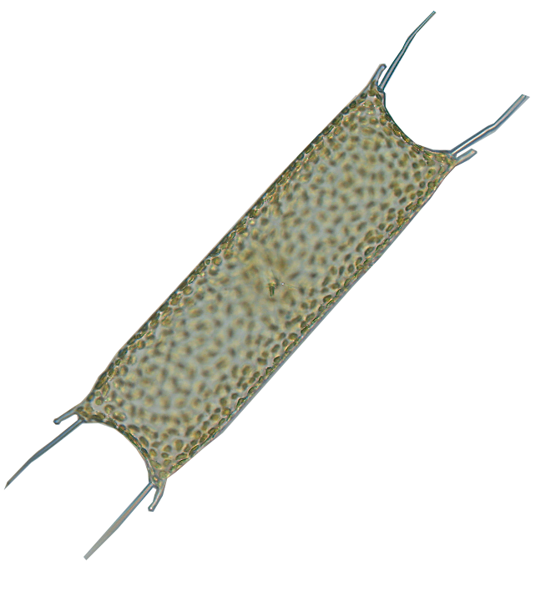
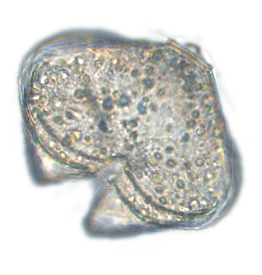
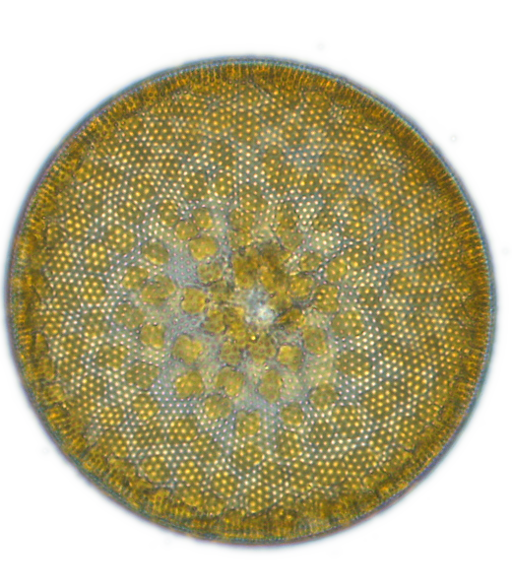
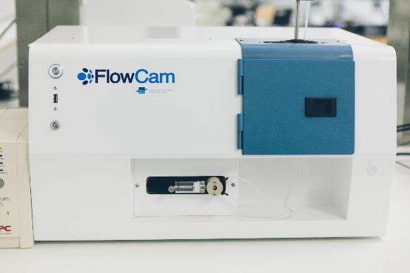
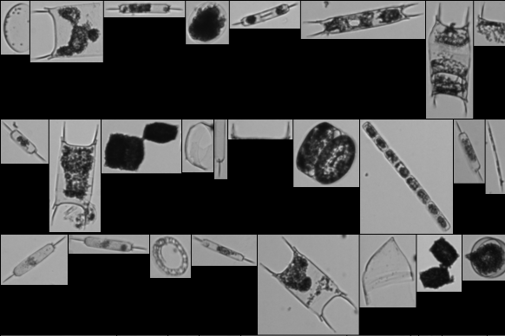
UC5 FlowCam phytoplankton identification
LifeWatch phytoplankton monitoring
Since 2017: monthly monitoring of
phytoplankton in the Belgian North Sea
Data acquisition using high-throughput imaging device: FlowCam
300 – 400 000 images to be analysed annually + Infrastructure provisioning

Slide 3
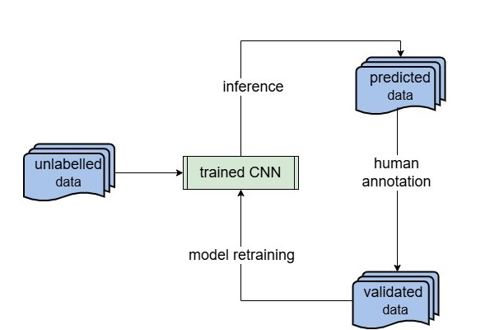
UC5 Flowcam phytoplankton identification
LifeWatch phytoplankton monitoring
Since 2017: monthly monitoring of
phytoplankton in the Belgian North Sea
Data acquisition using high-throughput imaging device: FlowCam
300 – 400 000 images to be analysed annually + Infrastructure provisioning
Semi-automated pipelines to process raw output data
Trained CNNs + Manual validation check
Only biodiversity result data open access
+ 1.2 M validated FlowCam images

Slide 4
UC5 Flowcam phytoplankton identification
FlowCam identification service
Objectives:
Optimise existing pipeline from sensor to database
Improve current metadata & data output formats towards compliance with community-based standards and vocabularies
Improve the service to incorporate the context input and increase the classification accuracy
Extend the training dataset by identification of additional particles currently grouped under a rest class
Prepare the data and processing components for connection, synchronization and migration to enable access from the iMagine platform

Slide 5
Second reporting period developments
FlowCam phytoplankton identification service
Maintenance of data pipelines and tools: 2,075,958 images processed and validated
Taxonomic review fully finished, update of bio-archives
Co-development and test-casing with 1 postdoc and 1 PhD user on lab protocols and image processing pipelines, data provision for one master student
Operational module on iMagine platform
Open access source code: top 2 accuracy 95%, 95 classes recognized
Published training dataset and image library open access
User documentation
Additional functionality
Notes:
The standardized LifeWatch biomonitoring added + 600k new manually validated images to the image library. Taxonomists revised the full image library back to 2017 and sorted rest groups, leading to fewer errors in the training data set as well as a higher number of classes to train on but which are more homogenous, leading to better overall model performance.
We got 4 user infrastructure requests this year, 3 biological researchers using flowcam to image phytoplankton samples and one sediment researcher using flowcam to investigate turbidity in the water column. Since they had large amounts of data, we not only facilitated lab use but also built custom datapipelines to fit their needs. This made our datapipelines more robust and flexible. As the module is not yet available on the imagine AI platform at the time of their analysis, we perfomed inference on in-house resources this year. Early next year we will refer users to the imagine AI platform for model training and inference.
We have optimized in-house data pipelines for ingestion from sensor to database by developing an in-house uploader tool makes database uploads more standardized and includes various quality control checks. The tool also standardizes data aggregations to the rshiny explorer and makes the biological result data open access via https://rshiny.lifewatch.be/flowcam-data/. Database structure was also revised, including imposing standardized naming convention and metadata revision based on scientists needs and scraping of missing metadata from archiving servers for all legacy data. In-house Python packages to process and format raw data have been adapted the 4 researchers mentioned above by custom raw data processing (different RV information systems, different metadata needs), database upload, image data prediction with pre-trained classifiers, use of the in-house image validation tool and data exports tailored to their research.
A prototype module of the FlowCAM phytoplankton identification service has been built on the iMagine AI platform and is being tested and further optimized before becoming public. A first training set was uploaded from the internal database to the iMagine storage, NextCloud, and will be updated throughout the course of the project by semi-automated data export as more validated data becomes available.

Slide 6
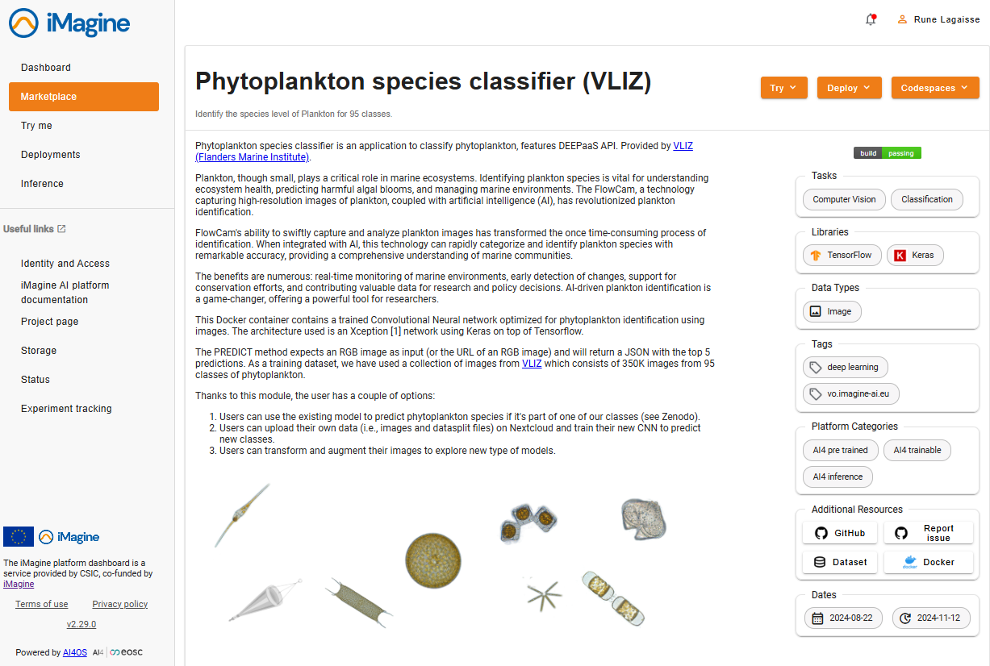
Experience with the iMagine platform
FlowCam phytoplankton identification service
User friendly
Clear documentation and tutorials
Efficient user support communication and follow-up
Continuous improvement through regular updates
Adequate storage space and computing resources for current needs
Notes:
The standardized LifeWatch biomonitoring added + 600k new manually validated images to the image library. Taxonomists revised the full image library back to 2017 and sorted rest groups, leading to fewer errors in the training data set as well as a higher number of classes to train on but which are more homogenous, leading to better overall model performance.
We got 4 user infrastructure requests this year, 3 biological researchers using flowcam to image phytoplankton samples and one sediment researcher using flowcam to investigate turbidity in the water column. Since they had large amounts of data, we not only facilitated lab use but also built custom datapipelines to fit their needs. This made our datapipelines more robust and flexible. As the module is not yet available on the imagine AI platform at the time of their analysis, we perfomed inference on in-house resources this year. Early next year we will refer users to the imagine AI platform for model training and inference.
We have optimized in-house data pipelines for ingestion from sensor to database by developing an in-house uploader tool makes database uploads more standardized and includes various quality control checks. The tool also standardizes data aggregations to the rshiny explorer and makes the biological result data open access via https://rshiny.lifewatch.be/flowcam-data/. Database structure was also revised, including imposing standardized naming convention and metadata revision based on scientists needs and scraping of missing metadata from archiving servers for all legacy data. In-house Python packages to process and format raw data have been adapted the 4 researchers mentioned above by custom raw data processing (different RV information systems, different metadata needs), database upload, image data prediction with pre-trained classifiers, use of the in-house image validation tool and data exports tailored to their research.
A prototype module of the FlowCAM phytoplankton identification service has been built on the iMagine AI platform and is being tested and further optimized before becoming public. A first training set was uploaded from the internal database to the iMagine storage, NextCloud, and will be updated throughout the course of the project by semi-automated data export as more validated data becomes available.

Slide 7
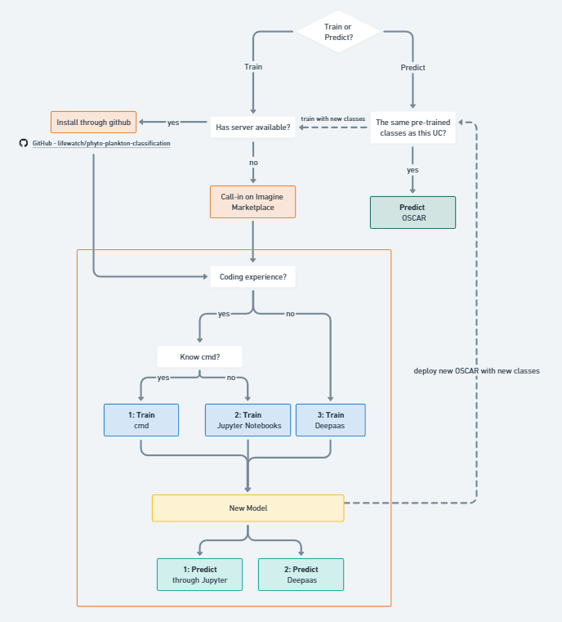
Second reporting period developments
FlowCam phytoplankton identification service demo
https://dashboard.cloud.imagine-ai.eu/marketplace/modules/phyto-plankton-classification
Notes:
The standardized LifeWatch biomonitoring added + 600k new manually validated images to the image library. Taxonomists revised the full image library back to 2017 and sorted rest groups, leading to fewer errors in the training data set as well as a higher number of classes to train on but which are more homogenous, leading to better overall model performance.
We got 4 user infrastructure requests this year, 3 biological researchers using flowcam to image phytoplankton samples and one sediment researcher using flowcam to investigate turbidity in the water column. Since they had large amounts of data, we not only facilitated lab use but also built custom datapipelines to fit their needs. This made our datapipelines more robust and flexible. As the module is not yet available on the imagine AI platform at the time of their analysis, we perfomed inference on in-house resources this year. Early next year we will refer users to the imagine AI platform for model training and inference.
We have optimized in-house data pipelines for ingestion from sensor to database by developing an in-house uploader tool makes database uploads more standardized and includes various quality control checks. The tool also standardizes data aggregations to the rshiny explorer and makes the biological result data open access via https://rshiny.lifewatch.be/flowcam-data/. Database structure was also revised, including imposing standardized naming convention and metadata revision based on scientists needs and scraping of missing metadata from archiving servers for all legacy data. In-house Python packages to process and format raw data have been adapted the 4 researchers mentioned above by custom raw data processing (different RV information systems, different metadata needs), database upload, image data prediction with pre-trained classifiers, use of the in-house image validation tool and data exports tailored to their research.
A prototype module of the FlowCAM phytoplankton identification service has been built on the iMagine AI platform and is being tested and further optimized before becoming public. A first training set was uploaded from the internal database to the iMagine storage, NextCloud, and will be updated throughout the course of the project by semi-automated data export as more validated data becomes available.

Slide 8
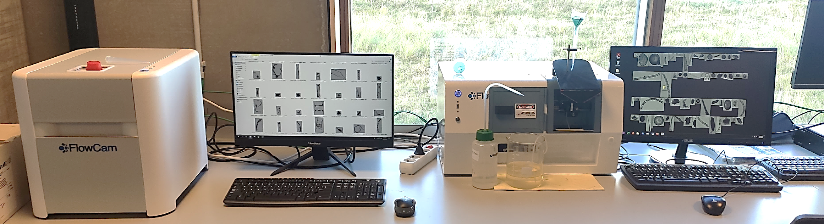
Outlook final reporting period
FlowCam phytoplankton identification service
Continuous data processing and releases
Mixed model input: inclusion of (environmental) metadata
Continued user support and documentation
Publication
Transformation to extend applicability to other FlowCam device versions
Possible applicability of other imaging sensor data (CytoSense, IFCB)

Slide 9
Contact us!
Rune.lagaisse@vliz.be
Wout.decrop@vliz.be

