Slide 1

Competence Center
Elnaz Azmi (KIT)
User Support Expert in WP3
Dissemination level: Public
iMagine RP2 Project Review
November 21, 2024
iMagine receives funding from the European Union’s Horizon Europe research and innovation program under grant agreement No. 101058625

Slide 2

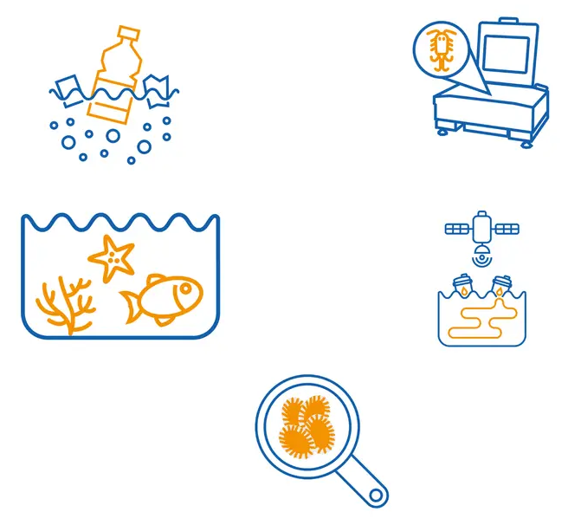
Outline
iMagine competence center
Use cases overview
Best practices for image analysis
Summary and outlook
Notes:
Today, I’ll start my presentation with introducing the iMagine competence center,
Then I’ll continue with how the UCs evolved, and which state they reached,
Afterwards I’ll present some highlights of the best practices captured from use case experiences,
and finally I’ll summarize my talk and introduce our next steps

Slide 3
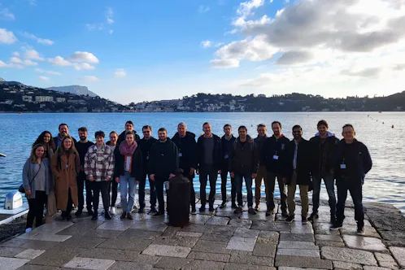
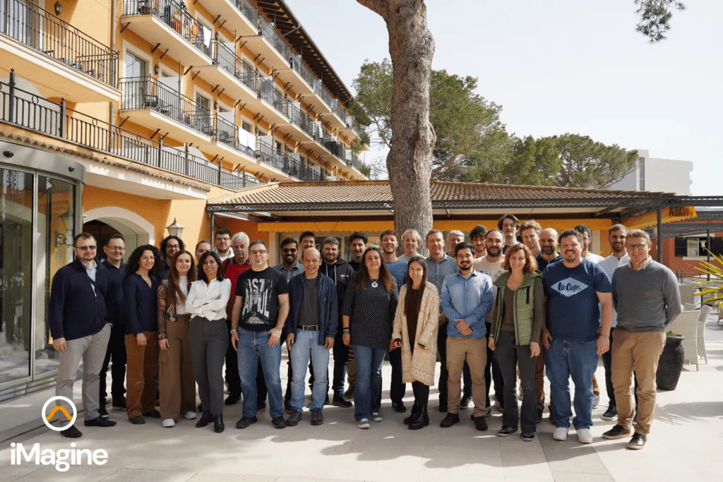
Competence Center:
Support
Monitoring and supporting of use cases through
  Regular meetings
Training sessions
  Annual competence center workshops and webinars
  AI4EOSC platform user workshop (November 2023)
Continuous feedback collection
Learning from use cases’ experiences
Documenting achievements in deliverables
France - 2023
Mallorca - 2024
Notes:
As a part of iMagine competence center in WP3, we do monitoring and supporting of use cases through regular bi-weekly meetings.
we have training sessions offered as annual competence center workshops and webinars. We had also AI4EOSC platform user workshop that took place last year in November.
we collect continuously feedback from use case experts and learn lessons from their experiences.
we also document developments, progress, achievements, best practices, and expert recommendations in form of deliverables.
These documents are guidelines for standardization and improving the quality of datasets and AI models.

Slide 4





Competence Center:
Synergetic approach
Competence Center
Domain & AI experts
(iMagine WP3)
IT experts
(iMagine WP4)
Platform developers
(AI4OS)
AI
Notes:
The competence center consists of AI, IT and domain experts from WP3 including marine and freshwater application experts, that monitor and support the use cases during AI technical integration,
as well as WP4 including AI framework and IT experts, that is introduced by Alvaro Lopez in the previous talk.
The iMagine AI platform is powered by the AI4OS software stack, developed by the AI4EOSC consortium.

Slide 5
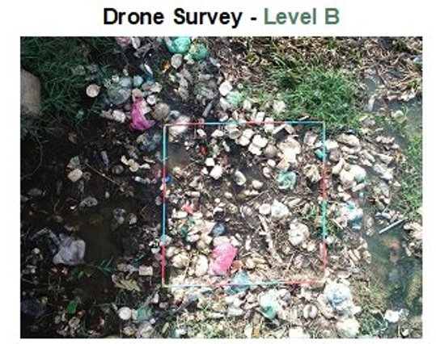
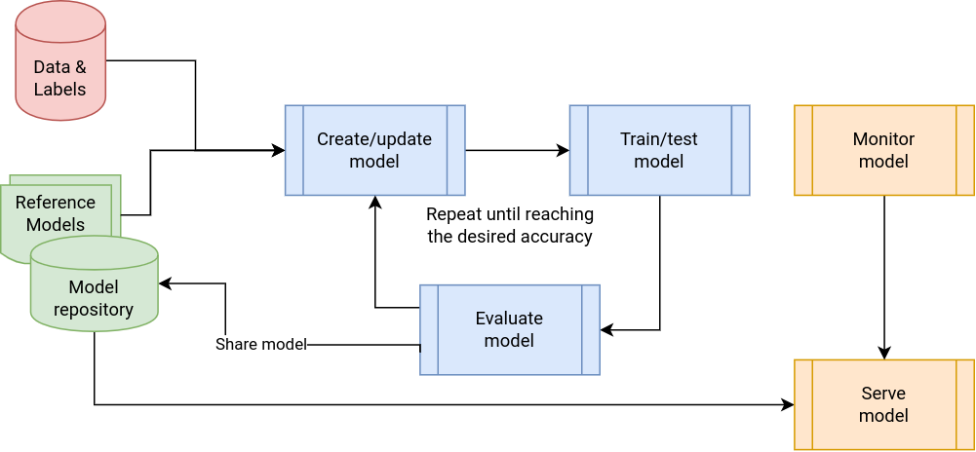

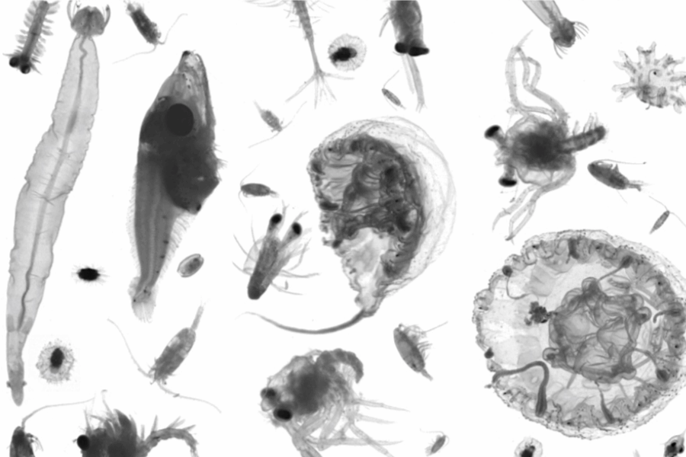

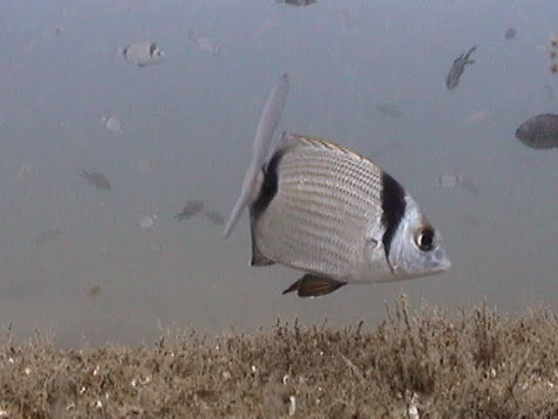
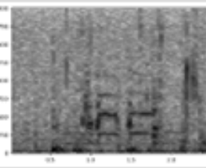

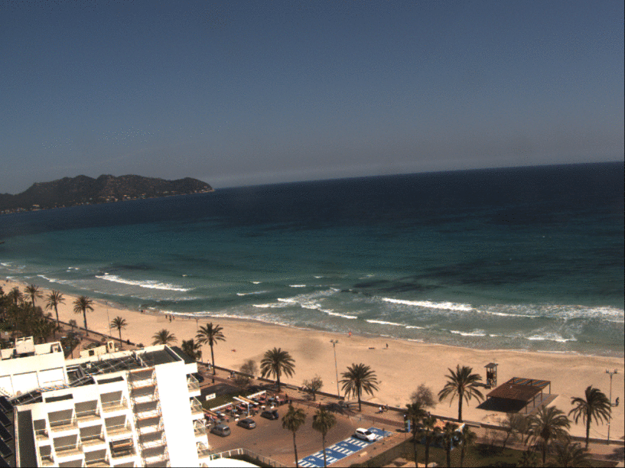
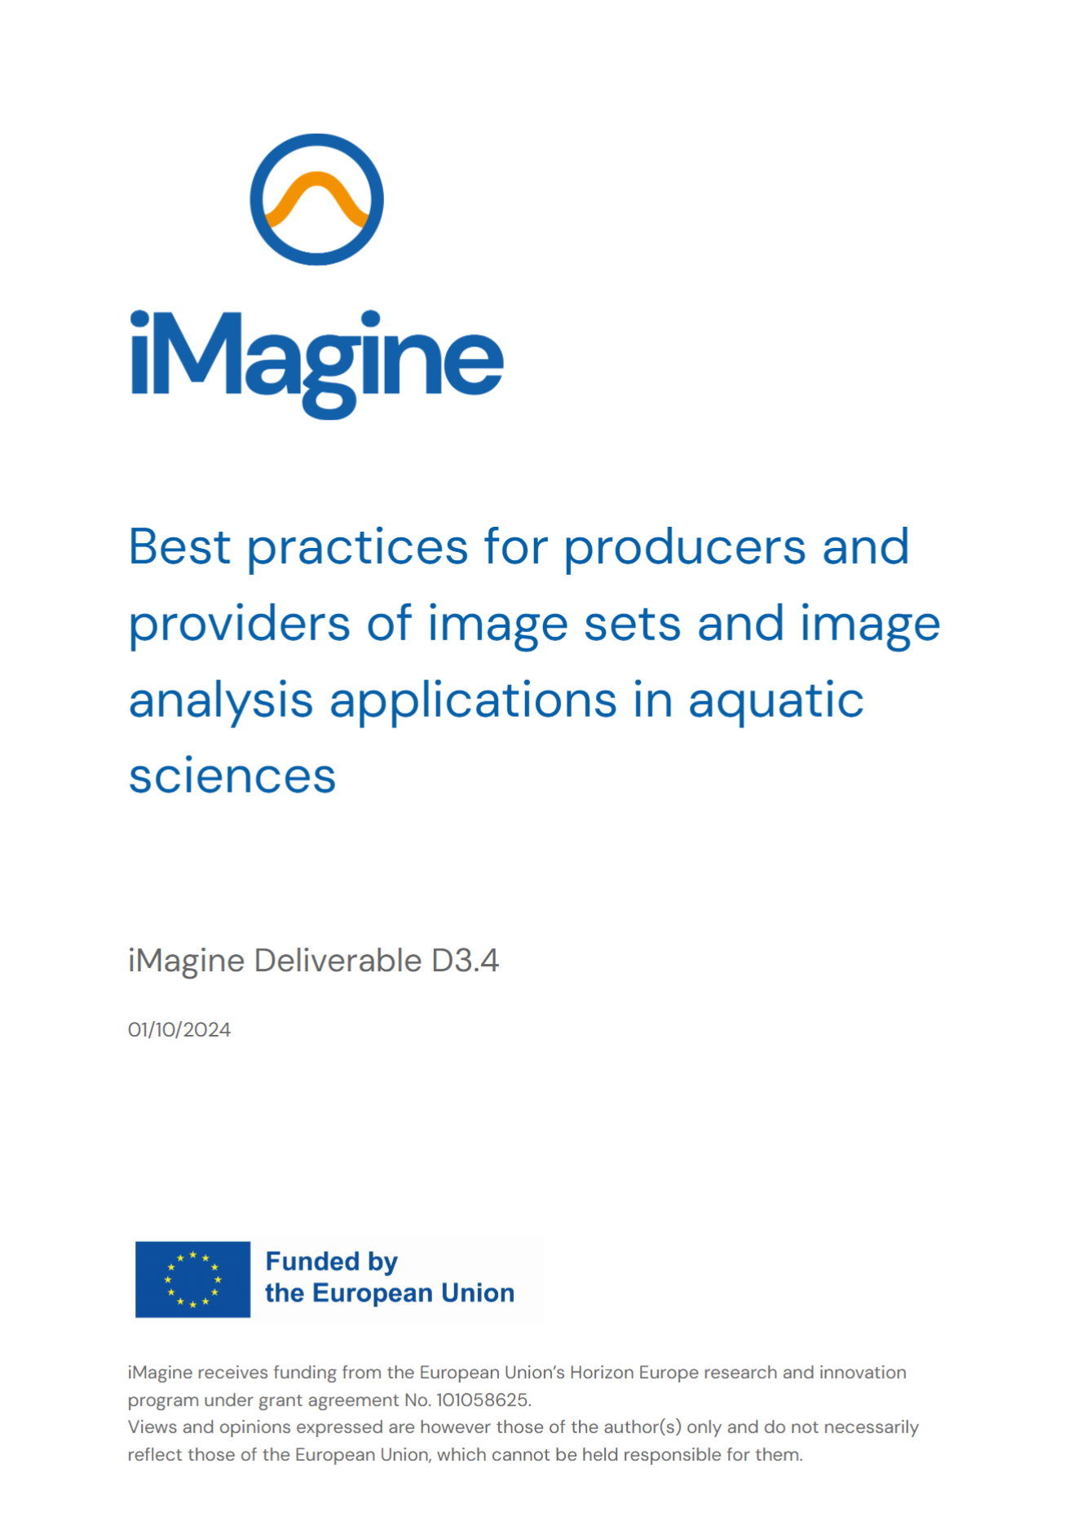
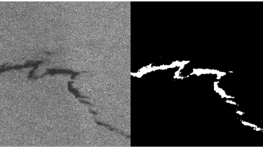
Competence Center:
From data to knowledge
Image analysis services / applications
(powered by trained models)
UCx collected raw data
AI/ML development cycle
Labeled training datasets
Best practices
‹#›
Notes:
The competence center support starts from the raw data collected by use cases and continues during the whole AI development cycle until serving the AI model as a service.
We provide different application delivery approaches such as iMagine marketplace and OSCAR.
The labeled training datasets are published with corresponding metadata on Zenodo.
Based on the lessons learned from use case experiences during the whole AI development cycle, we have published the best practices document.

Slide 6
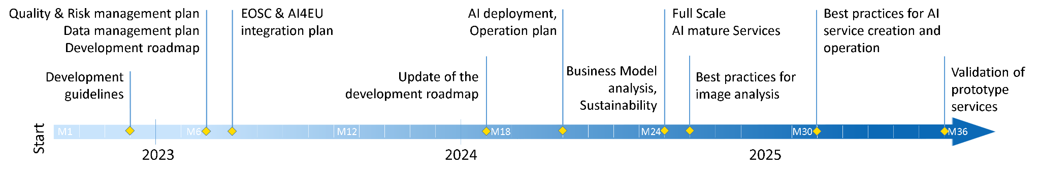
Competence Center:
Timeline
RP1
RP2
We are here in M27
Continuous interaction with users, feedback & knowledge sharing
Data delivery
Best practices on AI for research infrastructures
Application service delivery
Notes:
Here you can see the timeline of the iMagine project with the highlighted actions of the competence center. During the second reporting period starting from September 2023, we have updated and published the technical development roadmap for the mature AI image analysis use cases in D3.2,
Then, published AI application upgrade, deployment, and operation plan from the project's mature use cases in D3.3,
and recently D3.4 that is the best practices for producers and providers of image sets and image analysis application in aquatic sciences has been made public.
In the next steps, the updated best practices and guidelines for developers and providers of AI-based image analytics services will be published,
and finally the prototype services for 3 image analysis use cases will be validated.
M17. Technical development roadmap updated for the mature AI image analysis use cases
M20. AI application upgrade/deployment, and operation plan
M25. Best practices for producers and providers of image sets and image analysis application in aquatic sciences
M30. Best practices and guideline updated for developers and providers of AI-based image analytics services (WP4)
M35. Validated prototype services for 3 image analysis use cases

Slide 7

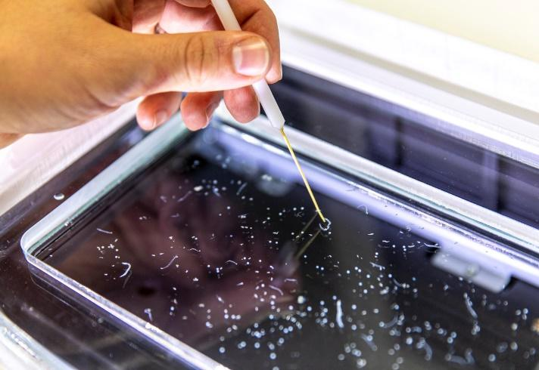
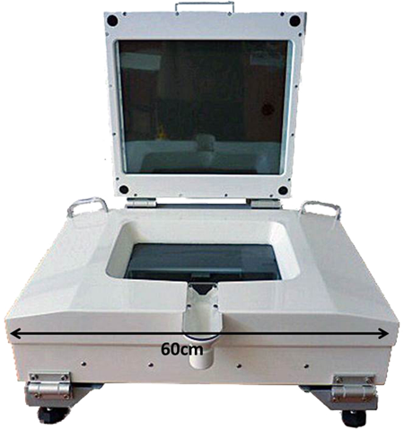
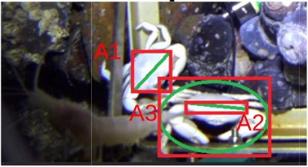
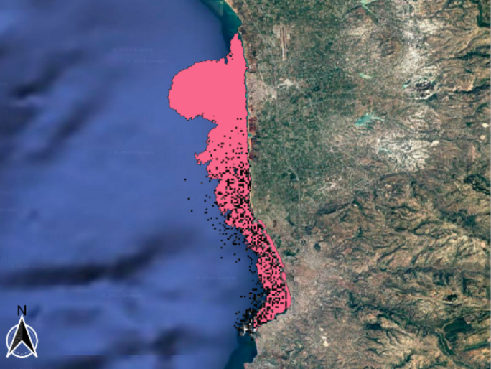
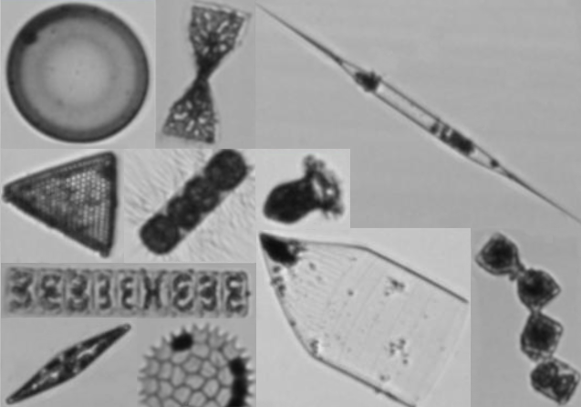
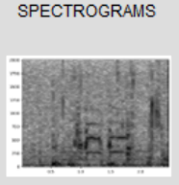
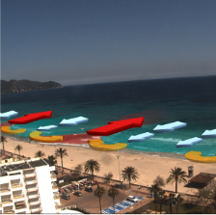
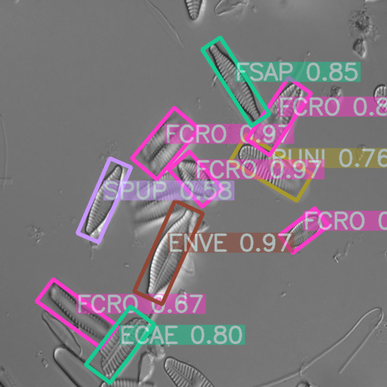
Use Cases Overview
5 mature - 3 prototypes
Aquatic Litter Drones
(DFKI, MARIS, OGS):
Monitoring system for Aquatic Litter Pollution
Zooscan – EcoTaxa pipeline (Sorbonne Uni.):
Taxonomic identification of
zooplankton using Zooscan
Marine Ecosystem Monitoring
(EMSO ERIC, UPC, IFREMER, MI):
Ecosystem Monitoring by means of
video imagery from cameras at EMSO sites
Oil Spill Detection
(CMCC, OrbitalEOS, UNITN):
Oil spill detection from satellite images
Flowcam phytoplankton
identification (VLIZ):
Taxonomic identification of phytoplankton
using FlowCAM images
Underwater noise identification (VLIZ):
Identification of sound events from
acoustic recordings using spectrograms
Beach monitoring (SOCIB):
Posidonia oceanica berms and rip-currents
detection from beach monitoring systems
Freshwater diatoms identification (UL-LIEC): Diatom-based bioidentification using automatic pattern recognition on microscope images
Notes:
Here as a recall, you can see an overview of 5 mature and 3 prototype use cases introduced by Gergely Sipos in the project overview.
These use cases joined us from the beginning of the iMagine project. They are diverse in their sub-domain, but all belonging to aquatic sciences.
The mature uses cases were advanced in their AI model developments, while the prototype use cases started with collecting and annotating their datasets.

Slide 8
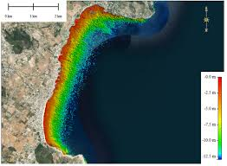
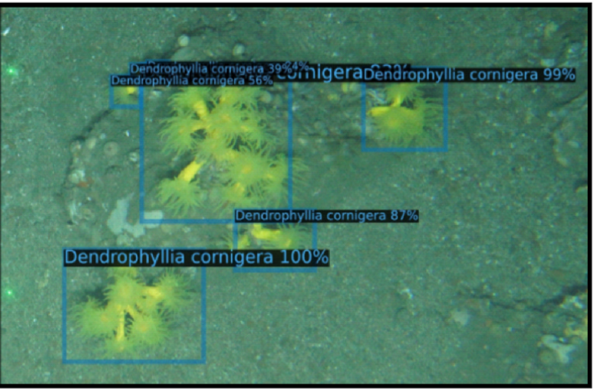
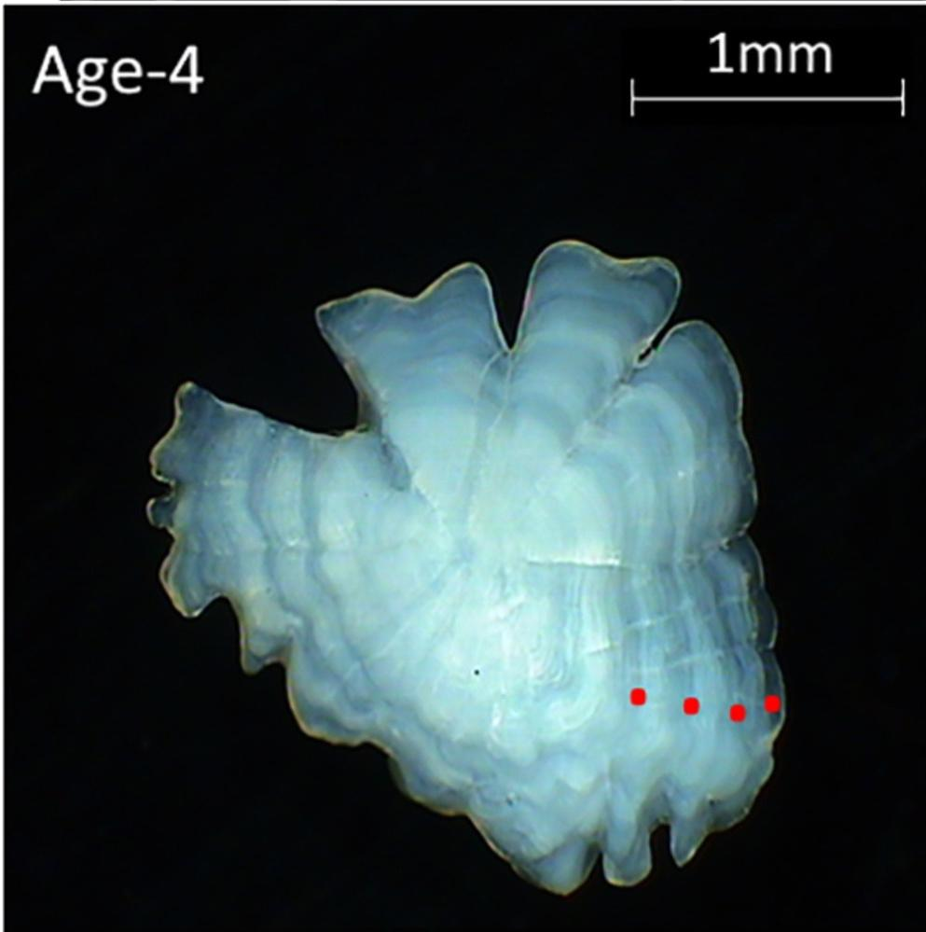
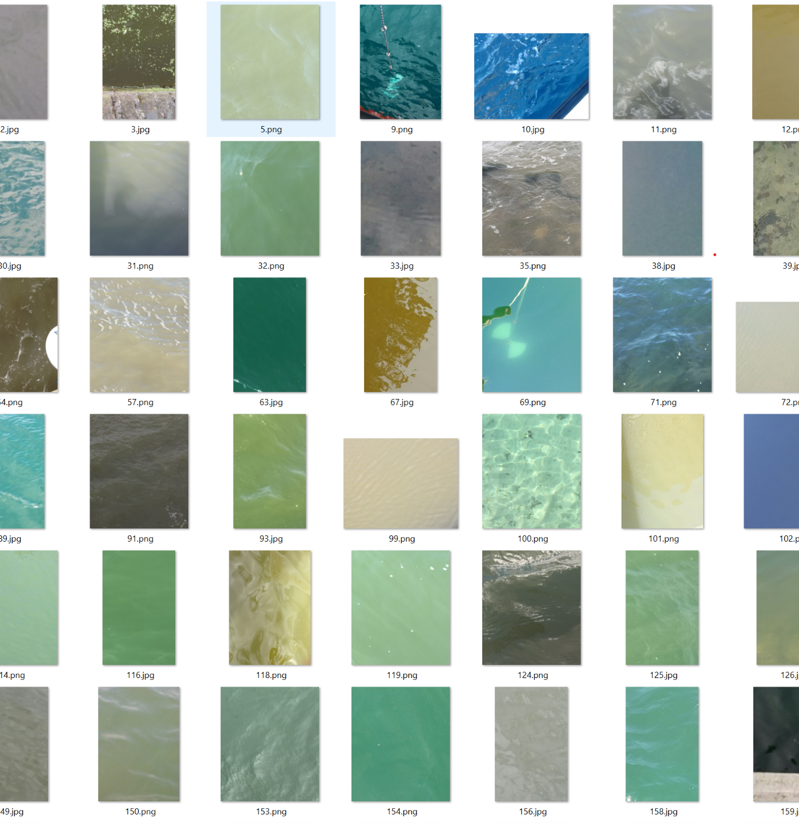
External Use Cases
Onboarded in PY2 via the Open Call
Satellite-Derived Bathymetry
Institute of Marine Sciences of Andalusia
Nearshore bathymetry for coastal studies
Improving knowledge about Cold Water Coral Reef
Spanish Oceanographic Institute
Use AI to precisely delineate areas of living coral and dead coral
AI for image based age reading from fish otoliths
Danish National Institute of Aquatic Resources
To develop an AI algorithm to identify the age of a fish from an otolith image
Validating images collected with the EyeonWater app
Maris
To detect and reject false images and give the right color to correct images
‹#›
Notes:
The external or additional use cases joined us via the open call of iMagine and the cold water coral reef use case is already delivered on the iMagine marketplace.

Slide 9
Diversity in AI development
Use cases | Labeling | Preprocessing | Data biases | Models | Performance metrics
UC1 - Marine litter assessment | prelabeled with in-house litter categories(JLIST) | resizing, augmentation, (horizontal flips, vertical flips, and random rotations) | unbalanced dataset, AI model checked, no need to address | MobileNetV2, SqueezeNet1.1., DenseNet121, ResNet50 | accuracy, precision, recall, F1-Score
UC2 - ZooScanNet | labeling with EcoTaxa, segmentation with current version of ZooProcess (both in-house tools) | Before AI: background subtraction on the original image (with a blank scan, by ZooProcess) Classif: data augmentation for (rotation, resizing, cropping, flipping) done just-in-time during training and inference Segment: no augmentation | unbalanced dataset, combination of resampling (for classif and segment) and weights (for classif) | Classif: MobileNet Segment: MaskRCNN, Mask2Former | Classif: binary cross-entropy Segment: accuracy, recall, precision, IoU
UC3o - EMSO OBSEA | labelImg, roboflow, label studio, BIIGLE | augmentation | cover the seasonality, one-year dataset, unbalanced dataset, adding dataset of other species | Faster-RCNN, YOLOv8 | mAP@50, precision, recall
UC3a - EMSO Azores | annotated by citizens | padding, bounding box corrections, addressing redundancy | unbalanced dataset, focused on two specific species | YOLOv8 | precision, recall, mAP50-95
UC3s -Smartbay | annotated by CVAT | augmentation (roboflow noise and contrast) | different sediment types, larger training datasets and more classes | YOLOv8, DOVER VQA | mAP50-95
UC4 - Oil spill detection | proprietary method developed by Orbital EOS | weight-loss | false positives, almost 98% of pixels are not real oil spills | Bayesian optimization | Fractions Skills Score
UC5 - Flowcam plankton identification | in-house developed labeling tool | augmentation | unbalanced dataset, resampling | CNN based on an Xception architecture | precision, recall, F1 score
UC6 - Underwater Noise Identification |  | window size, features extraction, | data from different locations and dates during one year | Contrastive Language-Audio model based on the CLAP model | RMSE
UC7 - Shoreline extraction, Beach monitoring | CVAT, in-house tool written in R | label format adaptation, colour space transformation, data scaling, split rows, patchify, augmentation | unbalanced dataset, (geographic locations and/or camera FOVs) | U-Net, YOLOv8,9,11-seg, Bi-LSTM | accuracy, loss, precision, recall, F1 score, IoU
UC8 - Freshwater diatoms identification | BIIGLE, LabelBox | pre-training on synthetic datasets, padding, bounding box corrections (resizing, rotation), features extraction | unbalanced dataset | YOLOv5, EfficientNet, MAPLE, SAM2 | accuracy, Expected Calibration Error, Negative Log-Likelihood, Precision-Recall curve
‹#›
Notes:
For general tasks such as, object detection and segmentation with AI, you can see here the diversity in AI development approaches applied through our use cases.
For example annotation and labeling of their training datasets using in-house tools, CVAT or BIIGLE.
Augmentation, feature extraction and data scaling in preprocessing steps.
Handling unbalanced datasets with different approaches such as, resampling, including various locations and time slots, and types of species to reduce data biases.
They tested the performance of different models in their use cases and continued with the best one, such as YOLO or MobileNet.

Slide 10
Mature Use Cases
Move to delivery → WP5
Use cases | Marketplace delivery | OSCAR delivery | Published training datasets | Additional remarks
UC1 | Achieved | Achieved | Achieved | So far: 9 unique Github cloners; 1 Marketplace user
UC2 | Achieved | W-I-P | Achieved | To reach compatibility with the old software
UC3-OBSEA | Achieved | W-I-P | Achieved | Embedded into data product pipeline + streamed online
UC3-Azores | Achieved | not planned | Achieved
UC3-Smartbay | Achieved | not planned | Achieved | Planned to run offline on research vessels
UC4 | Achieved | W-I-P | Achieved
UC5 | Achieved | Achieved | Achieved | So far: 7 users, inc. from LifeWatch, Jerico RIs
‹#›
Notes:
Here you can see an overview of the delivery status of the mature use cases.
All of them deployed their models on the marketplace and published their training datasets.
UC1 and UC5 use also OSCAR platform to deploy their inference services and have some users for their models.
The other use cases are in progress to integrate OSCAR in their services.

Slide 11
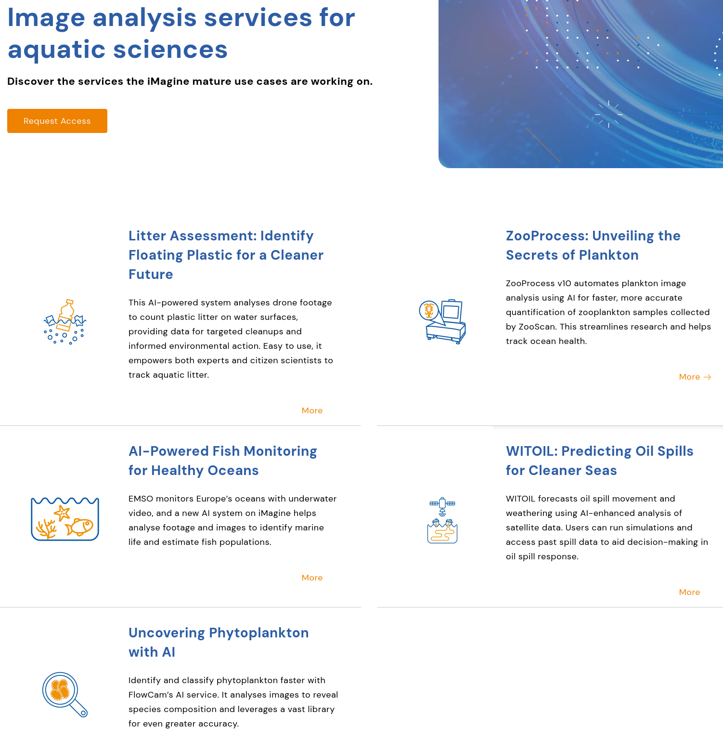
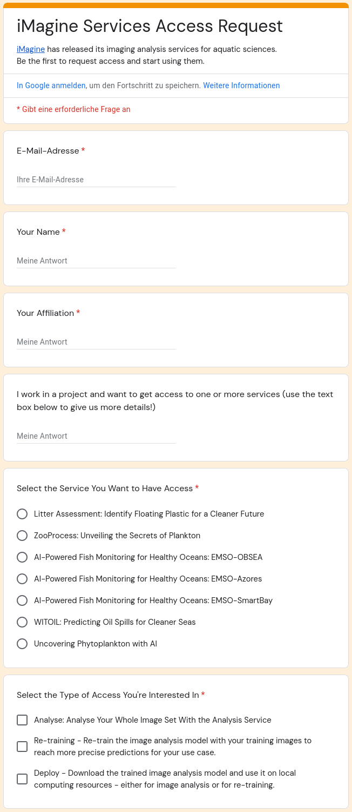
WE ARE OPEN FOR BUSINESS!
Thematic Services for Image Analysis
https://www.imagine-ai.eu/services/image-analysis-services-for-aquatic-sciences
‹#›
Notes:
As an end user, one can discover and use the AI services of the iMagine mature use cases from this page of the iMagine website.
Some of the use cases are already available and offer their services, so that one can request an access via filling out this form and will be informed about how to use the service.

Slide 12
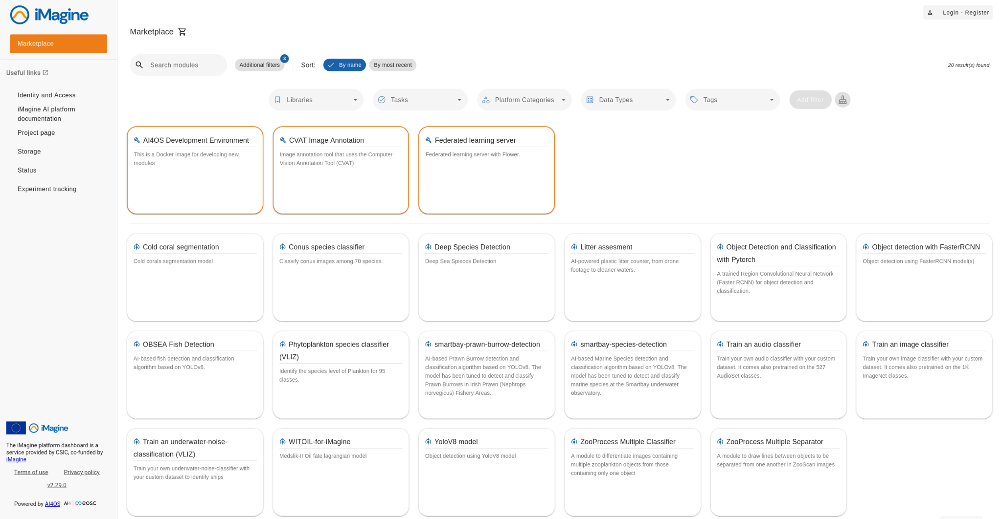
Marketplace
COLOR LABELS:
Mature use case modules
External use case modules
General purpose modules
AUC1
UC3a
UC1
iMagine
UC3o
UC5
UC3s
UC3s
iMagine
UC4
iMagine
UC2
UC2
‹#›
Notes:
Here you can see the dashboard of iMagine Marketplace, where all deployed mature use case modules are highlighted in green and one external use case in blue.
The orange boxes are showing the general purpose modules developed and integrated by the iMagine experts, such as Yolov8, FasterRCNN, and image classifier.

Slide 13
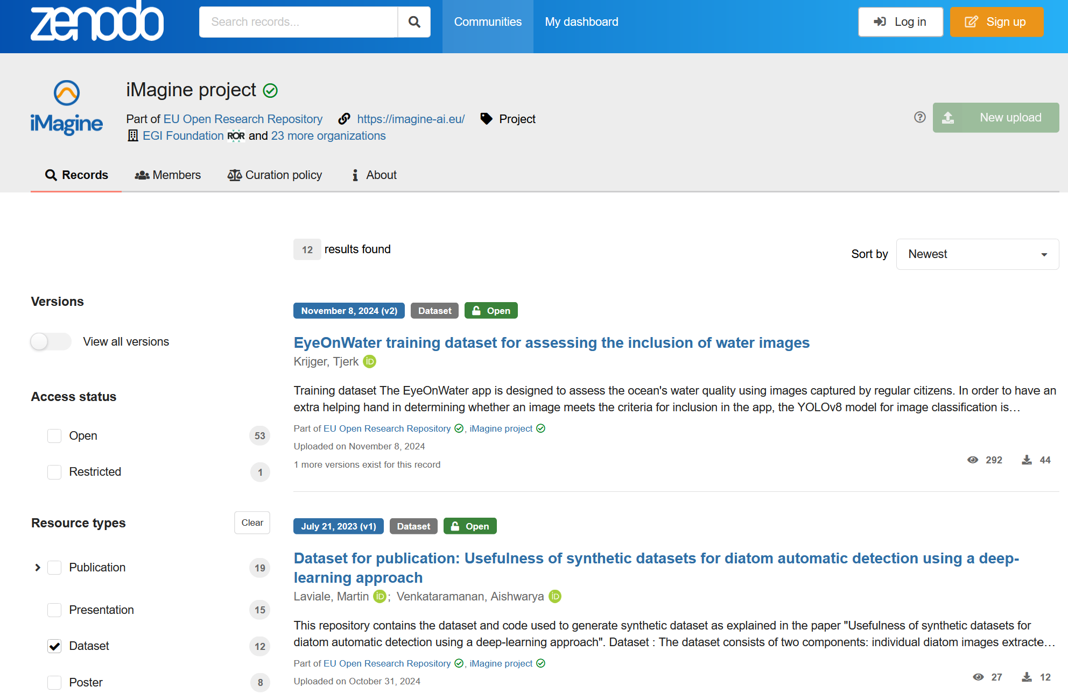
Data Delivery
Sharing training datasets on Zenodo
Use cases create and use labeled datasets for training applications
iMagine aims to make image training datasets accessible to external users
  Increasing user trust by sharing images used in AI model training
  Improving FAIRness of training datasets
Zenodo provides:
  A catalogue solution for metadata
  Physical storage or metadata gateway for some use cases
12 iMagine training datasets are in the iMagine community at Zenodo:
  https://zenodo.org/communities/imagine-project
Notes:
The iMagine use cases create and use labeled datasets for training their AI models.
In order to make these datasets accessible to external users and improve their FAIRness, iMagine created a project repository on Zenodo.
12 training datasets of our use cases have been published with corresponding metadata on Zenodo, or the metadata accessible via Zenodo and linked to other storage.

Slide 14
Data Delivery
Adding domain-specific metadata to Zenodo
Zenodo serves as a general repository for diverse EU results across various domains
iMagine has partnered with Zenodo (via EU-funded Zenodo-ZEN project) for a domain-specific approach
iMagine created a dedicated template for training image datasets with extra metadata and aquatic vocabularies
The proposed and agreed metadata format can be found at: ZENODO Extended DCAT profile
Metadata format agreed with CERN before summer 2024; will include CMS and API for machine-to-machine exchange
iMagine plans to launch the template and services in early 2025
iMagine use cases use Zenodo’s common template, with future migration planned
Notes:
Zenodo serves a general repository for various domains. As our use cases are in aquatic sciences, iMagine agreed with Zenodo via Zenodo-Zen project for a domain-specific format of metadata.
The extension and adaptation have been agreed with CERN before the summer 2024 and its deployment will include configuring a dedicated Content Management System (CMS) and later also an API to facilitate a machine-to-machine exchange of the iMagine Zenodo entries.
iMagine plans to launch the template and services in early 2025 and the common templates will be migrated into the domain-specific format.

Slide 15

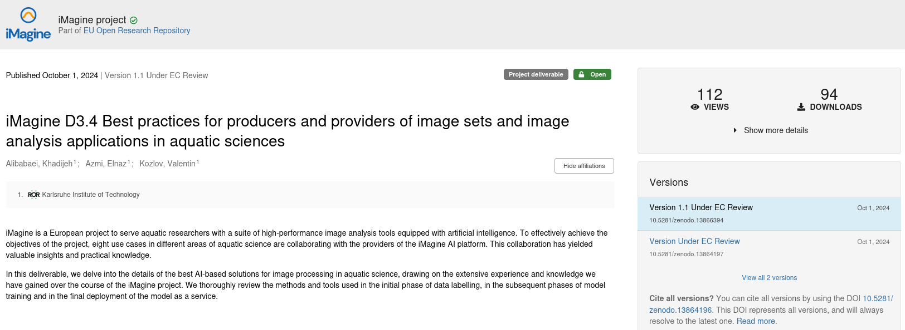
Best Practices for Image Analysis
Lessons learned during the whole AI development cycle
Experiences from 8 aquatic image analysis use cases
Available since 1st of October 2024 at:
  https://doi.org/10.5281/zenodo.13864196
Notes:
We have learned lessons from the 8 use cases during their whole AI developments and published them in October as best practices for producers and providers of image sets and image analysis in aquatic sciences.

Slide 16
Best Practices:
Covered topics
Deep Learning
Annotation Tools
Data Repositories and Open-source Dataset for Marine Applications
Preprocessing Techniques
AI/ML development cycle
Performance Metrics and Evaluation Methods
Tools for Monitoring Model Performance
Data Biases and Fairness in Aquatic Science Models and Data
Model Delivery
AI Model Drift Tools
Use Case Experiences
‹#›
Notes:
To give you an overview of this document, these are the covered topics starting from suitable deep learning models and annotation tools for labeling training datasets to open-source data repositories, performance monitoring tools and delivery approaches.
In the next slides I’ll show you some examples of this deliverable in detail.

Slide 17

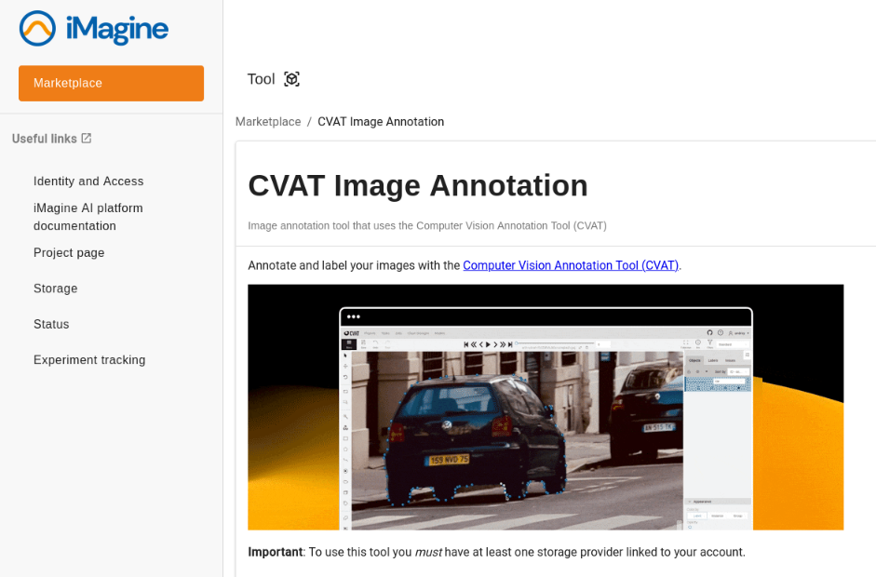



Best Practices:
AI/ML development cycle
Data and Labels
Annotation Tools
  CVAT: user-friendly interface, robust annotation features, and flexibility
Notes:
Label Studio: more complex to use and install locally
BIIGLE: web-based for marine image annotation
RoboFlow: cloud-based platform with data augmentation
LabelBox: customizable for different data types

Slide 18


Best Practices:
AI/ML development cycle
Data Repository
Data Repositories and Open-source Dataset for Marine Applications
  Zenodo: robust solution, open-access platform to share, store, and manage datasets
Data Biases and Fairness in Aquatic Science Data
  Recommendations about handling Imbalanced datasets
  FAIR EVA tool: improve the FAIRness of published training datasets concerning the metadata used in Zenodo
zenodo.org
FAIReva
Notes:
FAIR EVA provides a percentage of digital object FAIRness *at time of running a test*
and guides researchers and repository administrators to improve FAIRness compliance

Slide 19
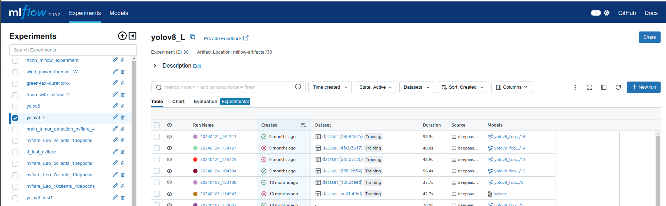
Best Practices:
AI/ML development cycle
Monitoring Model Performance
Experiment Tracking Tools
  Mlflow: efficient management and tracking of machine learning experiments
  Tensorboard: less functionality, single user and self-hosted
  Weights and Biases: self-hosted server is by default is not appropriate for production environment

Slide 20

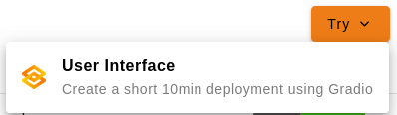



Best Practices:
AI/ML development cycle
Serve Model
Sharing and Serving AI Models via iMagine Marketplace
  AI models are published as Docker images and code repositories
  Anyone authenticated can “Try” an inference endpoint (for 10 min)
Model Deployment in Production
  OSCAR: efficient and scalable deployment for running the AI model inferences
Marketplace
Notes:
TRY is 10 minutes. Is this 10 minutes compute time, or the whole user session?
I think, this is time allocated for the deployment in total, i.e. deployed - 10 min passed, removed @Alvaro ?
because "Try" can be used by anyone in the world after authentication through EGI Check-In. No VO membership is required

Slide 21




Summary & Outlook
Mature use cases completed developments and are moving into production
Best practices for image analysis is public
Continue monitoring and support of use cases
Extend best practices for AI-based image analytics services
Validate three prototype use cases
Marketplace
Image processing Tips
twitter.com
zenodo.org
imagine-ai.eu

Slide 22
Thank you for your attention
iMagine receives funding from the European Union’s Horizon Europe research and innovation program under grant agreement No. 101058625

Slide 23
Backup

Slide 24
Best Practices:
AI/ML development cycle
Data and Labels
Preprocessing Techniques
  Data Cleaning: removing errors and inconsistencies
  Normalization & Standardization: scaling pixel values to same scale
  Handling Imbalanced Data: oversampling/undersampling and class weight adjustment
  Data Augmentation: transformations such as flipping and rotating

Slide 25
Best Practices:
AI/ML development cycle
Create/Update/Train/Test Model
Deep Learning Models
  Classification
    Mobilenet
  Object Detection
    YOLOv8: most commonly used for object detection, showed strong performance
  Segmentation
    YOLOv8
    Mask2Former: achieved better performance in panoptic segmentation than instance segmentation with Mask R-CNN
Training and Testing on iMagine Marketplace
Marketplace

Slide 26
Best Practices:
AI/ML development cycle
Evaluate Model
Performance Metrics and Evaluation Methods
  Accuracy: correct predictions over total predictions
  Precision: the ratio of correctly predicted positive observations to the total predicted positives
  Recall: the ratio of correctly predicted positive observations to all observations in the actual class
  F1 score: the harmonic mean of precision and recall, useful for imbalanced dataset
  Intersection over Union (IoU): the overlap between two boxes, with greater overlap indicating a higher IoU

