Slide 1
The iMagine AI platform
WP4 update and status
Álvaro López García <aloga@ifca.unican.es>
Advanced Computing and e-Science Group (IFCA-CSIC-UC)
iMagine WP4 leader
iMagine RP2 review
November 21st 2024
iMagine receives funding from the European Union’s Horizon 2020 research and innovation programme under grant agreement No. 101058625.

Slide 2
DEEP-HDC, AI4EOSC, iMagine, AI4OS…
AI4EOSC platform → Platform “powered by AIOS”
DEEP-3 → AI4EOSC-3
https://status.ai4eosc.eu - https://ai4eosc.eu/platform/
AI4OS → software distribution
Possible to build custom platforms, partially integrated with AI4EOSC platform (i.e. reusing services) or not
https://github.com/AI4OS
DEEP-1, DEEP-2: Platform releases
Platform and software tightly coupled and interlinked, complicated to self-deploy and customize
(large) User input,
missing features
iMagine WP3
Competence Center
Feature delivery via AI4OS software
iMagine AI platform
Customized platform for AI image processing
Support for AI service deployment and creation
Exploitation of DEEP/AI4OS software as technology provider
https://www.imagine-ai.eu/services/imagine-ai-platform/
https://dashboard.cloud.imagine-ai.eu

Slide 3
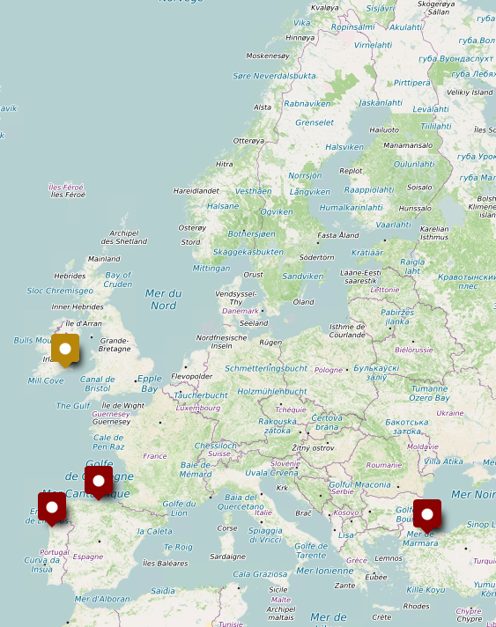
A distributed and federated platform
Integration of different cloud computing providers from the EGI Federated Cloud (T4.3)
To deliver the iMagine AI development platform (T4.1) to build AI models
To be deployed in the iMagine AI service platform (T4.2) to provide services and applications
A federated and distributed platform, spanning pan-EU e-Infrastructures state of the art resources:
GPU access
CSIC Scientific Cloud (Spain), INCD Cloud (Portugal), TÜBITAK-ULAKBIM (Turkey)
CPU access
Walton Institute (Ireland)
EOSC integration enabled by upstream software (AI4OS) therefore low entry barrier for the iMagine platform in the EOSC

Slide 4
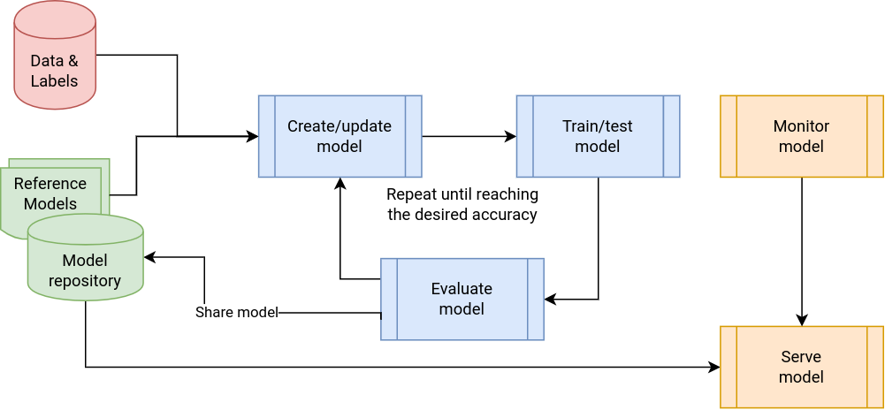
AI/ML application development lifecycle
Development Training Delivery

Slide 5
Main updates since RP1
Use case identified gap / platform need |  | Updated solution
Lack of ability to monitor GPU/CPU/Storage consumption |  | Fine-grained resource consumption accounting delivered through the dashboard
Manual process for the integration of new sites |  | Semi-automated inclusion of new sites in the platform
Non-rich metadata and lack of searching and filtering options in the dashboard |  | Updated module metadata and updated dashboard look and feel
Integration with storage systems and data repositories, including automated data retrieval |  | Data synchronization from Zenodo, DataOne, Figshare, etc
 |  | Link with internal and external storage (NextCloud) and secret management
Lack of experiment-centric features and use-case focused additional tools |  | Integration with MLFlow for experiment tracking
 |  | Additional tools for image classification (e.g. CVAT)
Streamlined deployment of model as service |  | Implementation of short-lived try-me endpoints
 |  | Serverless (OSCAR), dedicated (Nomad), BYOR (IM)

Slide 6
Platform & integration status

Slide 7
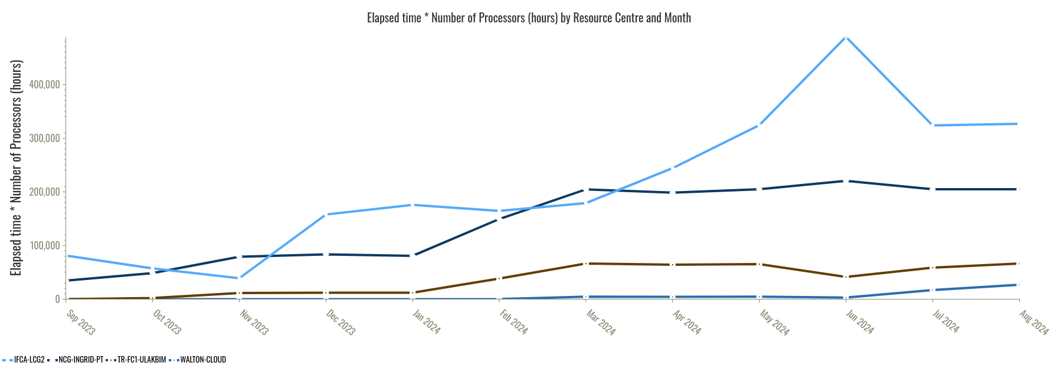
Integration status
Federated Compute Infrastructure (T4.3)
All sites now supporting iMagine VO (Operators group) to deploy platform services
Usage reported through EGI accounting system (link)
CSIC-IFCA
INCD Cloud
TÜBITAK-ULAKBIM
WaltonCloud

Slide 8
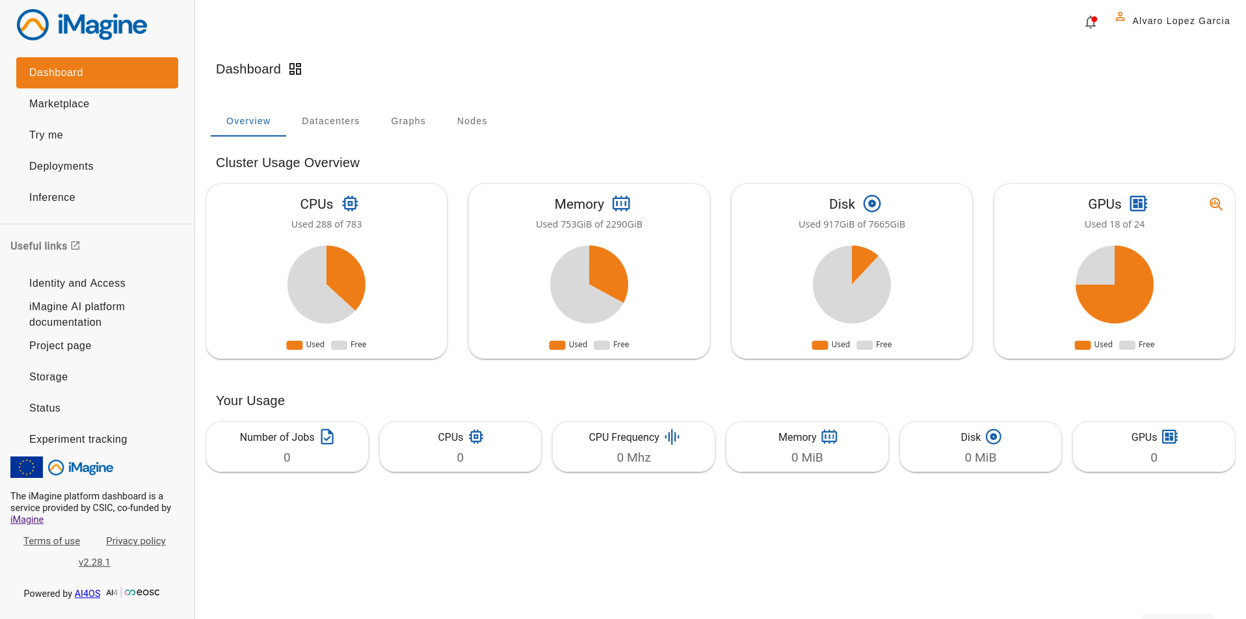
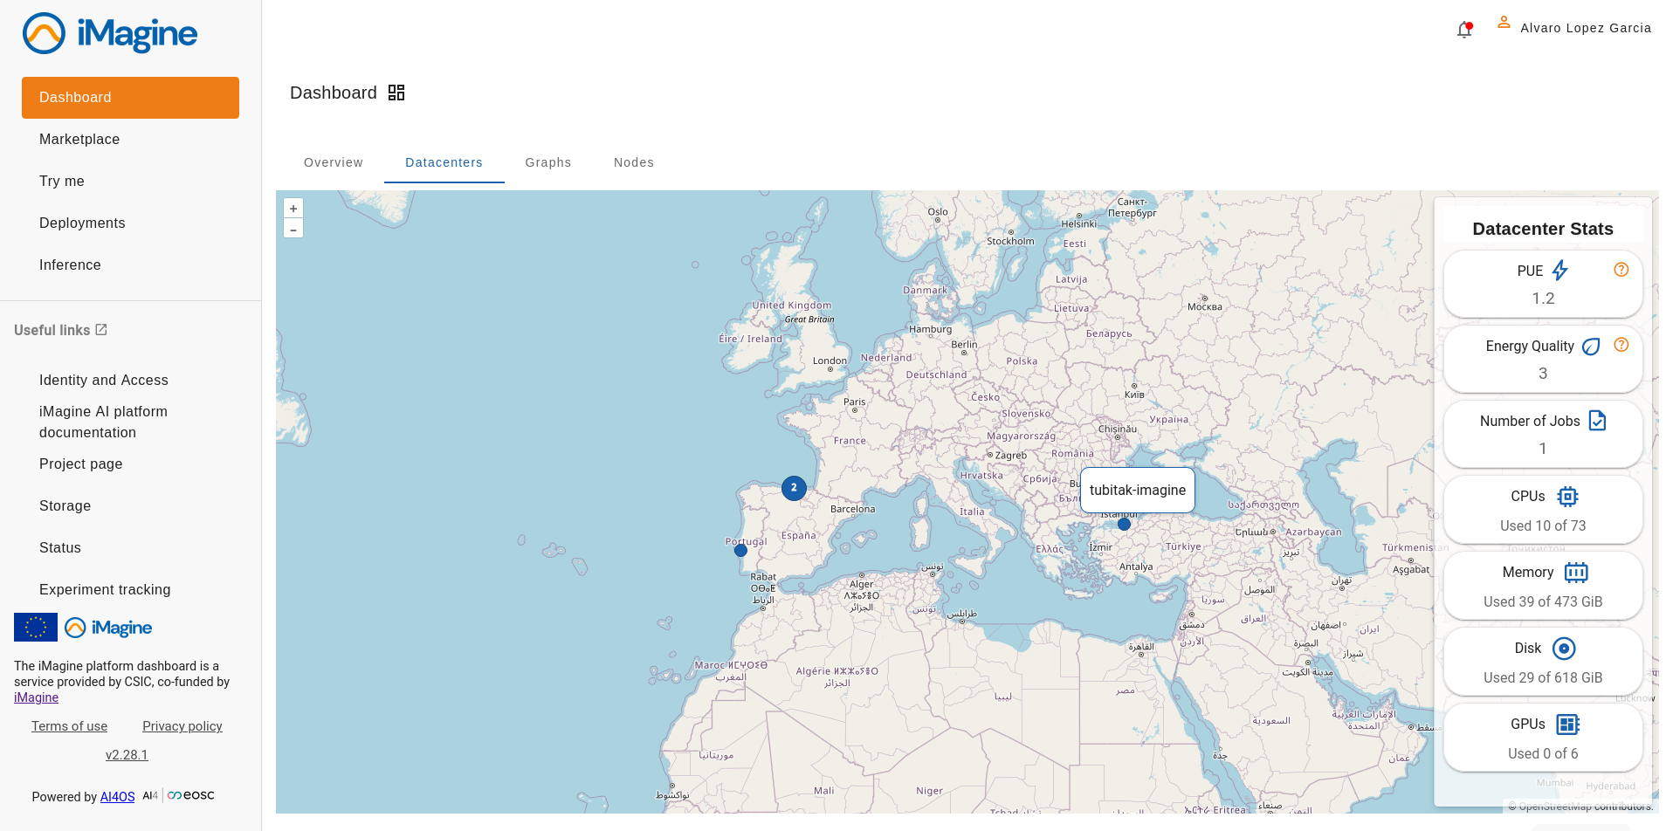
Integration status
Imagine AI development platform (T4.1)
Rolling updates of AI4OS software, providing latest features and preview access for early developments
Production system, actively used by iMagine communities https://dashboard.cloud.imagine-ai.eu/
CSIC, INCD, TUBITAK (GPU), Walton (CPU)
Development testbed https://dashboard.dev.imagine-ai.eu/
CSIC, INCD

Slide 9
Integration status
Imagine AI service platform (T4.2)
Currently exploiting CPU resources for inference
Different application and service delivery scenarios
Dashboard delivery (self-contained in platform)
Standalone bring your own resources (e.g a VM through EGI IM)
Serverless OSCAR clusters (serverless inference)
Catch-all instance (managed by WP4) with automated model update
Dedicated instances per use cases (managed by users)
Deployment of models via platform dashboard / API and automated through CI/CD pipelines

Slide 10
For end users and user communities
Platform features

Slide 11
AI/ML application development lifecycle
Development Training Delivery

Slide 12
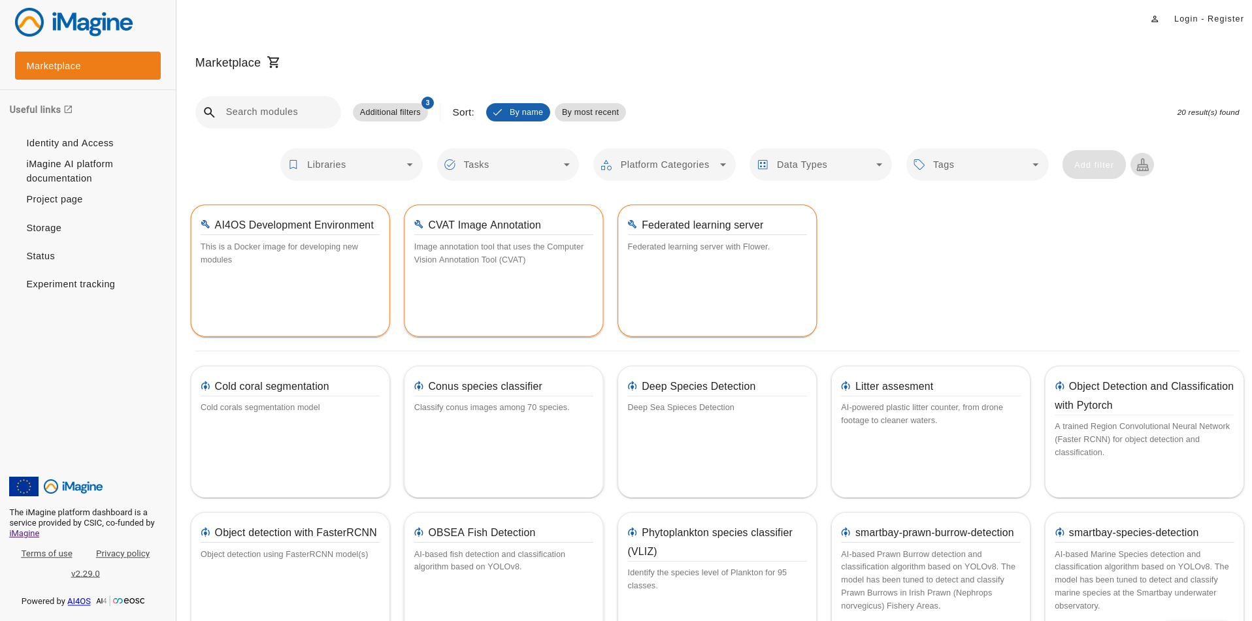
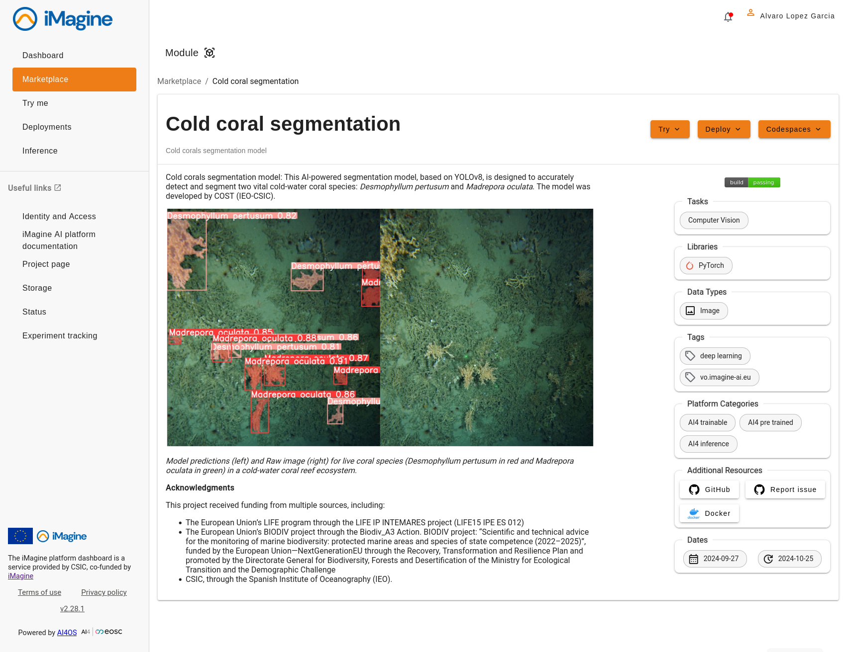
AI platform features and updates
Dashboard and marketplace: new L&F
https://dashboard.cloud.imagine-ai.eu/

Slide 13
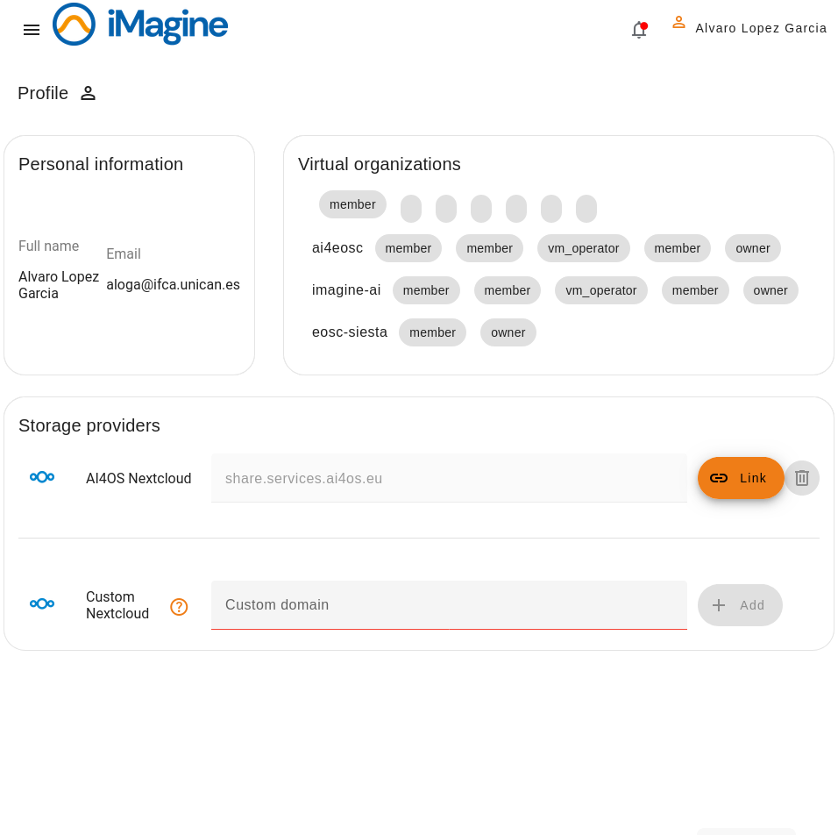
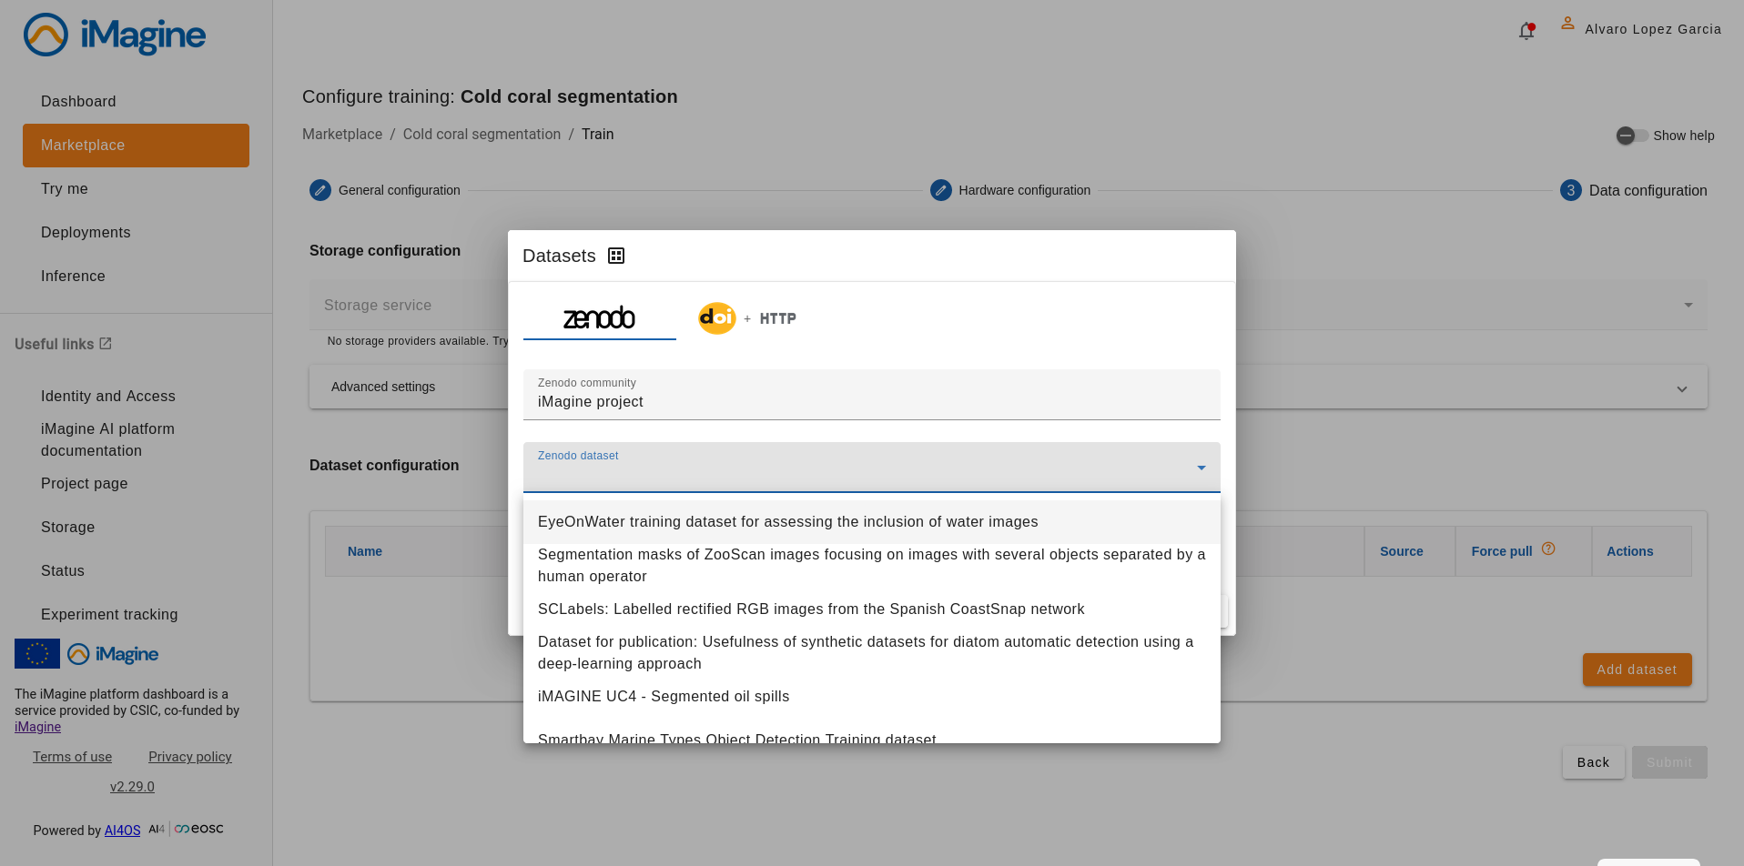
AI platform features and updates
Storage services & data synchronization
The platform allows to link with external storage systems (currently NextCloud)
Once linked, it allows to download and sync data from external sources (default Zenodo) via DOI
FAIR evaluation of datasets performed via FAIR-EVA: https://fair.dev.imagine-ai.eu/en

Slide 14
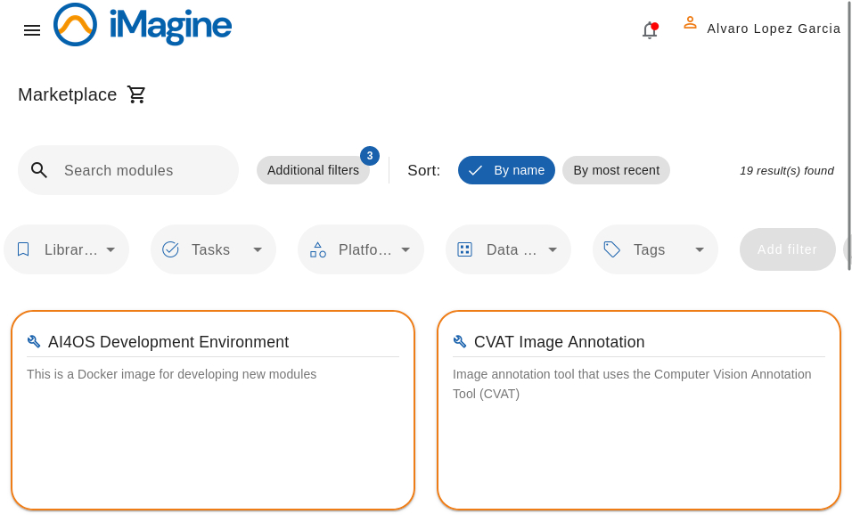
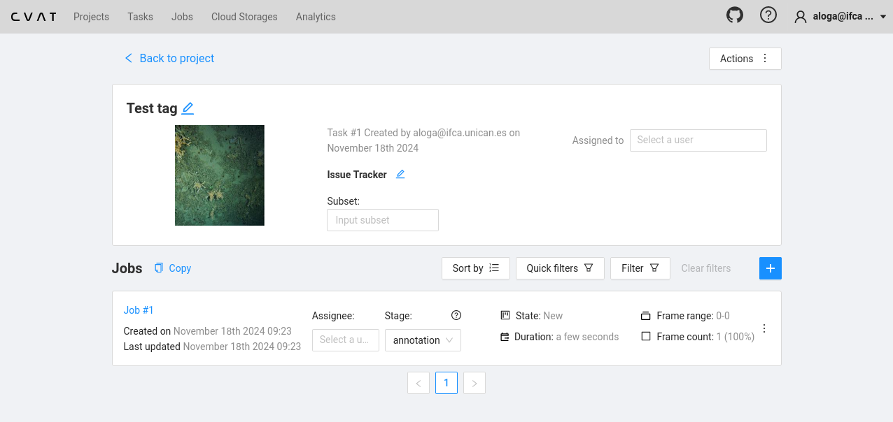
AI platform features and updates
Image annotation tools via the dashboard
Annotations synced with linked storage (e.g. https://share.services.ai4os.eu)
No need to work offline and sync data with the platform

Slide 15
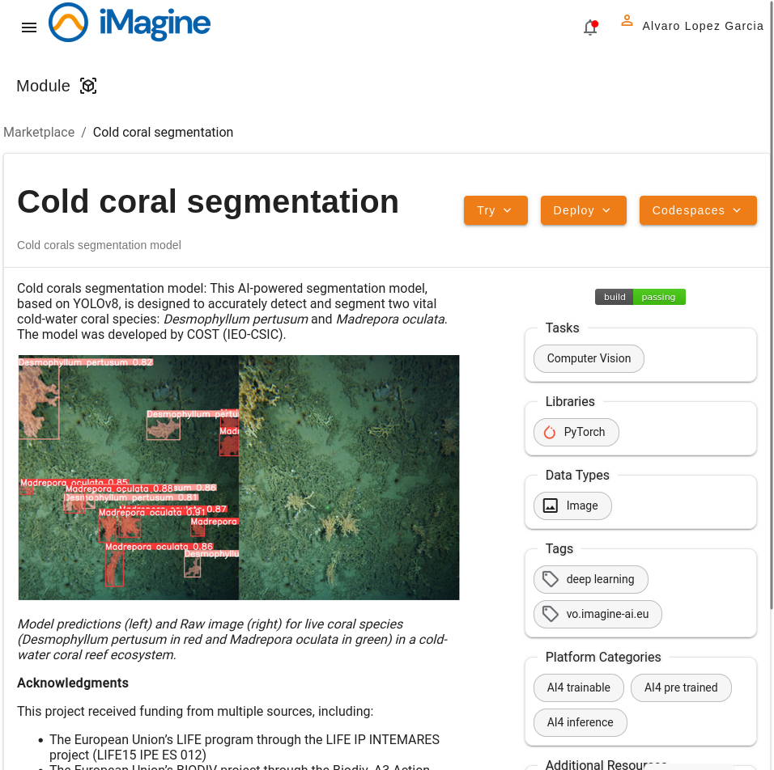
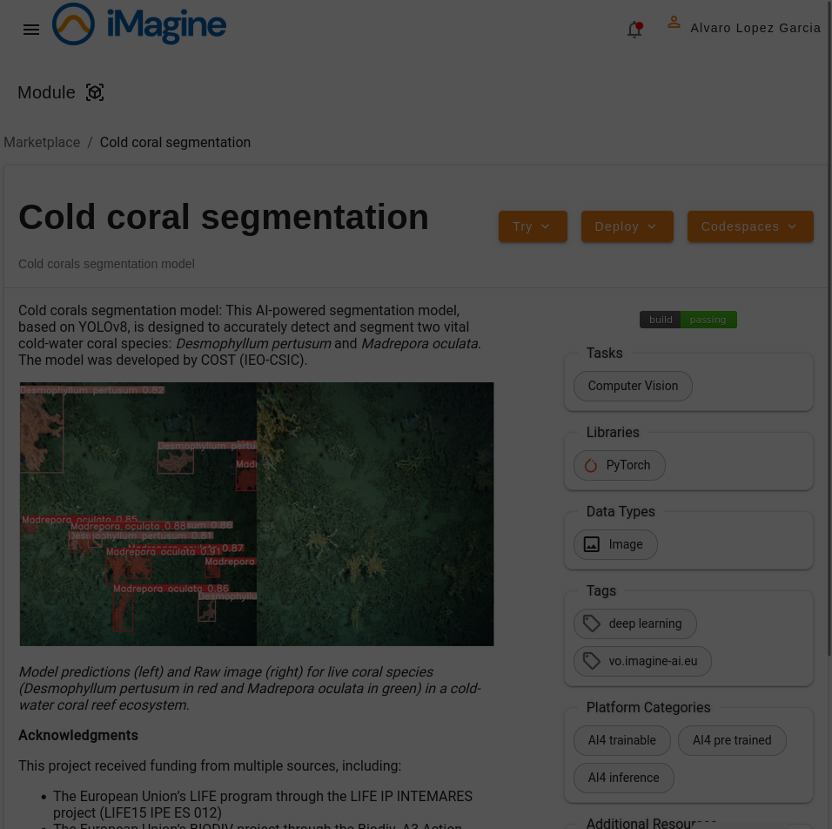
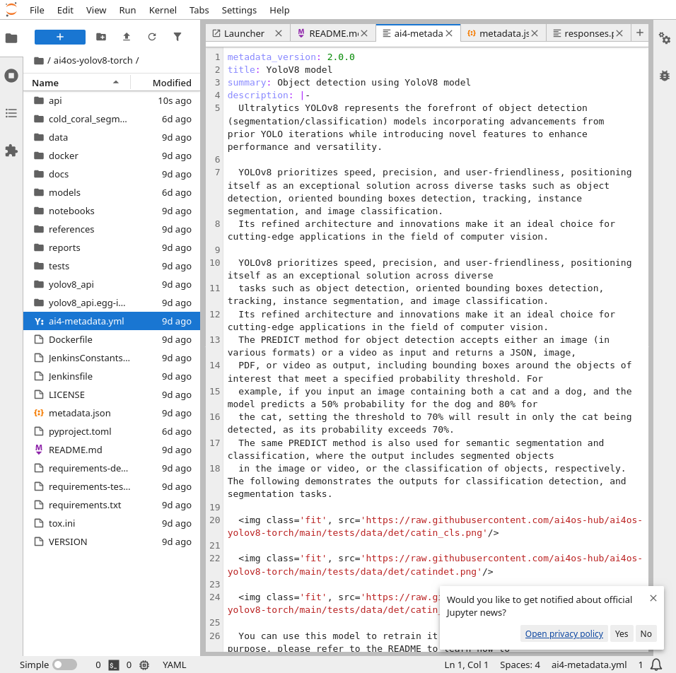
AI platform features and updates
Dashboard as central hub for model management

Slide 16
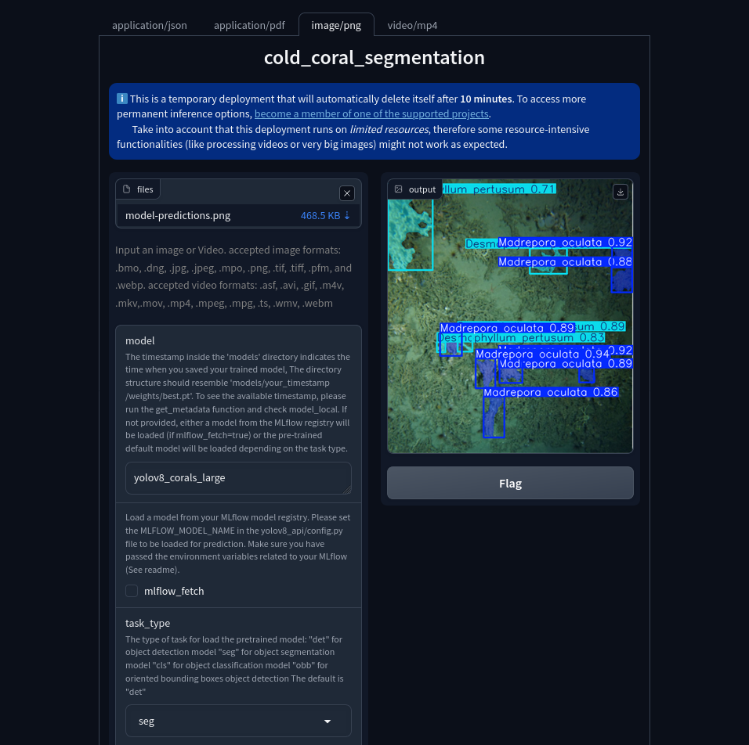
AI platform features and updates
Dashboard as central hub for model management

Slide 17
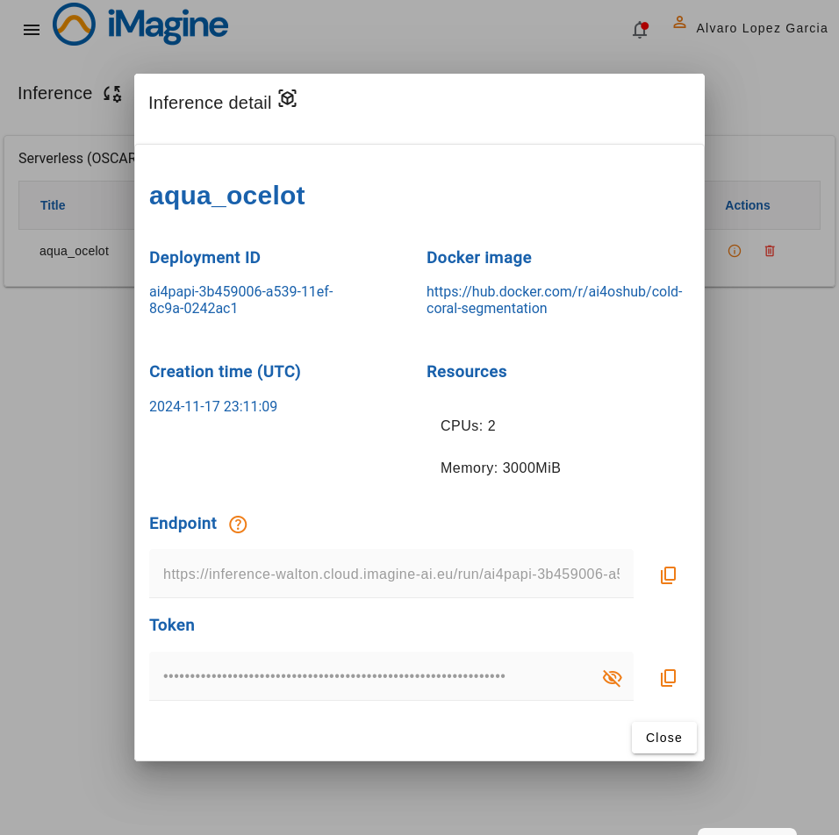
AI platform features and updates
Dashboard as central hub for model management

Slide 18
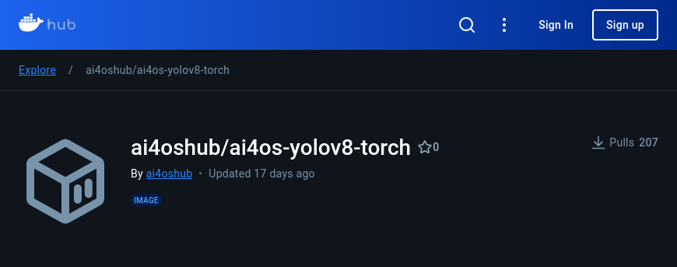
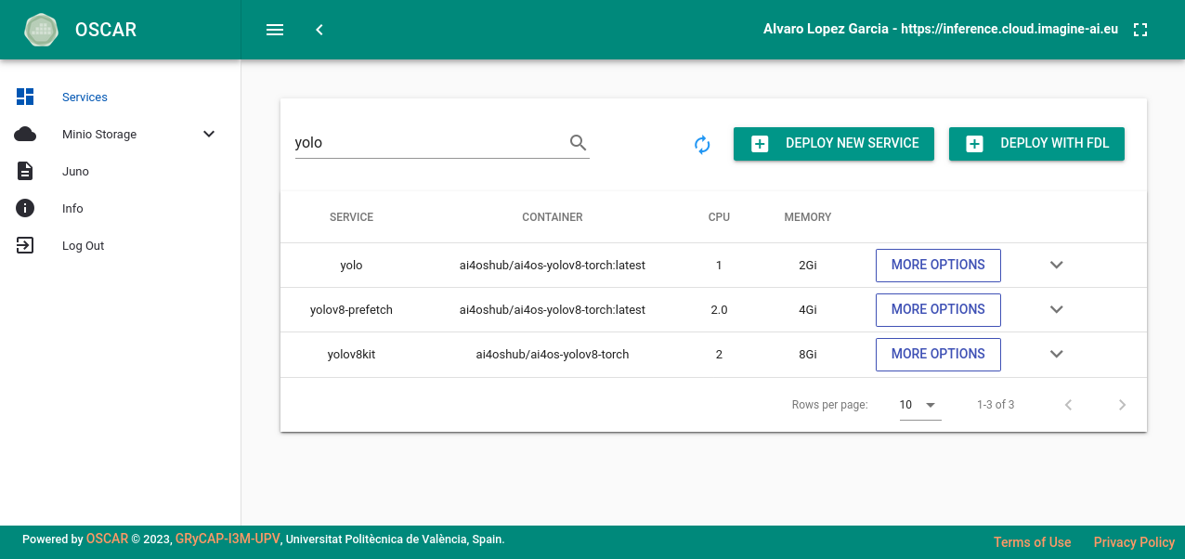
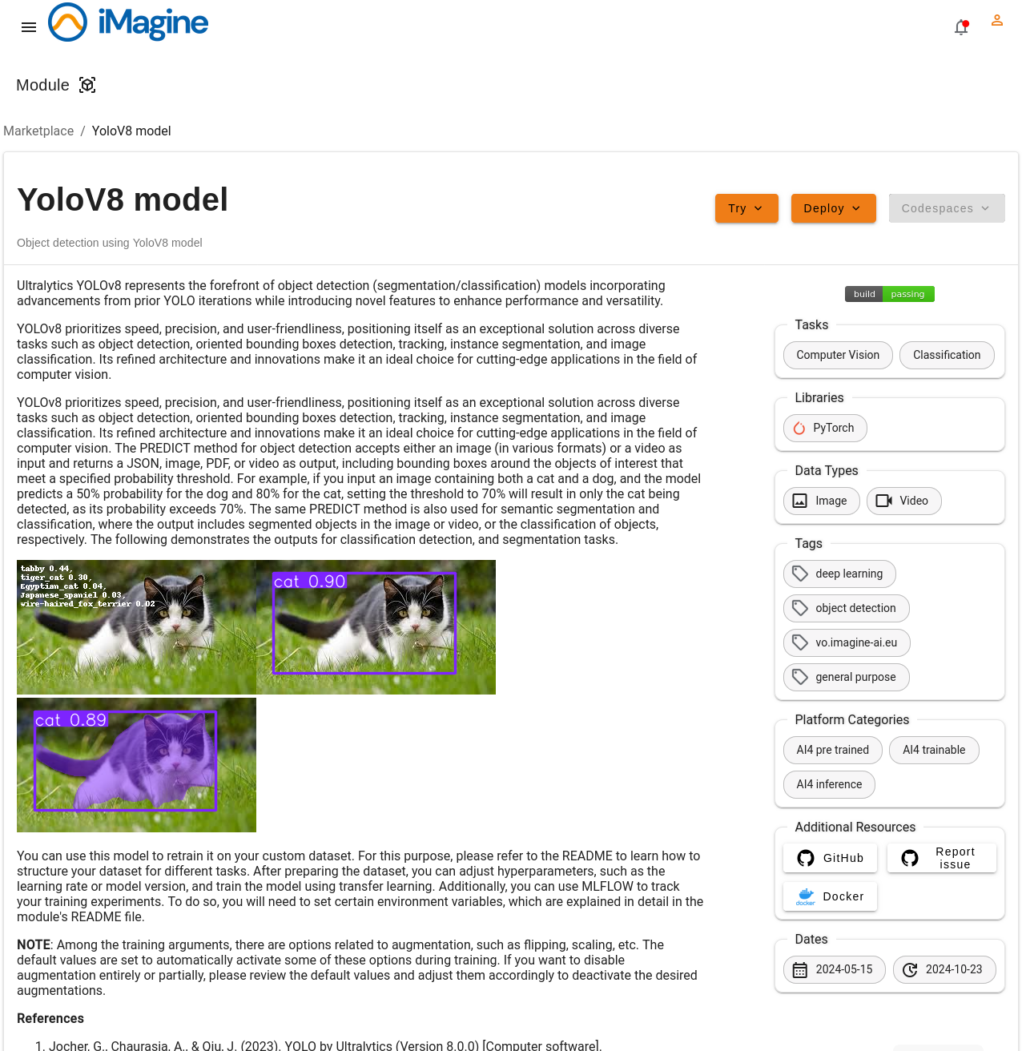
AI platform features and updates
MLOps pipelines, CI and CD

Slide 19
Conclusions, next steps
Wrap-up

Slide 20
Conclusions
And expected (user) features for 2025
PY1-2 PY2: user application development and initial application delivery
Platform: Capacity (GPU, CPU and storage) and integrating providers
User: Codespaces, secret management, storage linking, dataset retrieval, integration of tools (e.g. CVAT and MLFlow)
PY3: final application delivery as services
Work during PY2 to streamline deployment as services: OSCAR (serverless), short-lived try-me, dedicated (platform, cloud)
Expected (relevant) features PY3
Integration of domain specific and model provenance metadata
Zenodo model automated delivery, improved asset linking via metadata
Additional serving architectures (e.g. streaming) to deal with a wide variety of use cases

Slide 21
Thank you!

Slide 22
Backup slides

Slide 23
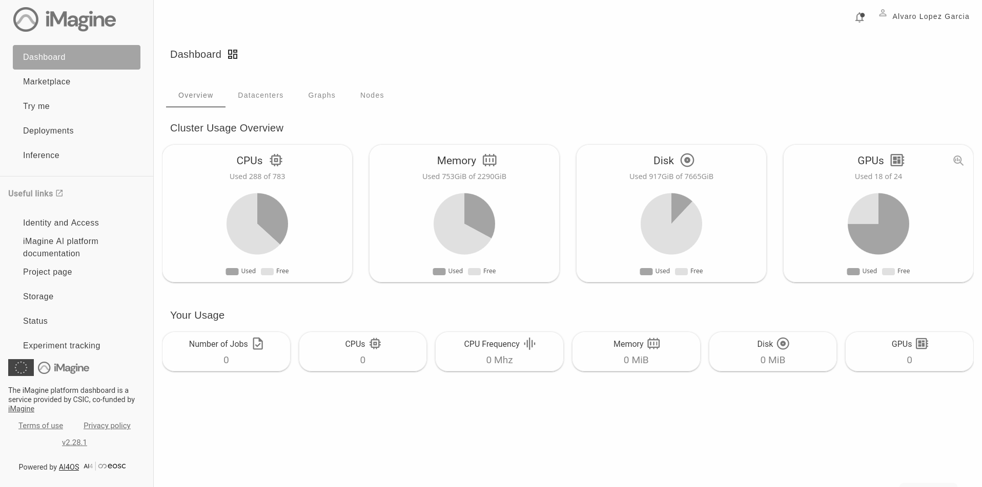
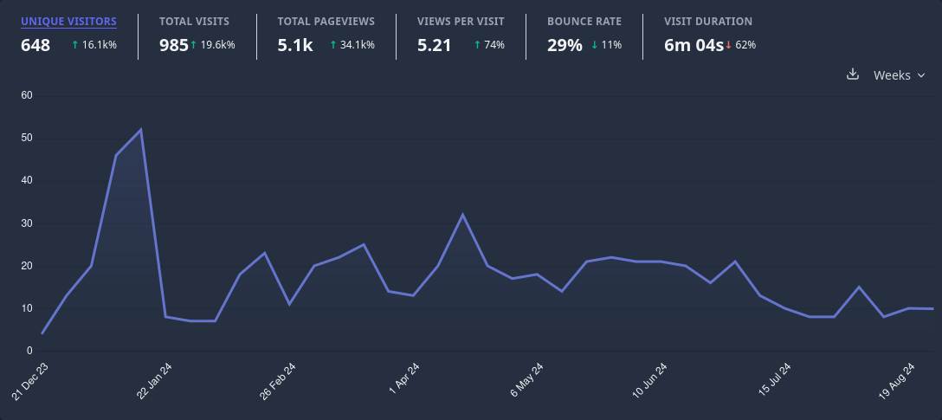
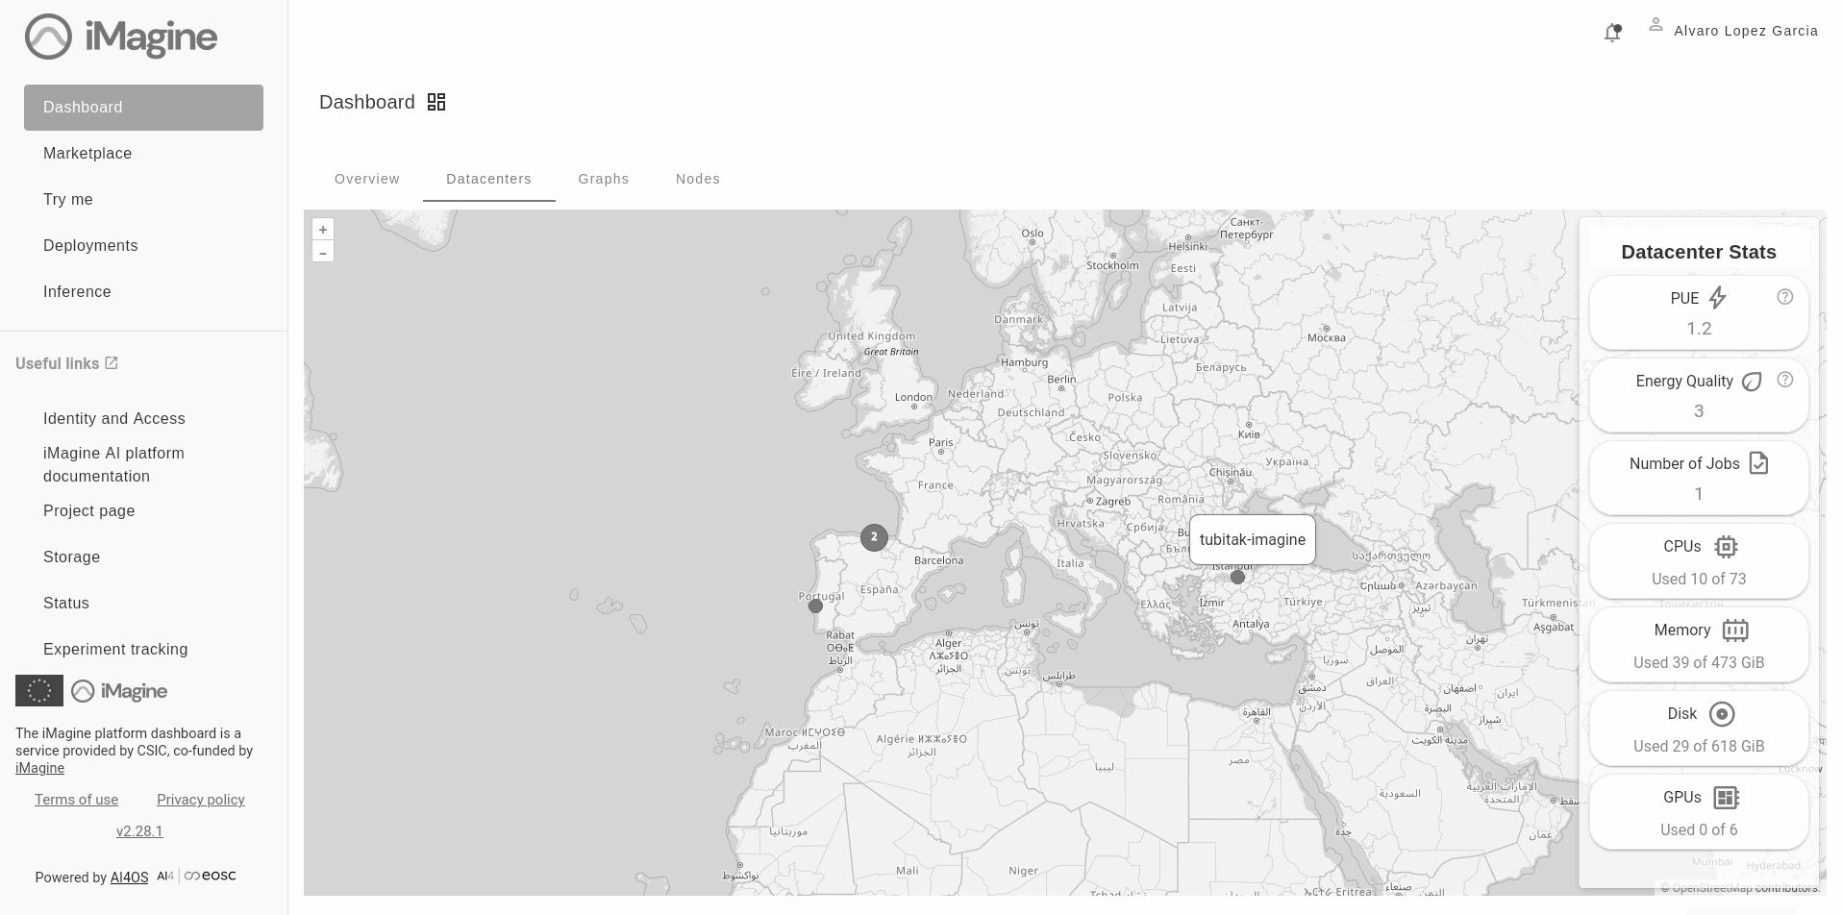
Integration status
Imagine AI development platform (T4.1)
Rolling updates of AI4OS software, providing latest features and preview access for early developments
Production system, actively used by iMagine communities https://dashboard.cloud.imagine-ai.eu/
CSIC, INCD, TUBITAK (GPU), Walton (CPU)
Development testbed https://dashboard.dev.imagine-ai.eu/
CSIC, INCD

Slide 24
Background, ecosystem, collaborations
2016 | 2017 | 2018 | 2019 | 2020 | 2021 | 2022 | 2023 | 2024 | 2025 | 2026 | …
DEEP 3 → AI4EOSC 3 platform
AI4OS → platform agnostic software stack
DEEP Platform and services
AI4EOSC Enhanced AI Platform for the #EOSC
INDIGO-DataCloud PaaS-based cloud solution for e-Science
Collaboration with INFRAEOSC projects
uDocker
PaaS Orchestrator
Infrastructure Manager
Identity and Access Manager
DEEP 1 platform
DEEP 2 platform
DEEP-Hybrid-DataCloud AI/ML/DL PaaS, access to GPUs
iMagine platform, powered by AI4OS
AI Compute platform for
the EOSC Compute Platform
iMagine (powered by AI4OS) AI imaging platform for aquatic sciences
EGI-ACE AI services for the EOSC Compute
Support to SME support
in EOSC DIH
EOSC-Hub
Industry and innovate SME support
Notes:
Technology providers and development: INDIGO, DEEP and AI4EOSC, supporting use cases coming from the EOSC, the EOSC DIH, the EGI-ACE (like INRAE and JRC) and now iMagine

Slide 25
For Operators
Platform features

Slide 26
Next features (RP1)
Expected (user) features for 2024
Final delivery of resource consumption accounting in the dashboard
Improving GPU usage and release
Work in progress for preemptible, interactive jobs
Streamlined model deployment as services
Including initial MLOps pipelines
Distributed learning schemes
Horovod and Tensorflow parameter server
Experiment centric dashboard (Q2 2024)
Integration of related tools (CVAT), tracking (MLFlow), training deployments and service deployments in a single space
Integrating metadata schemes in the model registry and dashboard
Both generic for ML and domain-specific
FAIRness of models and ML assets

Slide 27
Multi-site deployment
A service mesh approach
Platform based on service mesh approach
Nomad: as workload management system
Consul: to enable service mesh
Traefik: to provide LB and proxy for running jobs
AI4-PAPI (AI4 - Platform API)
Unified access to the platform, integrated with EGI AAI
Share-nothing architecture → horizontal scalability
Automation of the deployment through Ansible roles
Additional job (task) types to deliver more complex services
E.g. Image annotation, etc.
AI4OS platform-wide container registry
Harbor https://registry.services.ai4os.eu/

Slide 28
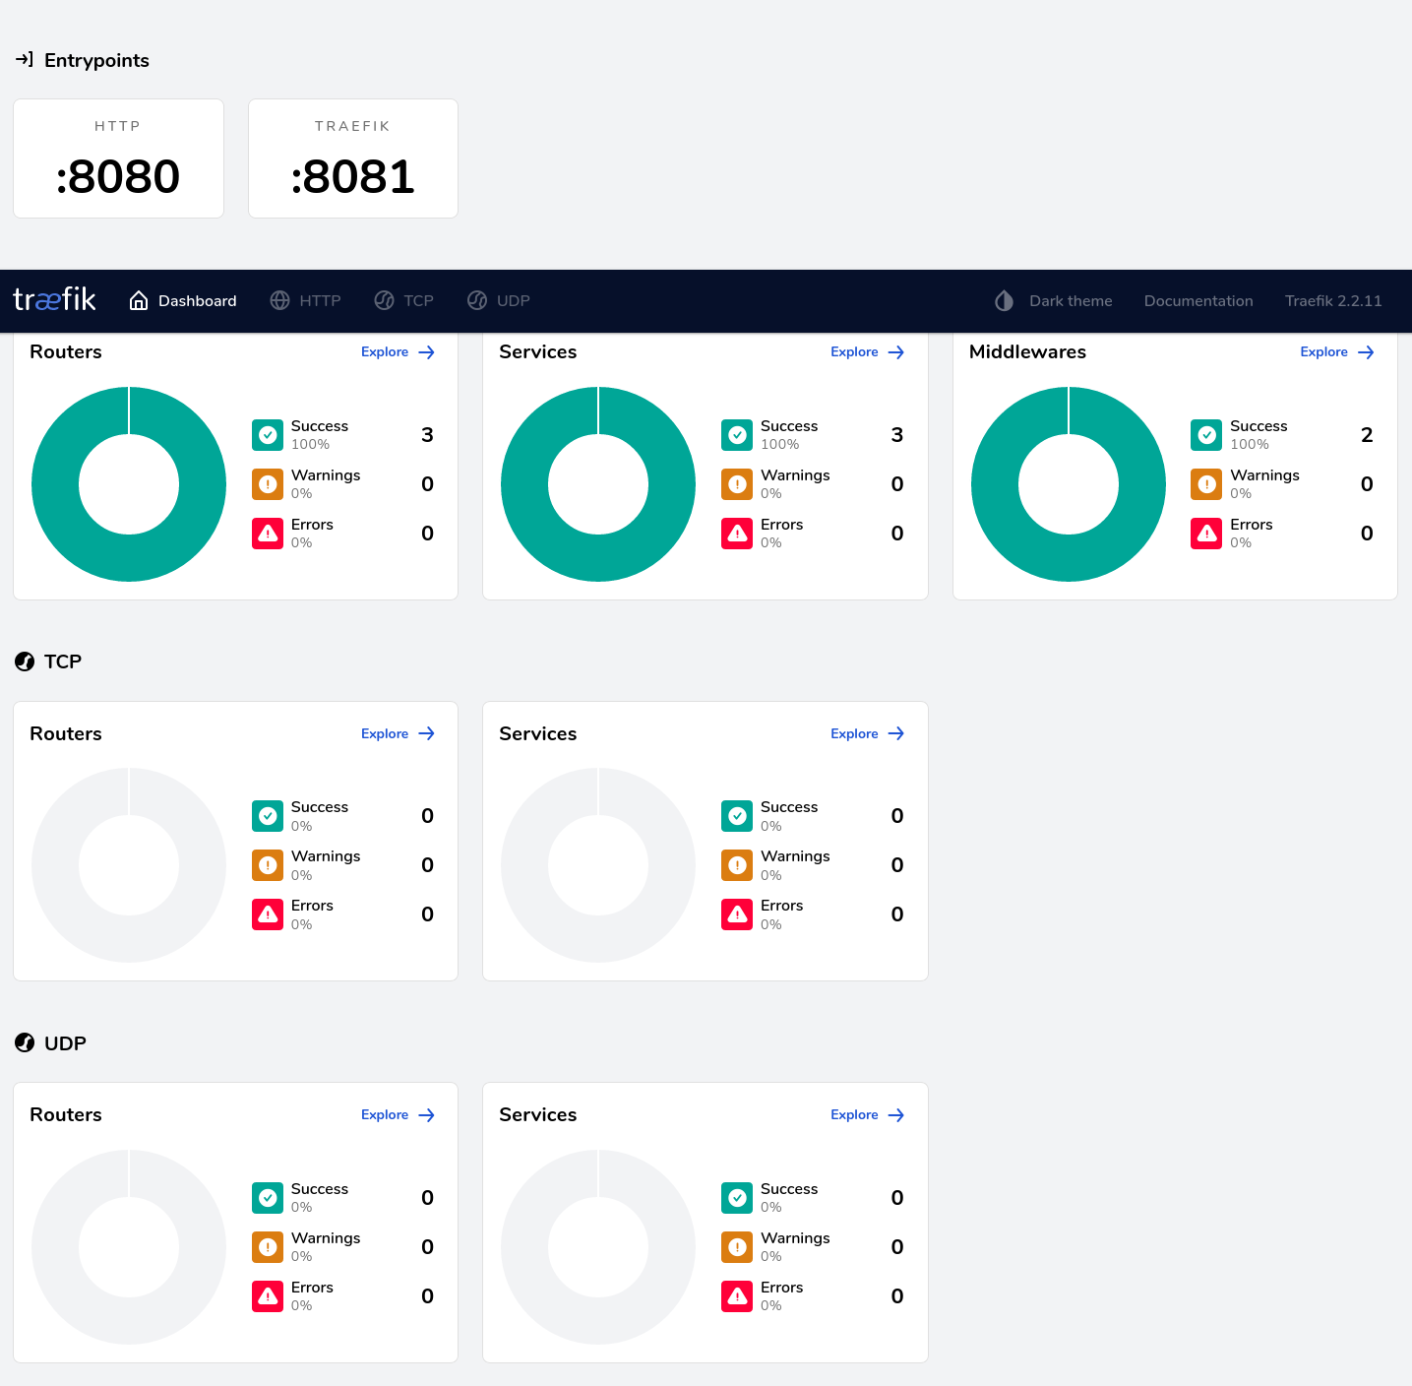
Traefik as service proxy
Providing access to underlying tasks
Rick monitoring of traffic status
Multi-traefik deployment
1 per Nomad datacenter
Pro: ensure access to user jobs in case of failure of other sites
Con: hostname will change if tasks are migrated
Dynamic creation of endpoints (secure) for user tasks, e.g.:
IDE
API
Monitoring
Federated server

Slide 29
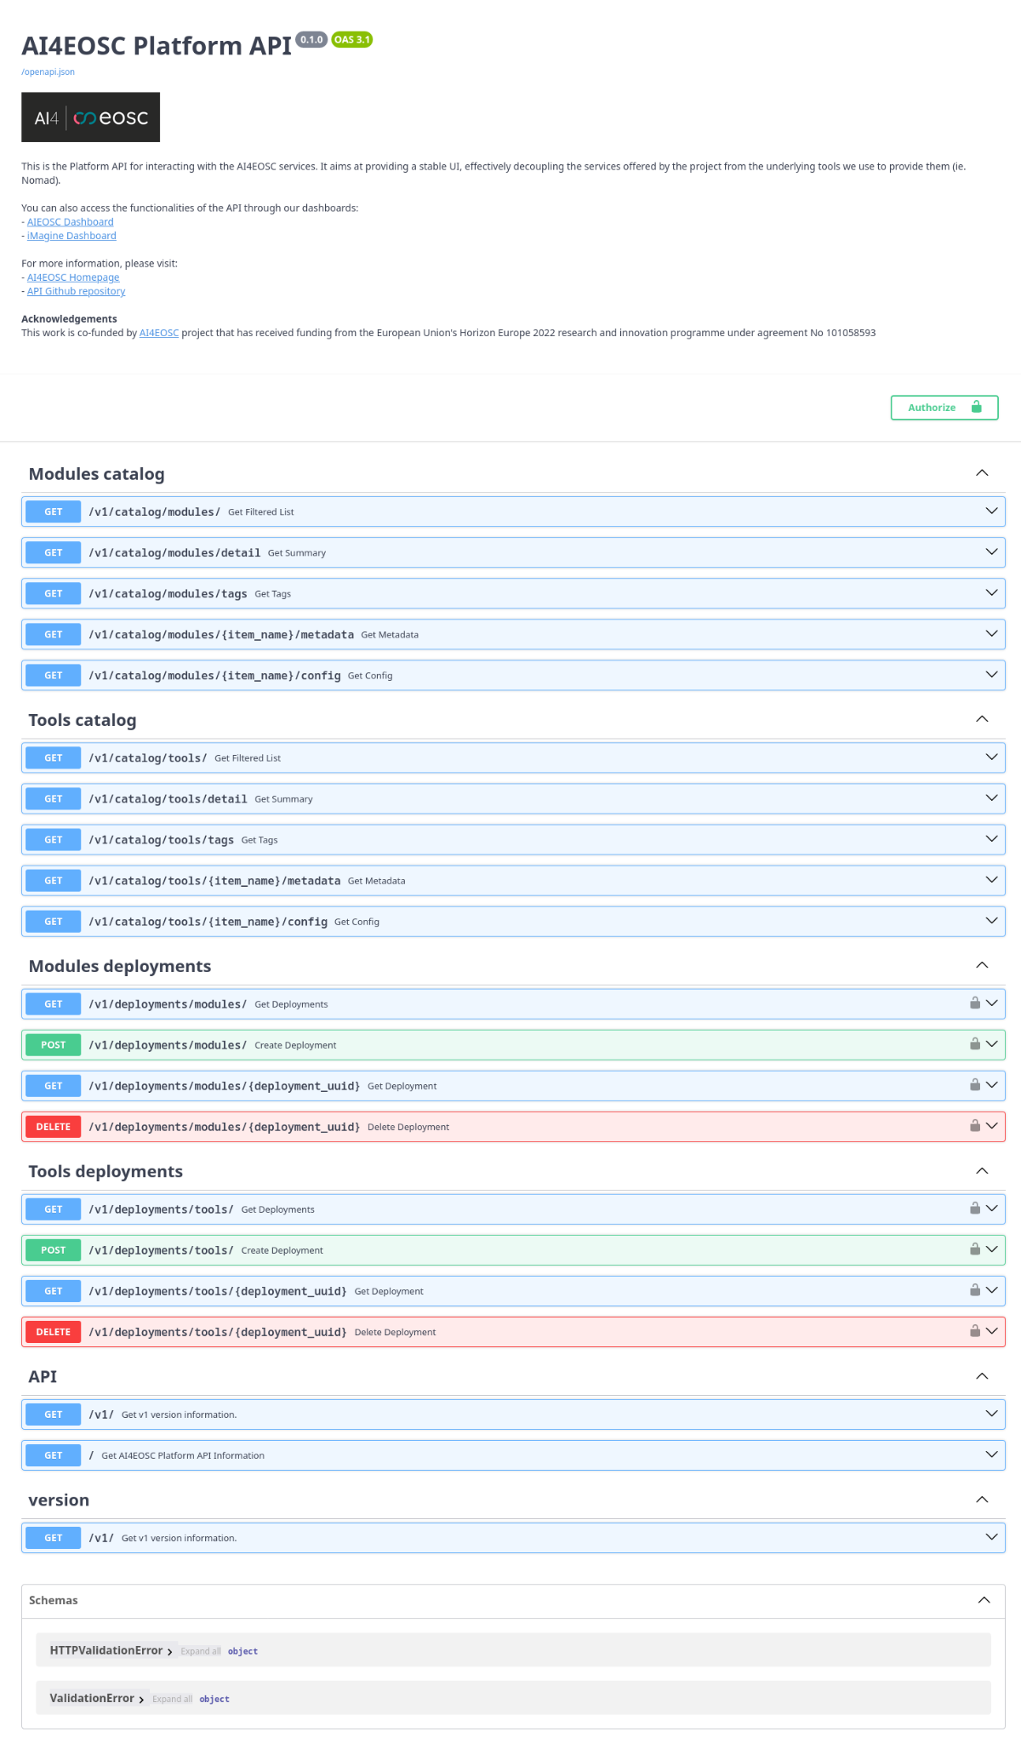
AI4-Platform API
Operator features
Nomad provides very basic AuthN/Z system
AI4-PAPI proxies user requests to the platform
i.e. no direct access to Nomad for the users
Additional sidecar containers and tasks
Storage sidecar container
Currently supporting remote mounting through rclone
Integrating with EOSC-RAISE storage
Creation of metering tasks
Fine-grained accounting system
Execution of complex tooling deployments
E.g. image annotation, development environments, tracking services…
Multi-API deployments are possible
Share-nothing architecture and stateless service

Slide 30
Platform next steps
Expected (operators) features for 2024
Streamlining integration of new sites
Semi-automatically through Ansible (done)
Implement automation through IM (mid-term)
Delivering iMagine AI Application Deployment Service
Initial work ongoing, but waiting for WP5 work to start
Different possibilities for deployment:
Through IM an a different cloud (done)
Through OSCAR in a platform-managed cluster (partially done)
Through OSCAR in user own resources (in progress)
Through AI4-PAPI in iMagine AI platform resources (planned)

Slide 31
For Operators
Platform Architecture

Slide 32
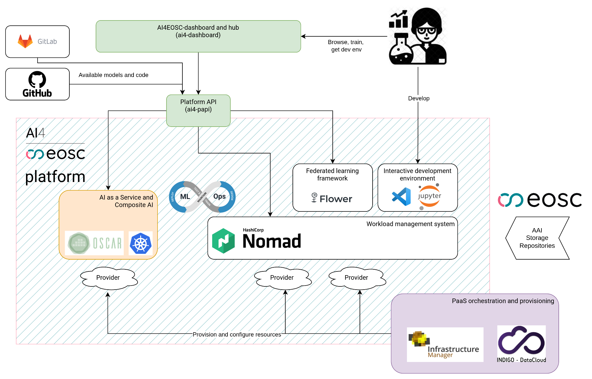
AI4OS high level architecture
Detailed C4 architecture can be found here:
Workspace https://structurizr.com/share/73873/2f769b91-f208-41b0-b79f-5e196435bdb1
Diagrams: https://structurizr.com/share/73873/2f769b91-f208-41b0-b79f-5e196435bdb1/images

Slide 33
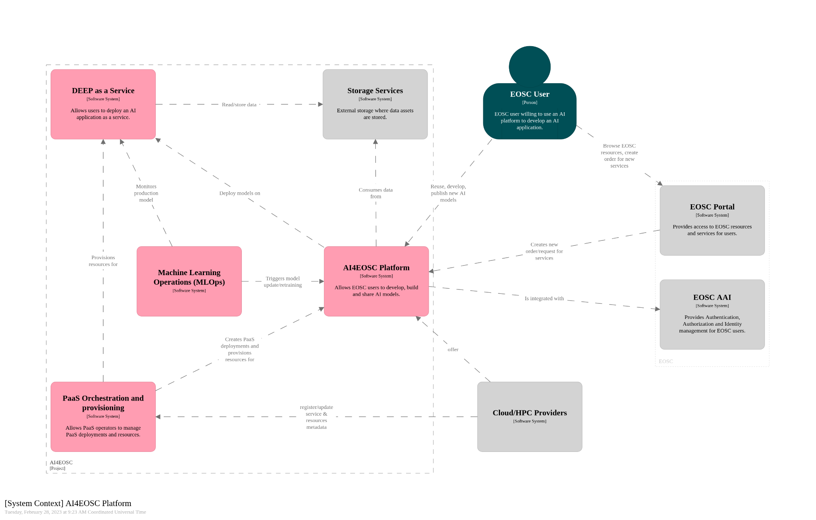
iMagine AI Platform system context (C4 Model)

Slide 34
For users
Platform features

Slide 35
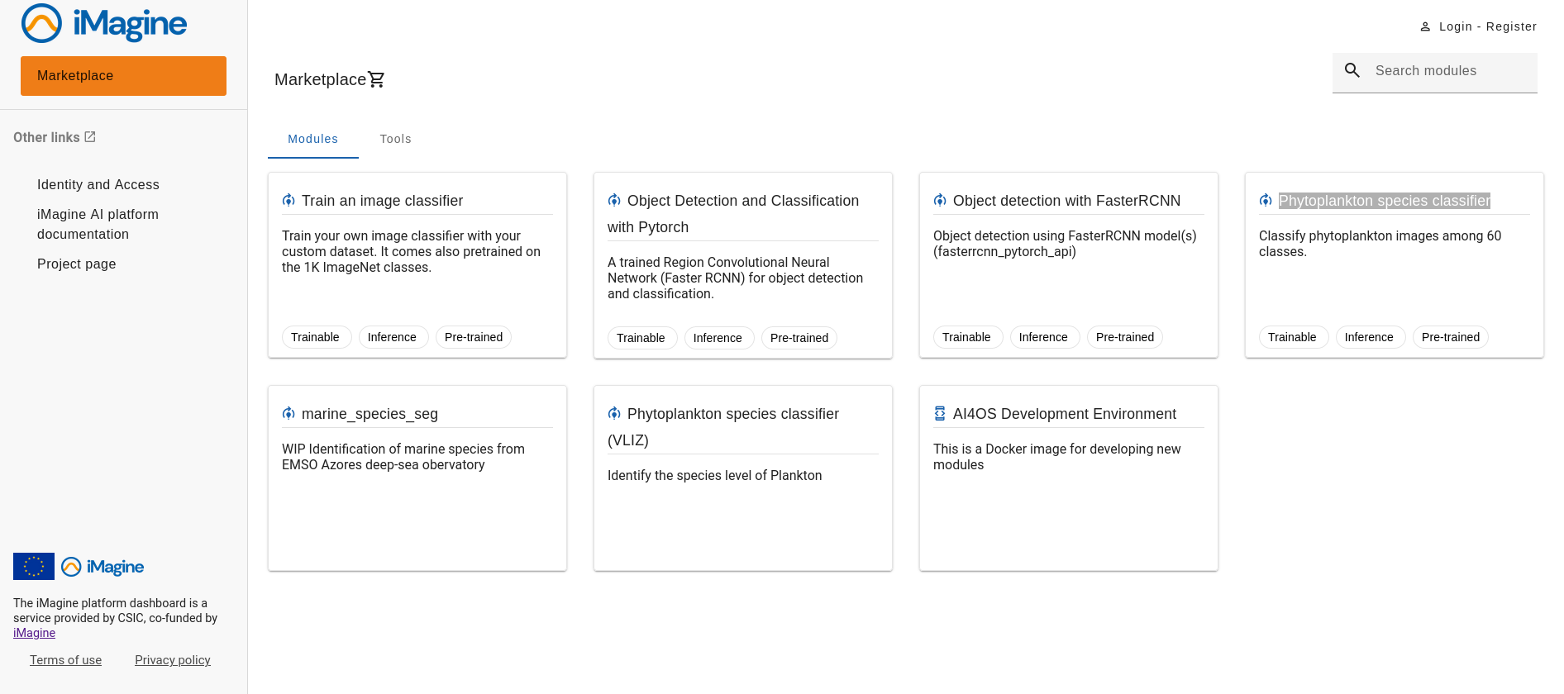
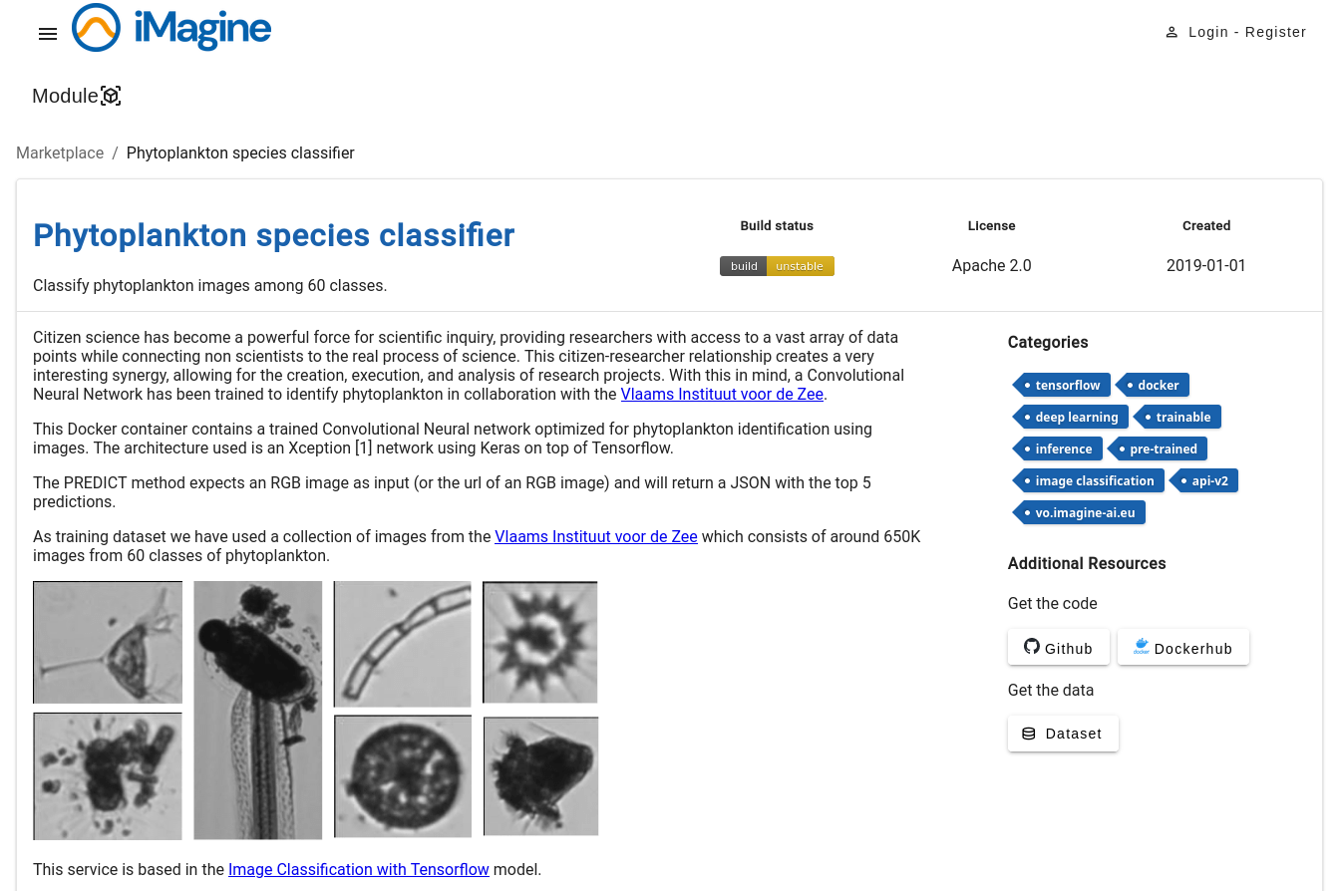
Services for AI/ML development
Model marketplace
https://dashboard.cloud.imagine-ai.eu/marketplace
https://marketplace.eosc-portal.eu/services/imaging-ai-platform-for-aquatic-science

Slide 36
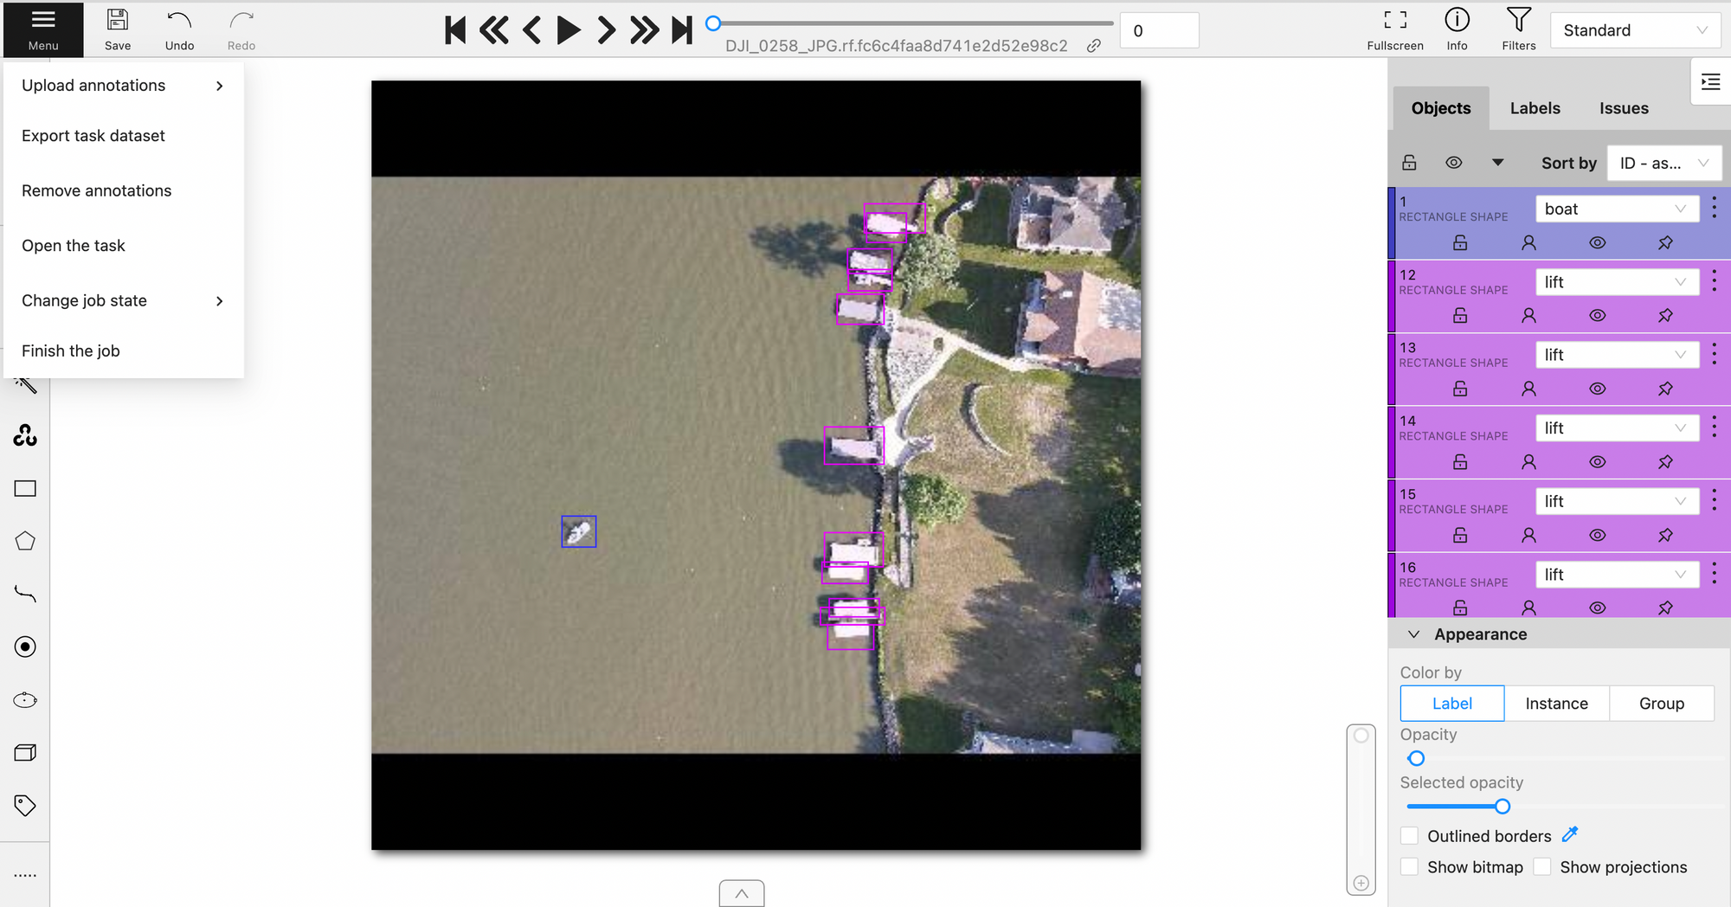
Services for AI/ML development
Dev tools: CVAT annotation

Slide 37
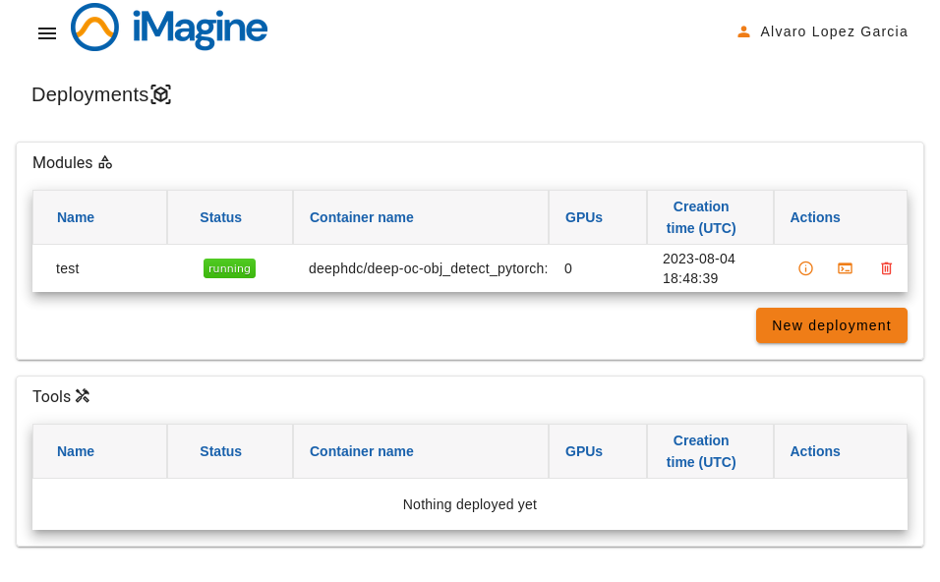
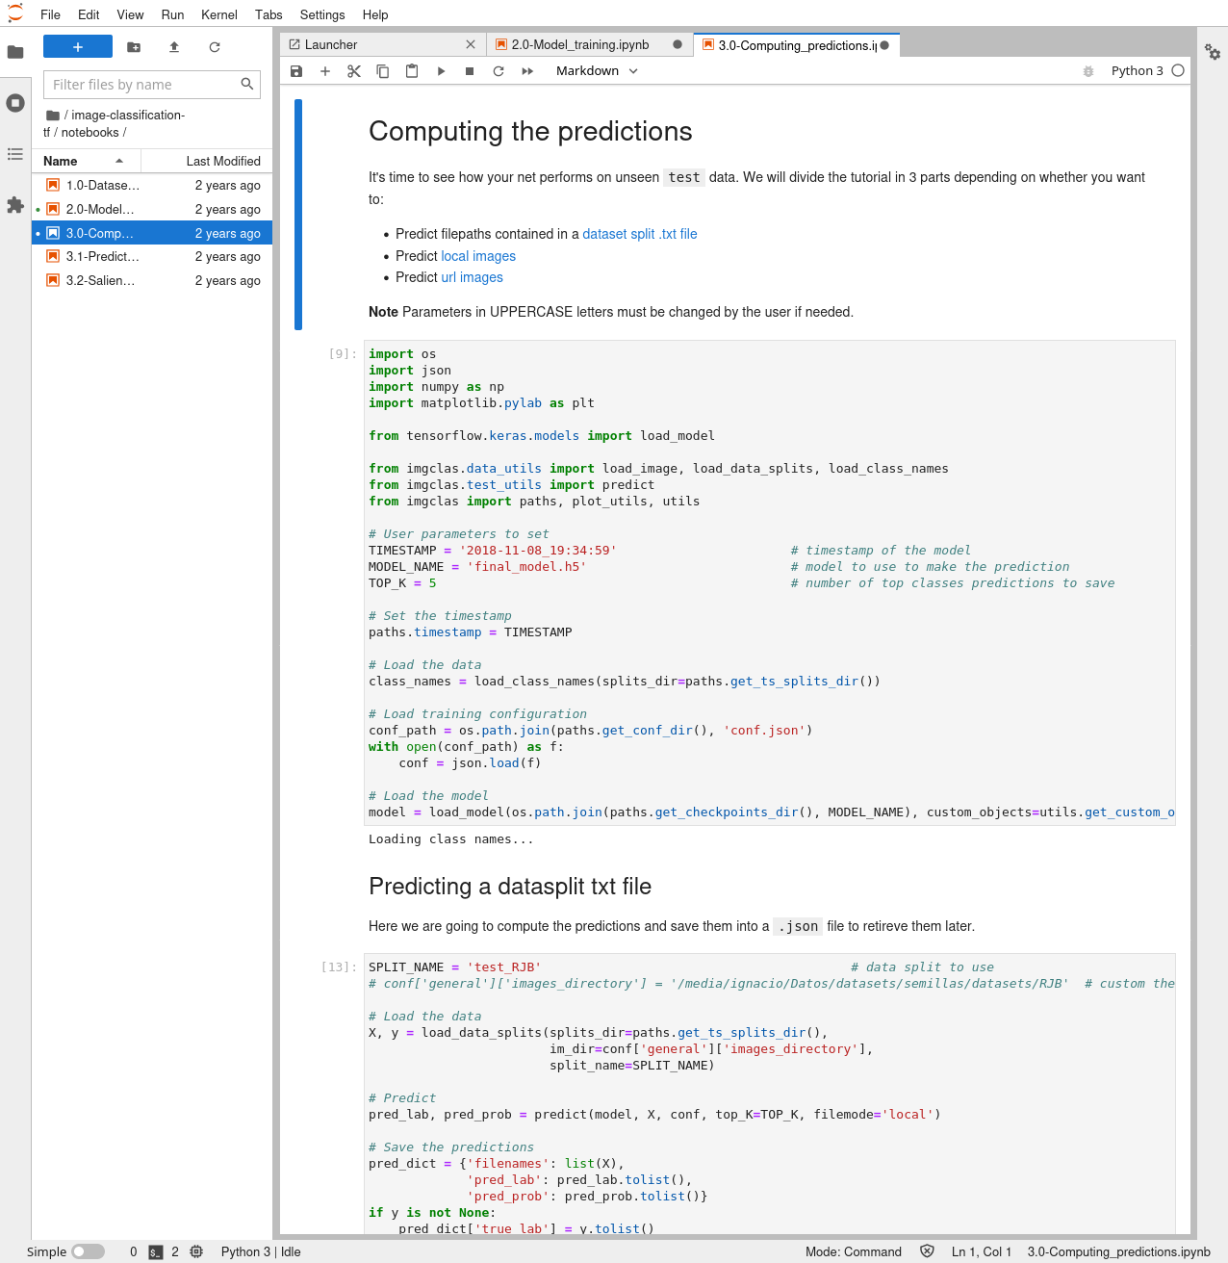
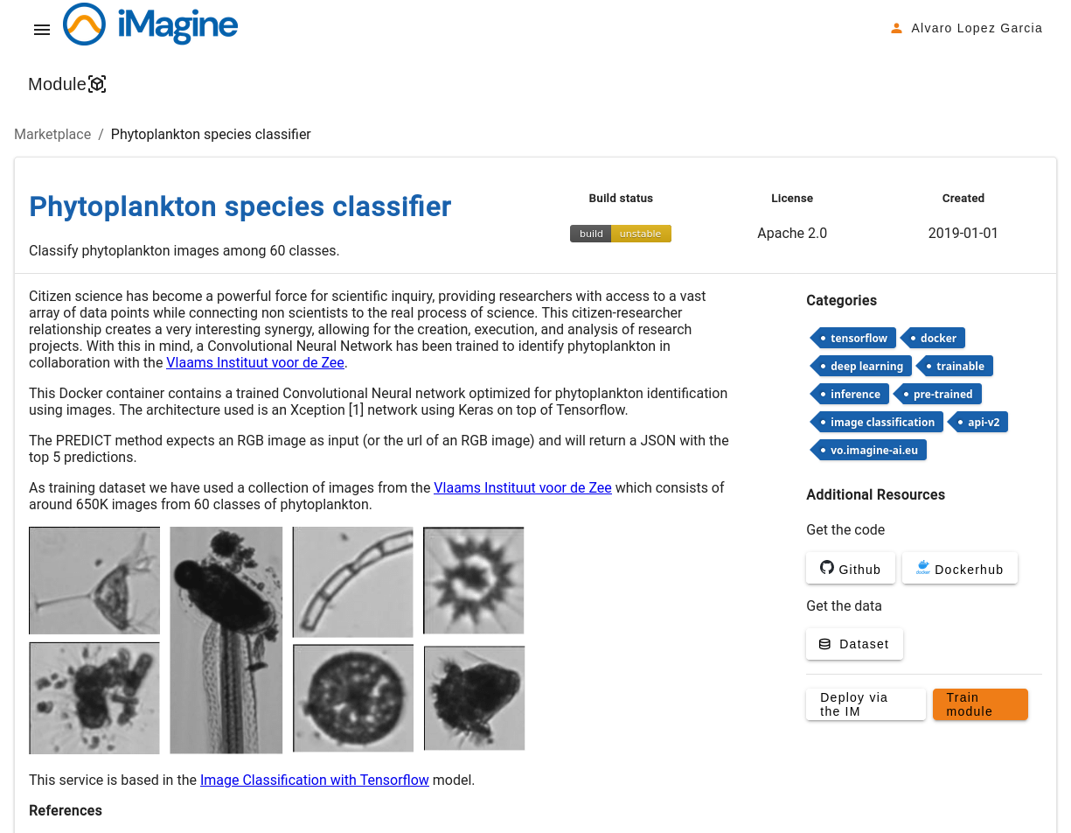
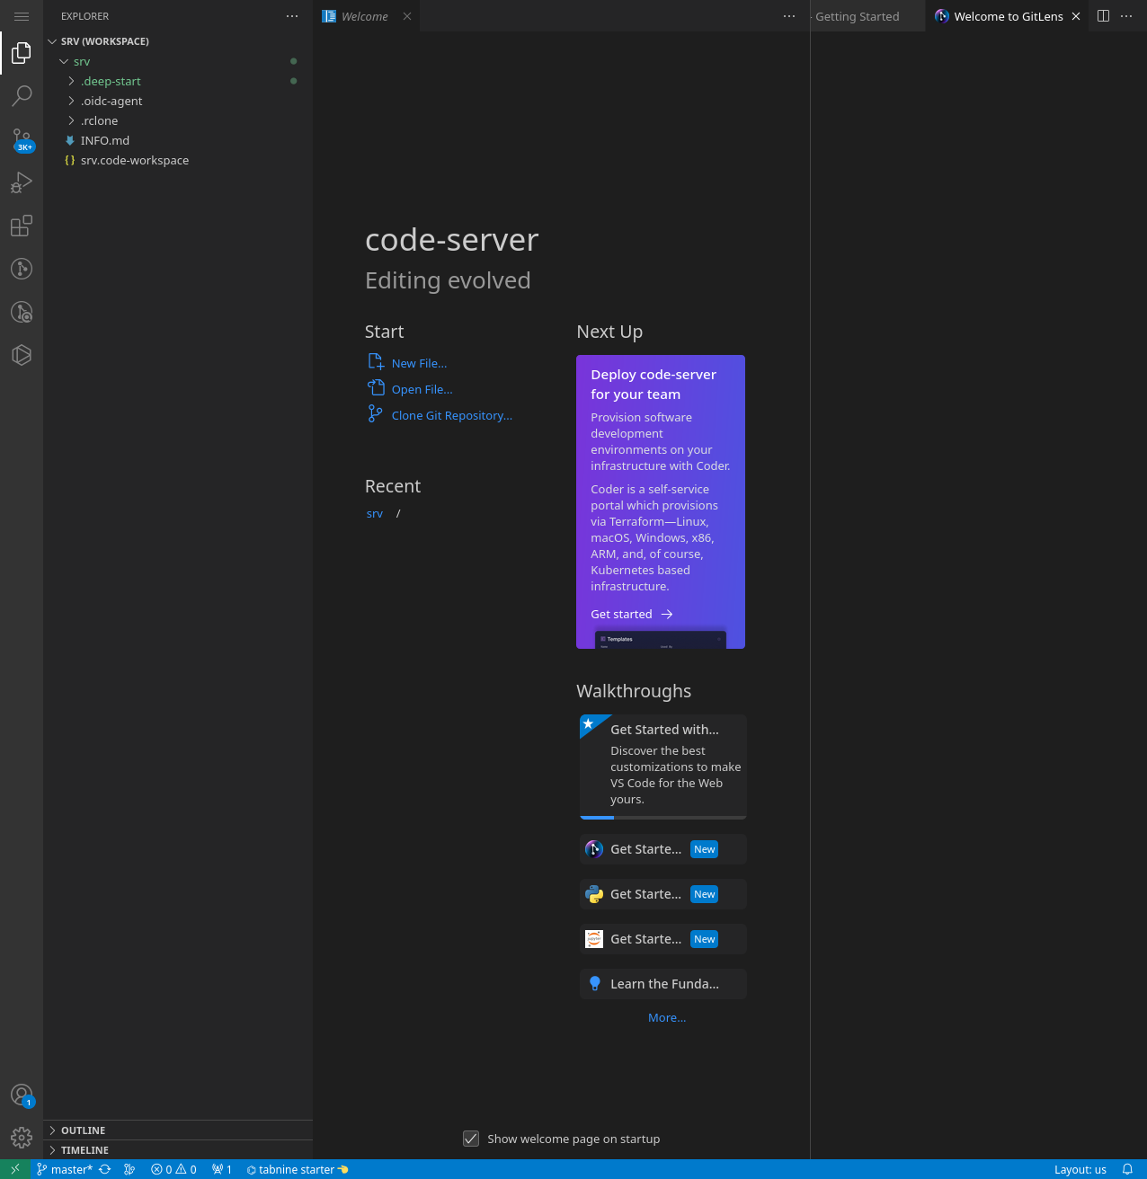
Services for AI/ML development
Dev tools: sandbox and online IDE

Slide 38
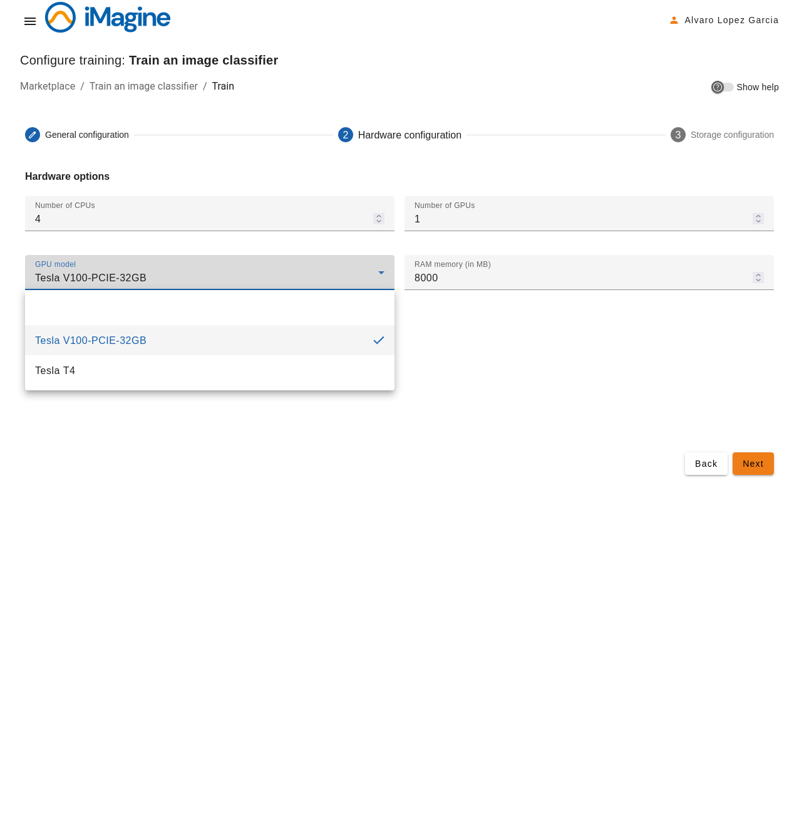
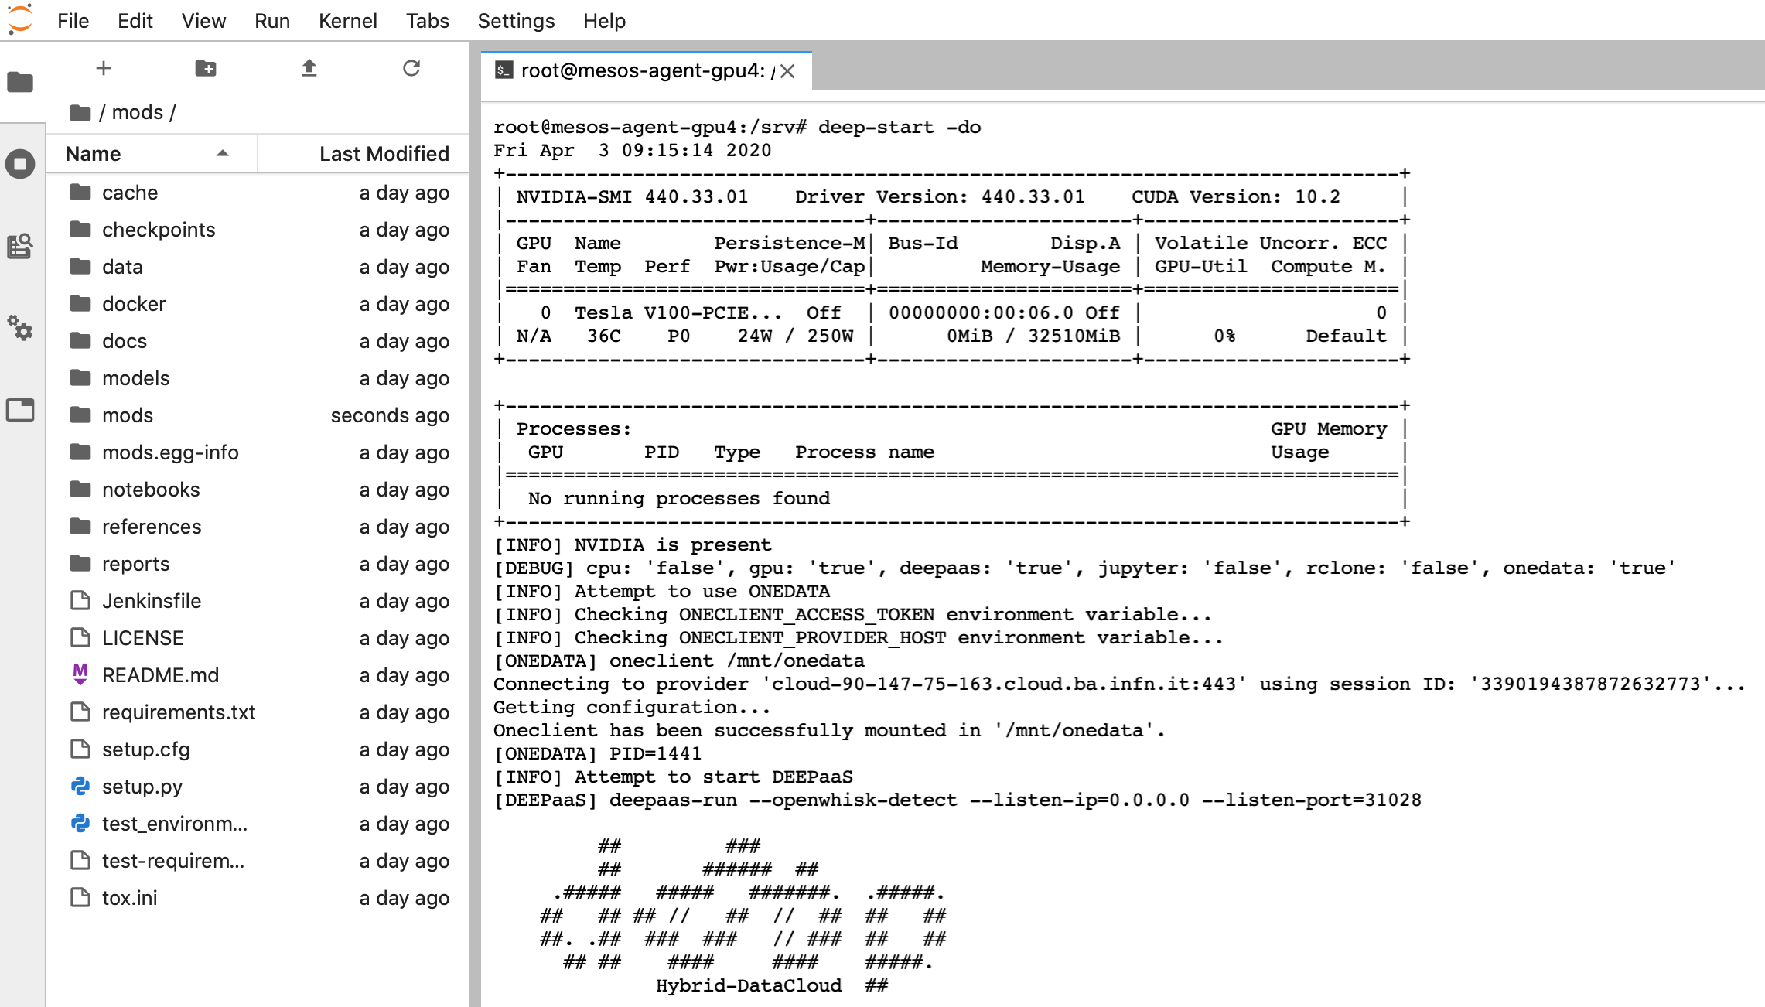
Services for AI/ML development
Training: Transparent GPU access

Slide 39
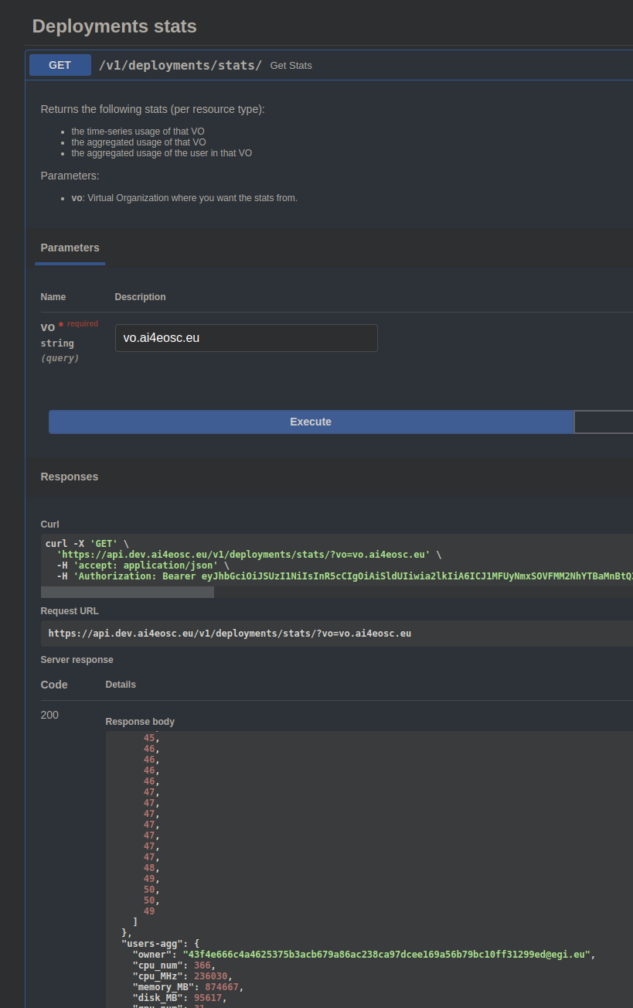
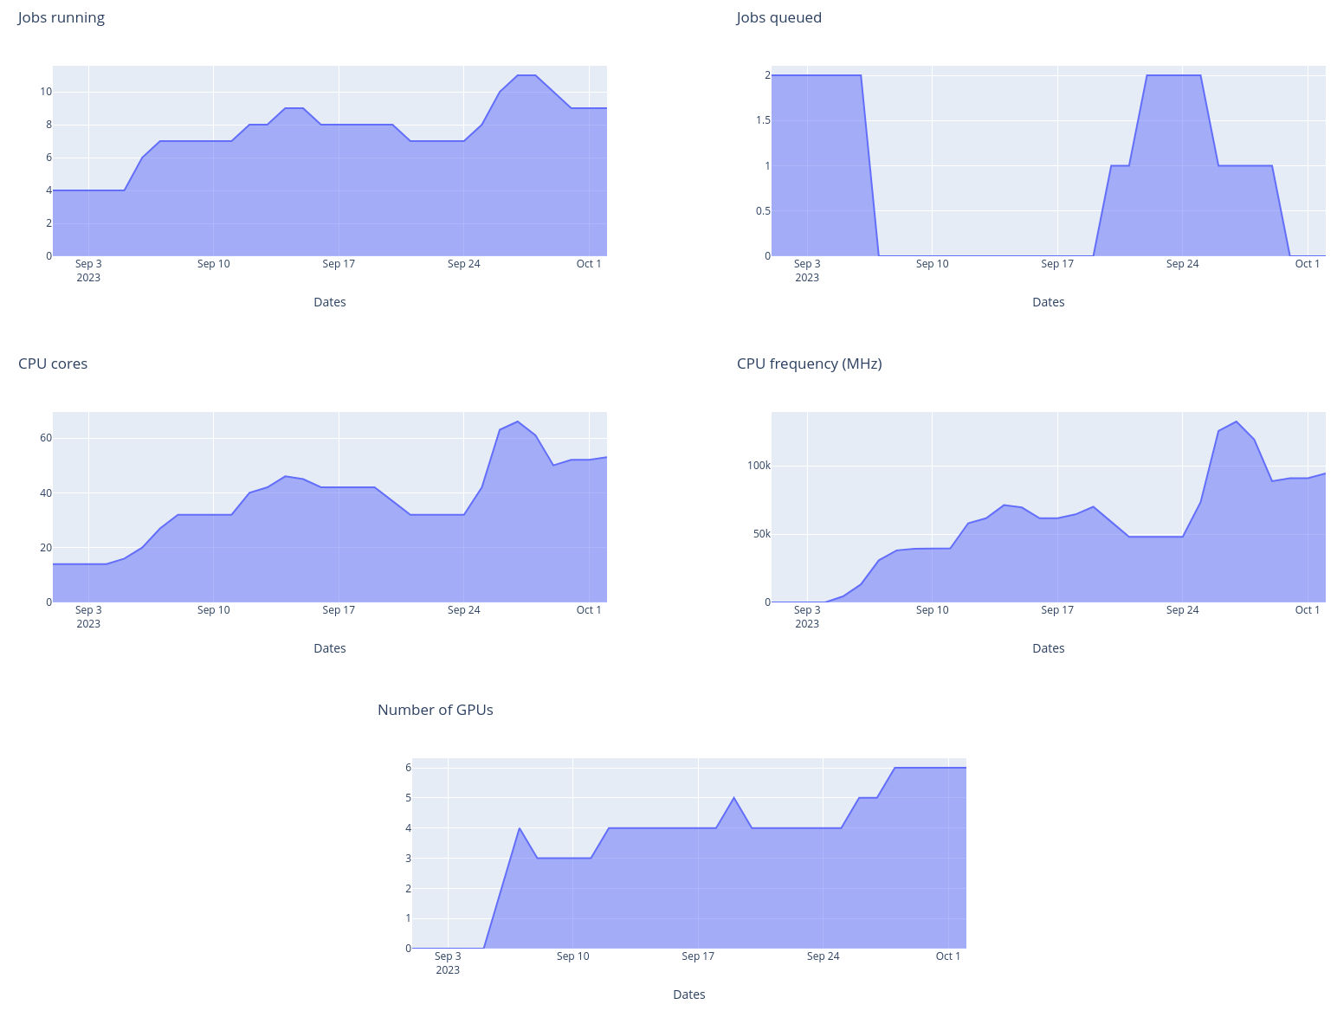
Services for AI/ML development
Training: Transparent GPU and storage
Automatic platform tasks to collect information from running jobs, then aggregation is performed
Time series delivered directly by API
Integration in upstream dashboard is in progress
Sidecar containers
Handle complex tasks transparently for the users
Provide access to different external storage technologies
Platform independent of image sources and storage systems

Slide 40
Services for AI/ML development
Deploy and monitor
Deployment
Providing services for deployment as services:
Through IM an a different cloud (done)
Through OSCAR in a platform-managed cluster
https://inference.cloud.imagine-ai.eu/ui/ (partially done)
Through OSCAR in user own resources (in progress)
Through AI4-PAPI in iMagine AI platform resources (planned)
Composite-AI tools (visually build more complex models)
http://flows.dev.imagine-ai.eu/ (in progress)
MLOps
CI/CD for ML development, deployment, monitoring and operations
https://jenkins.services.ai4os.eu/
Monitoring
Tools to instrument ML models in production (i.e. drift detection)

Slide 41
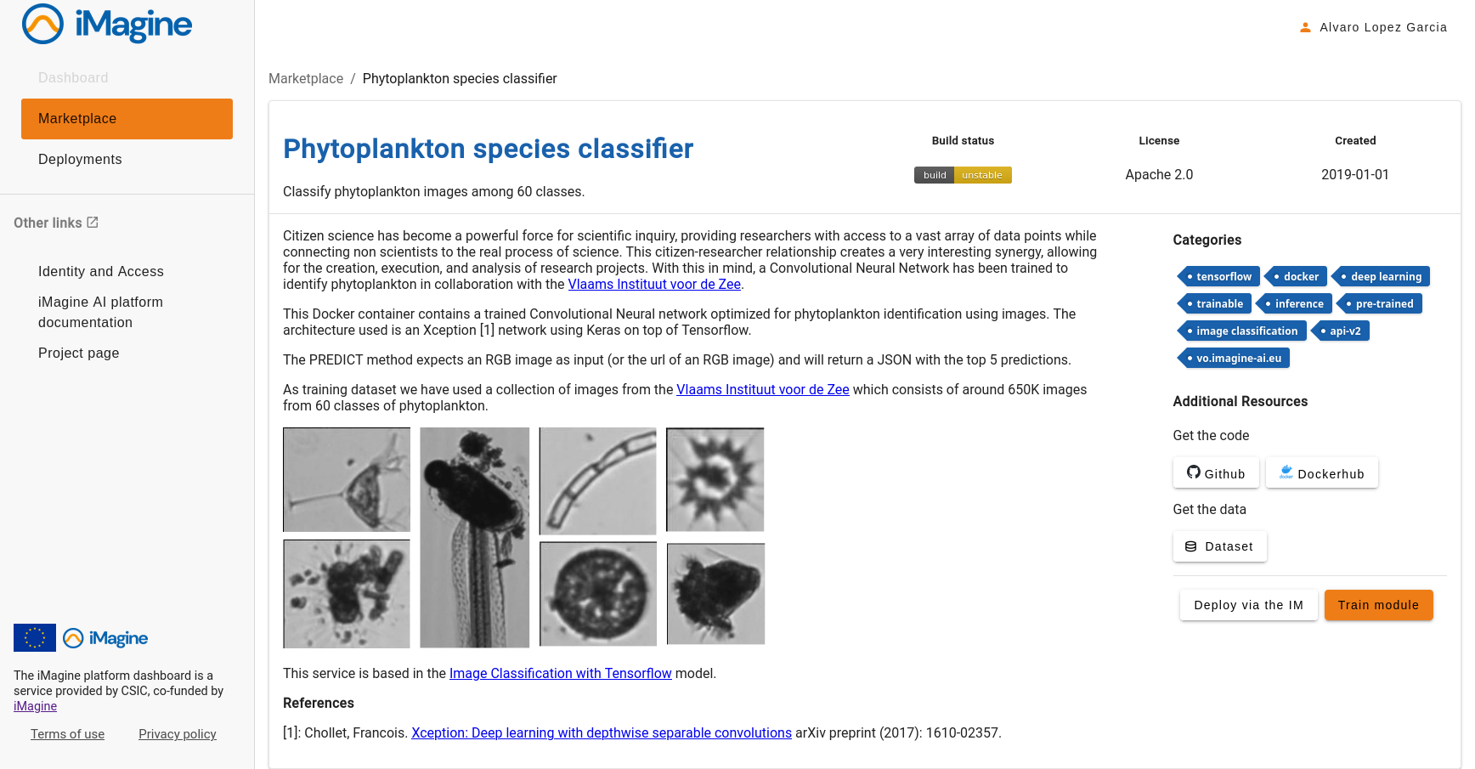
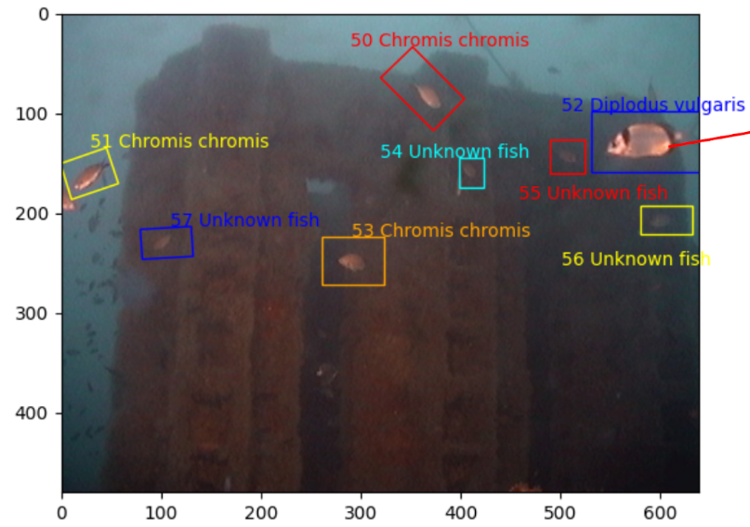
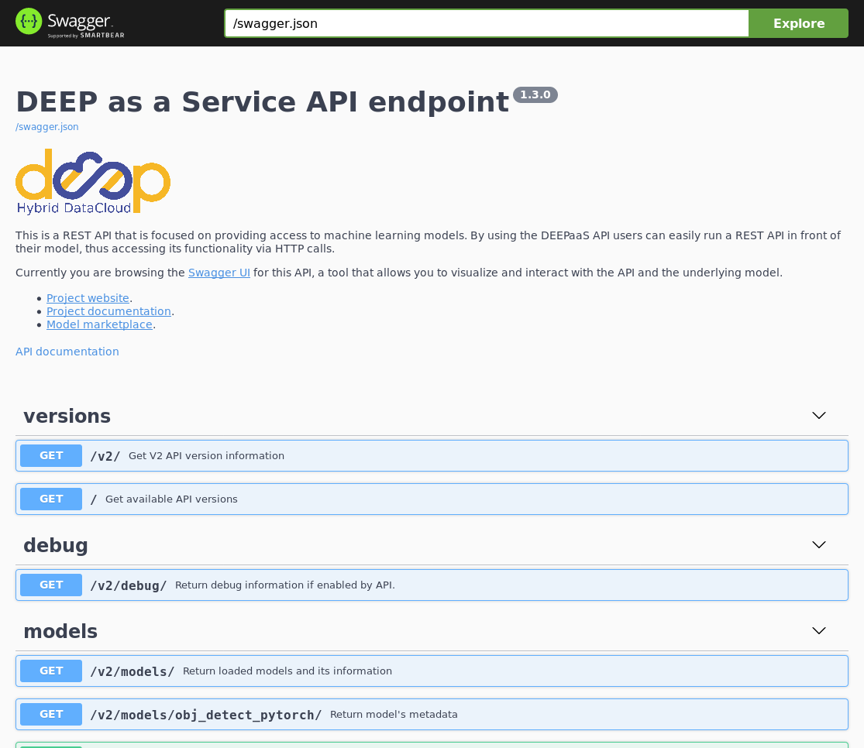
Services for AI/ML development
Deployment: standalone service

Slide 42
Services for AI/ML development
Deployment: Composite AI
Load video
Species identifier 1
Mean Probabilities
Visualization Result
Extract relevant frames
Species identifier 2
Use case: multiple AI models can be triggered for inference and later aggregate the results for enhanced accuracy
Reuse functions (subflow)
Visual support (drag & drop + customization)
Minimize orchestration costs

Slide 43
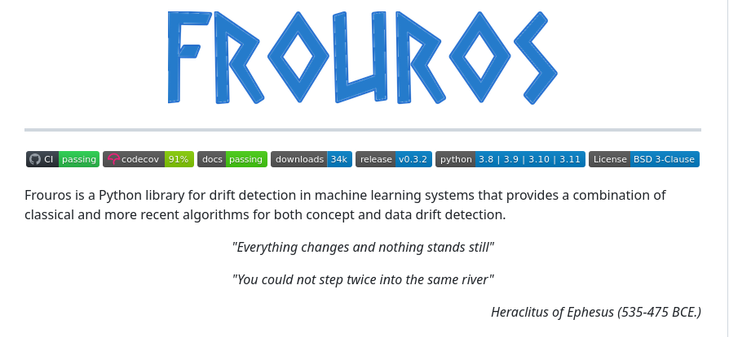
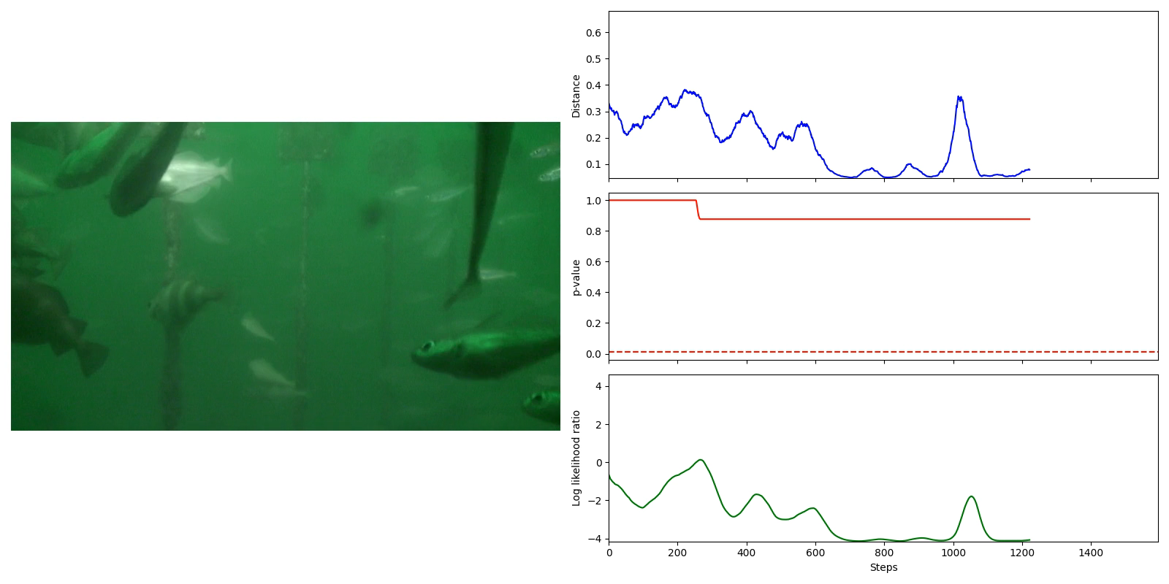
Services for AI/ML development
Deployment: Drift detection
Monitoring of models in production is not enough
Model learns from data, data is not stationary
Concept learnt by them model may change over time
Data and concept drift detection → essential to build more robust models
Frouros: state-of-the-art library for drift detection in ML problems
https://github.com/IFCA/frouros
Ongoing work towards online services for drift detection → MLOps pipelines with drift detection
Example: data drift detection in underwater video

Slide 44
Services for AI/ML development
Training: upcoming features
Other distributed training schemes
Split learning
Parallel training with Horovod
TF Parameter server
Model provenance system (MLFlow)
Including FAIR principles for ML models
Experiment centric dashboard
i.e. group different models, data, trainings into one experiment
Allow to compare easily compare results
Integration with additional online storage systems

Slide 45
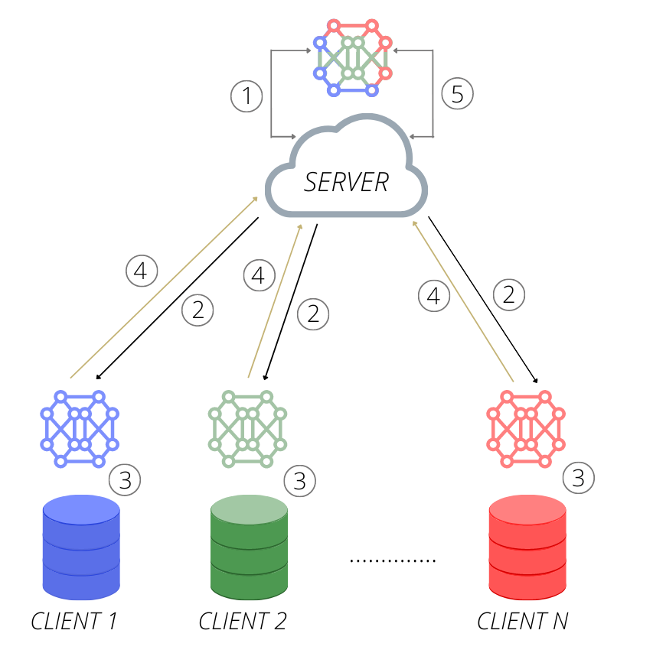
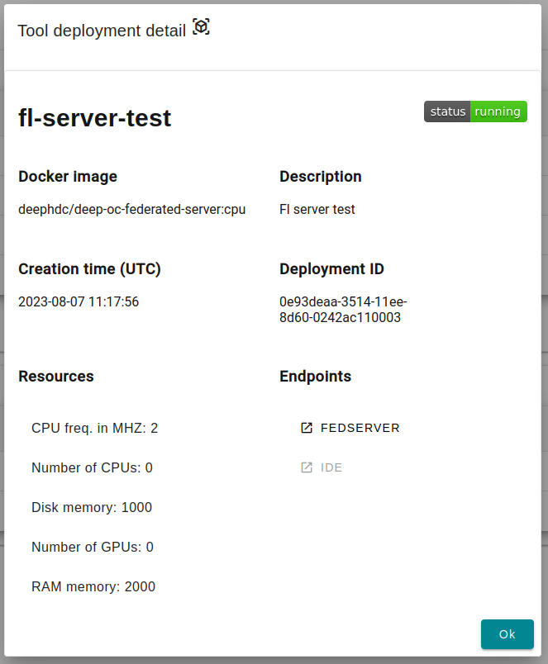
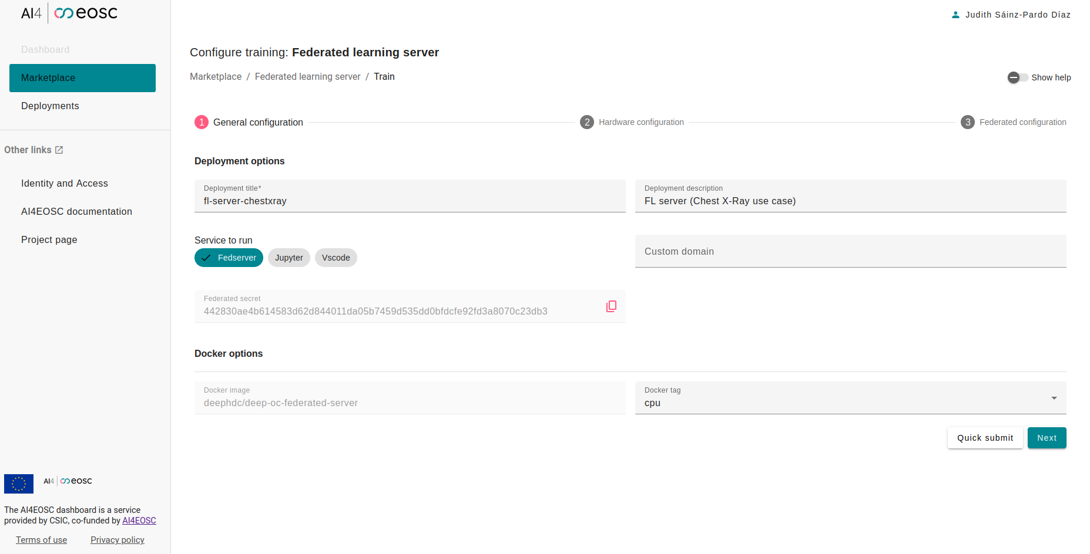
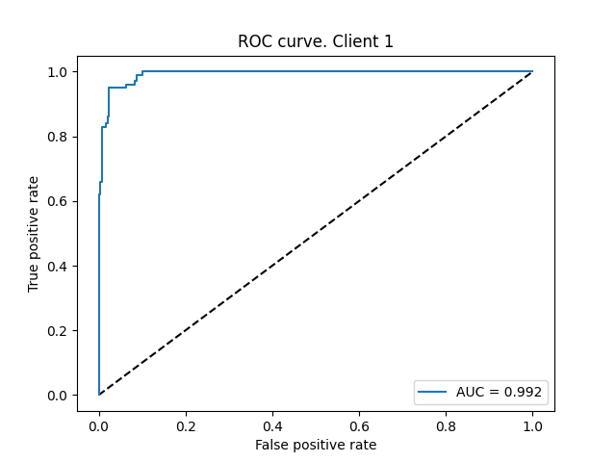
Services for AI/ML development
Training: federated learning
Collaborative and decentralized approach to build ML models
No need to centralize a dataset (i.e. technical or privacy restrictions)
Management of experiments through platform dashboard
Participating clients both within AI4EOSC platform or external (with authentication)

Slide 46
Services for AI/ML development
Deployment: OSCAR
OSCAR (https://oscar.grycap.net) to run the AI models for inference (AI as a Service)
Serverless event-driven execution
Asynchronous Mode: Files uploaded to the object-store trigger the invocation of a data-processing script that is run inside a container (out of user-defined Docker image) within a scalable Kubernetes cluster (e.g. batch jobs)
Synchronous mode: Scalable HTTP-based endpoints (based on KNative)
https://inference.cloud.imagine-ai.eu/ui/

Slide 47
Services for AI/ML development
Deployment: Drift detection
Monitoring of models in production is not enough
Model learns from data, data is not stationary
Concept learnt by them model may change over time
Data and concept drift detection → essential to build more robust models
Frouros: state-of-the-art library for drift detection in ML problems
https://github.com/IFCA/frouros
Ongoing work towards online services for drift detection → MLOps pipelines with drift detection
Example: data drift detection in underwater video

Slide 48
Services for AI/ML development
Deploy and monitor: upcoming
Streamlining deployment and monitoring of models through CI/CD for ML applications and services
MLOps pipelines definition
Automation for the whole ML lifecycle
Retraining based on given events (e.g. low accuracy)
Compatibility with other ML deployment frameworks
Improvements in API model definition (i.e. DEEPaaS)

