Slide 1

European marine policies, data and research
Dick M.A. Schaap (MARIS)
Scientific Coordinator
Dissemination level: Public
iMagine RP2 review
21 November 2024
iMagine receives funding from the European Union’s Horizon 2020 research and innovation programme under grant agreement No. 101058625.

Slide 2
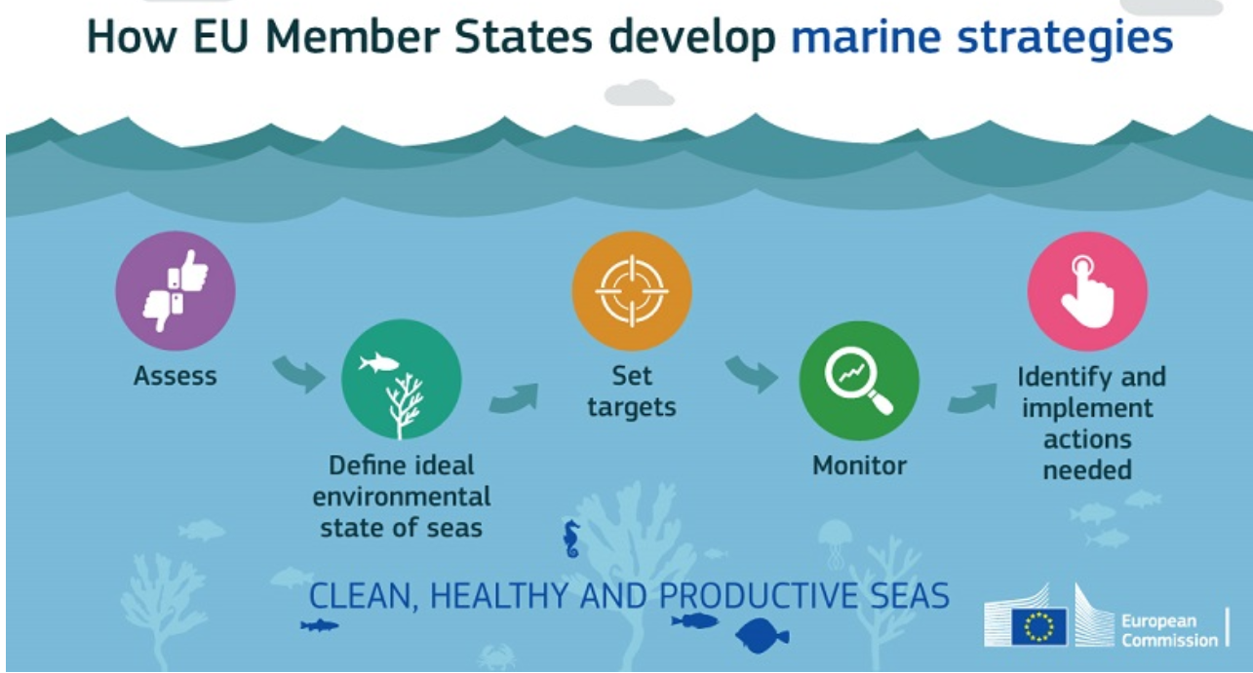




Marine environmental management and policy making
Relevant EU Directives and initiatives for aquatic domain, such as:
Marine Strategy Framework Directive (MSFD)
Water Framework Directive (WFD)
European Green Deal
Mission Restore our Ocean and Waters by 2030
United Nation’s 2030 Agenda for Sustainable Development
United Nation’s Decade of Ocean Science (2021-2030)
Source: EU MSFD website

Slide 3
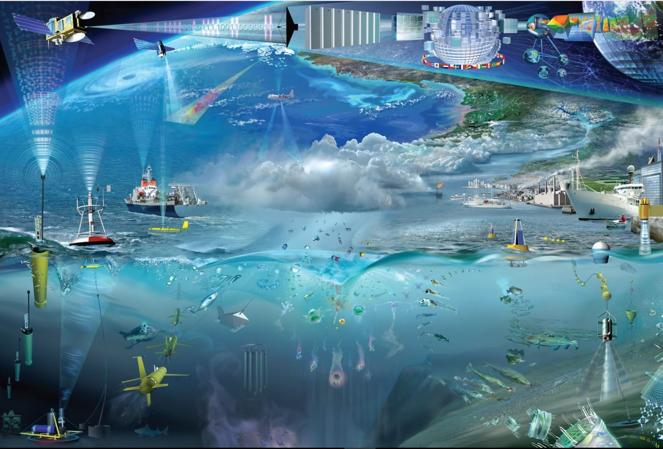
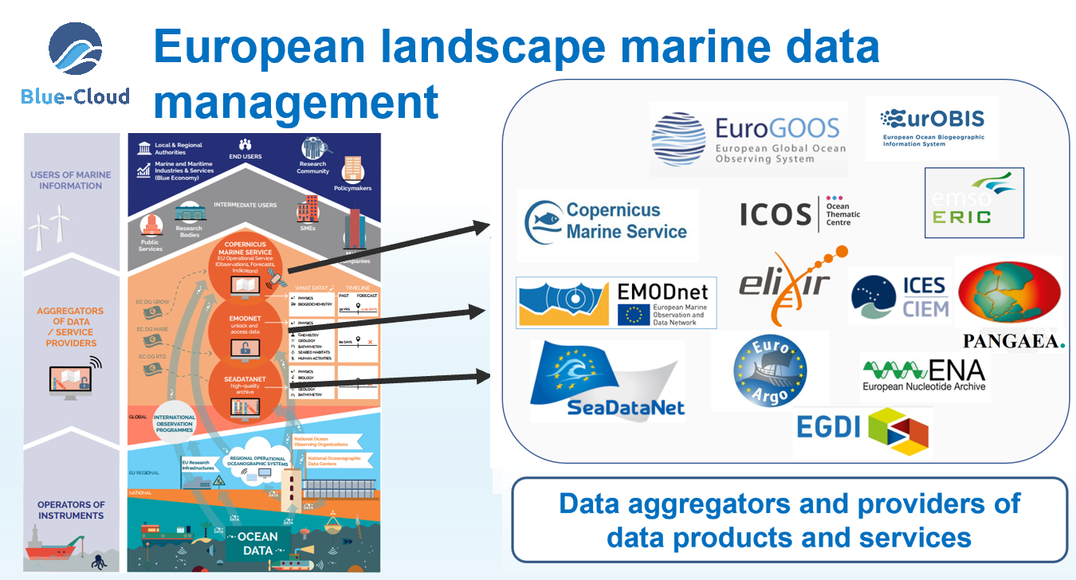
Implementation requires knowledge
The implementation requires an increase of our overall knowledge, demanding more science and improved access to observation data and analytical processing.
Europe already has developed an impressive capability for aquatic environmental observation, data-handling and sharing, modelling and forecasting, second to none in the world. This builds upon national environmental observation and monitoring networks and programs, complemented with EU initiatives such as EMODnet, Copernicus Marine, and European Research Infrastructures (RIs).
In Europe we spent circa 1.4 Billion Euro a year in marine data acquisition (1.0 BE in-situ; 0.4 BE remote sensing)

Slide 4
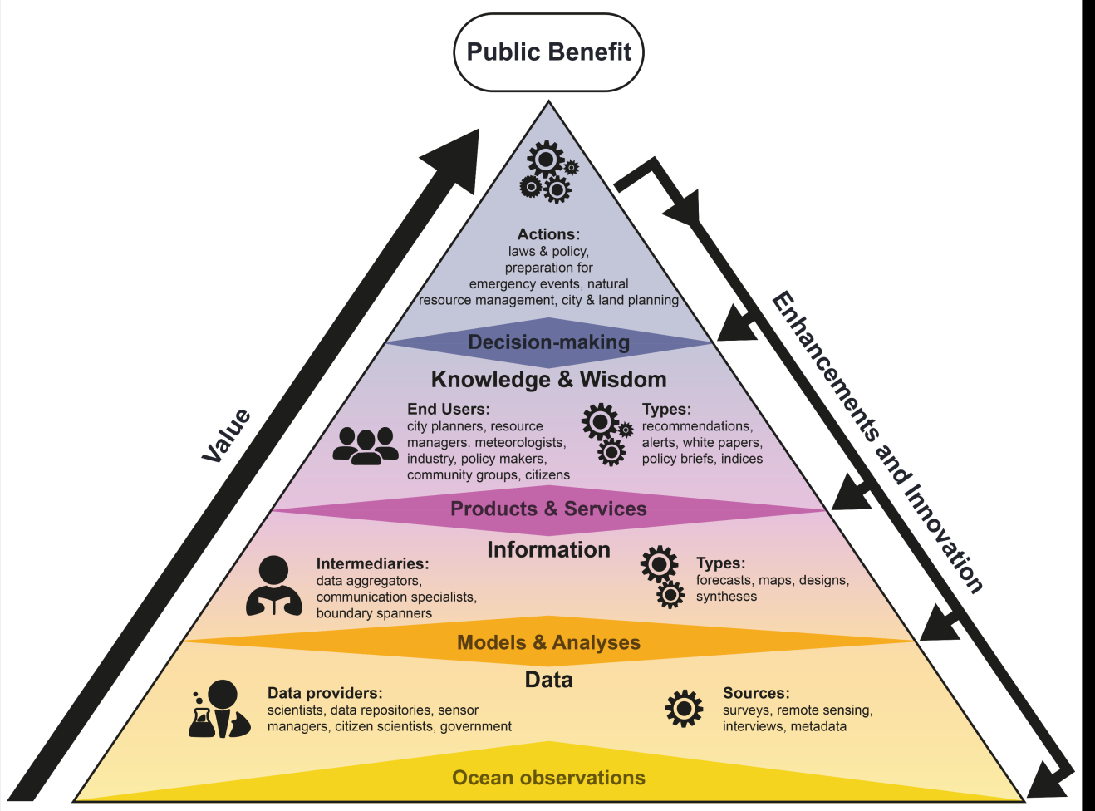
Marine Knowledge Value Chain
In situ: data and samples collected for atmosphere, water, seabed, fauna and flora, with diverse instruments and platforms. Samples are further analysed. In situ data are complemented by remote sensing observations.
Observations: ocean, seas, coastal waters, estuaries, river mouths; physics, chemistry, biology, bathymetry, geophysics, and geology
Value chain: steps from sensor data and samples to information to knowledge and benefits - with feedback loops
Public Benefit: Accessible data, High Quality data products, and Knowledge of use for Blue Economy, Resource Management, Ocean Health, Hazards, and Advancing Science
Image: EMB

Slide 5
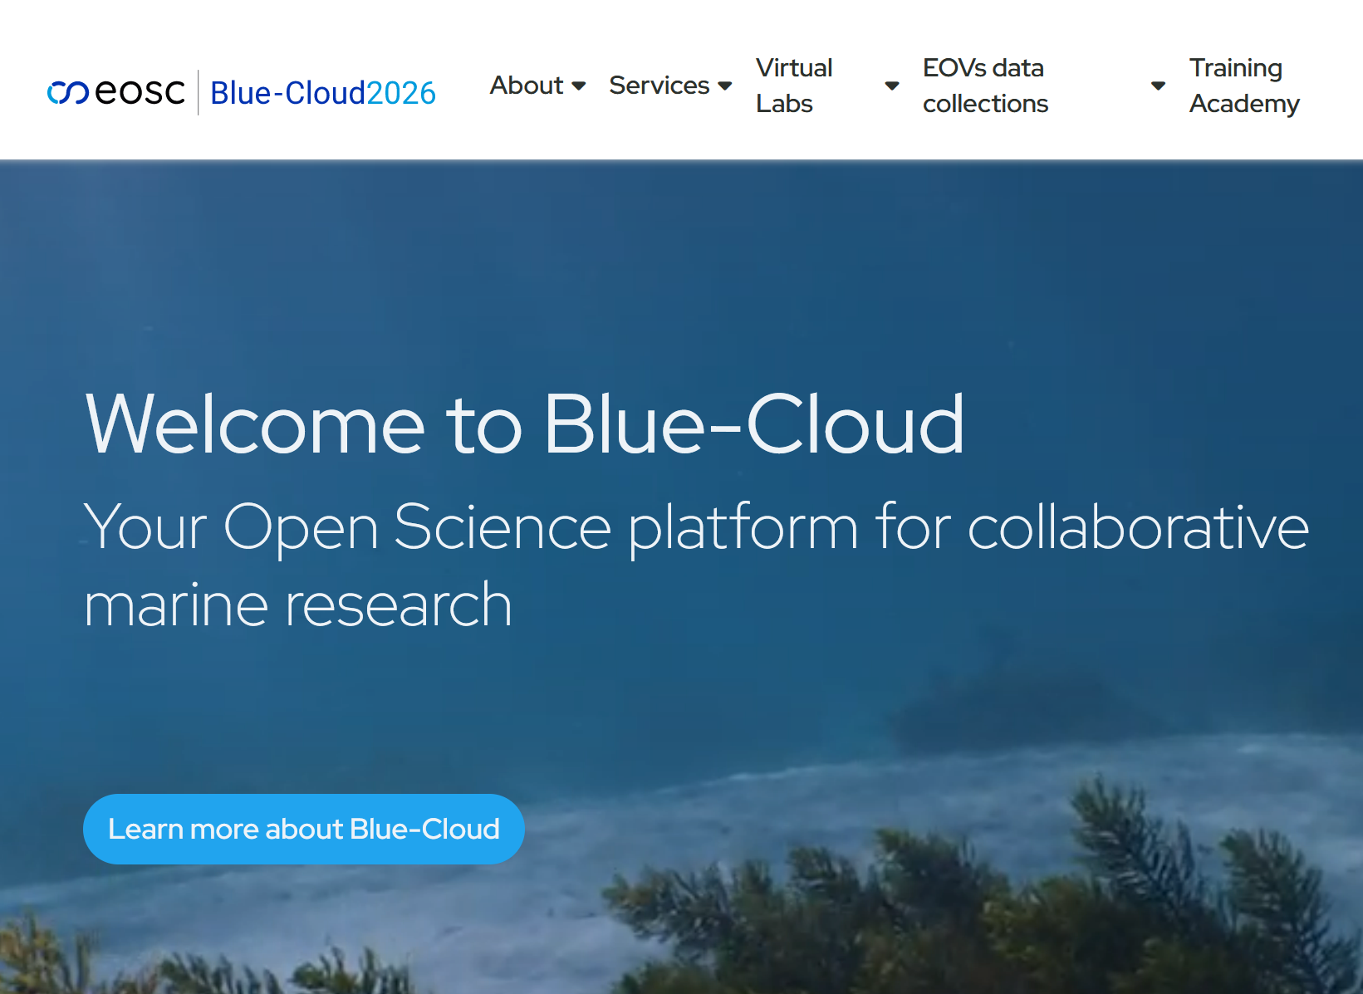


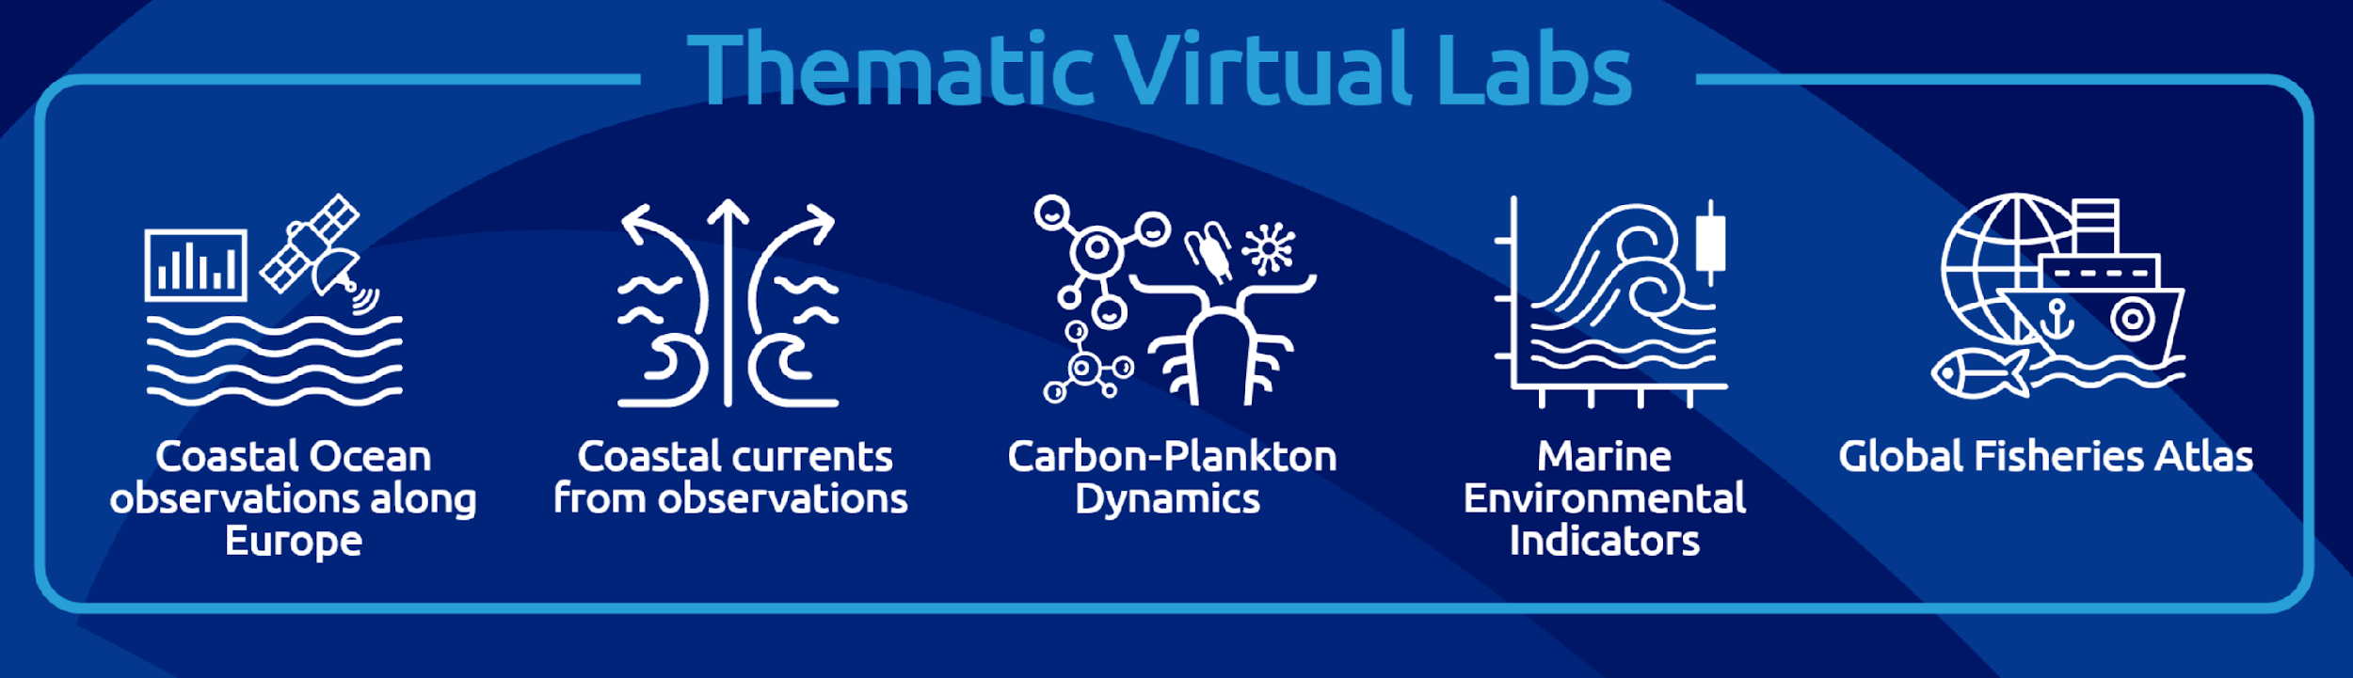
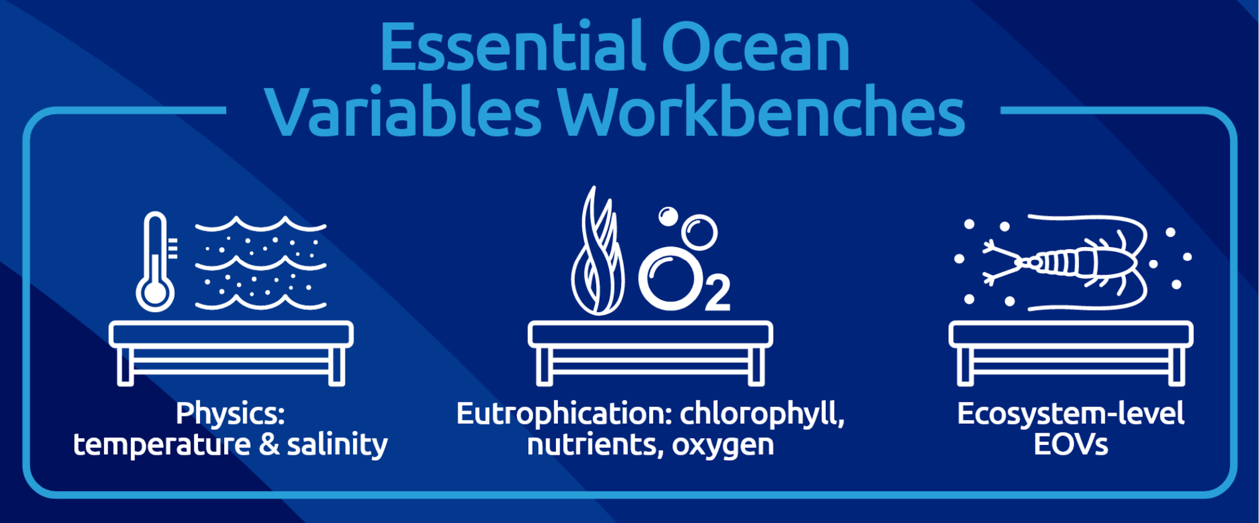
European Open Science Cloud (EOSC) and Blue-Cloud 2026
The vision for EOSC is to put in place a system in Europe to find and access data and services for research and innovation. This will facilitate researchers to store, share, process, analyse and reuse FAIR research outputs within and across disciplines and borders.
Blue-Cloud develops and operates a Federated European Ecosystem to deliver FAIR & Open data and analytical services, instrumental for deepening research of oceans, EU seas, coastal & inland waters.

Slide 6
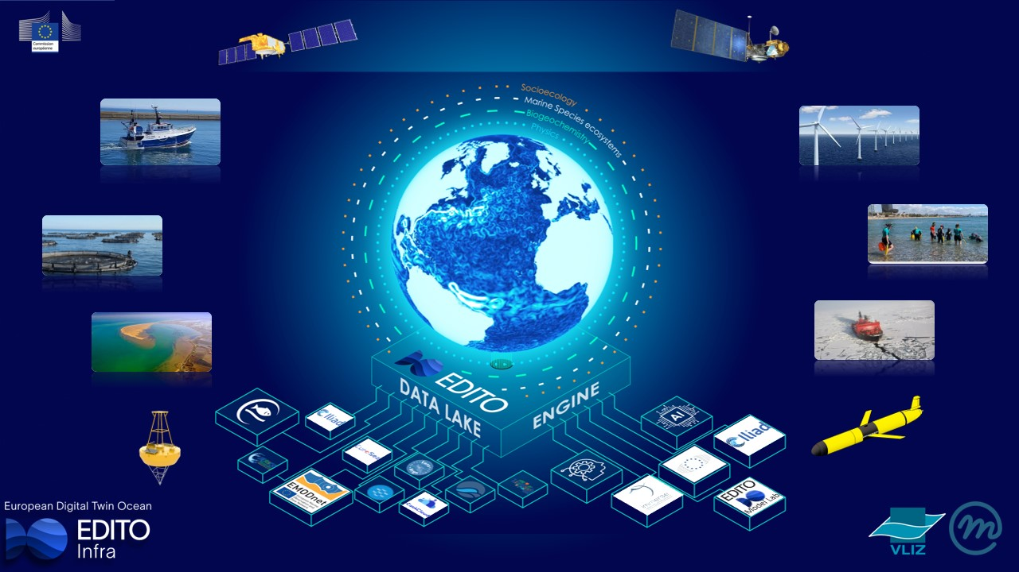
Digital Twin of the Ocean – EDITO developments
EDITO as 3rd EU coordinated and funded long term initiative for the marine and ocean domain next to and supported by EMODnet and Copernicus Marine, also engaging with marine RTD projects and infrastructures

Slide 7
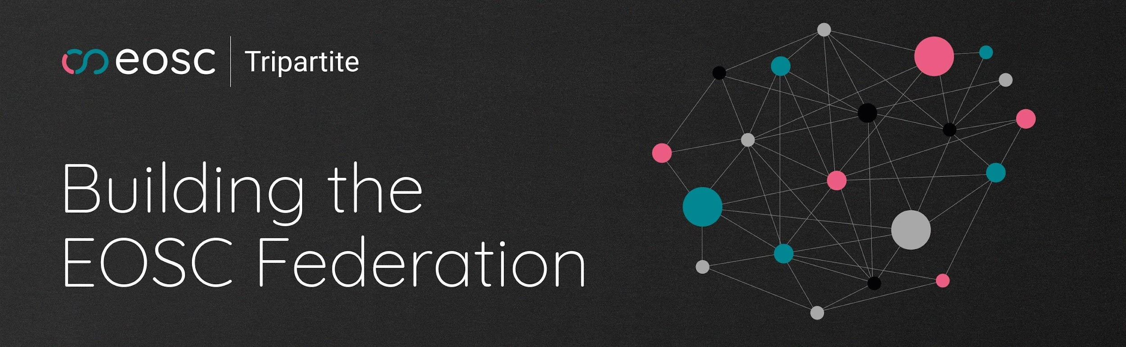
Blue-Cloud to become an EOSC Blue Thematic Node
The EOSC Federation will consist of multiple EOSC Nodes that are interconnected and can collaborate to share and manage scientific data, knowledge, and resources within and across thematic and geographical research communities.
Blue-Cloud 2026 applied to become thematic ‘blue’ node for marineopen research, serving also as incubator for EMODnet, CMEMS, and EDITO

Slide 8
Horizon Europe - iMagine project
Great potential in collecting and processing image data using high-performance image analysis tools, including Artificial Intelligence (AI) techniques, and in more sharing of image repositories, filling gaps in the European marine data and knowledge landscape.
OBJECTIVE:
To deploy, operate, validate, and promote a dedicated iMagine AI framework and platform, connected to EOSC and AI4EU, giving researchers in aquatic sciences open access to a diverse portfolio of AI based image analysis services and image repositories from multiple RIs, working on and of relevance to the overarching theme of ‘Healthy oceans, seas, coastal and inland waters.
We have the ocean and marine network and working relations with EMODnet, CMEMS, and RIs for contributing and supporting the EDITO development. Synergy and federation of the iMagine AI platform and the new AI image processing services with the Blue-Cloud EOSC thematic node might pave the way.

Slide 9
Thank you!
Questions?

