Slide 1
Project overview
Gergely Sipos (EGI Foundation) Project Director
Dissemination level: Public
iMagine RP2 review
21 November 2024
iMagine receives funding from the European Union’s Horizon 2020 research and innovation programme under grant agreement No. 101058625.

Slide 2
iMagine Overview
OBJECTIVE:
To deploy, operate, validate, and promote a dedicated iMagine AI framework and platform, connected to EOSC and AI4EU, giving researchers in aquatic sciences open access to a diverse portfolio of AI based image analysis services and image repositories from multiple RIs, working on and of relevance to the overarching theme of ‘Healthy oceans, seas, coastal and inland waters’.
36 months
From Sept. 2022 until Aug. 2025
€4.5 million EC funding
23 participants (19 beneficiaries + 4 affiliated partners)
18 service installations (Virtual Access)

Slide 3
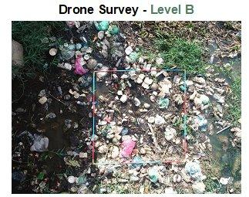
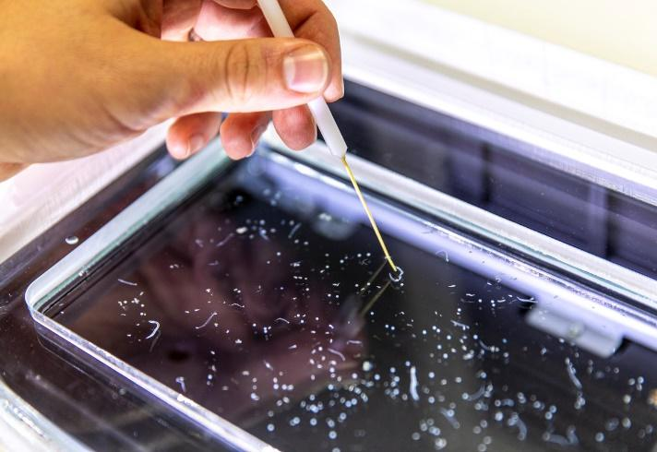
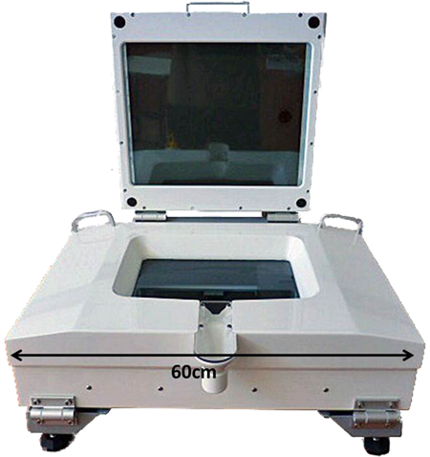
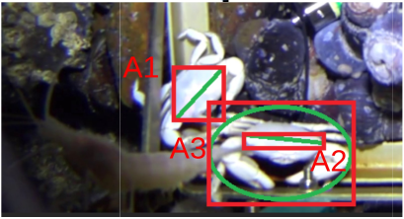
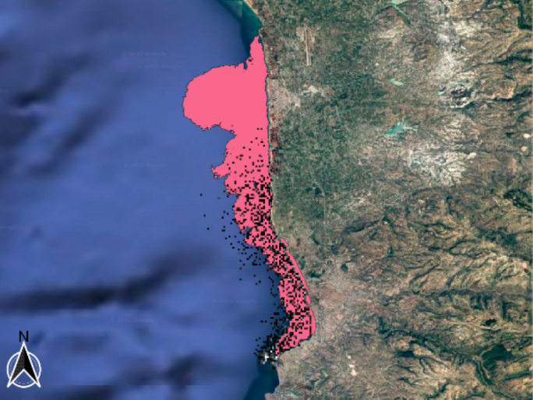
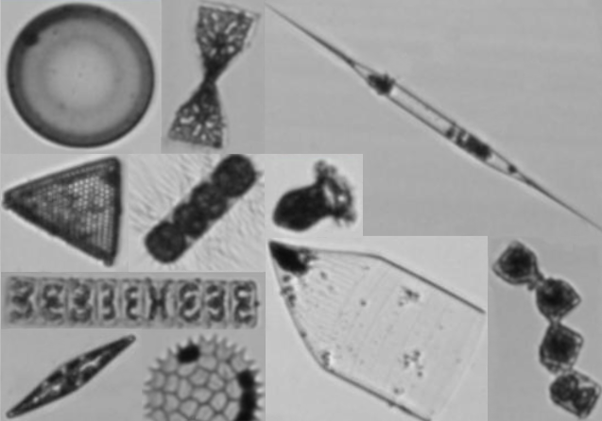
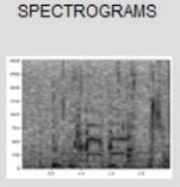
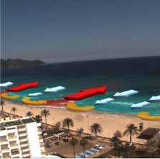
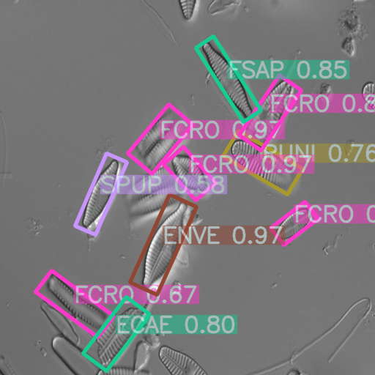
Achieving Impact with 8+ use cases and 10+ RIs In the consortium: 5 mature, 3 prototypes
Aquatic Litter Drones (DFKI, MARIS, OGS):
Monitoring system for Aquatic Litter Pollution
Zooscan – EcoTaxa pipeline (Sorbonne Uni.):
Taxonomic identification of zooplankton using Zooscan
Marine Ecosystem Monitoring (EMSO ERIC, UPC, IFREMER, MI):
Ecosystem Monitoring by means of video imagery from cameras at EMSO sites
Oil Spill Detection (CMCC, OrbitalEOS, UNITN):
Oil spill detection from satellite images
Flowcam phytoplankton identification (VLIZ):
Taxonomic identification of phytoplankton using FlowCAM images
Underwater noise identification (VLIZ):
Identification of sound events from acoustic recordings using spectrograms
Beach monitoring (SOCIB):
Posidonia oceanica berms and rip-currents detection from beach monitoring systems
Freshwater diatoms identification (UL-LIEC): Diatom-based bioidentification using automatic pattern recognition on microscope images

Slide 4
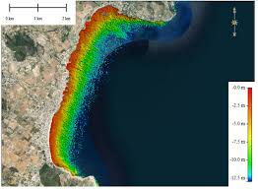
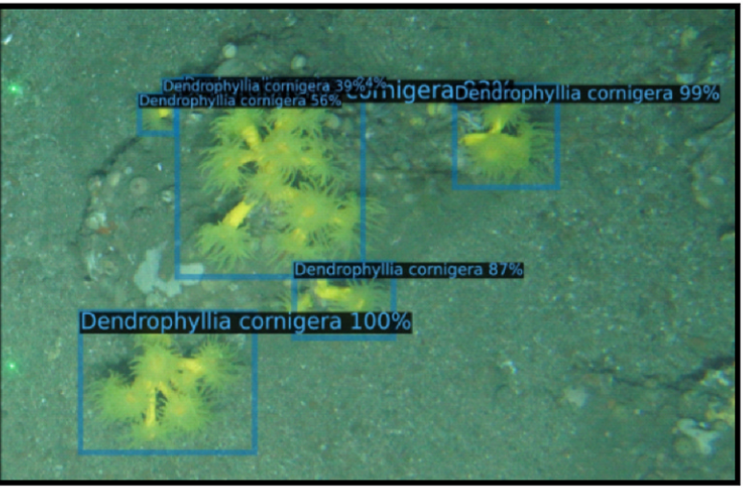
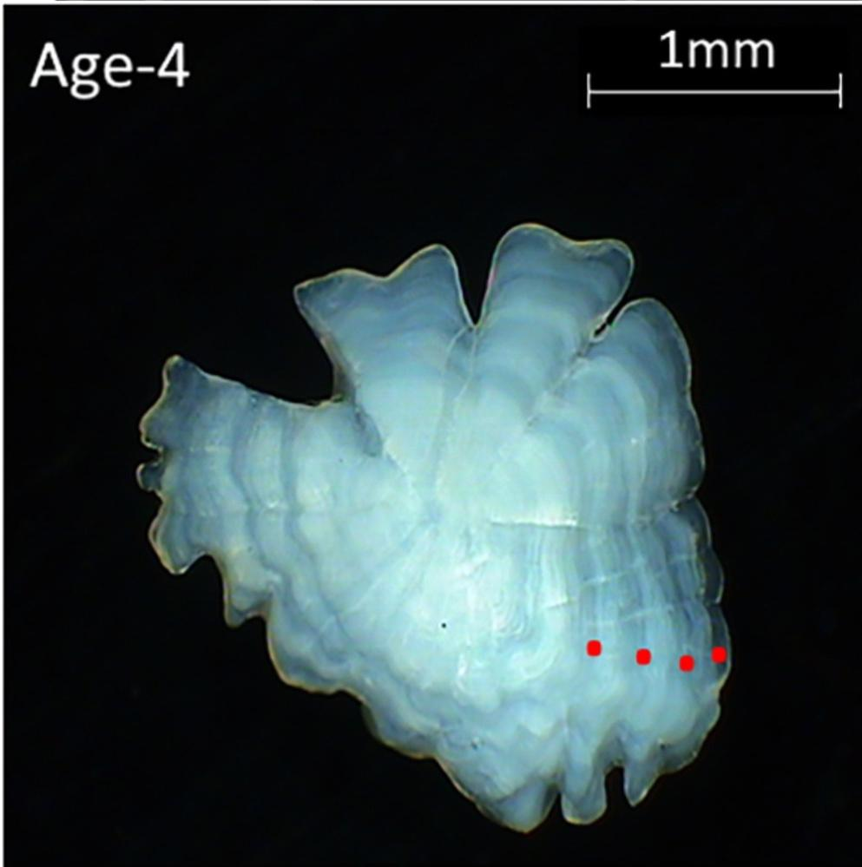
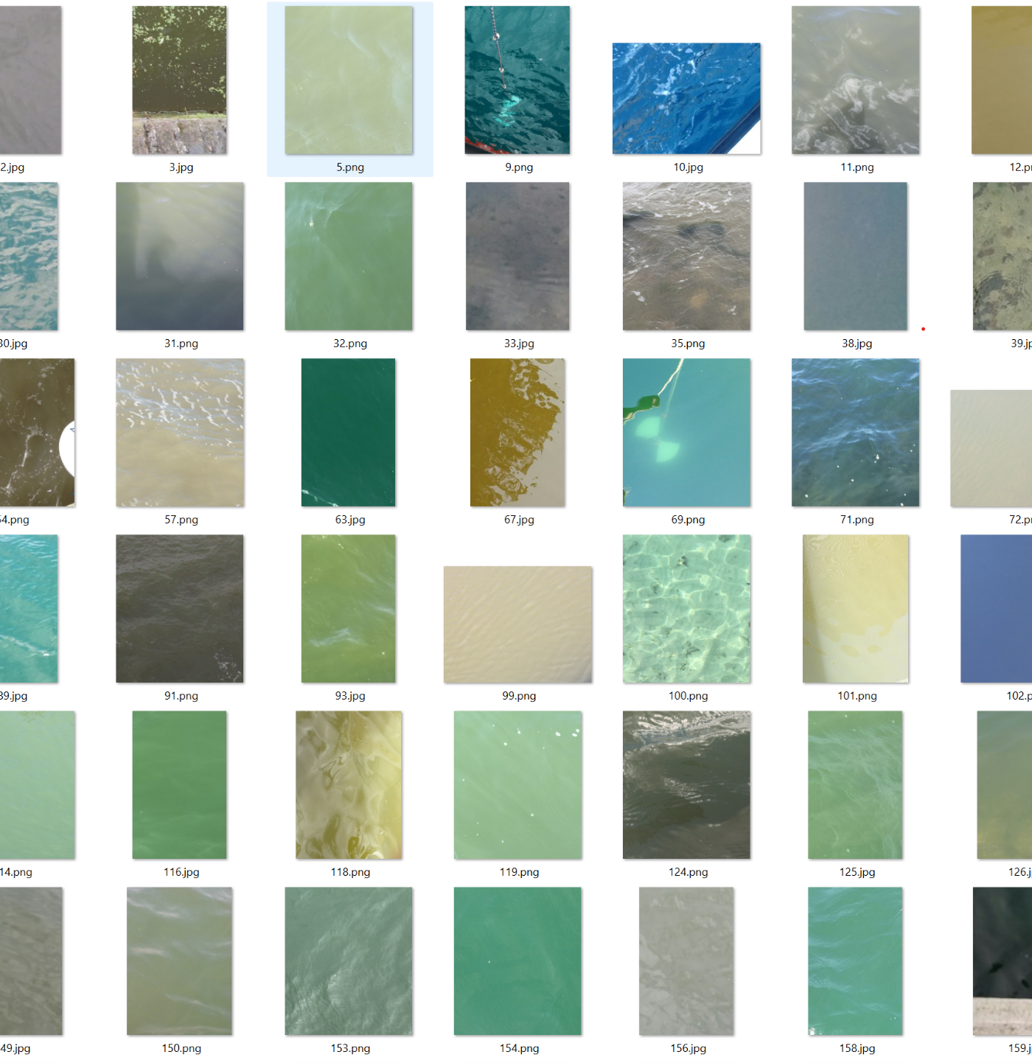
4 External Use Cases onboarded in PY2 via the Open Call
Satellite-Derived Bathymetry
Institute of Marine Sciences of Andalusia
Nearshore bathymetry for coastal studies
Improving knowledge about Cold Water Coral Reef
Spanish Oceanographic Institute
Use AI to precisely delineate areas of living coral and dead coral
AI for image based age reading from fish otoliths Danish National Institute of Aquatic Resources
To develop an AI algorithm to identify the age of a fish from an otolith image
Validating images collected with the EyeonWater app Maris
To detect and reject false images and give the right color to correct images

Slide 5
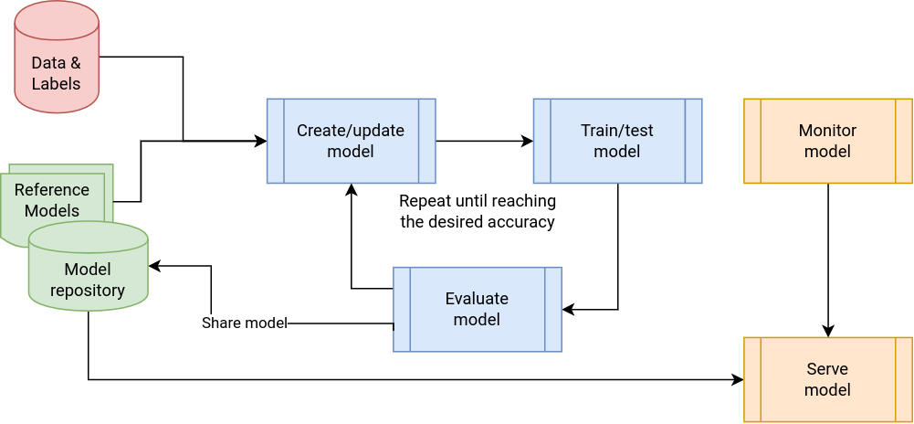
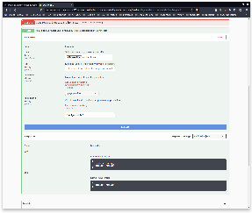
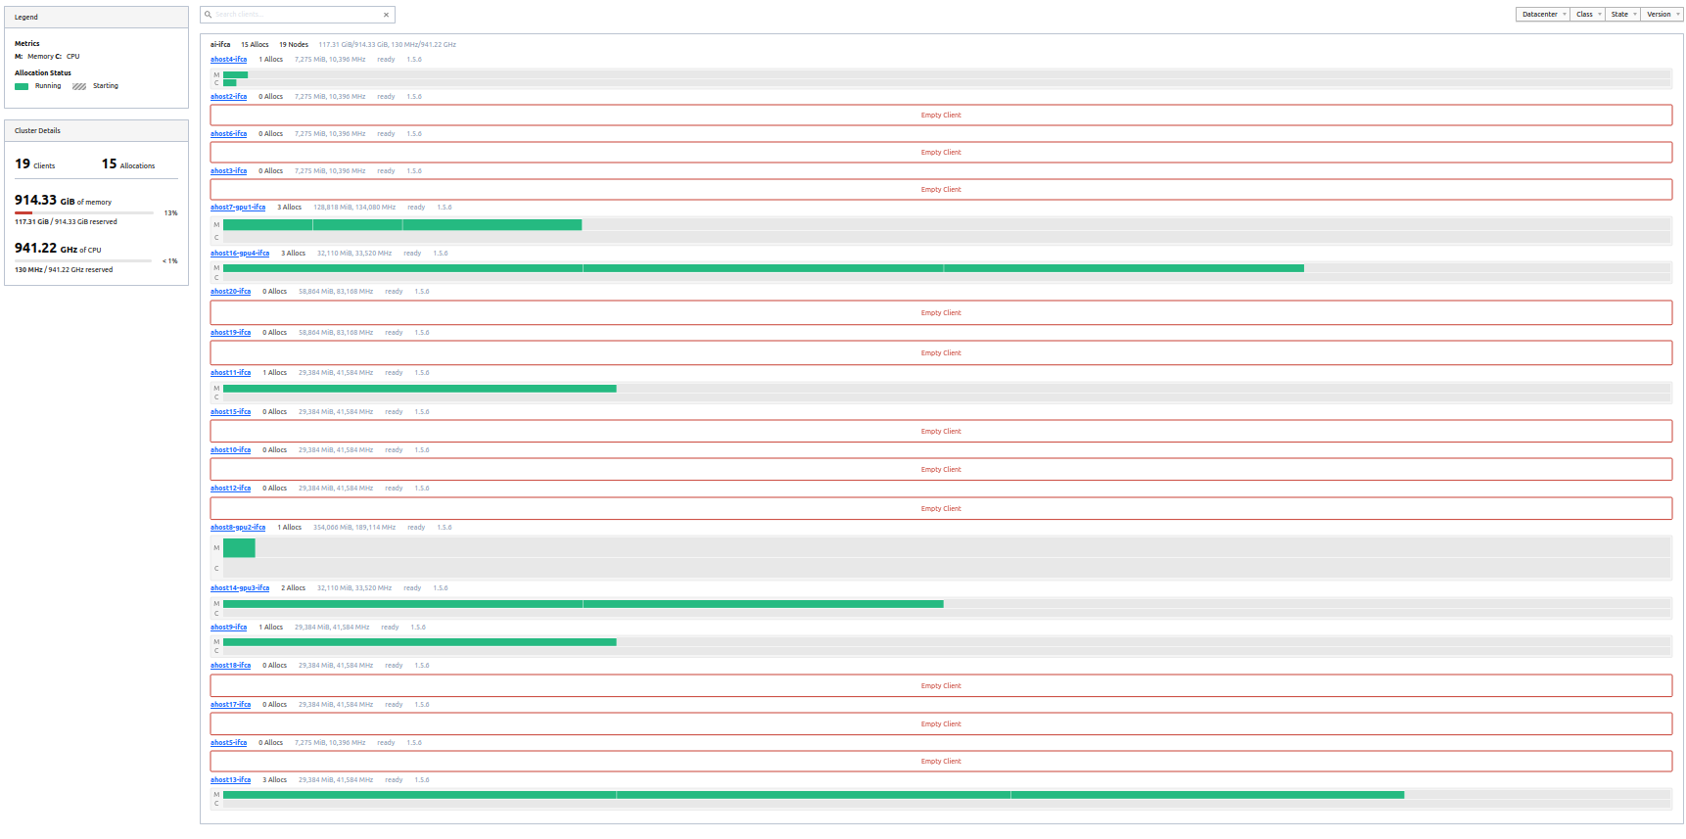
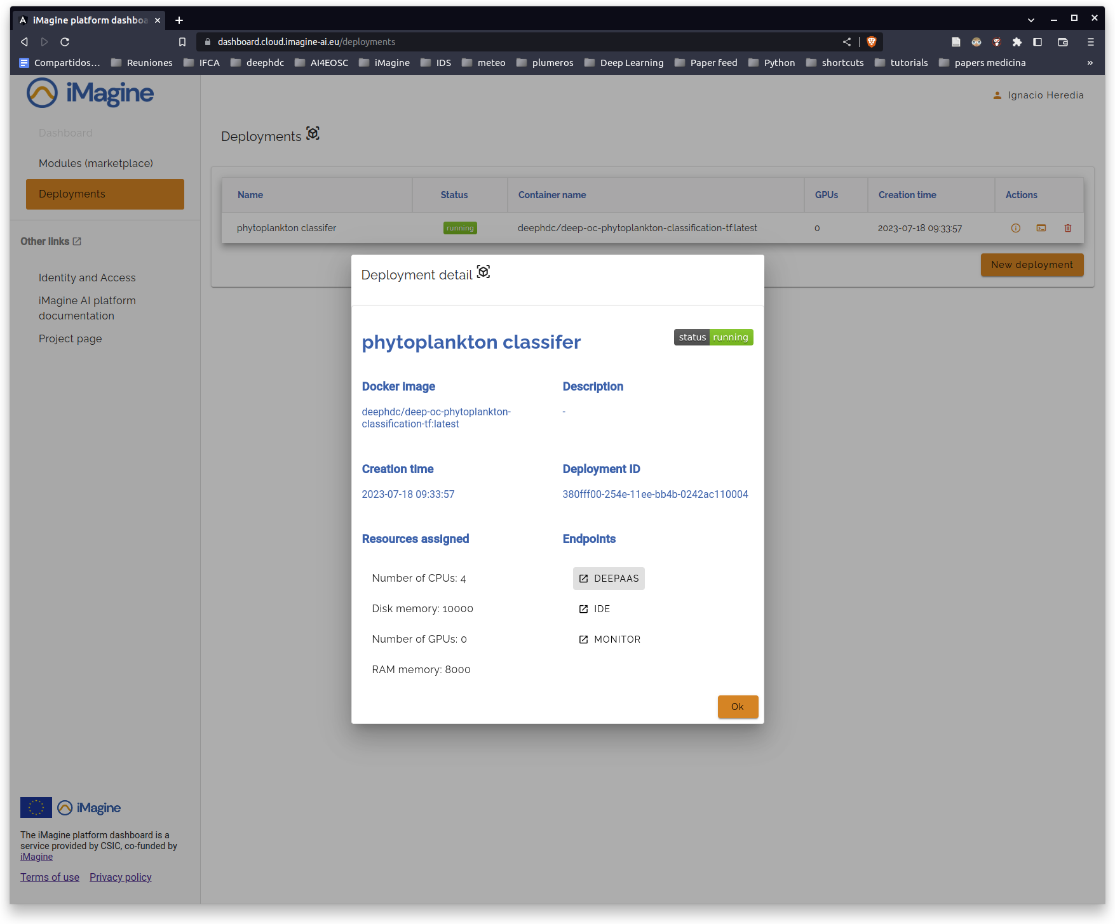
The iMagine Approach
PY2 focus: Model evaluations, data quality improvement, service & data delivery
PY1 focus: Learning the platform, first model trainings
Competence Centre
CPU intensive
GPU intensive
8 internal, 4 external use cases
Benefitting 10+ Research Infrastructures &
Thematic Services
iMagine AI Platform: Generic, scalable platform for developing and sharing AI/ML applications.
Platform Service
Infrastructure
1500 TB-months → 495 consumed
132,000 GPU-hours → 183,262 consumed
6 Million CPU-hours → 4.2 Million consumed
4 federated cloud sites
PY2: Integrated in the AI platform

Slide 6
Response to Y1 Review Recommendations
1. Include best practices in the OBPS system
Our best practice documents were submitted and are under review in the OBPS repository (revised versions of D4.1, D3.4)
2. More efforts in Dissemination and Communication
Present at 15 events, with the highest impact reached at Ocean Decade Conference, European Maritime Day, IMDIS 2024, MARTECH 2024
11 application to our open call
3. Consider integration of ZooScan, FlowCam and Freshwater
They already work together in the Competence Centre. Further integration would not bring additional value:
Different instruments; Distinct user base; Different ecosystems
Their images have different characteristics (Colour schema; Orientation; Object overlaps)
ZooScan focuses on segmentation; Flowcam focuses on classification; Freshwater on both
4. Better scope definition of use cases, bias checking tool
Improved descriptions on the Website; In the Marketplace
Studying bias during performance validation, then resampling and/or class weight adjustment
Notes:
REC3:
Difference 1: ZooScan and FlowCam are different types of physical instruments; therefore, the user base who owns them is separate. The two use cases address them separately.
Difference 2:ZooScan and FlowCam target marine ecosystems; Freshwater Diatom targets freshwater ecosystems.
Difference 3: the three use cases rely on images with different characteristics: ZooScan images are grey on almost pure white (since the background is pre-subtracted), in any orientation and with potential overlap; raw FlowCam images are on a grey background, all aligned by the fluidic and with, normally, no overlap; diatom images come from microscopes and can have a range of aspects and overlaps.
Difference 4: ZooScan focuses on segmentation (specifically for the separation of touching objects). Flowcam focuses on classification; Diatoms interest both segmentation and classification, IIRC.

Slide 7
Specific Objectives and Indicators
SUCCESS INDICATOR:
O1
Objective 1. Deliver a scalable, shared IT platform for image analysis in marine and freshwater research
Operational iMagine platform with common AI development framework from TRL 7 to 9 (WP4) AI PLATFORM BROADENED TO 4 CLOUDS
MARINE SCHEMA IMPLEMENTATION FOR ZENODO
O2
Objective 2. Advance existing image analytical services to increase research performance in aquatic sciences
Launch of 5 aquatic AI image services, running operationally at the iMagine platform
UC1 (Marine Litter), UC5 (FlowCam plankton iden.) served 17 users, incl. LifeWatch, Jerico (WP5)
UC2-3-4 opened in Nov 2024
O3
Objective 3. Develop & prototype new image analytical services and datasets that can accelerate progress towards healthy oceans, seas, coastal and inland waters
Availability of three prototype services (TRL5) for RI communities in the iMagine platform with agreed functionality.
EXTERNAL VALIDATIONS TO START IN Q1 2025 (WP3)
O4
Objective 4. Capture and disseminate development and operational best practices to imaging data and image analysis service providers
Best Practices documentation, interaction with EOSC and AI4EU platforms.
D4.1, D3.4 Best practices for image analysis
Outreach programme
15 events with reach to 1,700+ participants in PY2
O5
Objective 5. Deliver a portfolio of scientific image and image analytics services targeting researchers in marine and aquatic sciences
Portfolio: operational services, image repositories, Best Practices, iMagine framework and platform
Growing portfolio through our website:
AI Platform → 11 Open Call applications
13 Datasets in Zenodo
5 analytics services
320 downloads for good practices (2 Docs)

Slide 8
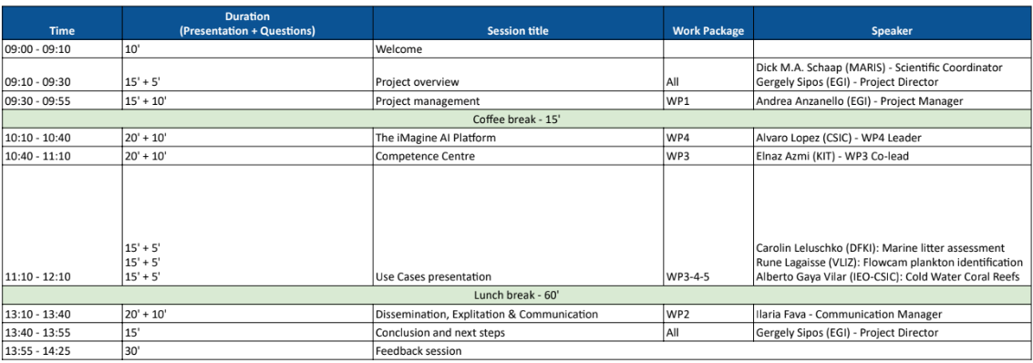
Agenda of the Day

Slide 9
Thank you!
Questions?

