Slide 1
UC1: Aquatic Litter Drones
Carolin Leluschko, Maria Eugenia Molina Jack, Matteo Vinci & colleagues November 21st 2024

Slide 2
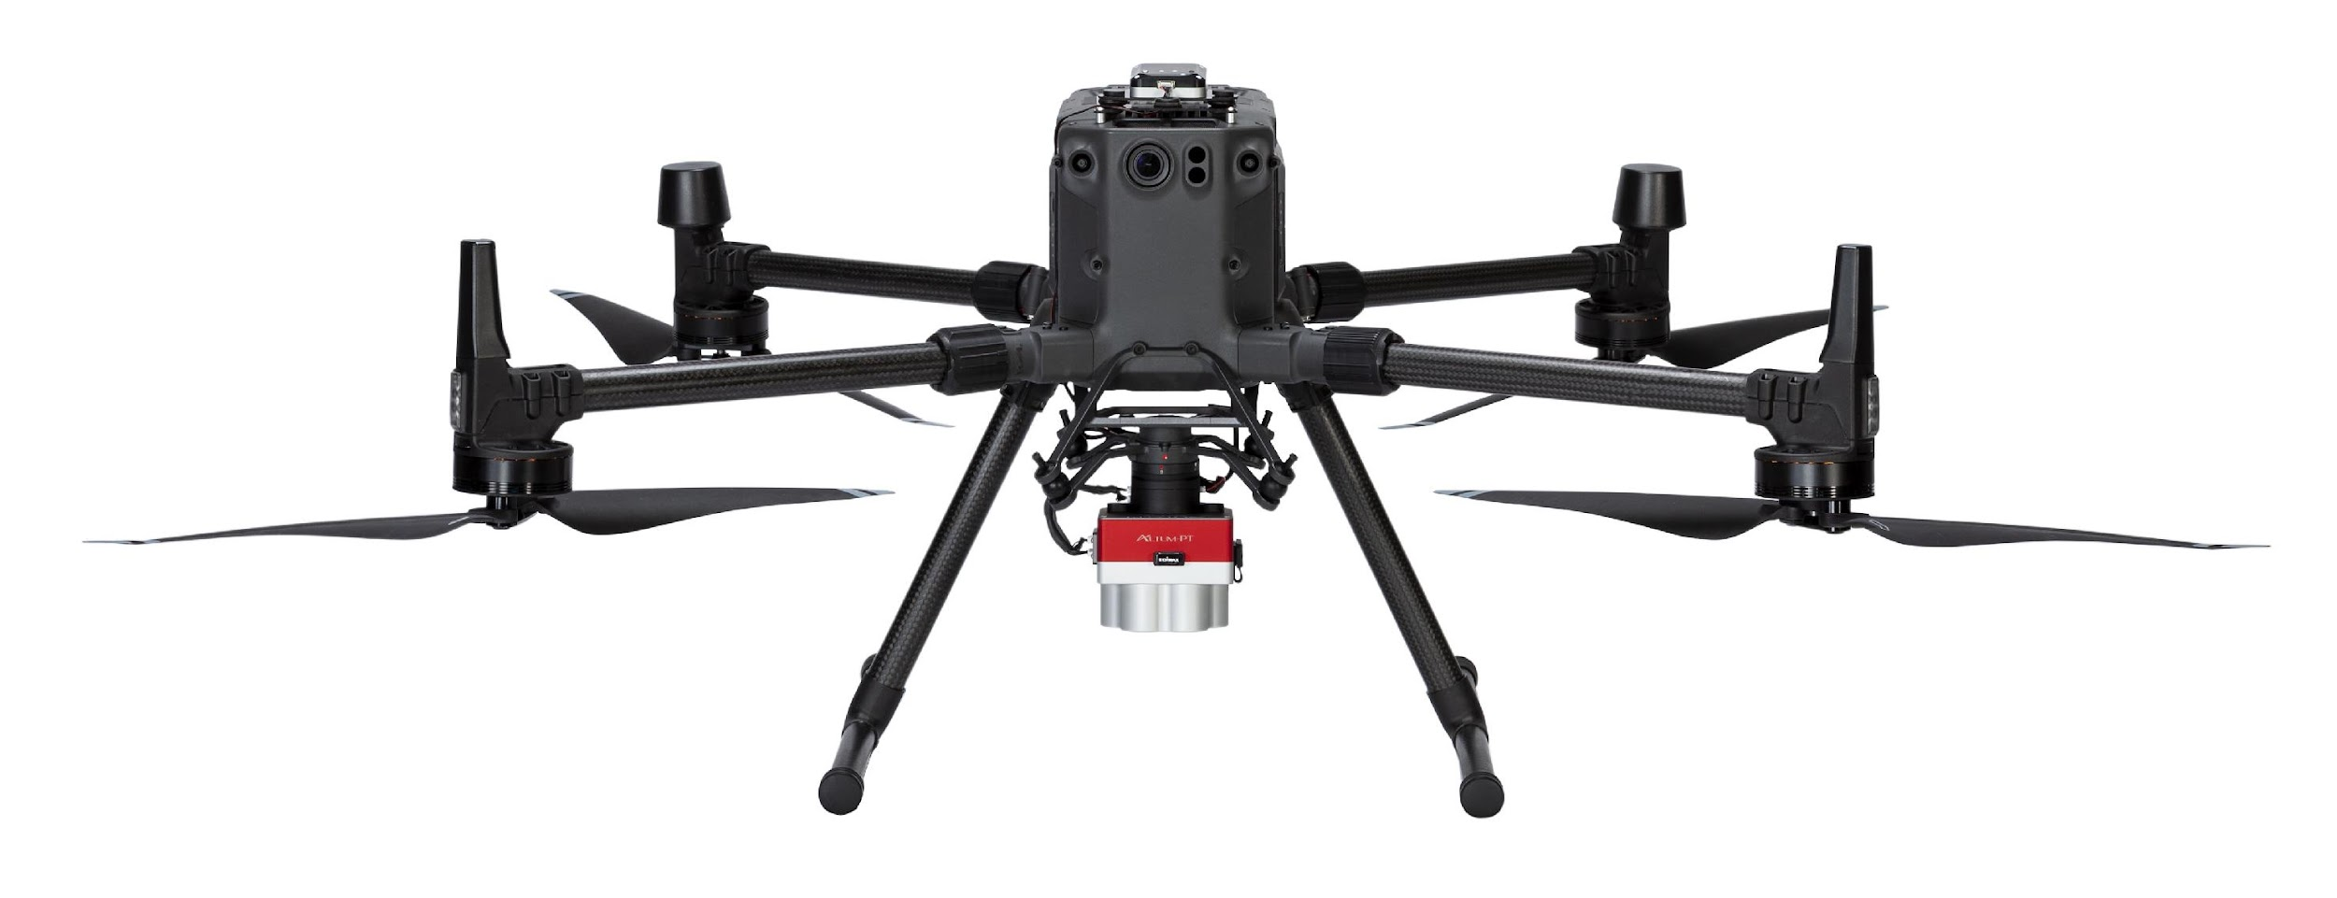
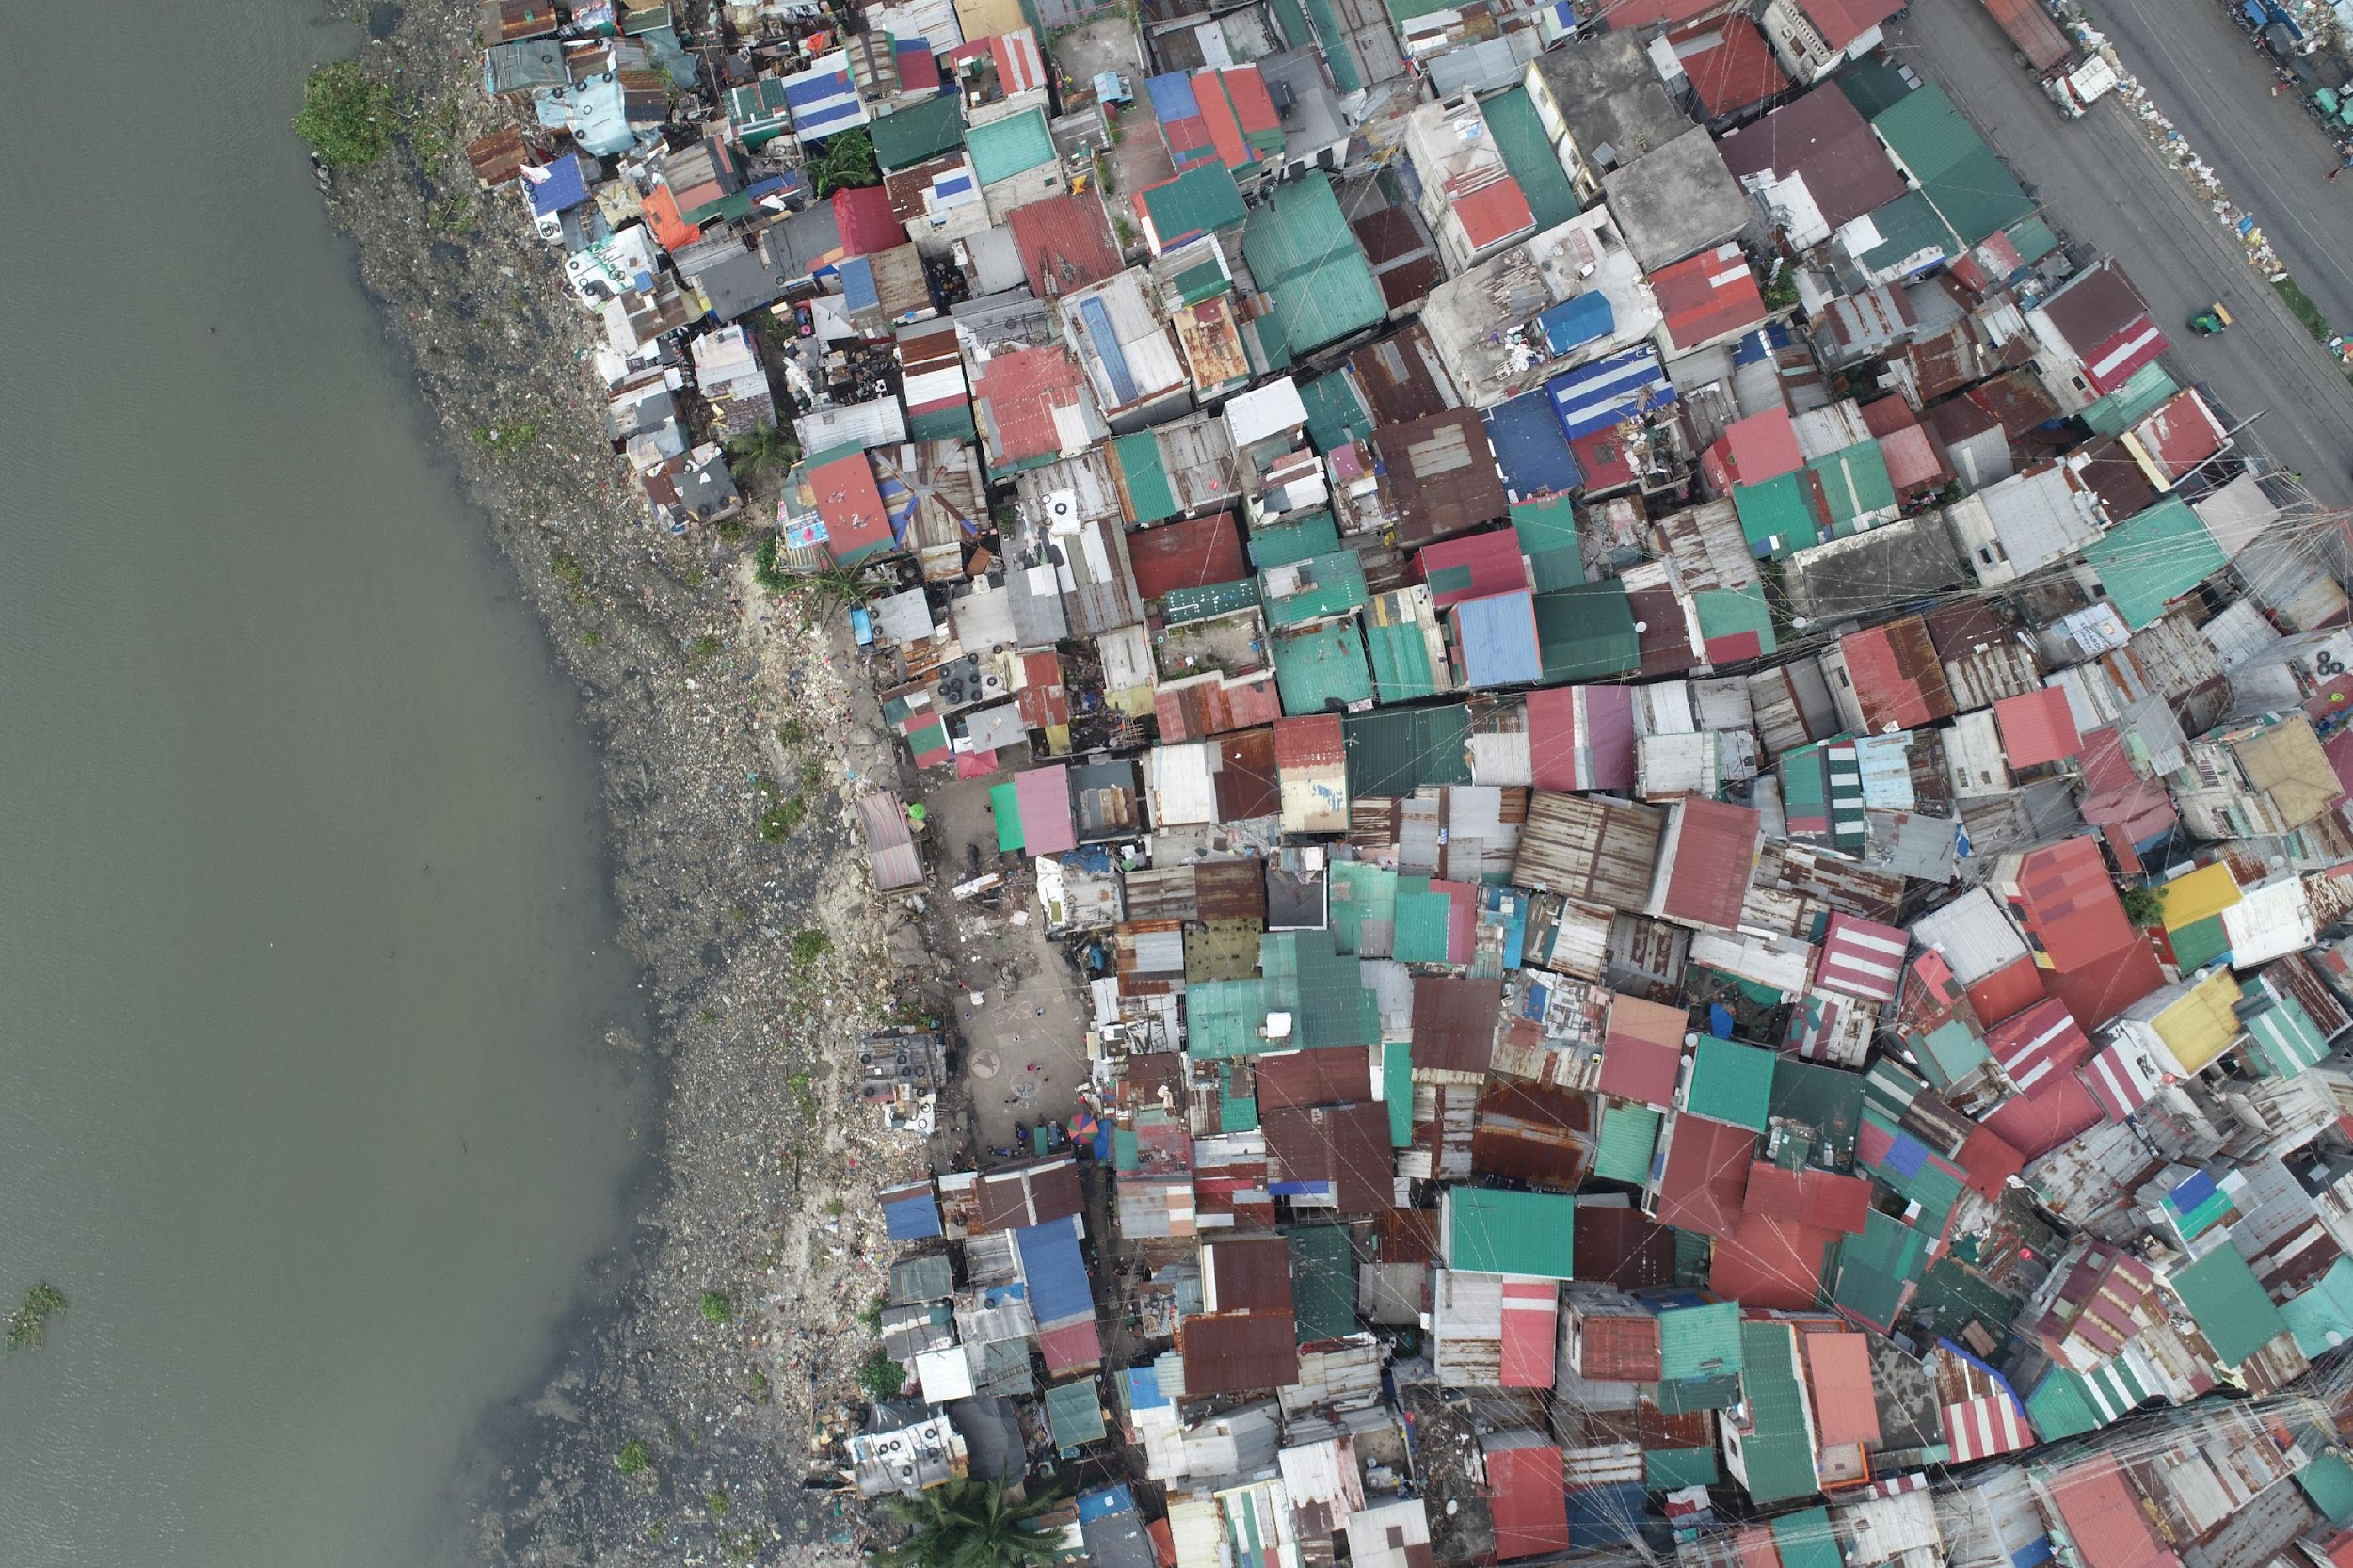
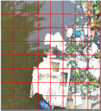
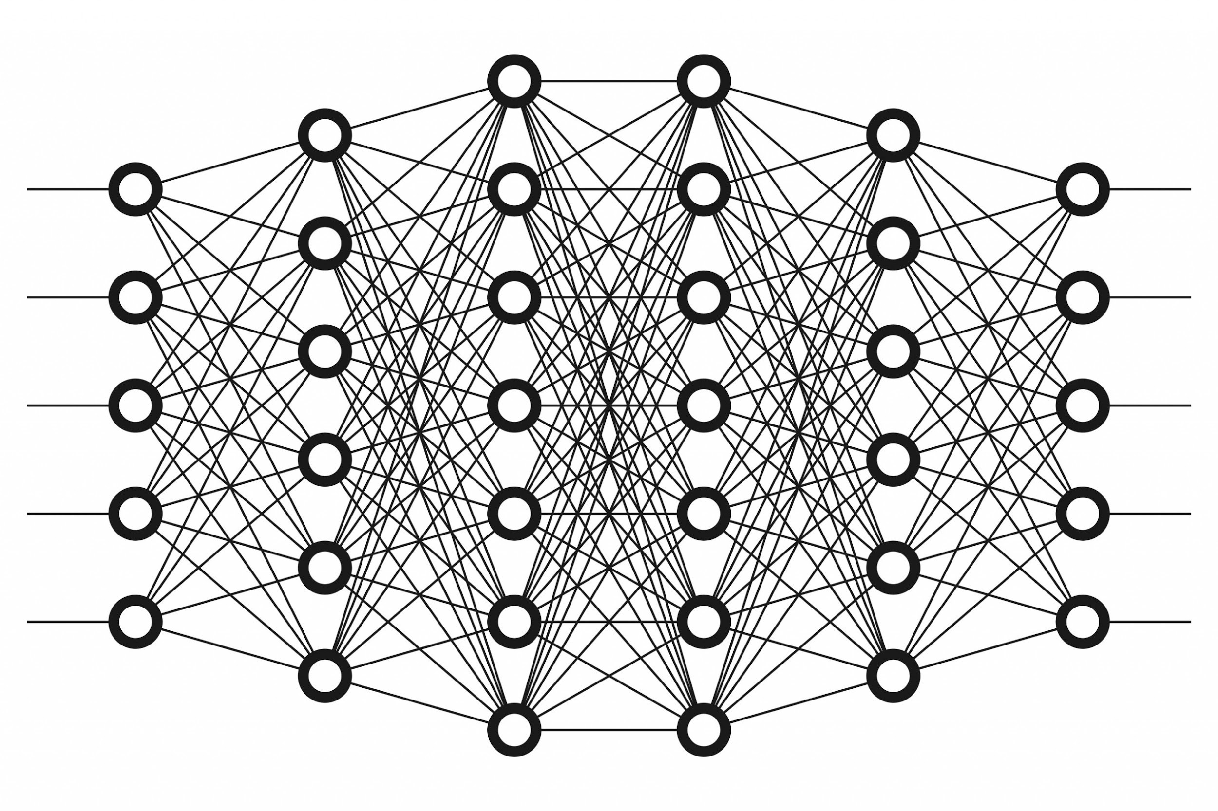
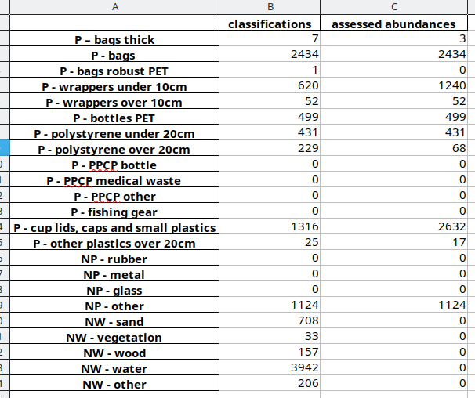
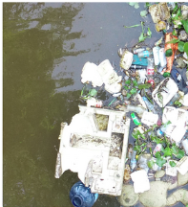
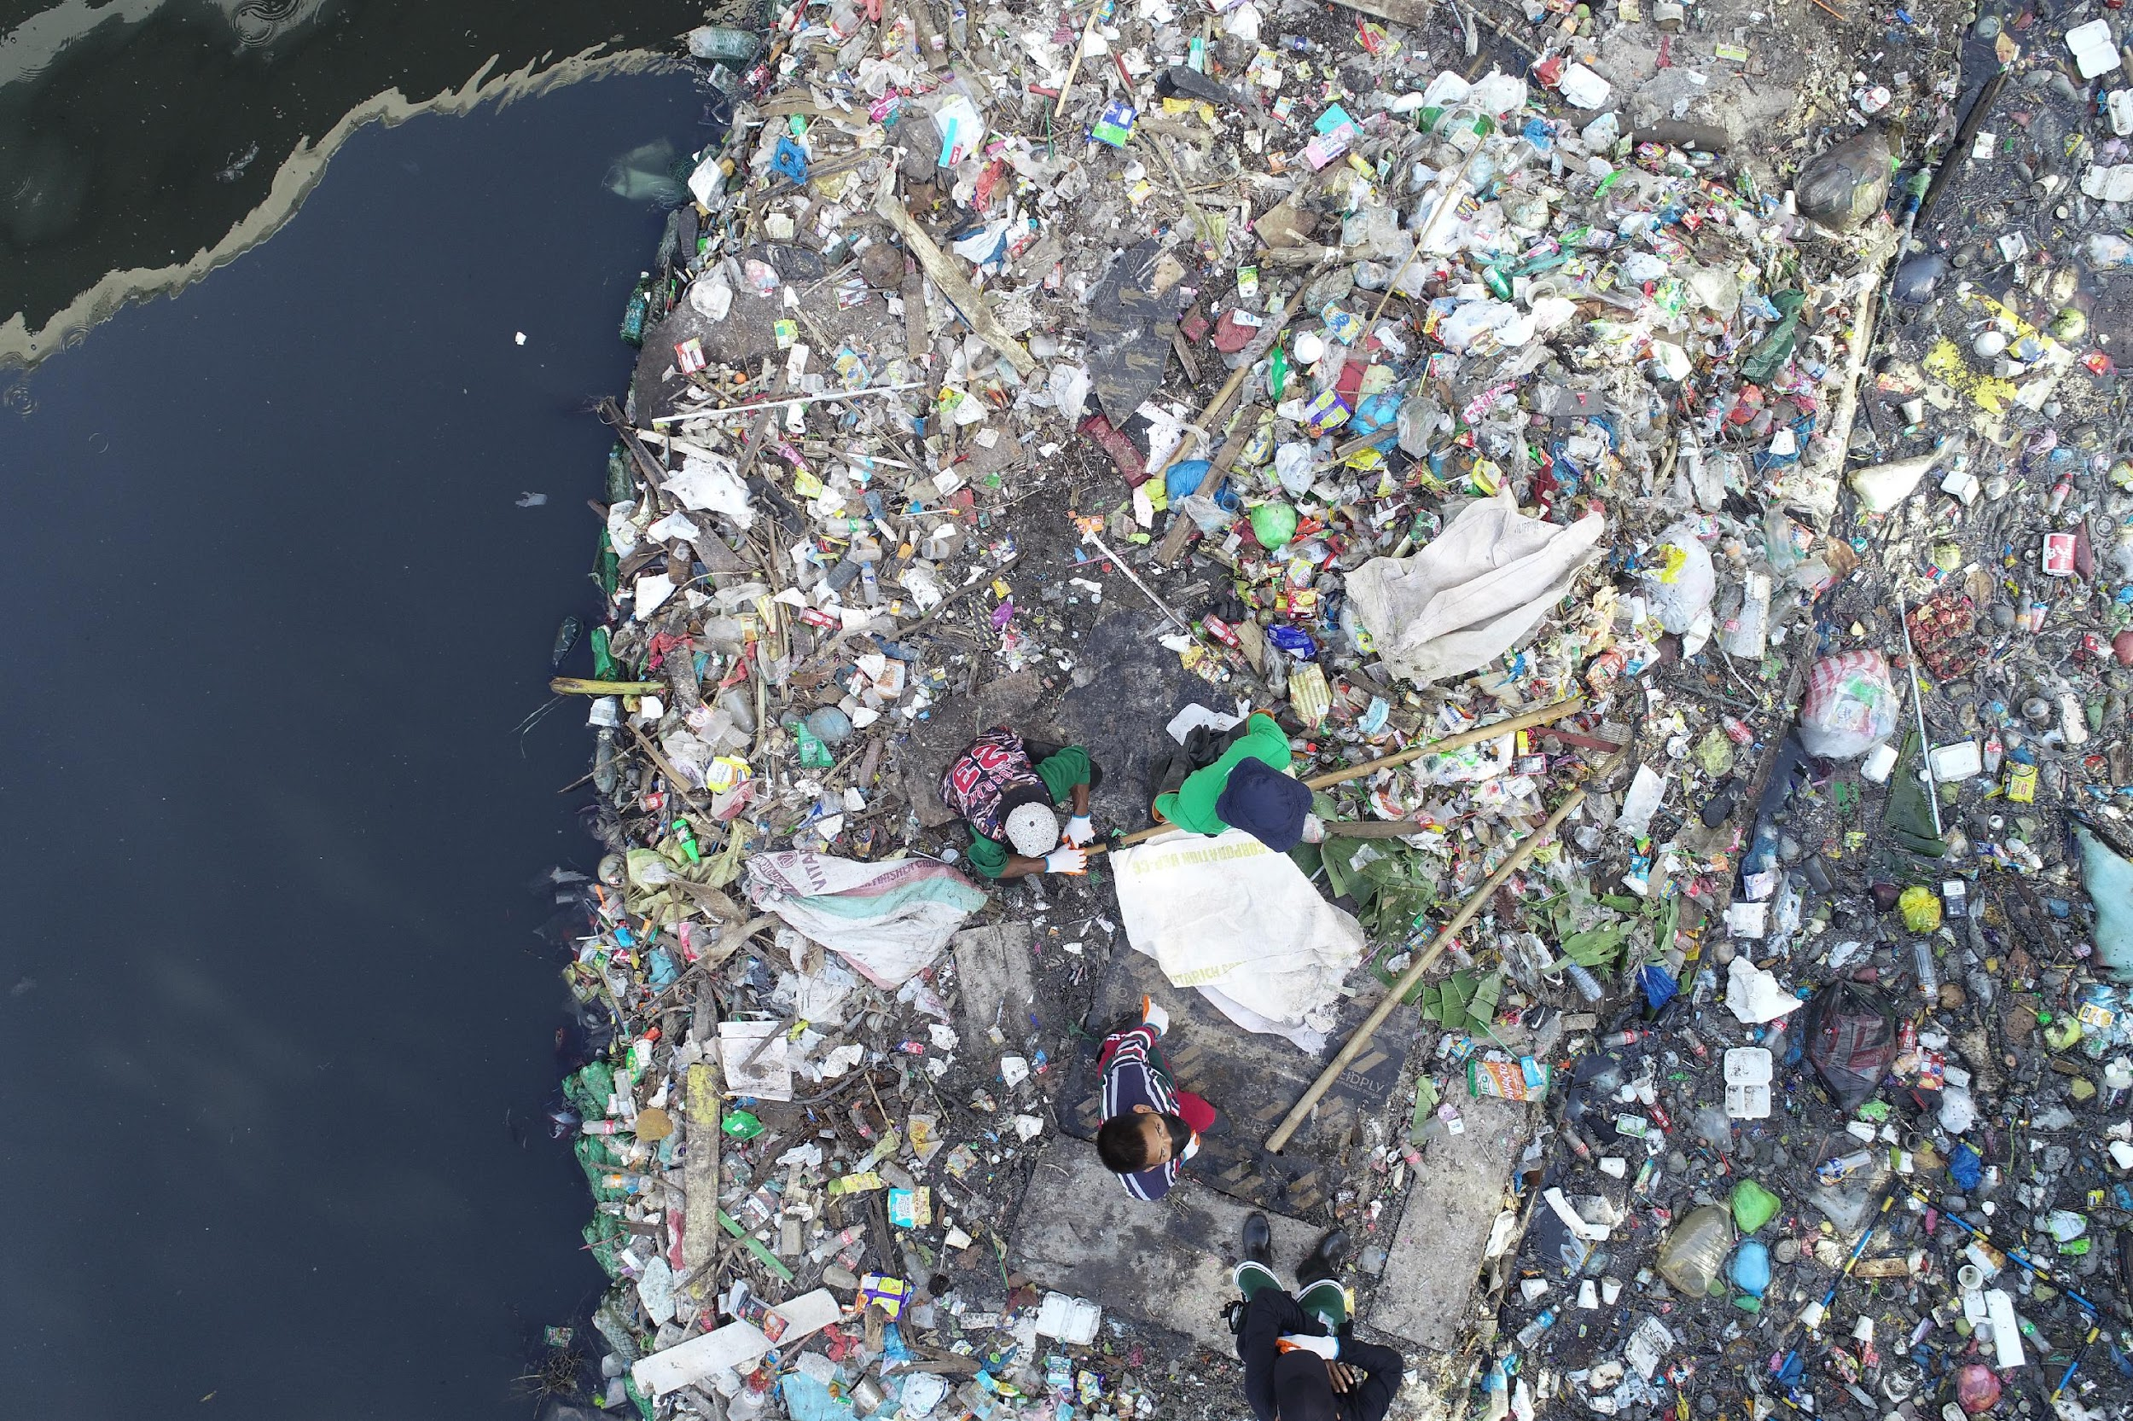
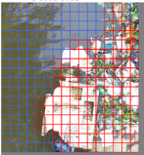
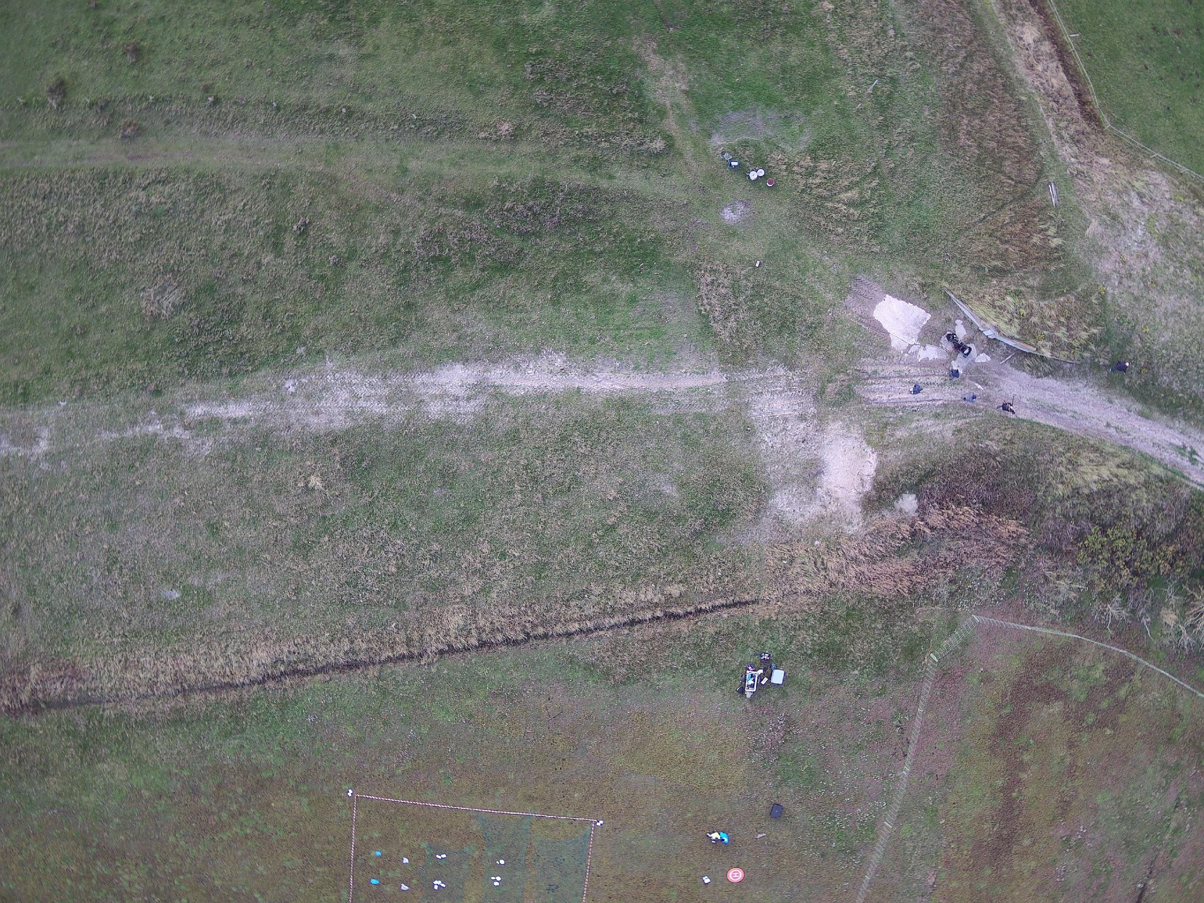
Use Case Overview
Aquatic Litter Drones
128x128x3
Plastic Litter Detection
64x64x3
Plastic Litter Quantification
Target users: NGOs, monitoring agencies, environmental managers

Slide 3
Use Case Overview – starting point
Aquatic Litter Drones
Users
AI models
Resulting litter data
Not user-friendly and hard coded GitHub repository
Outdated and inefficient model architecture​
Generic litter categories that work well with AI classification models but are not compatible with EU litter monitoring categories
Wrappers under 10cm
Wrappers over 10 cm
Bottles PET
Polystyrene under 20cm
Polystyrene over 20cm
Bottles PET
Bags LPDE

Slide 4
Use Case Overview
Aquatic Litter Drones
Aim
Challenge
Use AI and remote sensing images to detect and classify litter
Find trade-off for suited litter categories for classification
Generate more litter distribution data by covering more area with drones and areas that are not manually accessible
Make the service as easy to use as possible for users to upload their data and get classification results

Slide 5
Use Case Overview – second year progress
Aquatic Litter Drones
Users
AI models
Resulting litter data
Not user-friendly and hard coded GitHub repository
Outdated and inefficient model architecture​
Generic litter categories that work well with AI classification models but are not compatible with EU litter monitoring categories
Methodology is available in operational environment on iMagine platform
Check performance bias
Joint List litter mapping test
Tested state-of-the-art CNN architectures for the litter detection model
Standard operation procedures for drone flights

Slide 6
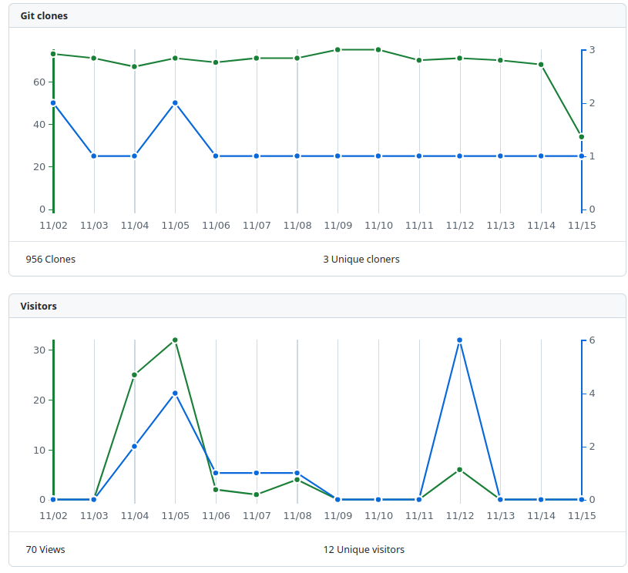
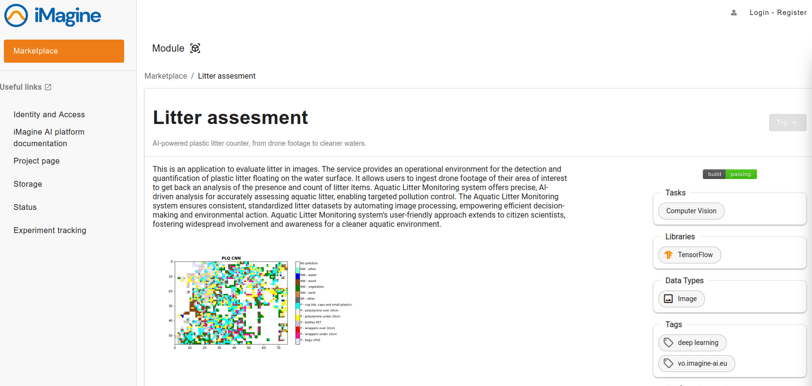
Second year progress – operational environment
Aquatic Litter Drones
Integration of the software into deepaas API, available on github
Litter assessment as module on the iMagine marketplace
Integration into OSCAR based on the previously set up API

Slide 7
Second year progress – SOP for drone flights
Aquatic Litter Drones
Standard operation procedures for drone flights
How to produce images that can be used with the service
Recommendation on drone models and the appropriate altitudes

Slide 8
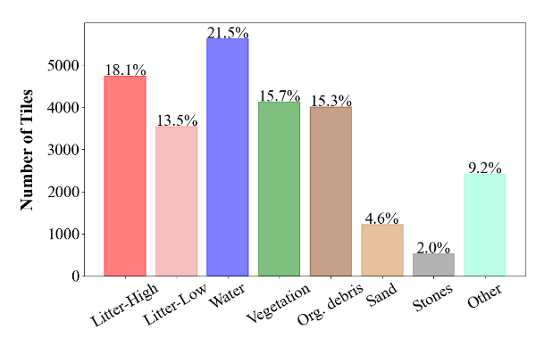
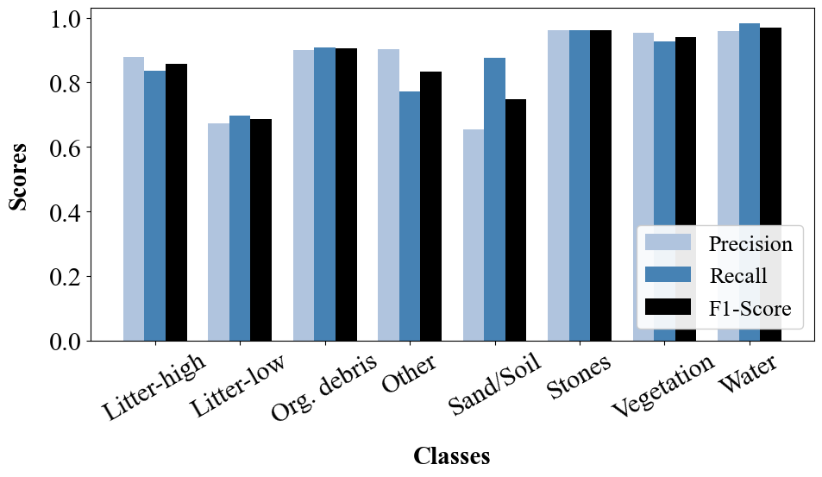
Second year progress – avoid bias in dataset
Aquatic Litter Drones
Collected and labelled data show unbalanced class distribution
Class performance (Precision, Recall, F1-Score) does not show bias

Slide 9
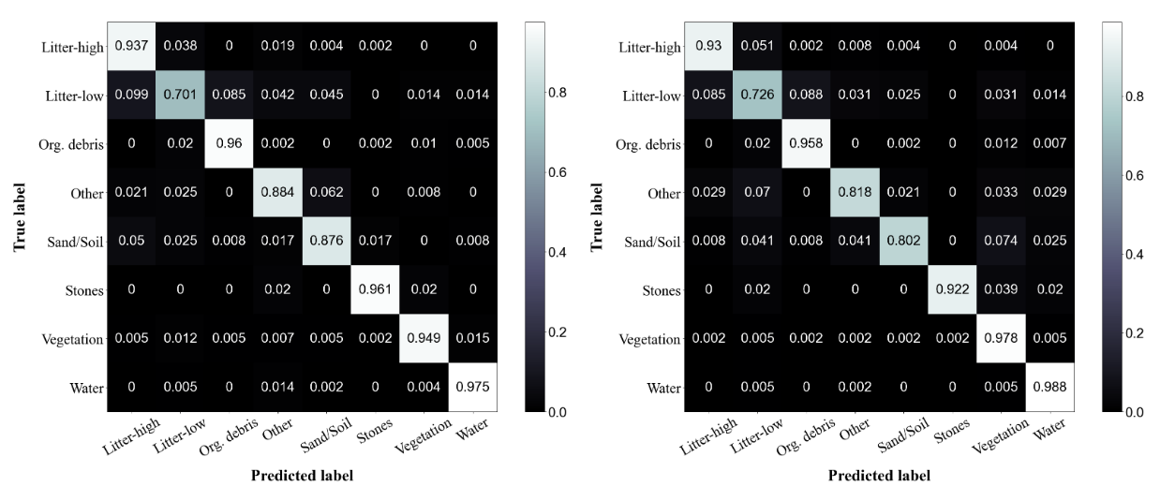
Second year progress – CNN architectures
Aquatic Litter Drones
Comparison of initial model and state-of-the-art architectures
Large models: ResNet50, DenseNet121 (Accuracy = 0.911)
Small models: MobileNetV2 (Accuracy = 0.910), SqueezeNet1.1
(a) DenseNet121
(b) MobileNetV2

Slide 10
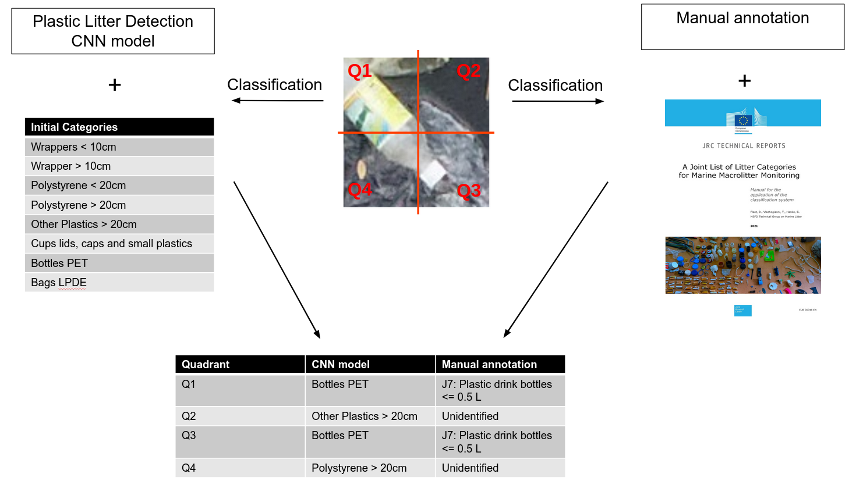
Second year progress - Joint List litter mapping test
Aquatic Litter Drones

Slide 11
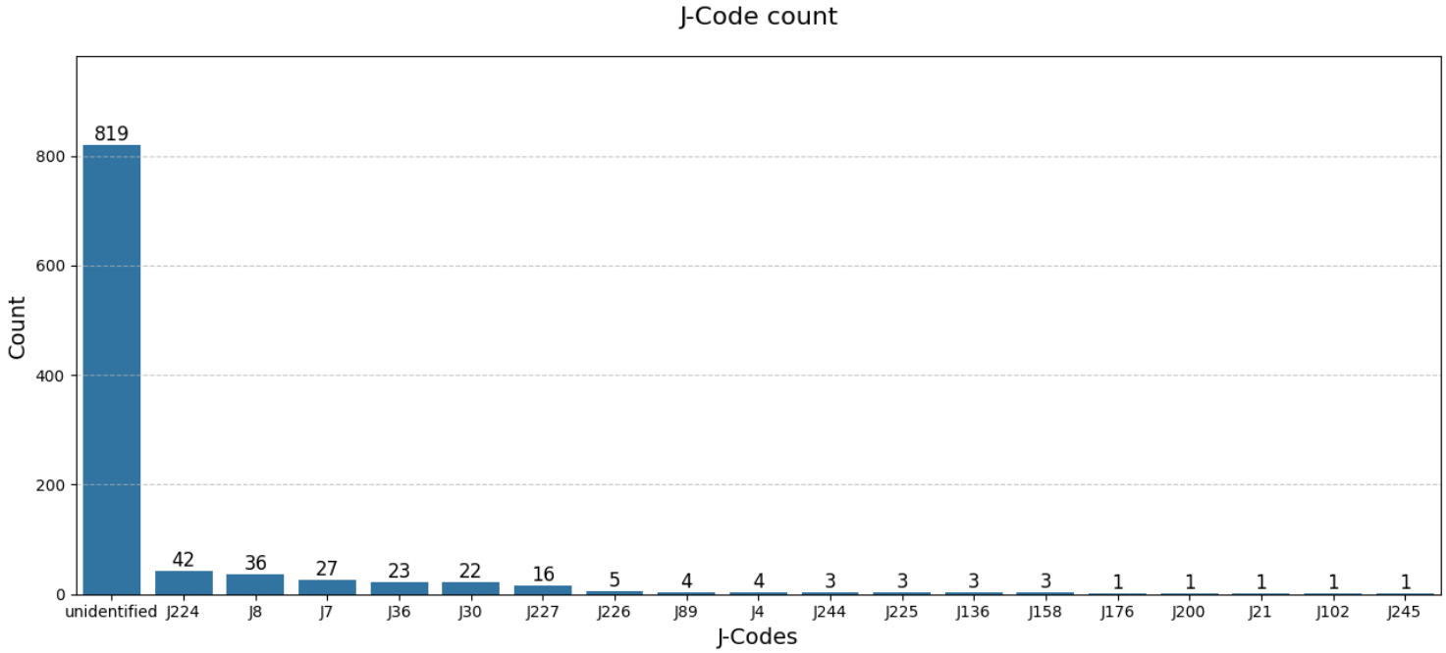
What JLIST categories are found?
Mapping Joint List

Slide 12
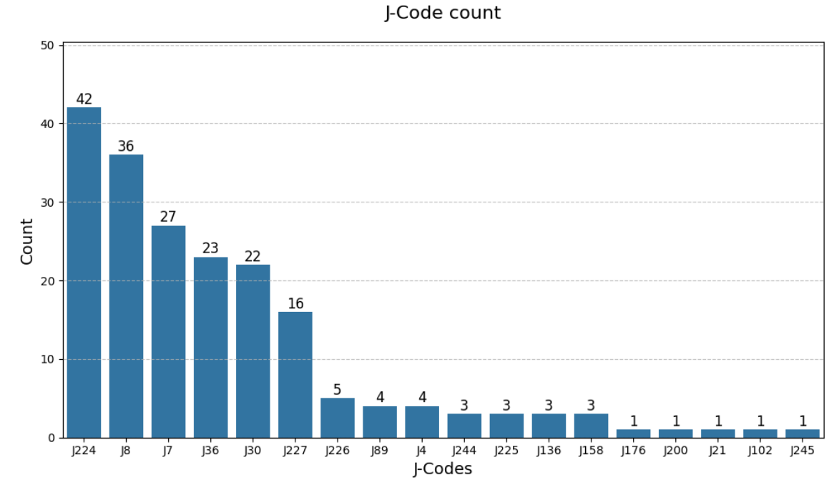
What JLIST categories are found?
Mapping Joint List
JLIST Code | JLIST Category
J224 | Plastic food containers made of foamed polystyrene
J8 | Plastic drink bottles > 0.5 L
J30 | Plastic crisps packets/sweets wrappers
J36 | Other plastic heavy-duty sacks
J7 | Plastic drink bottles <= 0.5 L
J227 | Cups and lids of hard plastic
J226 | Cups and lids of foamed polystyrene
J225 | Plastic food containers made of hard non-foamed plastic
J89 | Plastic construction waste (not foamed insulation)
J4 | Small plastic bags
J136 | Footwear made of plastic – not flip flop
J244 | Paper cups
J158 | Other paper items
J245 | Paper food trays, food wrappers, drink containers
J200 | Glass bottles
J21 | Plastic caps/lids drinks
J176 | Metal food cans
J102 | Plastic flip flops

Slide 13
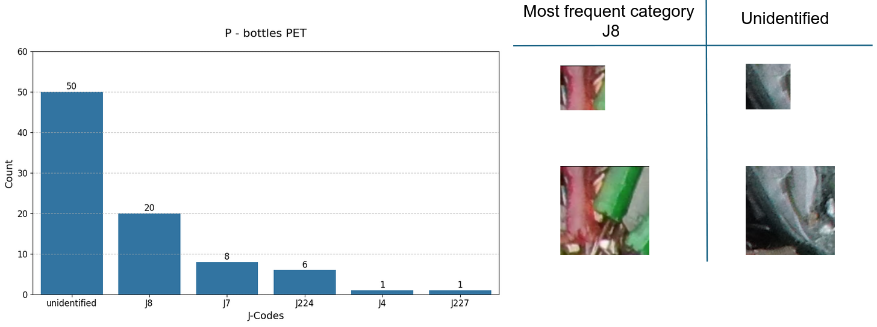
Bottles PET
Mapping Joint List
Plastic drink bottles > 0.5L

Slide 14
Plans for 3rd year
Aquatic Litter Drones
Users
Further Developments
Promote the available service (e.g. to TGML)
Present the results and the service at relevant events (e.g. OCEANS)
Collect feedback
Test different state-of-the-art CNN architectures for litter quantification model
Integrate multitenancy support of the service with OSCAR
Conduct another test, classifying the items with less detailed categories of JLIST

Slide 15
Questions?
Contact: litter_assessment_support@dfki.de

