Slide 1
iMagine - Cold Coral Segmentation
Alberto Gayá-Vilar & colleagues
COST (IEO-CSIC)
iMagine RP2 Project Review
18/11/2024

Slide 2
Deep Learning at the service of marine research:
A use case in the Bay of Biscay
Images and Deep Learning
Objective Assessment
Automating the analysis reduces human bias and ensures consistent evaluation over time
Non-Destructive Monitoring
Image-based surveys allow for repeated assessments of reef health without causing harm
Efficient Analysis
Deep learning algorithms can rapidly and analyze vast amounts of image data, identifying coral species and quantifying their coverage

Slide 3
Starting point
Progress
Live/Dead ratio
Notes:
The implementation requires an increase of our overall knowledge, demanding more science and improved access to observation data and analytical processing.
This builds upon national environmental observation and monitoring networks and programs, complemented with EU initiatives such as the Copernicus programme (CMEMS) and EMODnet, and European Research Infrastructures (RIs).
Great additional potential in collecting and processing image data using high-performance image analysis tools, including Artificial Intelligence (AI) techniques, and in more sharing of image repositories.

Slide 4
Starting point
Progress
Live/Dead ratio
https://github.com/SierraSergio/Deep_ramp
Notes:
The implementation requires an increase of our overall knowledge, demanding more science and improved access to observation data and analytical processing.
This builds upon national environmental observation and monitoring networks and programs, complemented with EU initiatives such as the Copernicus programme (CMEMS) and EMODnet, and European Research Infrastructures (RIs).
Great additional potential in collecting and processing image data using high-performance image analysis tools, including Artificial Intelligence (AI) techniques, and in more sharing of image repositories.

Slide 5
Starting point
Progress
Live/Dead ratio
https://github.com/SierraSergio/Deep_ramp
Notes:
The implementation requires an increase of our overall knowledge, demanding more science and improved access to observation data and analytical processing.
This builds upon national environmental observation and monitoring networks and programs, complemented with EU initiatives such as the Copernicus programme (CMEMS) and EMODnet, and European Research Infrastructures (RIs).
Great additional potential in collecting and processing image data using high-performance image analysis tools, including Artificial Intelligence (AI) techniques, and in more sharing of image repositories.

Slide 6
Starting point
Progress
Live/Dead ratio
https://github.com/SierraSergio/Deep_ramp
Notes:
The implementation requires an increase of our overall knowledge, demanding more science and improved access to observation data and analytical processing.
This builds upon national environmental observation and monitoring networks and programs, complemented with EU initiatives such as the Copernicus programme (CMEMS) and EMODnet, and European Research Infrastructures (RIs).
Great additional potential in collecting and processing image data using high-performance image analysis tools, including Artificial Intelligence (AI) techniques, and in more sharing of image repositories.

Slide 7
Starting point
Progress
Live/Dead ratio
https://github.com/SierraSergio/Deep_ramp
Notes:
The implementation requires an increase of our overall knowledge, demanding more science and improved access to observation data and analytical processing.
This builds upon national environmental observation and monitoring networks and programs, complemented with EU initiatives such as the Copernicus programme (CMEMS) and EMODnet, and European Research Infrastructures (RIs).
Great additional potential in collecting and processing image data using high-performance image analysis tools, including Artificial Intelligence (AI) techniques, and in more sharing of image repositories.

Slide 8
Starting point
Progress
Live/Dead ratio
https://github.com/SierraSergio/Deep_ramp
Notes:
The implementation requires an increase of our overall knowledge, demanding more science and improved access to observation data and analytical processing.
This builds upon national environmental observation and monitoring networks and programs, complemented with EU initiatives such as the Copernicus programme (CMEMS) and EMODnet, and European Research Infrastructures (RIs).
Great additional potential in collecting and processing image data using high-performance image analysis tools, including Artificial Intelligence (AI) techniques, and in more sharing of image repositories.

Slide 9
Starting point
Progress
Live/Dead ratio
https://github.com/SierraSergio/Deep_ramp
Notes:
The implementation requires an increase of our overall knowledge, demanding more science and improved access to observation data and analytical processing.
This builds upon national environmental observation and monitoring networks and programs, complemented with EU initiatives such as the Copernicus programme (CMEMS) and EMODnet, and European Research Infrastructures (RIs).
Great additional potential in collecting and processing image data using high-performance image analysis tools, including Artificial Intelligence (AI) techniques, and in more sharing of image repositories.

Slide 10
Starting point
Progress
Live/Dead ratio
https://github.com/SierraSergio/Deep_ramp
Notes:
The implementation requires an increase of our overall knowledge, demanding more science and improved access to observation data and analytical processing.
This builds upon national environmental observation and monitoring networks and programs, complemented with EU initiatives such as the Copernicus programme (CMEMS) and EMODnet, and European Research Infrastructures (RIs).
Great additional potential in collecting and processing image data using high-performance image analysis tools, including Artificial Intelligence (AI) techniques, and in more sharing of image repositories.

Slide 11
Starting point
Progress
Live/Dead ratio
https://github.com/SierraSergio/Deep_ramp
Notes:
The implementation requires an increase of our overall knowledge, demanding more science and improved access to observation data and analytical processing.
This builds upon national environmental observation and monitoring networks and programs, complemented with EU initiatives such as the Copernicus programme (CMEMS) and EMODnet, and European Research Infrastructures (RIs).
Great additional potential in collecting and processing image data using high-performance image analysis tools, including Artificial Intelligence (AI) techniques, and in more sharing of image repositories.

Slide 12
New approach

Slide 13
New approach
670 img

Slide 14
New approach
670 img

Slide 15
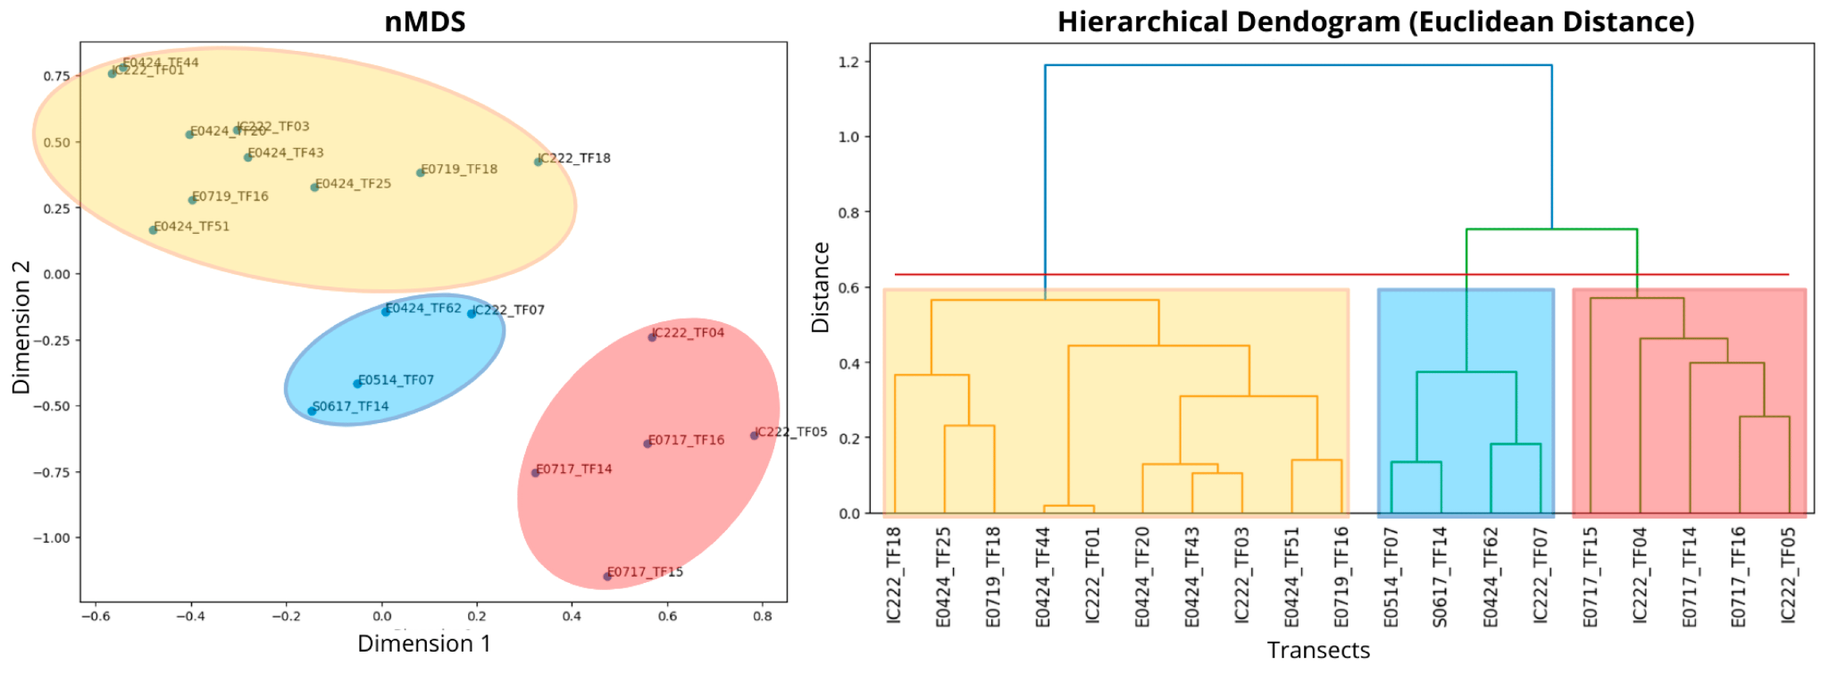
New approach
670 img

Slide 16
iMagine: A positive experience with the platform and its resources
O1
Advice and technical support: Resolving doubts and providing code for managing annotation formats, which has streamlined the development process
O2
Annotation tools: CVAT, which has made the task of labeling images easier
O3
Data storage: NextCloud, which has allowed secure and efficient access to project data
O4
Training: Workshops that have helped us better understand the platform and expand our contact network

Slide 17
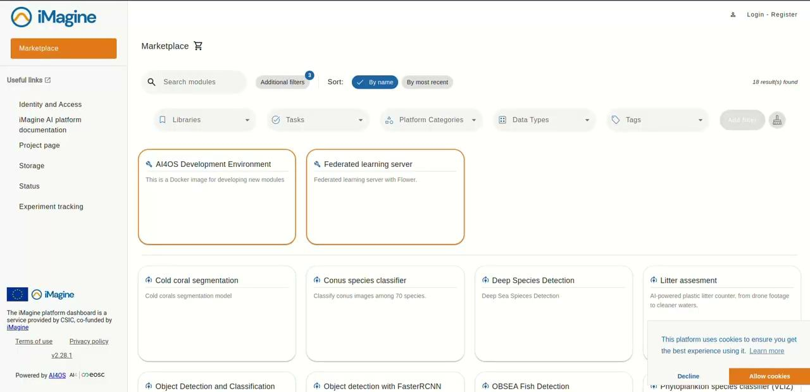
DEMO

Slide 18
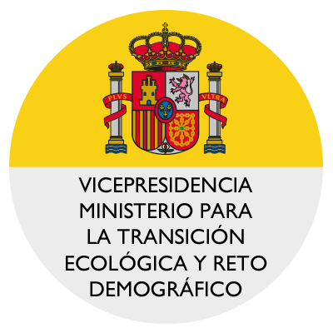
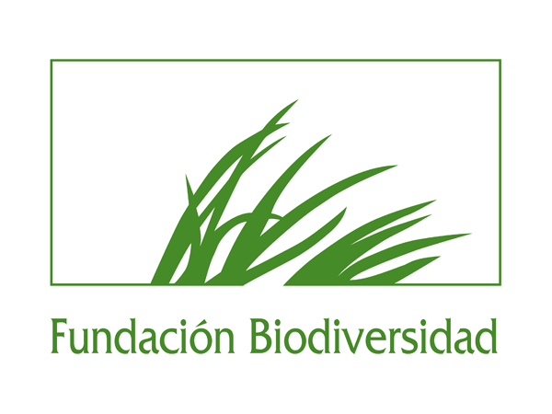
Future Plans
CIRCAFISH: Assessing deep-sea fish biodiversity in the North Atlantic with estero-cameras to inform conservation efforts.
NorthAtlanticAI: Using deep learning to analyze images, detect key reef species (Habitat Directive 1170), and predict their distribution in the North Atlantic to support conservation efforts.

Slide 19
Thank you
Contact us:
Alberto Gayá-Vilar (alberto.gaya@ieo.csic.es)
Elena Prado (elena.prado@ieo.csic.es)
https://www.imagine-ai.eu
IiMagine receives funding from the European Union’s Horizon Europe research and innovation programme under grant agreement No. 101058625

