Slide 1











DCI Assets for eScience in IGE
Alexander Papaspyrou, Dissemination Manager, IGE
DCI Projects Meeting, October 24, 2011, Amsterdam, Netherlands

Slide 2
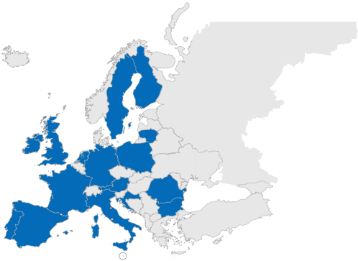





IGE’s Position in the European Landscape
Tier 0
Tier 2
Tier 1
(with NGIs)
Notes:
Project created due to popular demand (grass roots movement). Then informal quick survey shows that 16 countries (blue in map) actively use Globus already now. Globus is the second most important middleware in Europe (25 for gLite, 8 for Unicore, 8 for ARC).
Map with GridFTP servers usage data shows strong clustering in the US and Europe, emphasizing the heavy Globus usage in Europe. This includes gLight sites, as gLight also uses GridFTP from Globus.
Scientists are already collaborating across all of Europe, but infrastructures are hindering this, because they are not interoperable....

Slide 3
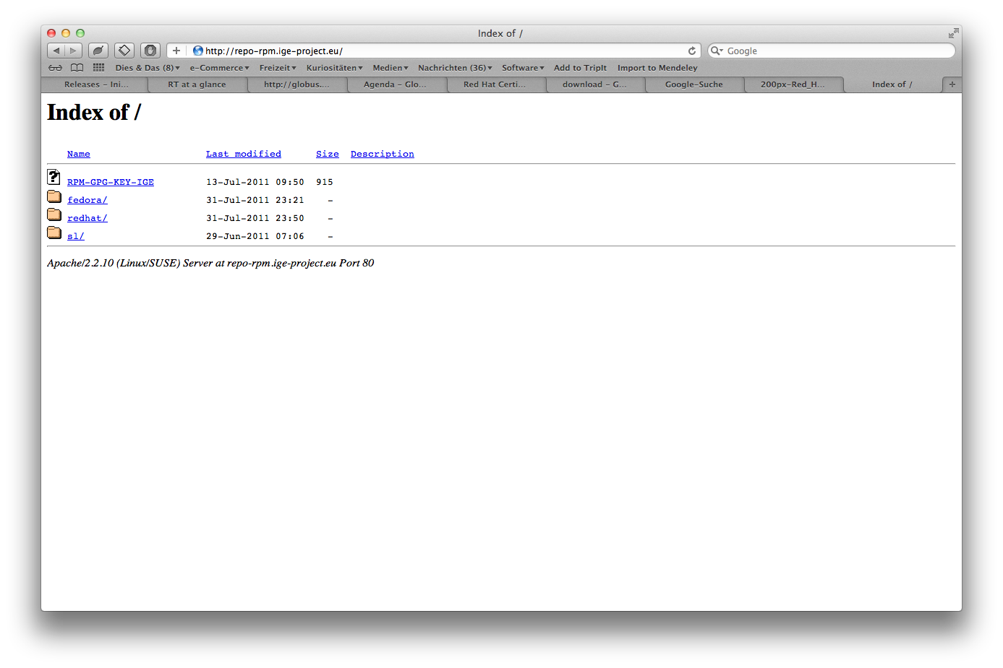
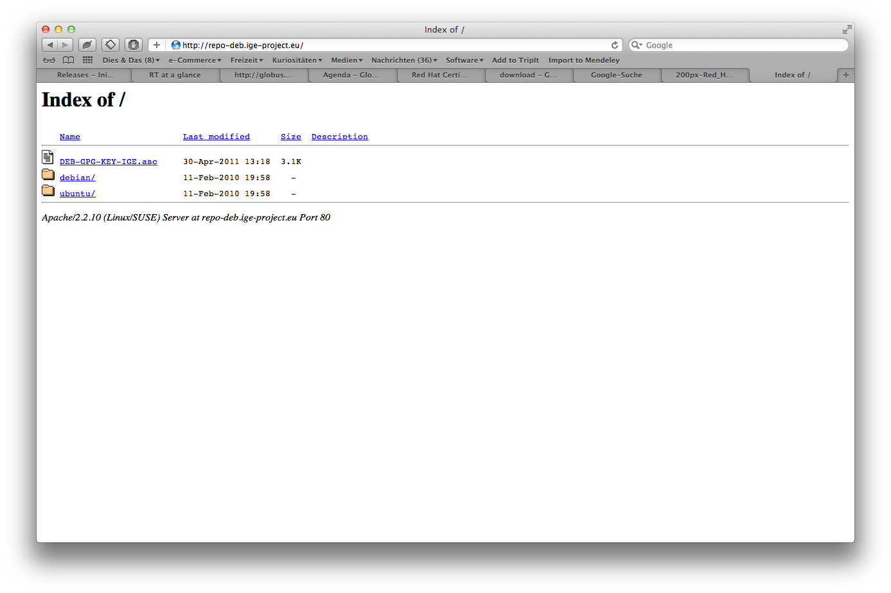



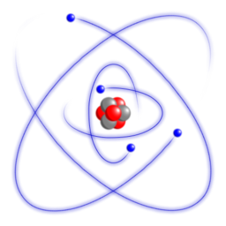

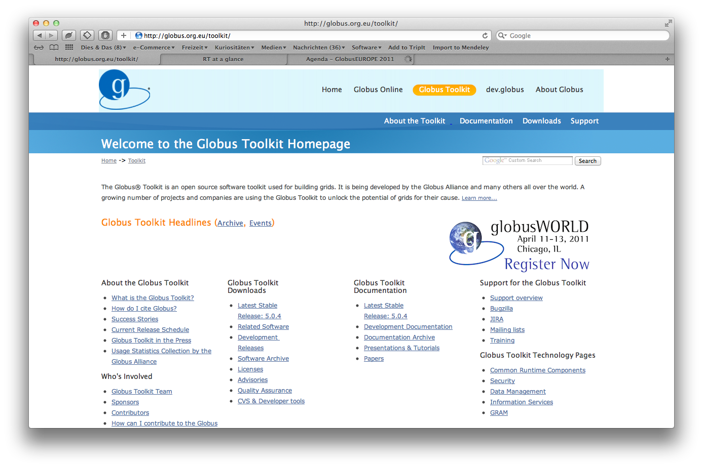
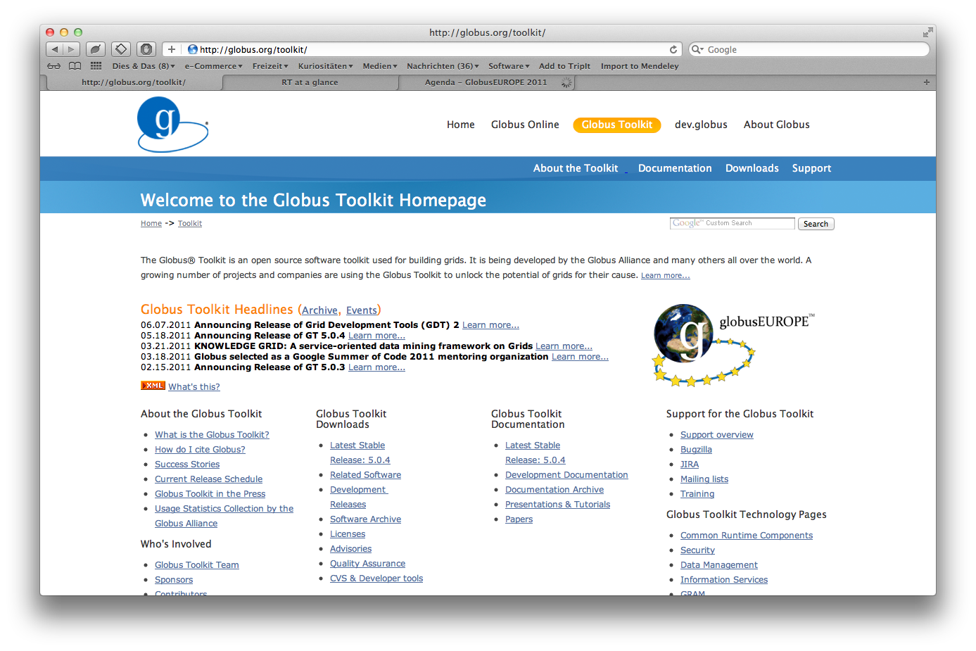
Software Repository and Mirror
EU
privacy-proof
Wide range of target platforms
(specific to European eScience Community requirements )

Slide 4
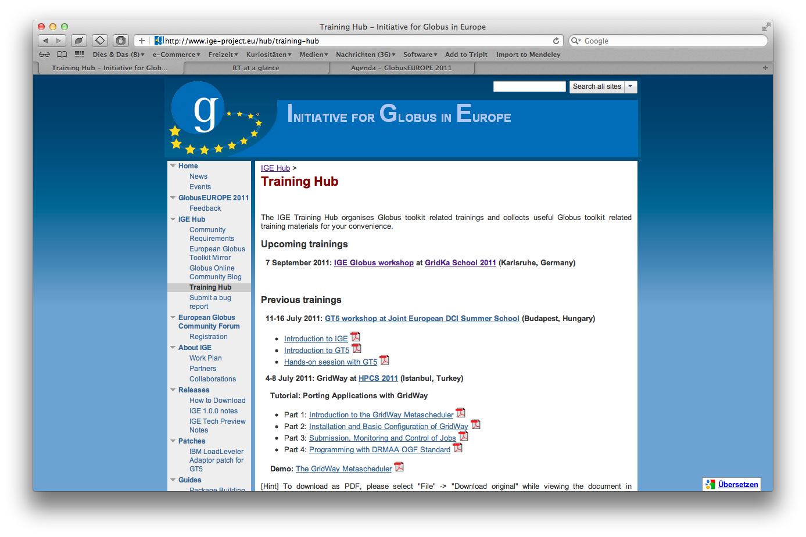
Training
Workshops
FAQs
Tips & Tricks

Slide 5



The Globus Online Platform
Data
Source
2
Globus Online moves files
Data
Destination
Reliable file transfer.
  Easy “fire and forget” file transfers
  Automatic fault recovery
  High performance
  Across multiple security domains
No IT required.
  Software as a Service
  No client software installation
  New features automatically available
  Consolidated support and troubleshooting
  Works with existing GridFTP servers
  Globus Connect solves “last mile problem”
1
User initiates transfer request
ISSUE
Globus Online notifies user
3

Slide 6
Beneficiaries
End Users (e-Science)
Infrastructure Providers
Middleware Providers

Slide 7



Sustainability for IGE
Connect scientists in the European Research Area!
Coordinate
Bring together
European Users,
Developers, and Operators
Streamline
Provide a
Single Point of
Information for Europe
Voice
Add the
European Perspective
to future developments
HARD
HARD
Notes:
Objectives
11 partners
8 countries

Slide 8
Interoperability Challenges
Interoperation
(not Interoperability)
ISSUE
Useful for TeraGrid,
resulting in a use case for interoperation
in the PGI-WG within Open Grid Forum: http://go.ige-project.eu/pgi-usecase
Standardised Interfaces
ISSUE
SOLVED
Useful for the integration into EGI,
(finally) resulting in the integration of a
native OGSA-BES door into Globus GRAM

Slide 9
Take Away Challenges
Not so much on the technical level
Even not regarding interoperability
Real interoperation
Sustaining the surroundings
The „big three“
ComplianceGovernanceJurisdiction
HARD
Really HARD
DOES NOT COMPUTE

Slide 10
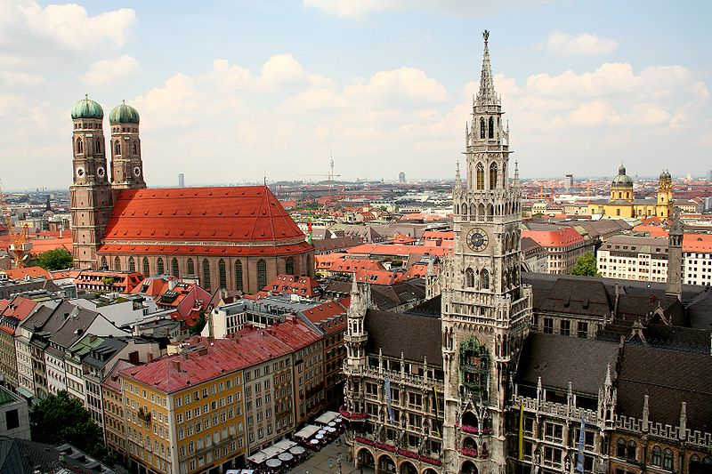
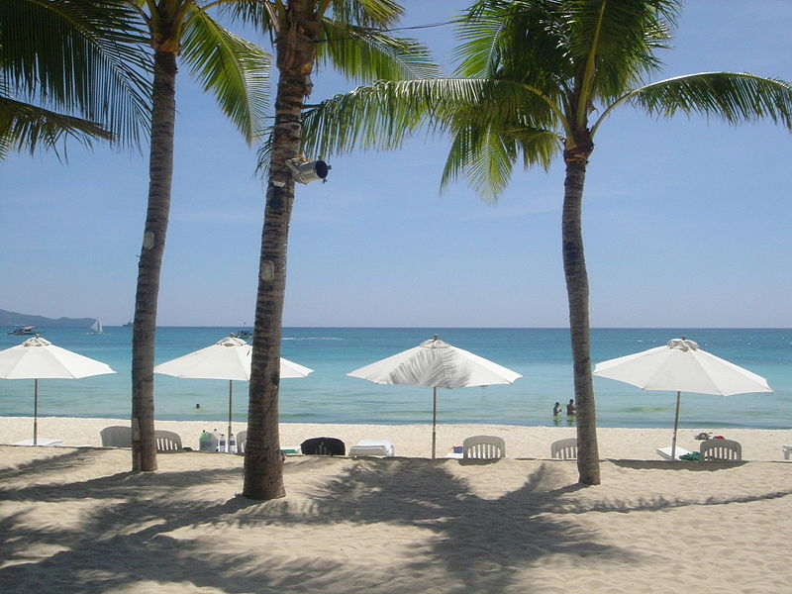


Thank you for listening.
Follow us on
http://www.ige-project.eu/news
@igeproject_eu
http://go.ige-project.eu/linkedin
2nd EGCF Meeting
Spring 2012
Munich, Germany
GlobusEUROPE 2012
Fall 2012
TBA

