Slide 1
EMI Sustainability
Alberto Di Meglio, CERN
DCI Projects Meeting Amsterdam, 24 October 2011

Slide 2
EMI Middleware Evolution
Before EMI
3 years
After EMI
Applications Integrators, System Administrators
Standard interfaces
Specialized services, professional support and customization
50%
Standard interfaces
EMI Reference Services
Standards, New technologies (clouds)
Users and Infrastructure Requirements

Slide 3
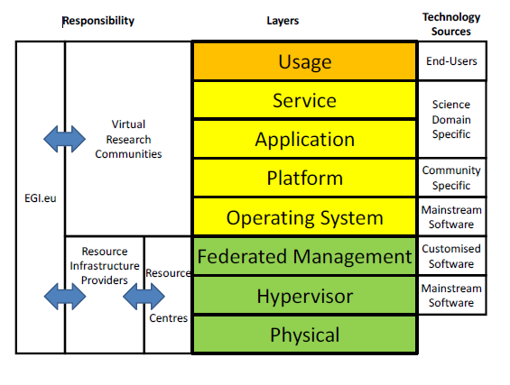
EMI Positioning in DCI Stack

Slide 4
Exploitable Elements
Software products
Improved standardization and compatibility with mainstream open source operating system
User-driven innovation
Documentation
Processes, procedures, organizational experiences
Release process
Community collaboration channels

Slide 5
Sustainability Pre-Conditions
Identify which user communities would keep using the software beyond EMI
Identify which software products have the best chances at being used beyond EMI
Work is in progress to clearly assess the previous conditions
Plan to publish the result as part of the next EMI Sustainability and Exploitation Plan in May 2012

Slide 6
Main Sustainability Assumption
Basic EMI Sustainability lies in making sure existing communities keep using EMI services and support them after EMI
Going beyond that requires the creation of a different structure able to offer an open source marketplace to increase visibility of individual products and a stable focal point for innovation and collaboration

Slide 7
Sustainability Strategy: Case 1
Give back to the users communities the software they need
e.g. WLCG will keep developing and supporting the services they need for as long as they need them
EMI must focus on developing only what is needed by those communities according to explicit requirements (cloud positioning unclear)
Closer interactions with users

Slide 8
Open Source Models
Community model
Apache, Eclipse
Red Hat, Canonical
MySQL, Zarafa
EMI and other publicly funded projects
Support contracts or Subscription model
Dual-licensing or Commercial model
Macro R&D Infrastructures model

Slide 9
Open Source Models
Incubation in the right condition becomes
Community model
Macro R&D Infrastructures model
Support contracts or Subscription model
Dual-licensing or Commercial model

Slide 10
Sustainability Strategy: Case 2
It is acknowledged that currently the EMI partners do not have the organization nor the skills to operate in any of the standard open source business models except the “Macro R&D Infrastructures model”
Hence, the need to create an incubator or marketplace where such an organization and skills can be established

Slide 11
Open Science Initiative
An open source software marketplace for software used as part of scientific research (middleware, applications, tools, etc)
Goals:
Give more visibility to software beyond their default projects and communities
Provide users with information and tools to find software and interact with other users and developers

Slide 12
Open Science Initiative
Start within EMI in collaboration with other projects, move towards a standard open source foundation legal form
Capitalize on the EMI experience in software engineering management

Slide 13
Open Science Initiative
Provide a portal and a set of services to
publish software projects and monitor their usage across diverse user communities
assist in testing compliance with open source repository and ease releasing into them (Fedora/EPEL, Debian)
find, investigate, discuss, rate software projects and their usage
link software and people in a modern “social network”-type of infrastructure

